Slide 1
Light weight deep learning moodel for intrusion detection in software defind network
Assistant Prof. Dr.
Ali Hussein Hamad

Slide 2
IoT Nodes serve as devices that establish connectivity to the Internet via a gateway, effectively enabling the integration of the physical world into the vast realm of the Internet.

Slide 3
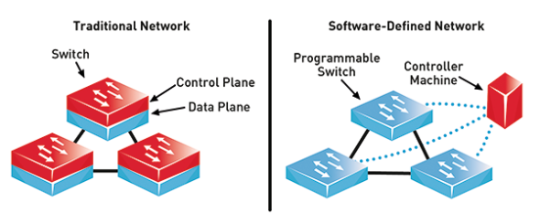
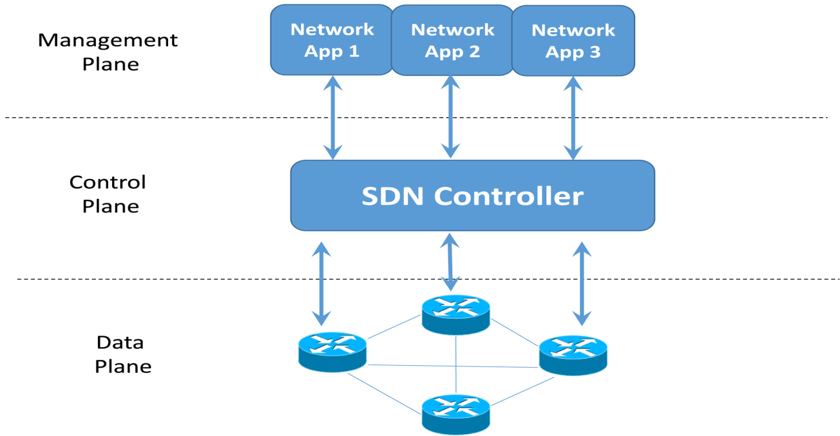
Software-defined networking (SDN) technology is an approach to network management that enables dynamic, programmatically efficient network configuration to improve network performance.
Notes:
A gene is a sequence of DNA or RNA that codes for a molecule that has a function

Slide 4
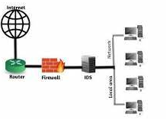
An Intrusion Detection System (IDS) is a network security technology originally built for detecting vulnerability exploits against a target application or computer.

Slide 5
Problem statement
Deploying constrained IoT devices in numerous areas makes them vulnerable to assaults due to limited resources.
Current solutions are insufficient to protect the complete safety scope of IoT networks
Intrusion Detection System (IDS) is used to identify and categorize assaults
Machine Learning (ML) and Deep Learning (DL) techniques, skilled in embedding intellect in IoT devices and networks, can address various security issues.
The implementation of deep neural networks can be challenging for processing tasks models typically include a complex structure with potentially hundreds of layers and large quantities of weight parameters. In addition, the number of calculations involved requires large amounts of memory and powerful processors, which are not available in IoT devices.

Slide 6
Attack class | Description of Activities
DoS | TCP-SYN, UDP, ICMP Flooding
DDoS | TCP-SYN, UDP, ICMP Flooding
Web Attack | XSS, SQL Injection
R2L | IMAP, Brute-Force, Mirai
Malware | Trojan, Botnet
Probe | Probe scan, Discover service, Vulnerability scan, Spoofing, Packet Sniffing, Ping Sweep
U2R | VSFTPD, Samba, Passive Exploitation

Slide 7
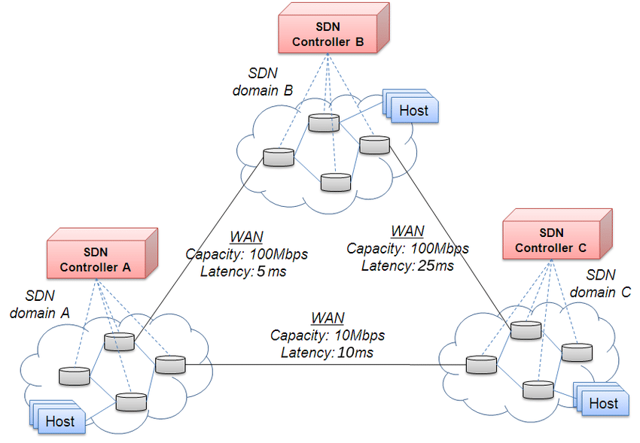
Aim & Objectives
1-study the different types of attacks in SDN
2- proposed a deep learning models for Intrusion detection system in SDN-IoT network.
3- Develop an optimized lightweight deep learning model for the IDS.
4-test the proposed system in different SDN topology inter-domain and intra-domain.

Slide 8
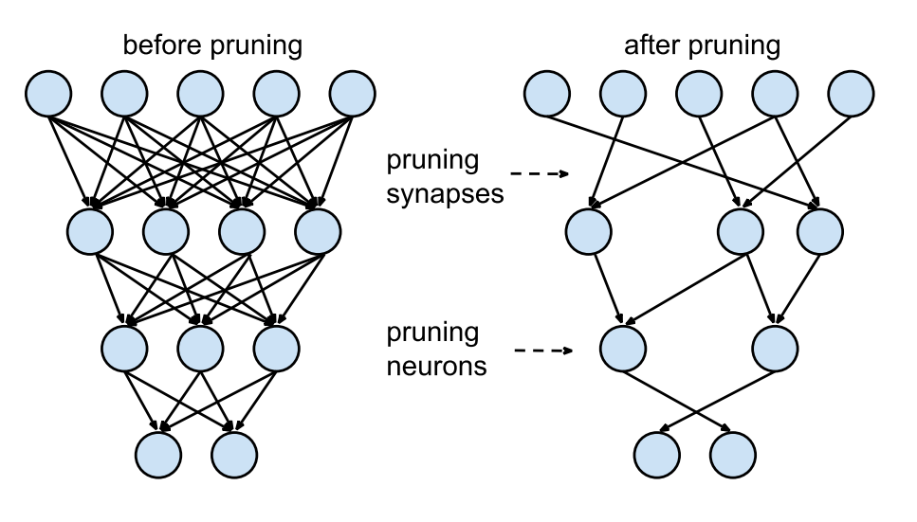
Methodologies
1- Implement the different type of SDN topology.
2-develop new dataset for IoT-IDS
3- use lightweight technique such as pruning , Quantization aware, post quantization and Clustering to optimize the deep learning model
4- Use simulation tools such as Mininet, Ryu controller, open flow swithches under Linux operating system.

