Slide 1
Clinical steps of complete denture

Slide 2
Clinical steps of complete denture
First step
EVALUATION OF THE PATIENT, DIAGNOSIS, TREATMENT PLAN AND PROGNOSIS

Slide 3
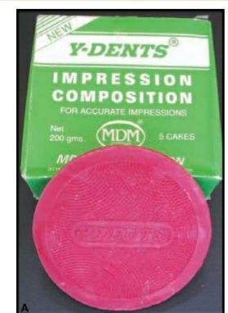
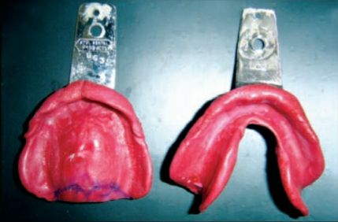
Clinical steps of complete denture
Second step
Primary impression

Slide 4
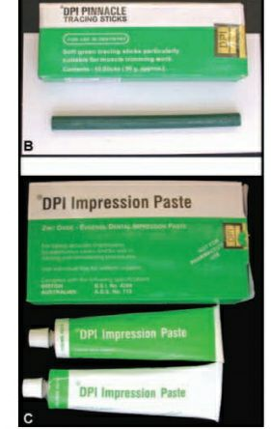
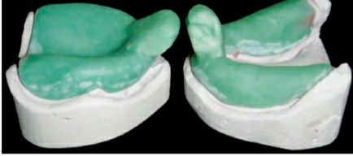
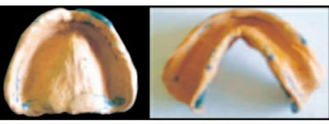
Clinical steps of complete denture
Third step
Secondary impression

Slide 5
Clinical steps of complete denture

Slide 6
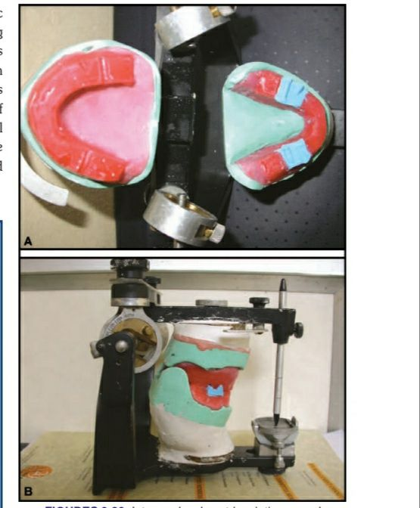
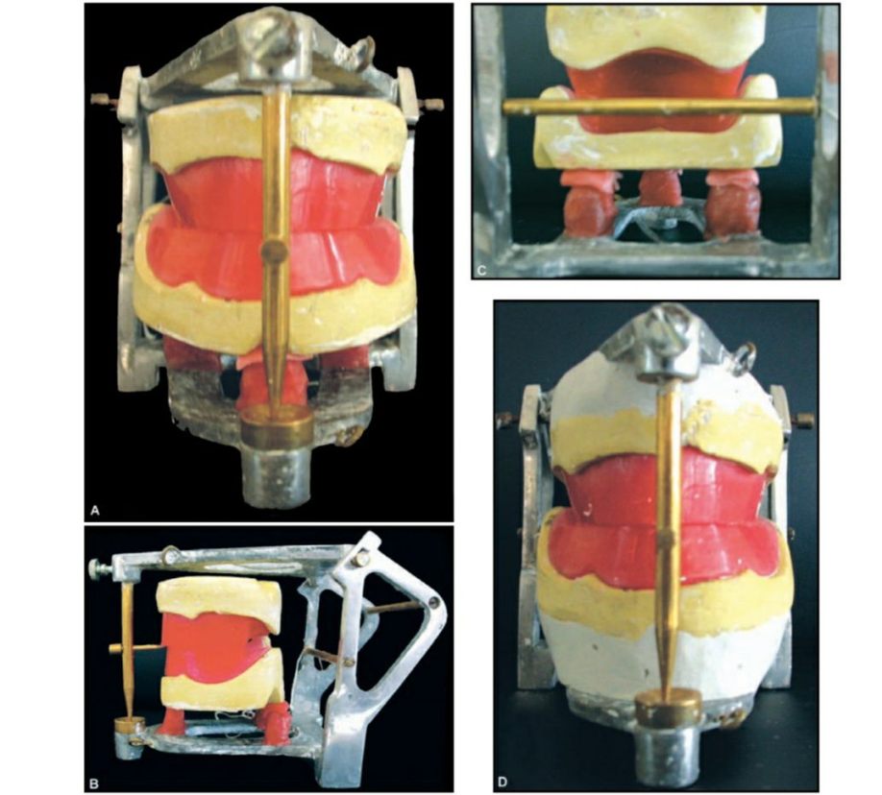
Clinical steps of complete denture
Fourth step
Upper and lower jaw relation

Slide 7
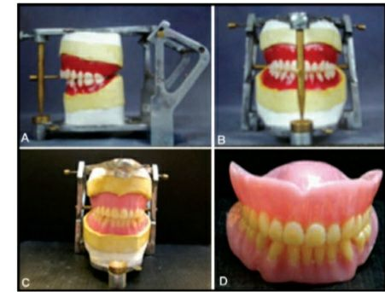
Clinical steps of complete denture
Fifth step
Try-in denture

Slide 8
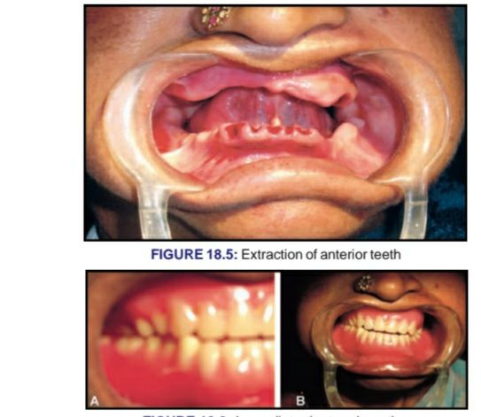
Clinical steps of complete denture
Insertion and patient instruction

