Slide 1
Clinical steps of RPD denture

Slide 2
REMOVABLE PARTIAL DENTURE STEPS

Slide 3
Denture: replacement missing teeth and
surrounding tissues
Classification according to material of construction:
1.Acrylic RPD
2.Cr/Co RPD

Slide 4
Clinical steps of RPD denture
Clinical steps for construction of Cr/Co RPD
Diagnosis and treatment plan
Mouth preparation(preparation of abutment)
Impression
Framework metal check
Bite registration
Try-in
Insertion
Follow up / adjustment
Clinical steps for construction of Acrylic RPD
Diagnosis and treatment plan
Mouth preparation
Impression
Bite registration
Try-in
Insertion
Follow up / adjustment

Slide 5
How are denture made?

Slide 6
Clinical steps of RPD denture
Diagnosis and treatment Plan
1. Patient interview
Personal details
Medical history
Dental history
2. Clinical examination
Intraoral examination
Extra oral examination

Slide 7
Clinical steps of RPD denture
Mouth preparation
1. Oral surgical preparation
2. Periodontal treatment
3. Restoration teeth

Slide 8
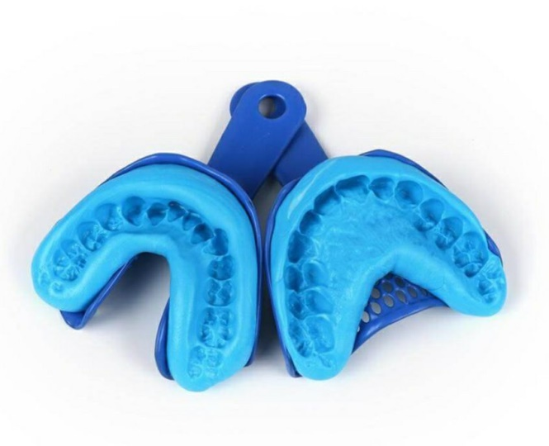
Clinical steps of RPD denture
1.impression
These are negative replica of patients hard and soft tissues of oral cavity usually taken using alginate in a stock/ custom tray

Slide 9
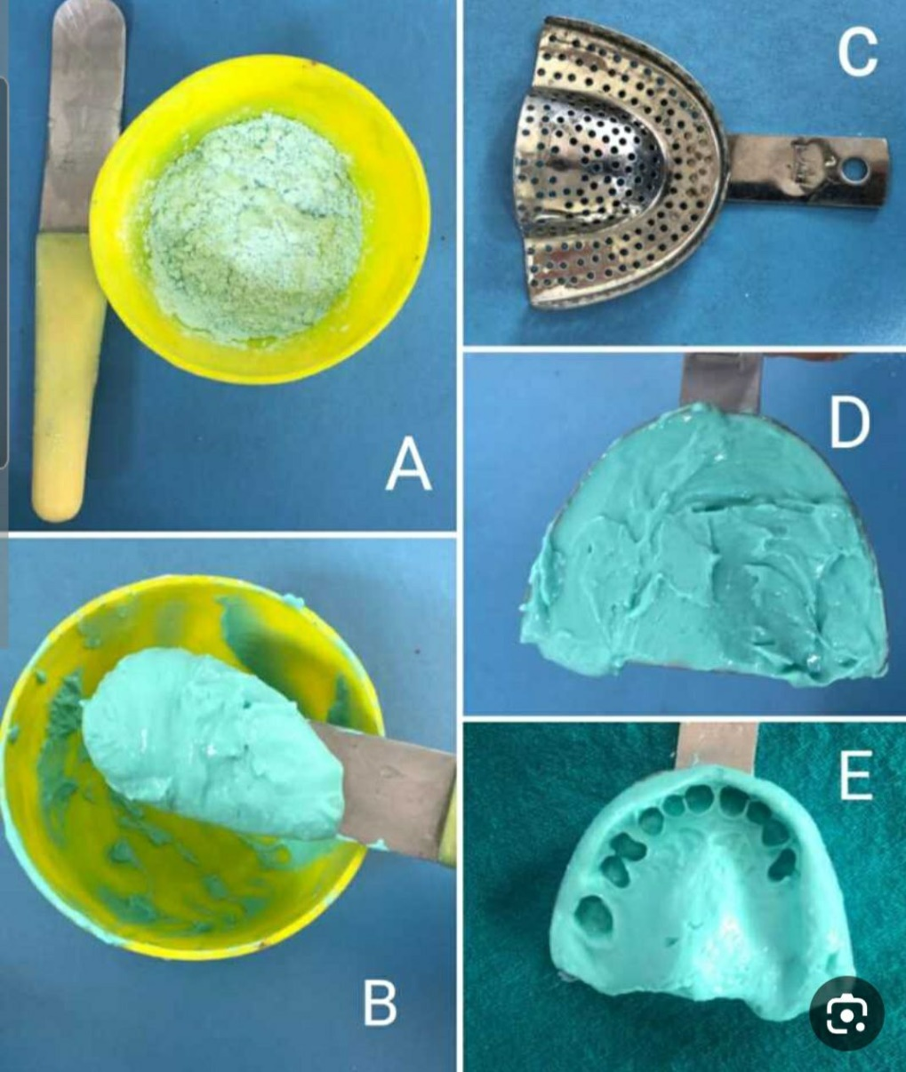
Clinical steps of RPD denture
A and B Mixing of alginate
C. loading try insertion
D. Removal then inspection

Slide 10
Clinical steps of RPD denture
Pour alginate impression
Remove impression from damp paper, mixing stone powder and water pour impression separate cast from impression send cast to lab for fabrication record base

Slide 11
Clinical steps of RPD denture
Bite registration (occlusion)

Slide 12
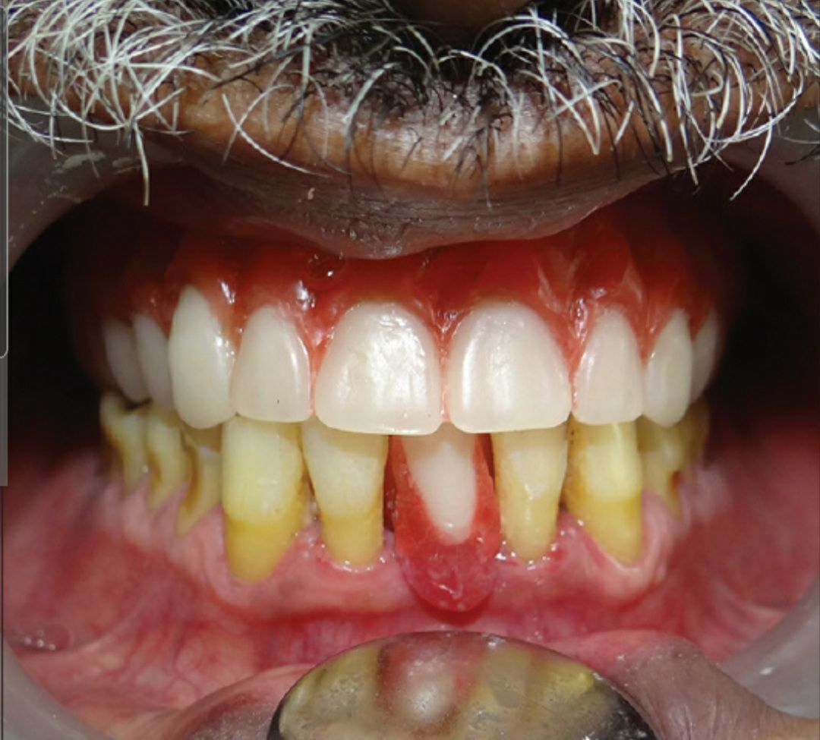
Clinical steps of RPD denture
Try-in: receive denture from dental lab , Exam denture on articulator then exam inside patient mouth
Then send back to dental lab for flasking , finishing and polishing

Slide 13
Clinical steps of RPD denture
Insertion and instruction to the patient
Instruction the patient

