Slide 1
Touch Typing
By
Mohammad yahya

Slide 12
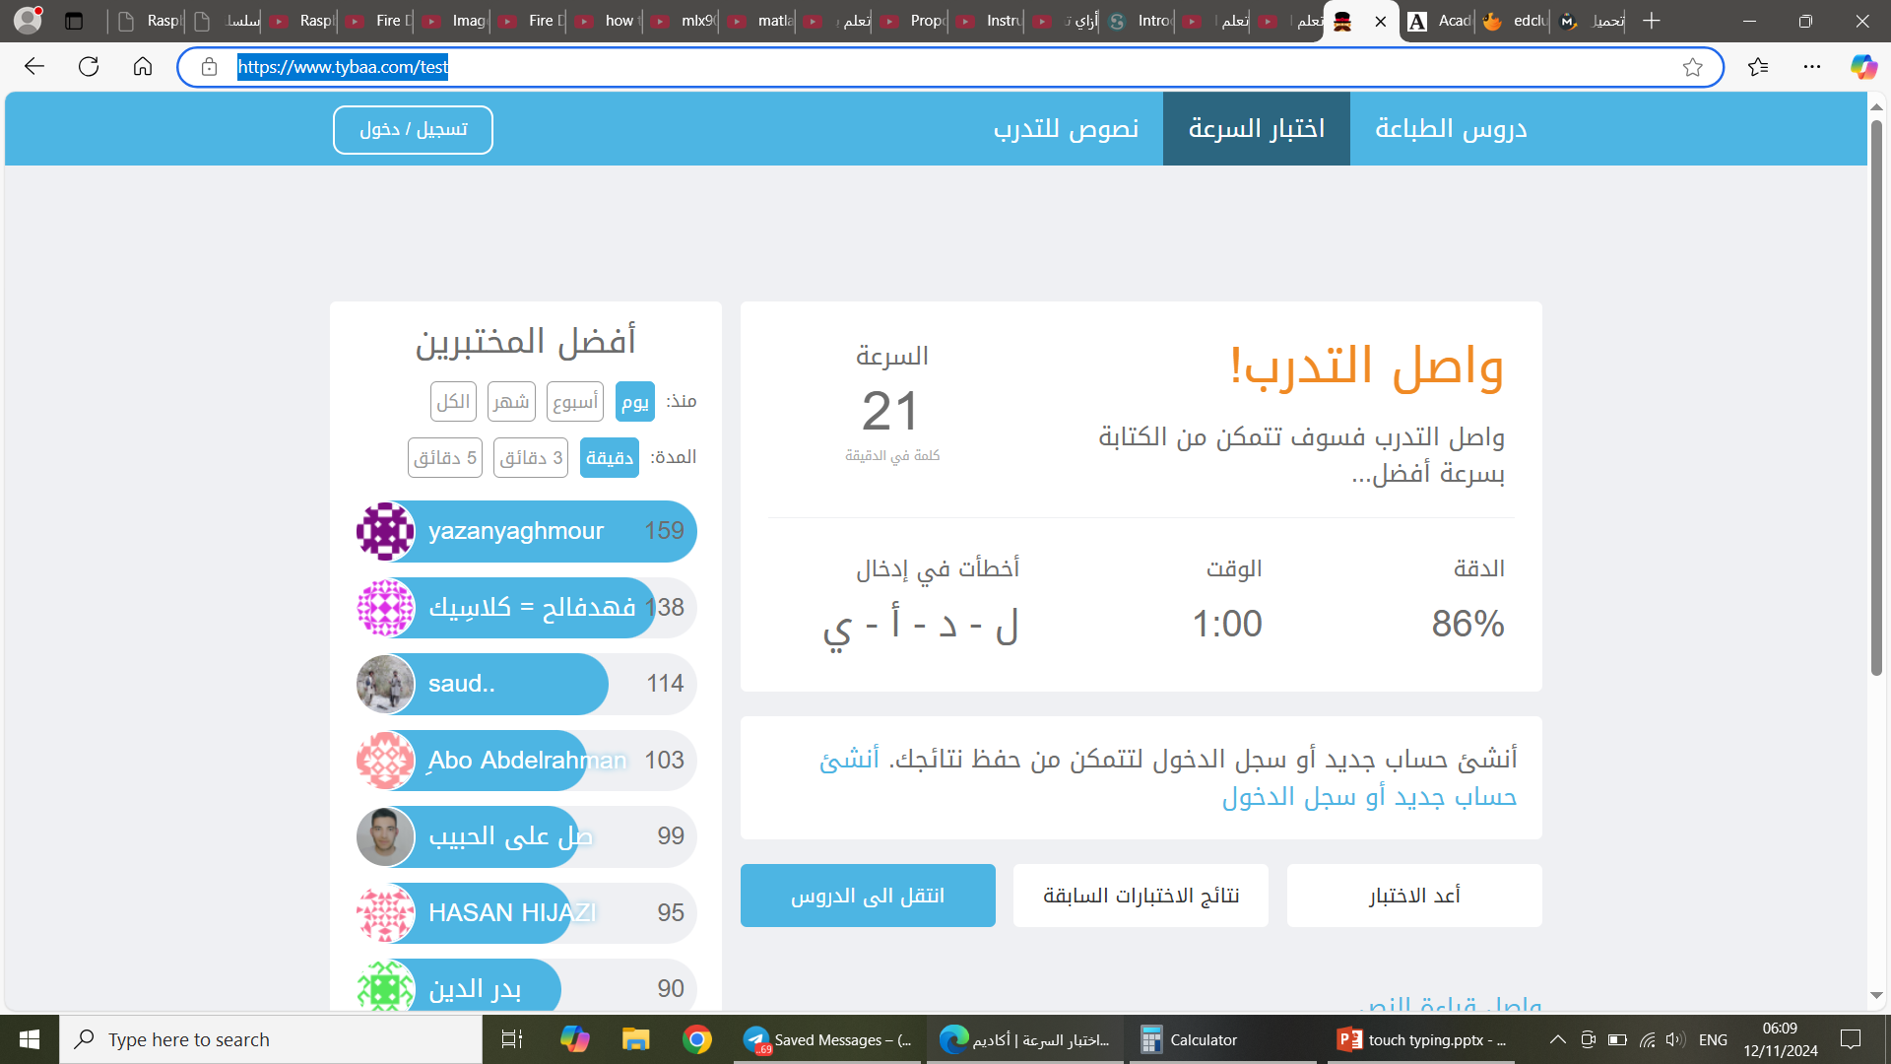
Helpful Sites
https://www.tybaa.com/test

Slide 16
