Slide 1
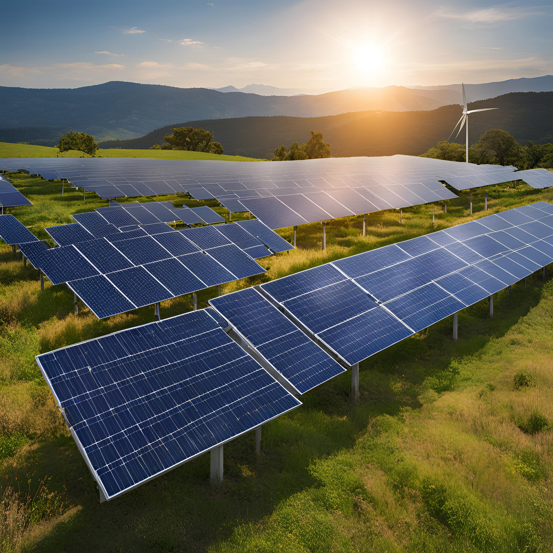

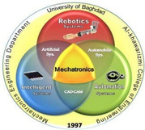

Using Artificial Intelligent to get the MPPT for the Solar System
Presented by
Heba Furat Abdalsattar
1

Slide 2
Contents
1. Introduction
2.Introduction of Photovoltaic System
3. Description of system components
4.The Role of Artificial Intelligence in Improving MPPT
5.Types of AI Algorithms Used
6.Conclusion
2

Slide 3
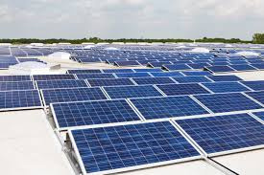
  Introduction of Photovoltaic System
  With the increasing focus on renewable energy, solar energy is one of the most widely used sources.
  To improve the efficiency of solar systems, advanced techniques like MPPT are crucial.
What is MPPT?
  MPPT (Maximum Power Point Tracking) is an algorithm aimed at extracting the maximum power from solar panels.
  Challenges such as lighting and temperature fluctuations make optimizing MPPT highly important.
3

Slide 4
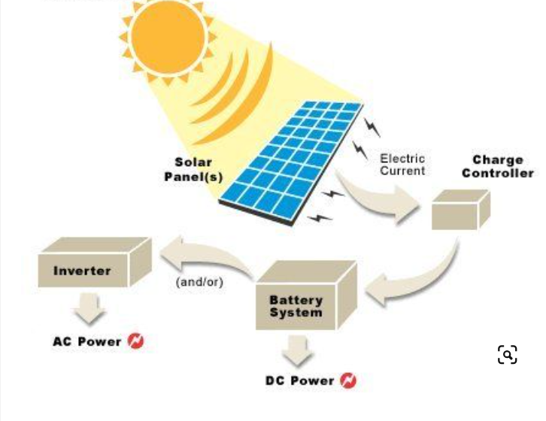
4

Slide 5
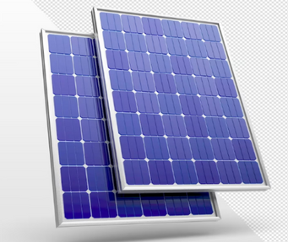
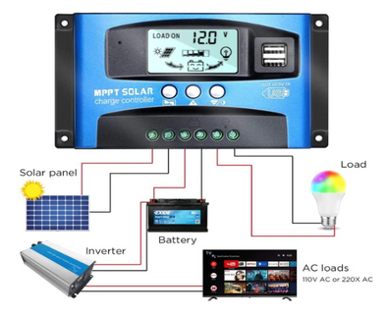
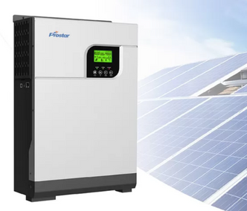
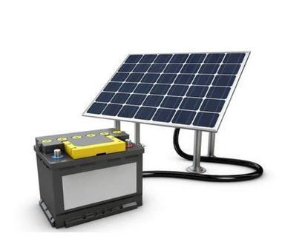
  Main Solar system components
Solar panels Controller
Solar inverter Solar Batteries
2/28/2024
5

Slide 6
  The Role of Artificial Intelligence in Improving MPPT
How Can AI Help?
  Deep Learning and neural networks can learn how to identify the best power point based on live data.
  Machine Learning can improve algorithms based on past experiences.
Advantages:
  Ability to adapt to changing environmental conditions.
  Real-time efficiency improvements.

Slide 7
Types of AI Algorithms Used
  Artificial Neural Networks (ANN):
Neural networks train a model to recognize patterns between voltage and current to find the optimal power point.
  Machine Learning Algorithms:
Support Vector Machines (SVM): Can be used to optimize the recognition of maximum power points.
Decision Trees: Used to make decisions on identifying the optimal energy point.

Slide 8
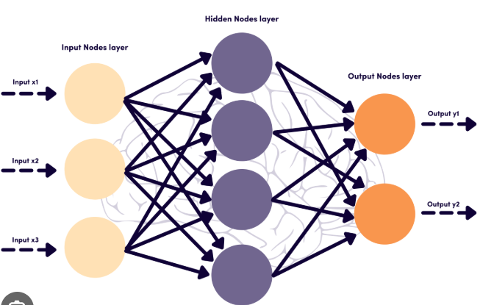
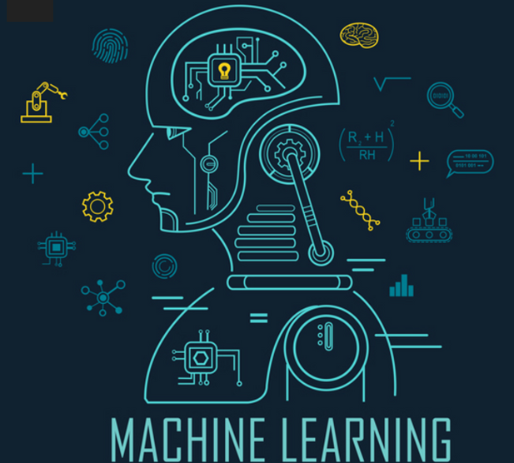
Types of AI Algorithms Used
  Artificial Neural Networks (ANN):
  Machine Learning Algorithms:

Slide 9
Current Challenges in Implementing AI in MPPT
Technical Challenges:
  The need for large and accurate data for training.
  High computational resources required for training models.
Economic Challenges:
  Higher cost of using AI technologies compared to traditional methods.
Environmental Challenges:
  Sudden changes in environmental conditions may impact the accuracy of the algorithms.

Slide 10
Conclusion
Summary:
  Artificial intelligence can significantly improve MPPT techniques, contributing to enhanced solar system efficiency.
Future Trends:
  AI will play a major role in the future in optimizing solar energy systems and expanding their use worldwide.

Slide 11
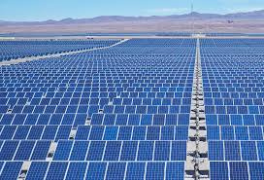
Thank you!
11

