Slide 1
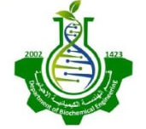
Biopharmaceutical
برعاية السيد عميد كلية الهندسة الخوارزمي الأستاذ الدكتور ودود طاهر محمد المحترم يقيم قسم الهندسة الكيميائية الاحيائية ورشة العمل الموسومة
المحاضرة
د. دعاء خالد مزعل

Slide 2
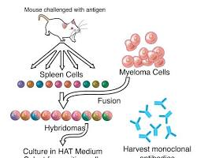
What are Biopharmaceuticals?
Biopharmaceuticals are complex medicines made from living cells or organisms, often produced using cutting-edge biotechnological methods. They include a wide range of therapeutic agents, such as:
Monoclonal Antibodies: These are laboratory-made proteins designed to target specific cells or substances in the body. They are used to treat various diseases like cancer, autoimmune disorders, and infectious diseases.

Slide 3
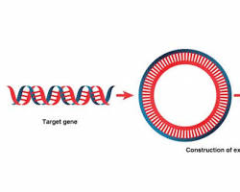
What are Biopharmaceuticals?
Recombinant Proteins: These are proteins produced through genetic engineering techniques. They mimic natural proteins in the body and are used to treat a variety of conditions, including growth hormone deficiency, diabetes, and hemophilia.

Slide 4
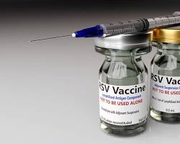
What are Biopharmaceuticals?
Vaccines are biological preparations that stimulate the body's immune system to protect against specific diseases. They are produced using biotechnology to create safe and effective vaccines for various infectious diseases.

Slide 5
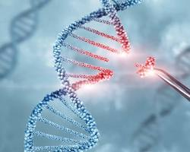
What are Biopharmaceuticals?
Gene Therapies: Gene therapies aim to treat genetic diseases by replacing defective genes with healthy ones. They offer the potential to cure diseases that were previously untreatable.

Slide 6
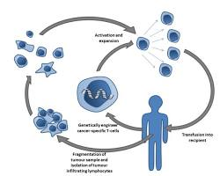
What are Biopharmaceuticals?
Cell Therapies: Cell therapies involve the transplantation of healthy cells to replace damaged or diseased cells. They are used to treat conditions like blood cancers and autoimmune diseases.

Slide 7
Biopharmaceuticals Advantages
High Specificity: Biopharmaceuticals, particularly monoclonal antibodies, can be designed to target specific molecules or cells, minimizing off-target effects and reducing side effects.
Complex Mechanisms of Action: They can engage in intricate biological processes, such as modulating immune responses or inhibiting specific signaling pathways, which often leads to more effective treatments.
Novel Therapeutic Approaches: Biopharmaceuticals have enabled the development of groundbreaking therapies, such as gene therapy and cell therapy, which address the root causes of genetic diseases.
Improved Patient Outcomes: By targeting specific disease mechanisms, biopharmaceuticals can offer better efficacy, improved quality of life, and increased survival rates for patients.

Slide 8
Impact on Healthcare and Patient Outcomes
Treatment of Previously Untreatable Diseases: Biopharmaceuticals have opened doors to treating conditions that were once considered incurable, such as certain cancers, autoimmune disorders, and genetic diseases.
Personalized Medicine: With their high specificity, biopharmaceuticals can be tailored to individual patients, optimizing treatment and reducing adverse effects.
Enhanced Quality of Life: By alleviating symptoms and improving disease progression, biopharmaceuticals significantly enhance the quality of life for patients.
Reduced Healthcare Costs: While biopharmaceuticals can be more expensive than traditional drugs, they can reduce long-term healthcare costs by preventing complications and hospitalizations.
Accelerated Drug Development: Advances in biotechnology have streamlined the development process, leading to faster time-to-market for new biopharmaceuticals.

Slide 9
Upstream Processing
Upstream processing is the initial stage of biopharmaceutical production, focusing on cultivating cells or microorganisms to produce the desired biomolecule. This critical step involves several key components:
Cell Culture Technology
Microbial Cell Culture:
Utilizes microorganisms like bacteria or yeast to produce biopharmaceuticals.
Offers advantages such as rapid growth, high productivity, and well-established culture techniques.
Commonly used for producing insulin, human growth hormone, and vaccines.
Mammalian Cell Culture:
Employs mammalian cells to produce complex proteins with post-translational modifications, essential for their biological activity.
Offers higher product quality and closer resemblance to human proteins.
Frequently used for monoclonal antibodies, recombinant proteins, and viral vaccines.

Slide 10
Factors Affecting Cell Growth and Product Yield
Nutrient Availability: Adequate supply of essential nutrients like glucose, amino acids, and vitamins is crucial.
Oxygen Supply: Sufficient oxygenation is necessary for aerobic cell growth and metabolism.
pH: Optimal pH levels are essential for cell growth and product formation.
Temperature: Appropriate temperature conditions are required to maintain cell viability and metabolic activity.
Shear Stress: Excessive shear stress can damage cells, especially in large-scale bioreactors.
Media Formulation: The composition of the culture medium significantly impacts cell growth and product yield.

Slide 11
Bioreactor Design and Operation
Bioreactors are vessels designed to provide a controlled environment for cell growth and product production. Key aspects of bioreactor design and operation include:
Type of Bioreactor:
Stirred-Tank Bioreactors: Widely used for both microbial and mammalian cell cultures, offering good mixing and mass transfer.
Airlift Bioreactors: Utilize gas sparging to provide oxygenation and mixing, reducing shear stress.
Single-Use Bioreactors: Disposable bioreactors made of plastic or other materials, reducing cleaning and sterilization costs.

Slide 12
Fed-Batch & Perfusion Culture Strategies
A well-formulated culture medium is crucial for optimal cell growth and product yield. Key components include:
Essential Nutrients:
Carbon sources: Glucose, fructose, or lactose are commonly used as carbon sources to provide energy for cell growth and metabolism.
Nitrogen sources: Amino acids, peptides, or inorganic nitrogen sources like ammonium salts or urea are required for protein synthesis.
Inorganic salts: Salts containing essential ions like sodium, potassium, calcium, magnesium, and phosphate are necessary for various cellular functions.

Slide 13
Media Formulation and Optimization
Growth Factors:
Hormones: Insulin, growth hormone, and other hormones may be required for mammalian cell growth and differentiation.
Growth factors: Proteins like epidermal growth factor (EGF) and platelet-derived growth factor (PDGF) can stimulate cell proliferation and differentiation.

Slide 14
Media Formulation and Optimization
To improve cell growth and product yield, fed-batch and perfusion culture strategies are often employed:
Fed-Batch Culture:
Nutrients are fed gradually to the culture over time, preventing nutrient limitations and toxic metabolite accumulation.
This approach allows for higher cell densities and increased product yields.
Perfusion Culture:
Fresh medium is continuously added to the culture, while an equal volume of spent medium is removed.
This maintains a constant culture volume and allows for prolonged cell culture, leading to higher product titers.

Slide 15
Media Formulation and Optimization
Genetic Engineering
Genetic engineering techniques are used to modify cells to enhance their ability to produce the desired biopharmaceutical:
Recombinant DNA Technology:
Involves the manipulation of DNA to introduce foreign genes into cells.
Key steps include gene cloning, vector construction, and transformation or transfection of cells.

Slide 16
Downstream Processing
Downstream processing is a critical step in biopharmaceutical production, involving a series of techniques to purify and isolate the target biomolecule from the complex cell culture broth. This multi-step process ensures the final product meets stringent quality and purity standards.
Cell Culture Harvest
The initial step involves separating the cells from the culture medium. Common techniques include:
Centrifugation: This technique exploits differences in density to separate cells from the supernatant.
Filtration: Membrane filtration can be used to remove cells and other large particles.

Slide 17
Downstream Processing
Primary Recovery
After cell harvest, the target biomolecule is released from the cells through:
Cell Lysis: This involves disrupting the cell membrane to release intracellular proteins. Techniques include mechanical methods (homogenization, sonication), chemical methods (detergents), or enzymatic methods (lysozyme).
Protein Extraction: The target protein is extracted from the cell lysate using techniques like solvent extraction or precipitation.

Slide 18
Downstream Processing
Purification
Purification techniques are employed to remove impurities and isolate the target biomolecule. Chromatography:
Affinity Chromatography: Exploits specific binding interactions between the target protein and a ligand immobilized on a chromatography matrix.
Ion Exchange Chromatography: Separates proteins based on their net charge using ion exchange resins.
Size Exclusion Chromatography: Separates proteins based on their size using porous beads.

Slide 19
Downstream Processing
Purification
Filtration and Ultrafiltration:
Filtration: Removes particles and impurities using membrane filters.
Ultrafiltration: Separates proteins based on molecular weight using membranes with specific pore sizes.

Slide 20
Downstream Processing
Polishing
The final purification steps, often referred to as polishing, aim to achieve the highest level of purity and potency. Techniques include:
Hydrophobic Interaction Chromatography (HIC): Separates proteins based on their hydrophobic properties.
Gel Filtration Chromatography: A type of size exclusion chromatography providing high-resolution separation.

