Slide 1
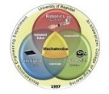
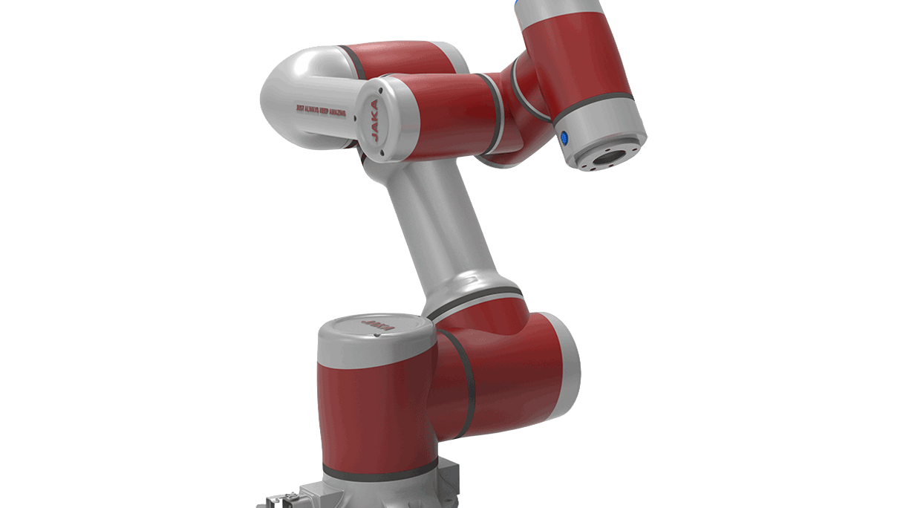
كلية الهندسة الخوارزمي
قسم هندسة الميكاترونيكس :
ورشة عمل
التحديثات على منهاج مادة الانسان الالي في الميكاترونكس
قسم هندسة الميكاترونيكس
Dr. Ahmed Rahman
PH.D. MECHATRONICS / ROBOTICS & HAPTIC TECHNOLOGY
28- OCT. -2024

Slide 2
JAKA Robot

Slide 3
Program Description
Semester
Year/Level | Course Code | Course Name | Credit Hours
2023-2024 / fourth stage | MTE444 | Fundamentals of Robotics | 2 2 hours theoretical | 1 2 hours Experiments
2023-2024 / fourth stage | MCT423 | Robotics Analysis and Control | 2 2 hours theoretical | 1 2 hours Experiments

Slide 4
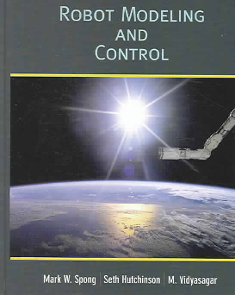
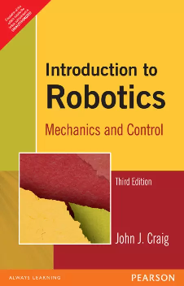
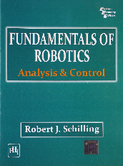
Course Text Book
Robot Modeling and Control by
Mark W. Spong, Seth Hutchinson, and M. Vidyasagar.
Introduction to Robotics Mechanics and Control by
John J. Craig.
Fundamentals of Robotics Analysis & control by
Robert J. Schilling

Slide 5
Fundamentals of Robotics ( Semester 1)
Week | Topic Title
1,2,3 | Introduction, background, and robot types, Drive technology, robot classification, motion control. Number of axis, speed and capacity, operating environment.
4,5,6 | Fundamentals of rotation, composite rotation, homogenous coordinate, translation and rotation, screw transformation.
7,8,9 | Direct Kinematics parameters, normal, sliding and approach vectors. Denavit Hartenberg D-H representation. Robotic arm matrix, arm equations.
10,11,12 | Five axis articulated robot (Rhino robot), link coordinate diagram, joint coupling. Four SCARA robot robotic arm matrix. Six axis articulated robot, coordinate diagram, arm Matrix.
13,14,15 | Inverse Kinematics, solving of robotic arm equation, inverse kinematics problem, tool configuration

Slide 6
Robotics Analysis and Control ( Semester 2)
Week | Topic Title
1,2,3 | Workspace analysis and trajectory planning, work envelope of five axis articulated robot, and work envelope of a four axis SCARA robot.
4,5,6 | Workspace fixtures, part feeder, conveyers, Fixed tool, The Pick and Place Operation, pick and lift – off point, place and set-down point, and speed variation
7,8,9 | Continuous path motion, Trajectory, continuous path control of five axis, and continuous path control of four axis.
10,11,12 | Interpolated motion, cubic polynomial parts, linear interpolation and parabolic blends. Straight line motion.
13,14,15 | Differential motion and statics, Jacobian matrix, joint singularity, manipulator Velocity analysis.

Slide 7
Laboratory of Manipulators
LabVolt 5150 Robot arm
The DENSO VG62432 Robot.

Slide 8
Mechatronics Engineering Bologna Process
Level | Semester | No. | Module Code | Module Name in English | اسم المادة الدراسية
4th | Seven | 3 | MCT413 | Robotics fundamentals | اساسيات الانسان الالي
 | Eight | 4 | MCT424 | Mobile Robotics | روبوت متحرك

Slide 9
Robotics Fundamentals (Bologna Process)
Week | Topic Title
1,2,3 | Introduction, robot types, Drive technology, robot classification, motion control. Number of axis, speed and capacity, operating environment.
4,5,6 | Fundamentals of rotation, composite rotation, homogenous coordinate, translation and rotation, screw transformation.
7,8,9 | Direct Kinematics parameters, normal, sliding and approach vectors. Denavit Hartenberg D-H representation. Robotic arm matrix, arm equations.
10,11,12 | Four SCARA robot robotic arm matrix. Six axis articulated robot, coordinate diagram, arm Matrix.
13,14,15 | Inverse Kinematics, solving of robotic arm equation, inverse kinematics problem, tool configuration

Slide 10
Course Text Book
Robot Modeling and Control
by
Mark W. Spong, Seth Hutchinson, and M. Vidyasagar.

Slide 11
Laboratory of Manipulators

Slide 12
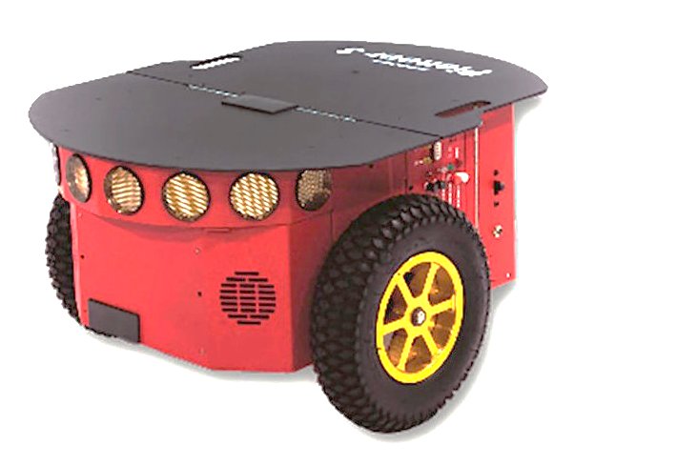
Mobile Robotics (Bologna Process)
Week | Topic Title
1,2,3 | Building Mobile Robot, Locomotion Mechanisms, wheeled mechanisms or legged locomotion, Four Basic Wheels Types, Mobile Robot Wheels Arrangements, Non-Holonomic Systems. .
4,5,6 | Differential Forward Kinematics Equations, the global reference frame of the plane and the local reference frame, The Velocity vector, Linear Velocity, Angular Velocity of Robot, examples.
7,8,9 | Inverse Kinematics motion, Mobile Robot Sensors Classification of Mobile Robot Sensors, Wheel and Motor Sensors, Odometry Position Estimation, ultrasonic sensor, laser scanner Lidar, Infrared Proximity Sensors, vision sensing.
10,11,12 | Mobile Robot Localization, Mobile robot Motion planning, Kinematics decomposition, Pure Pursuit Algorithm, .
13,14,15 | Probabilistic Roadmap (PRM), Mobile robot Dynamics, Differential wheeled Dynamics

Slide 13
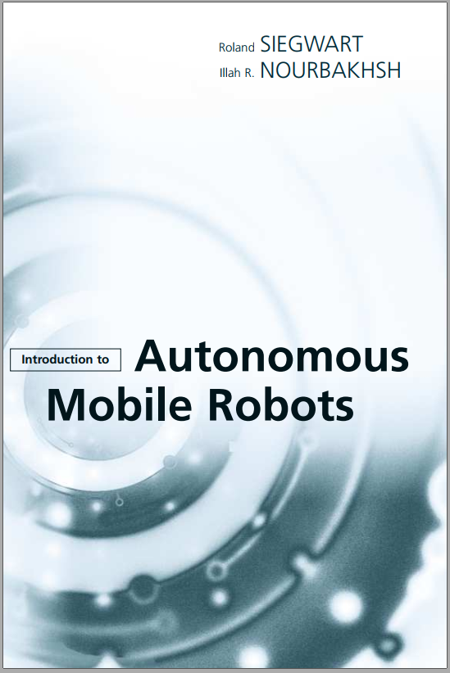
Course Text Book
Introduction to Autonomous Mobile Robots, second edition
Roland Siegwart, Illah Reza Nourbakhsh, Davide Scaramuzza
Introduction to Mobile Robot Control (Spyros G. Tzafestas)

Slide 14
Laboratory of Mobile Robot
Notes:
non-holonomic constraint is non-integrable. constraint. Example: A constraint on velocity does not induce a constraint on. position. For a wheeled robot, it can instantaneously move in some directions (forwards and backwards)

Slide 15
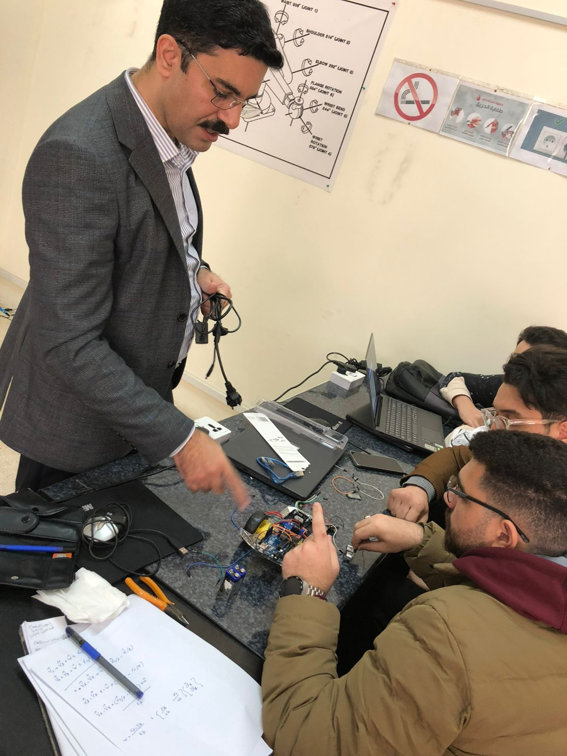
Lab. Project

Slide 16
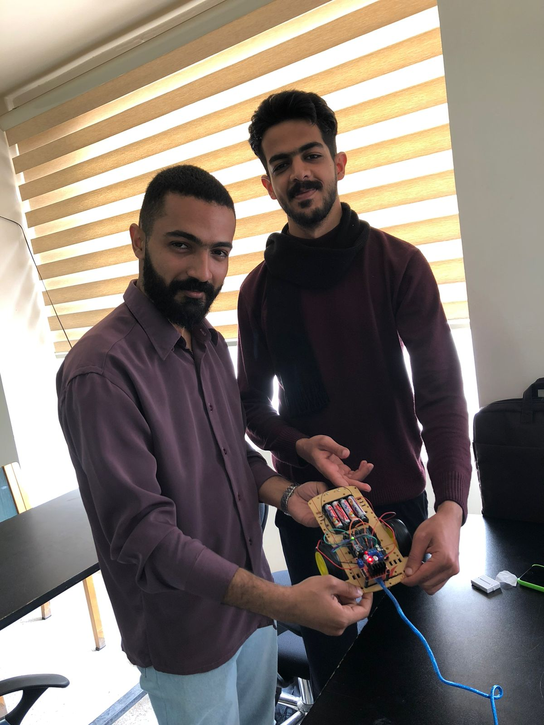
Lab. Project

Slide 17
THANKS

