Slide 1
Preservatives in Food Industry
Prepared by: Raghad A. Ameer

Slide 2
Common Food Additives:
Preservatives (e.g., sodium benzoate)
Colorants (e.g., Red 40)
Flavor enhancers (e.g., monosodium glutamate)
Stabilizers (e.g., guar gum)
Thickeners (e.g., xanthan gum)
Sweeteners (e.g., aspartame & cyclamates )
Acids (e.g., citric acid)

Slide 3
Preservatives
A food preservative is a substance added to food to prevent spoilage, extend shelf life, and inhibit the growth of harmful bacteria, molds, and yeast. According to the U.S. Food and Drug Administration (FDA), preservatives help maintain the safety and quality of food products.

Slide 4
Natural Preservatives
Salt
Sugar: Acts as a preservative in jams, jellies, and canned fruits.
Vinegar: Commonly used in pickling.
Lemon Juice: Contains citric acid, which helps preserve foods.
Honey: Has antimicrobial properties and can be used in various foods.

Slide 5
2- Synthetic Preservatives:
Sodium Benzoate: Commonly used in acidic foods like salad dressings, carbonated drinks, and fruit juices.
Sorbic Acid and Sorbates: Used in cheeses & baked goods to inhibit mold and yeast growth.
BHA and BHT (Butylated Hydroxytoluene): Used to preserve fats and oils in processed foods.
Potassium Bromate & Calcium Propionate : Used in baked goods to prevent mold.
Nitrites and Nitrates: Commonly used in processed meats to inhibit bacterial growth and enhance color.

Slide 6
Industrial preservatives can be categorized based on the types of foods they are used in as follows:
1. Meat and Poultry
Nitrates or Nitrites: Used for curing meats, preventing botulism, and maintaining color.
Sorbic Acid: Helps inhibit the growth of mold and bacteria.
2. Dairy Products
Sodium Benzoate: Common in cheese and yogurt to prevent spoilage.
Potassium Sorbate: Often used in soft cheeses and dairy products to extend shelf life.

Slide 7
3. Baked Goods
Calcium Propionate: Used to prevent mold growth in bread and baked goods.
Sodium Diacetate: Helps in preserving freshness and extending shelf life.
4. Fruits and Vegetables
Ascorbic Acid (Vitamin C): Acts as an antioxidant and preserves color in fruits.
Sulfur Dioxide: Commonly used in dried fruits to prevent browning and spoilage.
5. Beverages
Sodium Benzoate & Potassium Sorbate: Used in soft drinks and fruit juices to inhibit microbial growth.
6. Snacks
BHA and BHT : Antioxidants used in chips and snack foods to prevent rancidity.

Slide 8
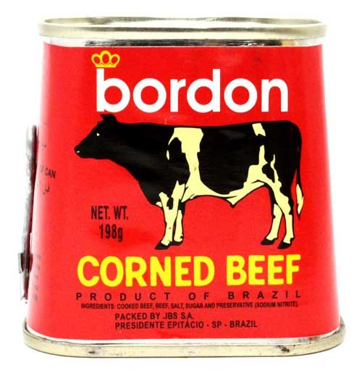
There are several food preservatives that are considered dangerous and are not approved by the FDA:
1- sodium nitrate and its related compounds(E249 – E250, E251 – E252):They can form harmful nitrosamines, which are known carcinogens, when exposed to high heat.

Slide 9
Sodium nitrate itself is not universally banned, but its use is regulated in various countries due to health concerns. For instance:
In Norway and Sweden, nitrate is banned in food.
In Austria and Hungary, regulations that limit or prohibit its use in certain foods are put.

Slide 10
2- Potassium Bromate: Used in some baked goods, potassium bromate has been linked to kidney and thyroid tumors in animal studies.
Due to its potential health risks, potassium bromate is banned in many countries, including the European Union, Canada, and some others. However, it is still allowed in the United States, where the FDA considers it safe in certain concentrations.

Slide 11
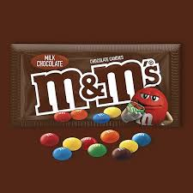
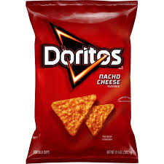
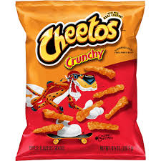
3- Allura Red (Red 40) is a commonly used artificial food color found in various food products. Some studies suggest a possible link between Red 40 and hyperactivity in children, as well as allergic reactions in sensitive individuals. Here are some examples of where it is typically used:

Slide 12
Many countries such Norway, Sweden, and Finland have banned (Red40) while other countries have restricted its use such as Austria.
In the European Union, Allura Red is not outright banned, it is subject to strict regulations, and there are mandatory labeling requirements.

Slide 13
Thank you

