Slide 1
CNC machines and its Potential in mechanical applications
Presented by
Omar Almuktar T.
Oct./7/2024

Slide 2
Outlines:
1- CNC machining vs. 3D Printing
2- Types of CNC machines
3- CNC CO2 Laser cutter
4- Components of a CNC CO2 Laser Machine
5- Materials Cut by CNC CO2 Lasers cutter
6- Common Applications of a CNC CO2 Laser Machine

Slide 3
CNC machining vs. 3D Printing
CNC machining
Is an Subtractive manufacturing process
3D printing
Is an additive manufacturing process

Slide 4
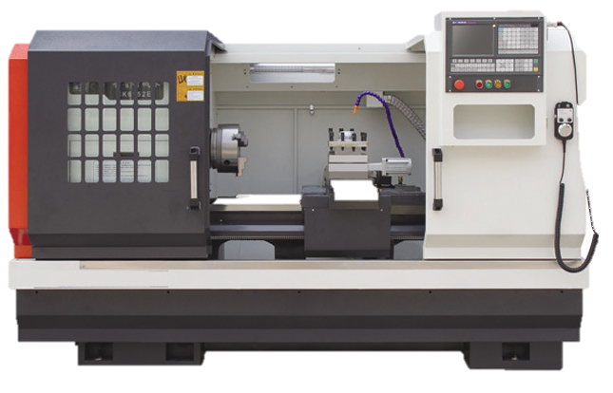
Types of CNC machines
CNC Lathe machine

Slide 5
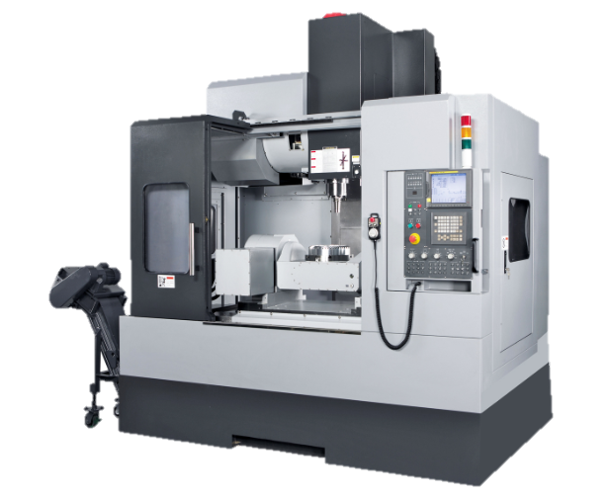
Types of CNC machines
CNC Router (milling) machine

Slide 6
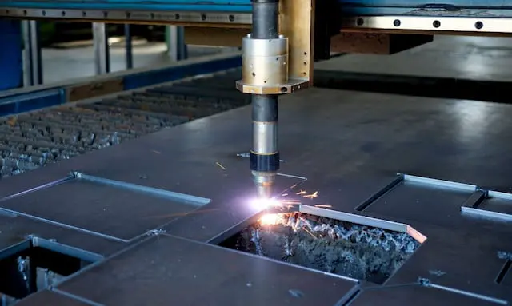
Types of CNC machines
CNC Plasma cutters

Slide 7
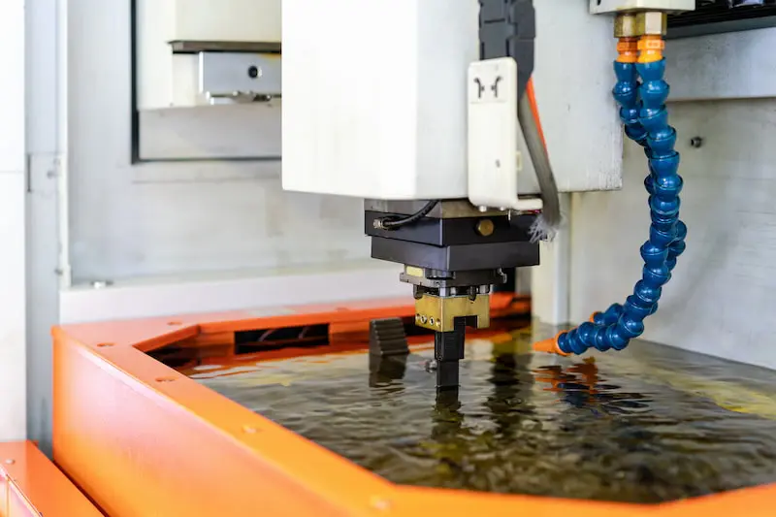
Types of CNC machines
Electrical discharge CNC machine

Slide 8
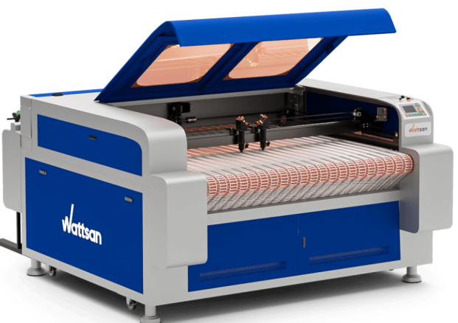
Types of CNC machines
CNC Laser cutting machine

Slide 9
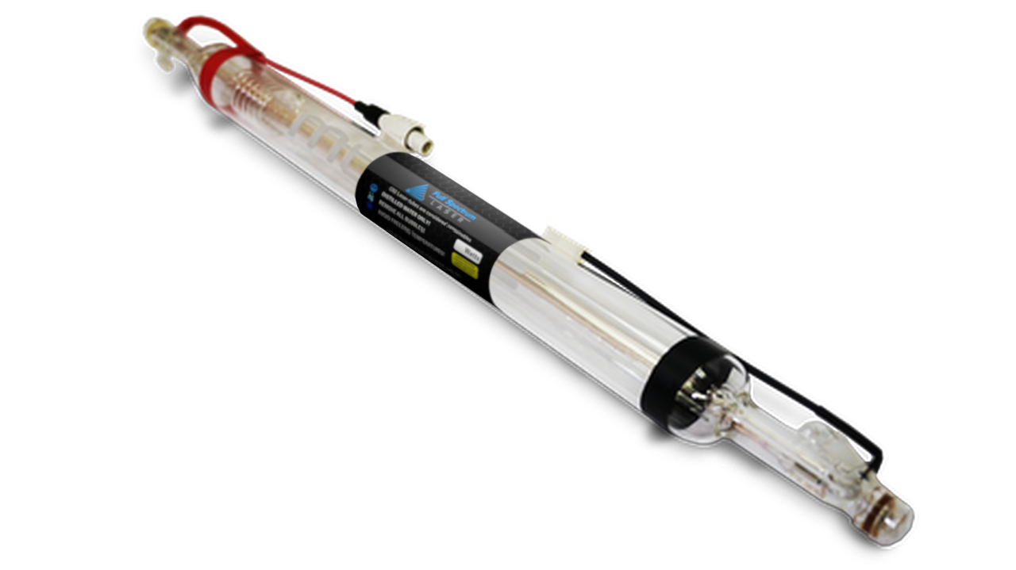
Components of a CNC CO2 Laser Machine
CO2 Laser Tube: Generates the laser beam using carbon dioxide, nitrogen, and helium gases.

Slide 10
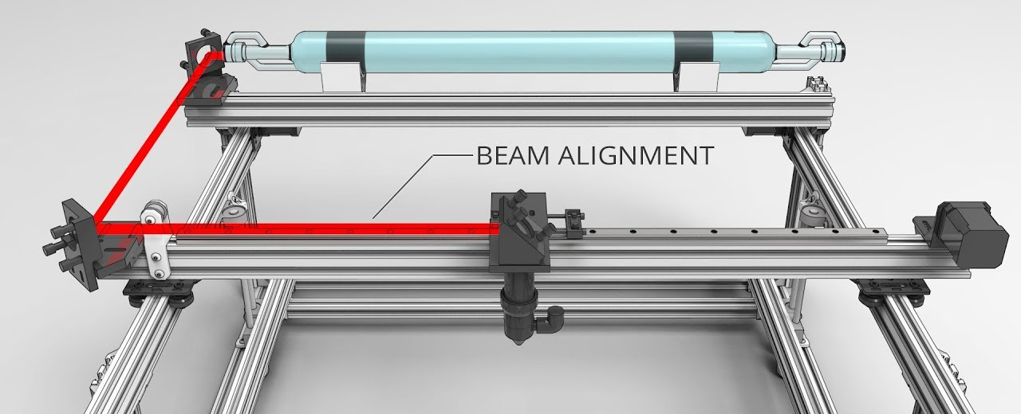
Components of a CNC CO2 Laser Machine
Mirror System: Reflects and directs the laser beam to the cutting area.

Slide 11
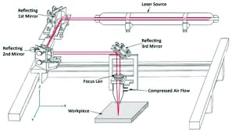
Components of a CNC CO2 Laser Machine
Focusing Lens: Focuses the laser beam for precise cutting or engraving.

Slide 12
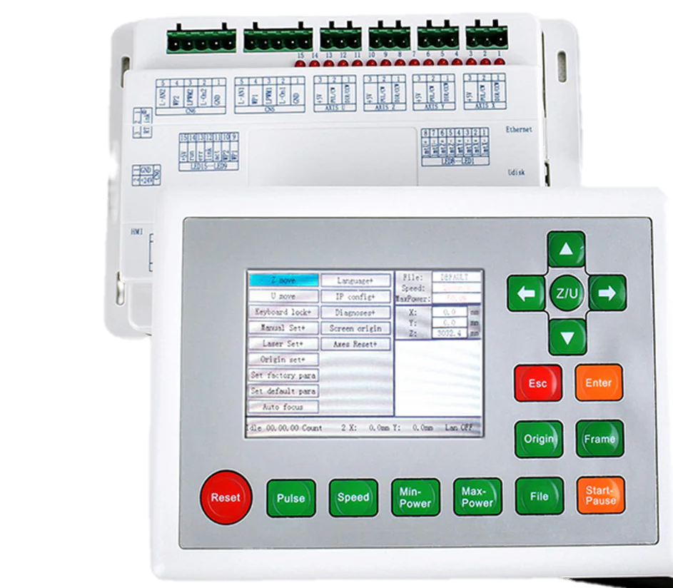
Components of a CNC CO2 Laser Machine
CNC Control System: Controls the movement of the machine’s axes (X, Y, Z) and adjusts the laser's intensity.

Slide 13
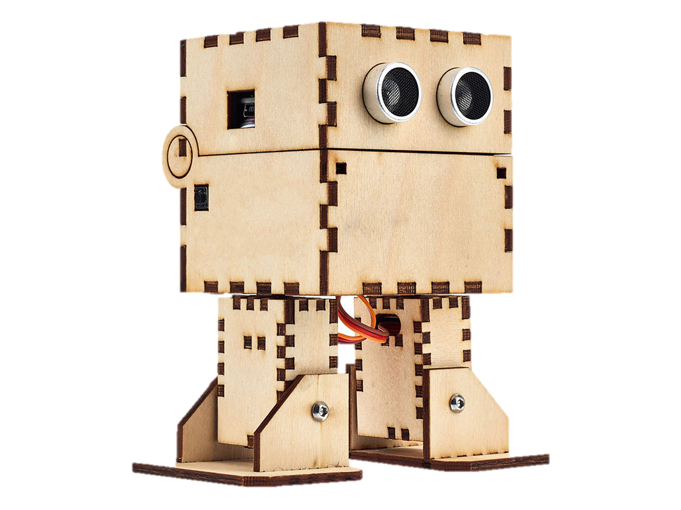
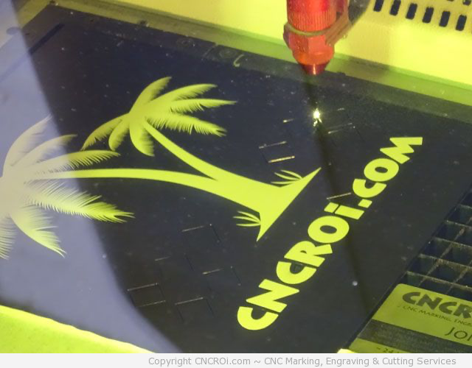
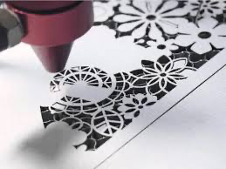
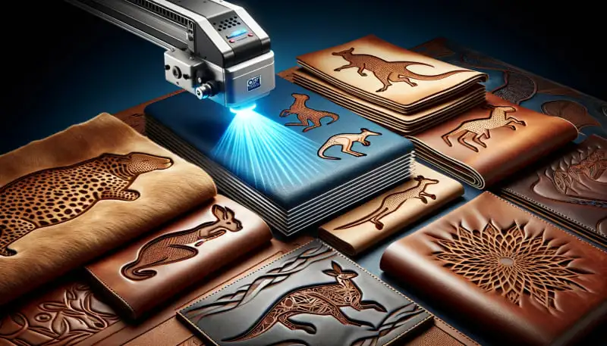
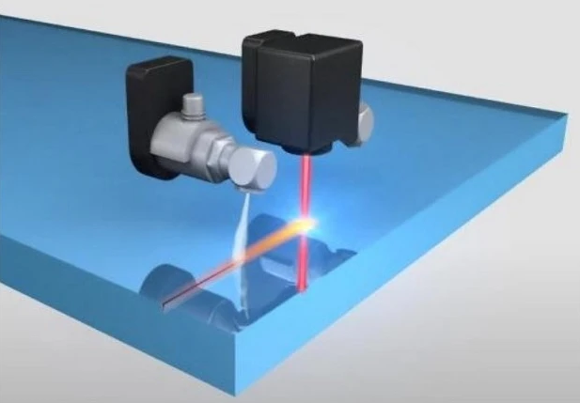
Materials Cut by CNC CO2 Lasers cutter
Wood
Acrylic
Paper
Leather
Glass.

Slide 14
Common Applications of
CNC CO2 Laser Machine
Industries:
Manufacturing of mechanical parts (like gears)
Decoration and interior design
Fashion (cutting fabric)
Jewelry (engraving)

Slide 15
Thank you for your attention

