Slide 1
Electroencephalography and Brain-Computer Interface
by
Asst. Lecturer
Oger Zaya Amanuel

Slide 2
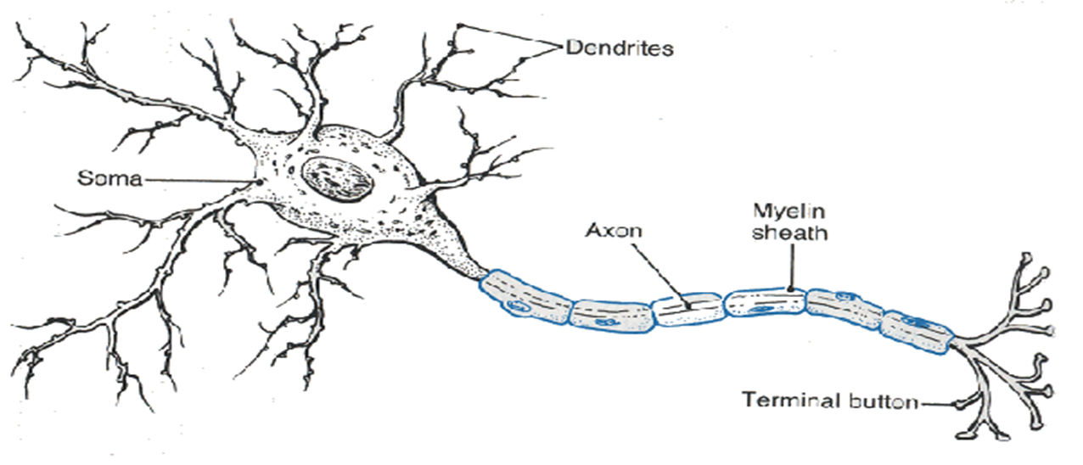
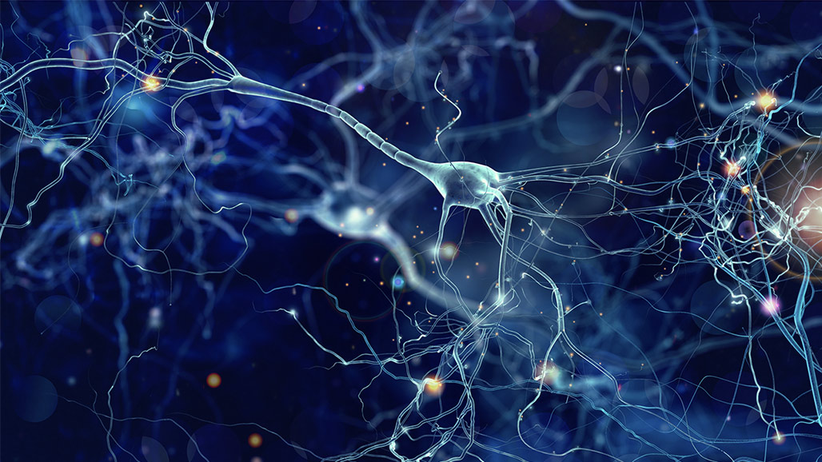
Brain Waves
The transmission of information between neurons is the source of our ideas, emotions and actions. Brain waves are produced by electrical impulses from nerve blocks that communicate with one another.

Slide 3
Classification of Brain Waves
Deep (dreamless) sleep, unconscious
Light sleep (dream), deep meditation
Light meditation, relaxed, conscious
Five physical sense, Normal waking state, focus, awake, consciousness
Motor function, higher mental

Slide 4
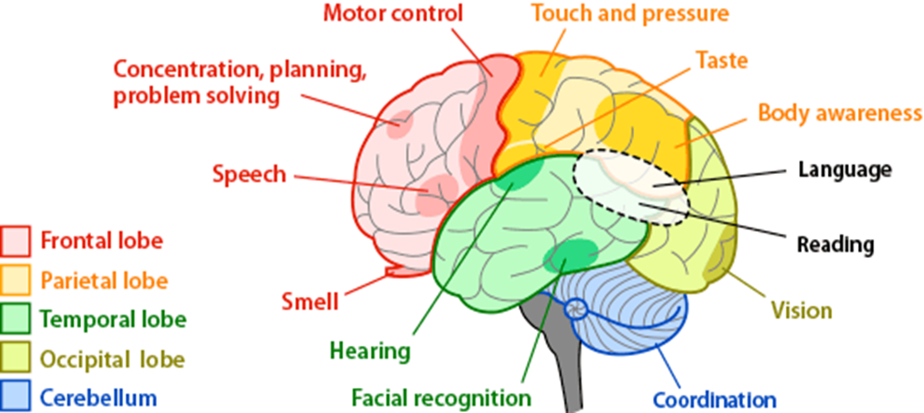

Slide 5
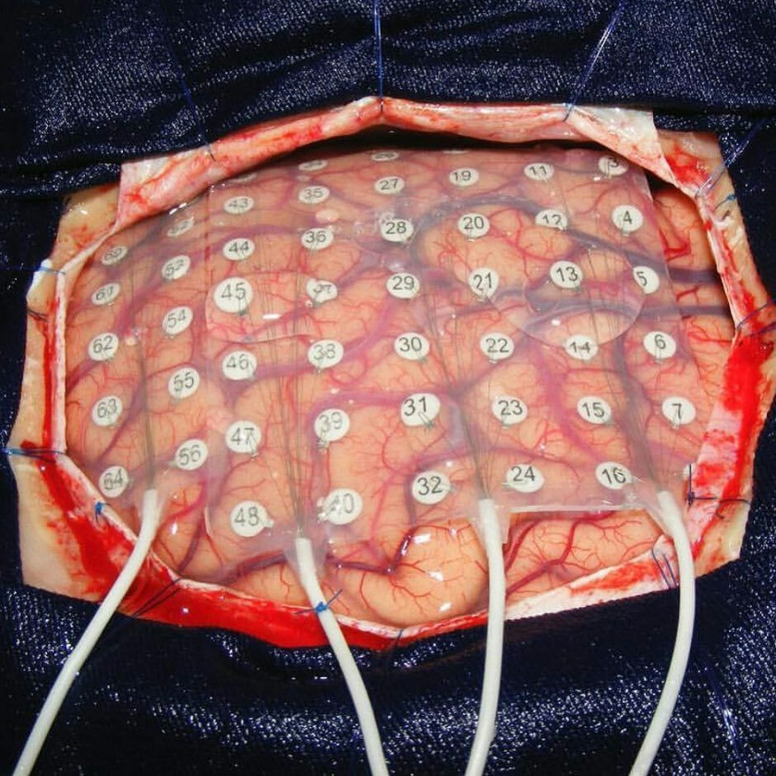
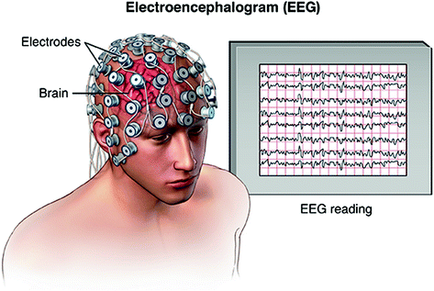
Electroencephalography (EEG)
The electroencephalogram (EEG) is the electrical activity of the brain that can be detected and measured by attaching some electrodes to the scalp according to the international 10-20 system. Electroencephalographic reading is a completely non-invasive procedure that can be applied repeatedly to patients, normal adults, and children with virtually no risk or limitation.
Invasive
Non-Invasive

Slide 6
An EEG can find changes in brain activity that might be useful in diagnosing brain disorders, especially epilepsy or another seizure disorder. An EEG might also be helpful for diagnosing or treating:
Brain tumors
Brain damage from head injury
Brain dysfunction that can have a variety of causes (encephalopathy)
Sleep disorders
Inflammation of the brain (herpes encephalitis)
Stroke
Head injuries
Brain infection
Alzheimer's disease
Degeneration of brain tissue
Metabolic conditions that affect brain tissue
Hormonal conditions that affect brain tissue
Brain death.

Slide 7
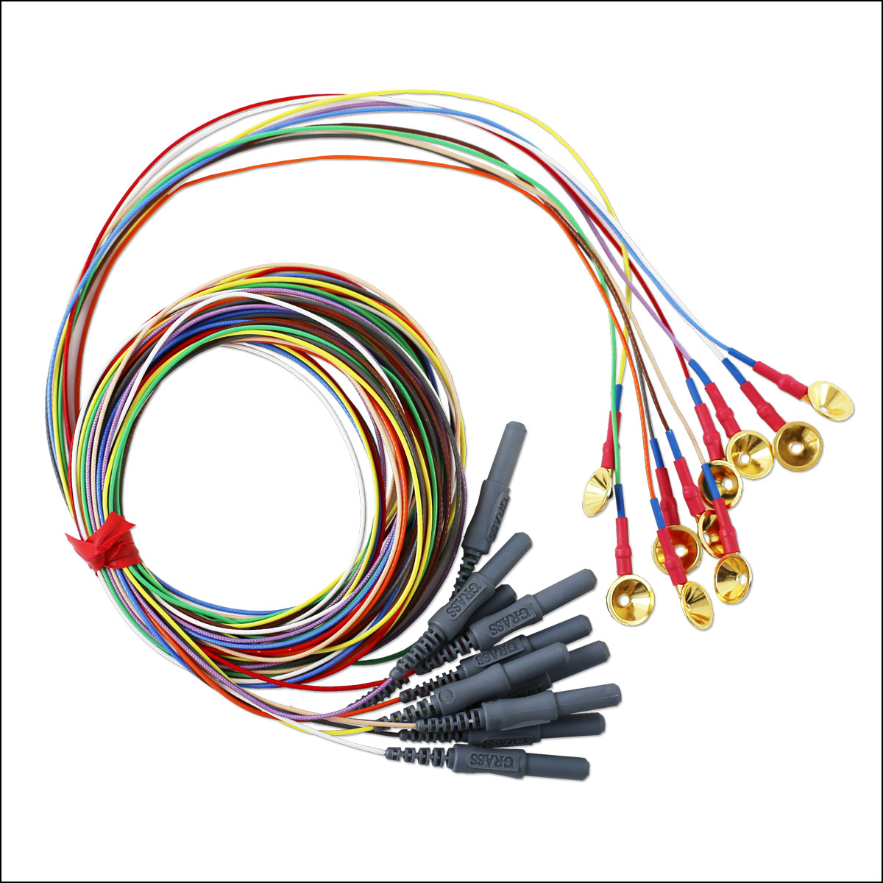
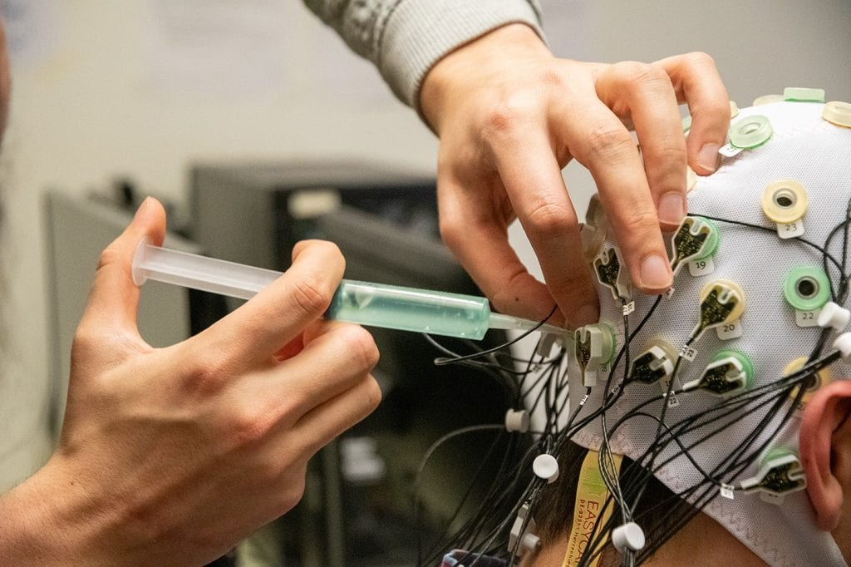
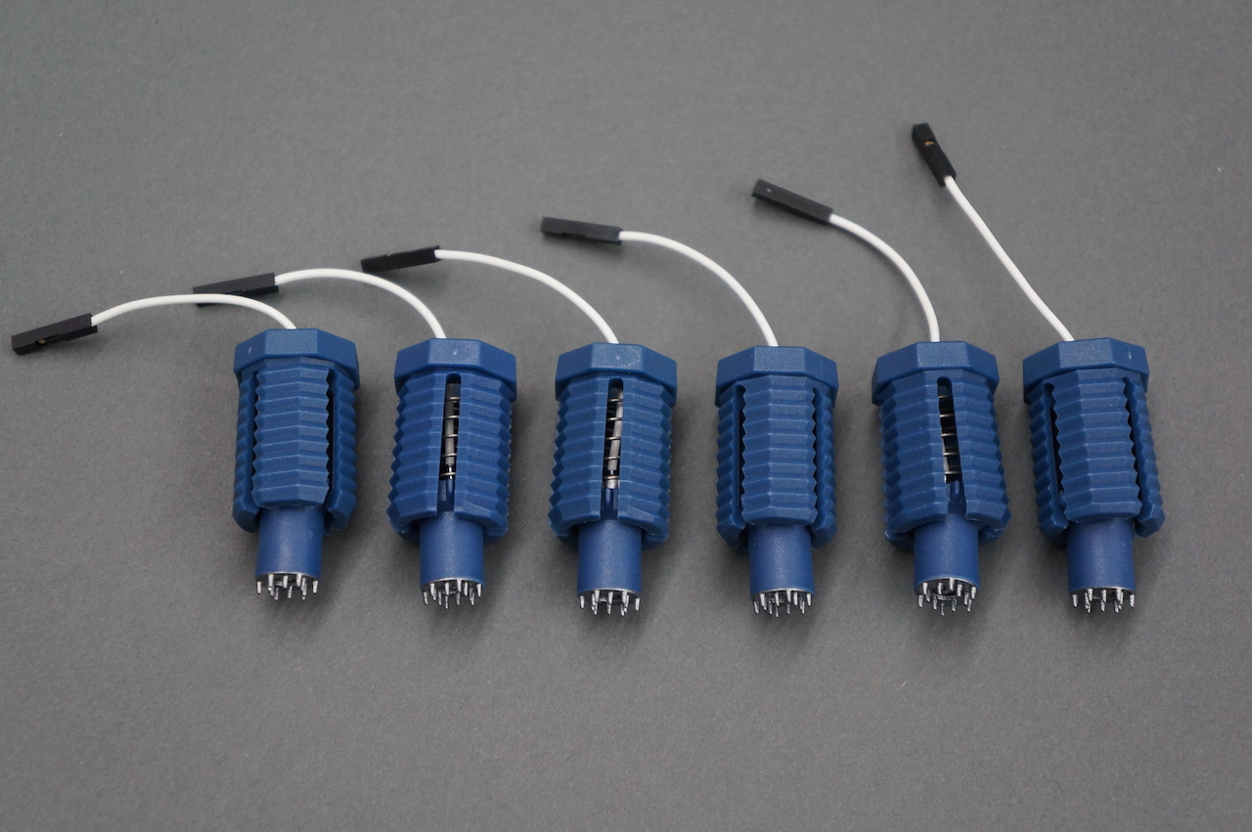
The process is done by using electrodes to measure the voltage fluctuations resulting from ionic current within the neurons of the brain over time (the dipole exists between the soma and apical dendrites). The electrodes consist of small metal discs with thin wires that are pasted onto the scalp, so when the wave of ions reaches the electrodes on the scalp.

Slide 8
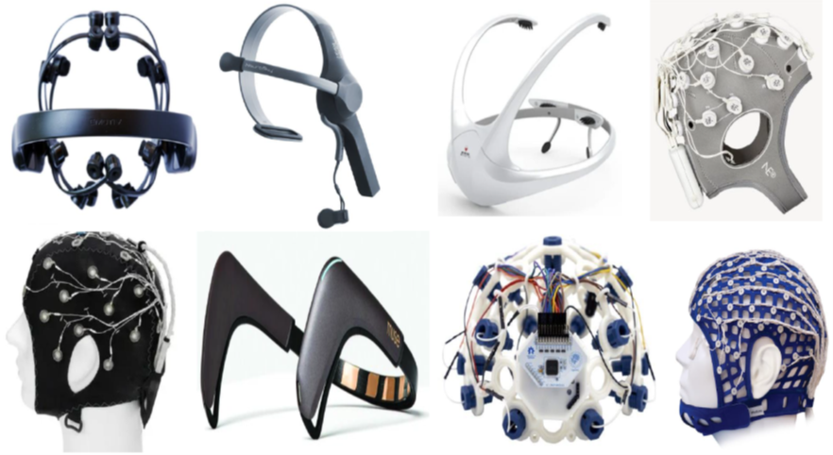
There are many different types of the EEG electrodes as shown in Figure below
a. Gel based: with this connection, electrodes are attached to the scalp by putting a conductive gel into each electrode’s hole. After the experiment has completed, it is important to wipe and clean the headset and electrodes by removing the gel.
b. Saline: Some EEG electrodes need to have saline to assist in creating a low-impedance electrical connection between the electrode and scalp. With this method, the saline is added to each electrode.
c. Dry: Dry EEG devices do not need saline or gel to attach the electrodes to the scalp. They are simpler to collect the EEG data without the assistance of a technician. Additionally, it takes much less time to set up than wet headsets.

Slide 9
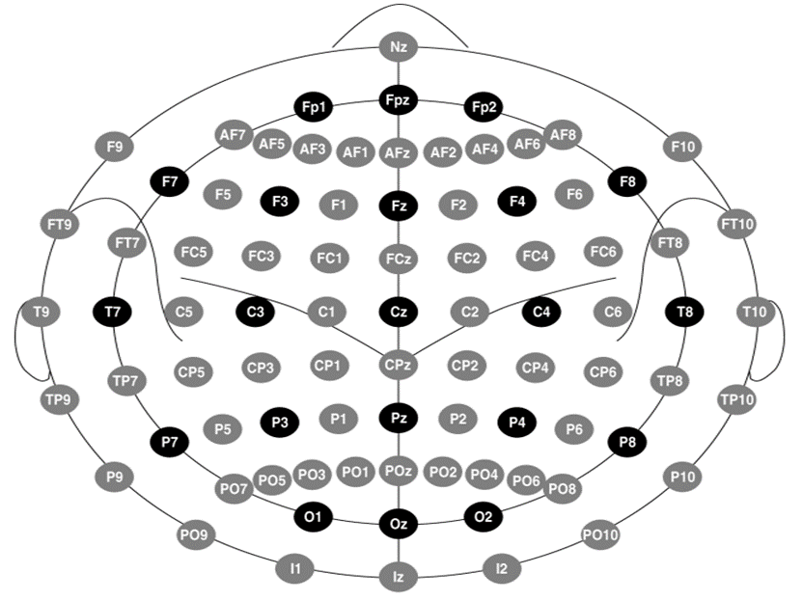

Slide 10
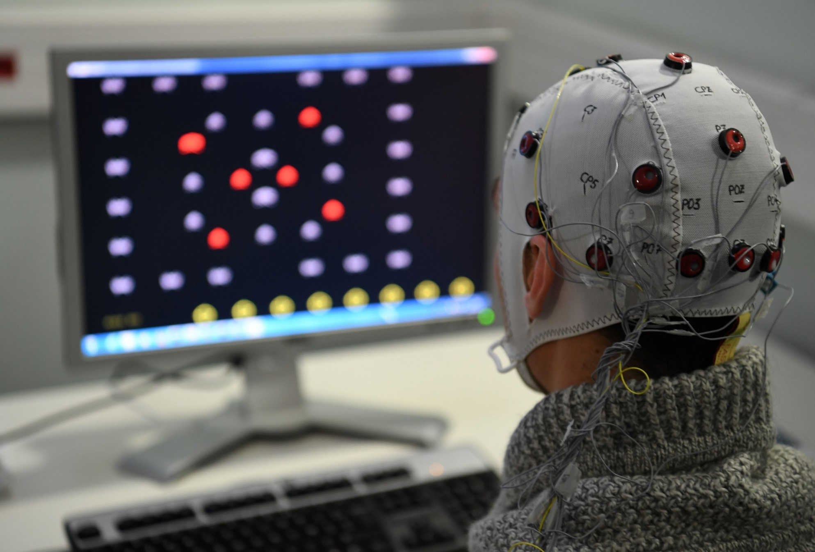
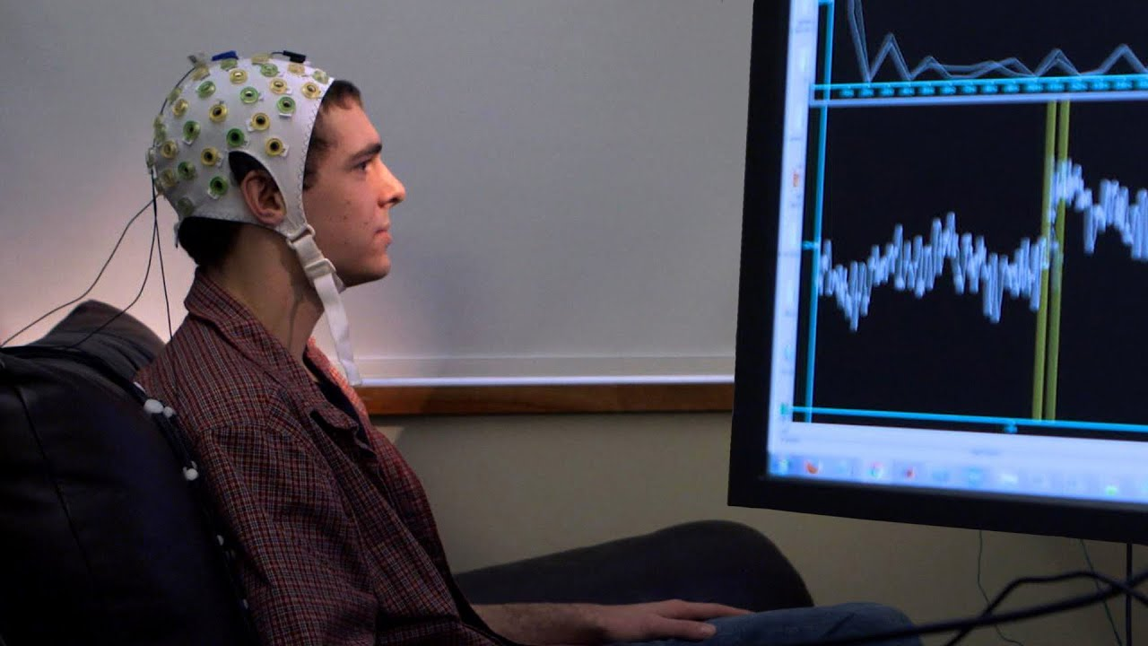
Brain Computer Interface (BCI)
The brain-computer interface is a direct communication channel between a biosensor-based brain signal processing unit and an external device (the brain of the user and a machine). BCI provides a new way of interacting with devices by allowing people to control a computer system through their brain signals without the need for physical activity.

Slide 11
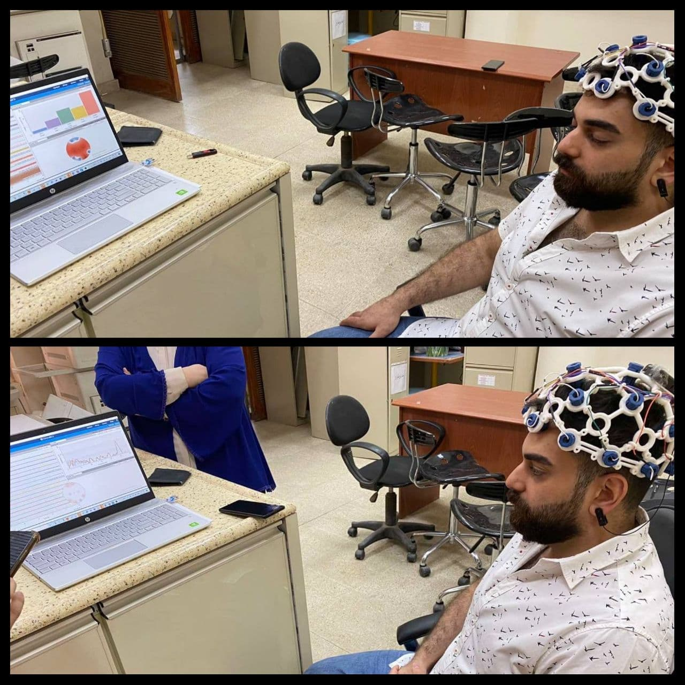

Slide 12
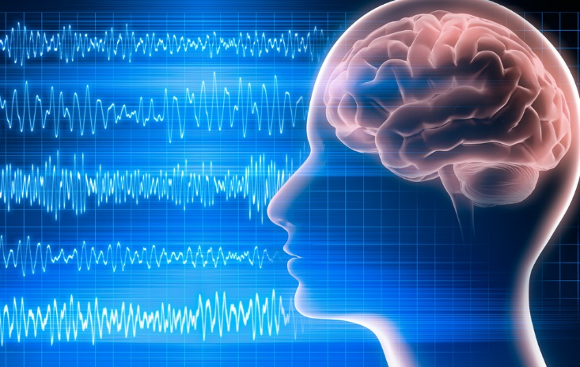

Slide 13
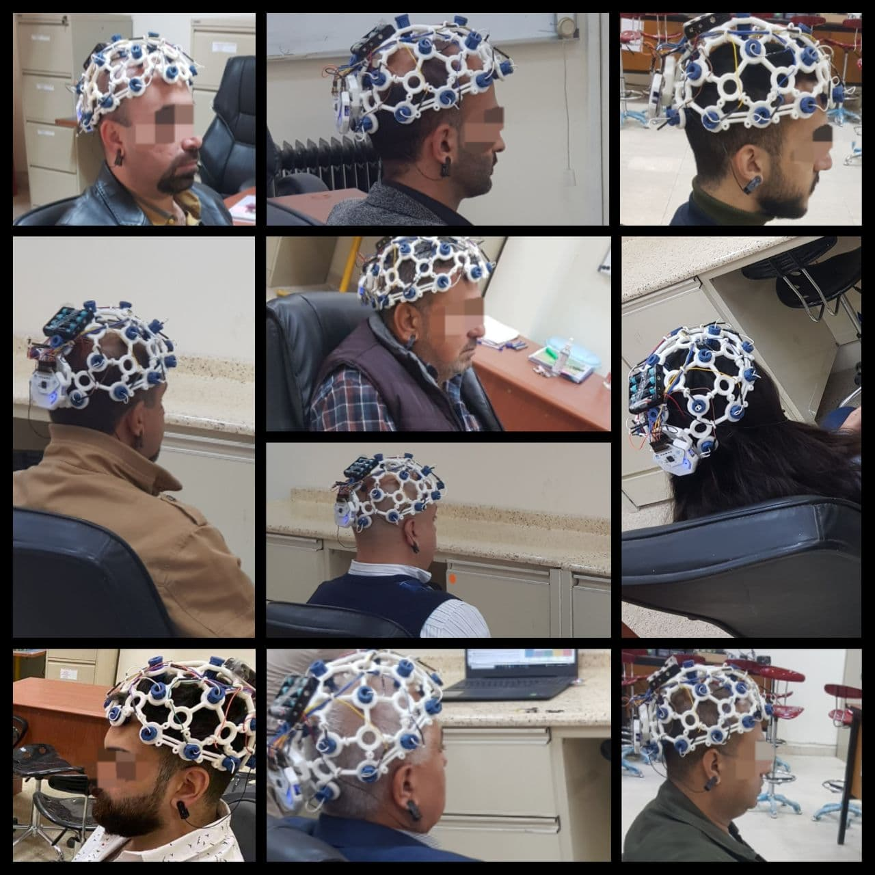
Collecting the Signals

Slide 14
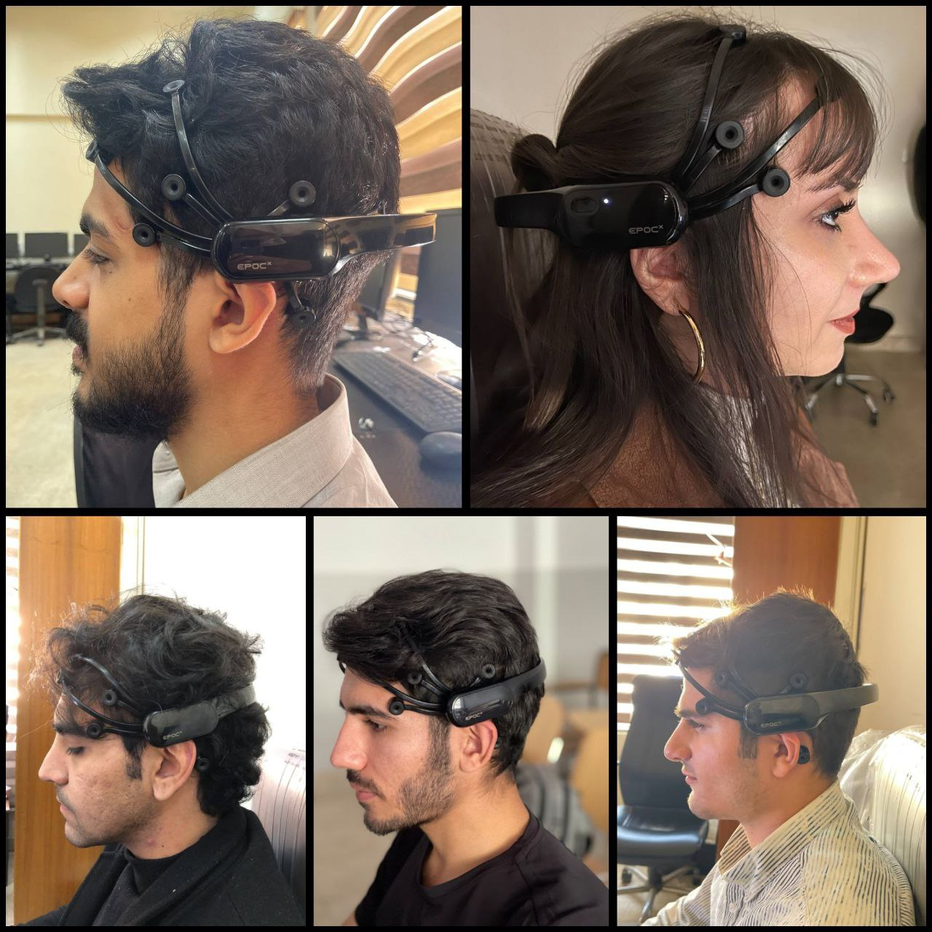

Slide 15
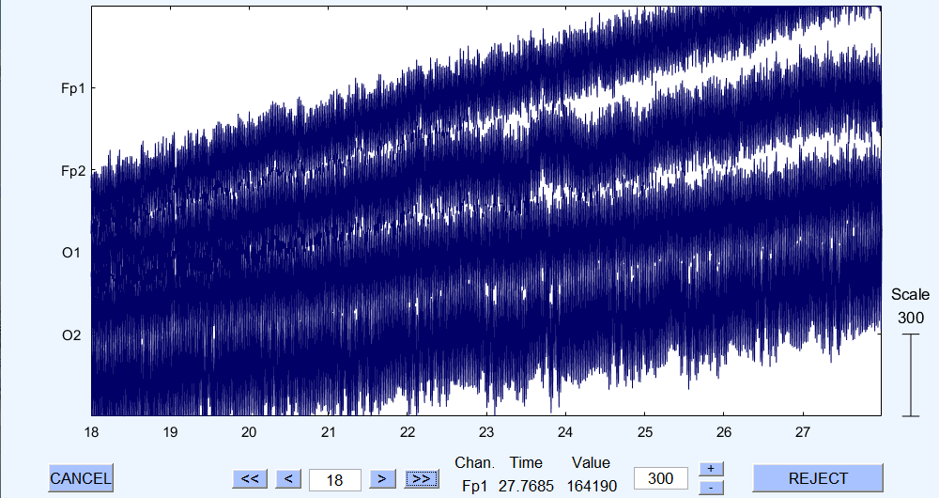
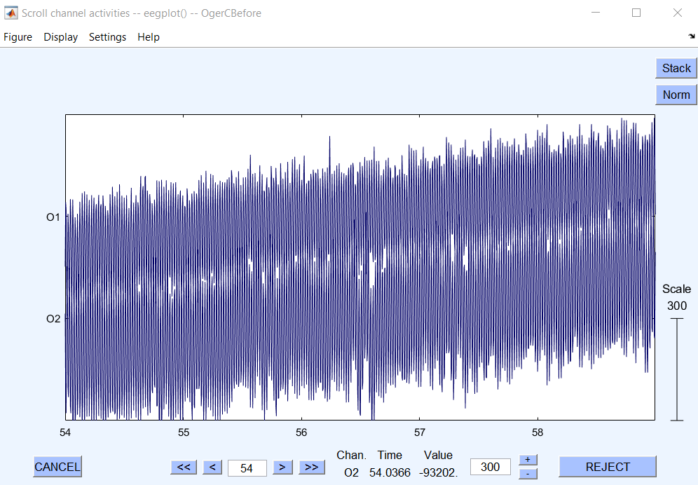
Pre-processing

Slide 16
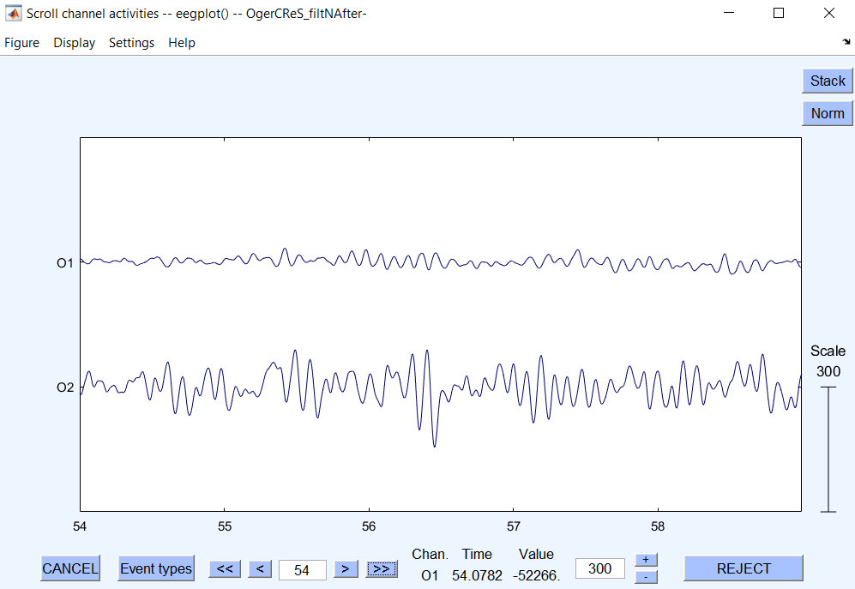

Slide 17
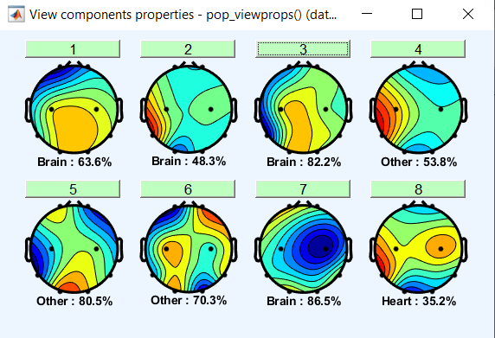
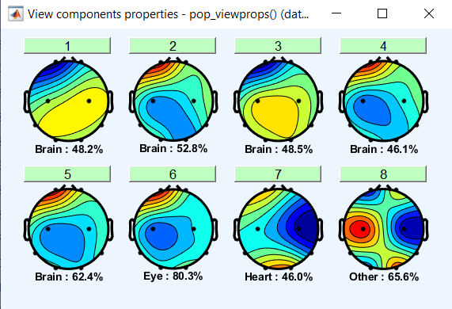
EEGLAB

Slide 18
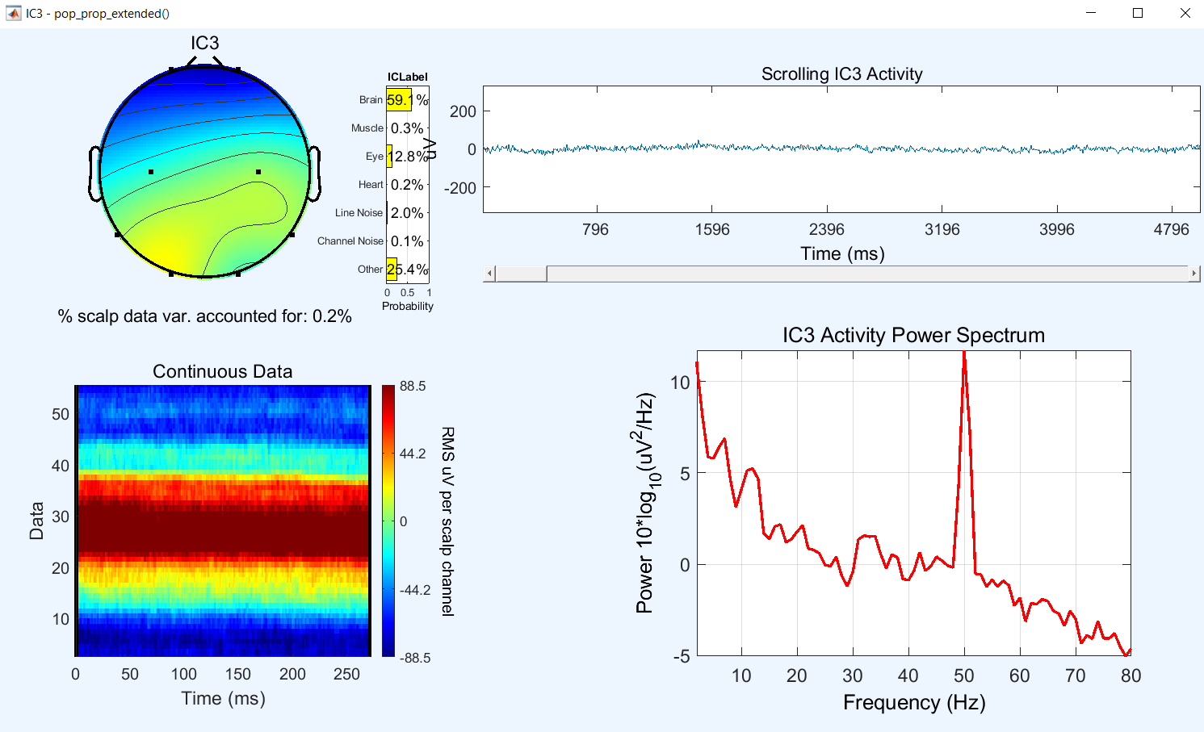

Slide 19
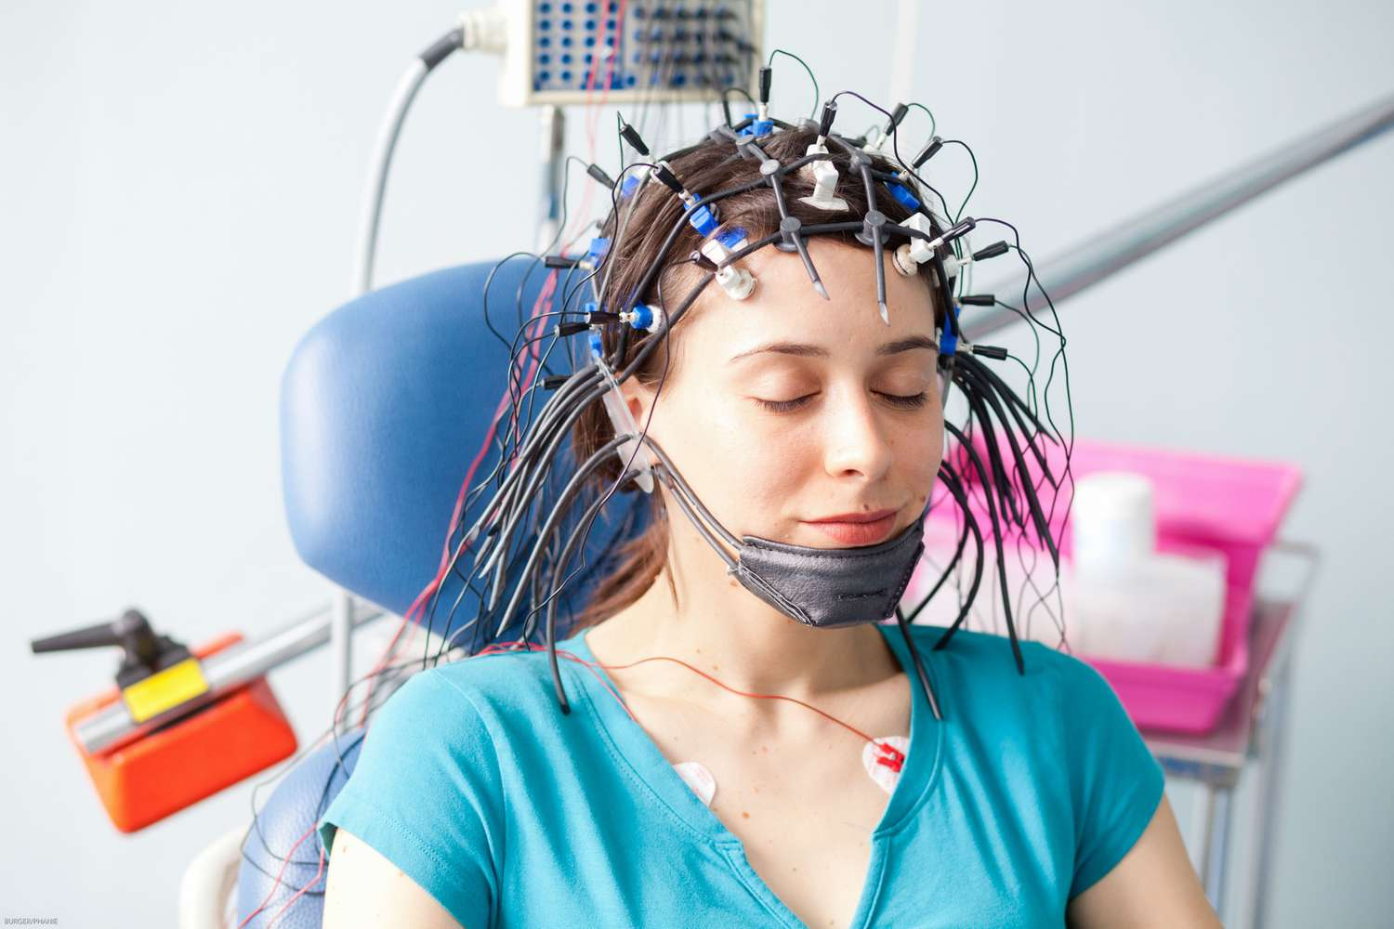

Slide 20
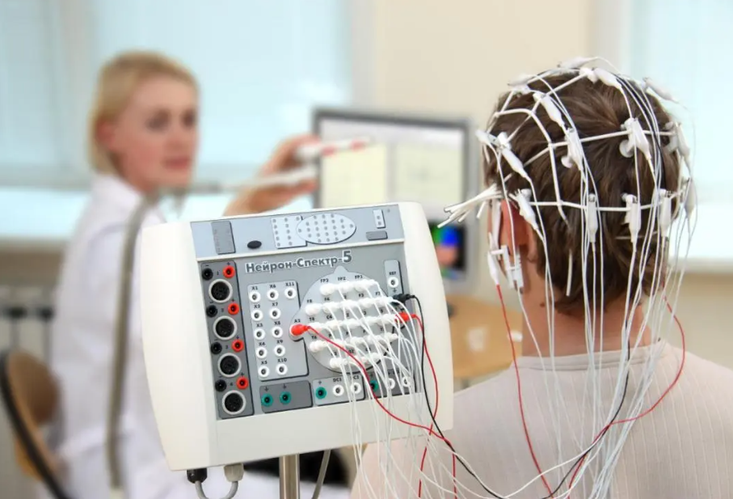

Slide 21
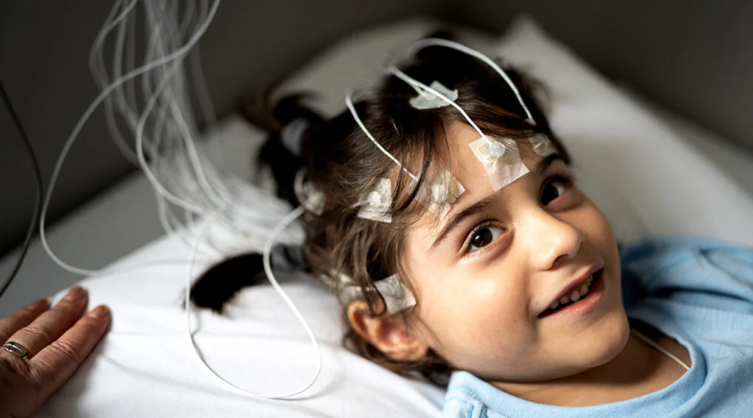

Slide 22
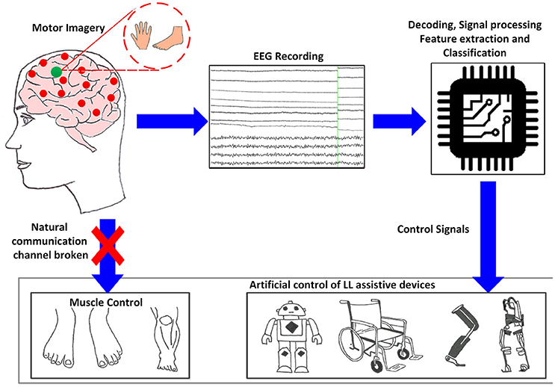

Slide 23
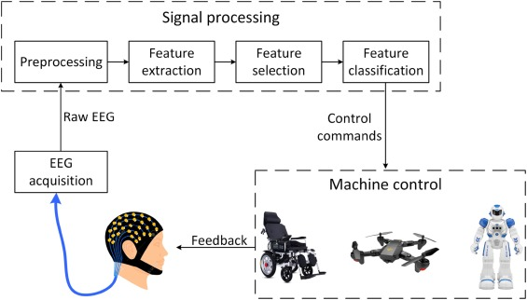

Slide 24
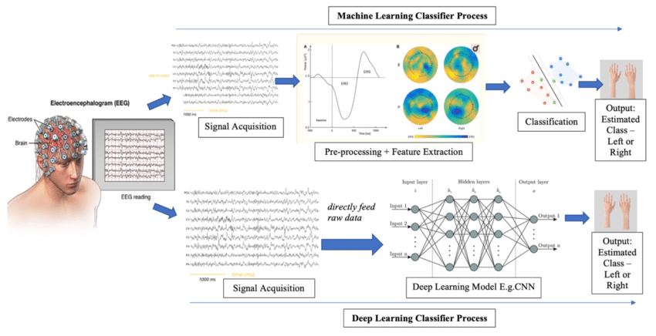

Slide 25
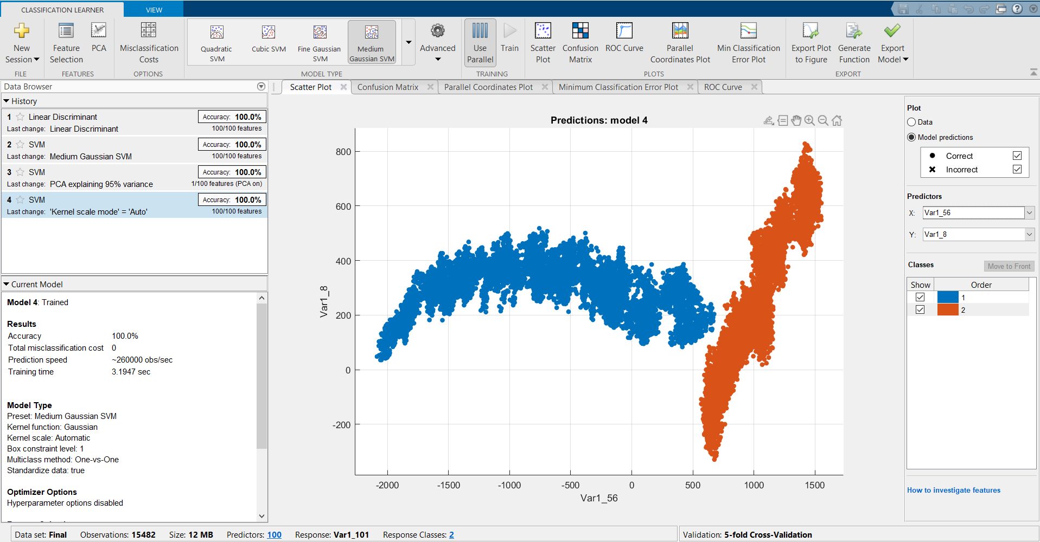

Slide 26
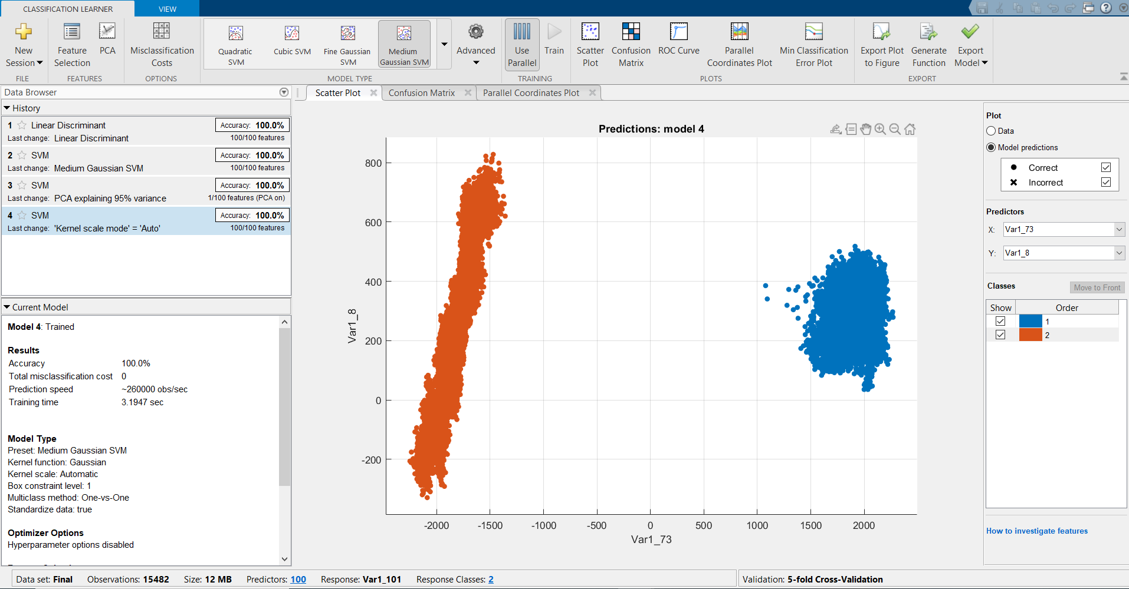

Slide 27
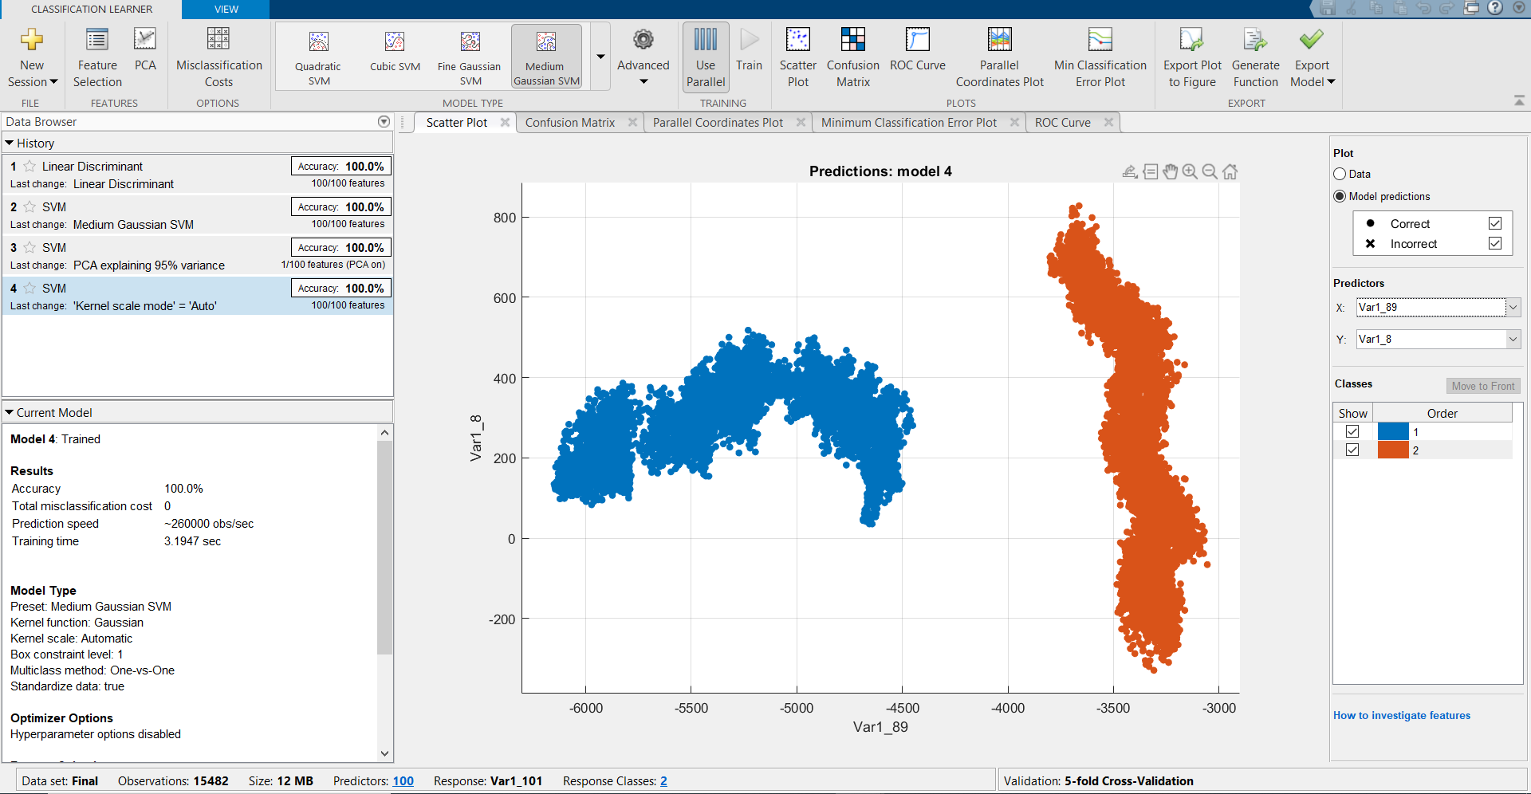

Slide 28
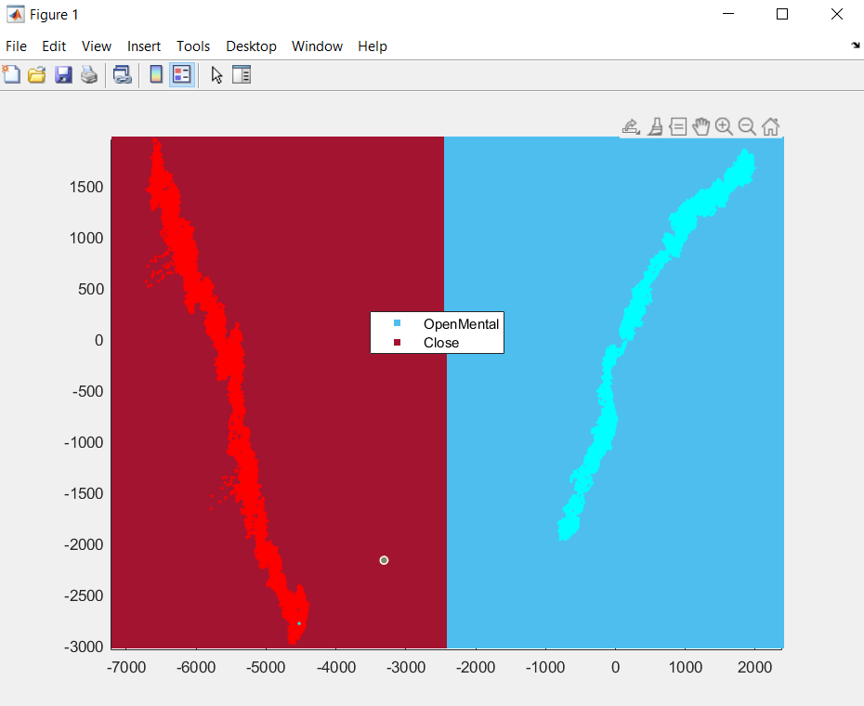

Slide 29
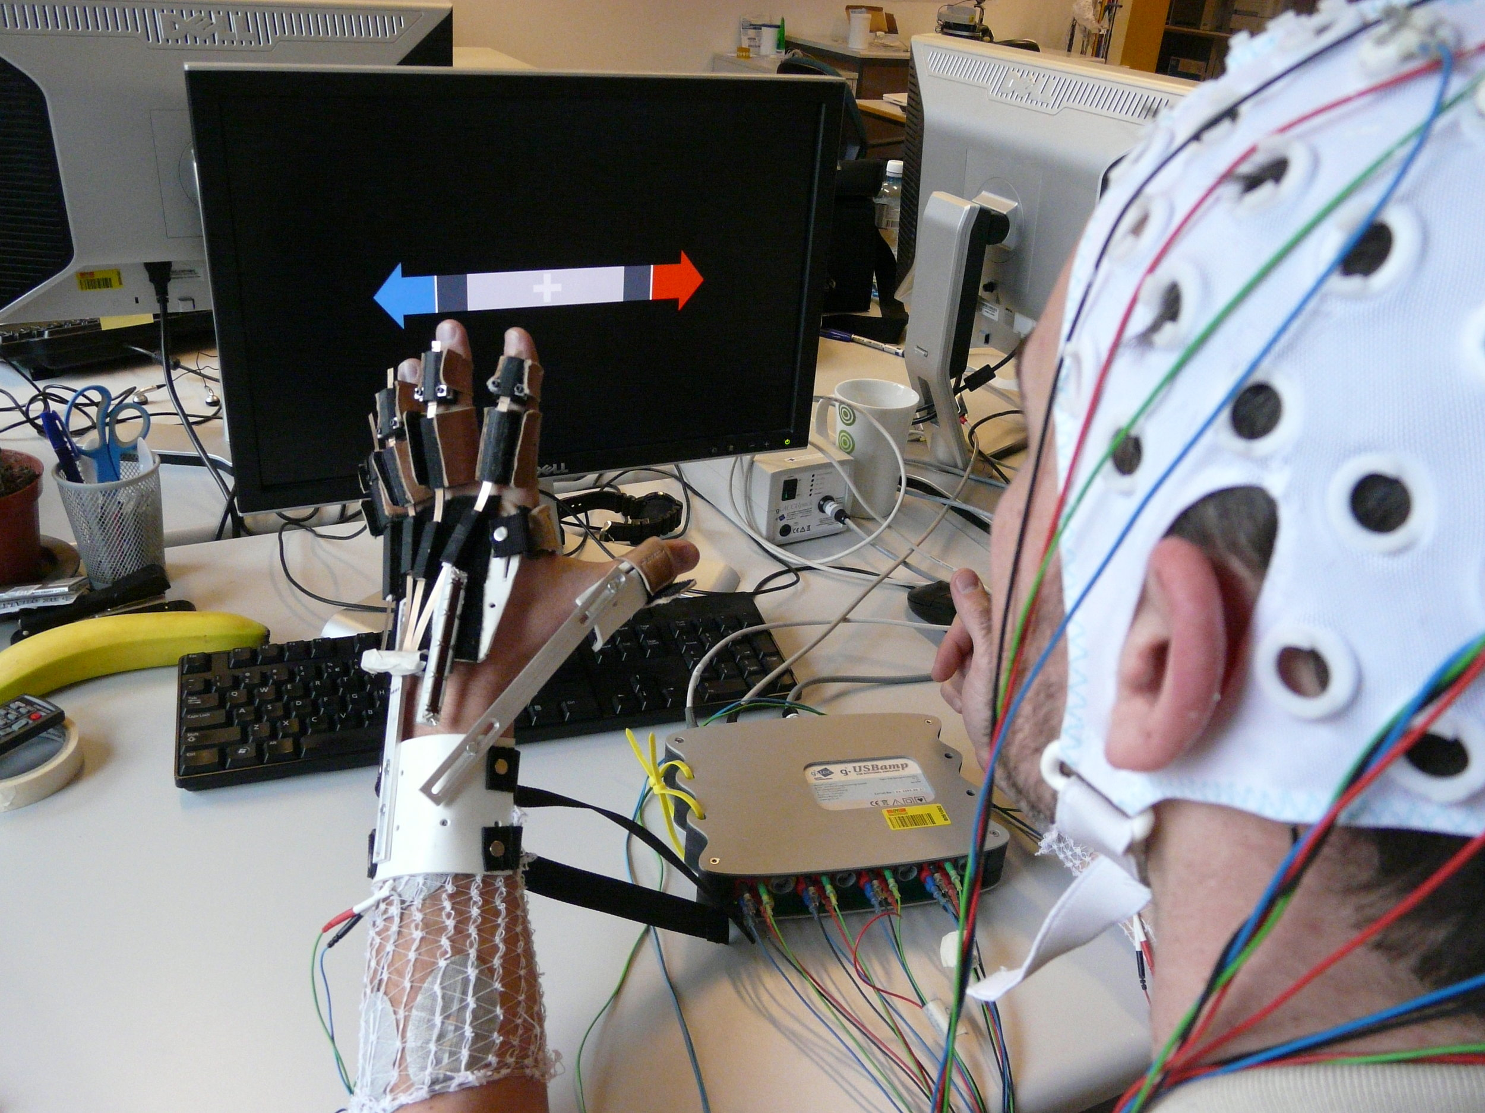

Slide 30
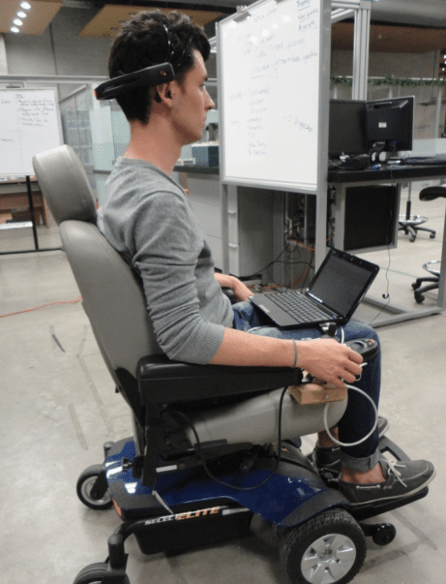

Slide 31
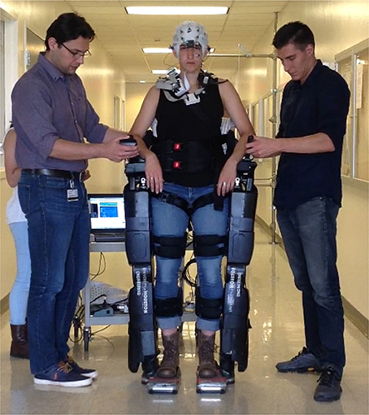

Slide 32
Thank You

