Slide 1
Personality Expression
Done by:
Lecturer dr. Ferial M. Abdulrida

Slide 2
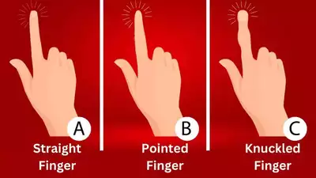
Straight finger shapes indicate honesty and a strong aversion to lies
pointed finger shapes suggest being an ardent dreamer who be .. Knuckled finger shapes indicate valuing truth and integrity, ..

Slide 3
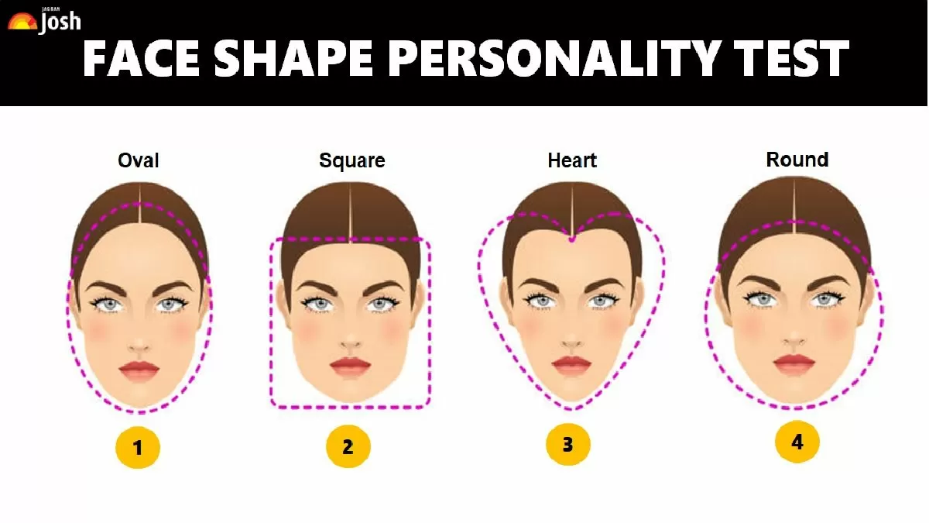

Slide 4
Oval face shape personality traits
Methodical, ambitious, practical, high achiever, dislikes norms of society and mundane routines, a mix of introversion and extroversion, good at making others feel good.

Slide 5
Square face shape personality traits
Headstrong, highly active, energetic, analytical, quick-witted, proactive, calm under stressful situations, a leader, and a good decision-maker.

Slide 6
Heart-face shape personality traits
Tich imagination, creativity, memory, good perception, entrepreneurial skills, intuitive, high emotional intelligence, strong-minded, stubborn, and loves solving complex problems.

Slide 7
Round face shape personality traits
Soft-spoken, a people person, kind, nurturing, giving (sometimes over-giver), compassionate, easy-going, tolerant, and good at interpersonal relationships.

Slide 8
Oval Face Shape | Square Face Shape | Heart Face Shape | Round Face Shape
Career Options: Actor/Actress/Model Lawyer News Anchor/TV Presenter Architect Marketing/Advertising Executive Government Jobs Professor/Educator Psychologist/Educator Software Developer/Programmer Entrepreneur | Career Options: C-Suite Business Leader Entrepreneur Athlete/Sports Coach Engineer Financial Analyst Military/Defense Personnel Fashion Designer Stylist Project Manager IT Specialist Sales | Career Options: Social Worker Customer Service Sales/Marketing Professional Makeup Artist Counsellor/Therapist Travel Blogger/Influencer PR Specialist Human Resources Teacher/Trainer Interior Designer | Career Options: Wellness Coach Yoga Instructor Graphic Designer/Illustrator Nutritionist/Dietician Early Childhood Educator Event Coordinator Social Worker Hotel Management/Hospitality Sales/Marketing Non-Profit Work

