Slide 1
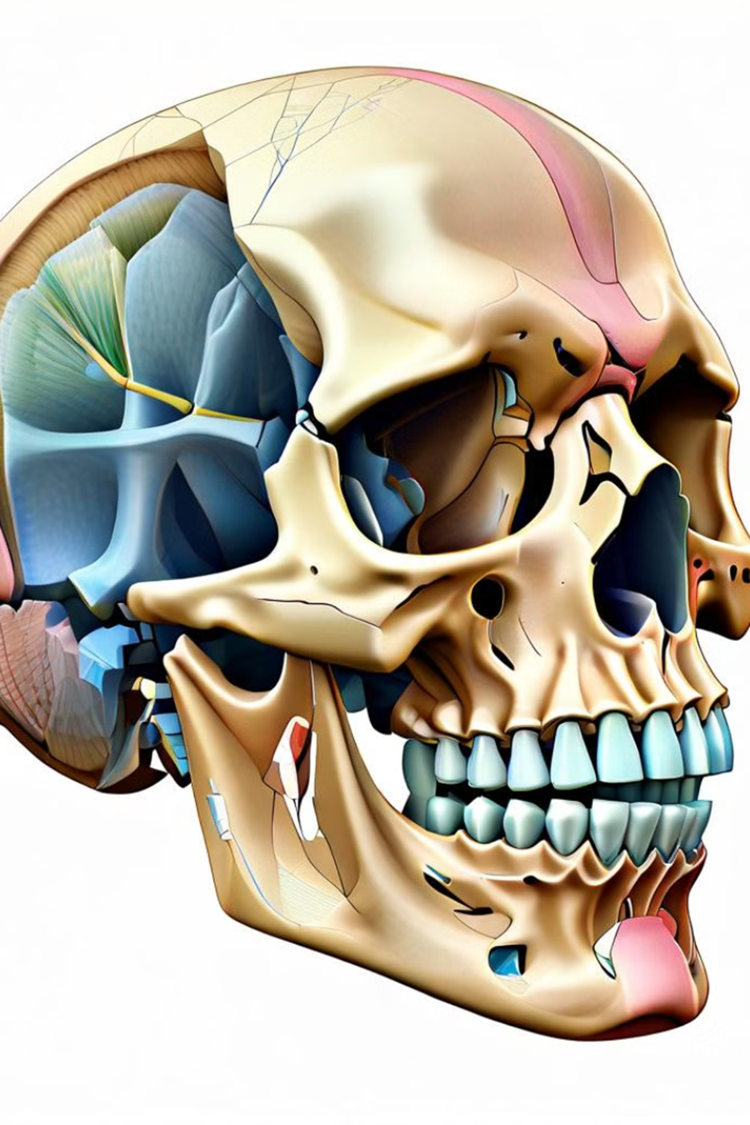
Subluxation of TMJ
By
Asst. Lec. Rana Murtadha

Slide 2
Introduction to TMJ Subluxation
Temporomandibular joint (TMJ) subluxation is a condition where the lower jaw, or mandible, partially dislocates from the temporomandibular joint. This can occur due to excessive opening of the mouth, such as during yawning, laughing, or eating hard or chewy foods. TMJ subluxation is a common occurrence, affecting up to 7% of the population, and is more prevalent in women than men.
The temporomandibular joint is a complex hinge joint that connects the mandible to the temporal bone of the skull. In a TMJ subluxation, the condyle of the mandible slips forward and out of its normal position in the joint, causing a partial dislocation. This can result in pain, difficulty closing the mouth, and a sensation of the jaw "locking".

Slide 3
Causes of TMJ Subluxation
There are several potential causes that can lead to this condition.
Trauma or Injury: Sudden impact or blows to the jaw, such as from a car accident, sports injury, or physical altercation, can cause the TMJ to become dislocated. This sudden force can displace the condylar head of the mandible from its normal position.
Excessive Mouth Opening: Excessive jaw opening during activities like yawning, laughing, or dental procedures can overstress the TMJ, leading to subluxation. This is more common in individuals with loose or lax ligaments supporting the joint.
Underlying Connective Tissue Disorders: Conditions that affect the integrity of the connective tissues, such as Ehlers-Danlos syndrome or Marfan syndrome, can predispose individuals to TMJ subluxation due to increased joint laxity and instability.
Oral Parafunctional Habits: Grinding, clenching, or bruxism (teeth grinding) can gradually wear down the joint surfaces and weaken the supporting structures, making the TMJ more prone to dislocation.
Anatomical Variations: Some individuals may have a naturally shallow or malformed glenoid fossa, which can increase the risk of TMJ subluxation, as the joint is less stable and more prone to dislocation.
Understanding the underlying causes of TMJ subluxation is essential for developing effective prevention and management strategies.

Slide 4
Symptoms of TMJ Subluxation
Pain and Discomfort
1
One of the primary symptoms of TMJ subluxation is pain and discomfort in the temporomandibular joint. Patients often experience a dull, aching pain in the area around the jaw, temple, or ear. The pain may worsen with chewing, yawning, or other jaw movements. In some cases, the pain can radiate to the shoulders, neck, or back, leading to headaches and general discomfort.
2
Difficulty Opening the Mouth
TMJ subluxation can also cause limited range of motion in the jaw, making it difficult for patients to open their mouths wide. This is often described as a "locked" jaw, and it can interfere with basic daily activities such as eating, speaking, and brushing teeth. In severe cases, the jaw may become completely immobilized, requiring immediate medical attention.
Clicking, Popping, or Grinding Sounds
3
Another common symptom of TMJ subluxation is the presence of unusual joint sounds. Patients may have clicking, popping, or grinding noises when opening or closing their mouth. These sounds are often caused by the displacement of the joint, which can lead to the irregular movement of the bones and cartilage within the TMJ.

Slide 5
Diagnosis of TMJ Subluxation
Diagnosing TMJ subluxation typically involves a comprehensive physical examination and imaging studies. A detailed medical history, asking about the patient's symptoms, onset, and any precipitating factors. Examination of the jaw, head, and neck, assessing range of motion, joint stability, and any tenderness or clicking sounds.
Imaging tests are often crucial in confirming the diagnosis of TMJ subluxation. Plain X-rays can help visualize the joint and identify any structural abnormalities or misalignment. More advanced imaging techniques, such as magnetic resonance imaging (MRI) or computed tomography (CT) scans, may be ordered to obtain a more detailed view of the joint and surrounding soft tissues. These tests can help differentiate TMJ subluxation from other conditions, such as osteoarthritis or disc displacement.
In some cases, specialized tests, such as joint aspiration or electromyography (EMG), to further evaluate the extent of the TMJ dysfunction and rule out other potential causes of the patient's symptoms. A thorough diagnostic process is essential to develop an effective treatment plan and manage the condition effectively.

Slide 6
Conservative Treatment Options
Medication Management
Physical Therapy
One of the first lines of conservative treatment for TMJ subluxation often involves the use of over-the-counter or prescription medications to manage pain and inflammation. This may include nonsteroidal anti-inflammatory drugs (NSAIDs) like ibuprofen or naproxen, as well as muscle relaxants or other analgesics. The goal of medication management is to provide short-term relief
A comprehensive physical therapy program can be highly effective in addressing the symptoms of TMJ subluxation. Physical therapists may employ a variety of techniques, such as manual manipulation, exercise therapy, ultrasound, and electrical stimulation, to reduce pain, improve joint mobility, and strengthen the surrounding musculature. This helps to restore proper joint function and prevent further subluxation episodes.
Splint Therapy
Lifestyle Modifications
Occlusal splints or nightguards, are a common conservative treatment for TMJ subluxation. These devices are designed to fit over the teeth and prevent excessive grinding or clenching, which can contribute to joint instability and subluxation. Splint therapy can help to alleviate pain, reduce muscle tension, and protect the joint from further damage.
In addition to medical and therapeutic interventions, patients with TMJ subluxation may benefit from making lifestyle changes to reduce stress on the joint. This may include practicing stress management techniques, such as meditation or relaxation exercises, avoiding chewing hard or crunchy foods, and using heat or cold therapy to manage pain and inflammation. These simple adjustments can help to prevent future subluxation episodes.

Slide 7
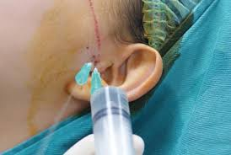
Surgical Treatment Approaches
When Conservative Treatments Fail
Surgical intervention may recommend . Surgical procedures for TMJ subluxation aim to address the underlying structural or functional issues causing joint instability and dislocation.
Common Surgical Approaches
Arthrocentesis: This minimally invasive procedure involves injecting fluid into the TMJ joint to flush out any debris or inflammatory byproducts that may be hampering joint mobility.
Arthroscopy: Using small incisions and a tiny camera, the surgeon can visually inspect the joint and perform minor repairs or debridement to restore proper function.
Open Joint Surgery: In more complex cases, open joint surgery may be necessary to reposition the displaced disc, repair damaged joint structures, or perform other reconstructive procedures.

Slide 8
Lifestyle Modifications for TMJ Subluxation
Stress Management
Dietary Modifications
Reducing stress is crucial for managing TMJ subluxation, as stress can exacerbate symptoms and contribute to muscle tension in the jaw. Incorporating relaxation techniques such as meditation, deep breathing, or yoga can help alleviate stress and prevent further joint instability. Additionally, engaging in regular exercise, such as walking or swimming, can also help reduce stress and improve overall well-being.
Adopting a soft, easy-to-chew diet can help minimize the strain on the temporomandibular joint during eating and prevent further subluxation. Patients should avoid hard, crunchy, or chewy foods and instead opt for softer options like soups, mashed potatoes, or smoothies. Additionally, maintaining proper hydration and limiting caffeine intake can also help reduce inflammation and muscle tension in the jaw area.
Oral Habits Awareness
Physical Therapy Exercises
Becoming aware of harmful oral habits, such as teeth grinding (bruxism), clenching, or excessive gum chewing, is crucial for managing TMJ subluxation. These habits can place excessive strain on the joint and contribute to its instability. Patients should make a conscious effort to avoid these habits and seek guidance from a dental professional on how to address them, such as through the use of a custom-fitted night guard.
Engaging in a tailored physical therapy program can help strengthen the muscles supporting the temporomandibular joint and improve its stability. Exercises may include jaw-opening and closing exercises, massage techniques, and the use of heat or cold therapy to reduce inflammation and pain. A physical therapist can also provide guidance on proper posture and ergonomic adjustments to minimize strain on the TMJ.

Slide 9
Conclusion
In conclusion, TMJ subluxation is a complex condition that can have a significant impact on an individual's quality of life. By understanding the anatomy of the temporomandibular joint, the common causes of subluxation, and the associated symptoms, healthcare providers can better diagnose and treat this condition. Early intervention and a combination of conservative and, in some cases, surgical treatments can often alleviate the pain and dysfunction associated with TMJ subluxation.
The key takeaways from this presentation are that TMJ subluxation is a common condition that can be caused by a variety of factors, including trauma, bruxism, and joint instability. Patients may experience a range of symptoms, including pain, clicking or popping sounds, and limited range of motion. Accurate diagnosis, through a combination of physical examination and imaging studies, is essential for developing an effective treatment plan. Conservative treatments, such as physical therapy, oral appliances, and stress management, are often the first line of defense, while surgical interventions may be necessary in more severe or refractory cases.
Ultimately, a multidisciplinary approach, involving healthcare providers from various specialties, is often required to effectively manage TMJ subluxation and its associated symptoms. By empowering patients with knowledge and providing them with a range of treatment options, healthcare professionals can help individuals with TMJ subluxation regain their quality of life and prevent long-term complications.

