Slide 1
الافاق المستقبلية في تطوير البحث العلمي في الهندسة البايوكيميائية
ا.د. علاء كريم محمد
ا.د. علي حسين عبار

Slide 2
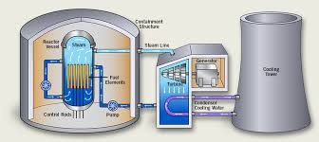
المحاضرة الاولى
الهندسة الكيميائية الاحيائية وتطبيقاتها
Biochemical Engineering and Its Applications

Slide 3
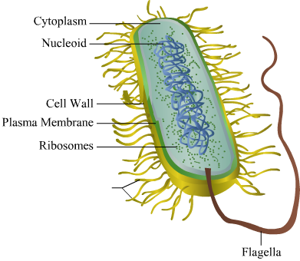
ماهي الهندسة الكيميائية الاحيائية
الهندسة الكيميائية الحيوية هي استخدام المواد البيولوجية (طبيعية أو عضوية) ، مثل الكائنات الحية والخلايا والمواد الحيوية ، لتطوير المنتجات والعمليات.
Products.
Such as
biofuel, Bioplastics
Biochemical Engineering
Processes
Such as
wastewater treatment
Removal of pollutants

Slide 4
تشمل الصناعات التي تعتمد على الهندسة البيوكيميائية ما يلي:
الوقود الحيوي
الصناعات
العقاقير الطبية
معالجة وتنقية المياه
المنتجات الغذائية

Slide 5
microorganisms
Bioprocess
biological catalysts
animal and plant cells
Higher value product
Raw materials
microorganisms
enzymes
sub cellular
components

Slide 6
وظائف المهندس الكيميائي الاحيائي
تصميم وبناء وحدة العمليات التي
تتضمن كائنات أو جزيئات بيولوجية
تطبيق المبادئ الهندسية على المواد والعمليات والأنظمة البيولوجية
Bioprocess engineers
ادارة العمليات الانتاجية
Biochemical engineers
البحوث
ترجمة الاكتشافات في الكيمياء الحيوية والطب إلى العمليات التجارية
التطوير

Slide 7
Fields combined and applied in Biochemical engineering
Chemical Engineering
Biochemistry
Biochemical Engineering
Biology
Genetics

Slide 8
تطبيقات الهندسة الكيميائية الاحيائية
1- الصناعات الغذائية
هناك عدة تطبيقات للعمليات الحيوية في مجال صناعة الأغذية مثل إنتاج:
الالبان
الاجبان
الخل
المحليات الغذائية
تركز الاتجاهات الجديدة في الهندسة الحيوية على العديد من الجوانب مثل:
التعبئة والتغليف: ضمان سلامة الغذاء.
الأنزيمات: توجد في جميع الخامات الغذائية. عند تنقيتها واستخدامها في إعداد الطعام ، تقدم بعض هذه الإنزيمات فوائد مثل تحسين النكهة والملمس وقابلية الهضم.

Slide 9
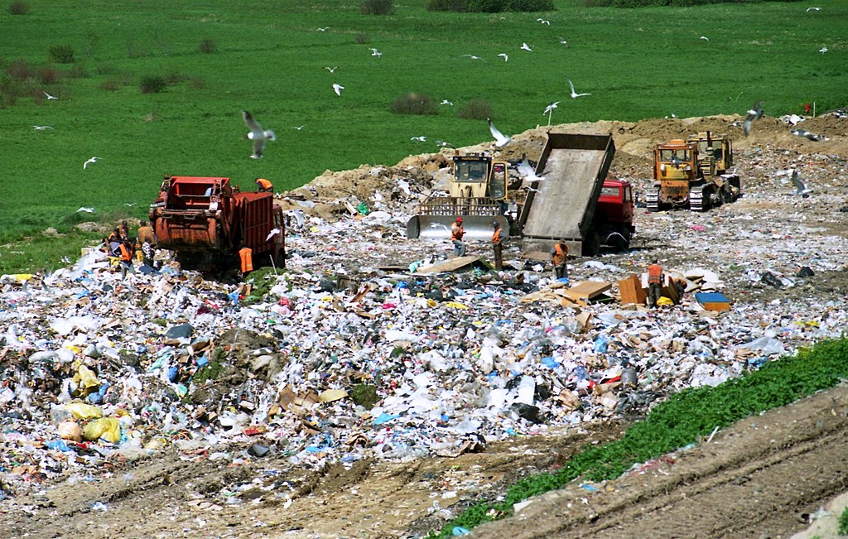
2- مكبات النفايات
تعتبر مدافن النفايات الطريقة الأساسية للتخلص من النفايات في أجزاء كثيرة من العالم ، بما في ذلك الولايات المتحدة وكندا.
مدافن النفايات الحيوية
من المتوقع أن تقلل مدافن النفايات الحيوية من مقدار التكاليف المرتبطة بإدارة النفايات، وزيادة معدل إنتاج الميثان (الغاز الطبيعي) للأغراض التجارية وتقليل مساحة الأرض المطلوبة لمدافن النفايات.
تجرى العديد من البحوث في يومنا هذا بغرض زيادة اداء وكفاءة المفاعلات الحيوية بهدف انتاج الوقود الحيوي وباقل كلفة ممكنة.

Slide 10
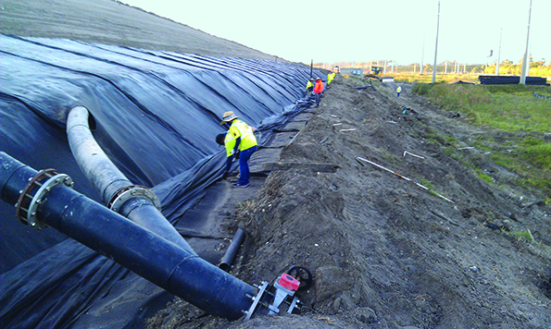
Bioreactor landfill
مدافن النفايات الحيوية

Slide 11
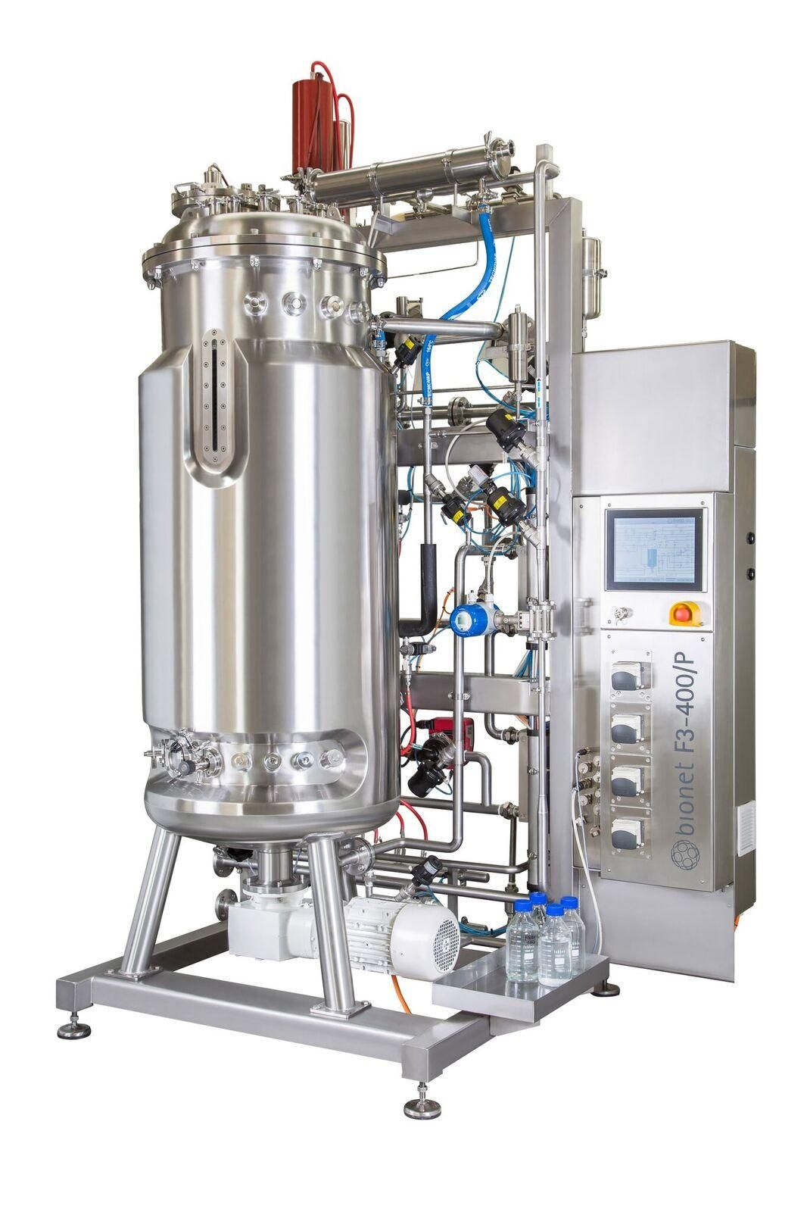
Lab Bioreactor landfill

Slide 12
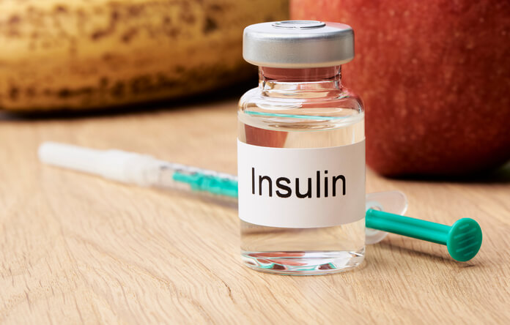
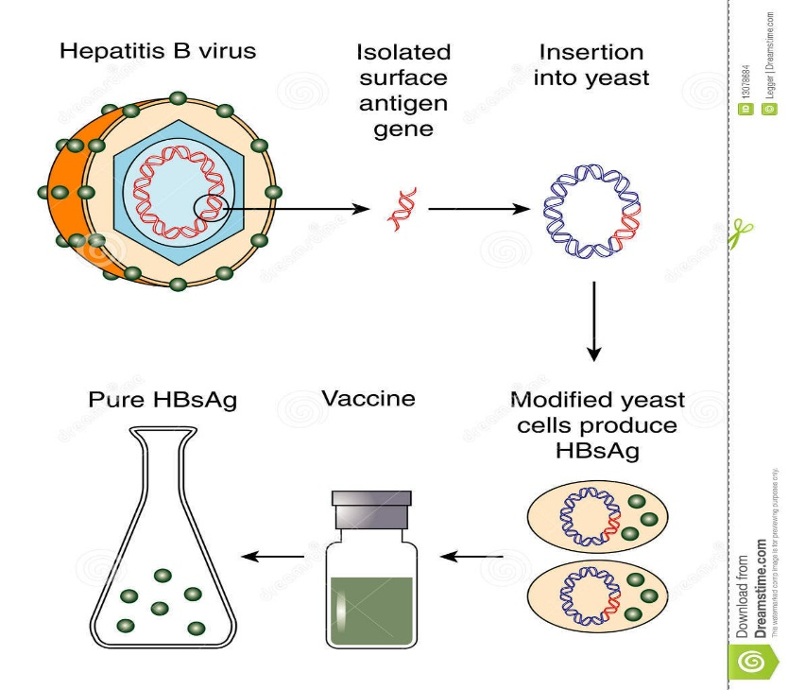
3- العقاقير الطبية
ساهمت التكنولوجيا الحيوية في اكتشاف وتصنيع الأدوية الصيدلانية التقليدية ذات الجزيئات الصغيرة وكذلك الأدوية التي هي نتاج التكنولوجيا الحيوية (الصيدلة الحيوية) مثل:
إنتاج الأنسولين لمرضى السكر
إنتاج لقاح التهاب الكبد الوبائي ب

Slide 13
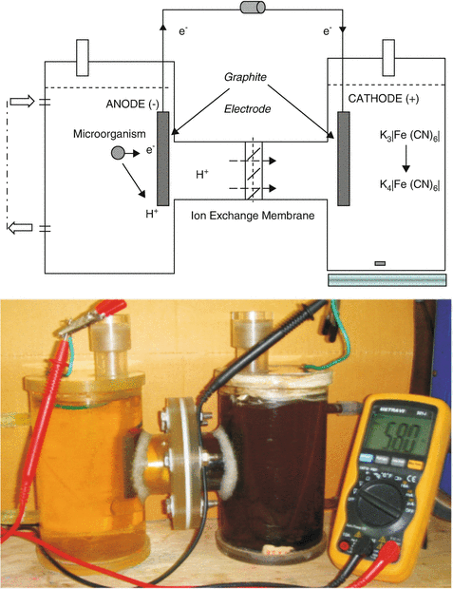
4- المفاعلات الكهروكيمياوية الحيوية
المفاعل الكهروكيميائي الحيوي هو نوع من المفاعلات الحيوية حيث تُستخدم العمليات الكهروكيميائية الحيوية لتحليل / إنتاج المواد العضوية باستخدام الكائنات الدقيقة
تتضمن أمثلة المفاعلات الكهروكيميائية الحيوية :
- خلايا التحليل الكهربائي الميكروبية
- خلية وقود ميكروبية
- خلايا الوقود الحيوي الأنزيمية
- خلايا التحليل الكهربائي
ينقسم هذا المفاعل الحيوي إلى قسمين: الأنود ، حيث يحدث تفاعل الأكسدة ؛ والكاثود حيث يحدث الاختزال.

Slide 14
4- الوقود الحيوي
الوقود الحيوي هو أي وقود مشتق من الكتلة الحيوية - أي مادة نباتية أو طحالب أو فضلات حيوانية. نظرًا لسهولة تجديد هذه المواد الأولية بسهولة ، يعتبر الوقود الحيوي مصدرًا للطاقة المتجددة ، على عكس الوقود الأحفوري مثل البترول والفحم والغاز الطبيعي.
يتم الترويج للوقود الحيوي بشكل شائع كبديل فعال من حيث التكلفة وغير ضار بالبيئة للبترول وأنواع الوقود الأحفوري الأخرى ، لا سيما في سياق ارتفاع أسعار البترول
توجد عدة تطبيقات للهندسة الكيميائية الحيوية في مجال إنتاج الطاقة الحيوية مثل:
الإيثانول الحيوي
وقود الديزل الحيوي
الوقود الحيوي الطحالب
الغاز الحيوي

Slide 15
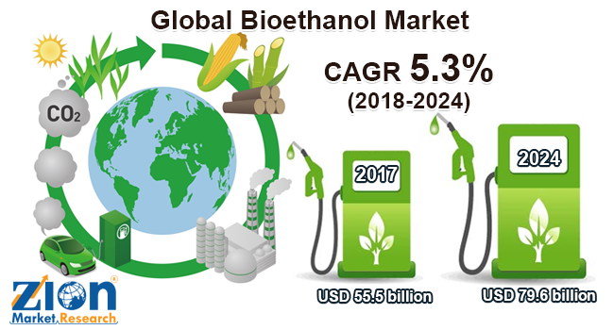
Bioethanol
Corn
Sugarcane
Bioethanol
Fermentation
of
Starch or Sugar

Slide 16
Ethanol from Celluloses materials (old method)
Celluloses
materials
H₂SO₄
0.5%
CO₂
H₂O
Ethanol
240ºC
Preliminary
treatment
Distillation
column
H₂SO₄
2%
Semi-Celluloses
materials
Fermentor
200ºC
Preliminary
treatment

Slide 17
Ethanol from Celluloses materials (New method)
CO₂
H₂O
Celluloses
materials
Ethanol
Cellulase Enzyme
Distillation
column
To produce 1 ton of Ethanol we need 4 ton of Celluloses material
Fermentor
- Converting cellulose into glucose is to use cellulase enzymes that are able to break down the cellulose.
- The enzymatic hydrolysis and sugar fermentation processes take place at the same time in the fermentor.
An advantage of this process is that sugars produced during hydrolysis are immediately fermented into ethanol, which avoids problems such as sugar accumulation and enzyme inhibition

Slide 18
Biodiesel
Oily plants
Soybean
Oil palm
Waste cooking oil
Biodiesel
Esterification

Slide 19
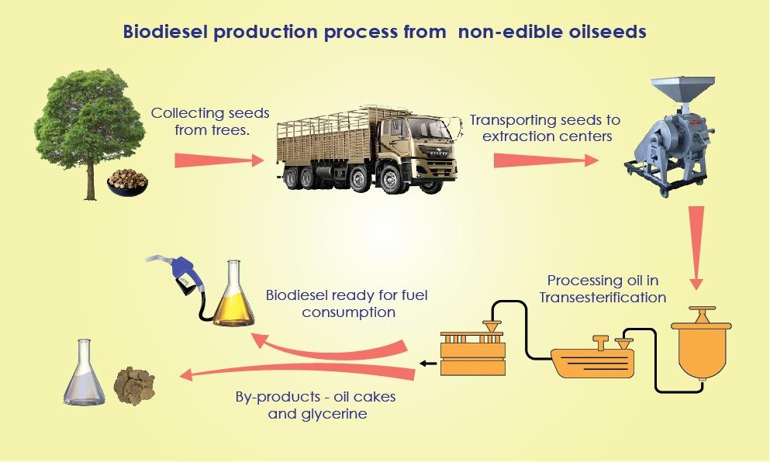

Slide 20
Production of Biodiesel
NaOH
Acid
Hexane
Separation
Unit
Reactor
50-66ºC
1.4 bar
Separation
Biodiesel
98%
purity
Oily seeds
Extraction
Methanol
Water
Glycerin
Treatment
Glycerin
For each 1 ton of (biodiesel) we need:
2.5 tons of oilyseeds
0.77 hectares land area.
Salts
Large , branched molecule structures of the oils (triglycerides) are transformed to smaller straight chain molecules

Slide 21
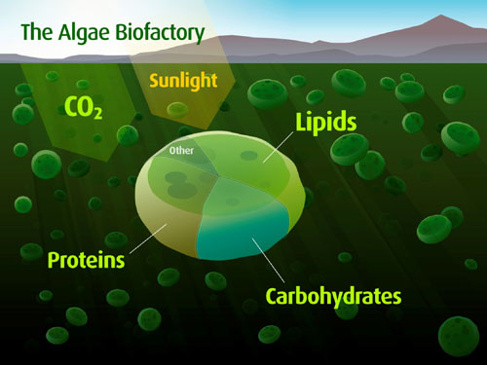
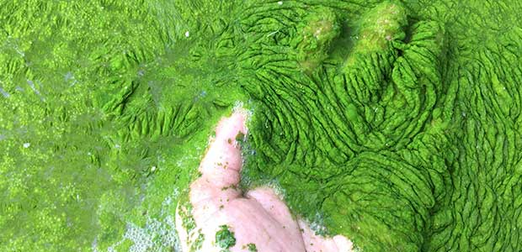
Biodiesel from Algae (Algal Biodiesel)
Algal biomass contains three main components:
Carbohydrates
Protein
Natural Oils

Slide 22
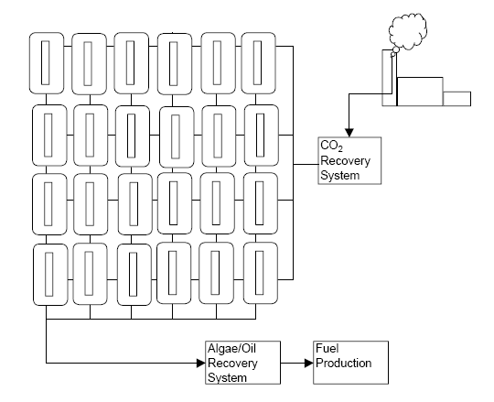
Algae farm

Slide 23
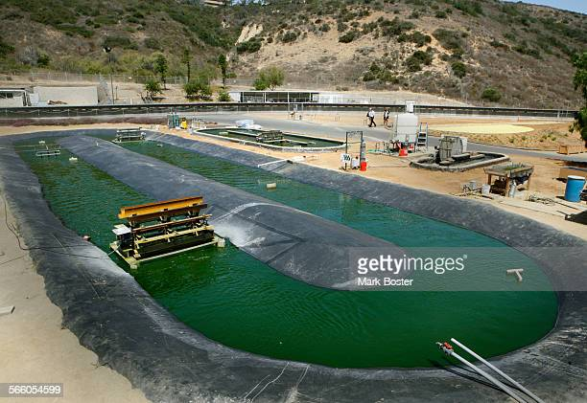
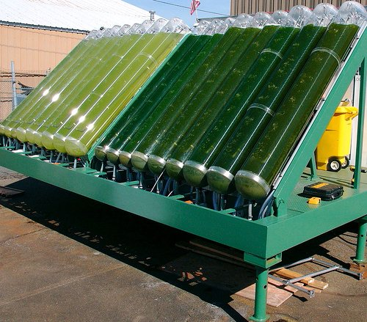
Algae Farm
Tubular bioreactors

Slide 24
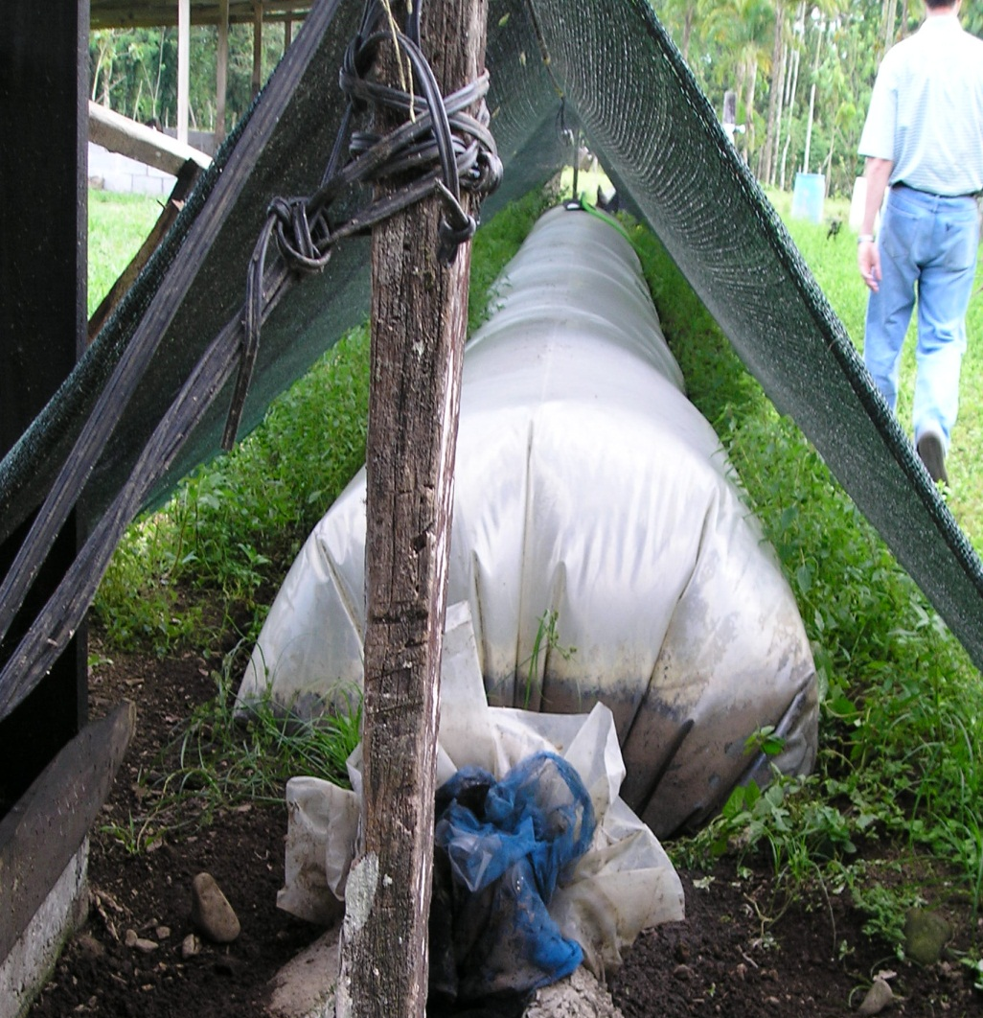
Biogas
Mainly methane
Clean, efficient source of renewable energy
Made from organic waste
Anaerobic digestion
Replaces non-renewable energy
Notes:
24
Biogas is an efficient way to produce clean, renewable energy out of different types of organic waste.
The organic waste, such as manure, fuels the process, causing anaerobic digestion to take place and break down the waste, creating methane.

Slide 25
Engineering Principles
Constituent | Measured | Typical
Methane | 66.60% | 60-70%
CO₂ | 33.32% | 30-40%
H₂S | 0.15% | <1%
Helium | 0.01% | -----
Nitrogen | 0.01% | -----
Hydrogen | Trace | -----
Biogas Treatment
Table shows the composition of biogas after it exits the digester
Biogas leaves the digester and is saturated with water
A condenser is facilitated to dry biogas and knock out all the impurities which dissolves in water
Hydrogen Sulfide needs to be removed by iron salt
Notes:
25
25

Slide 26
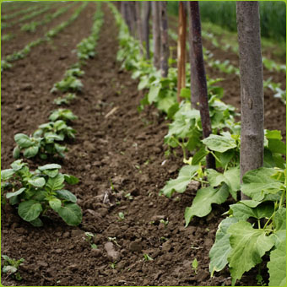
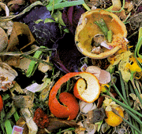
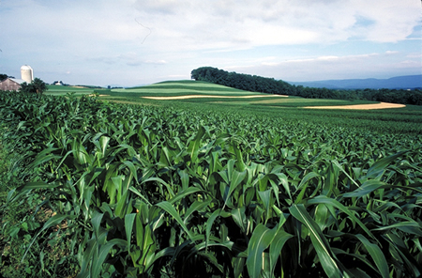
Biogas
Methane
+
ENERGY
O2
H2S
Ammonia
CO2
Organic Fertilizer
Organic Material, Biodegradable Waste
Anaerobic Environment
Hydrolysis, Fermentation, Acetogenesis, Dehydrogenization, Methanogenesis
Notes:
26

Slide 27
Some examples of biogas plants
Notes:
27

Slide 28
Biochemical process of anaerobic fermentation/digestion
Step 1:
Hydrolysis + Acidogenesis
Step 2:
Acetogenesis
Step 3: Methanogenesis
Bacterial
mass
Bacterial
mass
H₂ , CO₂,
acetic acid
Organic waste
Carbohydrates
Fats
Protein
Water
Methan
+ CO₂
Bacterial
mass
Propionic acid
Butyric acid
Alcohols,
Other components
H₂ , CO₂
acetic acid
Fermentative
bacteria
Acetogenic
bacteria
Methanogenic
bacteria
Notes:
28

Slide 29
Small scale plant
Plant details
Small Scale units
Suitable for household use
Can be erected anywhere.
Requires between 500gm - 1Kg of waste/day only!!!
Plant designed to use Kitchen waste!!!
Notes:
29
29

Slide 30
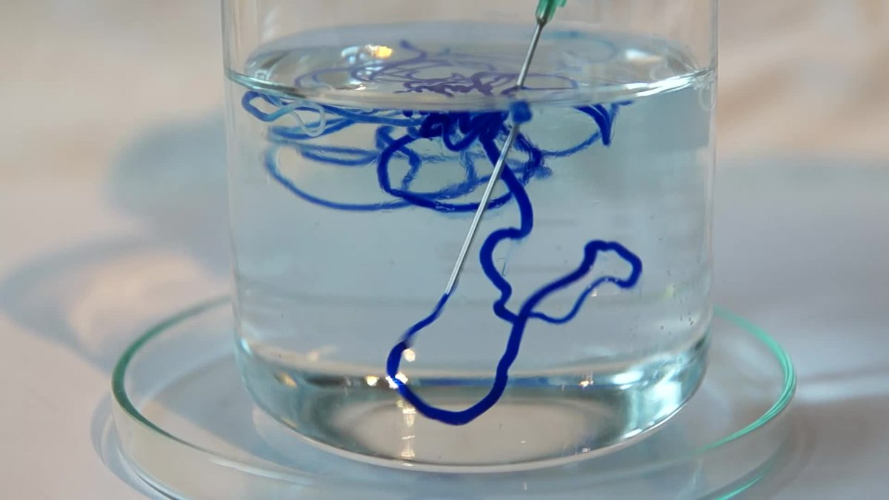
Activities of Biochemical Engineering Department Al-Khwarizmi Engineering College
Several studies concerning Biochemical Engineering have been carried out in biochemical Engineering department /Al-Khwarizmi Engineering College. Some of these studies are:
Production of Rayon from date palm fronds

Slide 31
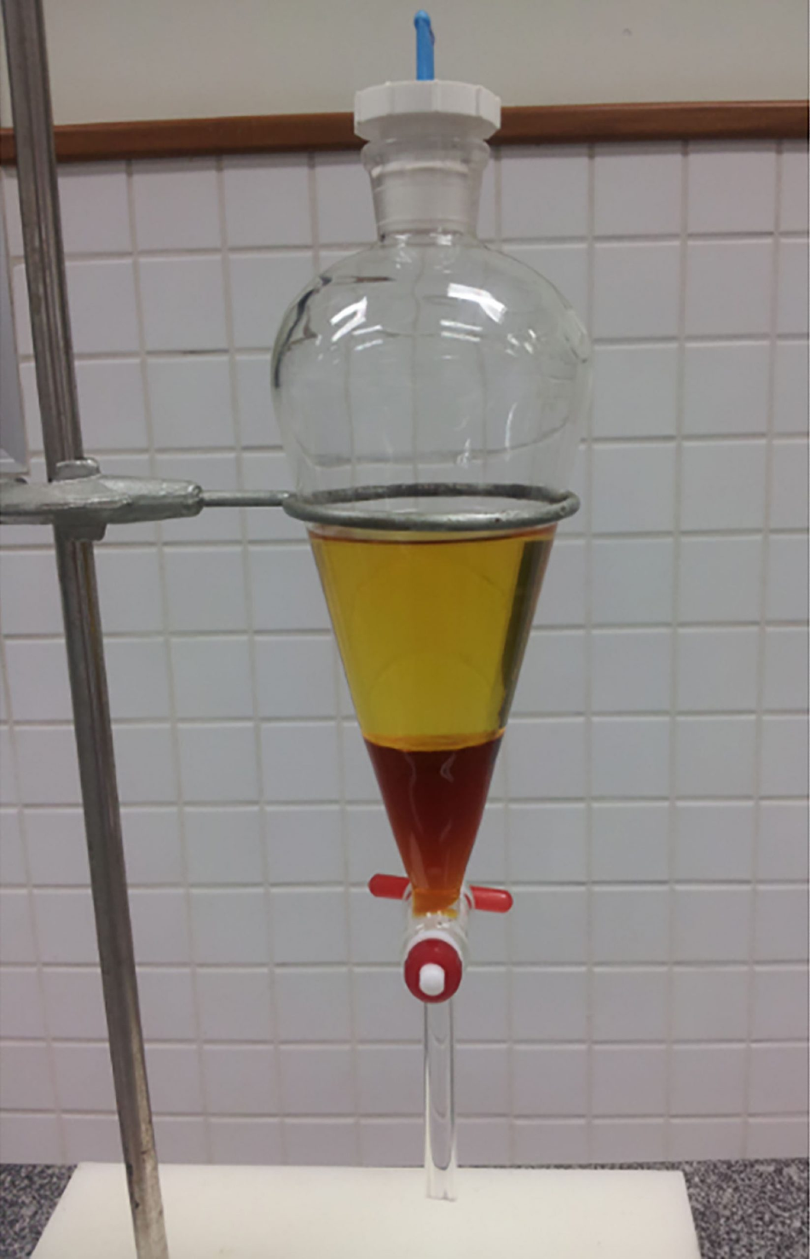
Production of Biodiesel from waste cooking oil using eggshells as catalyst.
Production of Biodiesel from waste cooking oil using snail shell as catalyst.

Slide 32
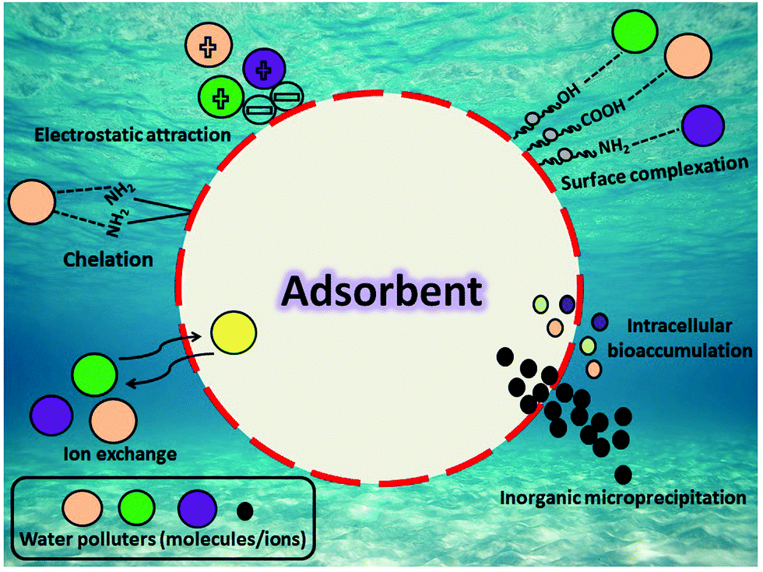
Removal of heavy metals from polluted water using different media such as
Bentonite
Activated Carbone
nanomaterials

Slide 33
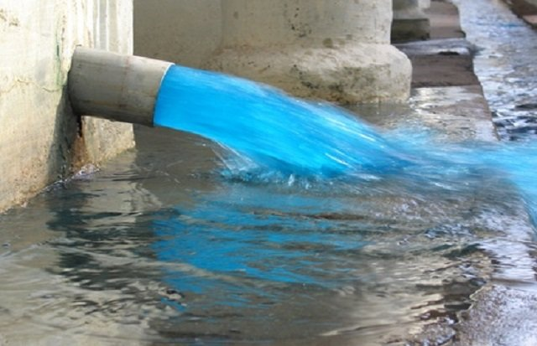
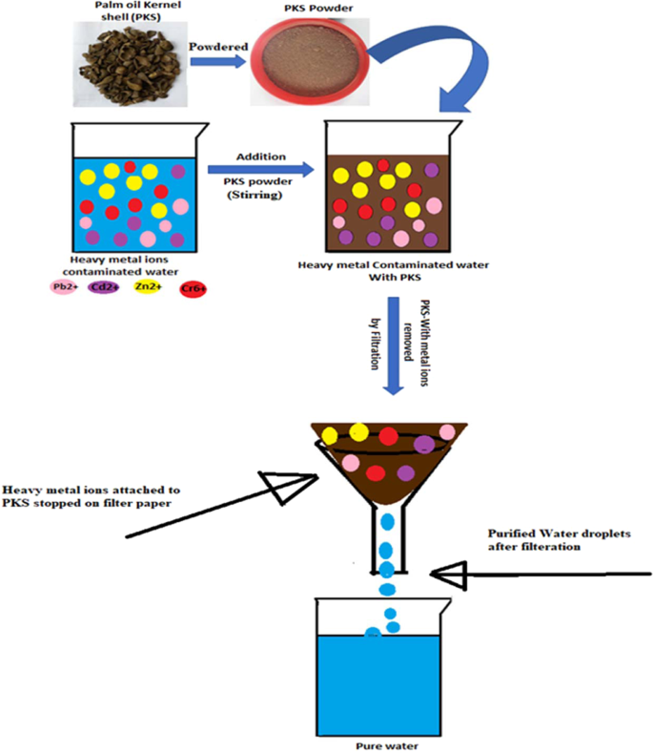
Removal of dyes from polluted water using different media such as
Bentonite
Activated Carbone
nanomaterials

Slide 34
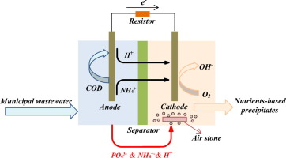
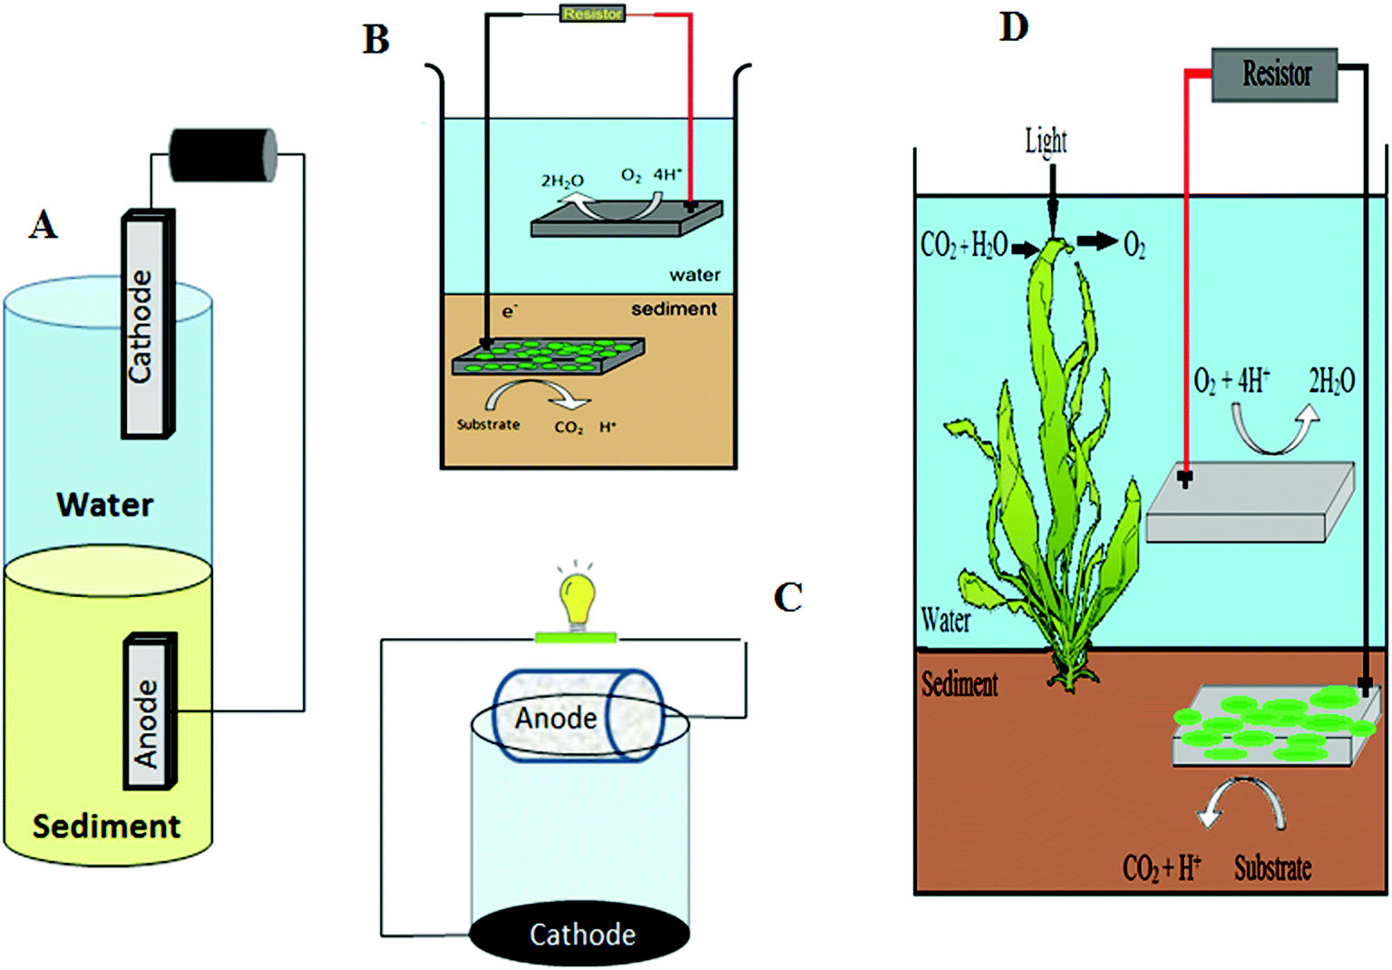
Using Microbial fuel cell for polluted water treatment

Slide 35
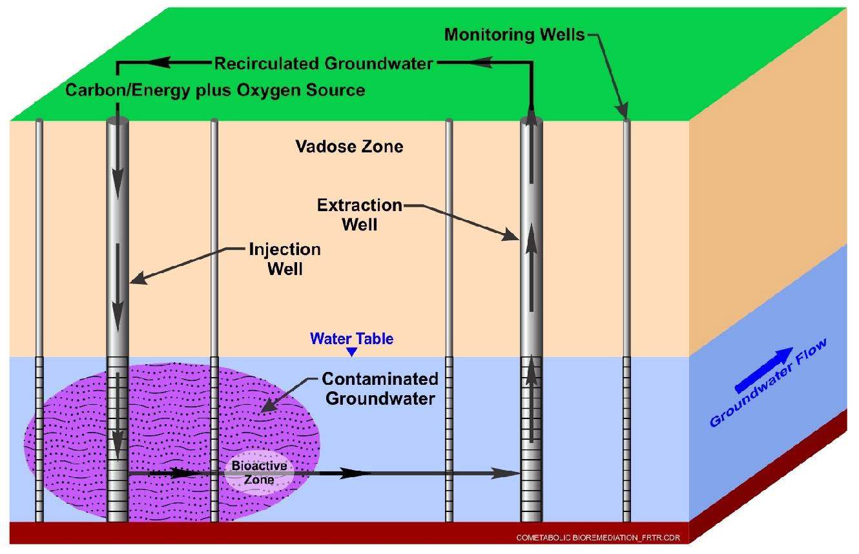
Using bioremediation to treat polluted soil

Slide 36
المحاضرة الثانيه

Slide 37
Bioelectrochemical systems (BESs)
Bioelectrochemical systems (BES) have been intensively studied as a new technology for wastewater treatment.
Bioelectrochemical systems (BESs) are unique systems, capable of converting chemical energy into electrical energy (and vice-versa) by employing microbes as catalysts.
The microorganisms play a crucial functional role in ensuring the success of electrochemical reactions in these devices.
Bioelectrochemical systems (BESs) are emerging technologies which use microorganisms attached to one or both bioelectrode(s) to catalyze the oxidation reaction in case of a bioanode and/or reduction reaction in case of a biocathode
Microbial electrolysis cells (MECs), microbial fuel cells (MFCs), microbial desalination cells (MDCs), enzymatic biofuel cells (EBCs), microbial reverse electrodialysis cells (MRECs), microbial solar cells (MSCs), and microbial electrosynthesis cells (MESCs), are all types of BESs. Among these different types, MFCs and MECs are commonly used for simultaneously treating wastewater and producing electricity or chemicals

Slide 38
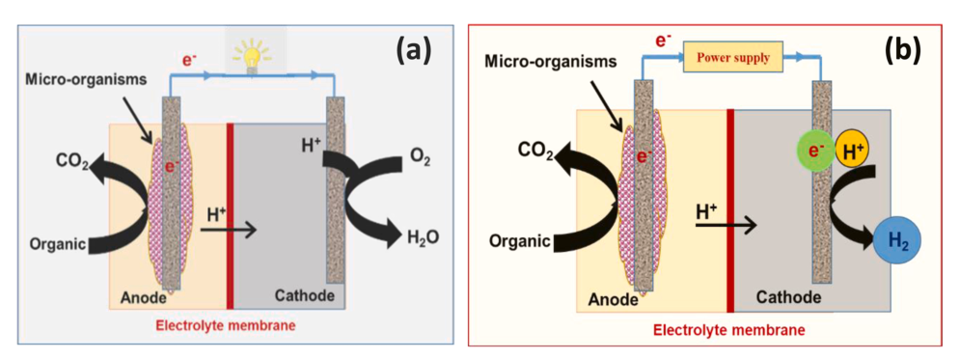
A BES is called a microbial fuel cell (MFC) if electrical power is harvested and is called a microbial electrolysis cell (MEC) if electrical energy is supplied to drive an otherwise nonspontaneous reaction. The schematics of microbial fuel and electrolysis cells, as typical examples of BESs are shown in Fig. 1. The figure shows that electricity is the main product from MFC, along with carbon dioxide and water. Meanwhile, hydrogen, carbon dioxide, and some other species are the main products from ME,
Fig. 1. Schematic diagram of bioelectrochemical cells, (a) microbial fuel cell MFC, (b) microbial electrolysis cell MEC.

Slide 39
Components of bioelectrochemical fuel cells
Electrode materials
An electrode is a solid electric conductor that carries the electric current in BESs. The electrodes in BESs are categorized into anode and cathode.
Specific consideration should be made during the selection of electrode material. These are excellent conductivity, enhanced mass transfer, and large surface area, low cost, mechanical strength, scalability, biocompatibility, and chemical stability.
Materials ideal for the anode includes carbon felt, carbon mesh, graphite fiber brush, and carbon cloth.
In Microbial fuel Cell (MEC), Materials suitable for the cathode include platinum black, platinum, and graphite. Platinum coated electrodes are normally utilized due to their effectiveness and superiority in the generation of energy. Despite the high cost of the platinum (Pt) catalyst, it is the best-known catalyst for oxygen reduction reactions (ORR).
In Microbial Electrolysis Cell (MEC), Pt is also the best catalyst for hydrogen evolution reactions (HER). However, due to its high cost and easy poising, its application in such systems is limited, therefore different Pt-free catalysts were investigated in MEC such as stainless steel, nickel, nickel alloys, and tungsten carbide.

Slide 40
Ion exchange membrane
Different ion-exchange membranes were used in BESs, including porous and nonporous membranes.
Porous membranes include microfiltration, ultrafiltration, and nanofiltration membranes. These membranes transfer the neutral or charged species according to the pore size.
Noneporous membranes include cation exchange membranes (CEM), anion exchange membranes (AEM), and bipolar membranes (BPM). These types of membranes allow for the passage of charged pieces and prevent the oxygen crossover. Nafion, Flemion, Hyflon, polyarylene ether sulfone, polyarylene ether ketone, and polyarylene sulfone were used in BESs.
One of the main challenges with membranes in BESs is fouling.

Slide 41
Substrates
The organic molecules, which microorganisms consume during cell operation, are referred to as substrates.
The substrate remains a key factor that affects the production of power. Substrates give energy to the bacterial cell to develop, which defines their pivotal role as a source for carbon energy.
The nature, constituents, and concentration of the substrate affect the microbial community and the energy that can be obtained from the BESs.
Different substrates have been considered as feedstock in BESs, including low molecular simple organic material. Complex carbohydrates, such as cellulose and starch have also been considered.
Glucose, cellulose, sodium acetate, oil refinery waste, agro process waste residuals, dairy, and vegetable waste, have all be explored as potential substrates for BESs

Slide 42
Microorganisms
Substrates that are organic in nature break down, with the aid of microorganisms, into various species and ions. This phenomenon affects the flow of electrons via the BESs.
These microorganisms are unicellular organisms with a simple or compartmented cell structure. A large number of microorganisms have proven their effectiveness as biocatalysts in BESs.
These include iron-reducing bacteria, such as Geobacter sulfurreducens, which produce high power at room temperature.
Some notable bacterial commonly used in BESs that uses glucose are Escherichia coli, Bacillus subtilis, and Proteus vulgaris. Escherichia coli, Proteus

Slide 43
Thermodynamics of BESs
The amount of energy of the electrons is expressed in the anode and cathode potential and is determined by thermodynamics of the anode and cathode reaction (Table 1).
To calculate these potentials, the Gibb’s free energy (kJ/mol) of the reaction needs to be determined. This Gibb’s free energy under standard conditions can then be converted into a standard potential E₀ (V vs normal hydrogen electrode (NHE)).
From these standard potentials, the actual potentials were calculated using actual concentrations that are typical for BESs at pH=5.
The many different reactions in a BES occur at their own specific potential. Only when combining an oxidation and reduction reaction, it becomes clear if the reaction is thermodynamically favorable, i.e., energy is produced, or if energy needs to be added to the system to let the reactions proceed.
Table 2 gives an overview of the energy output and input when combining acetate oxidation as a typical anode reaction with the cathode reactions.
We see that most reactions are thermodynamically favorable, while only the production of hydrogen and ethanol are electricity-consuming reactions.

Slide 44
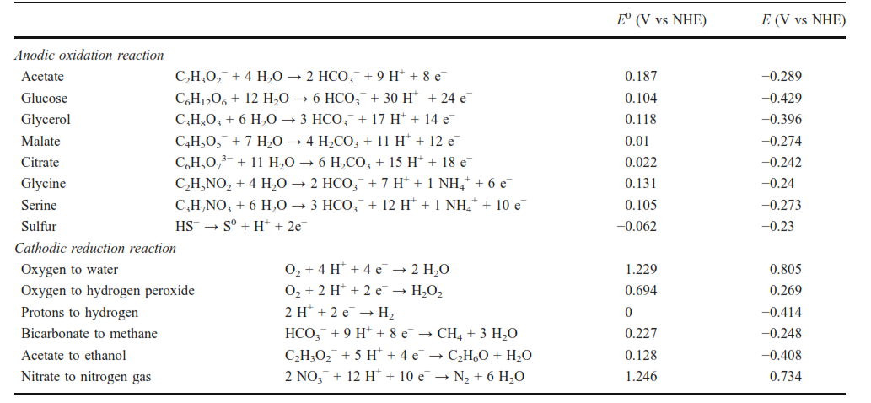
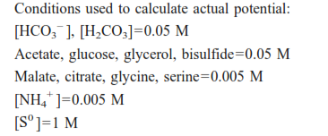
Table 1 Overview of reactions with standard potential (E0 ) and actual potential (E)

Slide 45
Table 2 The voltage that is gained or needs to be applied when linking acetate as the anode reaction to the different cathode reactions
Production of fuels and chemicals
Bioelectrochemical systems can be applied for the production of fuels and chemicals. For example production of hydrogen peroxide, hydrogen, methane, and ethanol .
The electrochemical reduction of carbon dioxide to methane is a complex reaction with only reasonable cathodic methane recovery on copper. The cathodic methane recovery depends on various conditions such as cathode potential, carbon dioxide concentration, and temperature .
Ethanol has been found as a byproduct in the electrochemical reductions of inorganics such as carbon monoxide. purely electrochemical reduction of organics to ethanol has not been described in literature

Slide 46
Application of BESs in wastewater treatment
Wastewater is discharged daily, with large amounts excreted from different sources, including all industrial, domestic, sewage, and agriculture sectors.
The conventional wastewater treatment technologies are cost-intensive and energy-consuming, with no valuable materials being regenerated (as the energy stored in organic wastes is useless).
Generally, around half of energy consumption occurs during aeration, while 15 % is consumed by pumping.
Bioelectrochemical systems (BESs) are unique systems, low cost with additional product as energy or material .
The proper treatment of domestic and industrial wastes and wastewater can be a useful source of energy.

Slide 47
Application of BESs in wastewater treatment
Microbial fuel cell
Microbial fuel cells are one of the most commonly exploited BESs. The application of MFCs is capable of transforming chemical energy into electrical energy via microbes. The microorganisms function as biocatalysts for the oxidation of chemical species in biodegradable substrates, with the aid of the electrodes.
These characteristics of MFCs contribute to their consideration as effective BESs for the generation of electricity .
Industrial wastewater, made up of simple and complex organic pollutants has been utilized as a substrate for MFCs.
The biofilm at the anode is complex and is usually made up of electroactive and fermentative microorganisms. The electroactive microorganisms are able to extract electrical energy from the breakdown simple organic molecules
Different types of wastewater were examined in MFC for producing electricity, as can be seen in Table 3. The table shows the effect of the anode or cathode type and/or modification on the power generation .

Slide 48
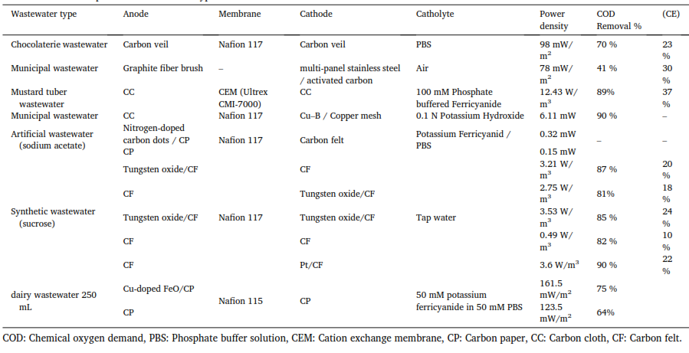
Table 3 Microbial fuel cells operated with different types of wastewater.

Slide 49
Microbial electrolysis cell (MEC)
The last decade has seen a considerable increase in research relating to microbial electrolysis cells for the production of hydrogen from waste.
MECs utilize biologically degradable organics as a source of electrons. MECs are designed to produce more hydrogen gas, due to their ability to exceed the fermentative barrier predominant in fermentation-based processes.
Although the progress and developments already achieved in MECs, there are still some challenges that need to be addressed before commercialization. Optimization of the technology to increase the hydrogen gas, along with a reduction in the overall cost of the technology are both critical for the eventual commercialization of this technology.
Wastewater from different sources was recently investigated as fuel to produce hydrogen in MECs. Different types of wastewater, electrode materials, and membranes were investigated to increase the COD removal efficiency, columbic efficiency, and hydrogen production rate. Table 4 summarizes some of the studies performed on hydrogen production by MEC from different wastewaters.
As clear from the Table that MEC is a viable option for simultaneous wastewater treatment and hydrogen production.

Slide 50
Table 4 Hydrogen production using wastewater in the microbial electrolysis cell

Slide 51
Metal removal and recovery using bioelectrochemical systems
The metal contaminated water posts great health and environmental concerns, because most metals are not biodegradable and can be accumulated in living tissues of plants, animals, and human bodies, causing diseases and disorders
Physical, chemical, and biological technologies have been developed to remove metals from wastewater, and more and more efforts have been made to possibly recover precious metals, so the treatment process can be cost-effective and sustainable.
The BES platform has recently demonstrated excellent performances in removing and recovering metals from different wastewaters, suggesting the use of electrode for metal recovery can be a new efficient and effective approach.
The conﬁgurations of BES systems used for removing different metal ions varies between dual and single chambered BES. Often a bioelectrochemical system comprises of an anode, a cathode and an optional separator membrane. The bioﬁlms living on the anode by oxidizing organic matter provide the driving force for an electrochemical metal reduction and recovery process at the cathode. The reduced metals are either deposited on the cathode, precipitated in the solution or remain soluble in the solution depending on the speciation of the metal, and the prevailing solution chemistry.

Slide 52
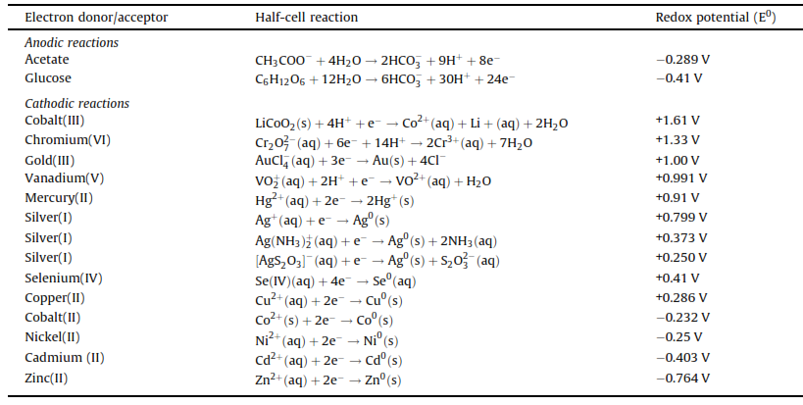
Table 5 Half-cell reactions at the anode and cathode of microbial bioelectrochemical systems used for removal and recovery of metal ions

Slide 53
All bioelectrochemically assisted metal recovery processes divides into four categories.
The first process involves direct reduction of the metals on an abiotic cathode for those with redox potential higher than the anode potential. Such metals include Au (III), V (V), Cr (VI), Ag (I), Cu (II), Fe (III), and Hg (II), etc., and their respective reduction products are shown in table 6 Fig. 2A. The reduction is thermodynamically favorable, and the metals can be directly used as the electron acceptor without any external power consumption
The second process requires an external power supply to force the electrons travel from the anode to the abiotic cathode, so metals with lower redox potentials than the anode potentials can be reduced. Such metals mainly include Ni (II), Pb (II), Cd (II), and Zn (II),etc., and their respective reduction products are demonstrated in table and Fig. 2B
The third mechanism is associated with microbial reduction of metal oxides on a cathode (Fig. 2C). For example, Cr (VI) was reduced with the assistance of microbial metabolisms on a biocathode
The last mechanism reported in literature is microbially assisted metal reduction with a poised potential (Fig. 2D), which is a combination of process 2 and 3. For instance, Cr (VI) can be reduced at a higher rate on a biocathode with poised potentials

Slide 54
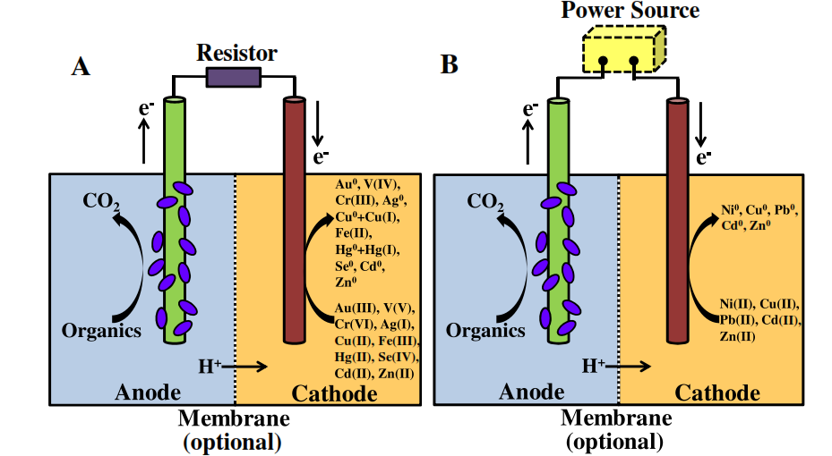
Fig. 2 metal recovery in bioelectrochemical systems. (A) Direct metal recovery using abiotic cathodes; (B) metal recovery using abiotic cathodes supplemented by external power sources. The membrane is optional.

Slide 55
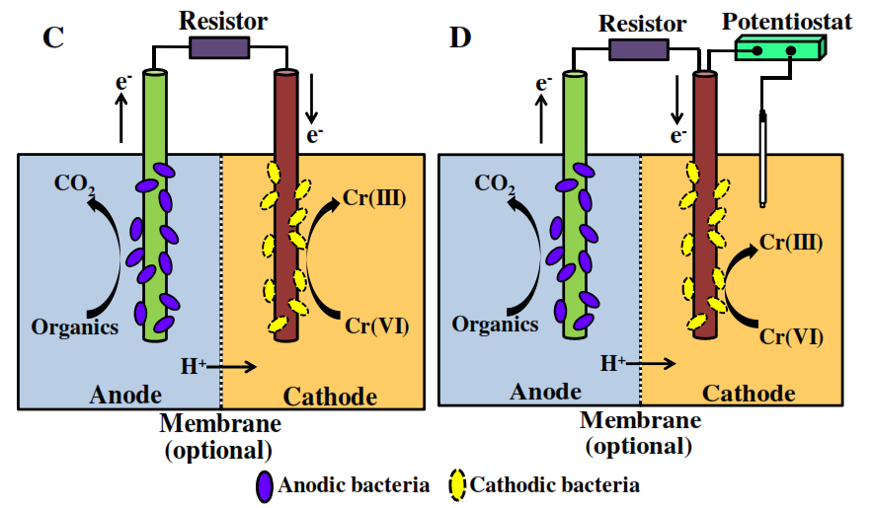
Fig. 2 metal recovery in bioelectrochemical systems. (C) metal conversion using bio-cathodes; (D) metal conversion using bio-cathodes supplemented by external power sources. The membrane is optional.

Slide 56
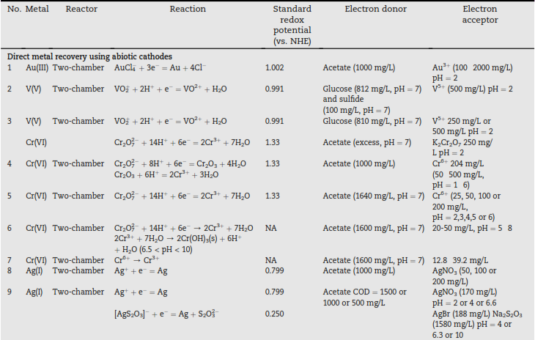
Table 6 Summary of bioelectrochemical recovery of metals.

Slide 57
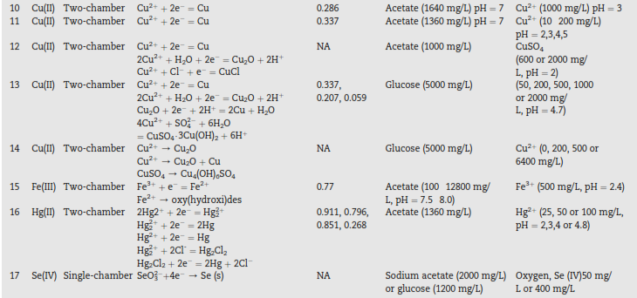
Table 6 Summary of bioelectrochemical recovery of metals.

Slide 58
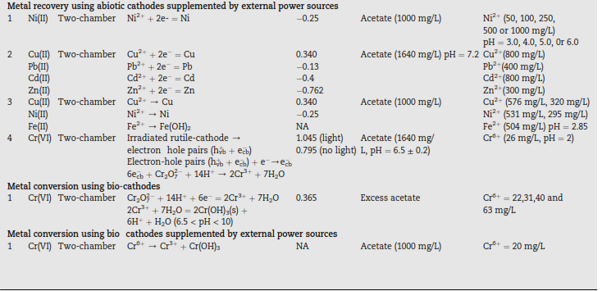
Table 6 Summary of bioelectrochemical recovery of metals.

Slide 59
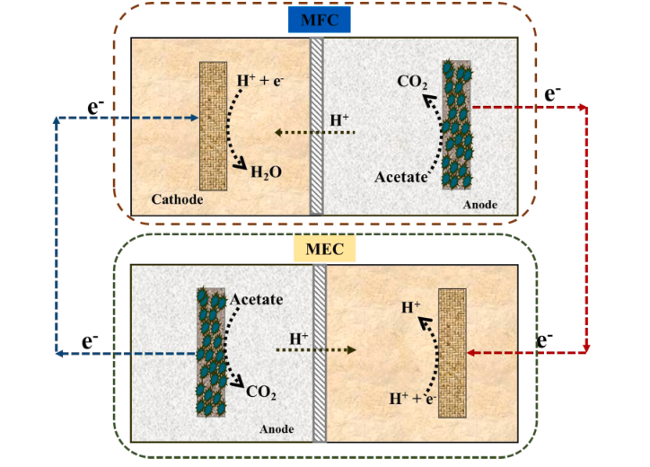
MEC Hybrid with other renewable energy sources
today many researchers are advocating for MFC being used with MEC in an integrated system as depicted in Fig. 3This technique has been used in hydrogen production in the absence of external power sources. With the aid of acetate as substrate

Slide 60
Thank you
For
Your listening

