Slide 1
LASER in Industrial Application
Dr. Enas A. Khalid

Slide 2
What is Laser?
Light Amplification by Stimulated Emission of Radiation
A device produces a coherent beam of optical radiation by stimulating electronic, ionic, or molecular transitions to higher energy levels
Mainly used in Single Mode Systems
Require Higher complex driver circuitry than LEDs
Laser action occurs from three main processes: photon absorption, spontaneous emission, and stimulated emission.

Slide 3
Properties of Laser
Monochromatic
Concentrate in a narrow range of wavelengths (one specific colour).
Coherent
All the emitted photons bear a constant phase relationship with each other in both time and phase
Directional
A very tight beam which is very strong and concentrated.

Slide 4
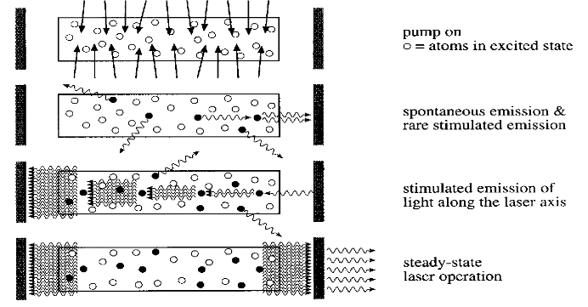
How a Laser Works
Notes:
‹#›

Slide 5
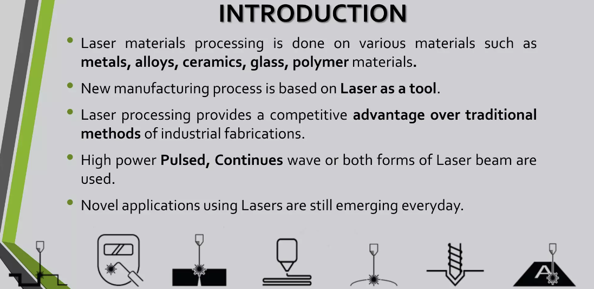

Slide 6
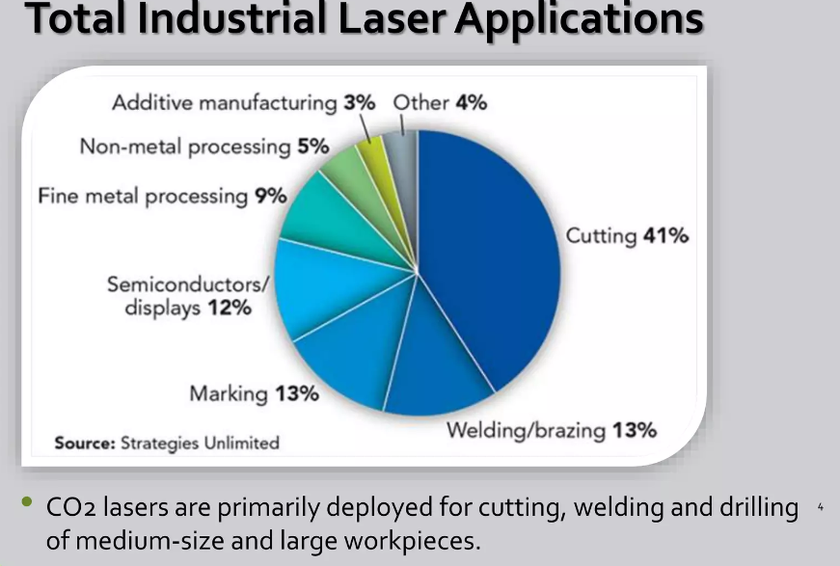

Slide 7
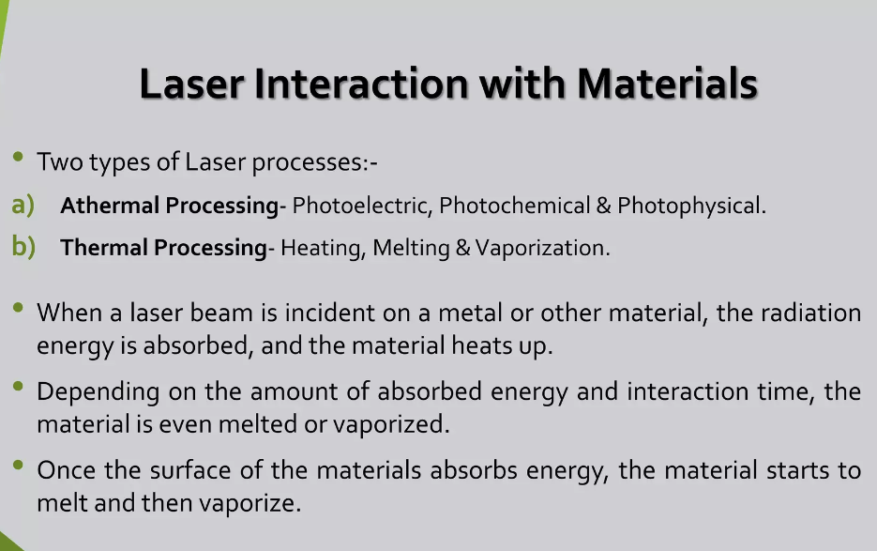

Slide 8
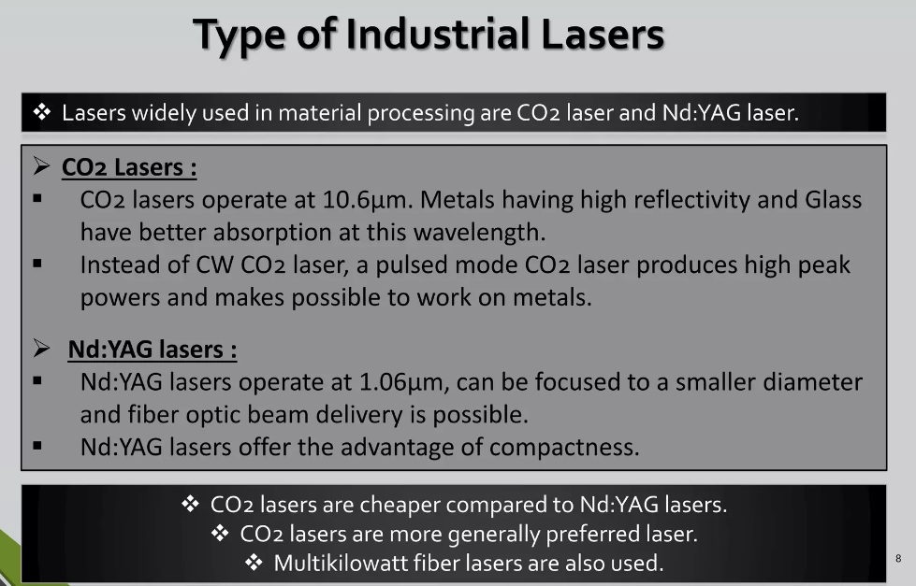

Slide 9
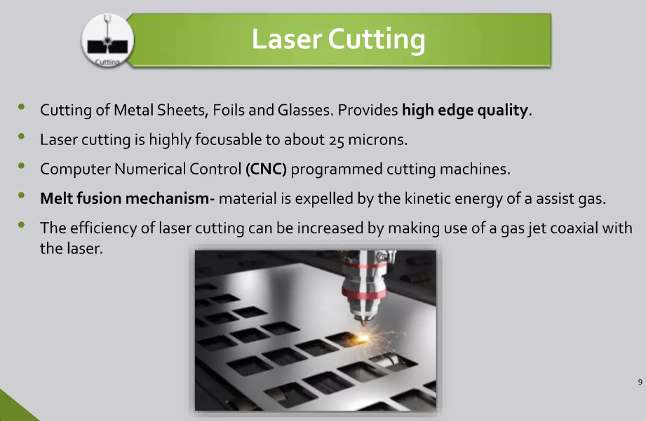

Slide 10
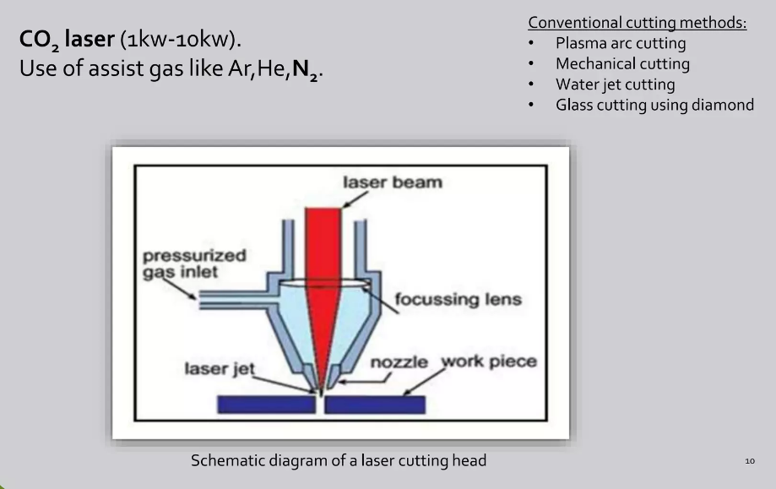

Slide 11
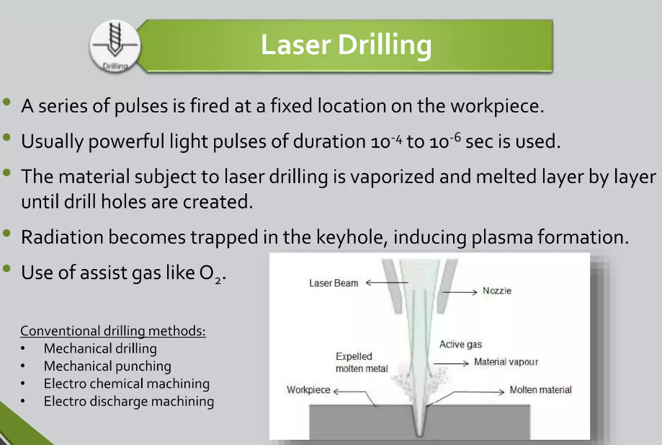

Slide 12
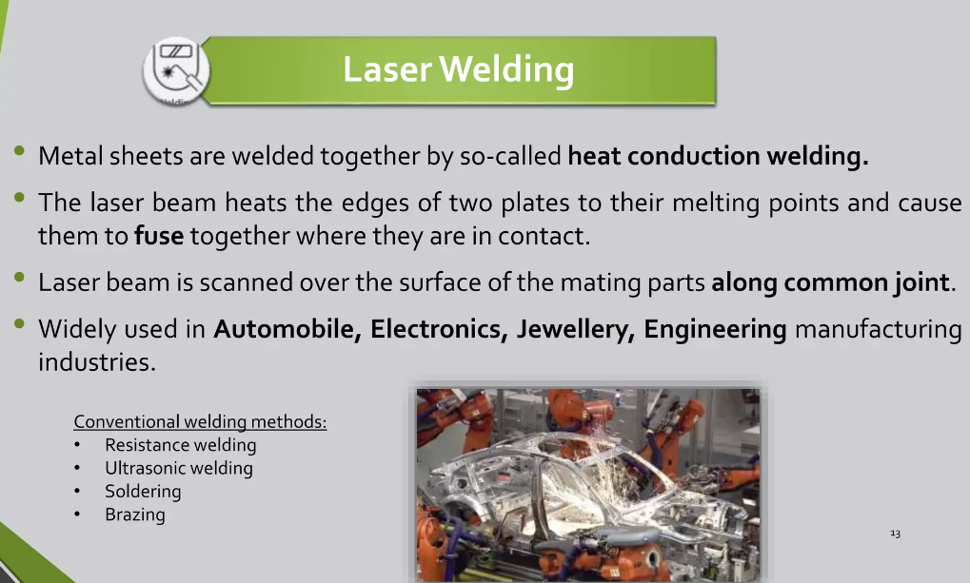

Slide 13
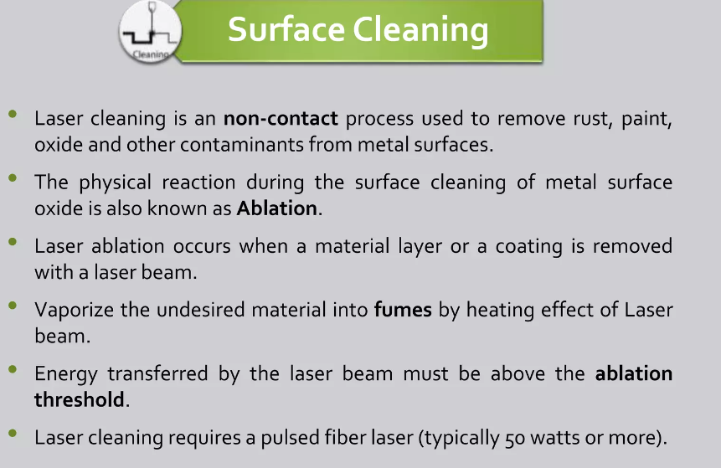

Slide 14
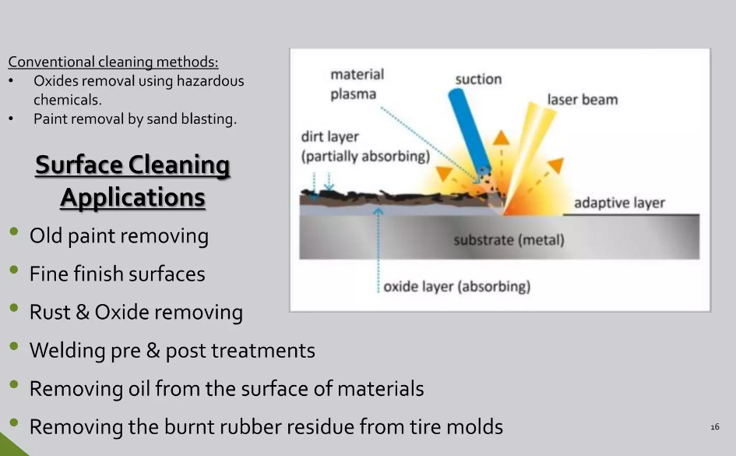

Slide 15
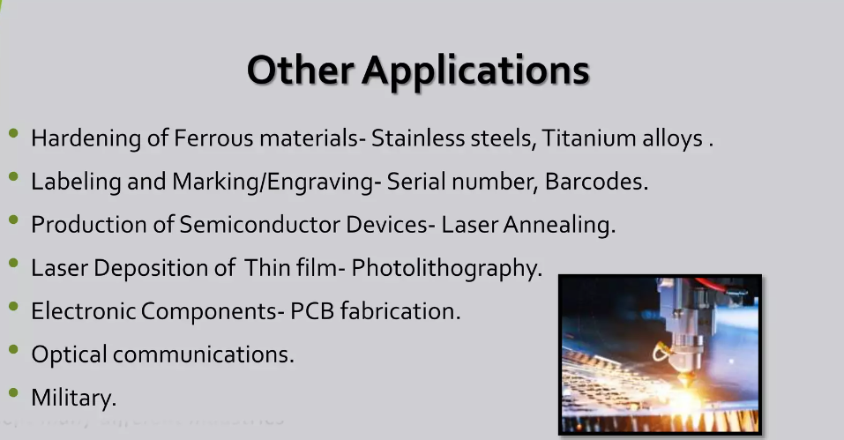

Slide 16
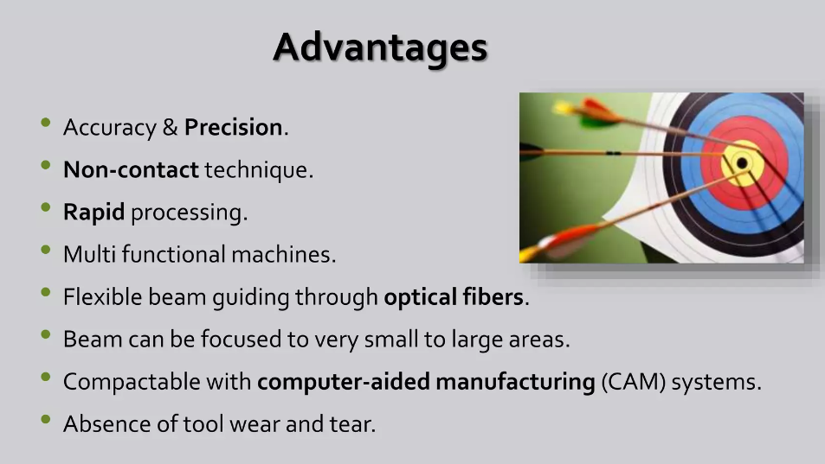

Slide 17
THANK YOU

