Slide 1


Quantum Optics Applications in Communication
Asst. Lect. Salwa Marwan Salih
Laser Applications /
Electronics and Communication Engineering

Slide 2
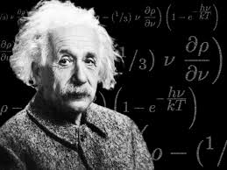
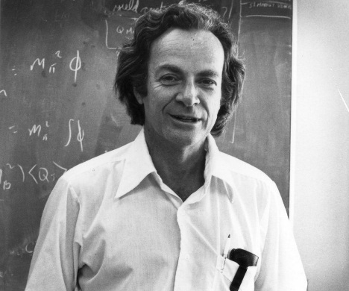
“ All these fifty years of conscious brooding have
brought me no nearer to the answer to the question,
'What are light quanta?'
Nowadays every Tom, Dick and Harry
thinks he knows it, but he is mistaken.”
Albert Einstein
“..it is safe to say no one really
understands quantum mechanics”
Richard Feynman

Slide 3

Basic Property of Quantum Mechanics
Quantization – Discrete values
Randomness
Quantum mechanics is inherently random.
The outcome of certain experiments cannot be predicted
Example: A single photon incident on a beam splitter
François Hénault, Quantum physics and the beam splitter mystery, Proc. SPIE 9570, The Nature of Light: What are Photons, 2015.
50/50

Slide 4
Quantum Optics
Quantum Cryptography
Quantum Computer
E91 Entangled photons
BB84 Single – Photon QC system
Quantum Teleportation

Slide 5
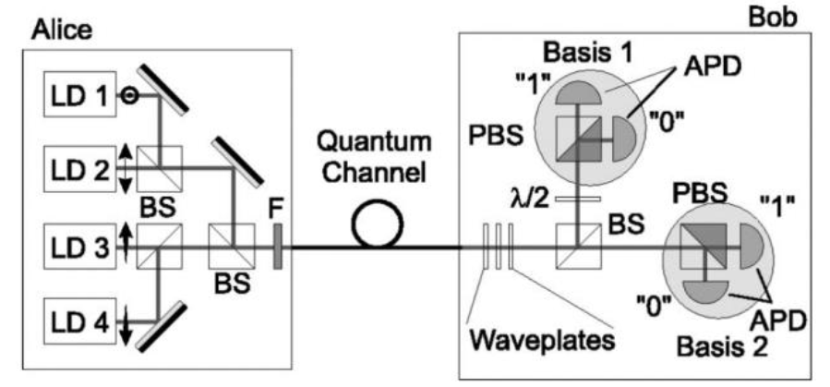
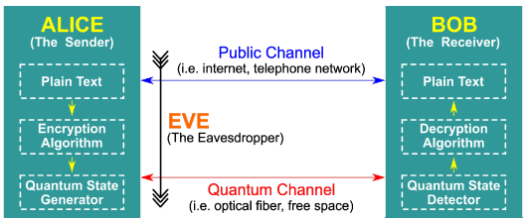
BB84 Protocol
Ali Ibnun Nurhadi and Nana Rachmana Syambas, Quantum Key Distribution (QKD) Protocols: A Survey. IEEE,2018

Slide 6
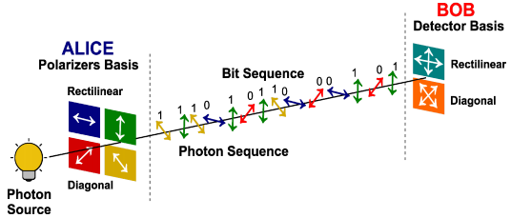
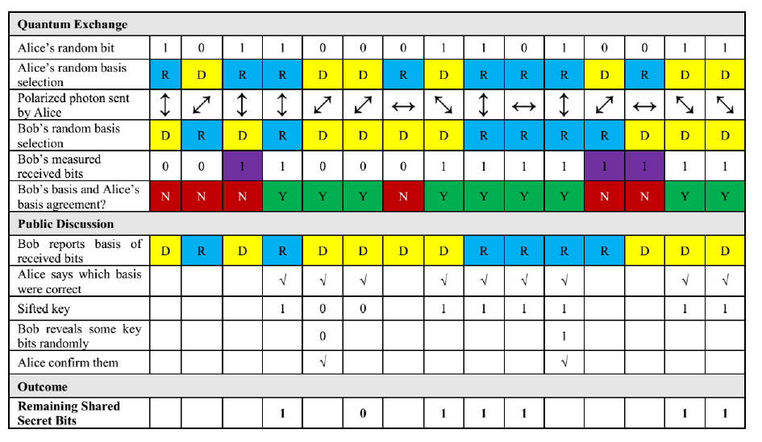

Slide 7
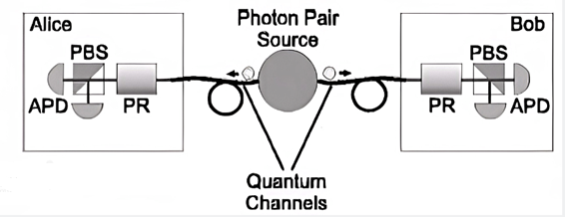
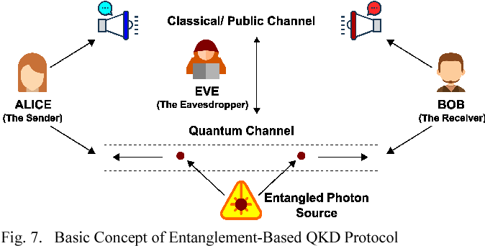
E91 Protocol
Ajay Kumar and Sunita Garhwal, State-of-the-Art Survey of Quantum Cryptography, Archives of Computational Methods in Engineering, 2021

Slide 8
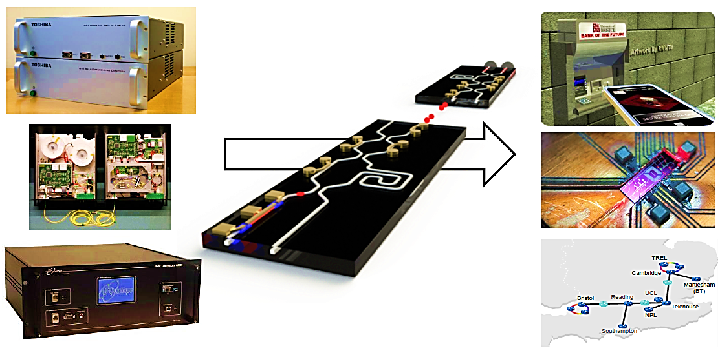
Integrated Phonics Platform
Silicon Photonics
• Mature semiconductor fabrication processing
• Cheap
• Reliable
• Mass-manufacturable
• Electronics integration

Slide 9
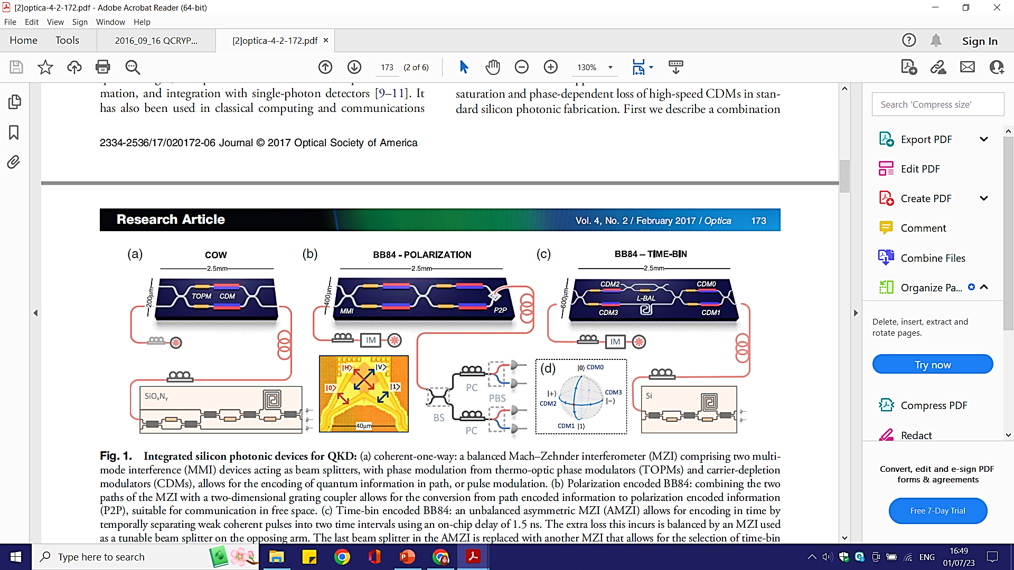
Silicon QKD –Experiments
Philip Sibson et al. , Integrated silicon photonics for high-speed quantum key distribution, Optica, 2017

Slide 10
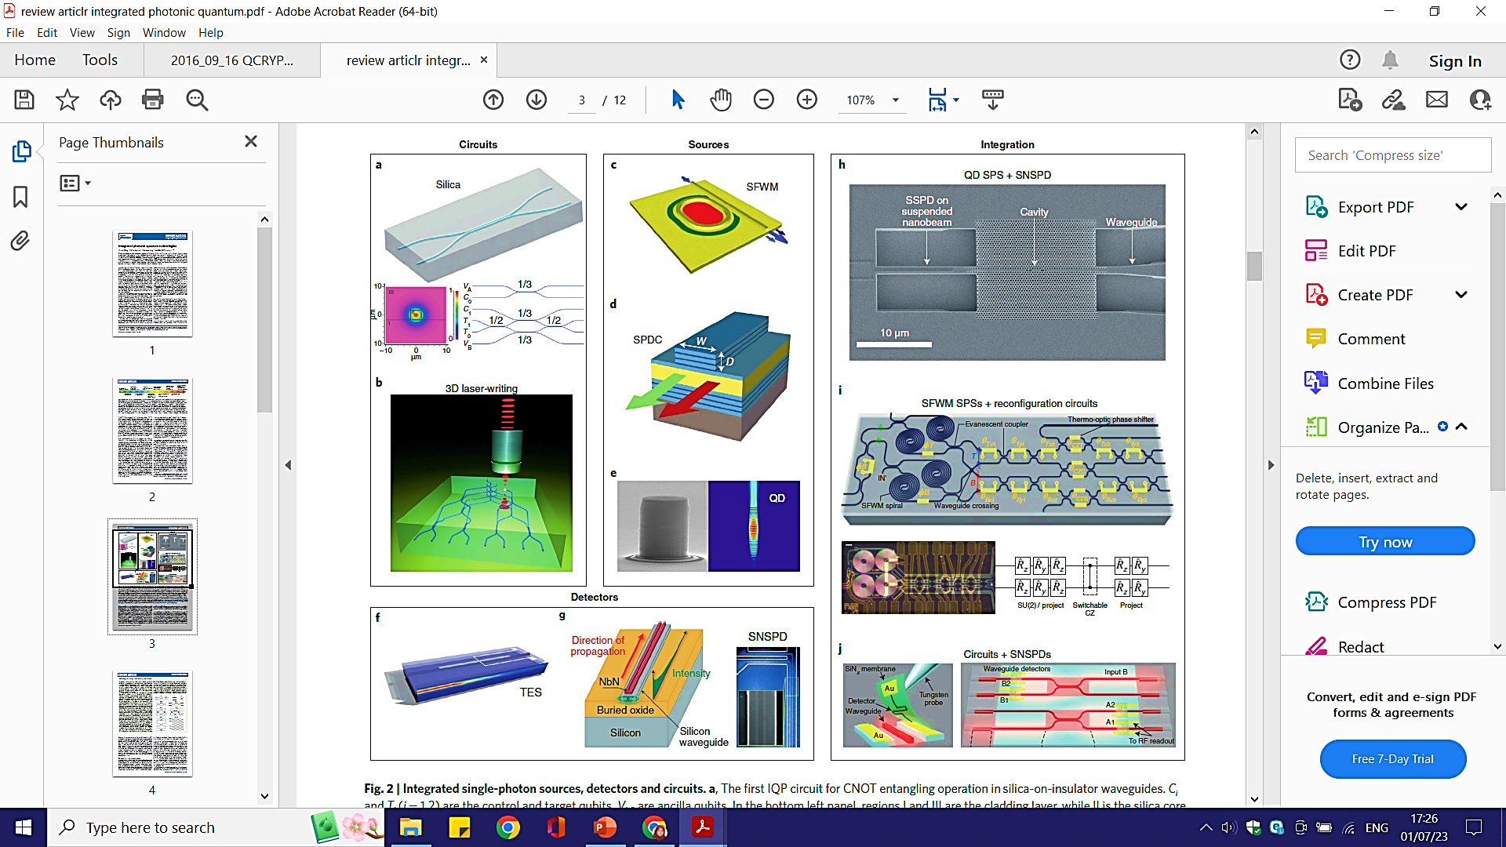
Jianwei Wang, et al., Integrated photonic quantum technologies. Nature Photonics, 2019

Slide 11
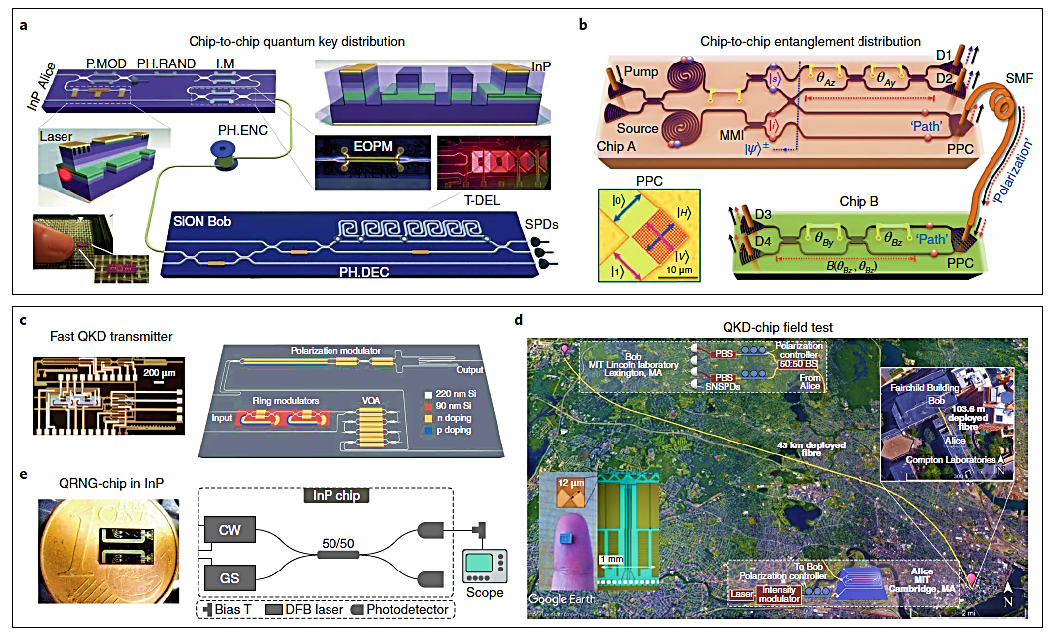

Slide 12

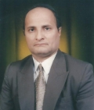
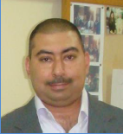
Group members
Founder
Prof. Khalil I. Hajim
Head
Asst. Prof. Shelan Kh. Tawfeeq
Consultant
Prof. Raad S. Fayath
Coordinator group member, Dr. Ahmed I. Khaleel
Dr. Alhuda A. Al-mafrji
Dr. Mayhem S. Jaber
Dr. Adel F. Mushatet
Dr. Farooq A. Khaleel

Slide 13
Thank you

