Slide 1

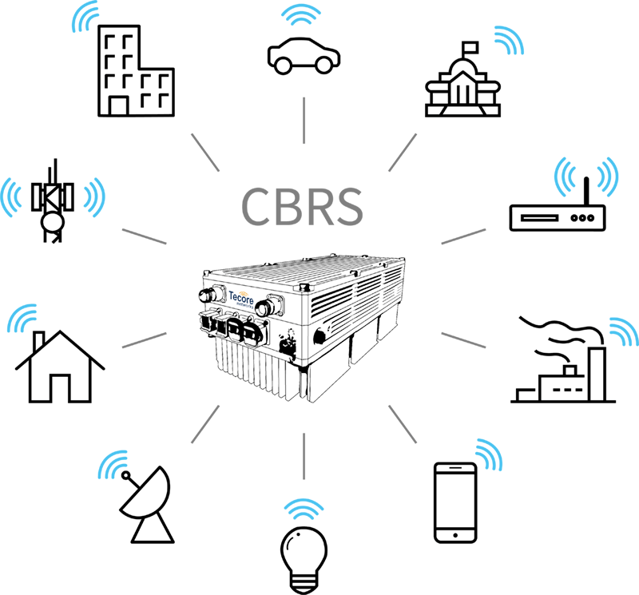
Citizen Broadband Radio Service
By:
Dr. Ahmed Noori Al-Naami

Slide 2

Introduction to CBRS
CBRS Technology
Resource Allocation

Slide 3
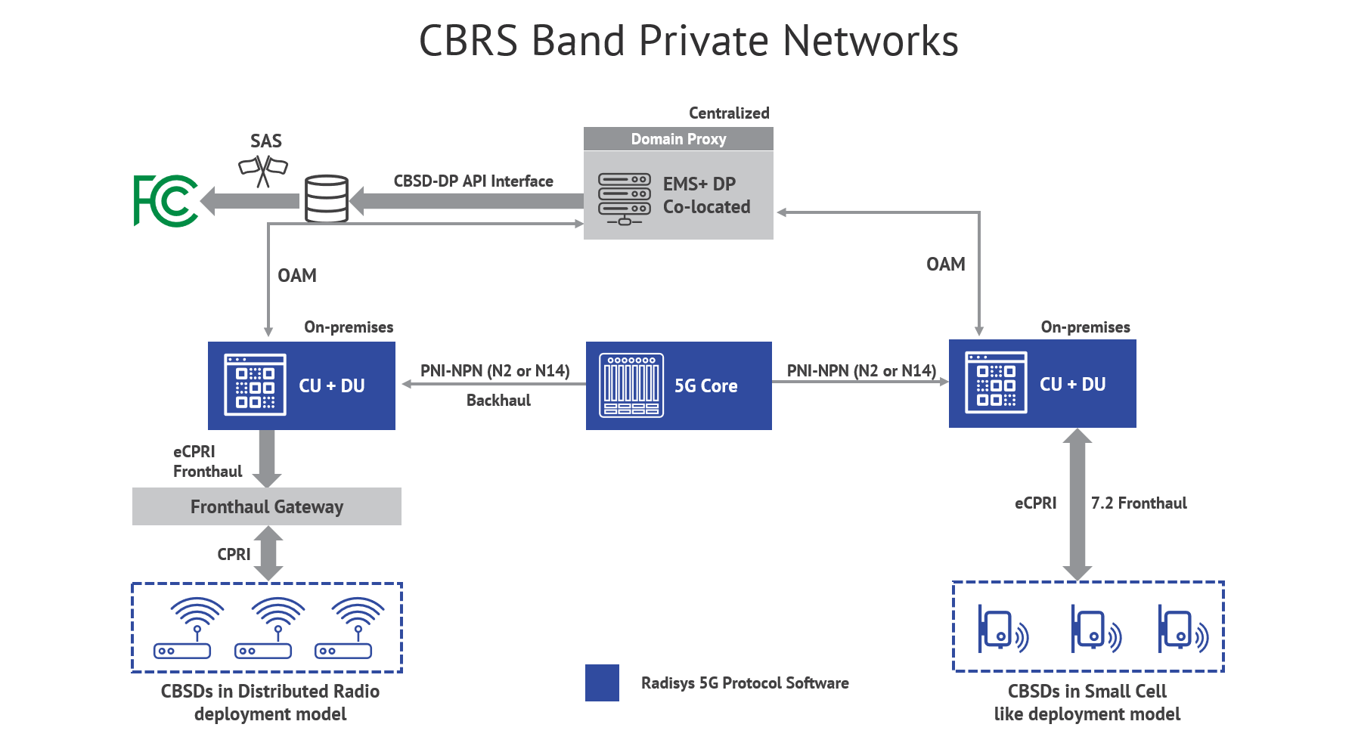
INTRODUCTION
Citizens Broadband Radio Service (CBRS) has become crucial for optimal spectrum utilization.
Spectrum sharing refers to the practice of allowing multiple users or systems to share the same frequency bands concurrently.

Slide 4

INTRODUCTION
Spectrum sharing involves allowing multiple users or systems to coexist and utilize the same frequency bands simultaneously.
These strategies aim to strike a balance between serving:
  As many users as possible,
  maintaining fair distribution, and
  ensuring optimal performance

Slide 5
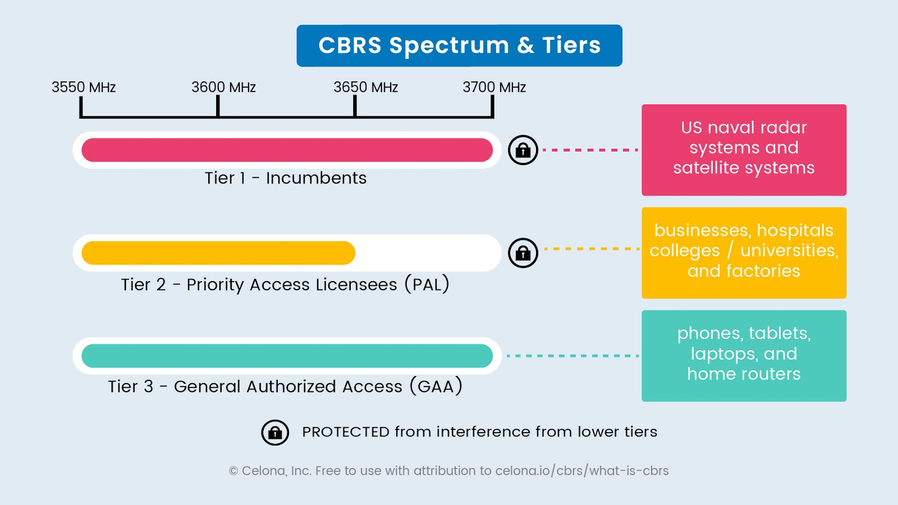

Slide 6
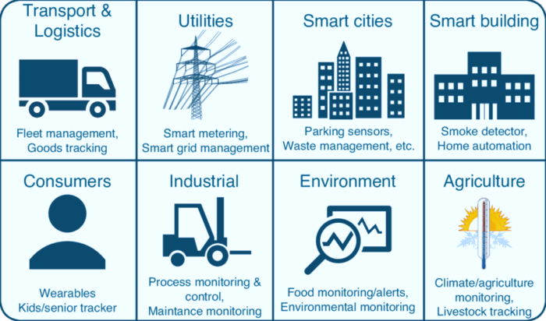
CBRS APPLICATIONS

Slide 7

Incumbent Access

Slide 8

Priority Access License

Slide 9

General Authorized Access

Slide 10
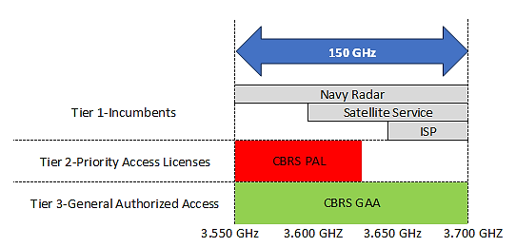
CBRS Resource Allocation

Slide 11

Thanks and Regards

