Slide 1
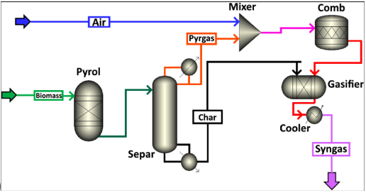
Aspen plus
Assist Prof Dr. Khalid W. Hameed
Al-Khwarizmi College of Eng.
University of Baghdad

Slide 2
What is the Aspen plus
Aspen Plus is the main Process Simulation tool in the market used by engineers to design and optimize chemical processes. It is widely used in the chemical, pharmaceutical, and energy industries.
It is designed by AspenTech was founded on August 12, 1981 to commercialize the technology. In 1982, the company released its first product, Aspen Plus. ASPEN is an acronym of Advanced System for Process ENgineering.
Specialized software for Chemical Engineering.

Slide 3
Most of known process simulators

Slide 4
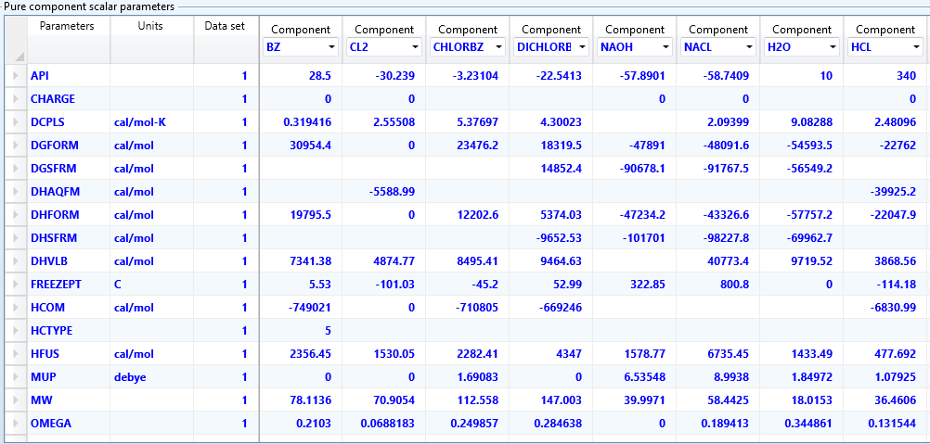
Advantages of the Software:
Contains the physical and thermodynamical properties of hundreds of chemicals.

Slide 5
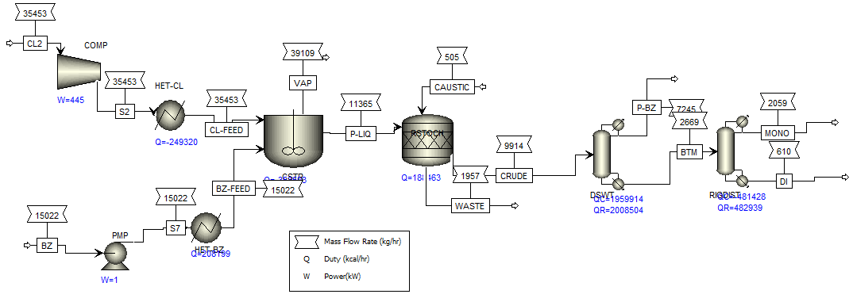
Performance the Material and Energy balance as well as unit conversion.

Slide 6
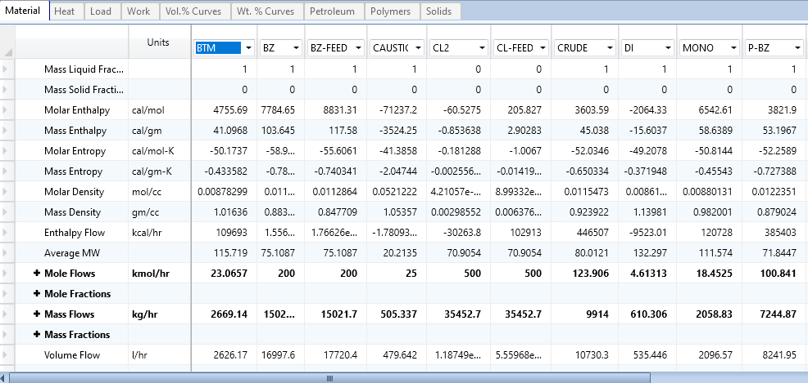

Slide 7
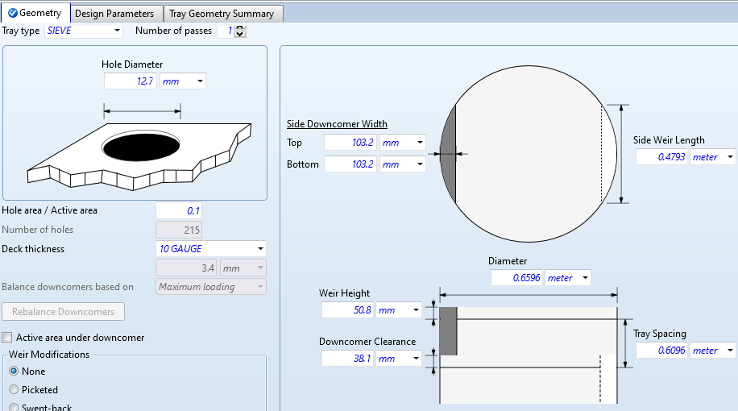
Performance the Design Calculations.

Slide 8
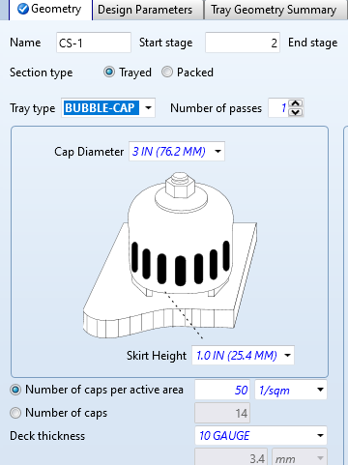
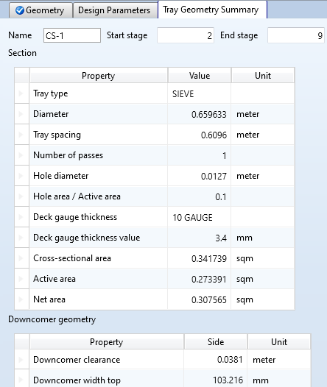

Slide 9
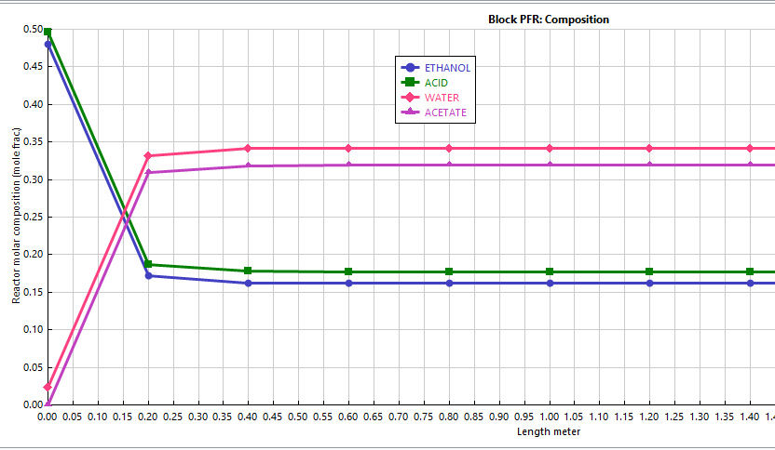
Perfect for analytical/numerical minds (How the process would behave under different conditions) e.g. Case steady research.

Slide 10
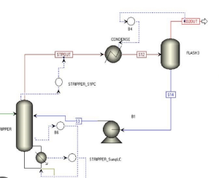
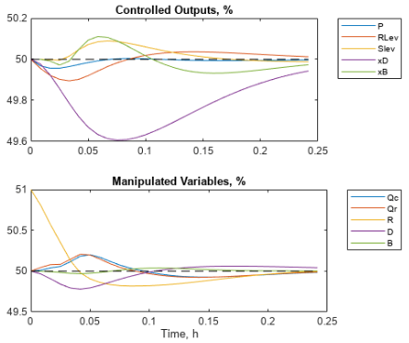
Execute the dynamics and control process as well as steady state.

Slide 11
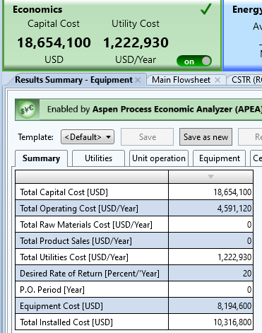
Performance the Economic Evaluation.

Slide 12
Obtain a report of all details of plant.
Eliminate of Routine and Saving of time. i.e. Make easer/ faster work as well as accuracy of results.
The software can present a virtual lab
It can be applied the operating conditions by software firstly, then in the practical field to avoid the errors and to obtain the optimum conditions.
Excellent for your curriculum as an engineer.

Slide 13
Thank You

