Slide 1
Quantum Technologies in a Military Strategy: A revolution in defense and security
Al-Khwarizmi College of Engineering University of Baghdad
By
Dr. Adil Fadhil Mushatet
1/4/2024

Slide 2
Talk outline
Basics of Quantum Mechanics
Quantum Technologies in Military Strategy
consequences and challenges
Conclusion

Slide 3
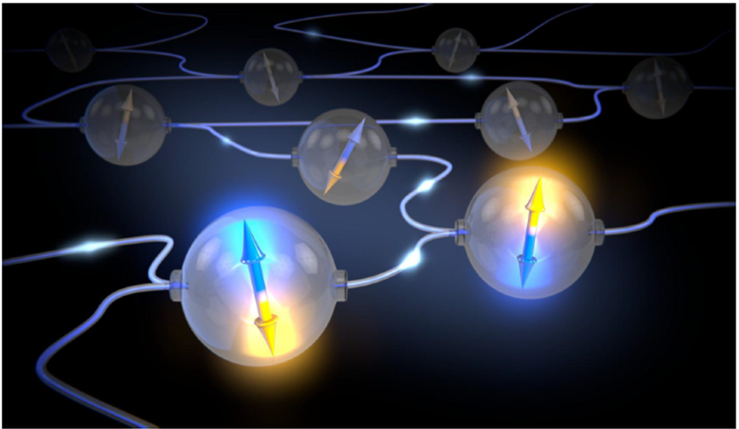
Quantum physics
Quantum technologies are enabled by various Quantum physics features:
No-cloning theorem
Quantum superposition
Quantum entanglement
Quantum bit
By manipulating individual quanta
(e.g. ion, electron, atom,…) we can reach
fundamentals limits and capabilities:
Computing capabilities with up to exponential speedup
Information theoretic secure communication

Slide 4
Quantum Technologies

Slide 5
Quantum Technologies (continued…)

Slide 6
‘keep the fight unfair’

Slide 7
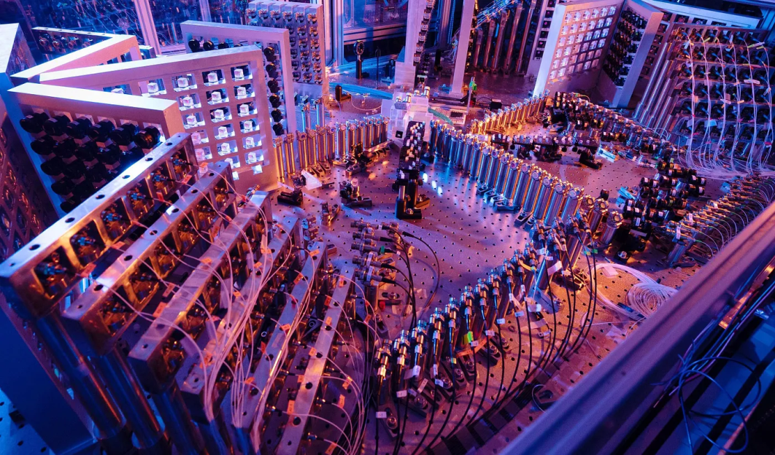
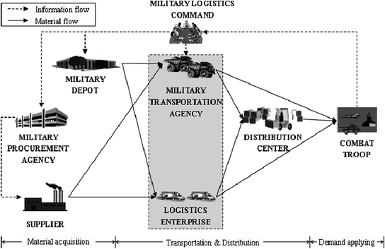
Quantum Computing
Process vast amounts of data and solve complex problems at speeds unattainable by classical computers
In the context of military operations:
Quantum computers have the potential to break even the most advanced encryption algorithms currently in use. Conversely, developing more robust encryption techniques, providing an extra layer of security for military communications.
Improve logistics, mission planning, and resource allocation. Thus, efficient military operations, better use of resources, and ultimately, a strategic advantage on the battlefield.
Advance military research by simulating complex systems and materials. Thus, discovery of next-generation weapons

Slide 8
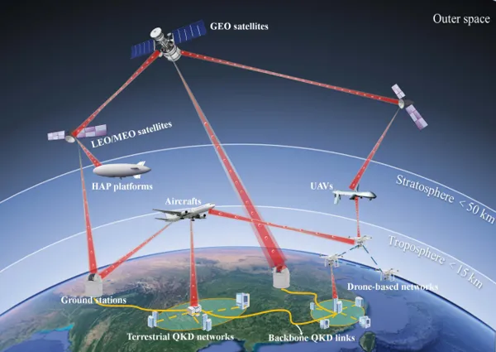
Quantum Internet
Transmission of information using quantum entanglement and superposition. Thus, creation of secure communication channels that are resistant to interception, ensuring the confidentiality of sensitive military data.
Generate and share encryption keys securely by QKD. This level of security is critical for maintaining the confidentiality of military information and secure communication channels during missions.
Enhance real-time decision-making on the battlefield. By connecting quantum devices and sensors.
Facilitate secure, long-range communication in challenging environments, such as underwater or deep space missions.

Slide 9
Quantum Cyber Warfare
As quantum computing and internet continue to advance, their impact on cyber warfare will become significant, necessitating a reevaluation of current strategies and tactics.
In offensive cyber warfare, quantum computing poses a significant threat to the security of current encryption methods.
In defensive cyber capabilities, QKD and quantum-secure communication channels can be used to protect military networks and communications from eavesdropping.
Adversaries may attempt to exploit quantum networks for espionage, sabotage, while defenders must develop new strategies to detect and counter these threats.

Slide 10
Quantum Communication
By leveraging the principles of quantum mechanics, quantum communication can transmit information securely and accurately, even in challenging environments i.e. ideal choice for protecting sensitive military data.
Enabling secure information exchange over long distances and in harsh conditions, such as underwater or deep space missions.

Slide 11
Quantum Magnetometry Sensing
Emerging technology that takes advantage of quantum principles to achieve unprecedented sensitivity in measuring magnetic fields.
A strategic advantage in naval operations by identifying the magnetic signatures of submarines at greater distances and with higher accuracy.
In land-based operations, detection and neutralization of unexploded ordnance and landmines in conflict zones.
Intelligence gathering by detecting magnetic anomalies associated with concealed infrastructure, vehicles, or weapon systems.

Slide 12
Quantum Chemical Detection
By utilizing the unique properties of quantum particles and interactions, quantum chemical detection techniques can identify and analyze chemical substances with exceptional precision and sensitivity.
In the area of chemical, biological, radiological, and nuclear (CBRN) defense, these techniques can identify amounts of chemical or biological agents in complex environments.
Monitor environmental conditions and gather intelligence on potential adversaries such as the presence of pollutants, toxins, or other substances that may indicate military activities or environmental hazards.

Slide 13
Quantum Radar
Quantum radar is a cutting-edge technology to detect and track objects with remarkable precision, sensitivity, and stealth.
Ability to overcome conventional radar countermeasures, such as stealth technology or electronic jamming.
By leveraging the unique properties of quantum particles, quantum radar can detect smaller and more distant objects, as well as distinguish between closely spaced targets.
Operate with lower signal emissions compared to conventional radar systems, reducing the likelihood of detection by adversaries.

Slide 14
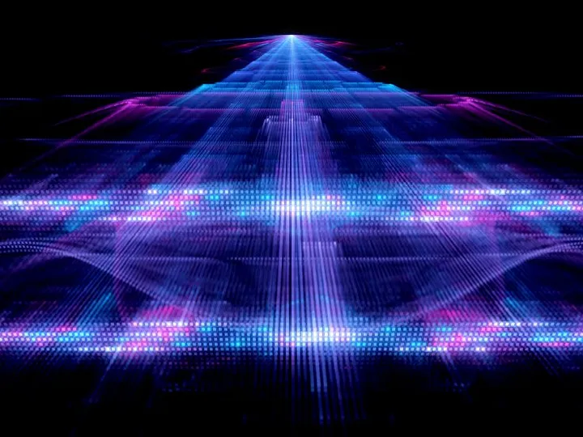
Quantum Underground/Underwater Mapping
For underground mapping, quantum gravimeters and magnetometers, can be employed to detect and characterize subsurface structures, tunnels, or hidden facilities with high sensitivity and precision which enable identification of subtle gravitational or magnetic anomalies which can be indicative of underground activities or infrastructure .
For underwater mapping, Quantum sensors, such as quantum accelerometers and magnetometers, can detect minute variations in underwater environments, enabling the identification of underwater obstacles, or vehicles which contribute to anti-submarine warfare and underwater reconnaissance missions.

Slide 15
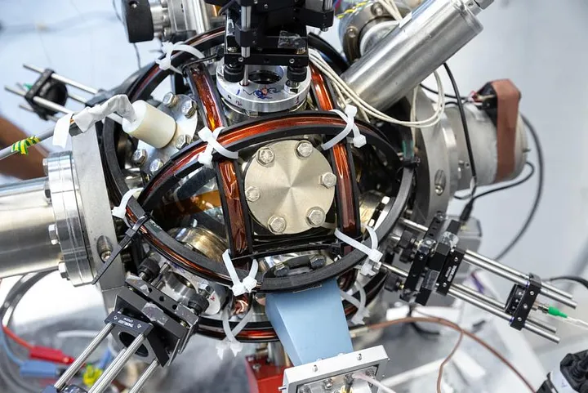
Quantum Navigation
To develop accurate positioning and navigation systems in environments where traditional systems, such as GPS, may be unreliable or unavailable.
In military applications, this system can provide precise positioning and timing information, which is essential for the effective planning and execution of operations. Quantum accelerometers, gyroscopes, and magnetometers can deliver extremely accurate measurements of motion, rotation and magnetic fields.
By integrating these quantum sensors into navigation systems, military vehicles and aircraft, can maintain accurate positioning and orientation even in the absence of external signals such as GPS or satellite-based navigation aids.

Slide 16
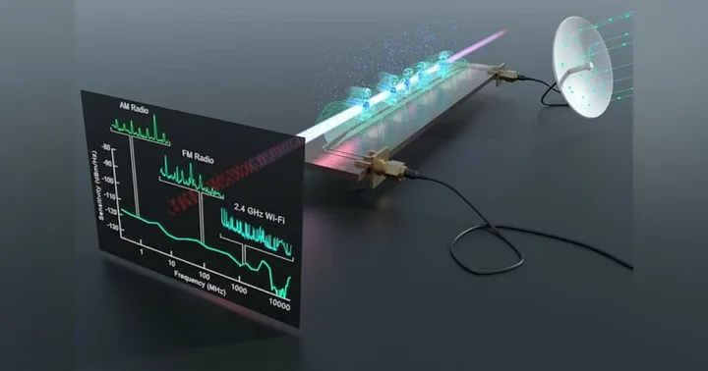
Quantum Electronic Warfare
Applies the principles of quantum mechanics to develop advanced systems for manipulation, disruption and protection of communication and information.
QKD and quantum communication can provide highly secure channels for the exchange of information which enhance the confidentiality and integrity of critical military data.
Counteract enemy jamming and deception techniques.
Quantum sensors can be utilized to detect and track enemy communication networks, radar installations, or weapon systems.

Slide 17
consequences and challenges
To avoid technological surprises due to neighboring or hostile countries, the monitoring of quantum technology evolution and adaptation is essential.
The national trade and export policies
should be considered.
The development of quantum technology Policies and strategies required research of Resources (universities, laboratories and corporations) and markets, the state of development and feasibility studies and the military and security threat.
Quantum warfare require an update, modification or creation of new military scenarios and plans to develop new techniques and weapons for the quantum age.

Slide 18
Conclusion
Quantum technologies hold great potential to revolutionize defense capabilities, offering a wide range of applications that could significantly enhance military operations.
The development of quantum
technology for warfare purposes
should be guided by a commitment
to global peace and security.
As we venture further into the realm of quantum technology, it is crucial to address the strategic implications that arise with the development and deployment of these powerful tools.

Slide 19
References
Yang, Y., Liu, L., Huang, Y., & Zhang, Q. (2021). Quantum technology and military operations: a review. EPJ Quantum Technology, 8(1), 1–19. https://doi.org/10.1140/epjqt/s40507-021-00113-y
Dowling, J. P., & Milburn, G. J. (2003). Quantum technology: the second quantum revolution. Philosophical Transactions of the Royal Society of London. Series A: Mathematical, Physical and Engineering Sciences, 361(1809), 1655–1674. https://doi.org/10.1098/rsta.2003.1227
Bennett, C. H., & Brassard, G. (2014). Quantum cryptography: Public key distribution and coin tossing. Theoretical Computer Science, 560, 7–11. https://doi.org/10.1016/j.tcs.2014.05.025
Pirandola, S., Bardhan, B. R., Gehring, T., Weedbrook, C., & Lloyd, S. (2020). Advances in photonic quantum sensing. Nature Reviews Physics, 2(12), 729–745. https://www.nature.com/articles/s41566-018-0301-6
Devitt, S. J. (2016). Performing quantum computing on encrypted data. Nature Communications, 7(1), 1–9. https://www.nature.com/articles/ncomms4074
Bahrampour, A. R., Iraji, Z., & Askari, S. R. (2018). Quantum communications and networks for military operations. IEEE Communications Magazine, 56(9), 34–39. https://arxiv.org/ftp/arxiv/papers/2011/2011.04989.pdf

Slide 20
Thank you
Any Questions…..?

