Slide 1
Electromagnetic Acoustic Trasducer EMAT for non-contact Bioimaging
By: Dr. Yarub Alazzawi
Mechatronics Engineering Department

Slide 2
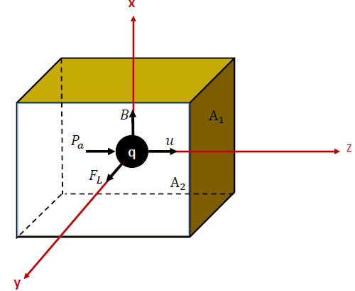


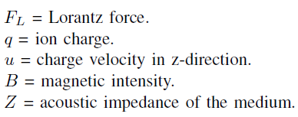
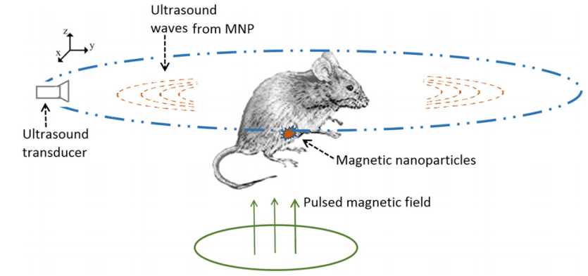



Theoretical Approach
Applied pressure :
Lorentz force :
Medium object volume describes the generation of
Lorentz force on the ion under investigation
= induced acoustic pressure in y-direction.
Key Paper: Magnetoacoustic Tomography based on IONP detection

Slide 3
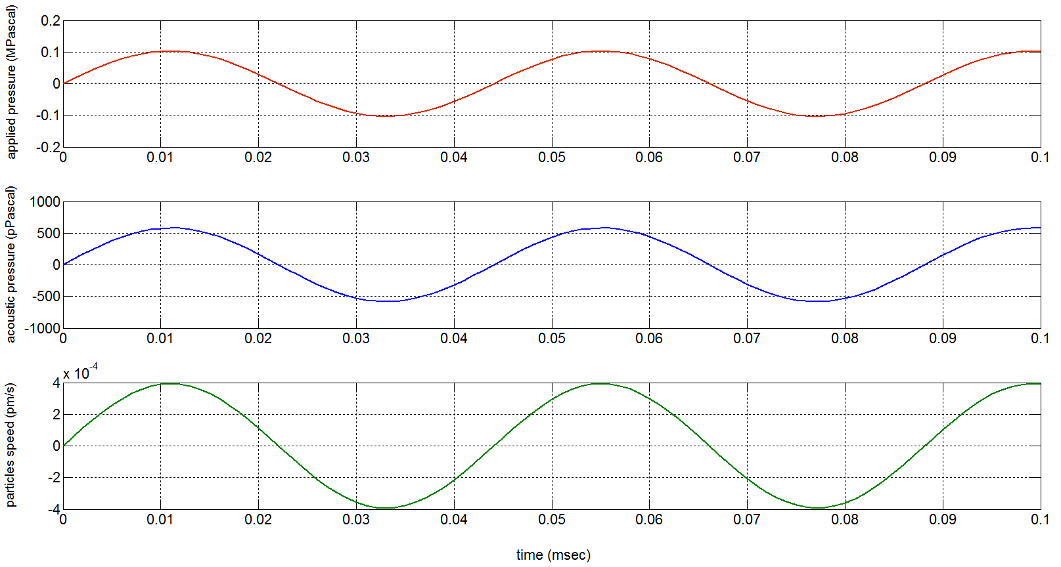



q = (1.6021765 * 10^-19)*10^6; % million of ion charge in column.
A2 = 5*5*10^-6; % projection area of the chamber in m^2.
B = 1.3 T; % ,Magnetic field intensity in Tesla.
f = 1.3 MHz; % applied excitation frequency.
y = 0.015; % Wave propagation distance in m.

Slide 4
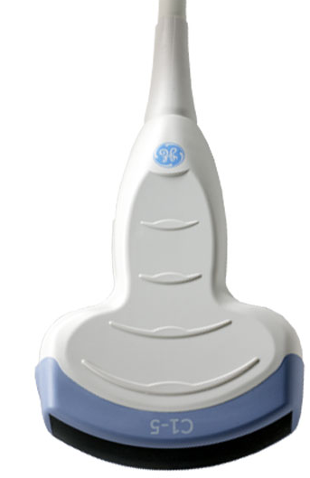
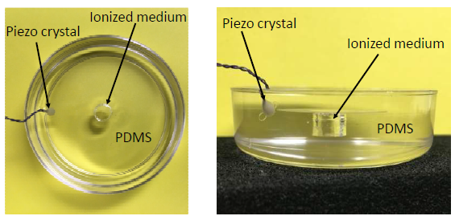

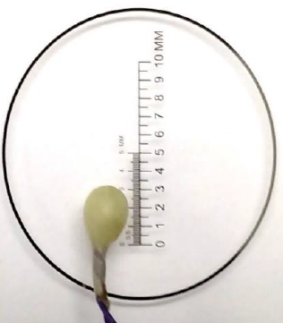
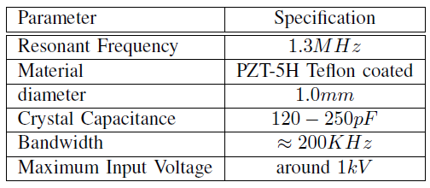
Experimental Setup
Transducer
Ultrasound
waves
Chamber
(a)
(b)
ions
Gel-filled
Setup-2
Sonomicrometery Crystal

Slide 5
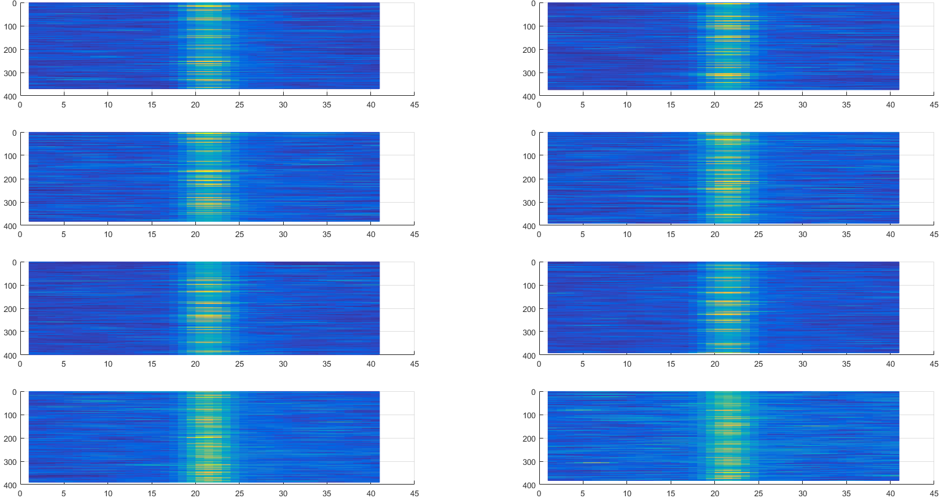
M-mode scans
Correlation Plots
Extracting the Pulses

Slide 6
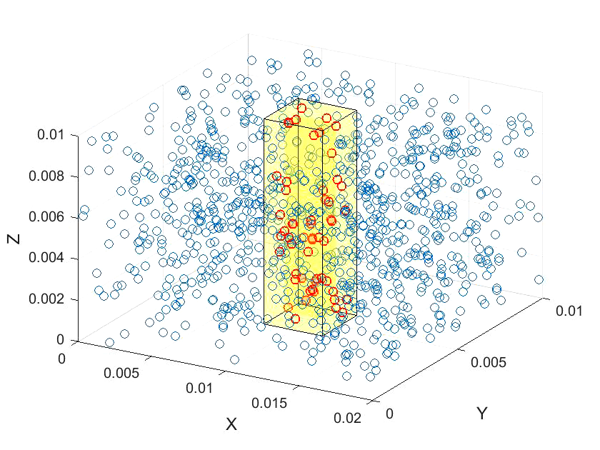
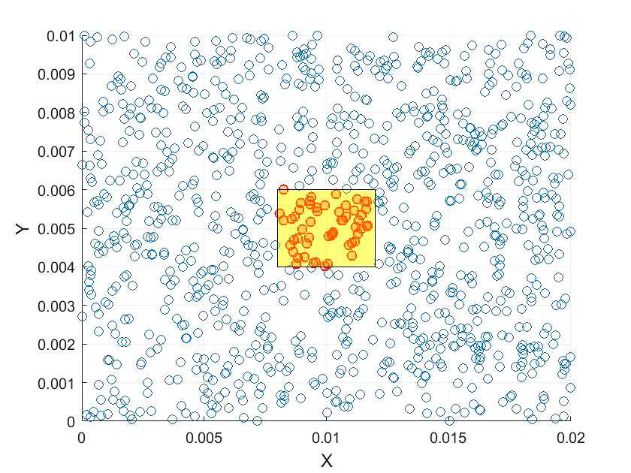
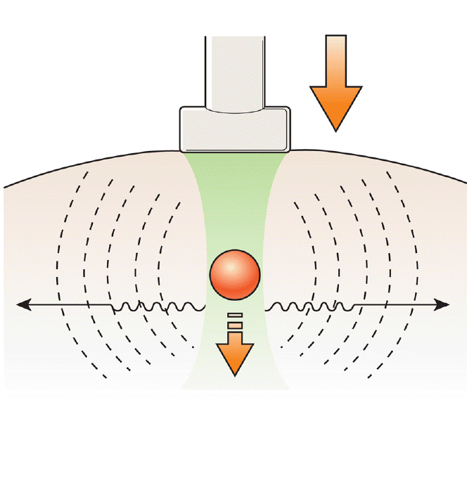
US Electrography
using
plane wave imaging
Effects on the contour in the absence/presence of Magnetic Field

Slide 7
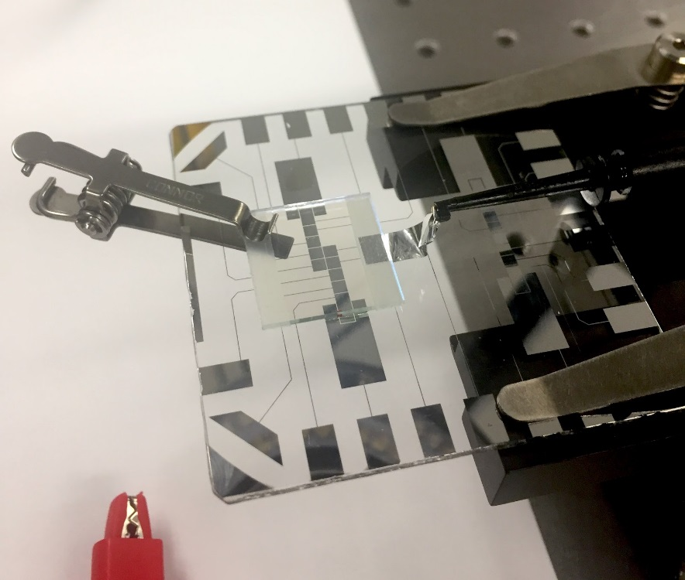
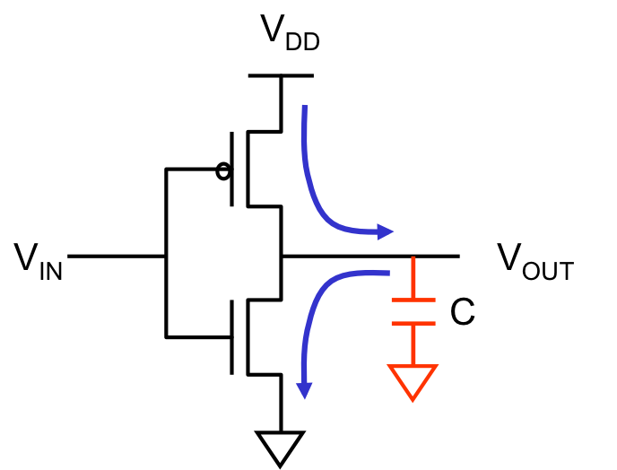
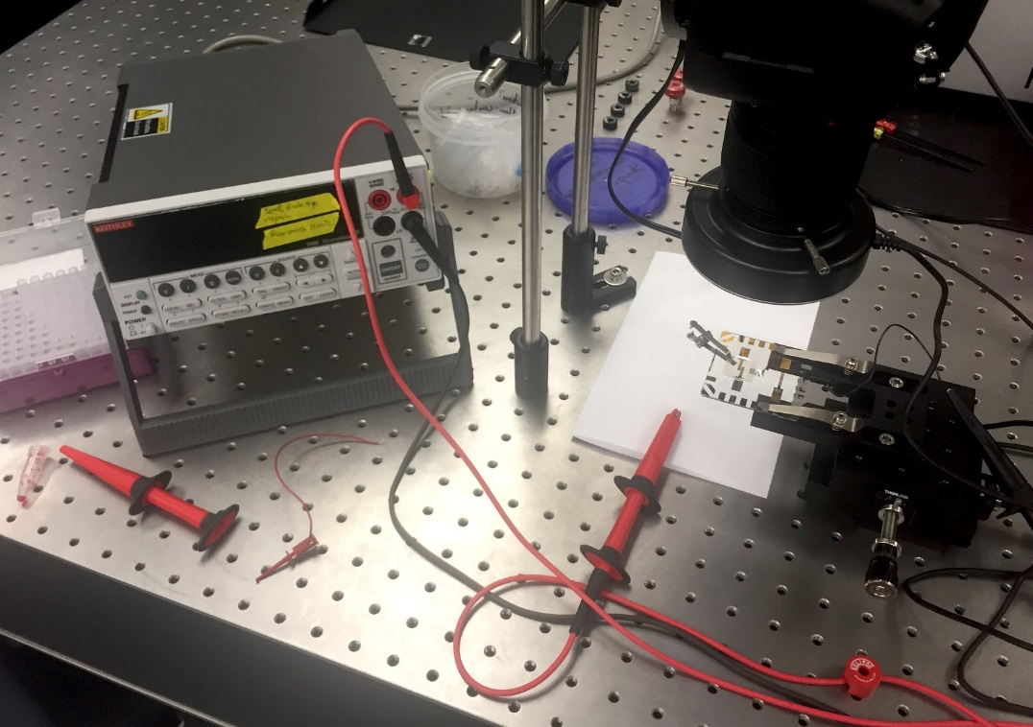
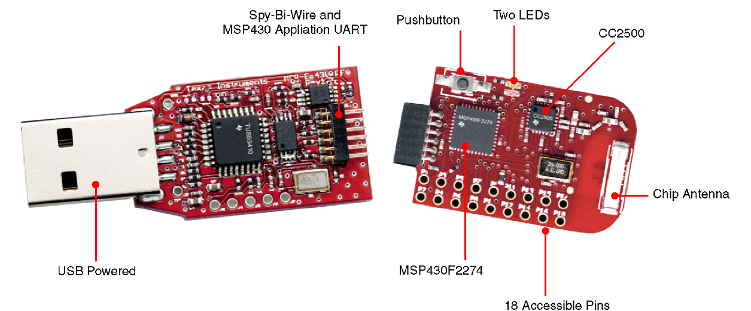
HV source
Chip
Driver
ITO
Chip
Holder
Microcontroller
Camera
HV source

Slide 8
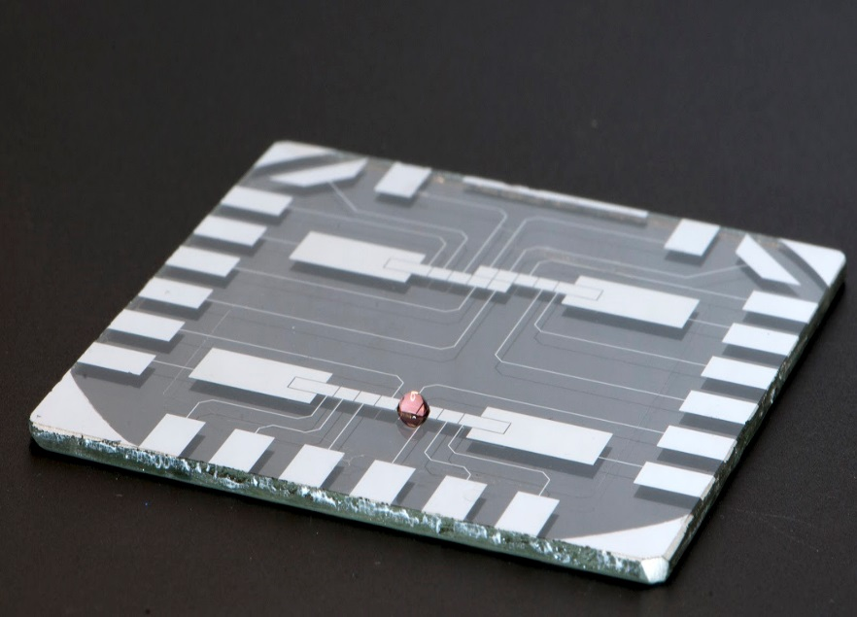
HV source
Chip
Driver
Microcontroller
Chip

Slide 9

Camera
HV source
ITO
Chip
Holder
(a)
(b)
$γ_{ls} and$ $γ_{gs}$

Slide 10
