Slide 1
Applications of nanotechnology for Food Packaging
تطبيقات تكنولوجيا النانو في تغليف المواد الغذائية
اعداد
أ.د. علاء كريم محمد
كلية الهندسة الخوارزمي / قسم الهندسة الكيميائية الاحيائية

Slide 2
Overview
1- Definition
2- Functions
3- Nano-materials
4- Application of Nano-materials for food Packaging.

Slide 3
Definition
Packaging can be defined as a method to protect and contain foods with the aim of minimizing the environment impact and maintaining nutritional quality and ensuring microbial safety.

Slide 4
Function
Packaging materials have four basic functions:
1- Protection
2- Communication
3- Convenience
4- Containment

Slide 9
Application of Nano-materials for Food Packaging
1- Polymer Nano composites
2- Nano Coatings
3- Surface biocides
4- Active packaging
5- Intelligent packaging
6- Bio-Plastics

Slide 21
3- Surface Biocides
What is Biocide ?
Biocide is defined as a chemical substance that exert a controlling effect on any harmful organism by chemical or biological means

Slide 22
Surface Biocides means

Slide 25
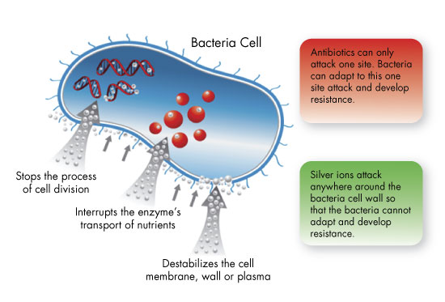

Slide 26
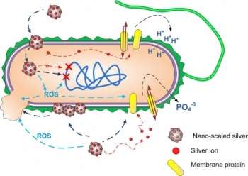

Slide 27
4- Active Nano -packaging

Slide 29
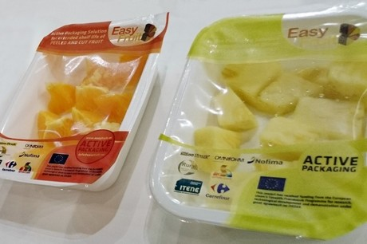

Slide 36
6- Bio-Plastics

Slide 41
