Slide 1
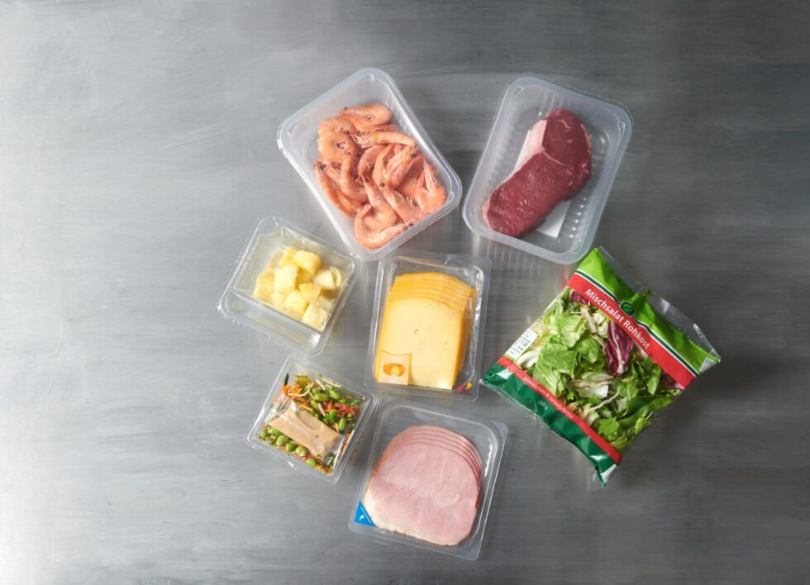
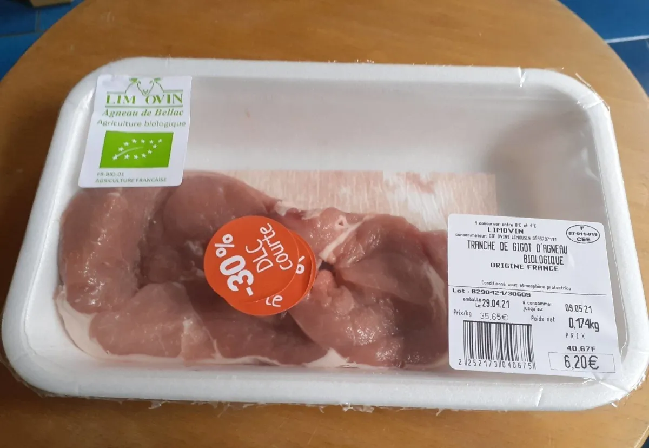
Intelligent packaging of food
ا.د زينه صائب خضير
فرع الصحة العامة البيطرية

Slide 2
Some examples of edible films in the food packaging industry.

Slide 3
Role of AI in the Food Processing
The intelligent systems in various tasks, such as intelligent food packaging,
intelligent package is monitor the quality and safety conditions of a food products and give warning to the consumer or food manufacturer.
Intelligent packaging refers to a package that can sense all the environmental changes, and in turn informs the the consumers.

Slide 4
The traditional method for detection the food conditions now discussed due to human errors that may arise from expert panels.
this method is suffers from low efficiency and precision.
Traditional microbiological tests including counting the bacterial population are very time consuming .

Slide 5
During the production and before the food delivery changes as chemical and microbiological may occure ,the “intelligent packaging,” monitor and display the Food quality from the factory to the final consumer
“intelligent packaging” is Technologies used in this form of packaging are indicators, sensors, and data carriers

Slide 6
It is estimation of the global food production must be in-creased by 60–110% to feed 9-10 billion of the population by 2050 .
intelligent packaging is designed to recorded the information the food origin, expiration date and the ingredients
Indicators used in the packaging of meat are time temperature indicators, oxygen and freshness indicators.

Slide 7
are indirect indicators of food quality, they provide information about factor in food changes (temperature abuse) rather than the changes themselves. Information on temperature abuse is useful to warn consumers about e.g. potential microbial growth, protein denaturation or emulsion breaking.
Temperature indicators are classified as
critical temperature indicators (CTI, which indicate whether a critical temperature value has been reached along storage) and time temperature (TTIs, which provide information on the full temperature history of the food product along the food supply chain).
They are based on temperature-induced mechanical, chemical, enzymatic or microbiological changes, , the information is usually expressed as a visible (and irreversible) response such as mechanical deformation or color development ,
also the thermochromic systems, which provide temperature indication based on reversible changes, thus useful rather for assessing real-time temperature for sensory purposes (cold beverages) than information on food stability.

Slide 8
Time–temperature and other indicators as signal the user can now about the quality of the packaged product (reported as far back as the 1960s)
biosensor, which can inform the user of the growth of microorganisms or even a specific microorganism in the package
Bar code to help communicate information for reheating or cooking of the contained food in an appliance (in the 1930s, but not implemented until the 1970s)
An ethylene sensor, probably for the ripeness of fresh fruit
Gas concentrations in modified atmosphere packages (with the advent of oxygen scavengers during the late 1980s)

Slide 9
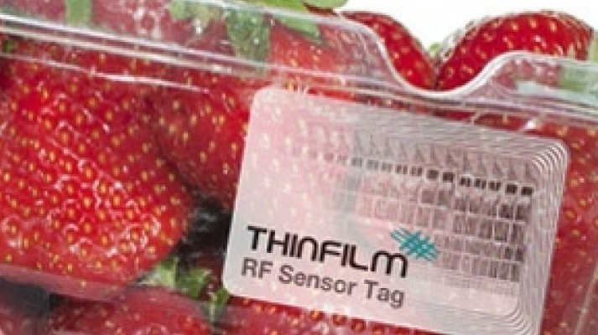

Slide 13
intelligent bio-based food packaging.

Slide 14
intelligent packaging system that is capable of carrying out intelligent functions as detecting, sensing, recording, tracing, communicating, to facilitate the making decision ,to extend shelf life, enhance safety, improve quality, provide information, and detection possible problems

Slide 15
The temperature indicators indicate the color change or color migration, the heat loads that the packaged product is exposed to in the distribution chain.
continuous indicators which records the temperature changes (weather-temperature indicators)
The registration indicators of extreme conditions (the product was exposed to higher or lower temperatures than the critical temperature.
Commercial indicators of the time–temperature type usually based on the chemical diffusion, polymerization reaction and enzymatic reactions. This type of indicator is mostly used in the frozen food from production to to final soring

Slide 16
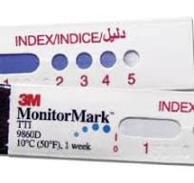
Time temperature indicators (TTIs)
are a group of indicators placed on the outer side of the package). They’re not in direct contact with the food product itself, but only monitor the conditions of storing.
TTI applications are abundant mostly in the US, Japan and Australia. In Europe however, their development and application meets strict regulations for food-contact materials.

Slide 17
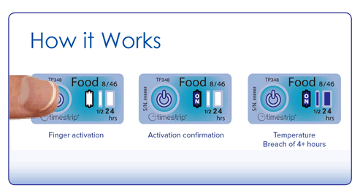
Time Strip Indicators
Timestrip Temperature Indicators for Food
Observing the temperature across of cold chain in food industry applications is simple, cost-effective process.
Timestrip® temperature indicator that shows how long the food products has been above the temperature, the indication is irreversible.

Slide 18
Gas indicators
principle of actions of both of oxygen and carbon dioxide indicators is based on changes in the color due to chemical or enzymatic reactions.
With the important advantage of the application is show the quality of the packaged product.
Monitoring changes in gas composition inside the package providing a method to monitor the quality and safety of food products, , Food packing in the form of Closed label or packaging printing film is used to detects oxygen, ethanol, hydrogen sulfide (H2S), carbon dioxide, or other gas components.

Slide 19
Freshness indicators
monitor the microbial breakdown of food products in the headspace of packaged food products specially the fish and meat.
pH indicator dyes that are sensitive to the action of the volatile compounds associated with food product spoilage .
pH-sensitive dye is entrapped within a polymeric matrix, and when the spoilage volatile compounds are released in the package the response occurs as visible changes in the color .

