Slide 1
The Fascinating World of Consonants: Fricatives vs. Plosives
Prof. Dr. Nareeman Jabbar Rasheed

Slide 2
Speaker Notes
In this presentation, we'll delve into the world of consonants, specifically focusing on two fascinating categories: fricatives and plosives. We'll explore their unique characteristics, how they are produced, and how they differ from each other. By understanding these sounds, we gain a deeper appreciation for the intricate tapestry of human language.

Slide 3
Plosives: A Complete Block, a Sudden Release
Plosives are consonants produced by a complete closure of the vocal tract at a specific point, followed by a sudden release of air.
Examples in English include /p/, /t/, /k/, /b/, /d/, and /g/.
Imagine saying "stop" - the /p/ sound is a plosive.

Slide 4
Speaker Notes
Plosives are like little explosions in speech. We block the airflow completely at a specific location in our mouth, and then release it abruptly, creating a distinct sound. The letters "p," "t," "k," "b," "d," and "g" in English all represent plosives, depending on whether they are voiced or unvoiced. The next slide will explore this distinction further.

Slide 5
Voiced vs. Unvoiced Plosives: A Matter of Vibration
Plosives can be further classified as voiced or unvoiced based on the vibration of the vocal cords.
Voiced plosives involve vibration of the vocal cords along with the closure and release. (e.g., /b/, /d/, /g/)
Unvoiced plosives lack vocal cord vibration, creating a sharper sound. (e.g., /p/, /t/, /k/)

Slide 6
Speaker Notes
The subtle difference between voiced and unvoiced plosives lies in the involvement of our vocal cords. When we produce voiced plosives, like the /b/ in "boy," our vocal cords vibrate along with the closure and release of air. This creates a buzzing sensation and a softer sound. Conversely, unvoiced plosives, like the /p/ in "pot," lack vocal cord vibration, resulting in a sharper and more explosive sound.

Slide 7
Fricatives: The Art of Narrowing the Passage
Fricatives are consonants produced by creating a narrow channel in the vocal tract, forcing air to flow through it, creating a hissing or turbulent sound.
Examples in English include /f/, /s/, /v/, /θ/ (voiced th), and /ð/ (unvoiced th).
Imagine saying "fish" - the /f/ and /ʃ/ sounds are fricatives.

Slide 8
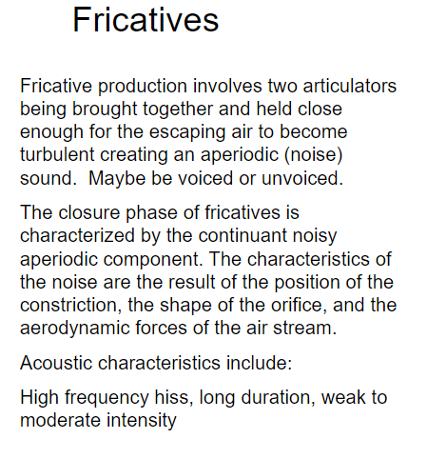

Slide 9
Speaker Notes
Fricatives take a different approach. Instead of completely blocking the airflow, they create a narrow passage in the mouth, similar to how you might whistle. This forces air to rush through the restricted opening, producing a characteristic hissing or turbulent sound. The letters "f," "s," "v," "th," and "dh" in English often represent fricatives, depending on their voicing.

Slide 10
Hold it or Let it Flow: The Continuum of Duration
Plosives are momentary sounds due to the complete closure and sudden release.
Fricatives, on the other hand, can be sustained for a longer duration as long as airflow continues.

Slide 11
Speaker Notes
One key difference between plosives and fricatives lies in their duration. Plosives are like quick bursts of sound. Once the air is released, the sound stops. For example, saying "stop" involves a very brief /p/ sound. In contrast, fricatives allow for more continuous airflow. Saying "fish" allows you to hold the /f/ sound for a longer stretch. This distinction is crucial in understanding how these sounds are used and perceived in language.

Slide 12
Putting it Together: From Theory to Practice
By understanding the differences between plosives and fricatives, we can better appreciate the intricate sounds that make up human language.

