Slide 1
Resazurin assay for assessment of cell viability
دورة تدريبية/ المحاضرون: د. رغد ناظم
د. زينب اسماعيل
د. زينب جمال

Slide 2
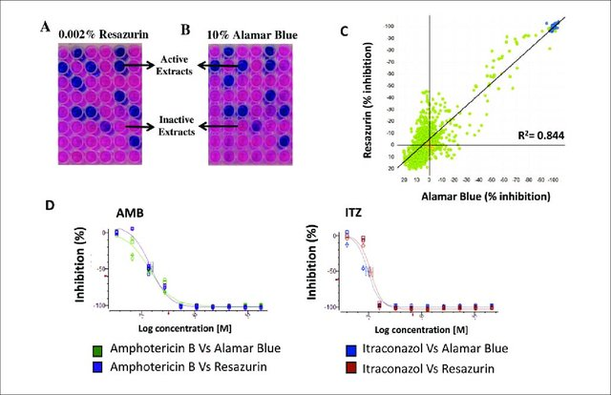
Outlines
Cell line
Cell viability
The resazurin assay
Resazurin assay protocol
Application of the resazurin cell viability Assay
References

Slide 3
Cell line
Cell lines that have been used in cytotoxicity assays include corneal epithelial cells, lung fibroblasts, Chinese hamster ovary (CHO) cells, canine renal cells, HeLa cells, and microorganisms.

Slide 4
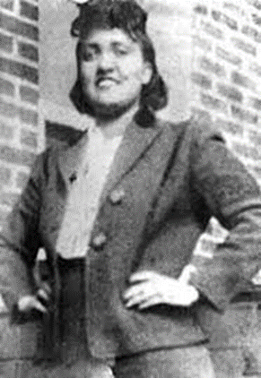
HeLa cells
*In 1951, Henrietta Lacks, a 31-year-old African-American woman, went to Baltimore's Johns Hopkins Hospital to be treated for cervical cancer. Some of her cancer cells began being used in research due to their unique ability to continuously grow and divide in the laboratory.
*HeLa is an immortalized cell line used in scientific research. It is the oldest human cell line and one of the most commonly used.

Slide 5
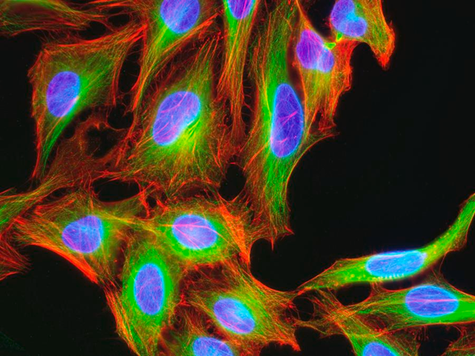
*HeLa cells are used by scientists to develop a cancer research method that tests whether a cell line is cancerous or not.
*Lacks' cells doubled every 20 to 24 hours. Today, these incredible cells — nicknamed "HeLa" cells, from the first two letters of her first and last names — are used to study the effects of toxins, drugs, hormones and viruses on the growth of cancer cells without experimenting on humans.
*Some of her cancer cells began being used in research due to their unique ability to continuously grow and divide in the laboratory. These so-called “immortal” cells were later named “HeLa” after the first two letters of Henrietta Lacks first and last name.
Hela Cervical Cancer Cells Photograph

Slide 6
Cytotoxicity assays
Cytotoxicity assays measure loss of some cellular or intercellular structure and/or functions, including lethal cytotoxicity. They thus give an indication of the potential to cause cell and tissue injury and as such have been used by some investigators to predict tissue injury, including eye injury.

Slide 7
Introduction
Cell-based viability assays are important to determine whether cells are alive or dead. Such assays are widely used for investigating cell response to a given agent, drug or to establish relative cytotoxicity of chemicals.
Living cells maintain a reducing environment within their cytoplasm and mitochondria, in which resazurin (blue and non-fluorescent) is reduced by dehydrogenase enzymes to form the red fluorescent dye resorufin. The amount of resorufin can be monitored by measuring fluorescence or absorbance, which is proportional to the number of living cells in the sample. Depending on the cell types, the resazurin assay can be used to detect as few as 40 cells with reproducible and sensitive signal.

Slide 8
Resazurin assay
The resazurin assay also known as Alamar Blue assay offers a simple, rapid, and sensitive measurement for the viability of mammalian cells and bacteria. Living cells are metabolically active and are able to reduce via mitochondrial reductase, the nonfluorescent dye resazurin to the strongly-fluorescent dye resorufin.

Slide 10
The fluorescence output is proportional to the number of viable cells over a wide concentration range.
As Alamar Blue is not toxic, cells exposed to it can be returned to culture or used for other purposes.
Proliferation measurements with Alamar Blue may be monitored using a standard spectrophotometer, a standard spectrofluorometer, or a spectrophotometric microtiter well plate reader.

Slide 11
The major advantages of the resazurin reduction assay
relatively inexpensive,
uses a homogeneous format,
and is more sensitive than tetrazolium assays.
In addition, resazurin assays can be multiplexed with other methods, such as measuring caspase activity to gather more information about the mechanism leading to cytotoxicity .
The disadvantages lie on the fact that conversion to resorufin depends on enzymatic conversion meanwhile absorbance-based method is less sensitive than fluorescence-based method.

Slide 12
Key Features
Sensitive: requires as few as 80 cells for reproducible results
Simple: cell lysis, cell fixation, and cell permeabilization are not required
Kinetic monitoring: non-toxic to cells, thus allowing long-term dynamic monitoring
Safe: non-toxic, non-radioactive, non-carcinogenic, requires only simple disposal
Versatile: successfully used in a wide range of cell types, including bacteria, protozoa, yeast, fungi, and cultured mammalian cells

Slide 13
Materials Required
96-well plate
Cell culture reagents
Mitochondrial viability dye
A fluorescent microplate reader
Multi and single channel pipettes

Slide 14
What is the difference between MTT assay (3-[4,5-dimethylthiazol-2-yl]-2,5 diphenyl tetrazolium bromide) and resazurin assay?
MTT is a colorimetric based assay. Because it is an insoluble product, the cells need to be lysed to make the formazan salt more soluble before absorbance can be measured. Resazurin can be measured using either colorimetric or fluorescence detection.

Slide 15
Resazurin Cell Viability Kit Protocol
1. Thaw out Resazurin solution (if kept frozen) and warm it to 37°C to ensure all components are completely in solution.
2. Plate cells in 96-well plate (black plate with clear bottom). Typical seed cell number is 0.02–2 x 10⁵ cells/well depending on cell growth rate. Cell number titration is recommended to determine the optimal cell seeding density.
3. Incubate cells with compound of interest for desired period of time (1–72 hr). Make sure all the wells contain the same volume of medium.
4. Add Resazurin solution to plate (10% of the initial volume in the well). For example, for plates containing 100 μl medium/well, add 10 μl resazurin solution to each well.
5. Incubate the plate for 1–6 hr in standard culture conditions. Incubation time depends on cell type and cell number.
6. The plate can be read multiple times to determine the optimal time point.
Measure the relative fluorescent units (RFU) using a plate reader. Ex = 530–570 nm, Em = 590–620 nm.

Slide 16
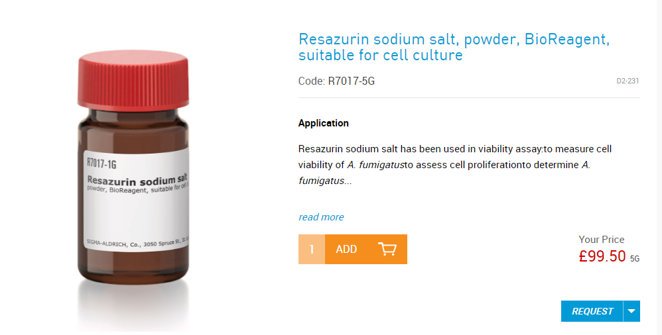

Slide 17
How to make resazurin?
Preparation of resazurin solution. The resazurin solution was prepared by dissolving a 270 mg tablet in 40 mL of sterile distilled water. A vortex mixer was used to ensure that it was a well-dissolved and homogenous solution.

Slide 18
The results showed that the resazurin colorimetric cell viability assay produces similar results to the standard method of colony-counting and giving, and also more sensitive results than the OD method. The resazurin assay can be used to quickly obtain the results of the cell viability effect profile using two different bacterial strains and several different phages at the same time, which is extremely valuable in screening studies. Moreover, this methodology is established as an effective, accurate and rapid method when compared to the ones widely used to monitor bacterial inactivation mediated by phages.

Slide 19
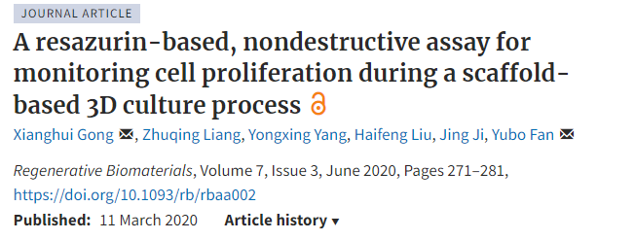
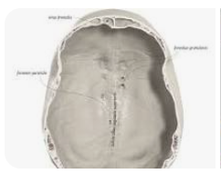
The osteoblastic cell line MC3T3-E1 has been established from a C57BL/6 mouse calvaria and selected on the basis of high alkaline phosphatase (ALP) activity in the resting state. Cells have the capacity to differentiate into osteoblasts and osteocytes and have been demonstrated to form calcified bone tissue in vitro.
The calvaria refers to the uppermost part of the skull, which acts as a protective covering for the brain by forming the roof of the cranial cavity.

Slide 21
Porcine sperm motility was assessed via resazurin reduction color change in sperm cells using a novel paper-based assay of our own design. We applied mixtures of resazurin solution and porcine semen onto hydrophilic test circles on our paper-based device and investigated the resulting reduction reaction expressed as red and blue color intensity (RBCI).

Slide 22
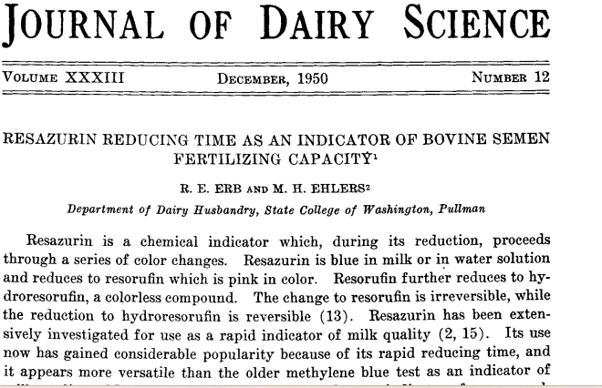

Slide 23
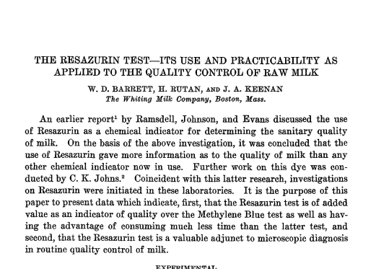

Slide 24
The objective of this study was to develop a method for a quick and reliable anticancer drug screen in 3D for tumour and human foetal brain tissue in order to investigate drug effectiveness and selective cytotoxic effects.

Slide 25
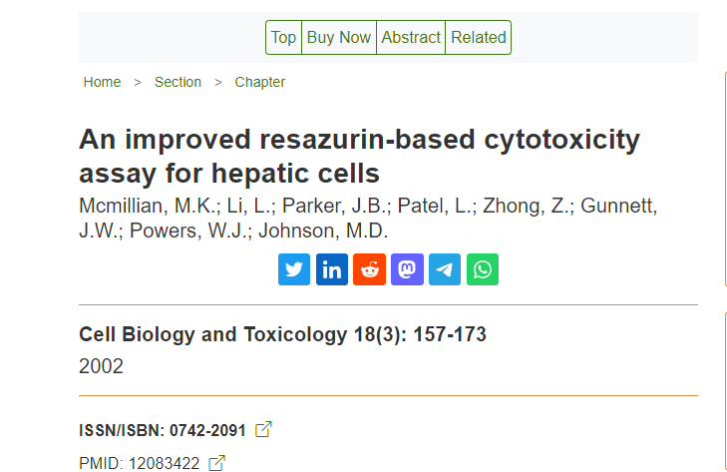
A simple resazurin-based cytotoxicity assay is presented for screening of cytotoxicity in hepatocytes and liver cell lines. Human hepatoma (HepG2) cells in 96-well culture plates were exposed to known toxic (cisplatin, 5-fluorouracil, ethionine, flufenamic acid, and diflunisal) and control (transplatin, 5-chlorouracil, methionine, and acetylsalicylic acid) compounds for 1-3 days, and resazurin (5 mumol/L) was added. A conventional short-term (1 h) assay was first performed, where cytotoxicity is indicated by decreased reduction of resazurin to its fluorescent product resorufin. Our improved assay consists of additionally measuring fluorescence 2-4 days later, when cytotoxicity is indicated by a striking increase in the concentration of resorufin, resulting from two distinct processes.

Slide 26
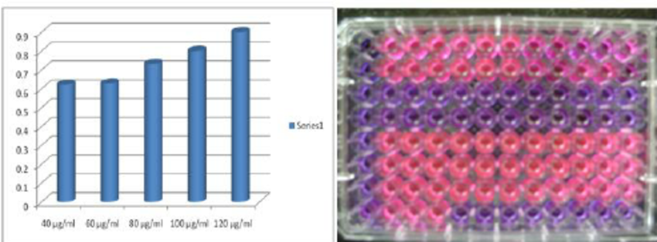

Slide 27
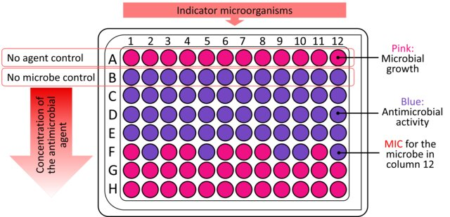
Figure 1: Resazurin assay protocol for screening and evaluation of antimicrobial activity. In the resazurin test, the antimicrobial agent is added to the wells of a microtiter plate. The plate is then inoculated with the target microorganism and incubated. Resazurin is subsequently introduced to the wells and incubated further. The color change, from blue to pink, indicates the presence of viable cells. The minimum inhibitory concentration (MIC) can be determined as the lowest concentration of the antimicrobial agent that prevents the observed color change.

Slide 28
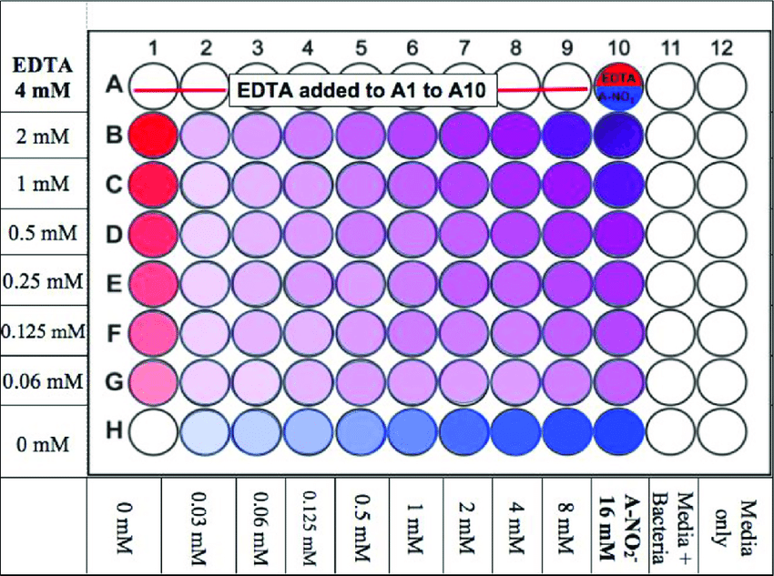

Slide 29
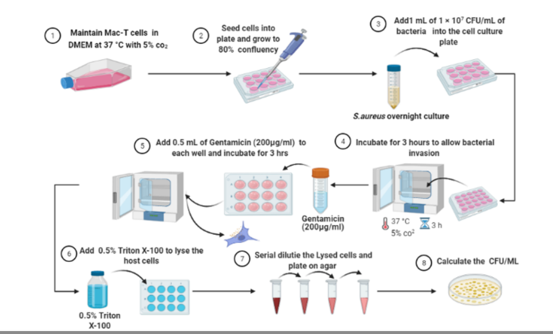

Slide 30
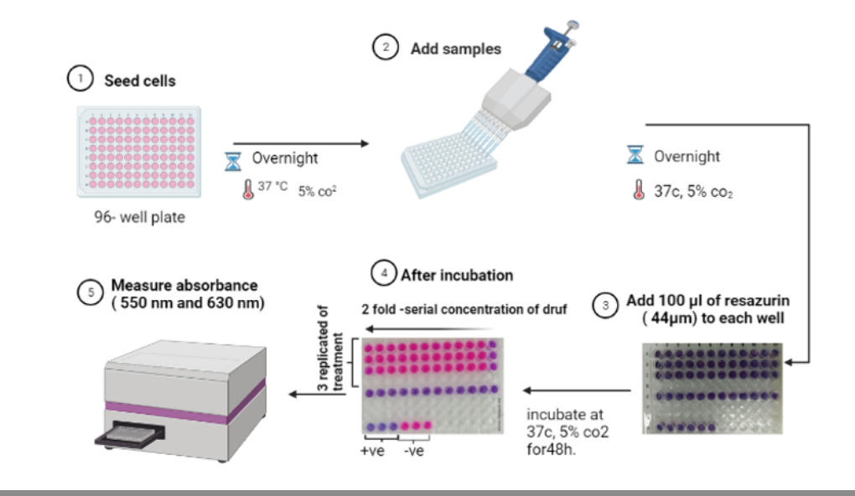

Slide 31
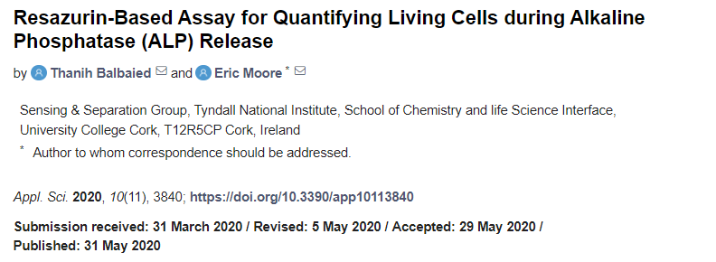

Slide 32
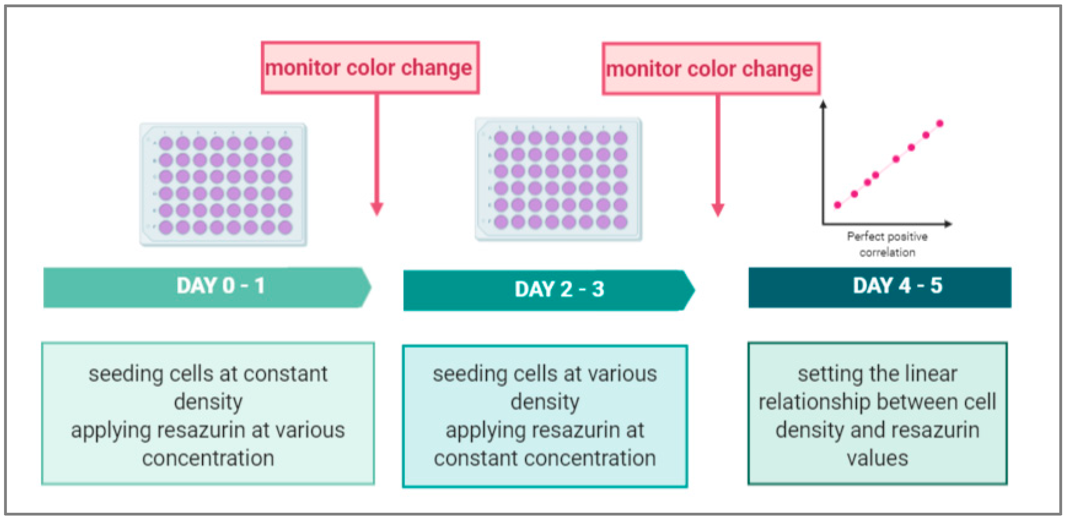

Slide 33
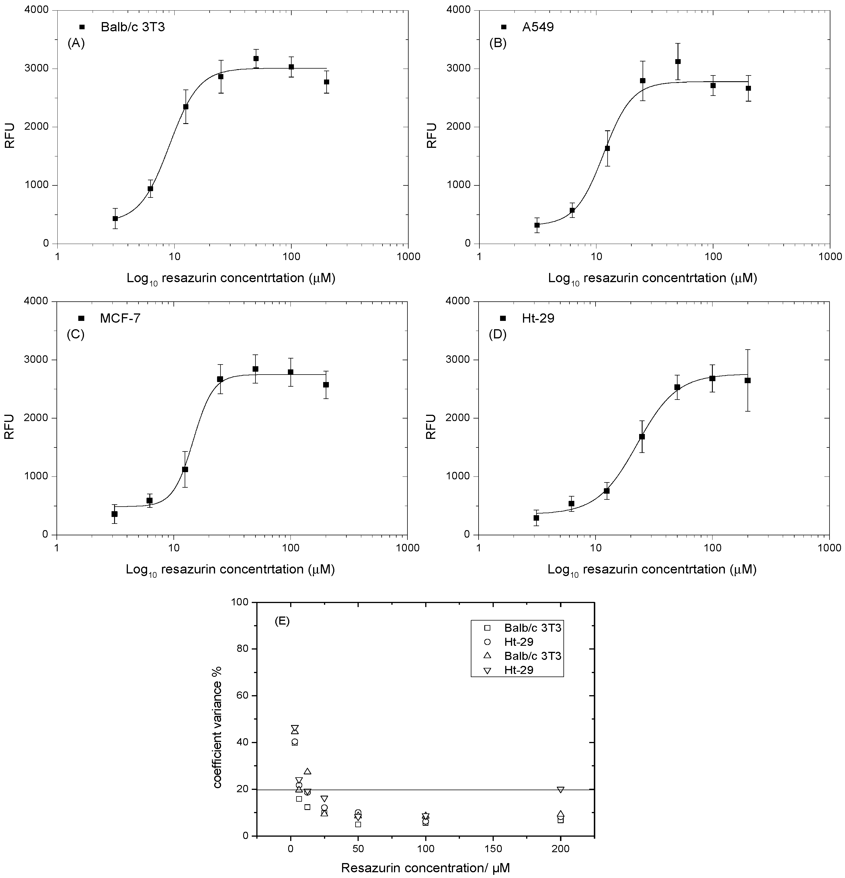
Figure 1. Optimization of the concentration of resazurin at various cell lines. (A) Balbc/3T3 cell lines; (B) A549 cell lines; (C) MCF-7 cell lines; (D) Ht-29 cell lines; (E) coefficient variance % of resazurin concentration of vs cells numbers. Data are expressed as the mean ± SD of measurements of three independent experiments.

Slide 34
Cell viability assay
To evaluate viability of HK2 and Caki-1 cells exposed to camel urines solutions for 24, 48, and 72 hours, the resazurin assay was adopted as previously described.

Slide 35
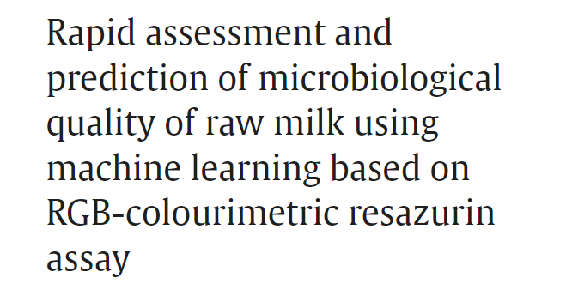
In this study, we developed a colorimetric resazurin assay and demonstrated the use of machine learning predictive modelling for screening raw milk based on microbiological quality as represented by aerobic plate counts. A colorimetric system was constructed using an ISL29125, an RGB-based colour sensor, enclosed in a new-design box applicable to a modified resazurin test performed in the six-well plate configuration.

