Slide 1
Examples of the Most Appropriate Veterinary Scientific Journals for Publishing your Research
Prepared by
Prof. Dr. Inam Jasim Lafta
PhD Molecular Biology/ Department of Microbiology, College of Veterinary Medicine/ University of Baghdad.
2022/2023

Slide 3
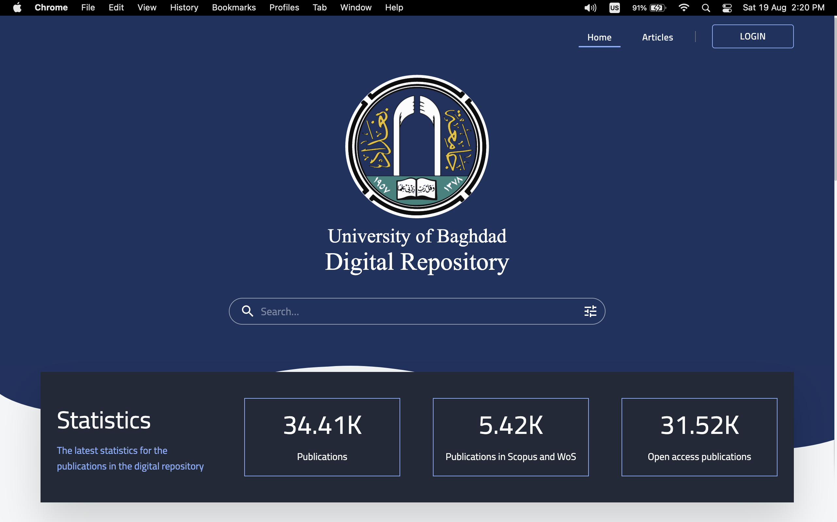

Slide 5
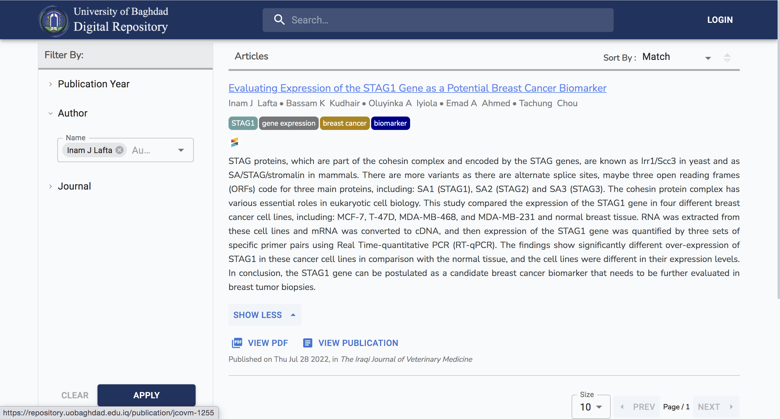

Slide 9
List of Veterinary Journals

