Slide 1

THE PUZZLE
of
VERTICAL PREPARATION
Asst. Lec. Marwah Ismael Abdulazeez
B.D.S, M.Sc (Conservative Dentistry)
Asst. Prof. Dr. Manhal Abdul-Rahman Majeed
B.D.S, M.Sc, Ph.D (Conservative Dentistry)

Slide 2
OBJECTIVES
1
Terminology & different types of vertical preparation
2
Preparation protocols
3
Tissue management, impression & provisionalization
4
Material selection, inverted cement space concept & cementation

Slide 3
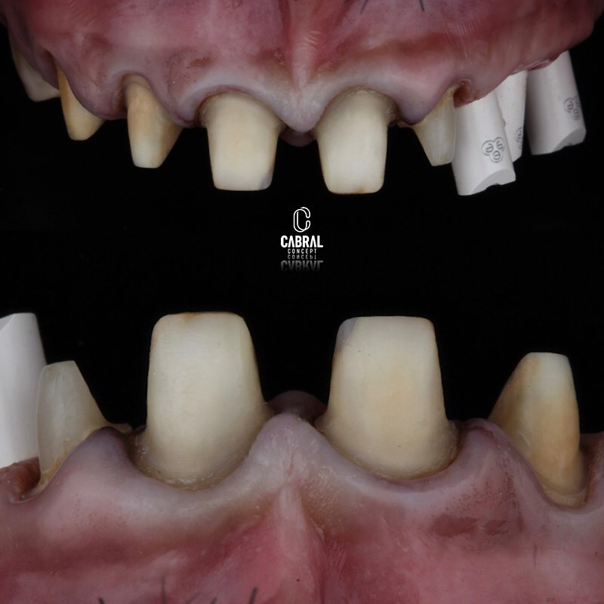
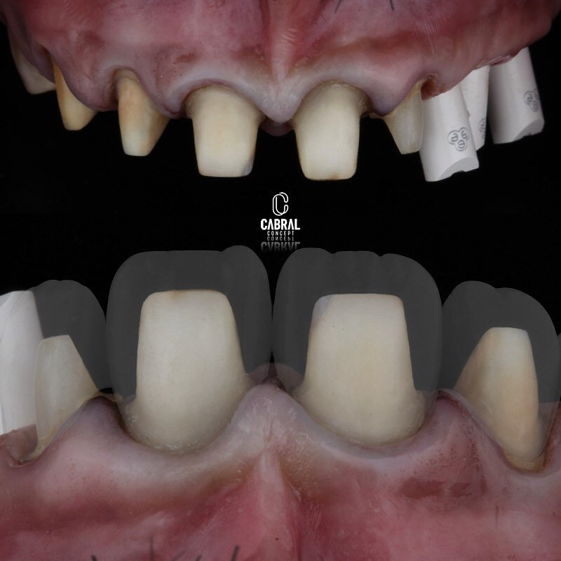


Slide 4
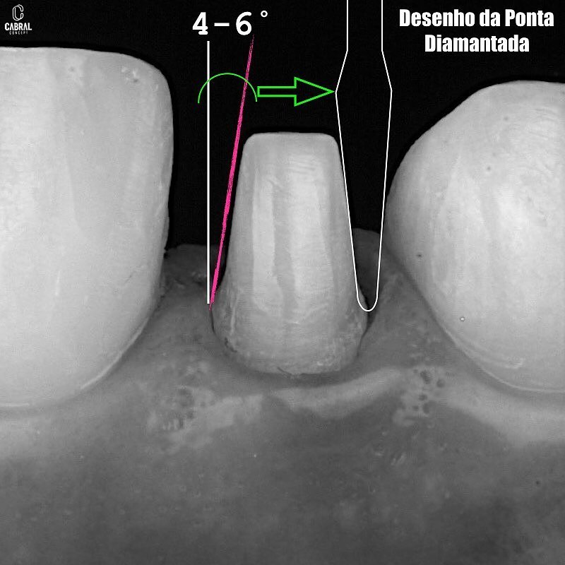
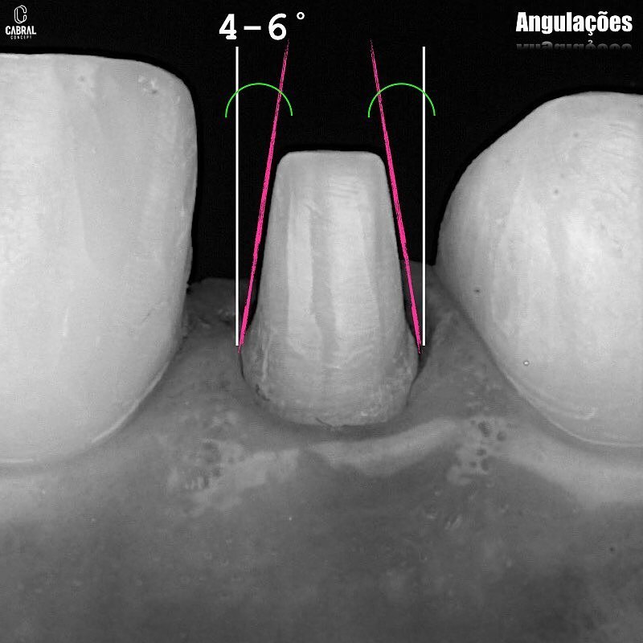

Slide 5
“Horizontalists” authors claim for the following alleged advantages:
1 - Avoiding overhangs
2 - Avoiding horizontal and vertical over-contouring
3 - Respecting of the biologic width
4 - Finish line capturing and determination on the die
5 - Better lab-clinician workflow
ADVANTAGES
Ramos et al. (2017)

Slide 6
1. Hypersensitivity, inflammation, pulp necrosis, endodontic treatment in the future.
Foster in 1990 found that 21 % of endodontic complication related to FPD after 6 years.
DRAWBACKS
Cheung in 2005 found that 15-years survival probability of vital pulp was:
81.2% in metal-ceramic single crowns
66.2% in FDP abutments.
Van Dijken and Hasselrot in 2010 found that all-ceramic partial coverage crowns have no or a very low endodontic complication between 7 and 12.6 years compared with metal-ceramic complete coverage crowns.

Slide 7
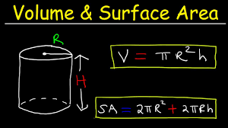
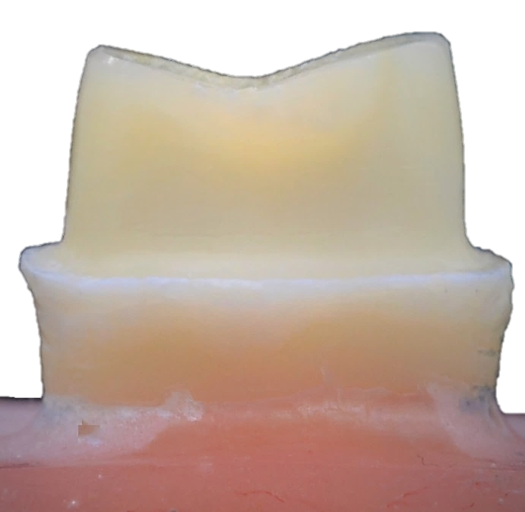
2. Loss of hard tooth tissue
Reduction of 1 mm in the radius of a cylinder from 4.5 mm to 3.5 mm will result in a surface area reduction of 40%.
Shoulder preparation requires a minimum of 1 mm in tooth reduction at the cervical level.
DRAWBACKS
Assume for a moment a shoulder preparation for a porcelain jacket crown on a 10-mm diameter root of a maxillary central incisor with a 1-mm diameter pulp. A shoulder preparation 1 mm in depth will result in 40% decrease in surface area (bulk) of the tooth at the finish line, compared to 20% reduction in bulk that can result from 0.5 mm finish line depth (Ramos et al., 2017).

Slide 8
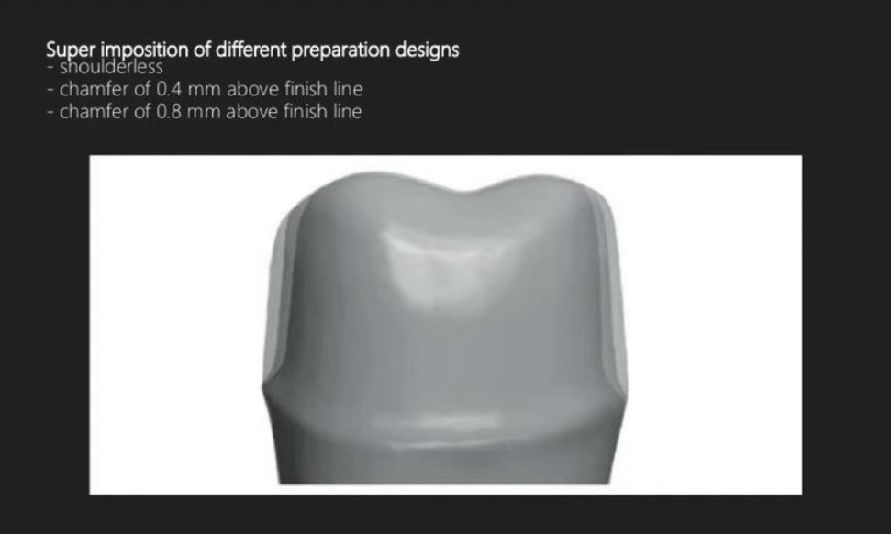
3. Lack of ferrule (tooth structure removal and stress concentration)
Increasing the finish line depth from 0.5 mm to 1 mm will result in 50% reduction in shear strength of the prepared tooth. Based on this example, shoulder preparations should be abandoned in favor of a shallow finish line preparation to preserve tooth bulk and maximize tooth resistance to cervical fractures. Failure in bending (snap-off) is most likely to occur as the shoulder acts as a stress concentration point.
DRAWBACKS

Slide 9
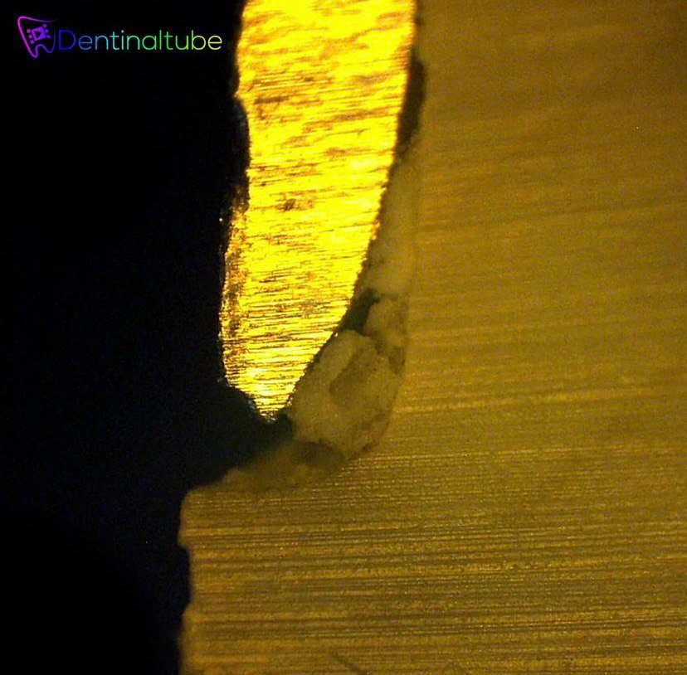
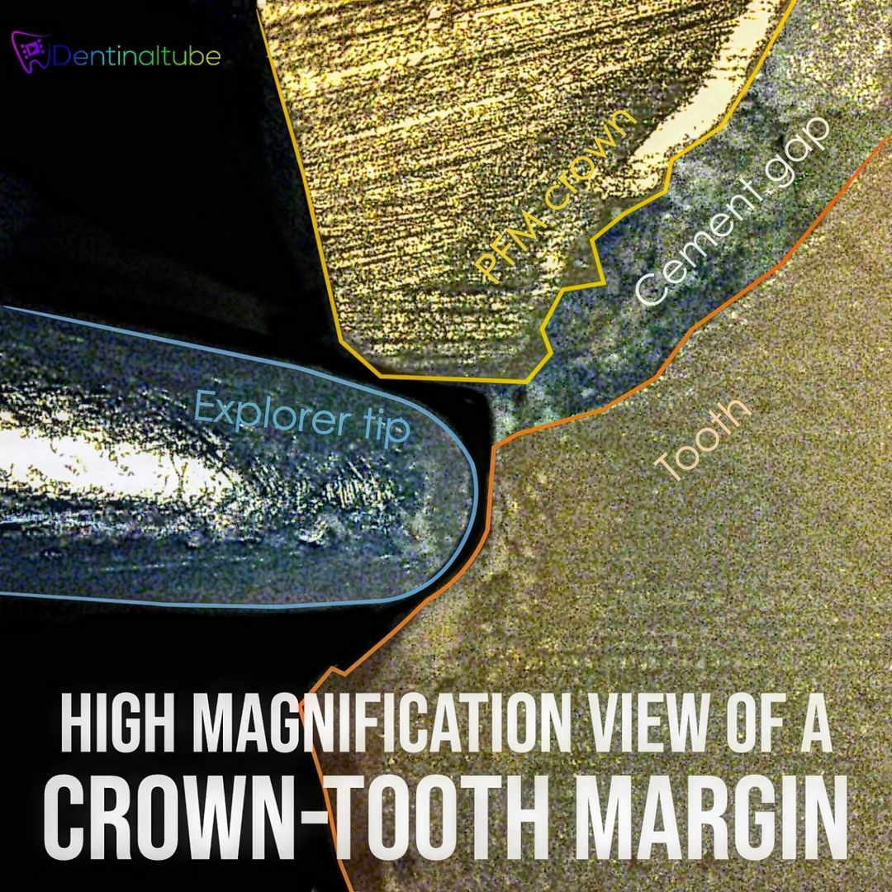
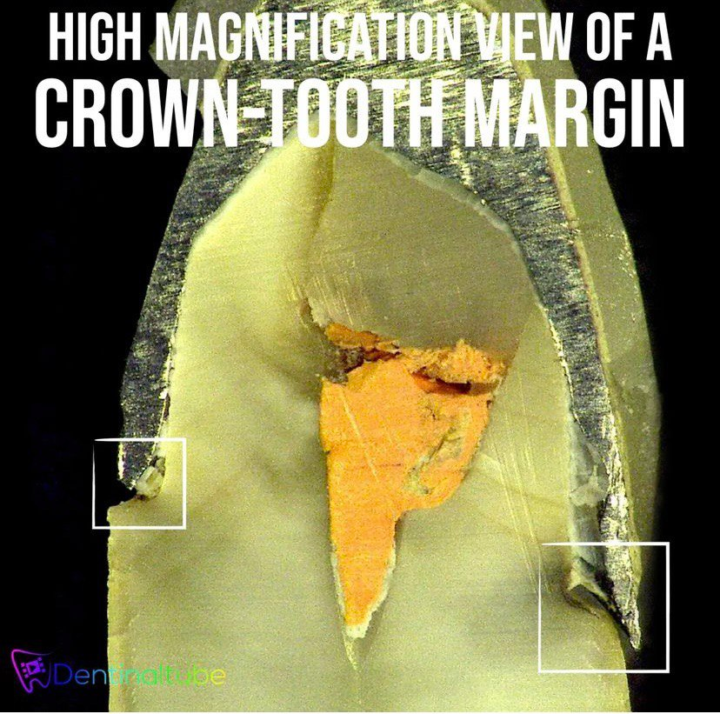
4. Incomplete seating
DRAWBACKS

Slide 10

TERMINOLOGY
BOPT
FEATHER EDGE
EDGELESS
SHOULDERLESS
VERTI PREP
VERTICAL PREPARATION

Slide 11
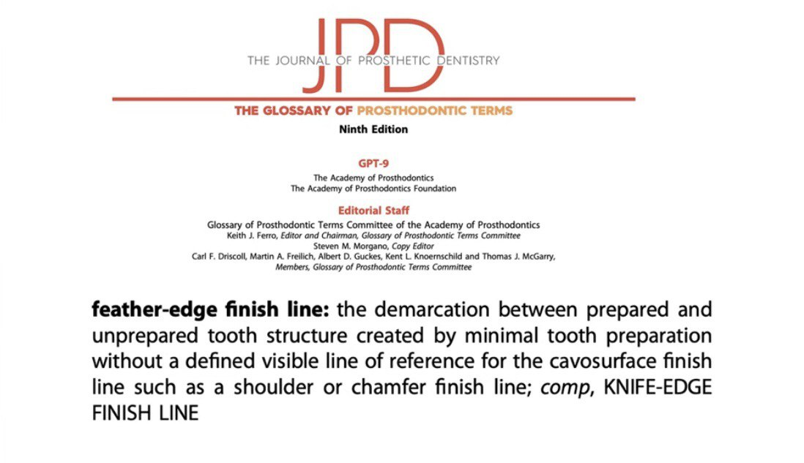

Slide 12
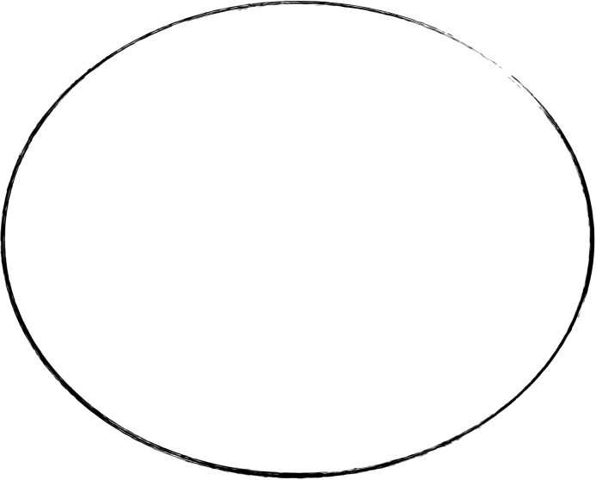
TYPES OF VERTICAL PREPARATION
Edgeless
Soulderless

Slide 13
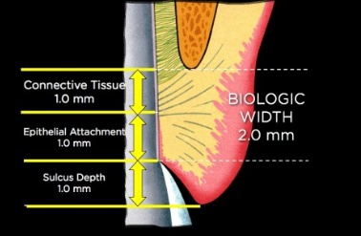
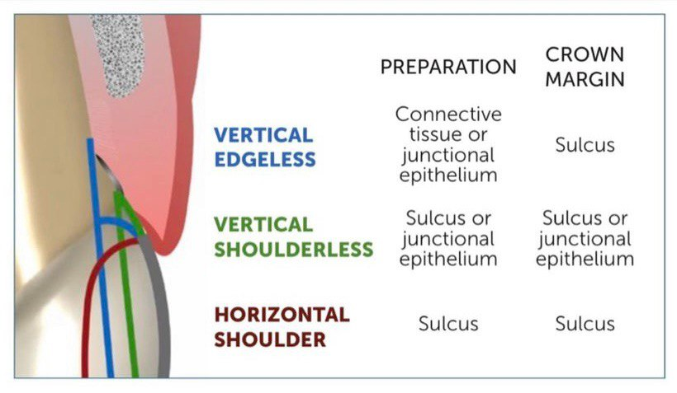
Cardoso et al 2023

Slide 14
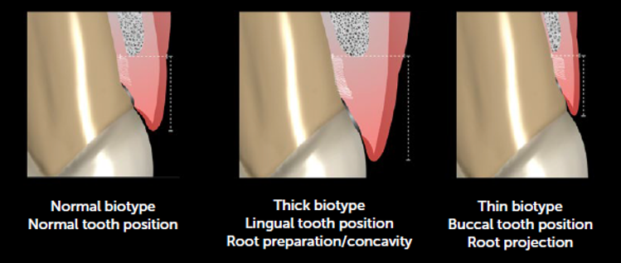
Cardoso et al 2023

Slide 15
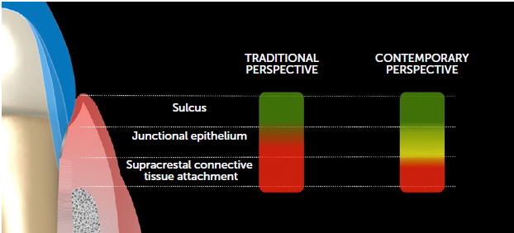
Cardoso et al 2023

Slide 16
Cardoso et al 2023
Shoulderless
Edgeless

Slide 17
EDGELESS
BOPT
The edgeless approach (gingitage) born by Vick Pollard and Rex Ingraham, then modified by Morton Amsterdam, and later by Di Febo & Carnevale (Mascarella’s school) and recently by Ignazio Loi as BOPT.
BOPT
The clinical crown does not match the anatomical crown (periodontal disease) on root area.
Amsterdam et al. (1963)
Di febo et al. (1985)
Davide (2012)
Loi (2013)

Slide 18
BOPT
The biologically oriented preparation technique (BOPT) was introduced in 2008 with the goal of promoting periodontal tissue stability in the short and long terms.
The BOPT consists of a set of procedures including vertical preparation of the tooth and periodontal tissues with immediate placement of an interim prosthesis.
In BOPT, during tooth preparation, the rotary instrument interacts with the tooth surface and the epithelial and/or connective tissue component of the periodontal attachment, reducing the convexity of the crown and regularizing the sulcular and junctional epithelium.
The bleeding caused by the rotary instrument generates a clot, a precursor of new supracrestal tissue, which should be placed in contact with the anatomic margin of the interim prosthesis.

Slide 19
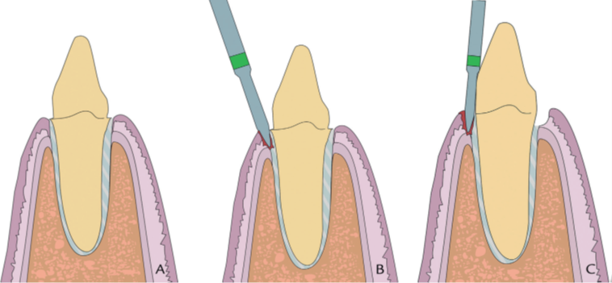
A. Extra Gingival Part Preparation
Horizontal preparation with chamfer finishing line
B. Internal Wall Preparation
Flame diamond rotary instrument (862.514.012 BOPT drills, particle size of 100/120 and a diameter of 1.2 mm), held at 15 degree angulation to eliminate 1mm of anatomical emergence, then placing the bur parallel to long axis of tooth.
BOPT PREPARATION
Agustín-Panadero and Solá-Ruíz (2015)

Slide 20
C. Gingitage
The tooth and gingiva are prepared. Rotary instrument prepares the area just up to CEJ. At this stage all emergence profile is removed (CEJ at the interface between junctional epithelium and connective tissue). Simultaneously, the epithelium is removed from the sulcus and JE. The preparation is refined with 20 µm bur.
The blood clot formed at the apical level of the preparation stimulates fibroblast differentiation and gingival tissue growth. The interim restoration will stabilize the clot.
BOPT PREPARATION
Agustín-Panadero and Solá-Ruíz (2015)

Slide 21
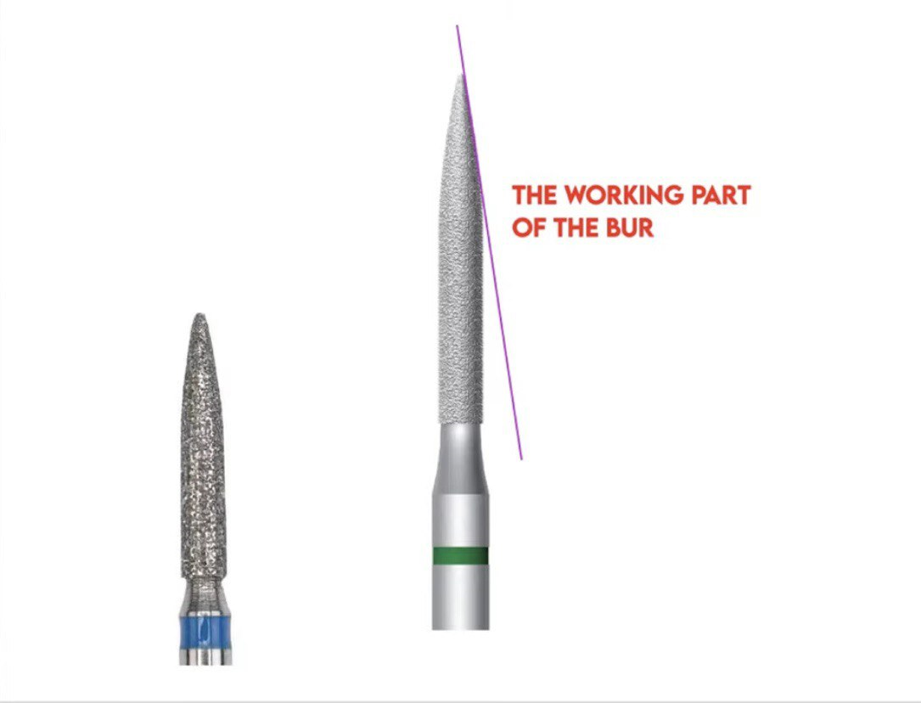

Slide 22
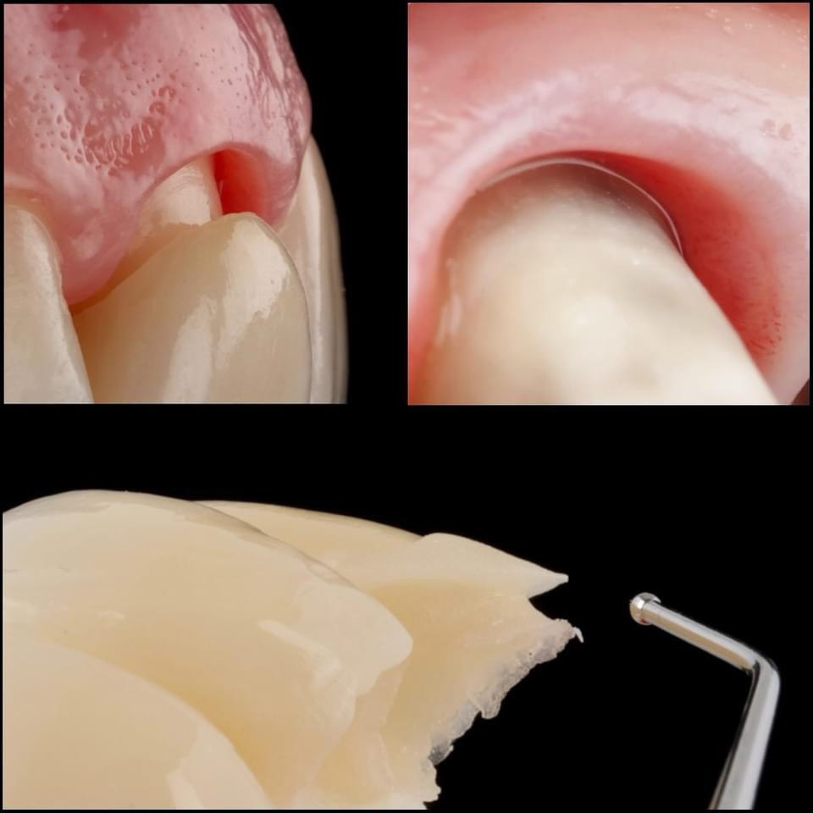

EDGELESS (BOPT) IN THE ANTERIOR REGION
-It allows some degree of change in the soft tissue position and maximizing its stability.
-The margin is usually non-visible (feather-edge).
-Provisionalization step will create a new, ‘prosthetic CEJ’ to guide the soft tissue healing for 6 weeks.
BOPT PREPARATION
-Impression at 6 weeks with healed tissue. Traditional double cord for soft tissue retraction.
-No margin is visible, therefore the ceramist is instructed to leave the margin in the sulcus and create a ‘prosthetic CEJ’ similar to the provisional.
-Initial preparation is deeper than the area covered by the final crown, which will increase the horizontal component of the supracrestal attachment, maximizing its stability.

Slide 23
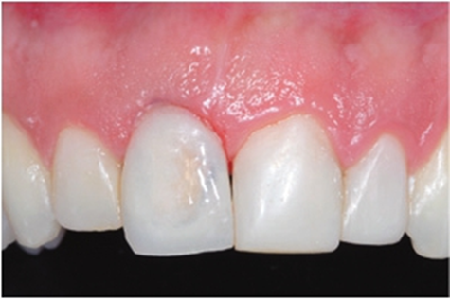
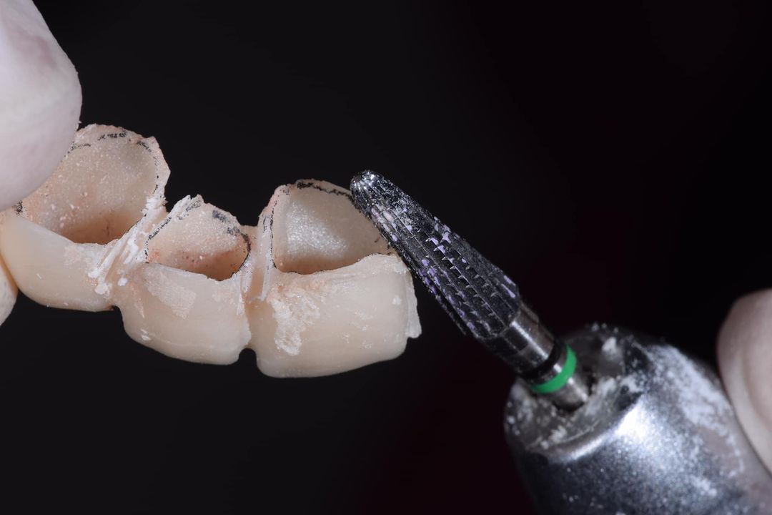
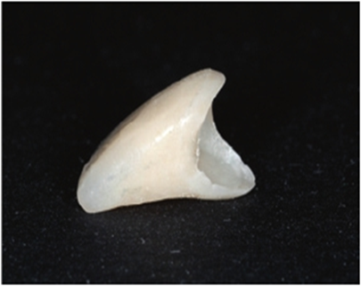
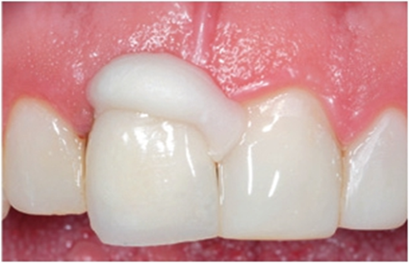
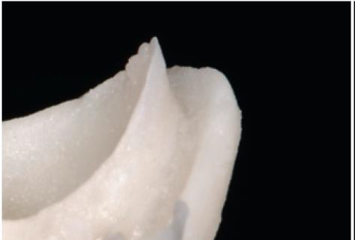
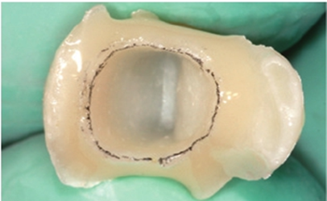
The power of temporary crown.
Healing and thickening of gingival tissue.
Over and under contouring control.
A hollowed acrylic resin crown, prefabricated prior to preparation, is relined with cold cure metacrylate resin.
Two distinct margins after setting.
Filling of the space with flowable resin.
Excess material removed and joining the margins and final shaping of the crown.
PROVISIONALIZATION

Slide 24
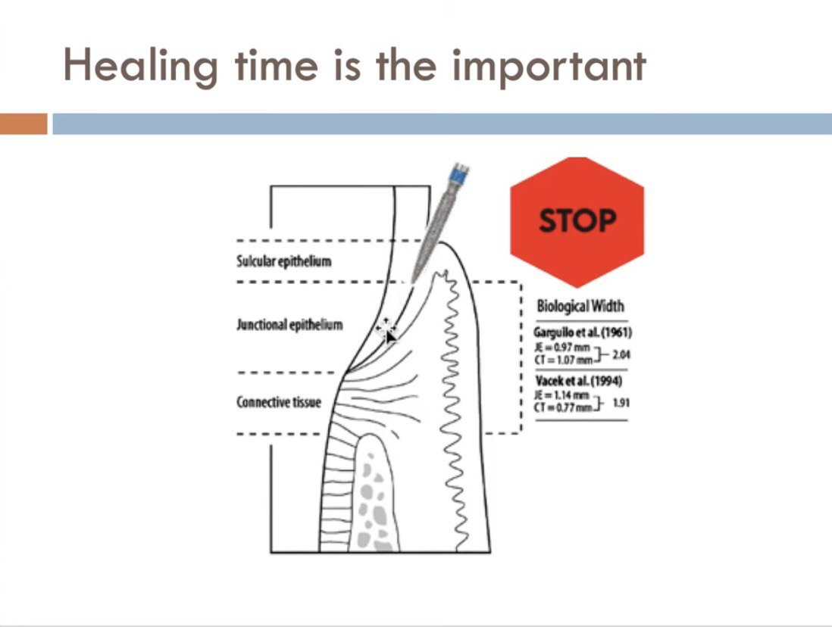
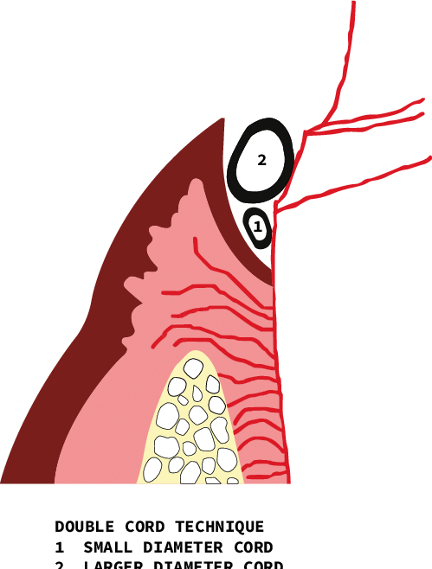
4-6 weeks
DOUBLE CORD
IMPRESSION TAKING

Slide 25
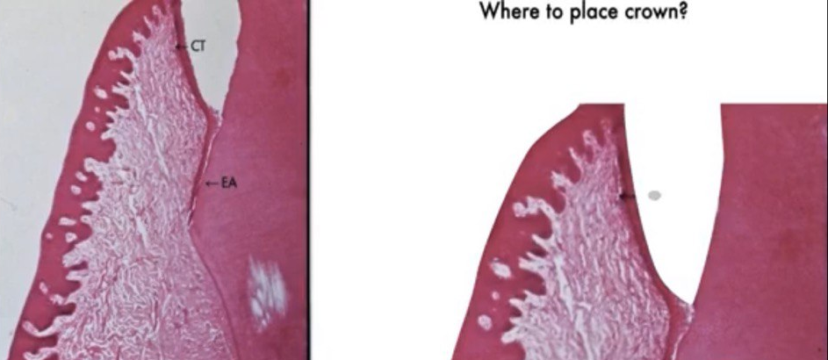
BOPT / edgeless
Finishing Area
?
Where to place the crown margin

Slide 26
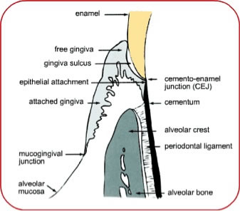
Vertical Termination
Correction of the anatomic (CEJ) in non-prepared and old finish line in a prepared tooth.
Repositioning of a “Prosthetic” finish line (controlled invasion into the sulcus, 0.5- 1mm).
Adaptation of emergence profile to the anatomy of the new prosthetic cemento-enamel junction (PCEJ) ( Loi and Felice, 2013).

Slide 27
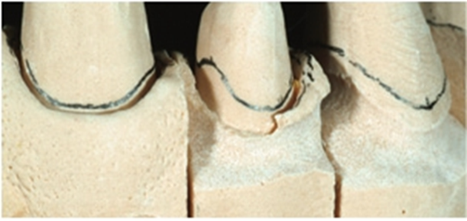
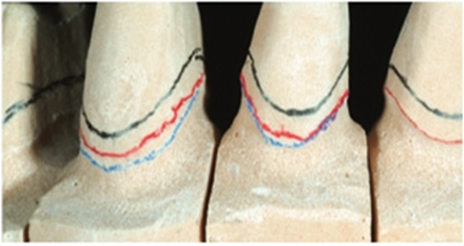
BLACK LINE
BLUE LINE
RED LINE
LAB PROCEDURE

Slide 28
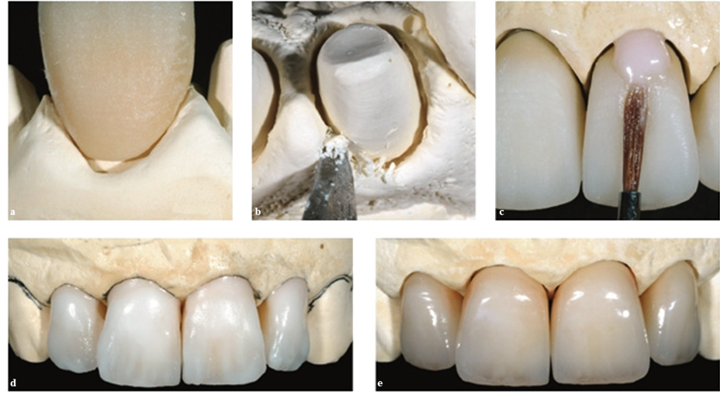
Detection of the finish line depends on esthetic needs and sulcus depth
LAB PROCEDURE

Slide 29
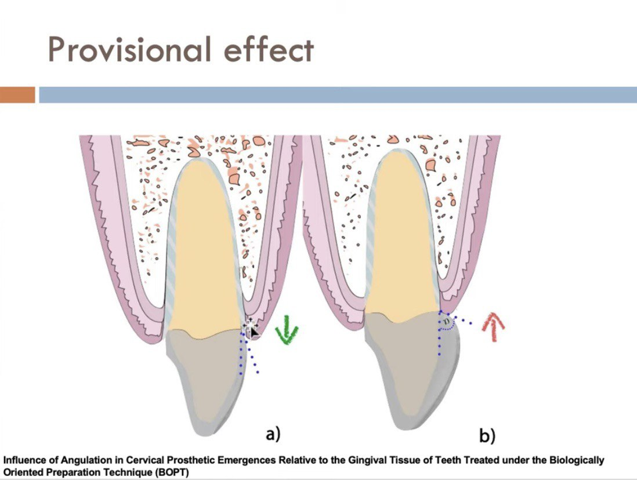

Slide 30
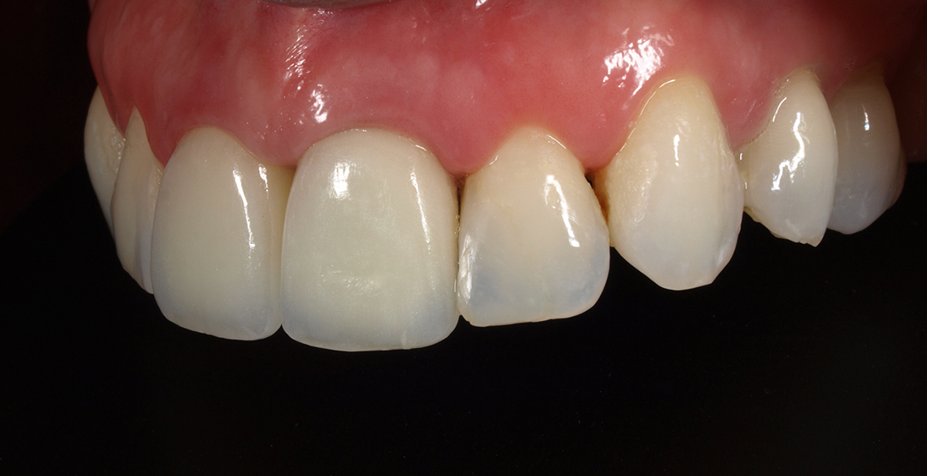
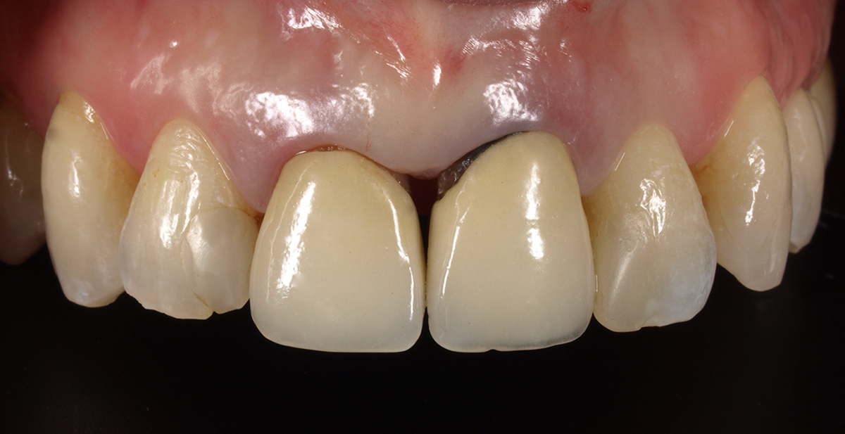

Slide 31
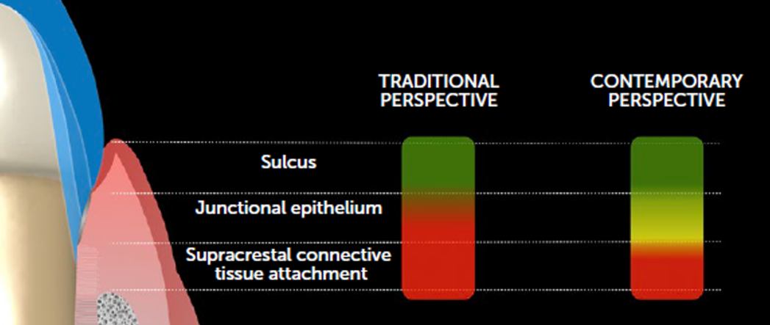
EDGELESS IN THE POSTERIOR REGION
To save severely compromised teeth, to increase ‘ferrule’ subgingivally
Periodontal risks are balanced with the alternative of tooth removal
Burs with an active tip
Significant bleeding due to disruption of the soft tissue
Provisional is advised not to reach the margin to allow faster healing
During placement, the healed gingiva will be repositioned prosthetically
BOPT PREPARATION
Cardoso et al 2023
Risk potential of periodontal damage of the marginal placement relative to the dentogingival unit. A margin placed on the junctional epithelium may eventually be well tolerated, depending on the material used, the marginal gap dimensions, and the gingival biotype (CARDOSO et al., 2023)

Slide 32
EDGELESS IN THE POSTERIOR REGION
Same-day impression is advisable to immediately capture deeper areas because the tissue will rebound after healing
Electrocautery and hemostasis agents such as aluminum chloride
No cords or tape to capture deep areas to maximize ‘ferrule’
Supracrestal tissue attachment is intentionally removed to expose areas for ‘ferrule’
Junctional epithelium and bone may be captured during impression
Margin into the junctional epithelium area
BOPT PREPARATION
Cardoso et al 2023

Slide 34
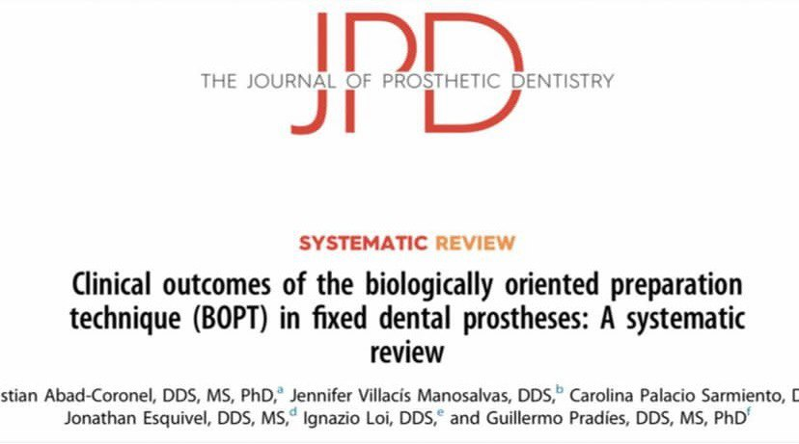
Regarding prosthesis survival rates, Serra-Pastor et al. reported a survival rate of 96.5% at a 4 year follow-up, while Agustin-Panadero et al. reported a survival rate of 100% at 5 years. Based on these 2 studies, BOPT appears to have a high survival rate when used as a restorative therapy.
Agustin-Panadero et al. suggested that, with BOPT, the healed gingival tissues are modeled according to the shape of emergence of the prosthesis and are structurally equivalent to normal periodontal tissue, which promotes a healthy environment free of inflammation.

Slide 35
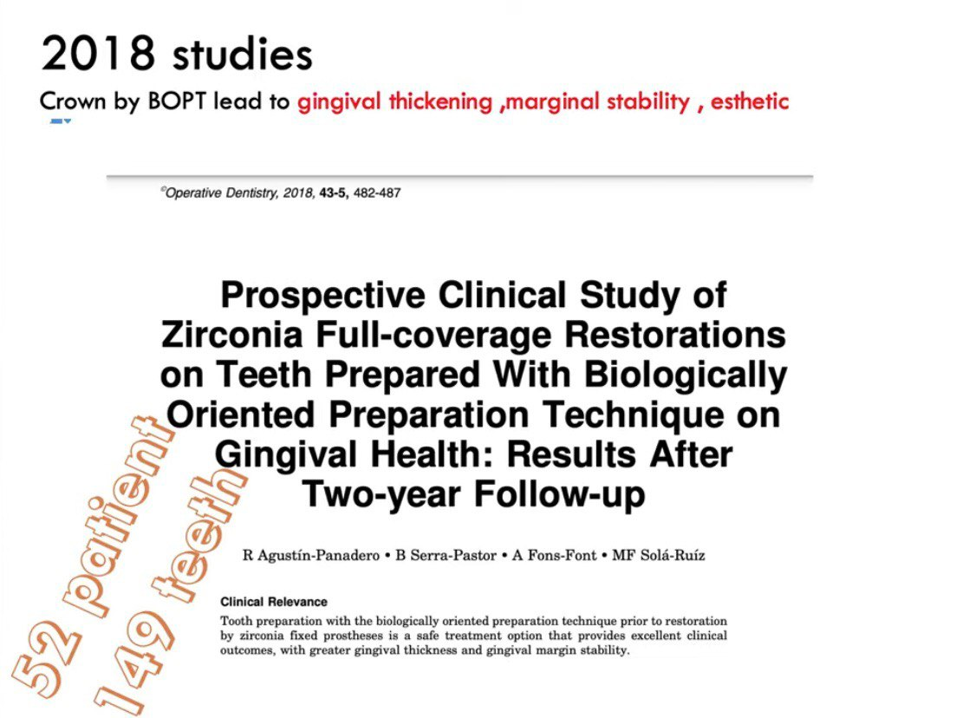
Crown by BOPT lead to gingival thickening , marginal stability, and esthetic.

Slide 36
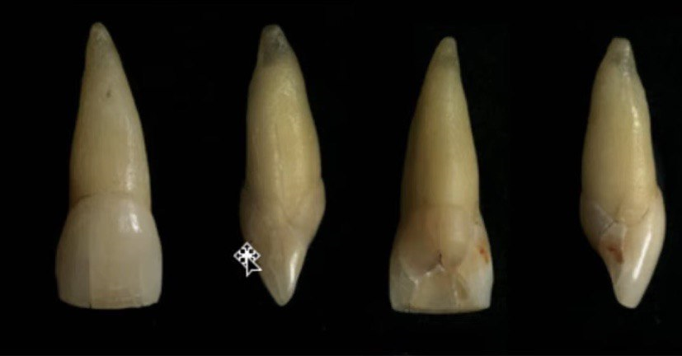
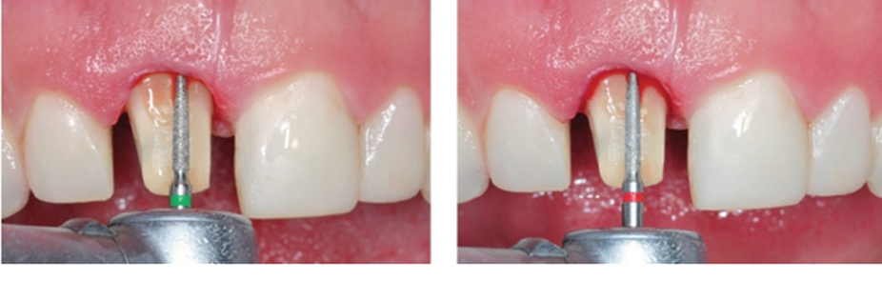
On the basis of prevailing thought, the academic world has unanimously considered the vertical preparation an incorrect approach.
1- Unavoidable overhangs
2- Unavoidable over-contouring
3- Uncontrolled invasion of the gingival sulcus and biologic width
4- Profuse bleeding
BOPT DRAWBACKS
5- Four to six weeks waiting/healing period prior to impression
6- Unpredictable soft tissue regeneration
7- Time consuming trial and error on temporaries during the healing period
8- Difficulty of capturing and determining a finishing line on the die
9- More difficult lab-clinician workflow
Ramos et al 2017

Slide 37
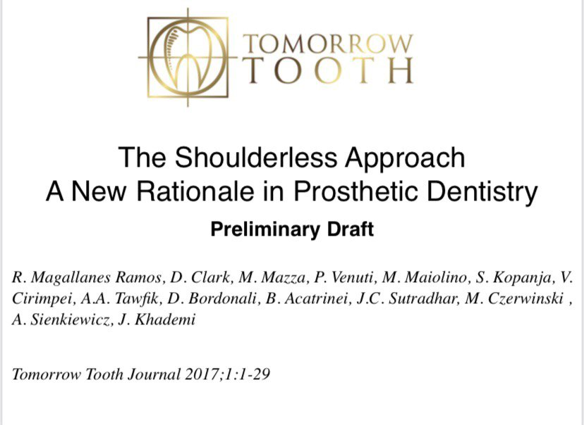
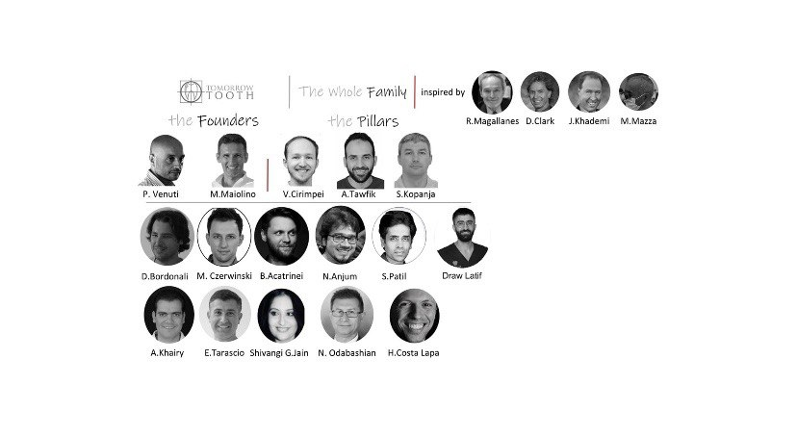
SHOULDERLESS

Slide 38

Shoulderless
BOPT

Slide 39
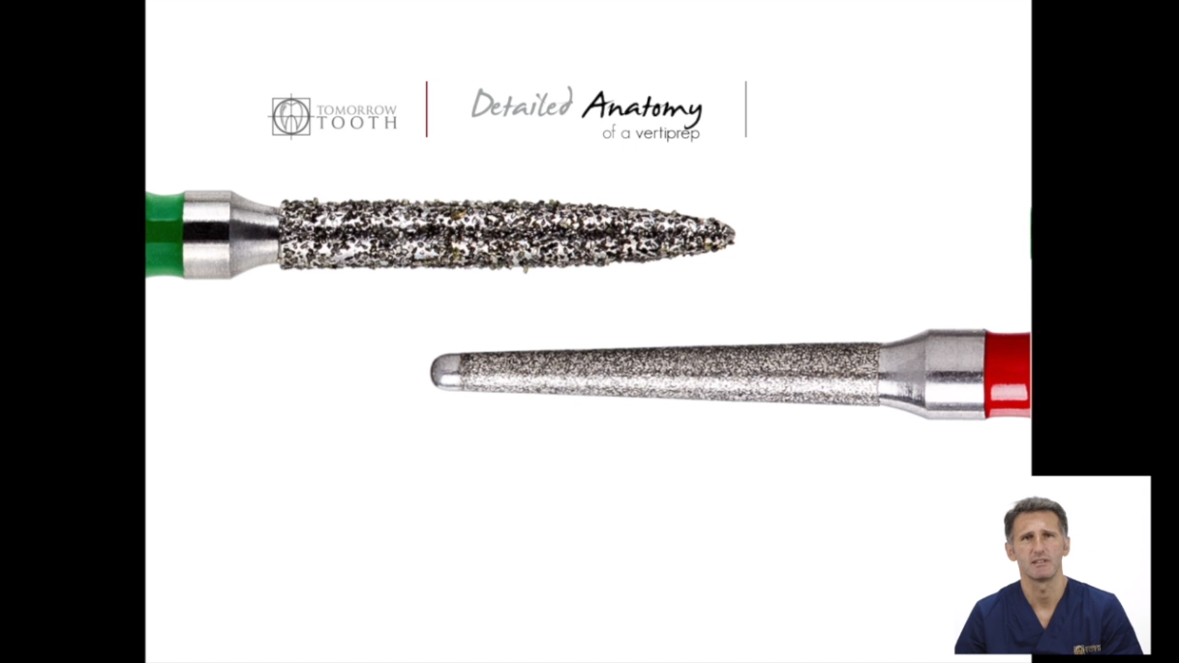
BATT BUR
The Game Changer

Slide 40
Non-cutting end of 1 mm.
2 degrees taper, so no undercut formation.
Coronal diameter of 1.2 mm and apical diameter of only 0.7 mm, which facilitates a very conservative approach.
A. No damage to CTA.
B. Guiding.
BATT BUR ADVANTAGES
C. Facilitates preparation.
D. Bloodless gingitage.
E. Acts as a periodontal probe.
F. Immediate impression if healthy tissue available.
G. Preparing in the presence of cord or teflon.
Ramos et al 2017

Slide 41
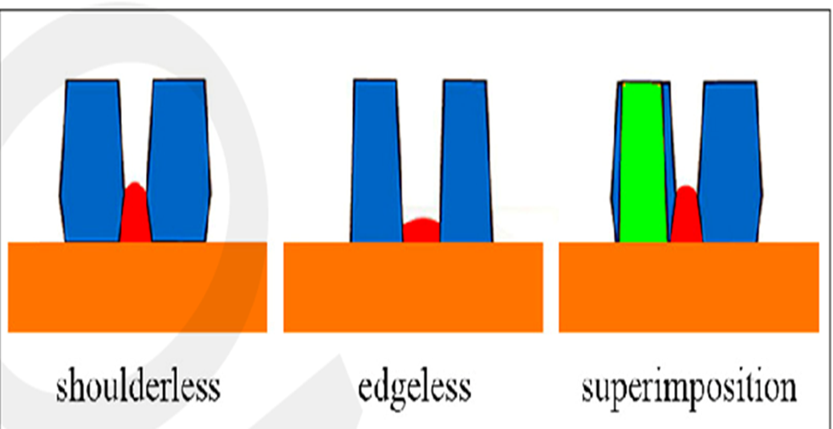
-Non-active tip, so not touching the first millimeter of root cementum.
-No or little bleeding (curettage just within the epithelial tissue).
-Saving the whole dentin thickness and part of enamel for good bonding, stress distribution and less sensitivity.
BATT BUR ADVANTAGES
-No need for IDS.
-Maintenance of the non-prepared area of the tooth and saving root convergence with neighboring tooth.
Ramos et al 2017

Slide 42
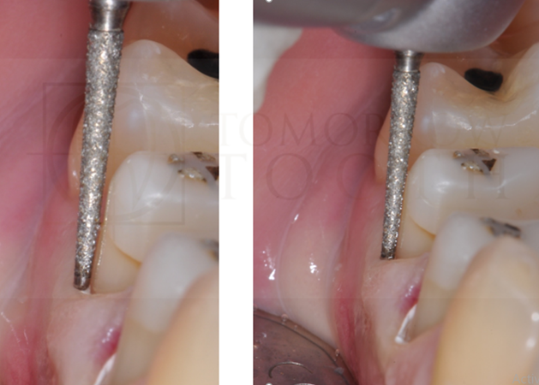
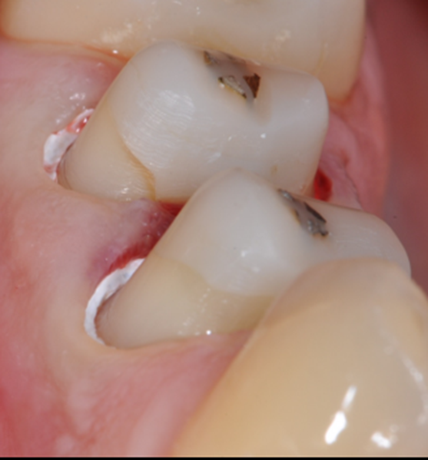
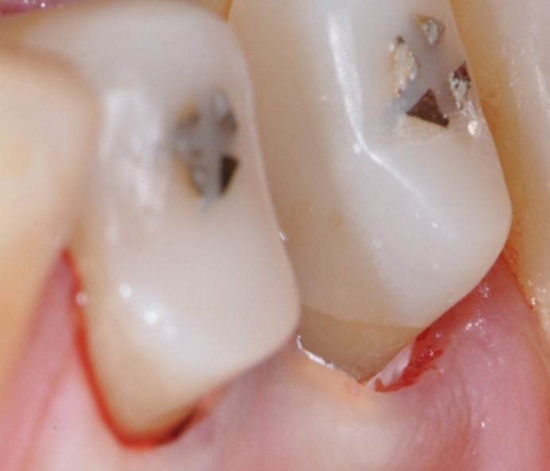
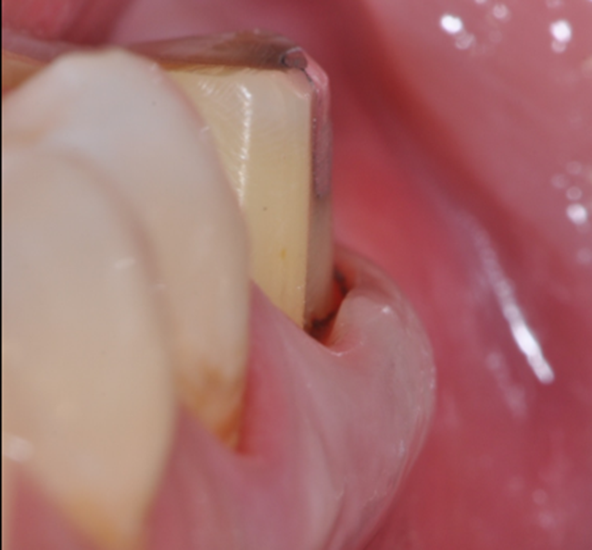
As a first-option alternative to a shoulder or chamfer in posterior crowns
Burs with an inactive tip to reduce the risk of undercuts, avoid supracrestal connective tissue attachment violation
The use of soft tissue retraction with Teflon tape during preparation has also been suggested for further protection of bur action and to facilitate the impression
Impressions can take place on the same day, and the resulting margin remains no deeper than the sulcus or junctional epithelium, avoiding connective tissue attachment
SHOULDERLESS
The marginal edge, 0.2 mm has been considered the maximum thickness

Slide 43
Cardoso et al 2023

Slide 44
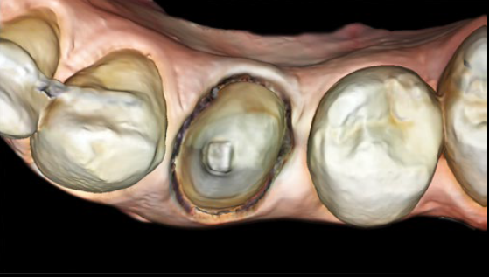

Slide 45
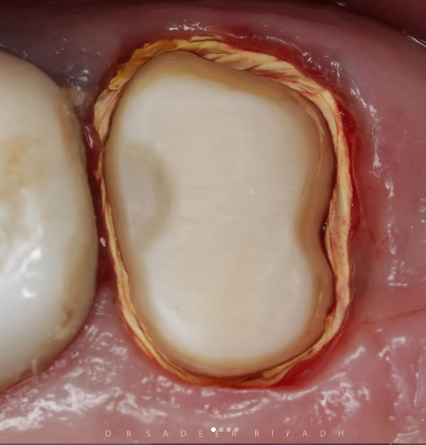


Slide 46



Slide 47



Slide 48


The vertical preparation is modified with a reverse shoulder at the buccal surface of the abutment tooth.
Aesthetics
Aesthetics
Biomechanics

Slide 49

Monolithic zirconia crowns with chamfer margins showed the least marginal accuracy.
The modification of the vertical preparation with a reverse shoulder provided a significantly better marginal adaptation of the zirconia crown than that of crowns prepared with vertical preparation only and horizontal preparation.
Modification of the vertical preparation with a reverse shoulder increased the fracture strength of monolithic zirconia crowns with vertical preparation up to the point that it becomes non-significant with chamfer preparation.

Slide 50






TOOTH PREPARATION
Horizontal Preparation
Vertical Preparation
Modified Vertical Preparation
Reverse shoulder
1.0 mm
Chamfer
0.8 mm

Slide 51


Marginal Adaptation
The more the restoration margin ends with an acute angle, the shorter the distance between the restoration margin and the tooth (Shillingburg et al., 1997).

Slide 52
The reverse shoulder increased the surface area of the preparation which results in a more spacer and consequently less friction between the tooth and crown which could improve seating and enhance the fitness of restoration.

Slide 53


Fracture Strength
The increased thickness of the restoration carries the occlusal forces and results in less stress concentration on axial walls of the substrate (Miura et al., 2018).

Slide 54

The fracture loads obtained with the modified vertical preparation were higher than with the vertical group, the reverse shoulder allowing more thickness of material which results in more favorable stress distribution.

Slide 55

CEMENT SPACE
cement spacer
hydraulic pressure
no spacer
-Improves the crown seating
-Reduces internal friction
-Improves cement escape
-Reduces cement film thickness
-Increases crown retention

Slide 56

INVERTED CEMENT SPACE
The cement gaps of zero at the margin should not be implemented since this will prevent the complete seating of the crown. This happens because the cement escape toward the margin will be blocked when the crown first touches the preparation in the cervical area where there is no space, causing a marginal gap
When the marginal area is relieved with a spacer and the occlusal area is not relieved to assure a stable stop, this will promote a better cement escape, and better seating will be achieved both internally and at the margins
The marginal and axial die spacer 25 to 40 μm and no spacer in the occlusal area

Slide 57
INVERTED CEMENT SPACE

Slide 58


INVERTED CEMENT SPACE

Slide 59
MATERIAL SELECTION

Slide 60

MATERIAL
MONOLITHIC
ZIRCONIA

Slide 61


Slide 62



Slide 63



Slide 64



Slide 65
I. Adhesive resin cements
-APC protocol
-Work even in non-retentive preps
II. Self-adhesive resin cements
-Used for resistive preparations such as crowns
-Simplified protocol (without the need for dentin preconditioning)
-They can have high tolerance to some degree of moisture and rubber dam isolation is therefore not mandatory
CEMENTATION PROTOCOL
III. Resin-modified GIC cement
-It is recommended in cases of deep subgingival margins with wet surfaces

Slide 66





2018

Slide 67


4 years follow up
6 years follow up

Slide 68


Slide 69

Thank You

