Slide 1

Recovery of bovine Babesia spp. after long-term cryostorage and comparison of bovine donor erythrocytes and serum
Lec. Amer Rasool Alhaboubi BSc, DVM, MSc, PhD
Dep. of Parasitology
University of Baghdad
Dr. Amer r. Alhaboubi

Slide 2
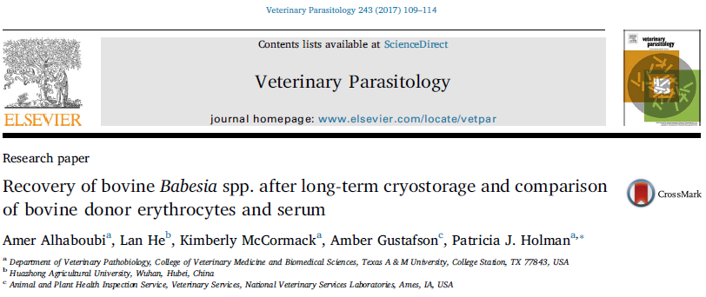
Dr. Amer r. Alhaboubi

Slide 3
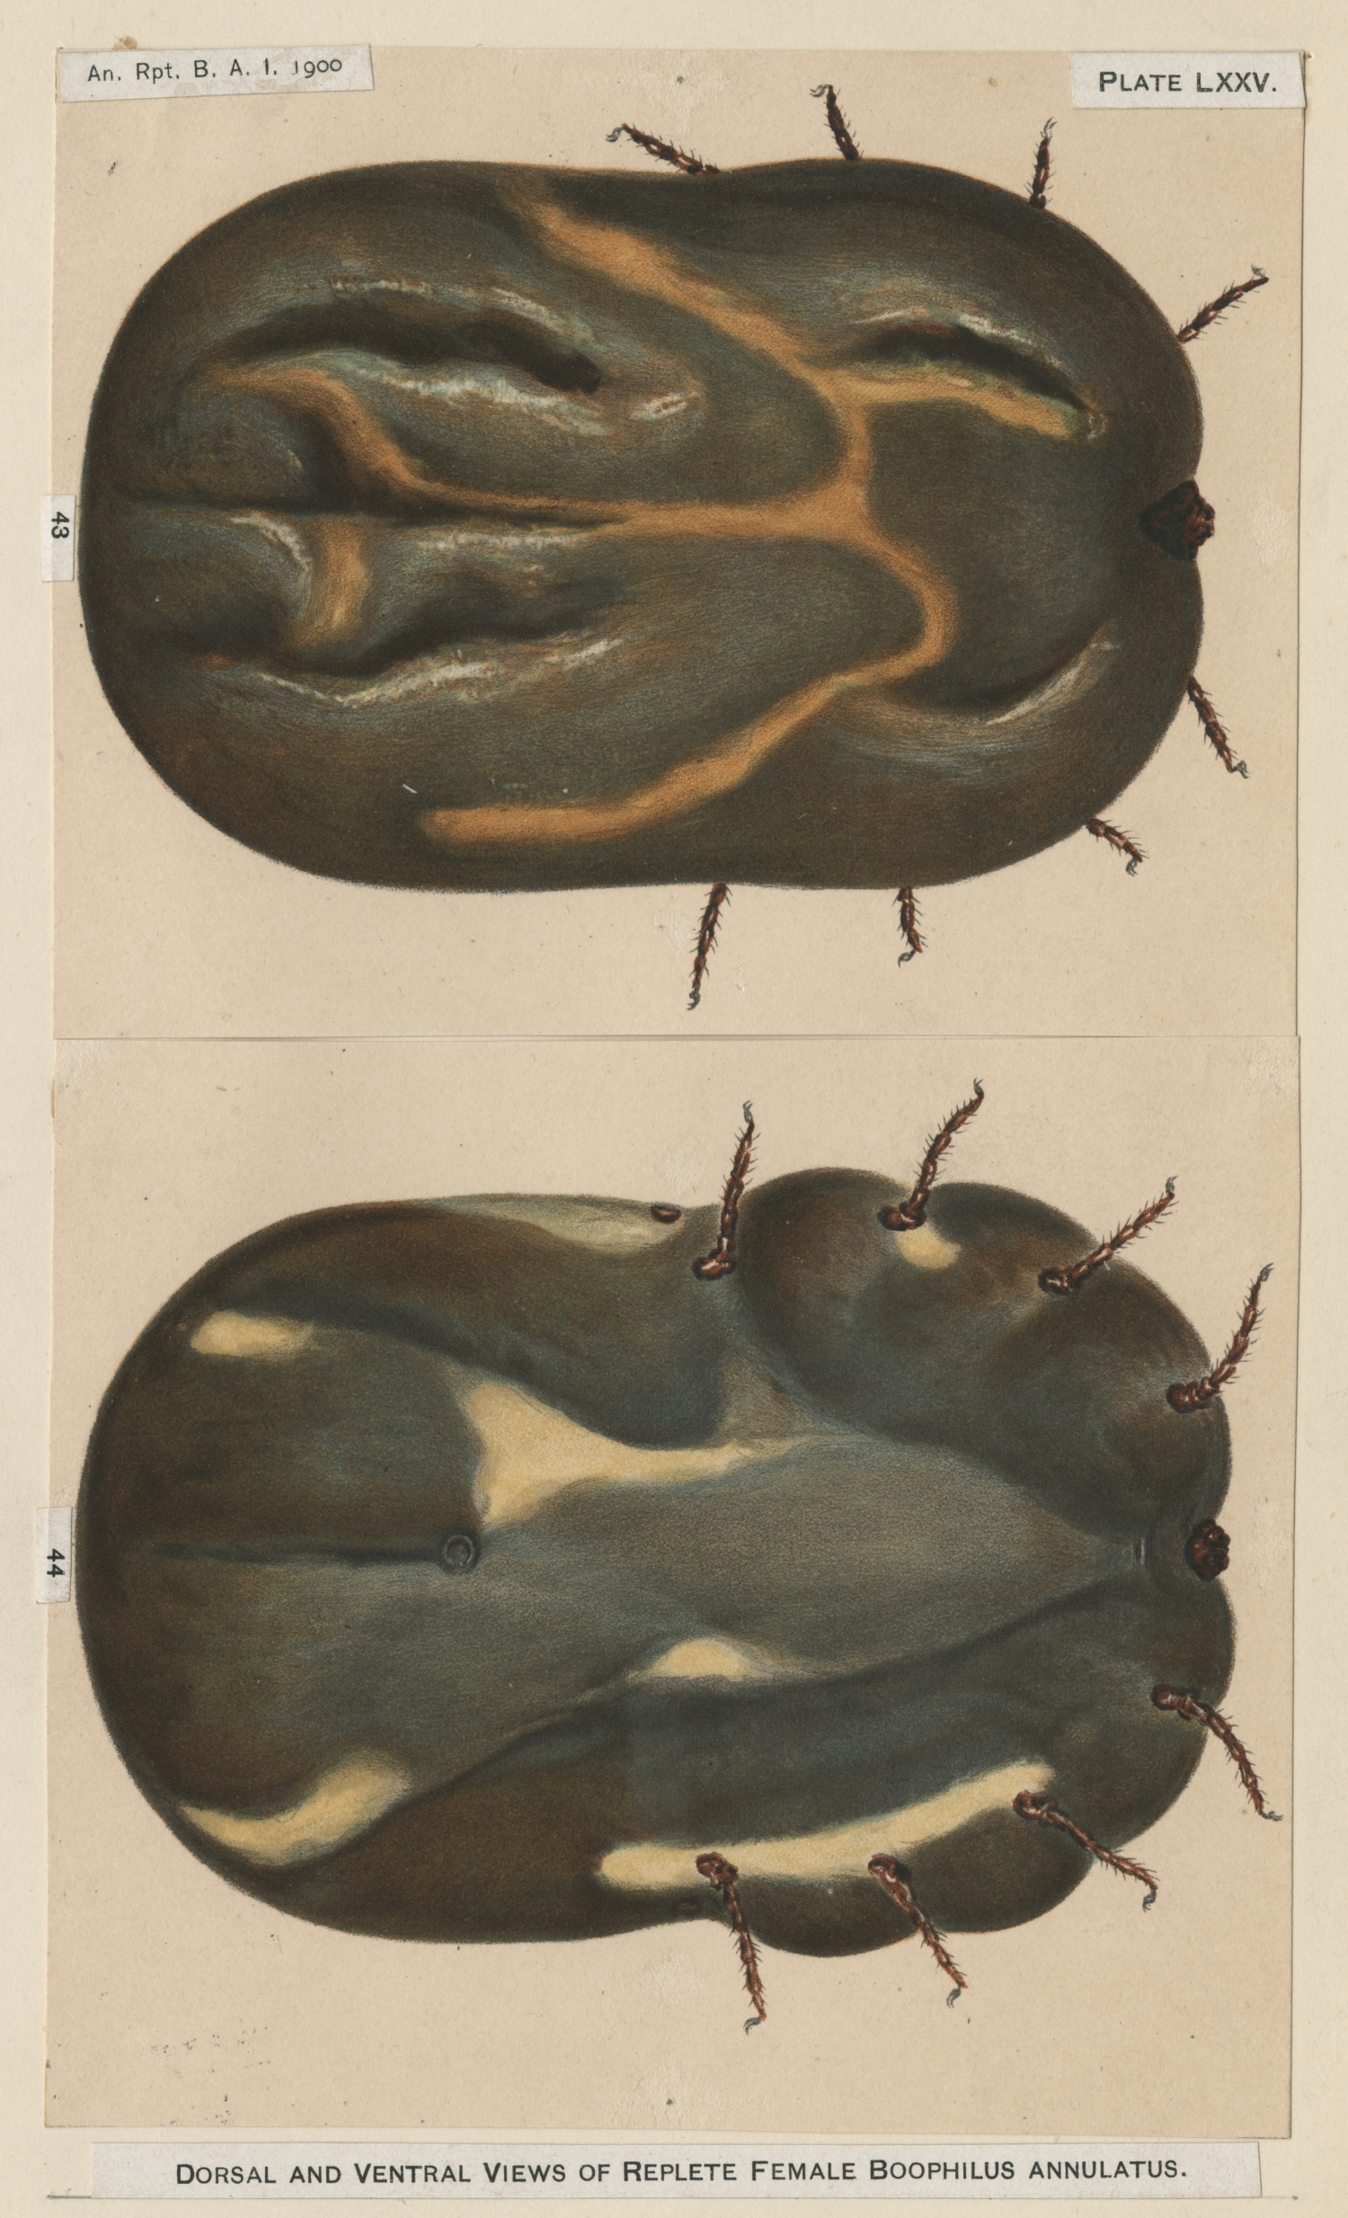
Introduction
Babesia bovis & Babesia bigemina are blood borne intraerythrocytic, tick-transmitted protozoans
They are highly pathogenic and the causative agents of Bovine Babesiosis worldwide
Well-recognized disease of veterinary importance in cattle
Both are transmitted by the ticks
  Rhipicephalus (Boophilus) annulatus
  Rhipicephalus (Boophilus) microplus
Notes:
Other sp. Of one host tick will be there in North Africa and Asia R. bursa

Slide 4
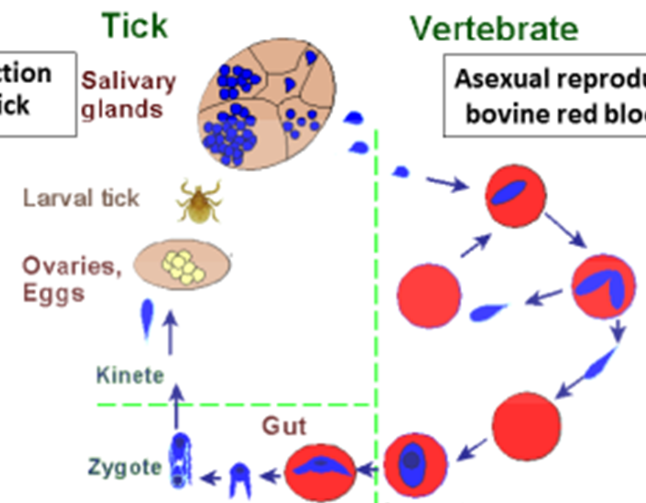
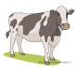

Babesia bovis & Babesia bigemina life cycle
Sporozoite
Sexual reproduction
In Tick vector
Asexual reproduction
In bovine RBCs
Trophozoite
Merozoite
Polymorphic Ray bodies
(Strahlenkorper)
Gamonts
Dr. Amer r. Alhaboubi

Slide 5
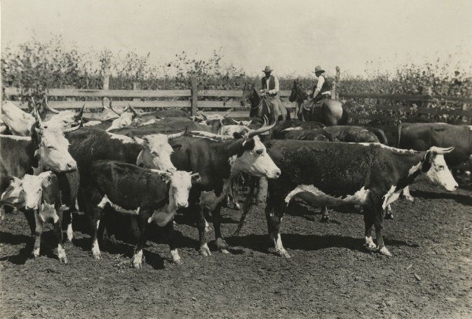
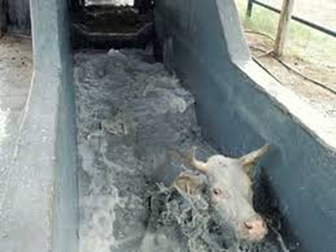
Distribution and Eradicatioin
Bovine babesiosis found globally in tropical and subtropical areas
United States free in 1943 after an extensive vector tick eradication program. (Texas cattle fever)
  A permanent vector tick buffer zone remains along the Texas border with Mexico
  Continuous threat of reemergence due to endemic babesiosis in Mexico
  Recent increase in tick vector outbreaks outside the buffer zone in Texas
Dr. Amer r. Alhaboubi
Notes:
Fortunately, its transmitted by one host tick, eradicated in 1960s from Floridia, More severely than young, enzootic stability ;a situation in which all factors influencing disease occurrence are relatively stable,

Slide 6
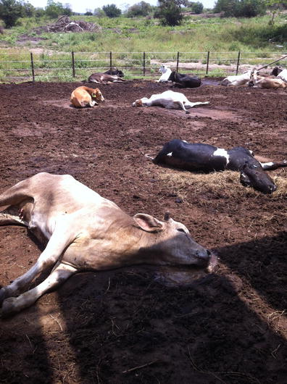
Clinical Signs
The disease affects adult animals more severely than young, leading to enzootic stability in regions where the climate is favorable to the tick vector
Clinical signs such as high fever, anemia, and hemoglobinuria, or even neurological signs may result from infection
Economic burden to the livestock industry due to abortions, loss of milk or meat production, loss of draft power or even death
Tamuin, San Luis Potosi outbreak Mexico

Slide 7
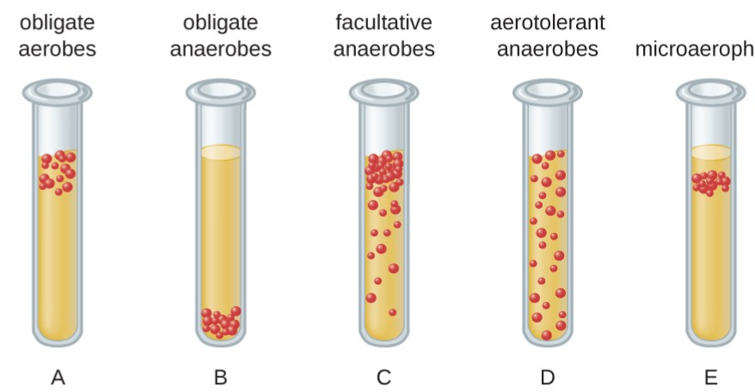
Continuous in vitro Cultivation
Microaerophilous Stationary Phase (MASP) culture system
  Microaerophilous – Babesia multiplication is dependent on a low oxygen tension in the erythrocyte layer
  Stationary Phase – The erythrocytic stages of the parasite
  Donor erythrocytes and nutrients are provided for Babesia invasion and multiplication
Notes:
Introduce the fact that other species that affect humans and companion animals can not be culture continuously? B. micro, B. canis. only very recently B. duncani has been culture. Just to emphasize the fact that culturing Babesia parasites it is not an easy matter.
3 part of the system : Low 02 tension , parasite development stage in he RBC , Nutrients and the RBC

Slide 8
Continuous in vitro Cultivation
Continuous cultivation:
Babesia bovis led to B. bigemina cultures (Levy and Ristic, 1980; Vega et al., 1985)
Cultured Babesia spp. are an unlimited laboratory source of parasites free of adventitious organisms for numerous applications
Molecular and biochemical studies, anti-babesial drug testing, diagnostics and vaccine development
Dr. Amer r. Alhaboubi

Slide 9
Specific Objectives
To recover cryostocks cultured B. bovis and B. bigemina after storage for nearly 30 years in liquid nitrogen
To compare animal donors for suitability of erythrocytes and serum in culturing Babesia

Slide 10
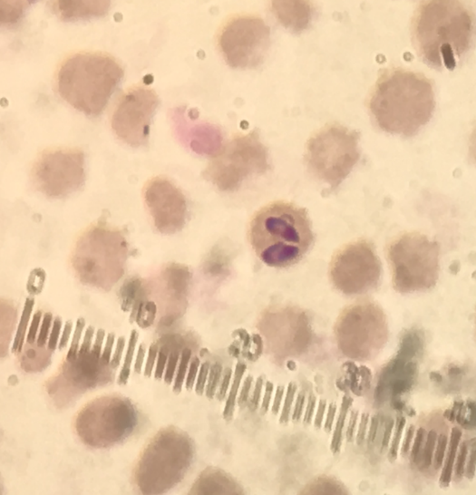
Babesia History of Early Work
Low temperature cryopreservation :
Babesia bigemina infected blood remained infective to cattle for almost 2 years using Glycerol as the cryoprotectant and storing at -79 °C (Barnett, 1964; Dalgliesh, 1972).
Dalgliesh (1972) demonstrated that dimethylsulfoxide (DMSO) effectively cryopreserved B. bigemina at -79 °C and later optimized the cooling rates for cryopreserving the parasite in DMSO at -196 °C (Dalgliesh and Mellors, 1974).

Slide 11
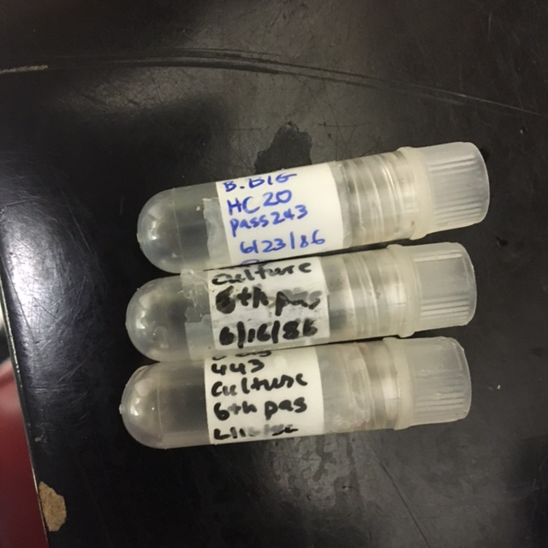
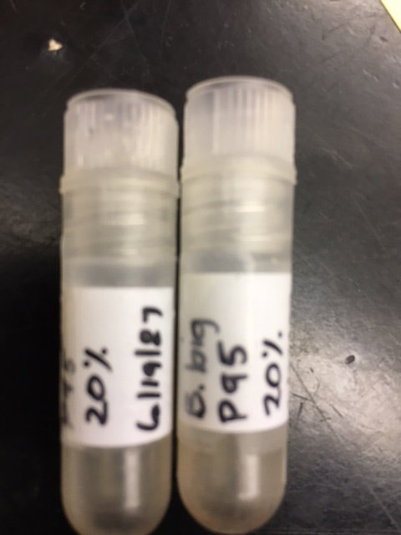
Materials and Methods
B. bovis and B. bigemina cryostocks MASP cultures of B. bovis and B. bigemina stored in liquid nitrogen since years 1986 and 1987
in polypropylene cryovials
Dr. Amer r. Alhaboubi

Slide 12
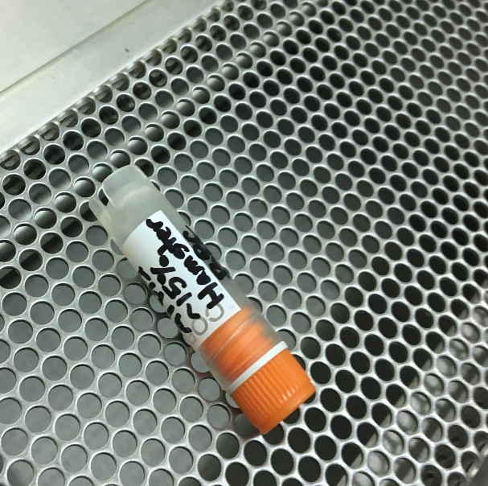
Thawing Stored Ampoules
Thawing of cells should be rapid
  Water bath @ 37°C to minimize crystal formation
Spray vial with alcohol to avoid contamination
Dilution Should Be Done Slowly
Most cells do not require centrifugation
Do not Require Centrifugation
Dr. Amer r. Alhaboubi

Slide 13

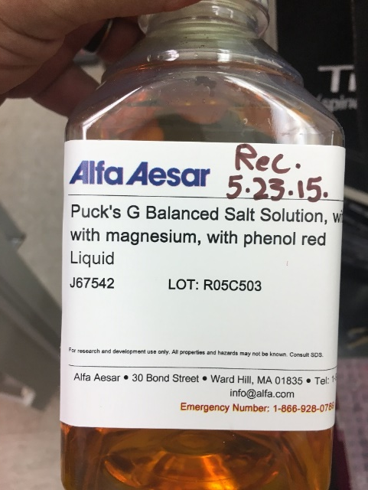
Donor Cattle and Blood Preparation
MASP cultures require donor erythrocytes and serum from a normal uninfected adult animal
Blood and serum from 4 cattle housed at the National Veterinary Services Laboratories, Ames, IA. USA
  2-year-old Angus steer (#913)
  7-year-old Jersey steer (#1393)
  Two 8-year-old Jersey steers (#58 and #61)
  Blood and serum tubes were shipped at 2-week intervals overnight to Texas A&M University
  The erythrocytes were washed 3 times by centrifugation with 5 volumes of medium and the final pellet resuspended in Puck's Saline Glucose until use
Notes:
Upon availability, blood were provided by the USDA

Slide 14
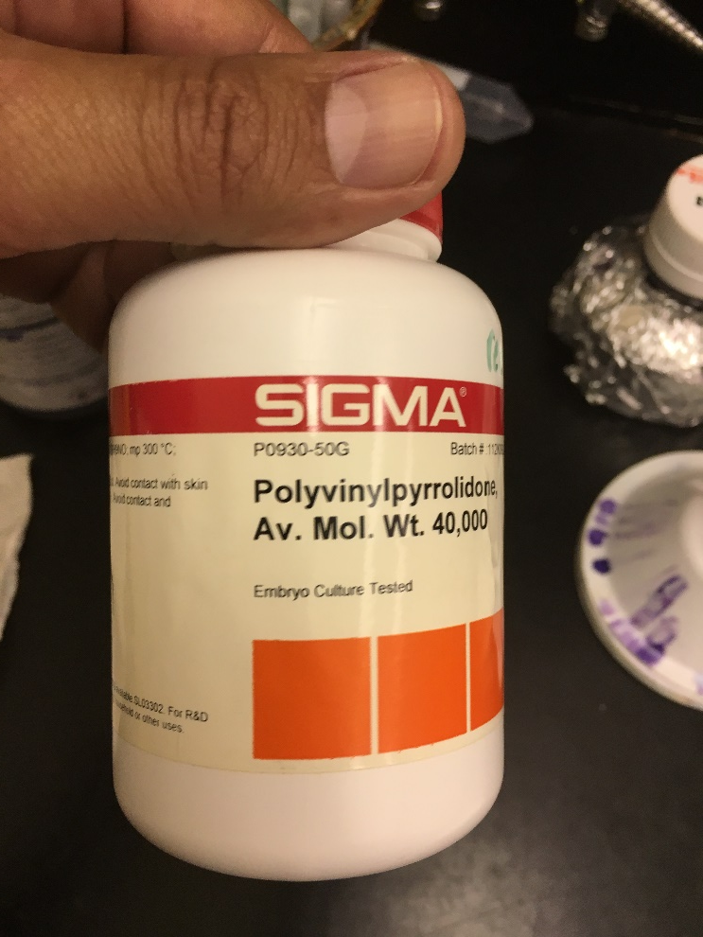

The study confirmed that the cryprotectant medium (final concentration 10% PVP-40 in PSG+G) introduced to cryopreserve Babesia spp. highly dependable for long term liquid nitrogen storage of cultured parasites

Slide 15
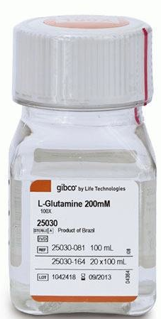
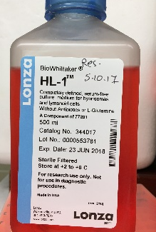
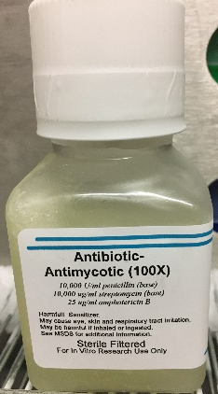
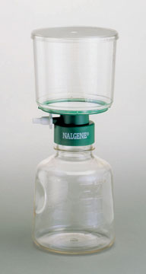
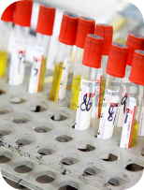

Medium Preparation
HL-1™ medium with 20% adult bovine serum corresponding to the donor RBCs
  Supplemented with 200 mM L-glutamine and antibiotic/antimycotic
HL-1™ is a chemically defined culture medium (hybridomas) containing, include Buffer, insulin, transferrin, testosterone, sodium selenite, ethanolamine, a variety fatty acids .

Slide 16
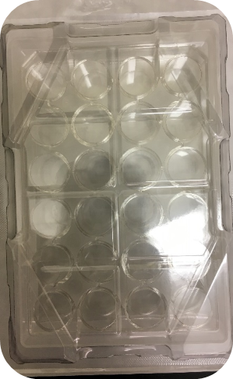
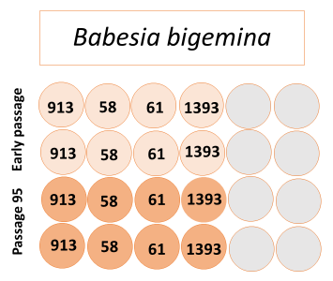
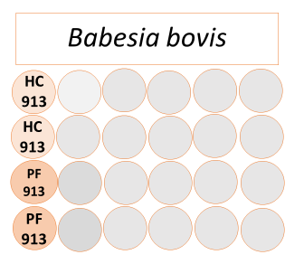
Babesia spp. Cryostock Recovery
The cryovials of the cultured Babesia were removed from LN2 storage and thawed rapidly in a 37ºC water bath.
The vial contents were pooled and 0.25 ml added to a well of a 24-well plate containing 0.9 ml medium + 0.1 ml donor RBC
Final volume 1.25 ml/well
Dr. Amer r. Alhaboubi
Notes:
Experiment designed and started by chose cryovails from both babesia spp, Thawing process ,upon availability . In specific hood in culture Rome

Slide 17
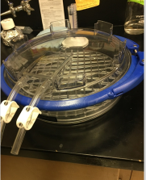
Babesia spp. Stock Recovery
The plates were placed in a humidified modular incubator unit
The unit was flushed with a gas mixture of 2% O₂, 5% CO₂, and 93% N₂
Incubated at 37 ˚C
MASP Unit
Gas Mix
37˚C
Notes:
The gas mix chamber (humidified modular unit). Gas and incubator

Slide 18
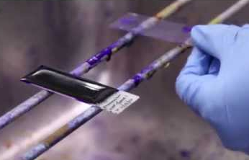
Daily Monitoring and Media Replenishment
Cultures replenished daily with new media
Sample smears made
The thin smear was air-dried, methanol fixed and stained with Giemsa
The stained smear was viewed by light microscopy at 1,000X under oil immersion to monitor for the appearance of parasites
Subcultured at a 1:5 split ratio
  0.25 ml resuspended cultures
  0.1 ml appropriate RBC
  0.9 ml appropriate medium
Dr. Amer r. Alhaboubi
Notes:
Changing media , Sampling , and Staining …. subculture if needed reched parasitemia

Slide 19
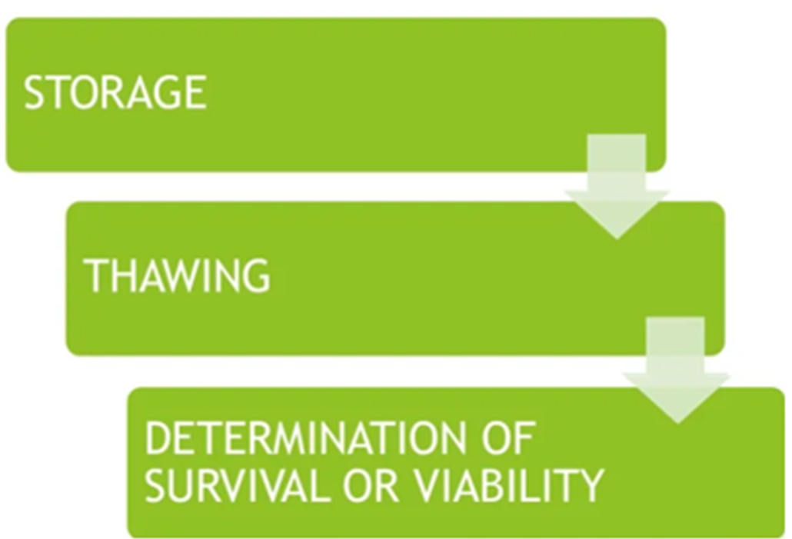

Slide 20
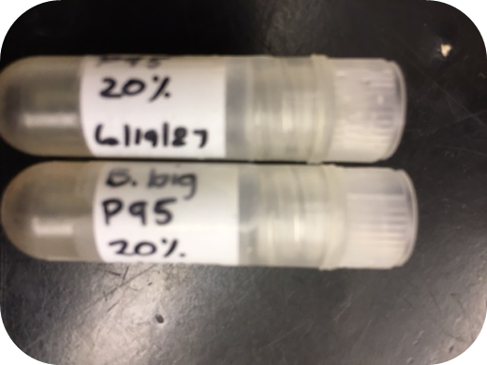
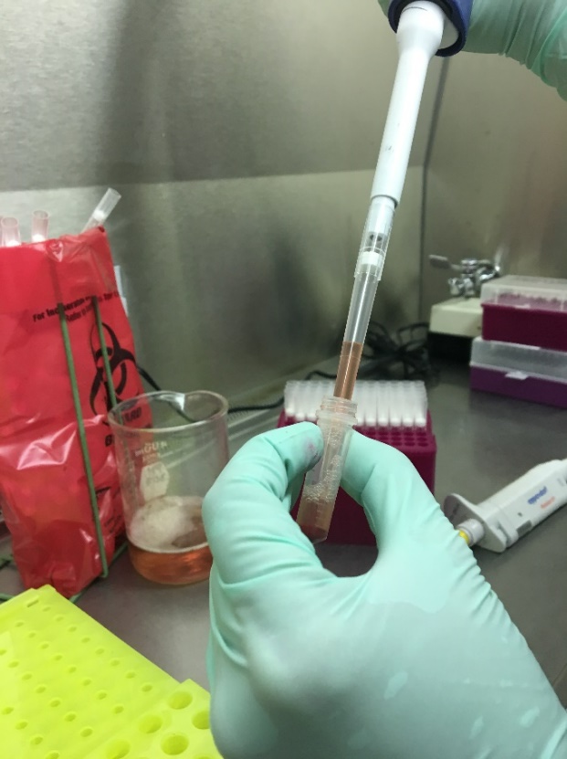
Storage
Polystyrene foam boxes to store vials
  This set up provides insulation for 1°C/minute cooling
Place in a –80°c freezerover night
Transfer to Liquid Nitrogen after 24 Hrs Or -150°C Freezer
Liquid nitrogen is widely used to store cells long term
  -196 °c
  Several types of liquid nitrogen cryofreezers are available

Slide 21
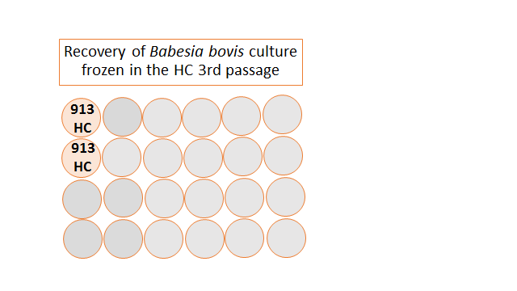
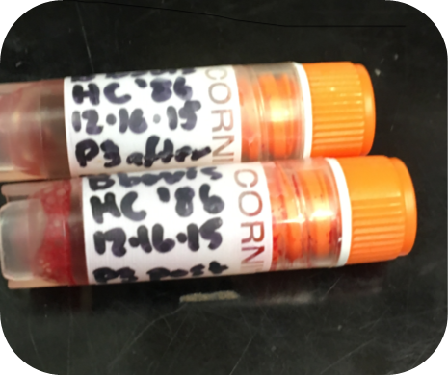
Cryopreservation and Recovery of B. bovis Cultured in #913
Babesia bovis culture cryopreserved after 3 subcultures
Stored in liquid nitrogen for 6 months and recovered as described before
Dr. Amer r. Alhaboubi

Slide 22
Results
Results: B. bigemina grew only in #913 RBC and serum
Babesia bigemina paired pyriforms in culture passage 4 (a) and passage 6 (b) after recovery from cryopreservation. Giemsa stain, 1000X oil immersion.
Babesia bigemina recovered from cryopreservation. The percent parasitized erythrocytes (PPE) in the culture are shown on days between subcultures incubated in a humidified gas mixture of 2% oxygen, 5% carbon dioxide and 97% nitrogen atmosphere (●), PPE on day of subculture in the gas mixture (□), on days between subculture when incubated in a humidified 5% carbon dioxide in air atmosphere (○), and on the day of subculture in 5% carbon dioxide (∆).
Notes:
Start early with late passages ,

Slide 23
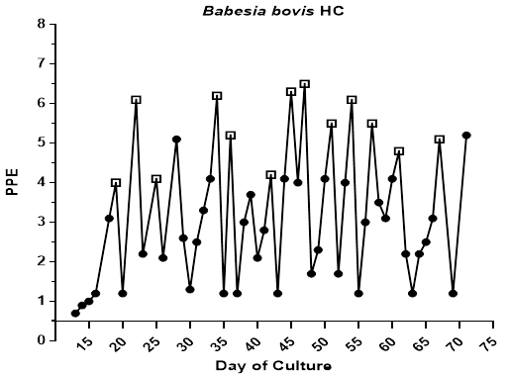
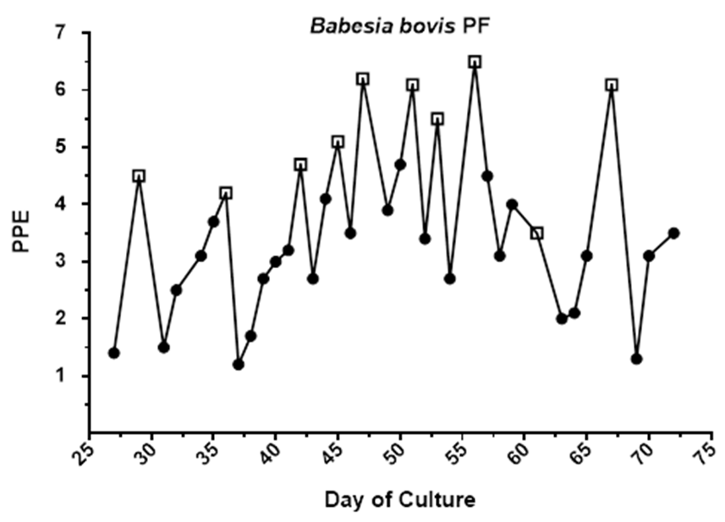
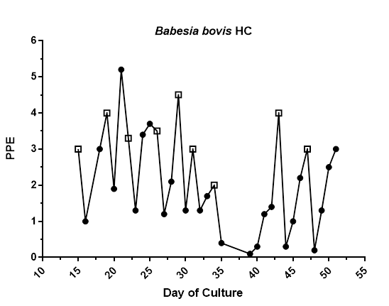
Results: B. bovis was cultured only in #913 RBC and serum
Growth of Babesia bovis recovered from cryopreservation. PPE between subcultures (●) and PPE on the day of subculture (□).
Babesia bovis paired pyriforms (black arrows) and singles (white arrows) in culture passage 2 (a) and passage 10 (b) after recovery from cryopreservation. Giemsa stain, 1000X oil immersion.
Resuscitation of Babesia bovis culture frozen in the 3rd passage after recovery and stored for 6 months in liquid nitrogen. PPE (●) between subcultures and PPE at subculture (□).

Slide 24
Discussion & take home message
Cryopreservation of Babesia stocks is well-recognized, but there is limited information regarding how long these stocks will remain viable under extended storage
This study shows that after nearly 30 years in liquid nitrogen storage, cultured B. bovis and B. bigemina were successfully recovered using the MASP system
The animal donor providing erythrocytes and serum for the medium is critical for successful culture of both B. bovis and B. bigemina
This study confirmed that the cryprotectant medium (final concentration 10% PVP-40 in PSG+G) introduced to cryopreserve Babesia spp. (Palmer et al. 1982) is highly dependable for long term liquid nitrogen storage of cultured parasites
Dr. Amer r. Alhaboubi
Notes:
Blood stabilates are reported to remain infective for animals after 19 years in storage at -196˚C (Zweygarth and Lopez-Rebollar, 2000).

Slide 25


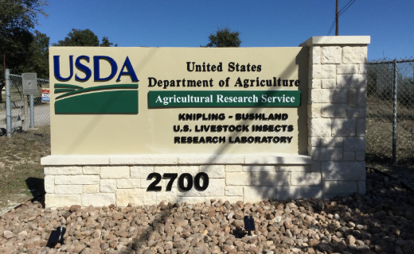

Acknowledgments
Committee members:
  Dr. Maria D. Esteve-Gasent
  Dr. Patricia Holman
  Dr. Linda Logan
  Dr. Luc R. Berghman
  Dr. Adalberto A. Perez de Leon
Veterinary Pathobiology at Texas A&M University,
  Dr. Ramesh Vemulapalli
  Dr. Thomas Craig
Maria Dr. Esteve-Gasent lab
  Dr. Christina Brock
  Dr. Wisam Hassan
  Joseph Modarlli
  Dr. Eman Hassan
  Anna Lee, MPH
Dr. Holman’s lab - former students
  Dr. Dana A. Pollard
  Dr. Kimberly McCormack
Other lab members
  Dr. Guan Zhu lab
  Dr. Karen Snowden lab
Texas A&M AgriLife Research
Caldwell Zoo, Tyler, TX,
USDA-APHIS, Ames, IA,
USDA-ARS, Kerrville, TX

Slide 26


