Slide 1

UNICEF’s Key facts
Almost two thirds of the world’s population experience severe water scarcity for at least one month each year.
By 2030, 700 million people could be displaced by intense water scarcity.
By 2040, roughly 1 in 4 children worldwide will be living in areas of extremely high-water stress.
Running Dry: water scarcity threatens lives and development in Iraq
Baghdad, 29 August 2021- Nearly 3 out of 5 children in Iraq have no access to safely managed water services and less than half of all schools in the country have access to

Slide 2
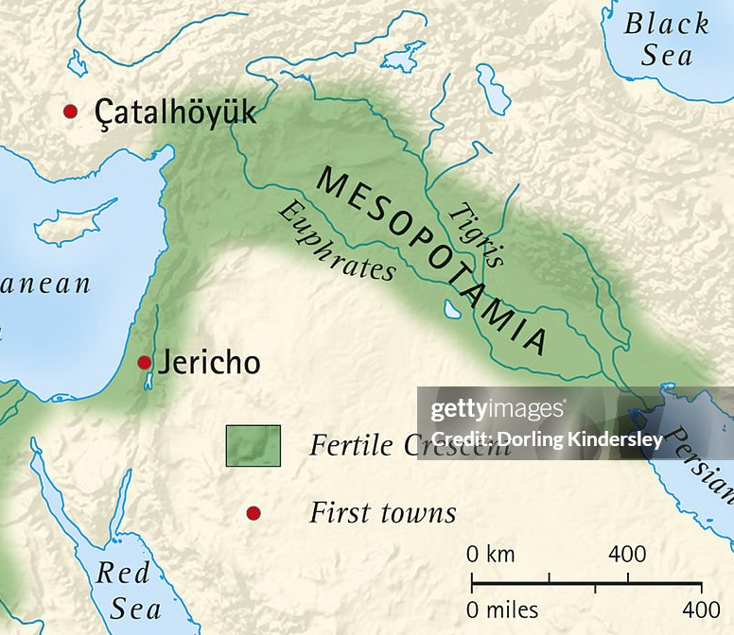
Water Desalination Applicable Applications in Mesopotamia
Dr. Safaa Abdalrasol
Institute of Genetic engineer and Biotechnology

Slide 3
It’s good to know
Water covers 3/4 of the surface. However, 97% of the available water on the earth is salty oceanic water, and only a tiny fraction (3%) is freshwater.
Fresh water - Less than 1,000 ppm.
Slightly saline water - From 1,000 ppm to 3,000 ppm.
Moderately saline water - From 3,000 ppm to 10,000 ppm.
Highly saline water - From 10,000 ppm to 35,000 ppm.
The six most abundant ions in salinity water are chloride (Cl⁻), sodium (Na⁺), sulfate (SO²₄⁻), magnesium (Mg²⁺), calcium (Ca²⁺), and potassium (K⁺)

Slide 4
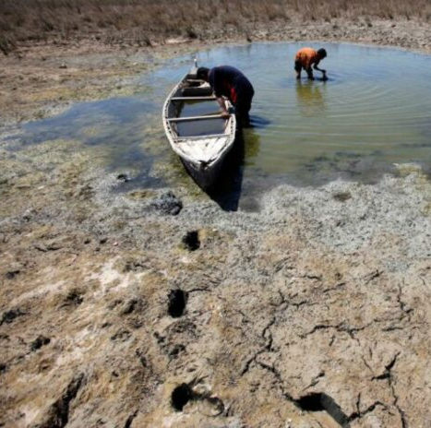
Current Water Issues in Mesopotamia
Scarcity of Freshwater Resources, the decrease in quantity and the increase in salinity of the flow that is entering the country
Impact of Climate Change
Growing Population and Urbanization
Rely on traditional water treatment techniques
irrigation return flows within Iraq.

Slide 5
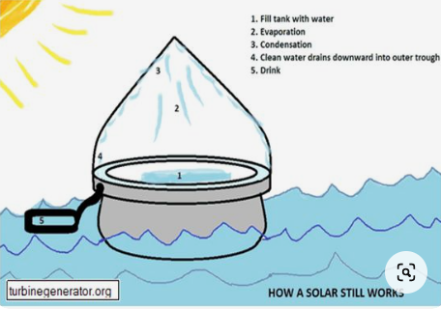
Traditional Desalination Methods
Overview of Ancient Mesopotamian Techniques
Use of Evaporation Ponds and Salt Flats
Historical Examples of Brackish Water Desalination
`
Notes:
Desalination has been used for thousands of years. Greek sailors boiled water so that fresh water could evaporate away from the salt. Also, the Romans trapped salt with clay filters.

Slide 6
Challenges with Traditional Methods
Limited Efficiency and Output
Unsuitability for Modern Water Demands

Slide 7
Innovation Desalination Technologies
Introduction to Modern Desalination Processes :
Reverse osmosis (RO)
Multi-stage flash distillation( MSF)
MED)

Slide 8
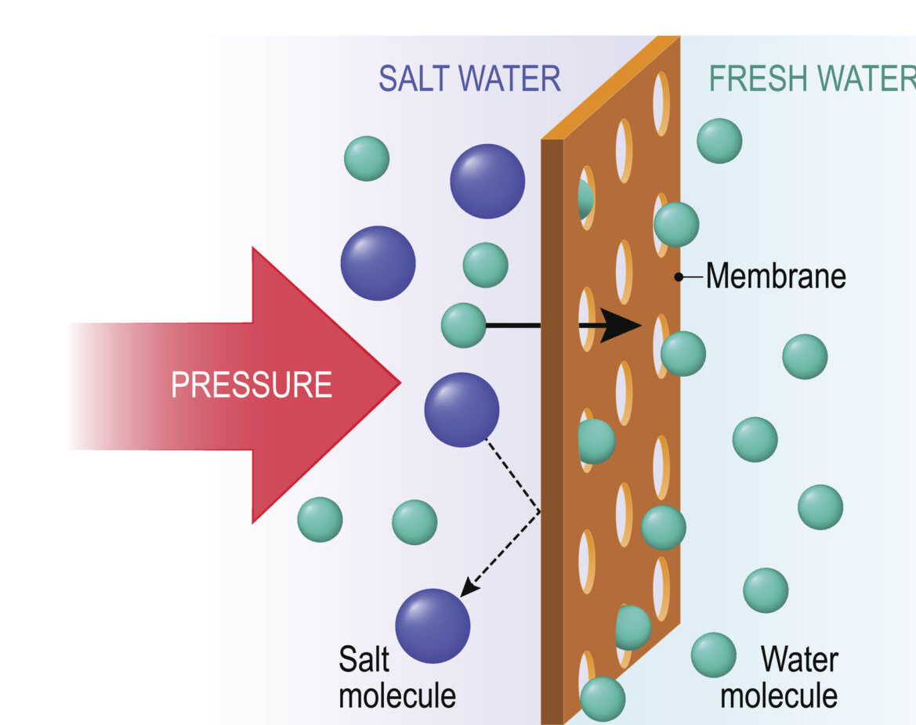
Reverse Osmosis (RO) Desalination
Reverse osmosis ( RO) is a water purification process that removes ions, unwanted molecules and larger particles from drinking water using a partially permeable membrane
Notes:
osmosis is the natural tendency of solvent molecules to move in order to equalize solute concentration on either side of a semipermeable membrane.

Slide 9
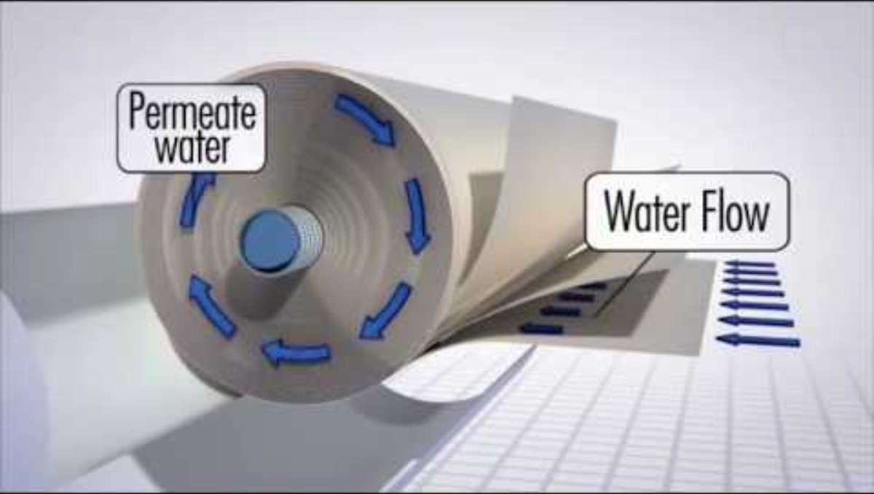

Slide 10
Efficiency
RO has the smallest membrane pore sizes of any membrane separation technologies, and is therefore capable of more complete separation than microfiltation, ultrafiltration and nanofiltration. RO removes contaminants based on particle size and charge, and is capable of separating out ions and molecules down to 0.0001 µm, such as:
    Metals and minerals (e.g. calcium, fluoride, potassium, lead, iron, manganese, chromium)
    dissolved salts
    Sulfates, detergents, and surfactants
    Nitrates and nitriles (e.g. cyanide)
    Total dissolved solids (TDS)
    Some taste-, color-, and odor-producing compounds
    Some organic contaminants and pesticides
    Some pyrogens and pathogens (e.g. bacteria and viruses)

Slide 11
Limitations
While RO is great for removing a broad range of contaminants, its effectiveness can be somewhat limited for removal of dissolved gases, volatile organic contaminants, and some types of pesticides, solvents, and pathogens.
Sometimes reverse osmosis leads to clogging of the whole system. It requires routine filter changes and maintenance
Pre-treatment is required
Massive Energy consumption.
Highly maintenance cost
Negative environment impact

Slide 12
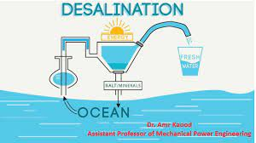

Multi-Stage Flash (MSF) Desalination
Multi Stage Flash (MSF), a thermal desalination technology based on flashing process, produces distilled quality water directly from seawater.

Slide 13
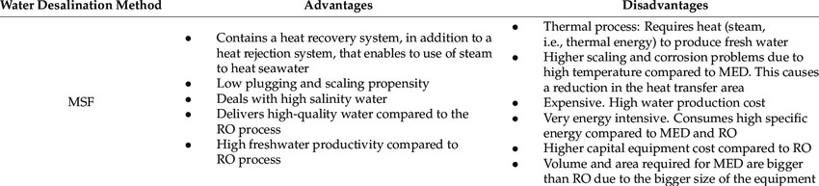
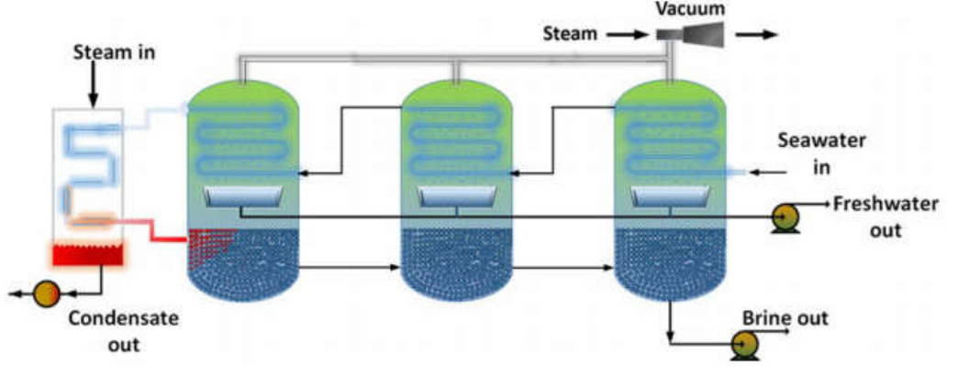

Slide 14

What are the environmental impacts of desalination?
Most forms of desalination are energy-intensive. Desalination has the potential to increase fossil fuel dependence, increase greenhouse gas emissions, and exacerbate climate change if renewable energy sources are not used for freshwater production.

Slide 15
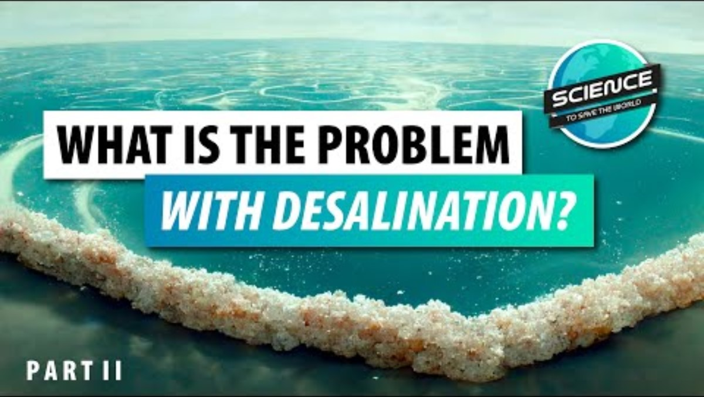

Slide 16

Sustainable Desalination Practices
Importance of Environmental Sustainability
Solar and Wind green energy
Strategies for Minimizing Energy Consumption
Brine Management and Disposal Solutions

Slide 17
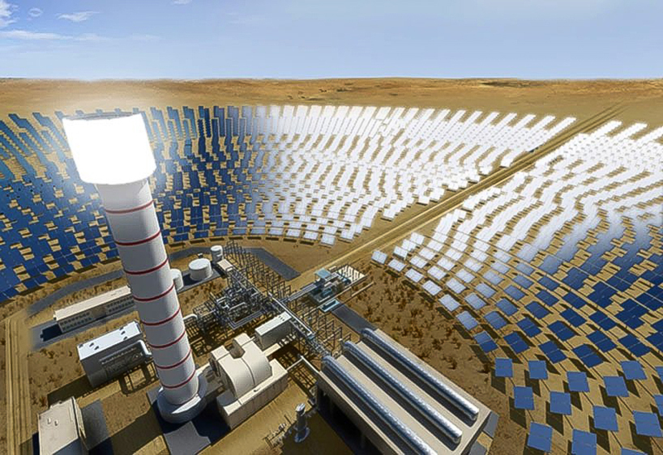
Solar farm:
Concentrated solar power systems generate solar power by using mirrors or lenses to concentrate a large area of sunlight into a receiver.

Slide 18
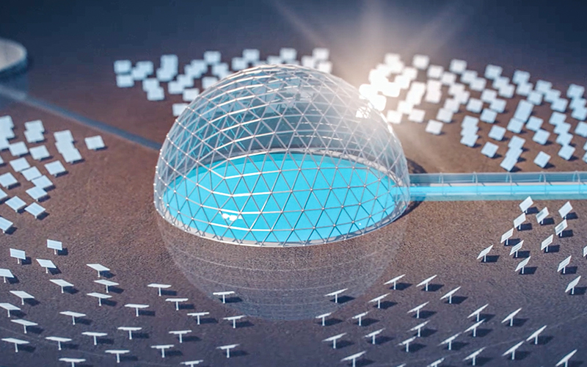
Solar dome

Slide 19


Slide 20
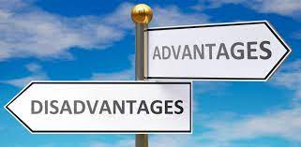
Advantages VS Disadvantages
The advantages of this technology, such as low energy requirements, high water recovery rates, and reduced environmental impact, make it a promising solution for addressing the world's expanding water challenges. Solar-powered desalination has some drawbacks, such as high upfront costs and maintenance requirements

Slide 21
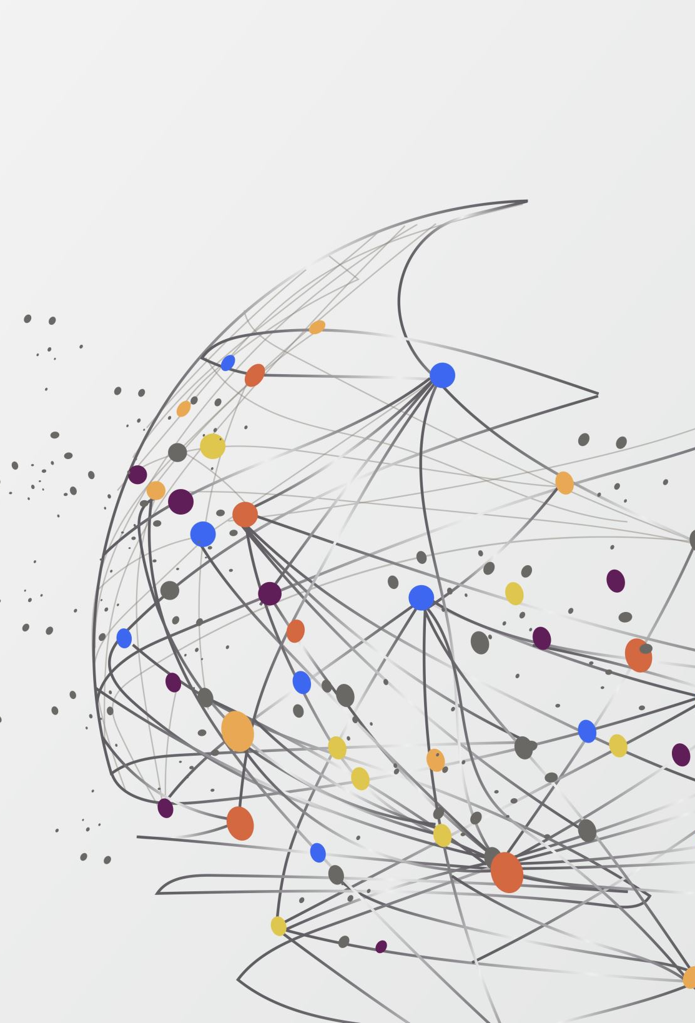
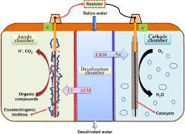
Microbial Desalination Cell (MDC) is a novel technology able to produce sustainable drinking water by using the energy provided from the metabolism of electroactive bacteria when organic matter is degraded
Microbial desalination cell (MDC)

Slide 22


Slide 23
Questions and Discussion

