Slide 1
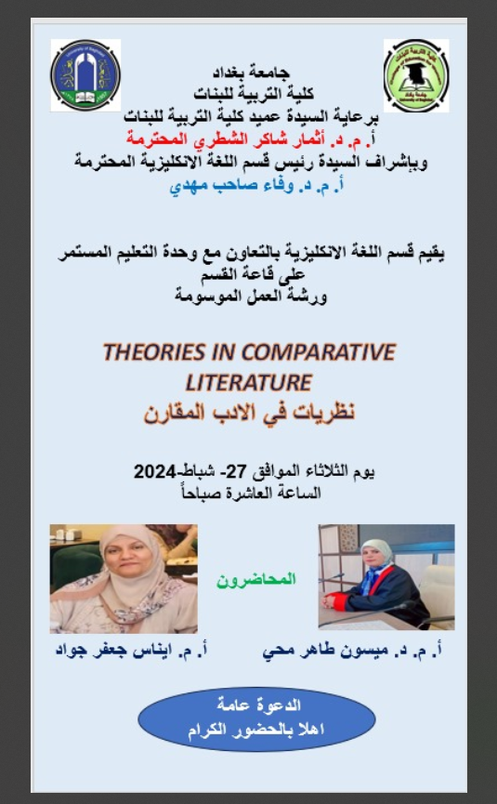

Slide 2
What is Comparative Literature?
Henry Remak defines comparative literature as, “the study of literature beyond the confines of one particular country and the study of the relationships between literature on one hand and other areas of knowledge and belief such as the arts (i.e. painting, architecture, sculpture, music), philosophy and history, the social sciences (politics, economics, sociology) the sciences, religion etc. on the other. In brief, it is the comparison of literature with other spheres of human expression.

Slide 3
Why do we study comparative literature?
- Broadening Perspectives
- Cross-Cultural Understanding
- Interdisciplinary Connections
- Literary Analysis
- Translation and Adaptation
- Reducing National Prejudice

Slide 4
History of comparative literature studies
-The comparative literature studies could be traced to the mythologists and ancient literary historians in Germany and France.
-The English usage of the term is attributed to Matthew Arnold who
is claimed to have used the term in 1848.
- Comparative Literature was established as a field of study with the
contributions of Charles-Augustin Saint-Beuve, who used the term in a
conference in 1868, even though previously, in 1840, he had already talked about “compared literary history.”
- The first specialized journal on the topic was published in Cluj, Romania, in
1877, and was run by Hugo Meltzl. The title appeared in several languages, with
the meaning &#39;comparative literature journal&#39;.

Slide 5
Theories in Comparative Literature
“All higher knowledge is gained by comparison and rests on comparisons”
Max Muller
“Everywhere, there is a connection, everywhere there is an illustration, no single event and no single literature is adequately comprehended except in relation to other events, to other literatures.” Mathew Arnold

Slide 6
An Introduction to the Theoretical Necessity
Comparative Literature attempts to understand literature in terms of producing a meaningful dialogue between literature and cultural diversity.
Since Theory is generally standing for the philosophical procedure that paves the way for a particularly in-depth approach to a certain phenomenon like a literary text, then Comparative literature is basically built as a theoretical basis for the study of literature.
Comparative Literature stands as an encompassing theory according to which there are built:
systematic theoretical layers
and
methodological empirical layers
for the study of literature and culture.

Slide 7
What are the theoretical Principles of Comparative Literature
There are 10 Principles on which Comparative Literature is constructed as a discipline
The “HOW” rather than the “WHAT”.
(The comparative strategy of the comparatist)
2. LITERARY AND CULTURAL DIALOGISM
(different literatures/ languages/ cultures/disciplines)
3. BILINGUALISM
(The comparatist is to be equipped with a full lingual and cultural knowledge)
4. Contextual framework of investigation
(working within a diversity of disciplines of knowledge)
5. Defying Colonization
The emphasis on the peripheral and the marginal defies Euro-American Centricity.

Slide 8
What are the theoretical Principles of Comparative Literature
6. Comparative Literature is essentially inclusive
(The inclusion of the “Other”)
7. Comparative Literature is ultimately cultural
The cultural studies is an essential platform in approaching the literary text
8. Interdisciplinary Methodology
Intradisciplinary (various disciplines of humanities)
Multi-disciplinary (any other discipline outside the humanities)
Pluri-disciplinary (team-work)= consensus
9. Globalization VS Localization
Comparative literature is both global and inclusive discipline of international literature
10. Comparative Literature is multilayered knowledge

Slide 9
Schools of comparative Literature
THE FRENCH SCHOOL
Source of Influence
historical perspective.
the desire for colonial expansion
searching for direct intercultural relationships
The emphasis on the direct influence of one work on another
Points to be Traced
Literary schools and genres
Ideological Echoes
Image echoes
Verbal echoes Human
models and heroes

Slide 10
Schools of comparative Literature
THE AMERICAN SCHOOL
Aesthetic sensibility and intertextuality
Announced the end of French- German school.
Giving broadness of view, aesthetic evaluation and universal sensibility.
going beyond the political borders of literary texts
The main fields of study are parallelism and intertextuality
Points to be Traced
The parallelism gives no importance to influence.
Intertextuality means the reference of a given text to another text. New text are always read under the light of old texts.

Slide 11
Schools of comparative Literature
THE RUSSIAN SCHOOL
Marxist /Democratic Method
a combination of influence study and parallel study.
closely relating Comparative study to social and historic backgrounds.
the national boundaries between different literature were obliterated.
Globalized man-made literature/culture

Slide 12






Slide 13


