Slide 1
Viral hemorrhagic fevers

Slide 2
Introduction
Viral hemorrhagic fevers (VHFs) represent a group of severe systemic febrile illnesses caused by four families of viruses - Arenaviridae, Bunyaviridae, Filoviridae, and Flaviviridae. These enveloped viruses are characterized by a myriad of symptoms that range from coagulopathies, hemodynamic instability, altered mental status, and, if severe enough, death. This activity outlines the evaluation and management of viral hemorrhagic fevers and highlights the role of the interprofessional team in the care of patients with this condition..

Slide 3
Transmission
Most of the viruses implicated in these diseases require vectors for transmission to humans, with the majority being arthropod-borne or rodent-borne infections. Given their zoonotic nature, these diseases are generally confined to the endemic areas where their hosts live. However, given increased human migration and further globalization, these diseases are no longer limited to their geographic origins

Slide 4
What causes viral hemorrhagic fevers?
Bunyaviridae family
Crimean-Congo hemorrhagic virus (CCHFV) - Crimean-Congo hemorrhagic fever
Dobrava-Belgrade virus (DOBV) - Hemorrhagic fever with renal syndrome
Filoviridae family:
Bundibugyo ebolavirus (BDBV) - Ebola virus disease
Marburg marburgvirus (MARV) - Marburg hemorrhagic fever
Crimean-Congo hemorrhagic virus (CCHFV) - Crimean-Congo hemorrhagic fever

Slide 5
Bunyaviridae family: In iraq
Crimean-Congo hemorrhagic virus (CCHFV) - Crimean-Congo hemorrhagic fever

Slide 6
Flaviviridae family:
Dengue virus (DENV-1-4) - Dengue fever
Kyasanur forest disease virus (KFDV) - Kyasanur forest disease
Omsk hemorrhagic fever virus (OHFV) - Omsk hemorrhagic fever
Yellow fever virus (YFV) - Yellow fever

Slide 7
Pathogenesis
Pathogens implicated in viral hemorrhagic fevers are able to replicate within macrophages and dendritic cells, allowing for rapid dissemination within the host. Macrophages are triggered to release cytokines and chemokines, which cause increased vascular permeability and a procoagulant state. These viruses can also trigger mechanisms resulting in disseminated intravascular coagulation. Infected dendritic cells are impaired, and the loss of its appropriate function can lead to lymphocytic apoptosis.

Slide 8
What are the symptoms of viral hemorrhagic fever?
Specific symptoms vary by type of viral hemorrhagic fever, but initial symptoms often include fever, fatigue, dizziness, muscle aches, loss of strength, and exhaustion. Patients with severe cases of viral hemorrhagic fever often bleed under the skin, in internal organs or from body openings. Severely ill patients may also exhibit shock, problems with the nervous system, coma, and seizures. Some types of viral hemorrhagic fever are associated with kidney failure.

Slide 9
The most severe complications of viral hemorrhagic fevers involve multi-organ system failure and death. Management is largely supportive. Given the risk for nosocomial infections and further outbreaks, viral hemorrhagic fever isolation precautions should be instituted immediately if this entity is suspected.

Slide 10
Evaluation
The clinical evaluation for viral hemorrhagic fevers includes complete blood count with differential, comprehensive metabolic panel, type and cross, coagulation studies, liver function tests, as well as evaluation for bacterial infections with urinalysis, urine culture, chest x-ray, and blood cultures. Serological testing for virus-specific IgM and IgG can be helpful but is not as sensitive or specific as molecular-based testing. Reverse transcriptase-polymerase chain reaction and virus isolation via cell culture are methods that can be used for diagnostic testing.

Slide 11
In Iraq
Between 1 January to 22 May 2022, the health authorities of the Republic of Iraq notified WHO of 212 cases of Crimean-Congo Hemorrhagic Fever (CCHF), of which 115 (54%) were suspected and 97 (46%) laboratory-confirmed; there were 27 deaths, 14 in suspected cases and 13 in laboratory confirmed cases. The number of cases reported in the first five months of 2022 is much higher than that reported in 2021, when 33 laboratory confirmed cases were recorded. Cases have been reported in several areas (governorates) in Iraq and the outbreak may pose additional pressure to an already over-stretched health care system.

Slide 12
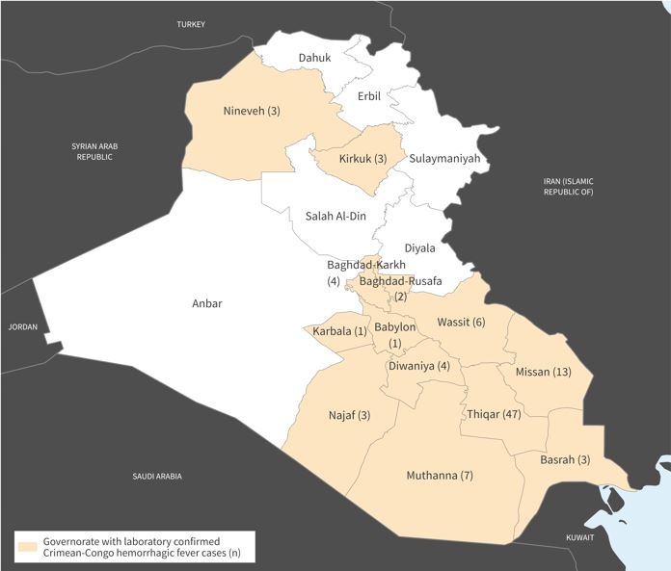
Distribution of laboratory confirmed cases of Crimean-Congo Hemorrhagic Fever by governorate, Iraq, 1 January to 22 May 2022 (n=97).

Slide 13
Among confirmed cases, most had direct contact with animals, and were livestock breeders or butchers. Just over half of the confirmed cases were 15 to 44 years old (n=52; 54%) and of male gender (n=60; 62%).
Nearly 50% of confirmed cases (n=47; 48%) were reported in Thiqar governorate, southeast Iraq, and the remainder of cases were reported from 12 different governorates; Missan (13), Muthanna (7), Wassit (6), Diwaniya (4), Baghdad Karkh (4), Kirkuk (3), Basrah (3), Najaf (3), Nineveh (3), Baghdad-Rusafa (2), Babylon (1) and Karbala (1) (Figure 1).

Slide 14
The Best Ways To Prevent And Control Viral Fever
Wash your hands:
Cover your mouth and nose:
Avoid direct contact with a sick person:
Prevent mosquito bites
Managing a viral fever

Slide 15


