Slide 1
كتابة وفهرسة المراجع العلمية بأستخدام برنامج EndNote
Assoc. Prof. Dr. Sami D. Salman
Biochemical Engineering Department
Al-Khwarizmi College of Engineering
University of Baghdad

Slide 2
INTRODUCING ENDNOTE
What is EndNote?
EndNote is a reference management software package, which is used to manage bibliographies and references when writing theses, essays and articles. The software is available for both PC and Mac.
EndNote allows you to:
Store all the references that you find during your research. They can be entered manually or downloaded from most databases.
Store PDF files, pictures, graphs, tables, etc.
Add citations to your work and create bibliographies in any output style (e.g., APA, Harvard, IEEE, and Vancouver…. etc). There are approx. 6,400 styles to choose from.
Fossil fuels

Slide 3
What is a Citation and References/Bibliography?
A citation is a reference that appears in the text of your document.
Example:
(Williams 2011)
A bibliography is a list of references provide complete publication or aces information on all cited works
Example:
S. D. Salman, I. M. Rasheed, and M. M. Ismaeel, "Removal of diclofenac removal from aqueous solution on apricot seeds activated carbon synthesized by pyro carbonic acid microwave," Chemical Data Collections, p. 100982, 2022/12/28/ 2022, doi: https://doi.org/10.1016/j.cdc.2022.100982.

Slide 4
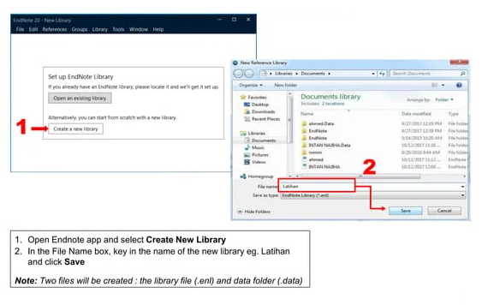
1. STARTING AND OPENING ENDNOTE LIBRARY

Slide 5
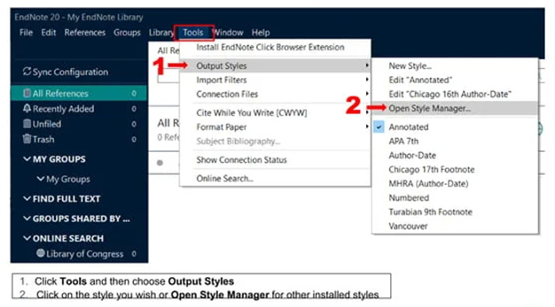
2. CHOOSING OUTPUT STYLE

Slide 6
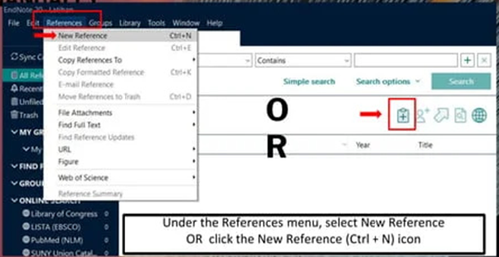
3. CEATING NEW REFFERENCE MANUALY

Slide 8
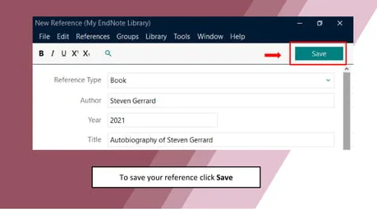

Slide 9
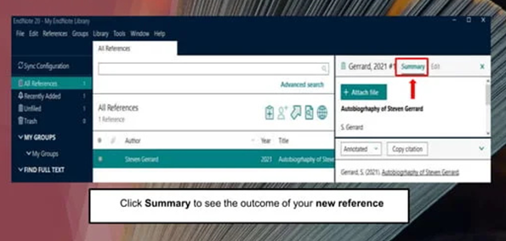

Slide 10
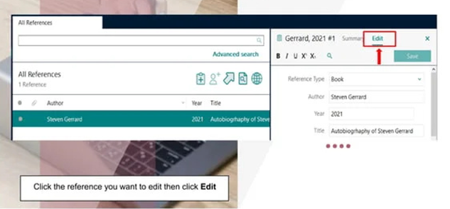
5. EDITING REFERENCE

Slide 11
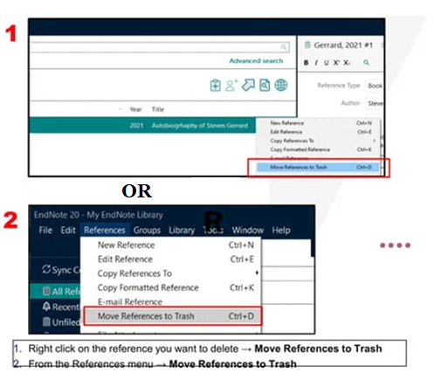
6. DELETING REFERENCES

Slide 12
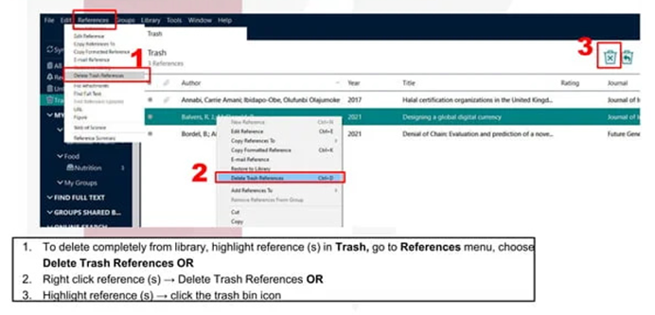
7. DELETING REFERENCES IN TRUSH

Slide 13
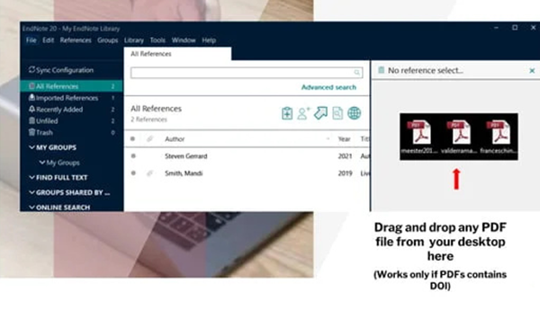
8. DRAG & DROP PDF FILES

Slide 14
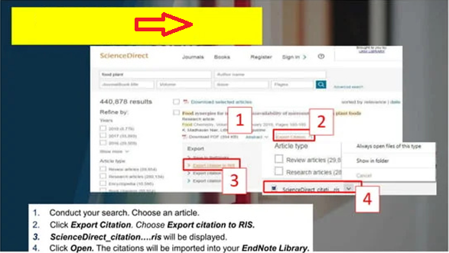
9A. EXPORTING REFERENCES

Slide 15
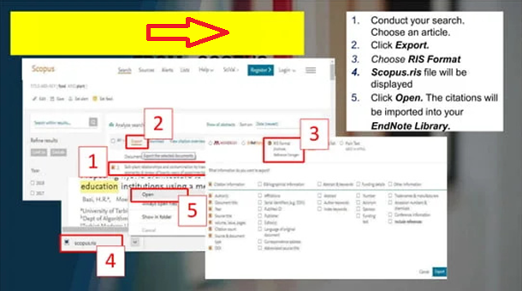
9B. EXPORTING REFERENCES

Slide 16
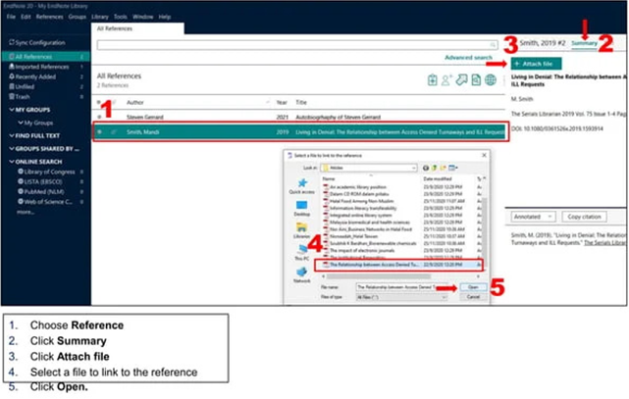
10. ATTACH PDF TO ENDNOTE LIBRARY

Slide 17
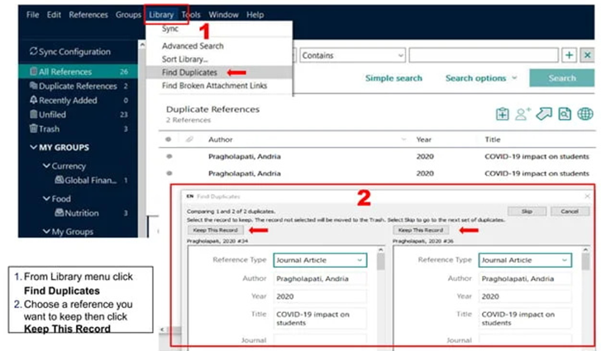
10. REMOVING DUPLICATE

Slide 18
11. WORKING WITH GROUPS

Slide 19
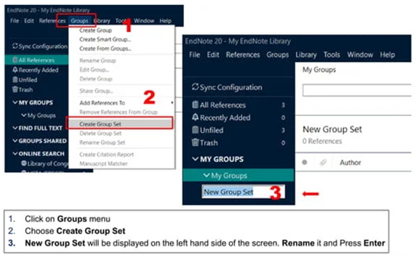
12A. TO CREAT GROUP SET

Slide 20
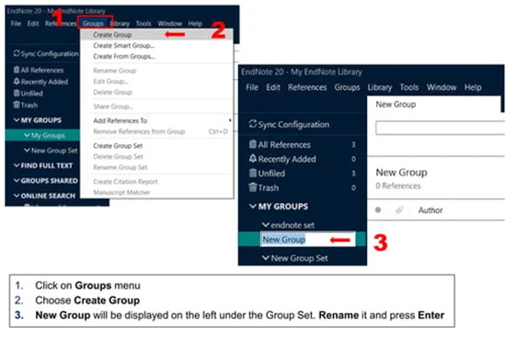
12B. TO CREAT A GROUP

Slide 21
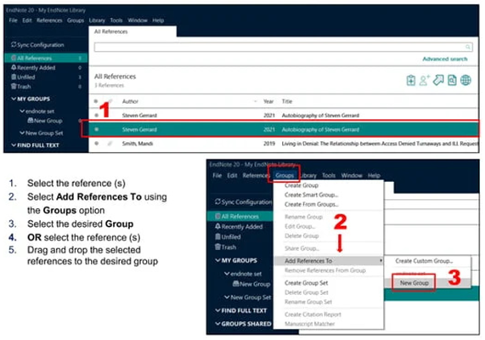
12C. TO ADD REFFERENCES TO GROUP

Slide 22
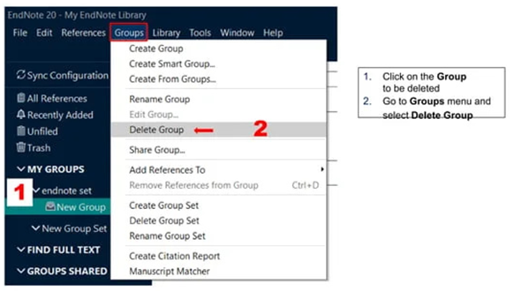
12D. TO DELETE GROUP

Slide 23
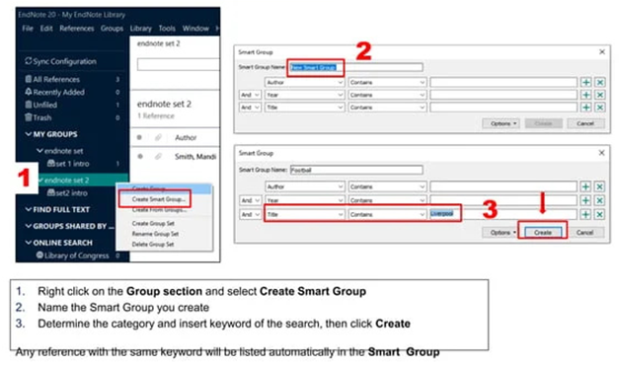
12E. SMART GROUP

Slide 24
13. CITE WHILE WRITING

Slide 25
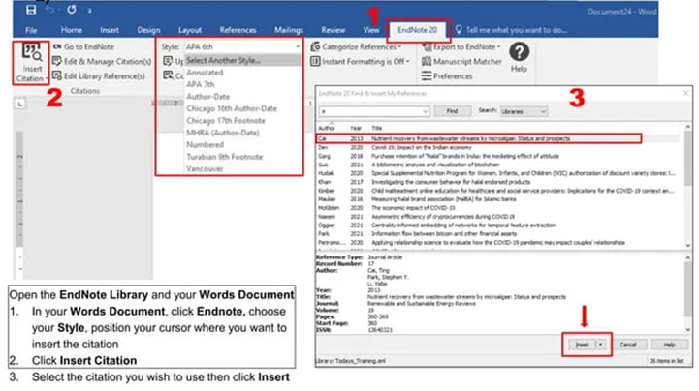
14A. INSERT CITATION

Slide 26
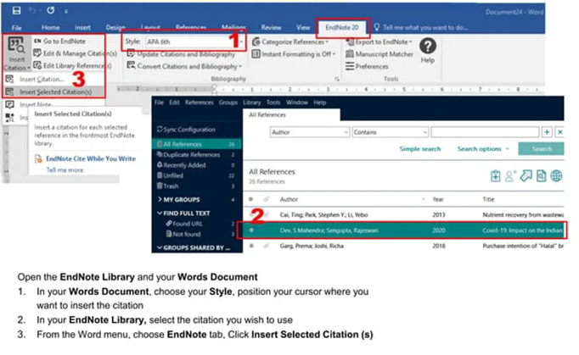
14B. INSERT CITATION

Slide 27
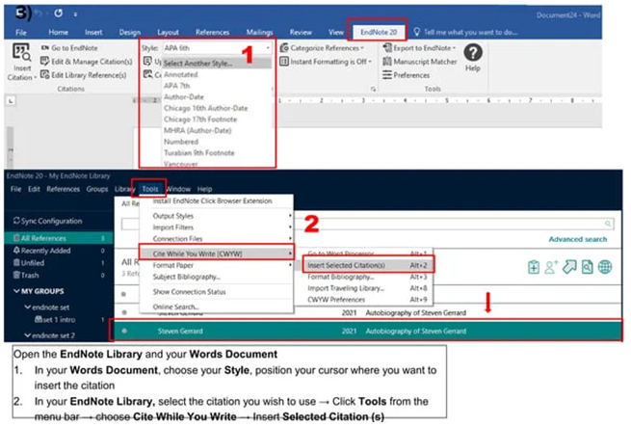
14C. INSERT CITATION

Slide 28
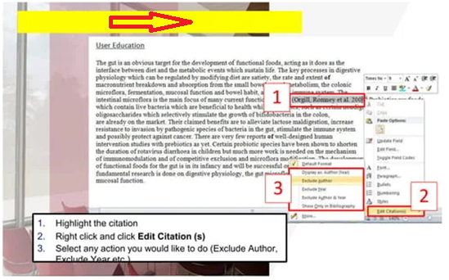
15. EDITING CITATION

Slide 29
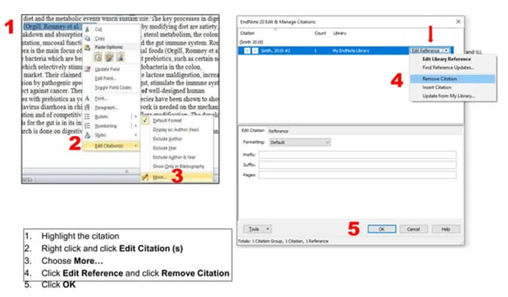
16. REMOVING CITATION

