Slide 15
.

Slide 24
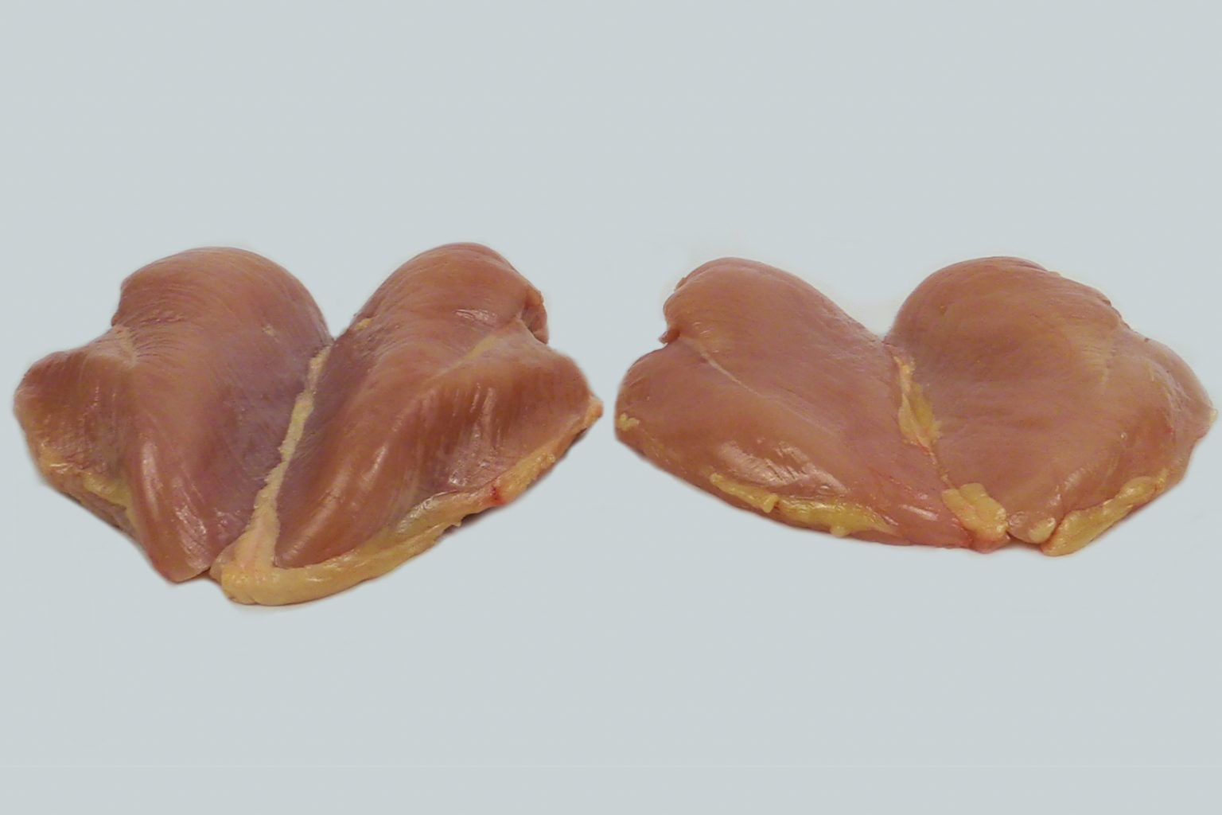

Slide 25
Wooden (or Woody) Breast (WB)
WB is macroscopically characterized by bulged, hard and rigid muscles with a surface hemorrhage and the presence of a light-yellow viscous exudate on the muscle surface Wooden breast muscle has a larger cross-sectional area and higher intramuscular collagen and ultimate postmortem

Slide 26
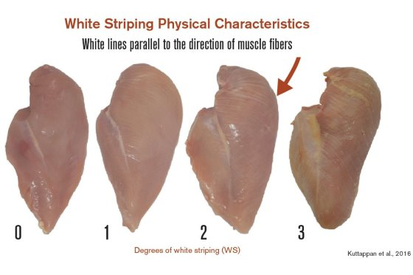

Slide 27
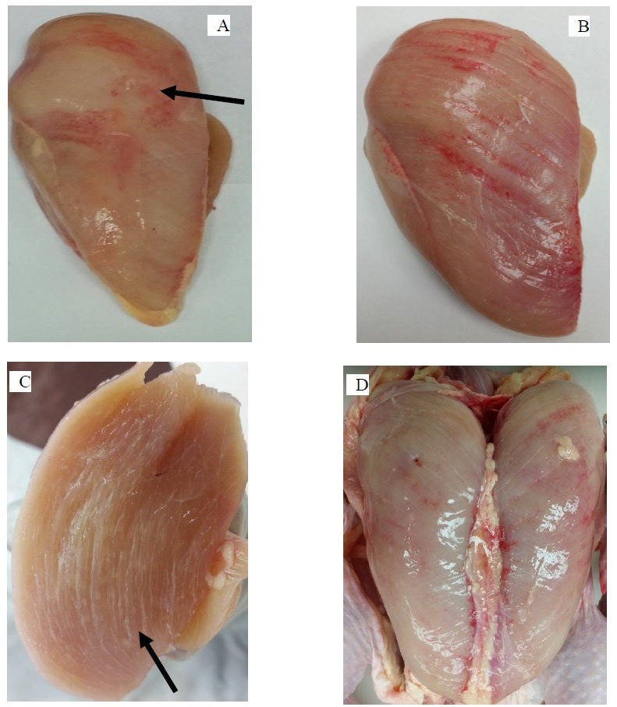

Slide 28
WB conditions on a breast muscle and WB conditions shown carcass. (A) WB: shows bulged areas (arrow) and hemorrhage, (B)
WB with white striping: shows bulged area, white stripes, and hemorrhages, (C) Cross section of WB muscle: white lines (arrow) are signs
of fibrosis and lipidosis, (D) WB conditions on a carcass shows bulged area, white stripes, hemorrhages and yellowish viscous fluids. WB,
woody breas

Slide 29
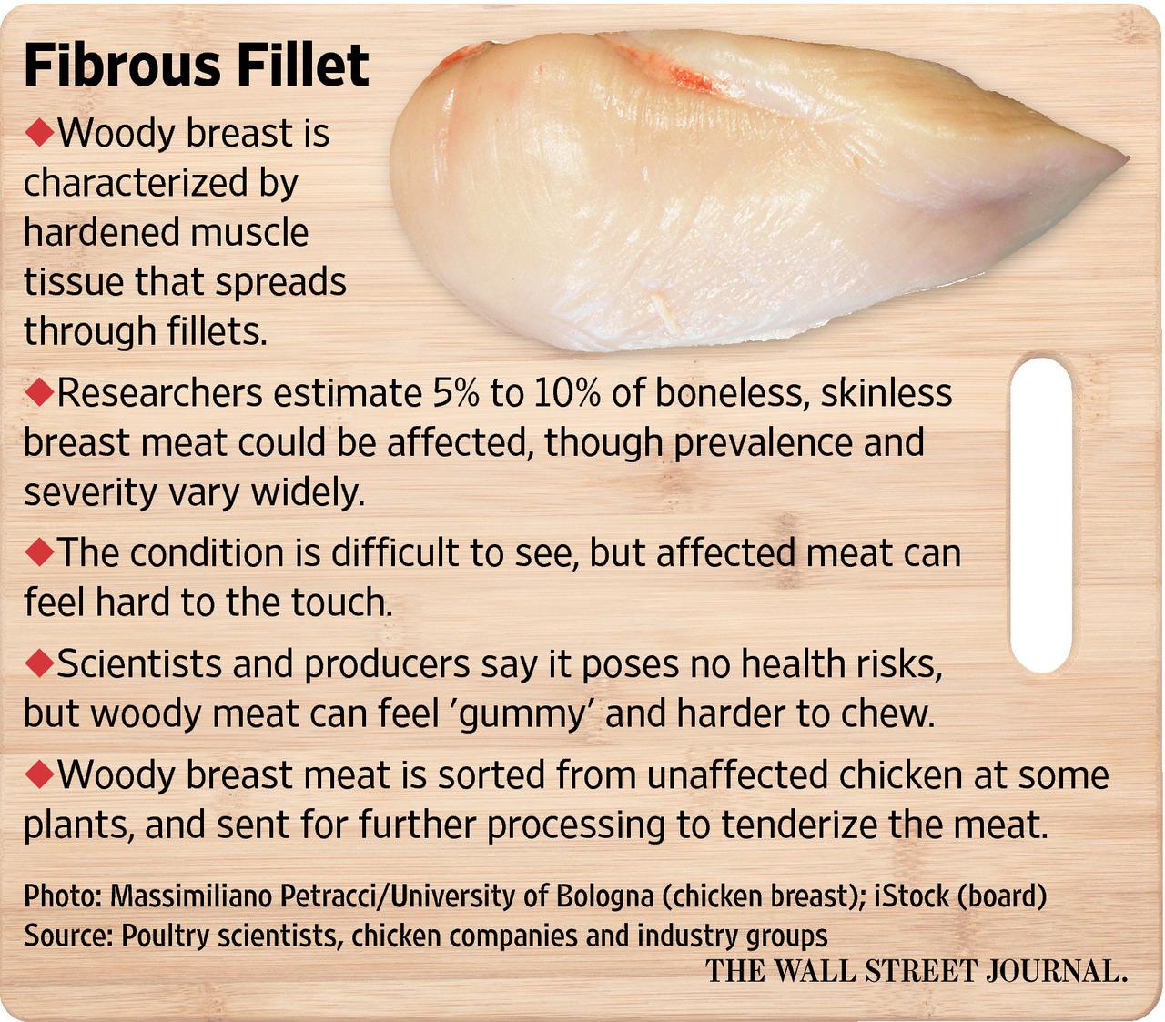

Slide 30
