Slide 2
1-poultry meat contain more protein as well as more amino acids than other meats.
2-poultry meat is quite low in cholesterol content .
3-poultry meat is excellent source for vitamins (A,B₁,B₂ ,B_{6 ,}B₁₂ ,C,Folic acid )as well as minirals (Iron ,Potassium ) .

Slide 3
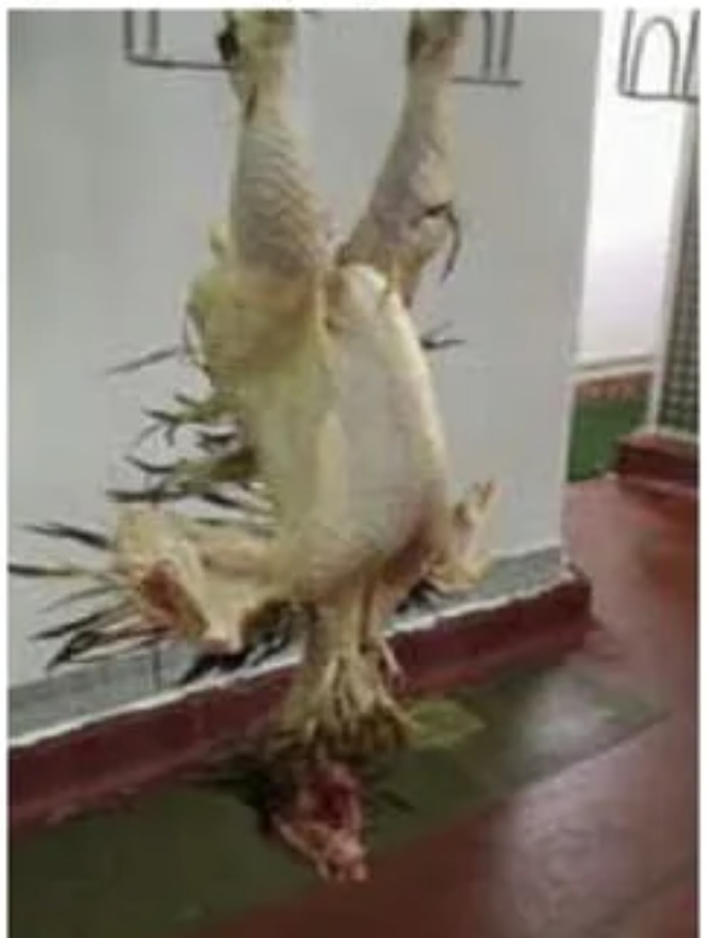
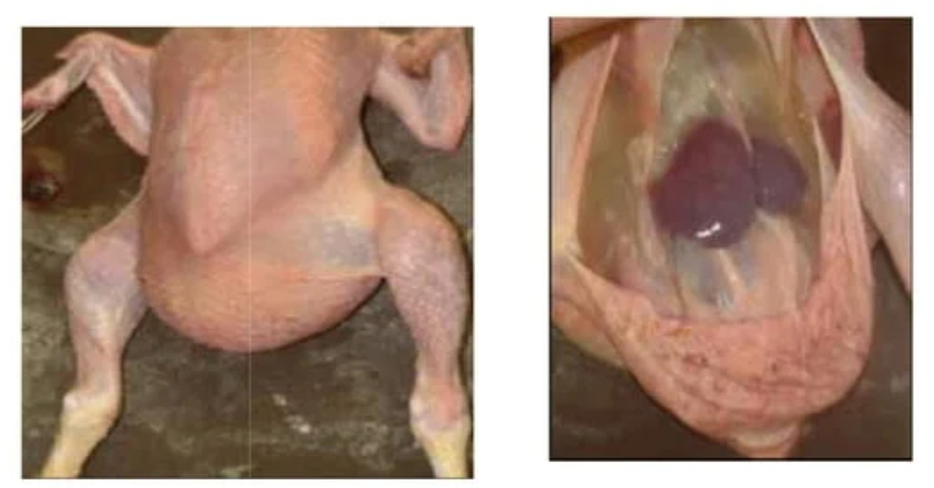
Condemnation
Complet condemmanition
Poorly plucked Ascitis

Slide 4
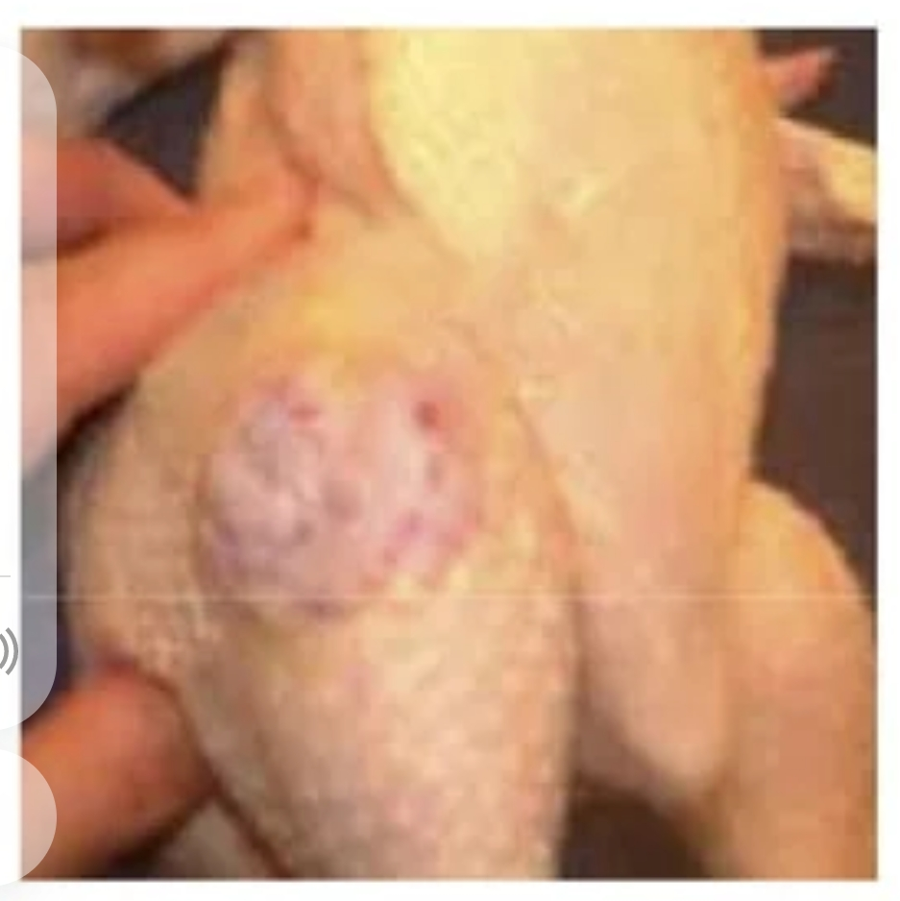
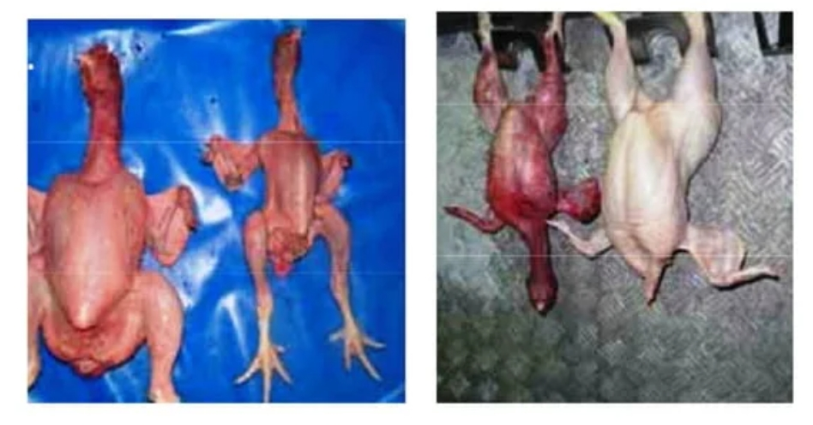
Condemnation
Complet condemmanition
Tumer (suspected fibromixoma) Emaciated Badly bled

Slide 5
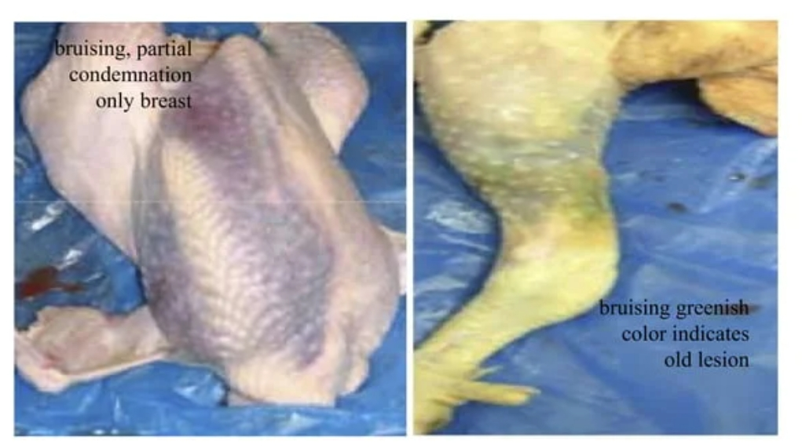
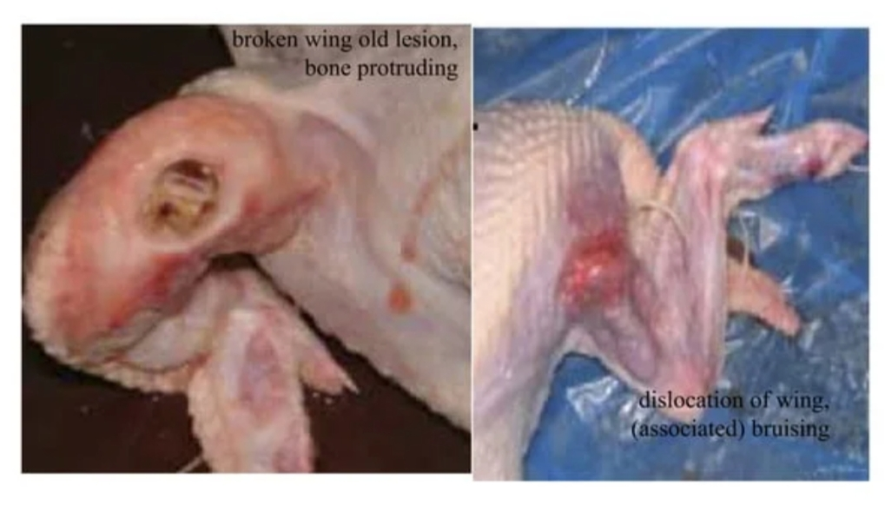
Condemnation
Partial condemmanition
Bruising Red Green Broken wings

Slide 6
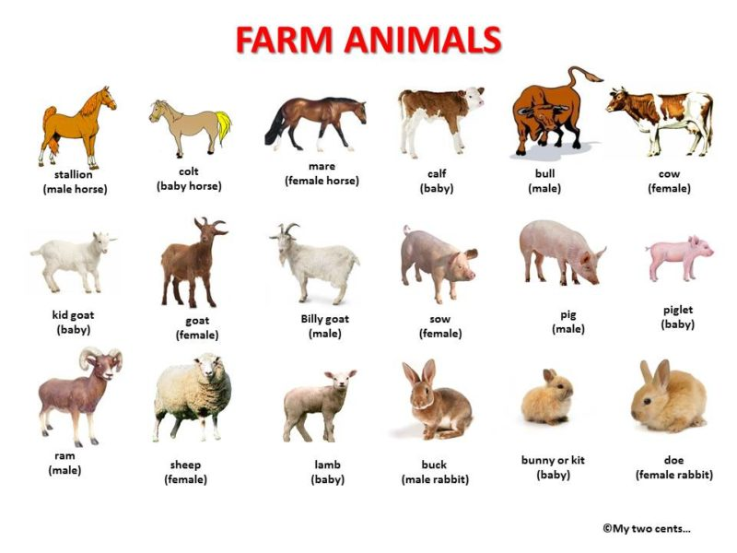

Slide 7
Necropsy vs. Autopsy?
Traditionally, the term “necropsy” has been used to refer to a post-mortem examination on an animal species, while “autopsy” has been reserved exclusively for human patients.
How do you perform animal necropsy?
Cattle, sheep, goats, and pigs are best positioned on their left side. Horses should be positioned on their right side.
Vedio

Slide 8
Inspection
What is ante mortem , post mortem ?
The term “ante-mortem” means “before death.” Ante-mortem inspection is the inspection of live animals prior to being slaughtered.
The term “Postmortem ” meaning “after death” .Postmortem inspection covers the inspection of the carcasses and parts of animal used for human food.

Slide 9
Brucellosis
Human Disease Animal Disease
Undulant Fever Bang’s Disease
Mediterranean Fever Contagious Abortion
Malta Fever Ram Epididymitis
Brucellosis, caused by bacteria of the genus Brucella, is an important zoonotic infection that causes reproductive disease in domestic animals and chronic debilitating disease in humans.
• Etiology:Brucella organisms, which are small aerobic (Gram –ve) intracellular coccobacilli.

Slide 10
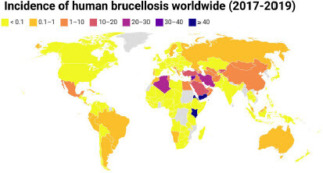
Geographic Distribution
Mediterranean region,Middle East
East and middle Asia
Central America
Sporadic cases in other countries Center

Slide 11
Species Affected Mainly sheep and goats
Occasionally –Cattle, camels, dogs
Rarely –Horses, pigs
Humans are very susceptible

Slide 13
Clincal singns
•Retained placentas
• Metritis
• Late term abortions
•Orchitis,epididymitis/or epididmo-orchitis
• Infertility
• Late term abortion or
birth of non-viable calf
• Mastitis
• Synovitis/arthritis

Slide 14
DIAGNOSTIC TESTS
Serology: Serum agglutination, complement fixation, ELISA.
Milk ring test
Culture maternal caruncle, placenta, stomach contents of oborted fetus .
PCR

Slide 15
Blackleg disease (Black quarter )
Definition: It is highly fatal, acute infectious disease of sheep and cattle, characterized by activation of latent spores in muscle with gas forming in tissues. Seasonal occurrence in warm, wet months. It has appeared in cattle of good condition with a tendency to be seasonal in summer affects animals 6 months to 2 years age and reduce incidence in animals more than 3 years.
Etiology: Clostridium chauvoei (Gram +, anaerobic, spores forming bacteria with virulent toxin)
Transmission: The spores of the organism can live in the soil for many years and can enter into the digestive tract with soil contaminated food and through cuts. In sheep, skin wounds from shearing, docking, castration, vulvar or vaginal laceration from parturition or the fresh navel (umbilicus) at birth are the most common routes. Infection of the vulva and vagina of the ewes during lambing may cause serious outbreak of the disease. Black leg is worldwide in distribution.

Slide 16
Blackleg disease (Black quarter )
Postmortem findings:
A.Gross lesion:
1-At necropsy, affected muscle is dark-brown or black in color, dry and sponge like or moist with numerous gas bubbles (bubbly appearance). Sweetish odor may be noticed.
2-Tongue, heart muscle and/or diaphragm may be blackish red.
3-Edema and hemorrhage of regional lymph nodes.
B.Microscopic lesion:
1- Gas bubbles in the fixed tissue are indicated by spherical spaces spreading muscle bundles and fascia.
2- Irregular areas of necrosis and collections of neutrophils and lymphocytes along muscle septa (edema is frequent).
3- Gram +ve bacilli demonstrated in section appearing singly or in small irregular clump.

Slide 17
Blackleg disease (Black quarter )
Cow, thigh muscle
Lesion: There are dark-red areas of hemorrhagic necrosis in the thigh muscle. Etiology: Clostridium Chauvoei
Cow, thigh muscle
Lesion: There are numerous “pseudocystic” spaces that were filled with substantial quantities of gas within hemorrhagic and necrotic muscle. Etiology: Clostridium Chauvoei

Slide 18
Blackleg disease (Black quarter )
Cow, thigh muscle
Lesion: Gram- positive bacilli (blue-stained rods) are present in the affected tissue. Formalin fixation, Gram stain.
Etiology: Clostridium Chauvoei

Slide 19
Any Question?

Slide 20
Fast Quiz
1-Ante-mortem inspection : is the inspection of live animals prior to being slaughtered . TRUE FALSE
2- Necropsy ? : has been used to refer to a post-mortem examination on an animal species . TRUE FALSE
3- Brucellosis : caused by bacteria of the genus Brucella
TRUE FALSE

Slide 21
Thank you

