Slide 1
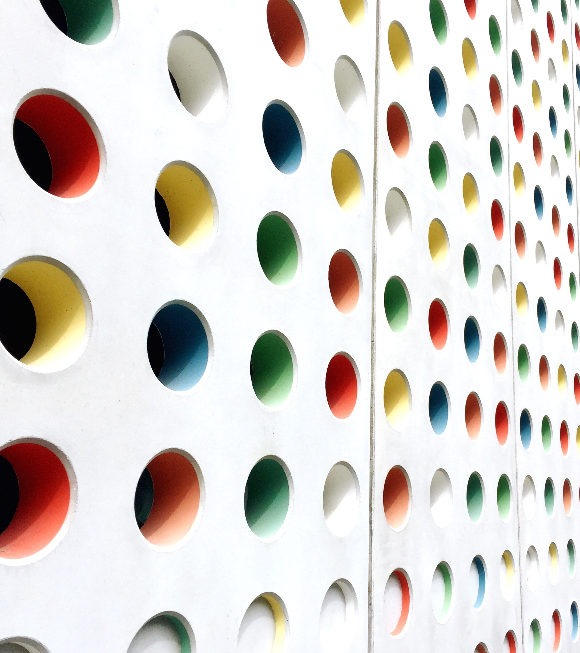
Assessment of dental cervical abrasion and its’ treatment needs

Slide 2
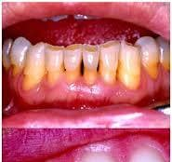
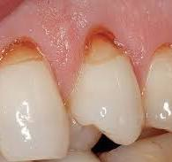
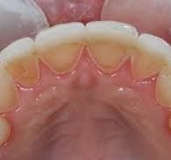
Tooth wear is a multifactorial process that results from three main interacting mechanisms
Each of these processes is continuous, unidirectional, and age-progressive
Attrition
abrasion
Erosion

Slide 3
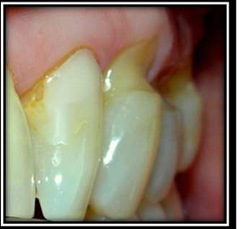
Dental Cervical Abrasion
Is a frequent pathological condition that consists of the wear of the hard tissues of the tooth, through a frictional mechanical process to repeated contact with different objects, different from the teeth
The initial state
A small horizontal groove near the CEJ on the vestibular surface of the crown of the tooth
A polished surface with a glassy appearance and tactile sensitivity which is derived from precipitated crystals of beta tricalcium phosphate substituted with Mg \ Beta-TCMP
With the advancement of the lesion
The walls constitute a “V” shape or wedge (cuneiform defect) with an acute axial angle close to 90°
The depth between 1 and 2 mm, although in exceptional cases lesions can be seen up to 4 mm deep, with possible pulpal exposure.

Slide 4
Causes of dental cervical abrasion
Aggressive tooth brushing or incorrect brushing technique / horizontal brushing was suggested as an etiological agent that increases wear two or three times compared to vertical brushing.
the use of a highly abrasive toothpaste / the type of toothpaste, the place where the toothbrush is started, the number of times the toothpaste is applied, the hardness of the bristles of the brush, the frequency and the pressure applied during brushing.
Hard bristles can cause less wear than soft bristles which can cause greater tooth abrasion. This is explained by the increase in the retention of the dentifrice to the smaller diameter of the element, increasing the contact area with the tooth surface during brushing.
Tooth brushing could increase cervical abrasion if there are acid substances in the oral environment; where, the erosive agents promote the demineralization of the tooth and facilitate the wear of the tissues, therefore after exposure to acidic foods or gastric liquids should be avoided tooth brushing for at least 1 hour.

Slide 5

Swasi classification ,2014
A classification system has:
To facilitate standardized identification of a condition
Help in diagnosis and treatment planning.
This Photo by Unknown Author is licensed under CC BY-SA

Slide 6
Sawai classification system for cervical abrasion
Class A: abrasion/tooth wear present only on the crown/ enamel with no involvement of root
Class B: abrasion/tooth wear present only on the root surface with no involvement of crown
Class C: abrasion/tooth wear present on both crown/enamel and the root surface
Each class can be further sub-classified to quantify the severity of the lesions. It is as follows:
Type I: Shallow concavities on the tooth surface, can be either wedge shaped or notched, the depth of the abrasion cavity is in the enamel surface or some exposure of dentine can be present
Type II: Tooth wear/concavity extending within the dentin, but pulp chamber is not visible
Type III: Tooth wear/concavity extending within the tooth dentin and the pulp chamber is visible
Type IV: Tooth wear/concavity extending within the tooth dentin and the pulp chamber is exposed to the oral cavity

Slide 7
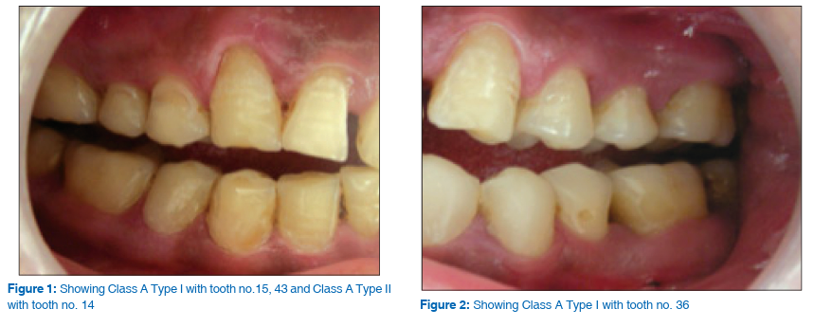
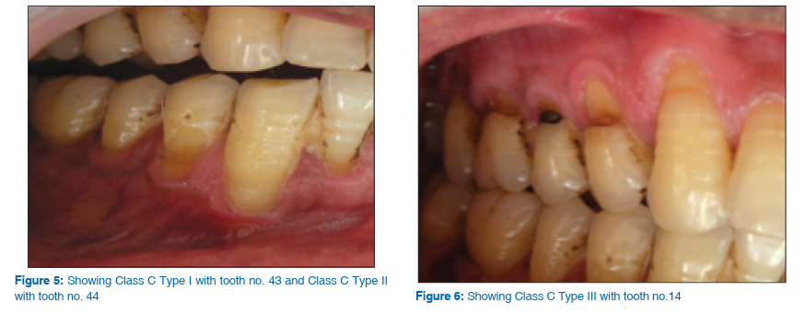

Slide 8

Treatment options for the patient
Class A Class B
Type I Restoration using composite resin
Type II Restoration using composite resin
Type III Restoration using GIC/ may require endodontic treatment
Type IV Endodontic treatment followed by crown
Type I Restoration using GIC
Type II Restoration using GIC
Type III Restoration using GIC/ may require endodontic treatment
Type IV Endodontic treatment followed by crown/ extraction

Slide 9
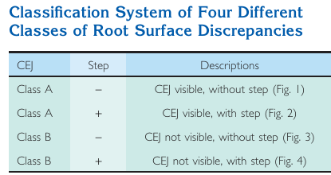
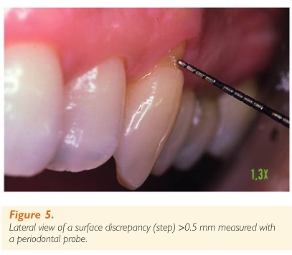
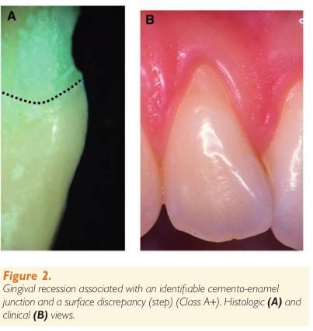
Pini- Prato, et al 2010
Dental surface defect in area of GR

Slide 10


