Slide 1











Ambiguity in Sports Language

Slide 2



What is Ambiguity?
a situation where a word, phrase, sentence, or expression has more than one possible interpretation or meaning.
‘Gillion, 1990’

Slide 3



l
Semantic Ambiguity
Types of Ambiguity
Syntactic Ambiguity
Lexical Ambiguity

Slide 4




Semantic Ambiguity
multiple possible interpretations of the meaning of a phrase or sentence

Slide 5
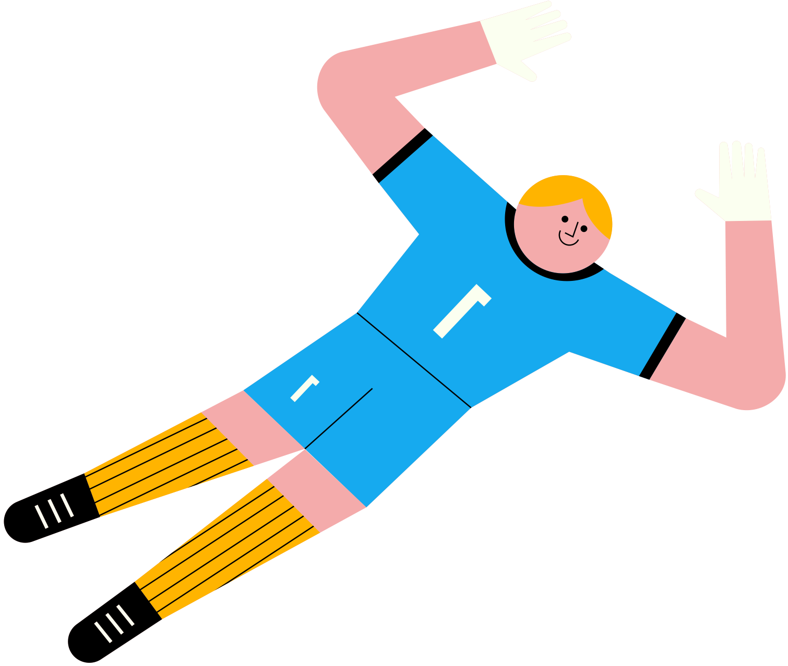








Examples
”Goalkeeper saves the day and his job“
Made crucial saves during the match, helping team to victory
His performance saved him from being replaced or fired

Slide 6



Examples
”Coach throws in the towel, Literally“
Coach has given up on their team’s chances or has resigned
Coach literally threw a towel onto the field, in frustration or a signal to players

Slide 7


Syntactic Ambiguity
A situation where a sentence or phrase has more than one possible interpretation because of its grammatical structure or arrangement of words.

Slide 8
Example (1)
”Coach Benches Player With Broken Arm“
Coach has decided not to play a player who has a broken arm
Coach, who has a broken arm, has benched a player for some reason

Slide 9


Example (2)
”Team Celebrates Victory With Trophy: Goalkeeper’s Heroics“
Team celebrated their victory by displaying the trophy won, attributing the win to the goalkeeper’s heroics
Team celebrated the victory with a trophy, which was achieved through the goalkeeper’s heroics
YOU ROCK!!

Slide 10

Lexical Ambiguity
multiple meanings of a single word

Slide 11


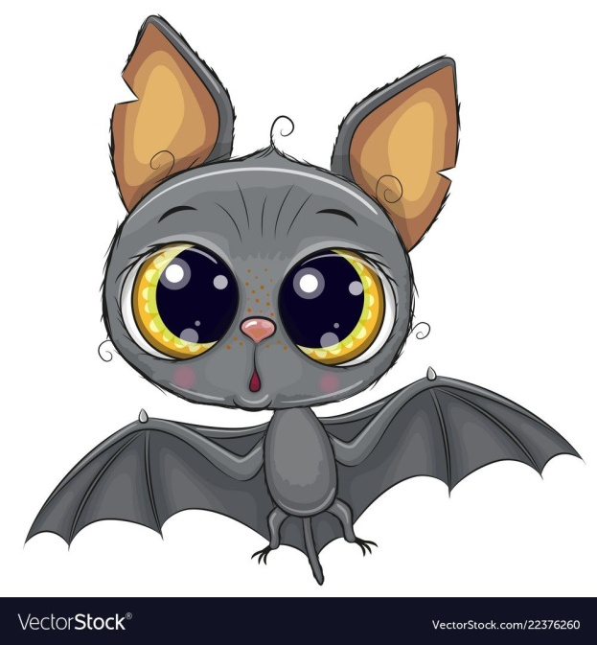


Lexical Ambiguity
These words have more than one meanings:
Match
Bat
Box

Slide 12
Negative effects of Ambiguity
Sport Language
Miscommunication
Disputes and Controversies
Loss of Credibility
Confusion on Newcomers
Negative Impact of Marketing Sposorship
Diminished Fans Engagement

Slide 13


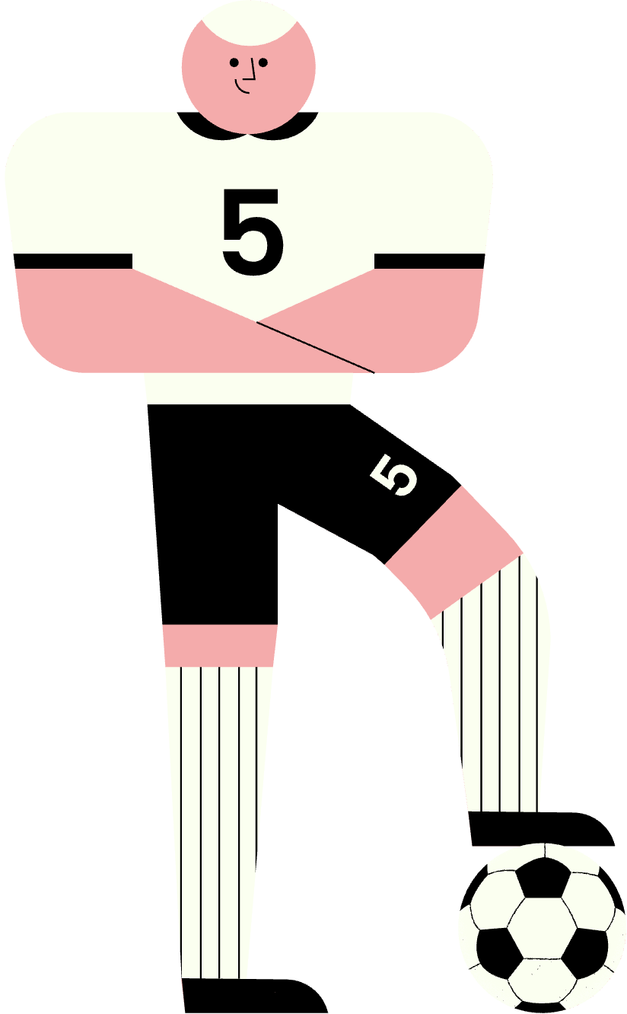
How to Avoid?!
Be Clear & Concise.
Define Terms.
Provide Context.
Use Examples.
Consider Your Audience.
Proofread.

Slide 14
Guess With Me
I shot the sheriff, but I did not shoot the deputy.
The sign said ‘ Fine for parking here’.
She’s cooking her family and her dog.
I’m on a whiskey diet. I’ve lost three days already.
I always take life with a grain of salt & a slice of lemon and a shot of tequila.
6
She told him that she loved him.
The chicken is ready to eat.
I saw a man on a hill with a telescope.
The dog bit the man who was passing by.
Time flies like an arrow; fruit flies
like a banana.
1
7
2
8
3
9
4
5
10

Slide 15


Thank you for listening.

Slide 16


References
  -Gillion, B. S. 1990. ‘Ambiguity, Generality, and Indeterminacy: Tests and Definitions’ Synthese 85. 391-416.
  Hamidi, Y. M. 2009. ‘Some cases of Ambiguity in English’: Daily Magazine, no. 38.1-21.
  Hocza, A. 2006. ‘Learning Tree Patterns for Syntactic Parsing’: Acta Cybernetica 17. 647-659.
  Oaks, D. D. 2010. Structural Ambiguity in English. An Applied Grammatical Inventory. Continuum International Publishing Group.

