Slide 1
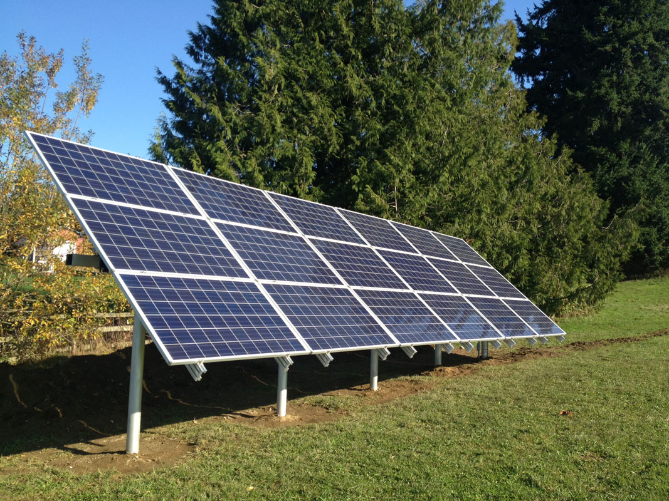
Introduction to Solar

Slide 2
Preview
Types of Renewable energy
photovoltaics PV
Does solar work in our cities?
Other uses
Q&A

Slide 3

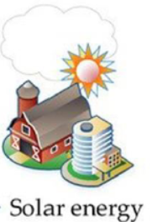

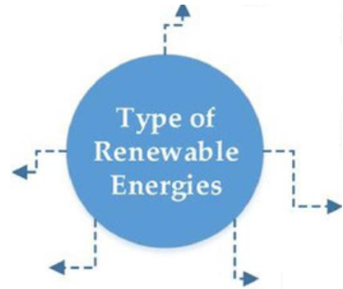
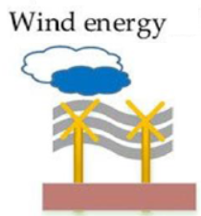
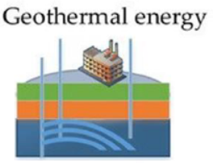

Slide 4
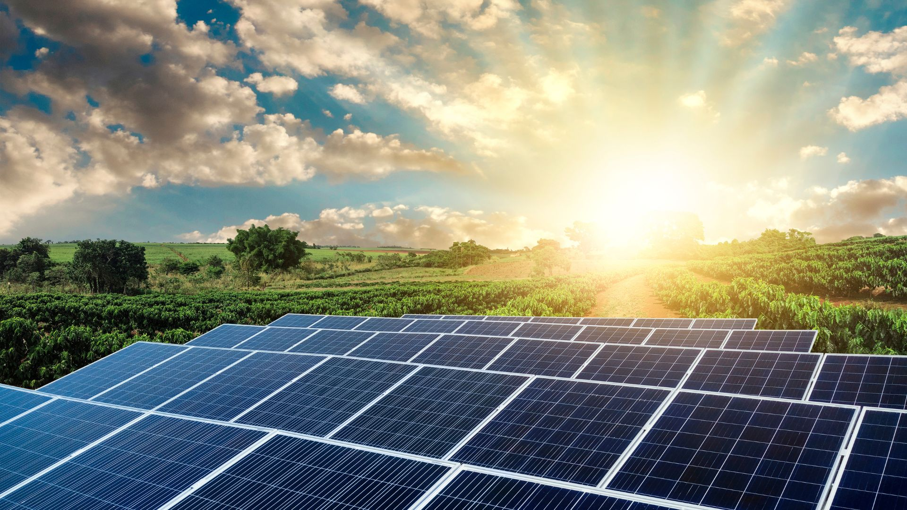

Slide 5
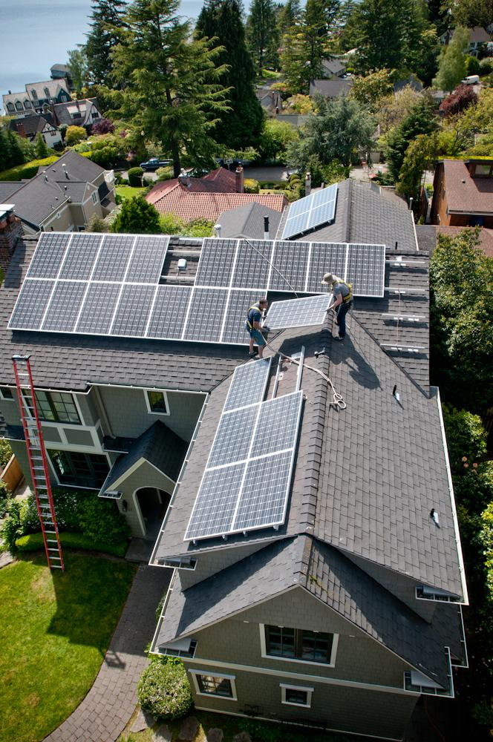
Solar photovoltaics
(solar PV)
A solar PV system generally consists of photovoltaic modules ("solar panels") installed as an array (series of panels) on a rooftop to generate electricity to be used by the home or business.
Notes:
The most basic solar PV set up is grid-tied and net metered. Battery storage either on or off-grid is more complicated.
Any excess electricity is sent to the grid to power neighboring homes and businesses.

Slide 6

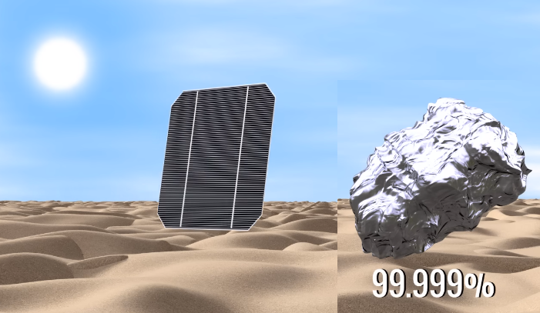
How to get solar energy ?

Slide 7
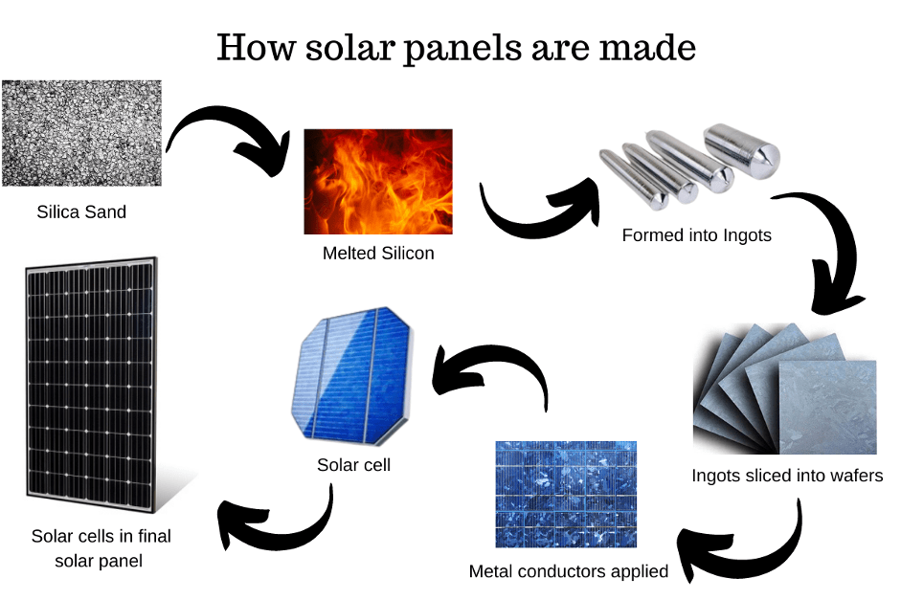

Slide 8
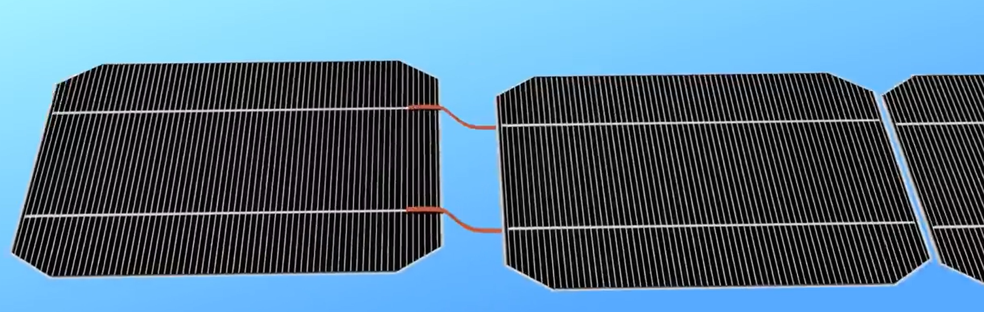
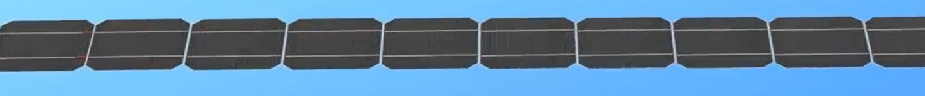
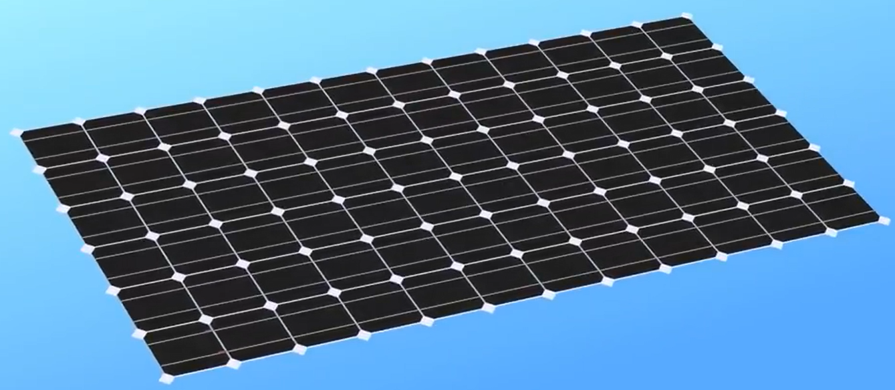

Slide 9
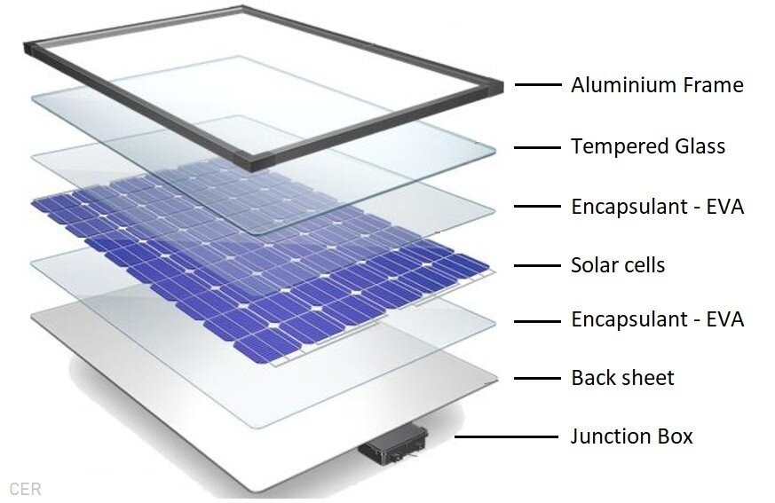

Slide 10
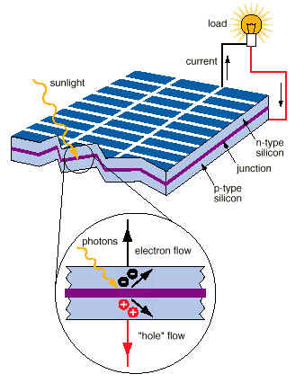

Slide 11
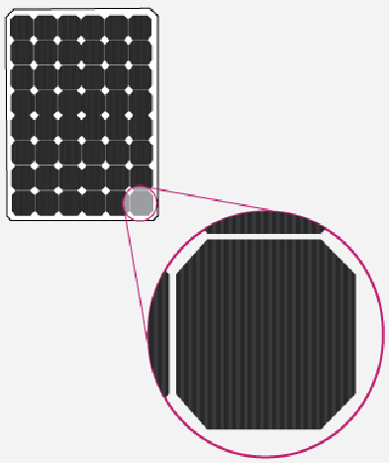
Types of solar panels
Monocrystalline
Polycrystalline
Thin film

Slide 12
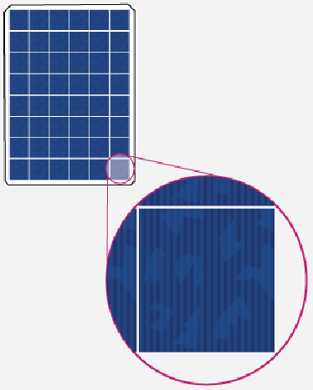
Types of solar panels
Polycrystalline

Slide 13
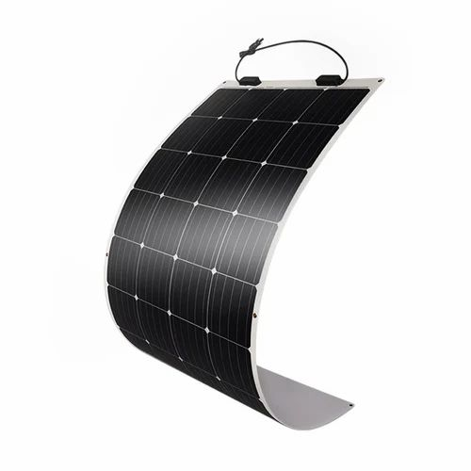
Types of solar panels
Thin film solar panel

Slide 14
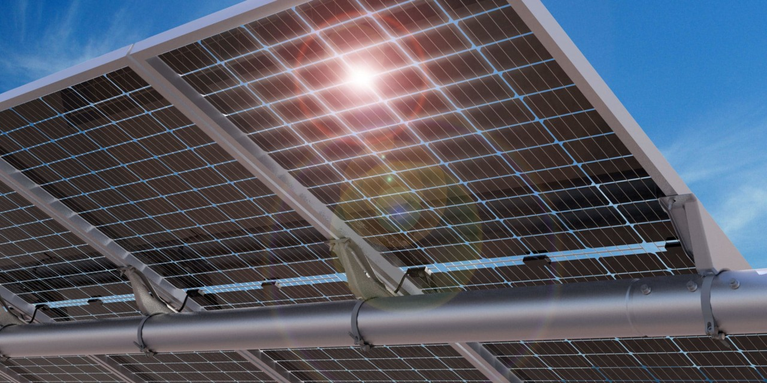
Types of solar panels
Bifacial solar panel

Slide 15
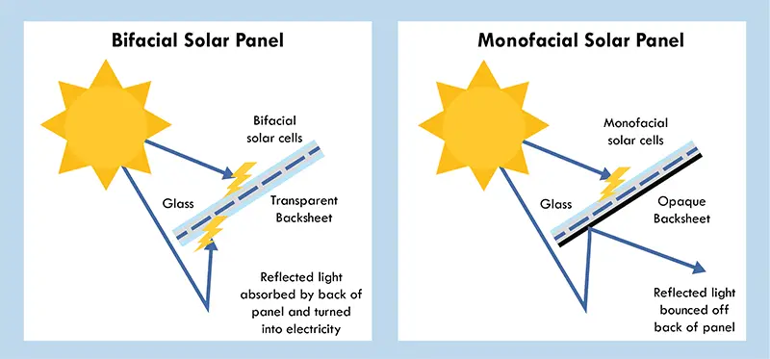

Slide 16
Types of solar systems
Stand-alone solar system
Off- grid solar system
On- grid solar system
Hybrid solar system

Slide 17
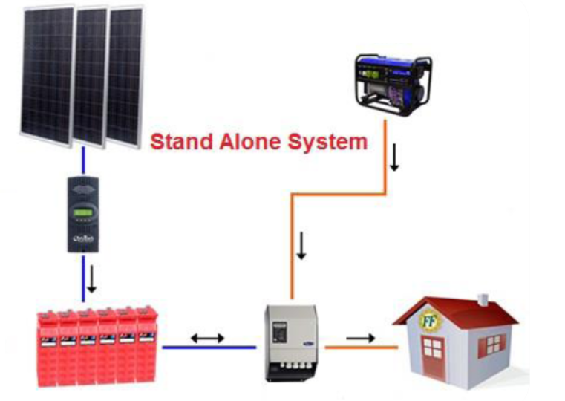
Stand-alone solar system

Slide 18
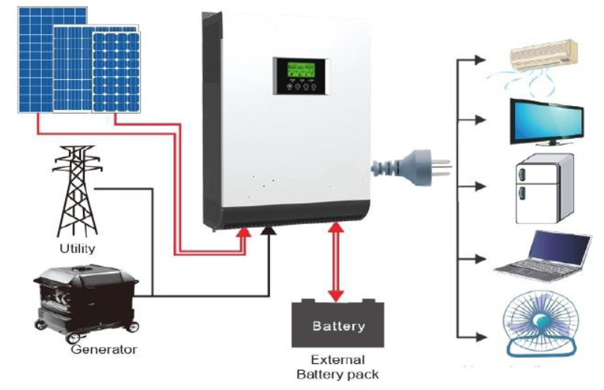
Off- grid solar system

Slide 19
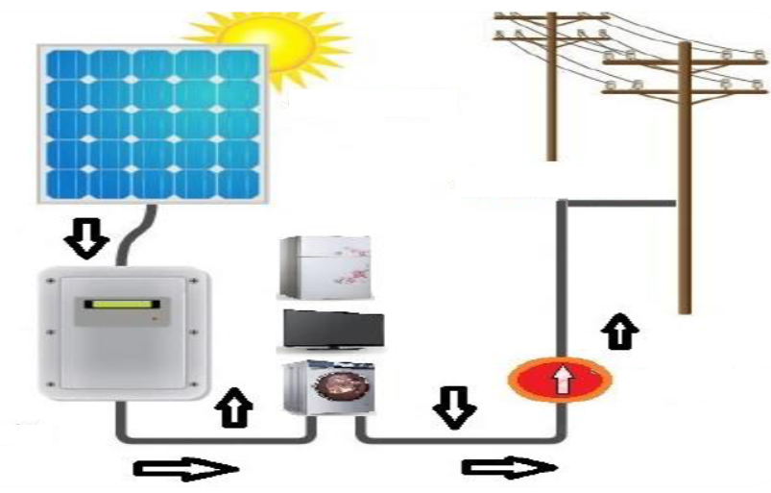
On-grid solar system

Slide 20
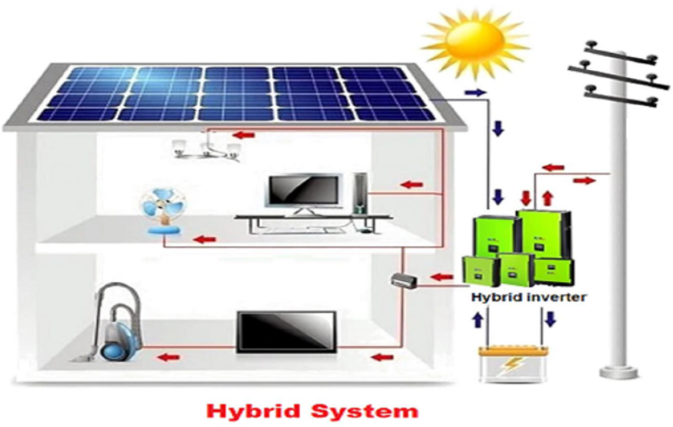
Hybrid solar system

Slide 21
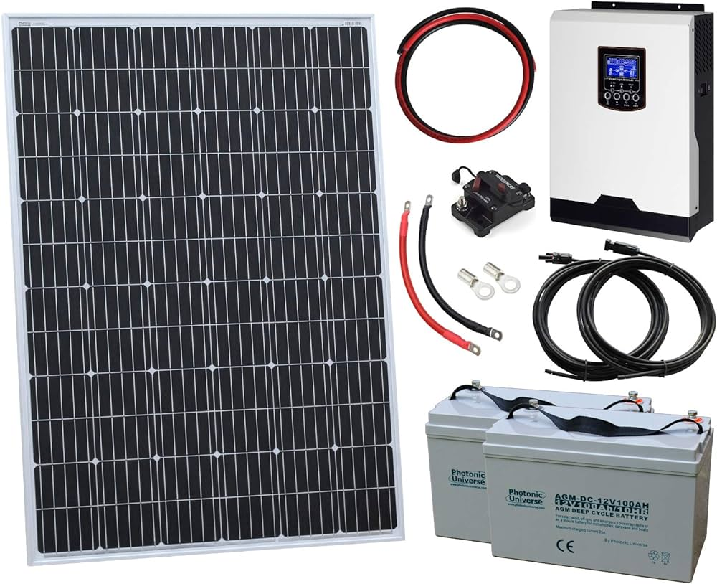
Components of solar system
Module or Panel is a solar photovoltaic panel.
Inverter converts DC electricity to AC electricity.

Slide 22
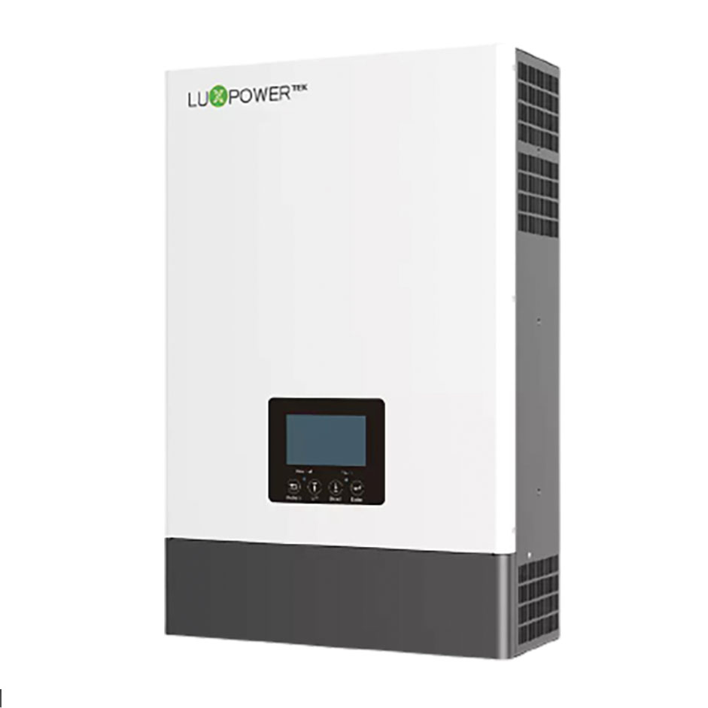
Components of solar system
Module or Panel is a solar photovoltaic panel.
Inverter converts DC electricity
to AC electricity.

Slide 23
Components of solar system
Batteries

Slide 24
Components of solar system
Solar charge controller

Slide 25
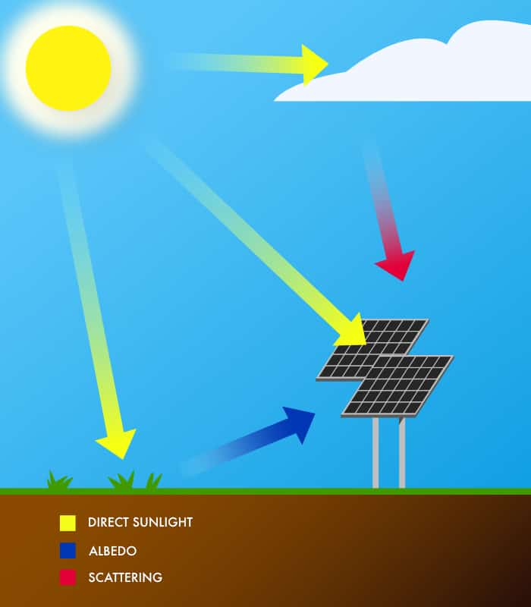
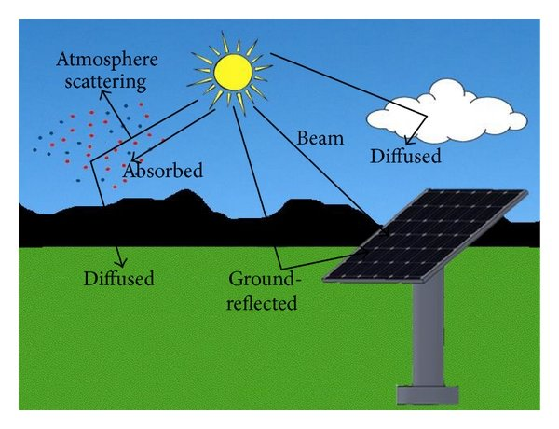
Effect of various parameters on the performance of solar PV
Solar radiation

Slide 26
Orientation angle
Tilt angle

Slide 27
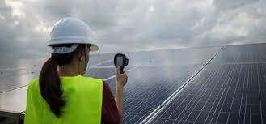
Temperature

Slide 28
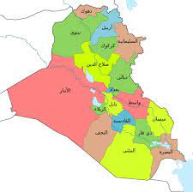
Does solar works in our cities?
Long summer days = more hours to capture sun’s energy
Solar systems keep working on cloudy days collecting scattered light
Notes:
Notes: Germany has approximately 10% fewer annual hours of sunlight than Seattle and most of the country is actually north of the Puget Sound’s latitudes, yet over half of the world’s solar energy is being generated there.
Solar works even in Alaska!

Slide 29
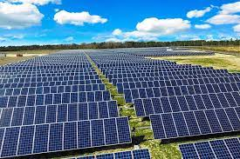
How can you use solar in your home or business?
Electricity from Solar
    Solar photovoltaics (PV)
Heat from Solar
    Passive solar
    Solar thermal/hot water
    Solar air heater
Notes:
There is a distinction is between generating heat vs generating electricity. Generating electricity from the sun is most common and what most people think about when you say “solar energy”.
For today’s presentation, we will focus on how you can generate electricity with solar energy. Specifically, photovoltaics – “PV” tied to the grid (no batteries).
Battery backup
For those off-grid or wishing for backup due to power outages, battery backup are strong considerations. There are additional costs compared with simple grid-tied systems. For this presentation, we will focus on grid-tied PV systems.
Later in the presentation we’ll have a brief summary on heat-related solar energy uses.

Slide 30

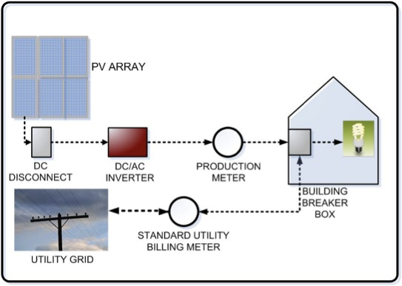
How a solar PV array captures the sun’s rays and delivers energy to a home
Notes:
No moving parts in a PV system.
Panels turn photons from the sun into DC electricity, sends it down to an inverter which converts DC into AC electricity (which feeds appliances, etc.) and is typically mounted close to your electric panel either on the inside or outside wall.
A separate production meter is also installed that measures the total amount of electricity produced by the PV system before it is used in the house. Washington State’s Production Incentive is paid based on the data recorded by this meter. The meter is required to participate in the Production Incentive
Goes into main service panel/breaker box to feed appliances, etc
If there is excess power being produced the electricity into the grid via your Net Meter. A Net Meter is also considered as the "Utility Billing Meter." Here in Washington, your utility may allow you to spin your Net Meter backwards and generate a credit for your excess solar power on your bill.
With net-metering the utility company calculates the remainder of energy that you consume minus the amount that your PV modules produce. You are charged only for this amount on your electricity bill. If your system produces more electricity than you use you will receive credit that can be carried over month-to-month.

Slide 31
Why solar energy?
Environmental concerns/reduce carbon emissions
Save money on electric bills
General interest in new technologies
Increase in home value
Notes:
Presenter: ask attendees why they are interested in solar to get a general sense of why they are there.
Designed to promote a little bit of discussion.

Slide 32
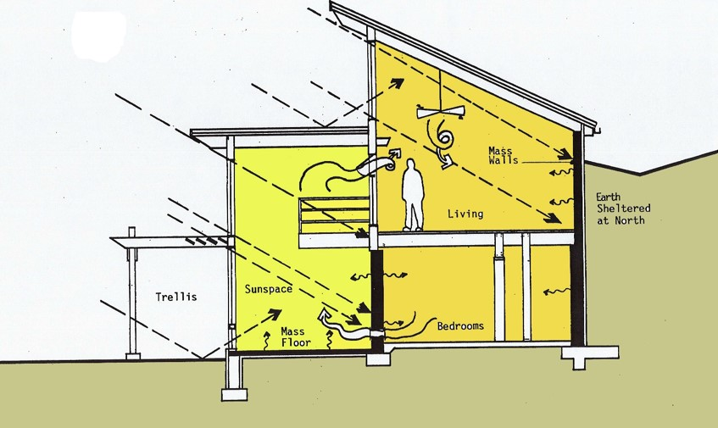
Heat from Solar:
Passive solar
Building a structure that collects heat from the sun and retains it in materials that store heat, known as thermal mass.
Solar heat is transferred from where it is collected and stored to different areas of the structure by conduction, convection, radiation and even small fans and blowers.
Notes:
Notes:
-Collects heat typically through south-facing windows
-Well-designed passive solar structures first reduce heating and cooling needs through energy-efficiency strategies (including good insulation) and then makes up for those reduced loads with solar energy. Designed to take advantage of it's location, climate, and materials to minimize energy use.

Slide 33
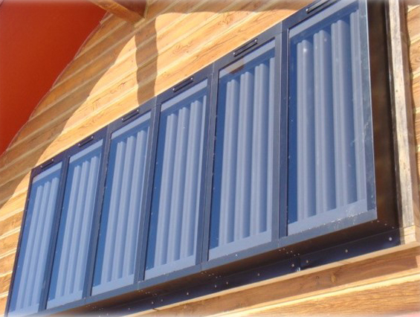
Heat from Solar:
Solar air heater
Energy from the sun is captured by an absorbing medium and used to heat air.
Works like a greenhouse by circulating air from inside a home through the system mounted on the exterior wall.
Notes:
Notes: The room air can gain up to 30 - 40 degrees before being vented back into the room.

Slide 34
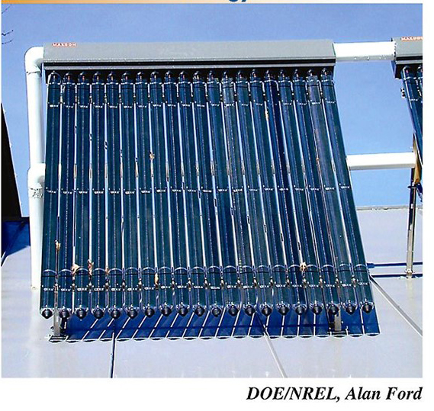
Heat from Solar:
Solar thermal/hot water
Used to heat residential, commercial or industrial water supplies as well as space heating and pools.
A collector - typically fastened to a roof or a wall facing the sun – is used to heat an anti-freeze solution that is either pumped (active system) or driven by natural convection (passive system) through it.
Notes:
A collector can be a traditional flat plate and the evacuated tube systems

Slide 35
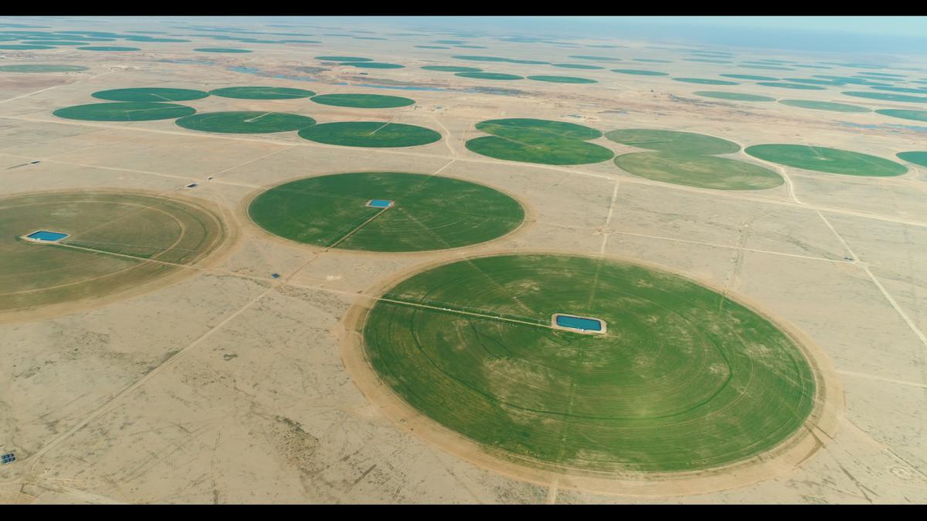

Slide 36
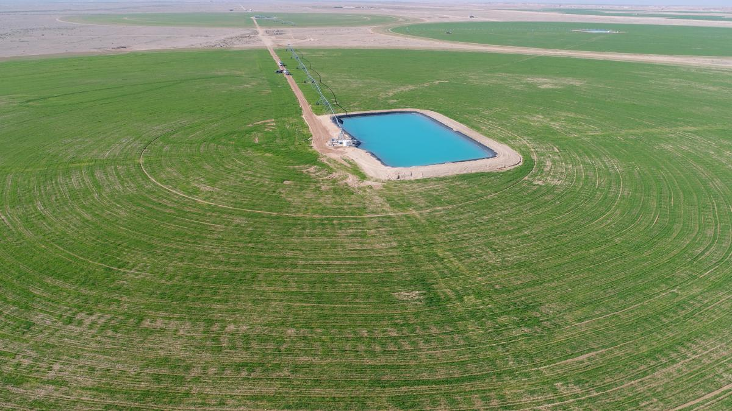

Slide 37
Determining system size
Your goals for electric bill offset
Roof space available for PV
Roof shading / orientation / pitch
Depends on your budget or your investment goals
      Complexity of installation will impact budget

Slide 38
Other benefits of Solar PV
Increased home values
Longer warranties
No moving parts
Low maintenance (Inverter replacement)
Unlimited resource / free fuel (the sun!)
Creates local jobs
Notes:
Comment pertaining to low maintenance: typical central inverter will need to be replaced after 10 years of operation. Folks should consider this when evaluating the maintenance needs of a PV system.

