Slide 1
Introduction to Arduino Programming
By
A.L. Mohanad Ghai Khamees

Slide 2
Contents:
1- Aim.
2- Background.
3- Products of the Arduino Company.
4- Arduino Uno Board.
5- Examples of Arduino Circuits

Slide 3
1- Aim:
The aim of this presentation is to give an idea of the Arduino programming in order to achieve various tasks

Slide 4
1- Aim:
These tasks are usually achieved by reading the value of a sensor and then activating a machine accordingly.

Slide 5
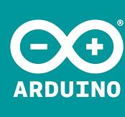
2- Backgraound:
Arduino is an Italian company founded by Massimo Banzi and David Cuartielles in 2005

Slide 6
2- Backgraound:
The Arduino project started as a tool for the students at the Interaction Design Institute Ivrea, Italy

Slide 7
3- Products of the Arduino Company:
Nowadays, the Arduino company provides both hardware and software that allows professionals and amatuers to achieve many electronic circuits that are easy to profram and connect

Slide 8
3- Products of the Arduino Company:
Their main software product is the Arduino IDE (Integrated Development Environment) which is a program that is downloadable for free from the website on all operating systems (Windows, Linux, MacOS, and others)

Slide 9
3- Products of the Arduino Company:
The Arduino IDE is a programming language that is used in order to program the Arduino board to do a specific task.
It shows the operation sequence of the program step by step and allows debugging.

Slide 10
3- Products of the Arduino Company:
There are many Arduino Hardware products, they can be mainly divided into 2 groups, which are:
A- Developments boards
B- Accessory boards

Slide 11
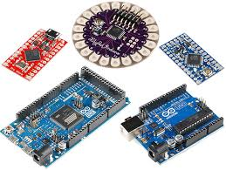
A- Developments boards
These are boards that contain a microcontroller unit that can be programmed to perform a certain task.

Slide 12
A- Developments boards
The development boards include the following:
I- Arduino Uno
II- Arduino Leonardo
III- Arduino Mega
IV- Arduino Due
and many other boards

Slide 13
A- Developments boards
These previous 4 boards differ from each other in the used microcontroller, clock, and some other differences

Slide 14
B- Accessory boards
These are boards that simplify adding a function to the proposed circuit. They include shield boards (sometimes called shields)

Slide 15
4- Arduino Uno Board:
This is the most commonly used Arduino board since it is very simple, and it has sufficient number of input and output pins. It also contains a memory that is capable of saving programs that perform multiple goals

Slide 16
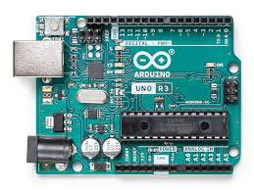
4- Arduino Uno Board:

Slide 17
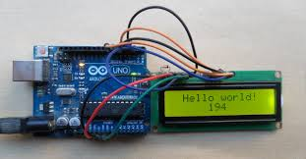
5- Examples of Arduino Circuits

Slide 18
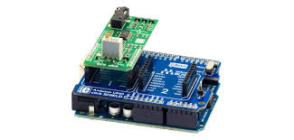
5- Examples of Arduino Circuits

Slide 19
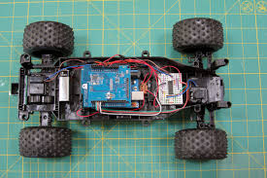
5- Examples of Arduino Circuits

Slide 20
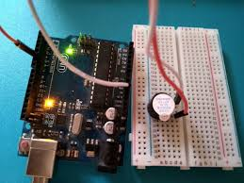
5- Examples of Arduino Circuits

Slide 21
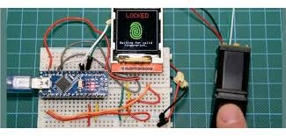
5- Examples of Arduino Circuits

Slide 22
Thank you very much

