Slide 1
GENETIC MARKERS
Assist. Prof. Dr. Ibtisam Qahtan Abdul- Kareem

Slide 2
GENETIC MARKERS
Is a gene or DNA sequence with a known location on a chromosome that can be used to identify individuals or species. It can be described as a variation (which may arise due to mutation or alteration in the genomic loci) that can be observed. A genetic marker may be a short DNA sequence, such as a sequence surrounding a single base-pair change (single nucleotide polymorphism, SNP), or a long one, like minisatellites.

Slide 3
For many years, gene mapping was limited to identifying organisms by traditional phenotype markers. This included genes that encoded easily observable characteristics such as blood types or seed shapes. The insufficient number of these types of characteristics in several organisms limited the mapping efforts that could be done. This prompted the development of gene markers which could identify genetic characteristics that are not readily observable in organisms (such as protein variation).

Slide 4
Some commonly used types of genetic markers are:
RFLP (or Restriction fragment length polymorphism).
SSLP (or Simple sequence length polymorphism).
AFLP (or Amplified fragment length polymorphism).
RAPD (or Random amplification of polymorphic DNA).
VNTR (or Variable number tandem repeat).
SSR Microsatellite polymorphism, (or Simple sequence repeat).
SNP (or Single nucleotide polymorphism).
STR (or Short tandem repeat).
SFP (or Single feature polymorphism).
DArT (or Diversity Arrays Technology).
RAD markers (or Restriction site associated DNA markers).

Slide 5
Molecular genetic markers can be divided into two classes:
a) biochemical markers which detect variation at the gene product level such as changes in proteins and amino acids. b) molecular markers which detect variation at the DNA level such as nucleotide changes: deletion, insertion, duplication and substitution.
Markers can exhibit two modes of inheritance, i.e. dominant/recessive or co-dominant. If the genetic pattern of homo-zygotes can be distinguished from that of hetero-zygotes, then a marker is said to be co-dominant. Generally co-dominant markers are more informative than the dominant markers.

Slide 6
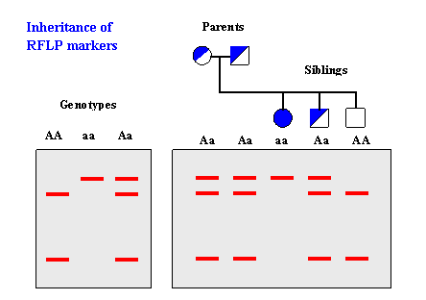

Slide 7
GENETIC MARKERS CAN BE USED TO :
1- Study of the relationship between an inherited disease and its genetic cause (for example, a particular mutation of a gene that results in a defective protein). It is known that pieces of DNA that lie near each other on a chromosome tend to be inherited together. This property enables the use of a marker, which can then be used to determine the precise inheritance pattern of the gene that has not yet been exactly localized.

Slide 8
2- Genetic markers are employed in genealogical DNA testing for genetic genealogy to determine genetic distance between individuals or populations. Uniparental markers (on mitochondrial or Y chromosomal DNA) are studied for assessing maternal or paternal lineages.
Genetic markers have to be easily identifiable, associated with a specific locus, and highly polymorphic, because homozygotes do not provide any information. Detection of the marker can be direct by RNA sequencing, or indirect using allozymes.

Slide 9
RFLP markers:
Restriction fragment length polymorphism (RFLP) is a technique that exploits variations in homologous DNA sequences, known as polymorphisms, in order to distinguish individuals, populations, or species or to pinpoint the locations of genes within a sequence. In RFLP analysis, a DNA sample is digested into fragments by one or more restriction enzymes, and the resulting restriction fragments are then separated by gel electrophoresis according to their size. RFLP analysis was the first DNA profiling technique inexpensive enough to see widespread application. RFLP analysis was an important early tool in genome mapping, localization of genes for genetic disorders, determination of risk for disease, and paternity testing.

Slide 11
AFLP
Is a PCR- based tool used in genetics research, DNA fingerprinting, and in the practice of genetic engineering. AFLP uses restriction enzymes to digest genomic DNA, followed by ligation of adaptors to the sticky ends of the restriction fragments. A subset of the restriction fragments is then selected to be amplified. This selection is achieved by using primers complementary to the adaptor sequence, the restriction site sequence and a few nucleotides inside the restriction site fragments. The amplified fragments are separated and visualized on denaturing on agarose gel electrophoresis, either through autoradiography or fluorescence methodologies, or via automated capillary sequencing instruments.

Slide 12
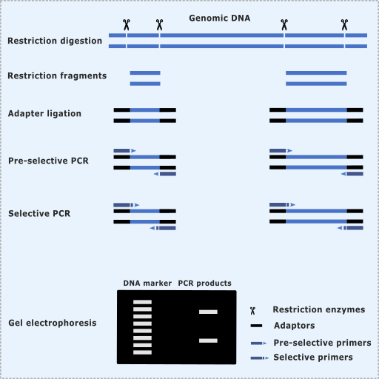

Slide 13
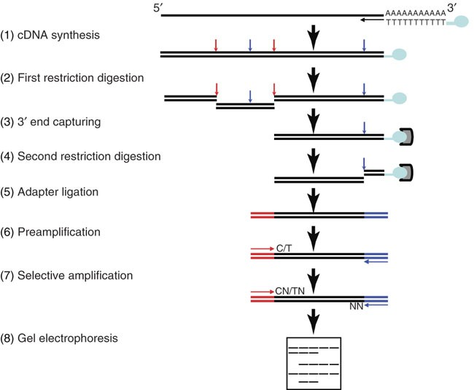

Slide 14
Random amplification of polymorphic DNA (RAPD):
Pronounced "rapid", but the segments of DNA that are amplified are random.The scientist performing RAPD creates several arbitrary, short primers (8–12 nucleotides), then proceeds with the PCR using a large template of genomic DNA, hoping that fragments will amplify. By resolving the resulting patterns, a semi-unique profile can be gleaned from an RAPD reaction. No knowledge of the DNA sequence of the targeted genome is required, as the primers will bind somewhere in the sequence, but it is not certain exactly where.

Slide 15
This makes the method popular for comparing the DNA of biological systems that have not had the attention of the scientific community, or in a system in which relatively few DNA sequences are compared (it is not suitable for forming a cDNA databank). Because it relies on a large, intact DNA template sequence, it has some limitations in the use of degraded DNA samples. Its resolving power is much lower than targeted, species-specific DNA comparison methods, such as short tandem repeats. In recent years, RAPD has been used to characterize, and the phylogeny of diverse plant and animal species.

Slide 16
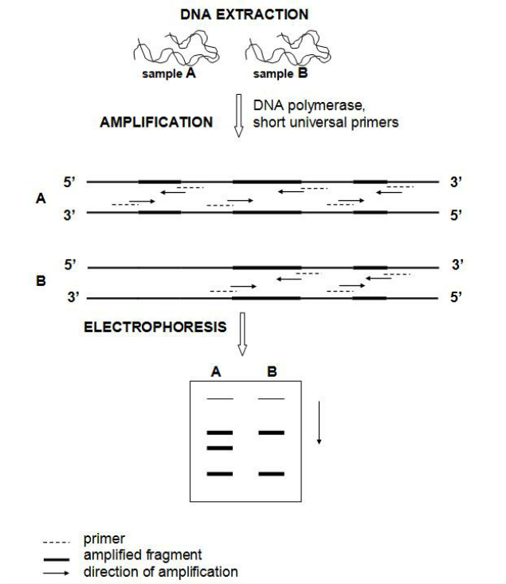

Slide 17
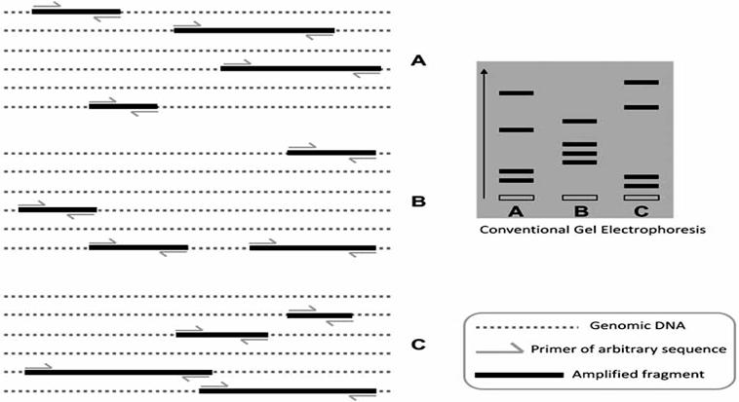

Slide 18
Microsatellite:
Microsatellites are often referred to as short tandem repeats (STRs) or as simple sequence repeats (SSRs) .
A microsatellite is a tract of repetitive DNA in which certain DNA motifs (ranging in length from one to six or more base pairs) are repeated, typically 5–50 times. Microsatellites occur at thousands of locations within an organism's genome. They have a higher mutation rate than other areas of DNA leading to high genetic diversity.

Slide 19
They are widely used for DNA profiling in cancer diagnosis, in kinship analysis (especially paternity testing) and in forensic identification. They are also used in genetic linkage analysis to locate a gene or a mutation responsible for a given trait or disease. Microsatellites are also used in population genetics to measure levels of relatedness between subspecies, groups and individuals

Slide 20
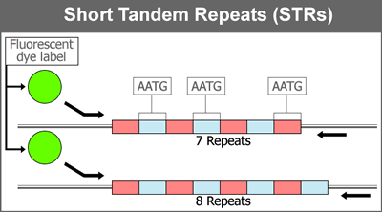

Slide 22
Single-nucleotide polymorphism SNP :
Is a substitution of a single nucleotide at a specific position in the genome. Although certain definitions require the substitution to be present in a sufficiently large fraction of the population (e.g. 1% or more),
SNPs pinpoint differences in our susceptibility to a wide range of diseases (e.g. sickle-cell anemia, β-thalassemia and cystic fibrosis). The severity of illness and the way the body responds to treatments are also manifestations of genetic variations caused by SNPs. For example, a single-base mutation in the (apolipoprotein E) gene is associated with a lower risk for Alzheimer's disease.

Slide 23
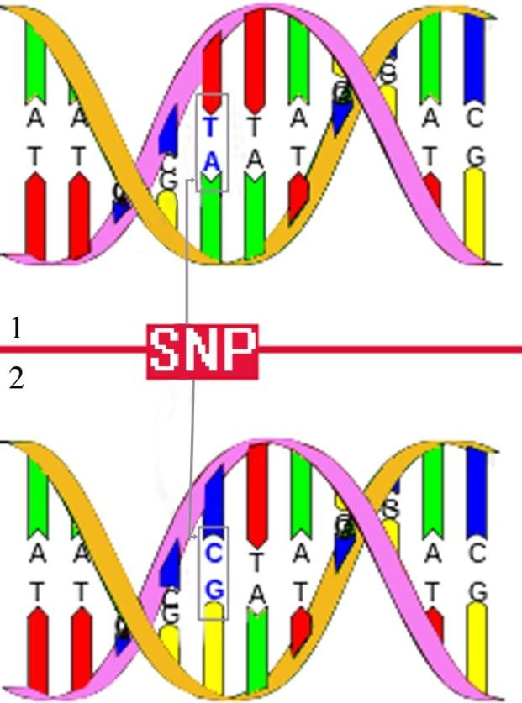

Slide 24
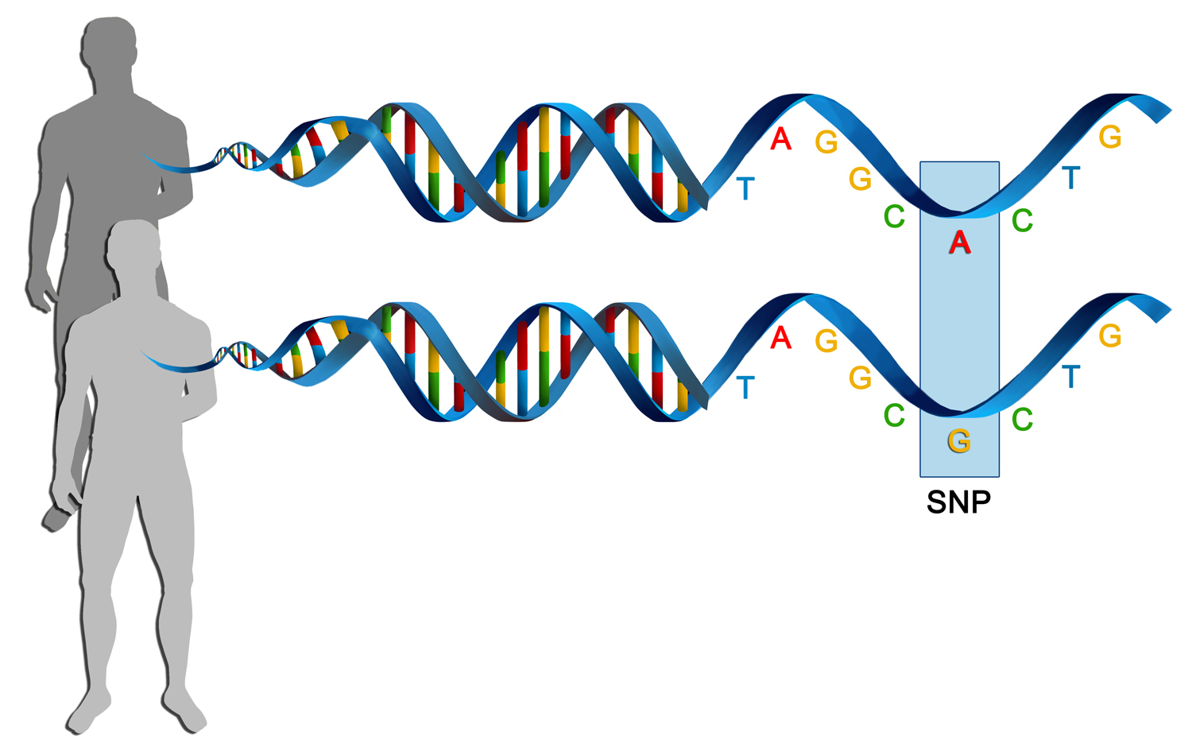

Slide 25
