Slide 1
التمنيع ضد القراد
Immunization Against Ticks
أ.د. حيدرمحمد علي صادق الربيعي

Slide 2
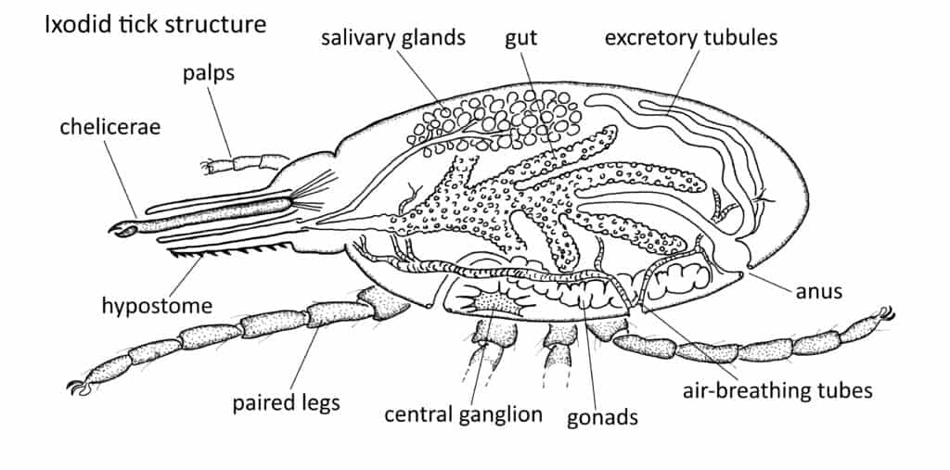

Slide 3
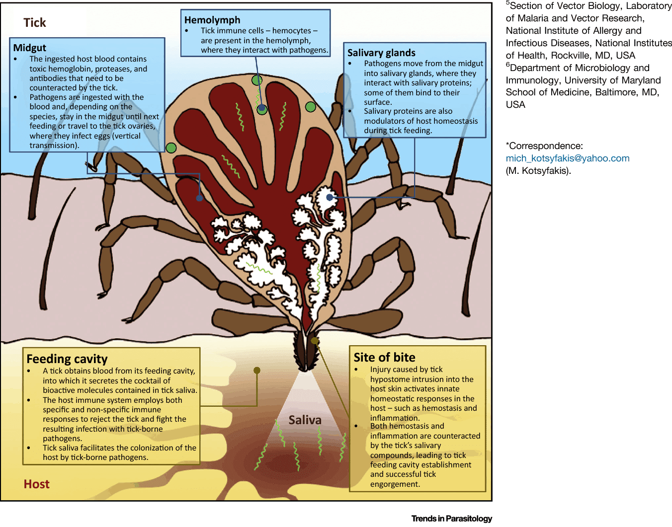

Slide 4
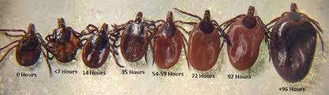

Slide 5
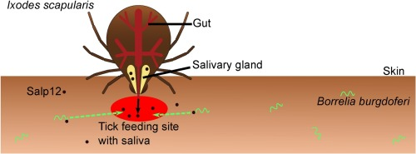

Slide 6
**Ticks are ectoparasitic arthropods that obligatorily feed on the blood of their vertebrate hosts including mammals, birds, reptiles, and even amphibians.
**A single Ixodid adult female can ingest more than ~1 mL of blood.
**Ixodid ticks insert their mouthparts into the host skin and take a blood meal for several days, resulting in increased body weight up to 200-fold.
**During blood feeding, tick saliva containing a wide range of bioactive substances(including vasodilator, anti-hemostatic, anti-inflammatory, and immunosuppressive reagents) is injected into host animals to promote successful blood sucking.

Slide 7
**The host can suffer from anemia, which negatively impacts the productivity of livestock and causes a huge economic burden worldwide.
**Ticks are probably the most harmful ectoparasites of domestic animals including cattle and wild animals, being of very substantial veterinary importance which cause a large economic losses in livestock production through blood sucking, weight loss, biting, skin damage, toxins injected and the transmission of a variety of viral, bacterial and protozoan diseases.

Slide 8
**It was estimated annual losses due to reductions in weight gain and milk production caused by the cattle tick Rhipicephalus microplus are approximately 3.24 billion dollars in Brazil alone.
**Also, they are considered second to mosquitoes as vectors of pathogenic microorganisms.

Slide 9
**In contrast to other arthropods, hard ticks are strictly hematophagous.
**In addition, some species feed on a different hosts in each developmental stages (larvae, nymphs, and adults), thereby increasing the chance of either acquiring or transmitting pathogens.

Slide 10
**More than 950 tick species have been described to date according to morphological and physiological characteristics are divided into two main families, Ixodidae (hard ticks), comprising more than 75% of tick species, and Argasidae (soft ticks); a third family, known as Nuttalliellidae, is monospecific.

Slide 11
**In Iraq ,there were 33 species and subspecies of hard ticks.
:In a survey was conducted during 2015 in 12 provinces showed five species belonging to two genera (Hyalomma and Rhipicephalus) were identified; the most abundant ticks were Hyalomma anatolicum (41.72%), Rhipicephalus turanicus (24.60%), Hyalomma turanicum (16.65%), Hyalomma scupense (13.26%) and Rhipicephalus annulatus (3.67%) ** There were differences between each province related to the environment.

Slide 12
**The tick immune system, as well as the immune system of other invertebrates, is more rudimentary than the immune system of vertebrates, presenting only innate immune responses. Although simpler, the large number of tick species evidence the efficiency of their immune system.
**The factors of their immune system act in each tick organ that interacts with pathogens, therefore, these factors are potential targets for the development of new strategies for the control of ticks and tick-borne diseases.

Slide 13
**In addition to host pathogens, ticks are in close contact with the microbiota of the host skin, which may also be acquired within the blood meal.
**Ticks are also exposed to microorganisms in the environment during the nonparasitic phases of their life cycle. Hence, the immune system of ticks must be activated continuously to protect them from harmful infections.

Slide 14
**Earlier morphological, ultrastructural, and physiological studies of the hemocytes in different tick species reported the presence of three basic types of hemocytes, namely, phagocytic plasmatocytes and granulocytes and nonphagocytic granulocytes .
**These cells apparently differentiate from prohemocytes .

Slide 15
**More recent studies have described additional types of tick hemocytes, namely, adipohemocytes in Rhipicephalus sanguineus and spherulocytes in R. microplus .
**The most important immune responses of arthropod hemocytes are phagocytosis, encapsulation, nodulation (which involves melanization by the prophenoloxidase -PPO cascade), coagulation, and production of immune-related molecules.
**The role of tick hemocytes in the phagocytosis of a variety of microbes, including bacteria, yeast, spirochetes, and foreign particles, has been investigated by several studies.

Slide 17
**Some animal species can acquire resistance to blood-feeding by ticks after a single or repeated tick infestation, resulting in decreased weights and numbers of engorged ticks or the death of ticks in subsequent infestations.
**This acquired tick resistance (ATR) can reduce the risk of pathogen transmission from pathogen-infected ticks to hosts.
**This is the basis for the development of tick antigen-targeted vaccines to forestall tick infestation and tick borne diseases.

Slide 18
**To counteract these, host animals activate various defense pathways, including innate and acquired immunity against tick infestation.
**In different studies , some animal species, including cattle, rabbits, guinea pigs and mice, have been demonstrated to develop resistance to tick feeding after a single or repeated infestation, depending on the combination of tick and animal species .
**This acquired tick resistance (ATR) is manifested by reduced weights of feeding ticks, reduced numbers of engorged ticks, prolonged duration of feeding, inhibition of molting, death of feeding ticks, diminished production of ova or reduced viability of ova.

Slide 19
**The expression of ATR is not confined to the skin lesion of previous tick bites and can be induced in uninfested skin of sensitized animals, suggesting the involvement of systemic rather than localized responses.
**It was found ATR was abolished when guinea pigs were treated with immunosuppressants agents such as methotrexate and cyclophosphamide .
**Furthermore, ATR can be transferred to naive animals with leukocytes or sera isolated from animals infested previously with ticks .

Slide 20
**These findings strongly suggested that ATR is a type of immune reaction and for the development of efficient anti-tick vaccines to prevent tick infestation and tick-borne diseases.
**It was reported in 1939 that when guinea pigs were repeatedly infested with Dermacentor variabilis larval ticks, large numbers of larvae engorged in the 1st infestation ,whereas relatively few larvae did so in the 2nd or subsequent infestations, indicating guinea pigs developed tick resistance after a single infestation.
**The resistant state developed within 2 weeks after starting the 1st infestation and lasted for at least 3 months.
**Skin reaction in tick-resistant guinea pigs was characterized by extensive accumulation of basophils and eosinophils, and basophils composed up to 70% of the skin-infiltrating cells.

Slide 21
**In cattle, rabbits and goats, the infiltration of basophils in the tick re-infestation site was also observed .
**The frequency of basophils among cellular infiltrates at the tick-feeding sites varied, depending on the combination of host animals and tick species.
**Basophils of the tick re-infested skin lesion was clearly demonstrated in both mice infestated with
H. longicornis larval ticks and those infested with
D. variabilis larval ticks as observed in guinea pigs, cattle, rabbits and goats.
**Also mast cells are essential for acquired tick resistance (ATR).

Slide 22
**It demonstrated in mice infested with
H. longicornis larval ticks that skin-resident, memory CD4+ T cells are involved in the recruitment of basophils to the re-infestation site, and leading to ATR.
**In response to the 1st infestation, tick saliva antigen-specific CD4+ effector T cells are activated and expand in draining lymph nodes and are distributed to the skin throughout the body, and a fraction of them stay there as skin-resident as memory T cells .

Slide 23
**In the 2nd infestation, tick saliva antigens injected into the tick-feeding site activate these memory T cells to secrete IL-3 that in turn promotes the recruitment of basophils to the tick-infested skin through facilitation of basophil adhesion to endothelium , leading to transendothelial migration.
**Also complements have been shown to play a part in ATR. Alternative rather than classical pathway activation.
**Basophils are chemotactic attracted by complement fragments C3 and C5.

Slide 24
**The deposition of complement components was observed at the dermo-epidermal junction near tick attachment sites and in the basophil-packed epidermal vesicles of resistant guinea pigs .
**In both guinea pigs and mice, the transfer of serum from animals previously infested with ticks indicating that heat labile IgE antibodies are responsible for the ATR transfer.

Slide 25
**The 1st tick infestation elicits the production of tick saliva antigen specific IgE by B cells, and blood-circulating basophils bind such IgE on the cell surface through Fce RI .
**In the 2nd infestation, tick saliva antigens injected into the tick reinfestation site bind to IgE on basophils, resulting in the activation of basophils .
**Tick saliva antigens can activate both basophils and mast cells through cross-linking the complex of tick antigen-specific IgE and Fce RI on the cell surface.

Slide 26
**Also IgG1 antibodies are responsible for significant level of tick resistance against ATR in guinea pigs.
**Histamine:
**It was found that the treatment of cattle with antihistamine lead to higher tick numbers while the injection of histamine into the cattle skin promoted tick detachment .
**Similar observations were reported in guinea pigs infested with D. andersoni and rabbits infested with Ixodes ricinus which suggesting in general , histamine is an effector molecule involved in ATR and its release from basophils but not mast cells is important for the manifestation of ATR.

Slide 27
**Microscopic examination revealed that basophils accumulated in the epidermis of the 2nd tick-feeding site and formed a cluster that surrounded a tick mouthpart.
**In contrast, most of mast cells were scattered in the dermis and located away from the tick mouthparts that make histamine released from basophils more effective than from mast cells.
**Histamine released from activated basophils appears to contribute to the manifestation of ATR through several different modes of action: induces itching and grooming responses in the skin, leading to removal of ticks from cattle.

Slide 28
**Histamine released from activated basophils acts on keratinocytes, leading to the hyperplasia and thickening of epidermis that in turn hamper tick attachment or blood-feeding in the skin during the 2nd infestation.
**The amounts of histamine-binding proteins injected by ticks into host animals may be correlated with differential responsiveness of ticks in the induction of tick resistance.
**In general, thought that when ticks feed on their natural or reservoir animal hosts, the animals show no or weak ATR.

Slide 29
**This suggests that a certain steps toward ATR development, including the production of tick-specific IgE, the generation of skin-resident, memory CD4 T cells, basophil recruitment, histamine release and epidermal hyperplasia.
-These may not be operative in natural hosts, perhaps due to the modulation of host immune system by tick-derived molecules.

Slide 30
**Analyses of tick salivary glands demonstrated that ticks of the same species differentially express tick saliva proteins, depending on host animals they feed .
**This difference in the composition of saliva proteins might contribute to the differences in host immune responses.
**This needs to be taken into account when anti-tick vaccine target antigens are selected.
**For that, the findings obtained using laboratory animals may not be applied to wildlife animals and humans.

Slide 34
**Trager investigated in 1939 the possibility of the artificial immunization with tick extracts to obtain tick resistance in guinea pigs. Since then, the artificial induction of significant levels of tick resistance has been achieved by immunizing guinea pigs with extracts of tick tissues including salivary glands.
**This helps define salivary protein candidates that can serve as vaccine targets to inhibit tick feeding, reproduction and pathogen transmission to animals and humans.

Slide 35
**Ticks of a given species may secrete more than 500 different proteins and peptides in their saliva during blood feeding.
**The composition of saliva appears to change during blood feeding, perhaps confronting the different host defense responses.
**Targeting salivary proteins expressed early during tick feeding could have the advantage of inhibiting tick feeding early and preventing the pathogen transmission.

Slide 36
**In summary : In sensitization phase of ATR (during and after the 1st infestation), tick saliva antigens injected into the skin are taken up by dendritic cells and delivered to draining lymph nodes where tick antigen specific B and CD4+ T cells are activated and expand, leading to the production of tick antigen-specific IgE that in turn binds to the surface of blood-circulating basophils through Fce RI.
**Skin infiltrating basophils are stimulated with tick antigens to release histamine that acts on keratinocytes, leading to epidermal hyperplasia that interferes with tick attachment or blood feeding.

Slide 37
**Some of tick antigen-specific CD4+T cells are distributed to the skin all over the body and remain as skin-resident, as memory T cells.
**In the effector phase of ATR(during the 2nd infestation), such memory T cells are activated in response to the stimulation with saliva antigens injected by ticks to produce IL-3 that in turn facilitates the recruitment of IgE-armed, blood-circulating basophils to the tick re-infestation site.

Slide 38
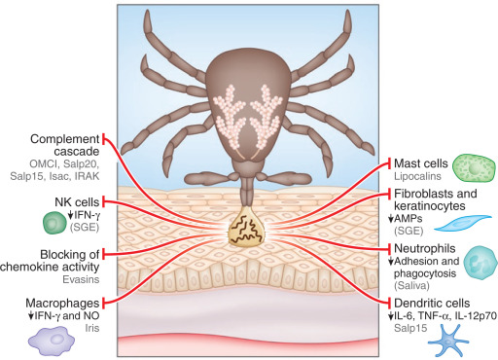

Slide 39
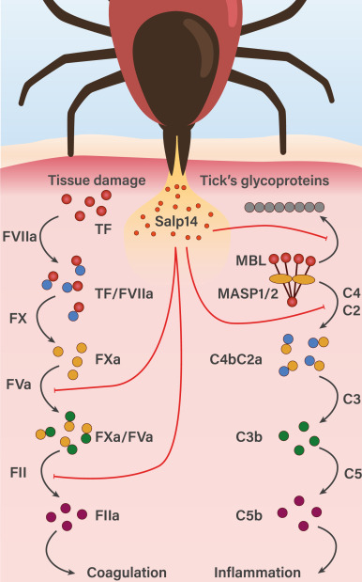
Figure . Schematic representation of the extrinsic coagulation and lectin complement pathways and Salp14 inhibitory activity.

Slide 40
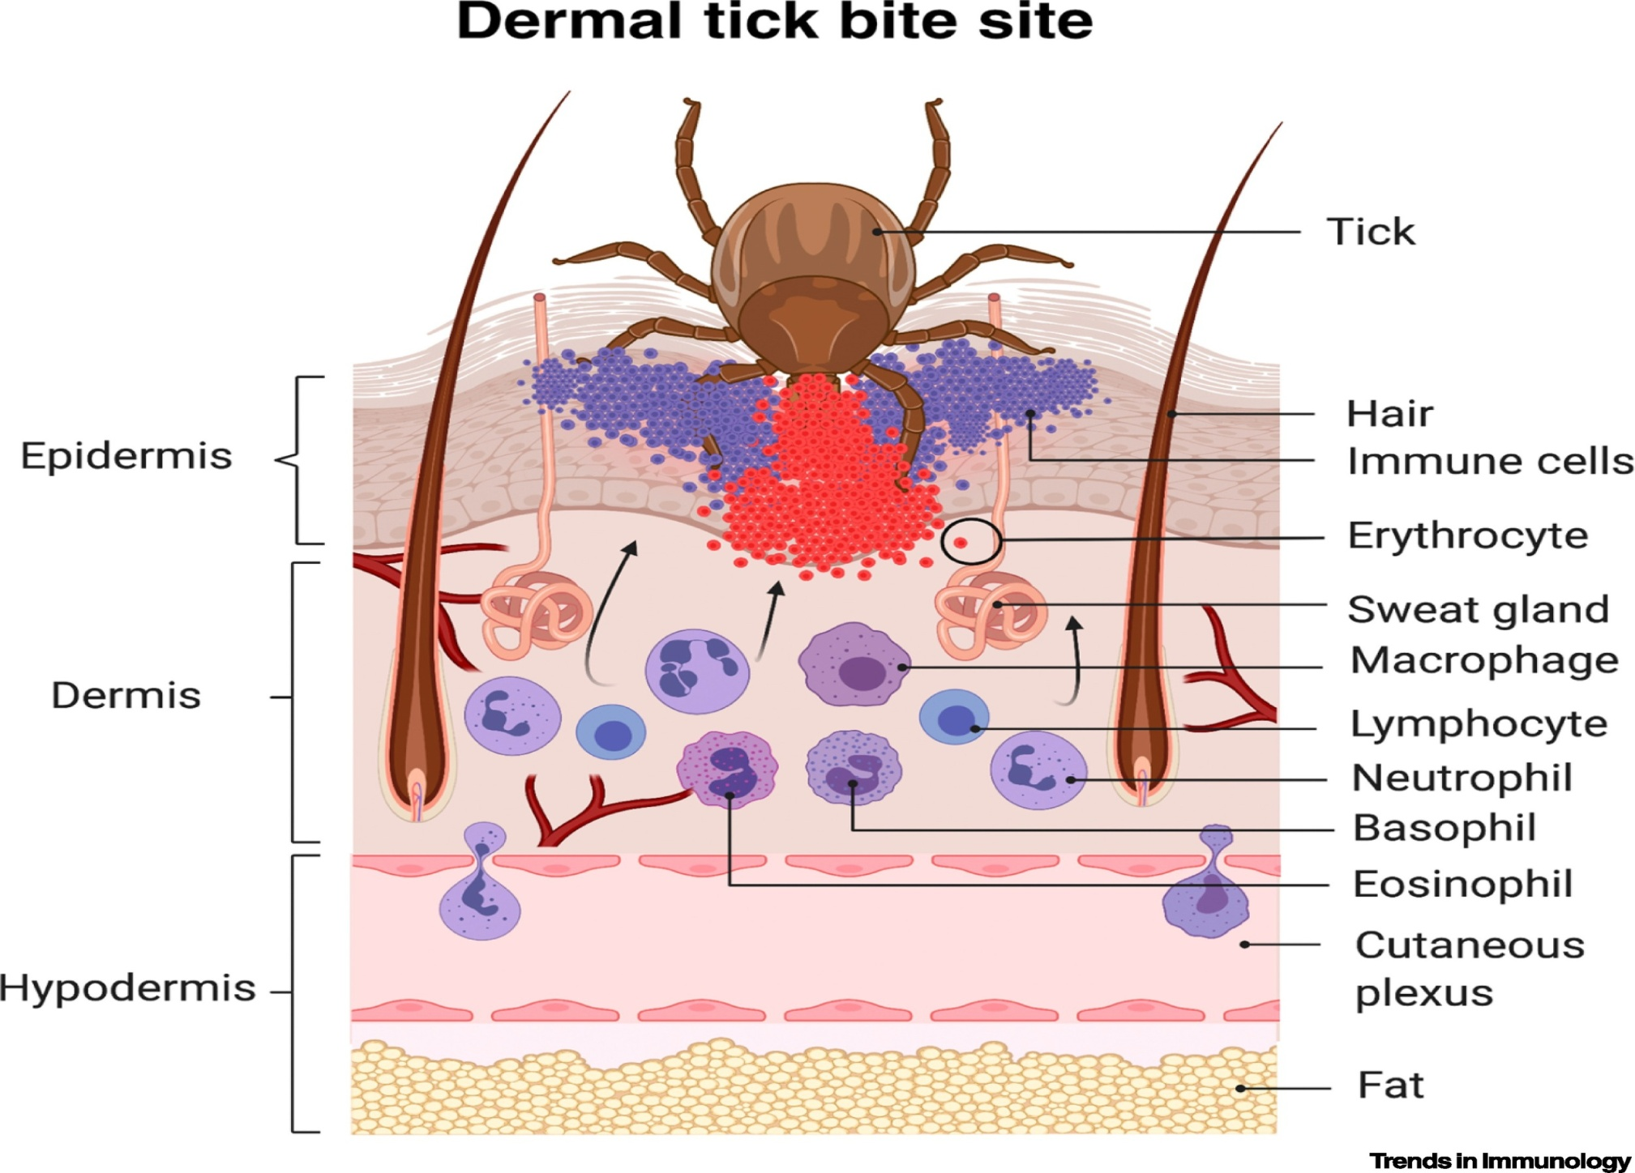

Slide 41
Types of Vaccines
1-Recombinant Rhipicephalus (Boophilus) microplus BM86 midgut antigen.
In the early 1990s, commercial vaccines.
2- Subolesin (SUB) candidate tick protective antigen, Major Surface Protein 1a (MSP1a; SUB-MSP1a), demonstrated effective control of arthropod vector infestations in various hard and soft tick species, mosquitoes, sand flies, poultry red mites and sea lice .
**A low-cost and effective alternative means of tick control. Both cattle and sheep developed antibodies against SUB in response to vaccination.
**The main effect of the vaccine in cattle was the 8-fold reduction in the percent of infested animals while vaccination in sheep reduced tick infestations by 63%.
**Female tick weight was 32-55% lower in ticks collected from both vaccinated cattle and sheep when compared to controls.

Slide 42
3- HAA86 antigen of Hyalomma anatolicum anatolicum, reported that vaccination of cattle protect against homologous tick challenge .
4- Recombinant ATAQ proteins is expressed in both midguts and Malpighian tubules. The vaccine efficacy against tick infestations has not been evaluated but it may constitute a good vaccine candidate with an increased cross- protective effect against heterologous ticks.
5- Tick salivary proteins (B-cell inhibitory protein BIP and Salp15 from I. ricinus and I. scapularis, respectively)

Slide 43
The main findings of ticks vaccination are:
Both cattle and sheep developed antibodies
in response to vaccination.
(b) The main effect of the vaccine in cattle was
the reduction in the percent of infested
animals but not in the tick infestation rate
in these animals.
(c) Vaccination in sheep did not affect the
percent of infested animals but reduced tick
infestations.
(d) Female tick weight was lower in ticks
collected from both vaccinated cattle and
sheep when compared to controls.

Slide 44
**During feeding, tick salivary glands secrete a large variety of pharmacologically active molecules with immunosuppressive properties that facilitate pathogen transmission and are potential candidates for anti-tick vaccines that limit infestations and interfere with tick-borne pathogen transmission.

Slide 45


