Slide 1
What is gluten? what is its effect on health?
L . Dr. Entesar Hussain Madi

Slide 2
What is Gluten?
Gluten is a protein complex which consist of glutenin and gliadin.
Gluten proteins play an important role in determining the quality of baking by providing water absorption capacity, viscosity, cohesivity and elasticity properties of the dough .
Existing in wheat, barley, oats, rye . The consumption of oats in gluten-free diet is controversial due to the risk of contamination with wheat, barley or rye during the milling process. Therefore, it may safe to consume only non-contaminated oats in gluten-free diet.

Slide 3
I. Classification of cereal proteins
Ozborn (1907) has first classified the wheat flour proteins into 4 main fractions according to their characteristics:
а) Albumins-disolve in water and coagulate on heat,
B) Globulins-disolve in neutral salt solurtion,
C) Glidains/Prolamins- disolve in 75% alcohol.
D) Glutenins/Glutelins-do not dissolve in alcohol, but dispolve in diluted acid or diluted base.

Slide 4
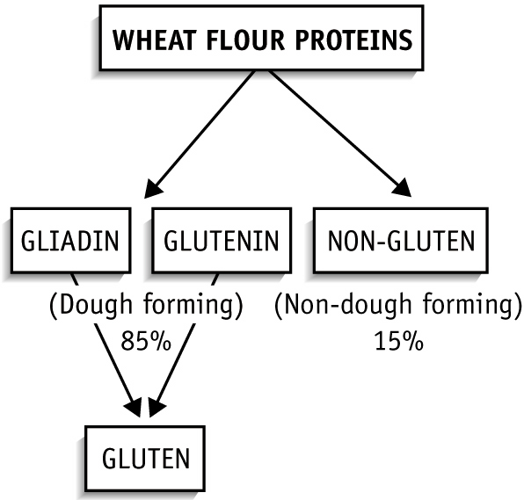
Gluten formation
Notes:
Non-gluten is consist of
الألبيومين والجلوبيولين وتوجد بنسبه 15%

Slide 5
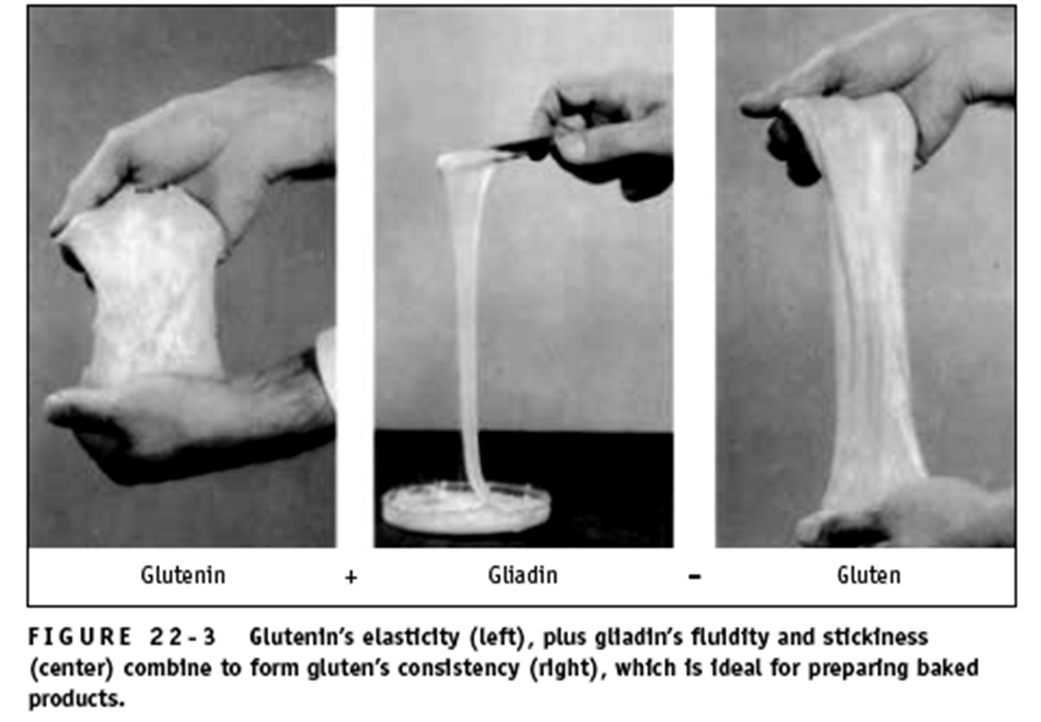

Slide 6
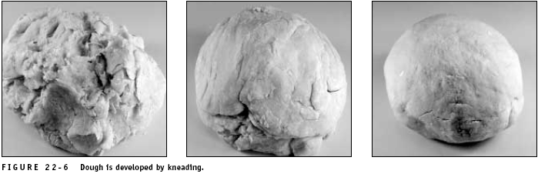
Kneading
It is used extensively in bread-making and briefly for biscuits and pastries.
It stretches the dough to increase gluten strength.
Distributes the yeast throughout the dough mass.
Redistributes the air bubbles, increasing fermentation and CO2 gas production.
Too much kneading will break the gluten strands, resulting in a sticky, lumpy dough with little elasticity.
Notes:
Sticky لزج lumpy متكتل

Slide 7


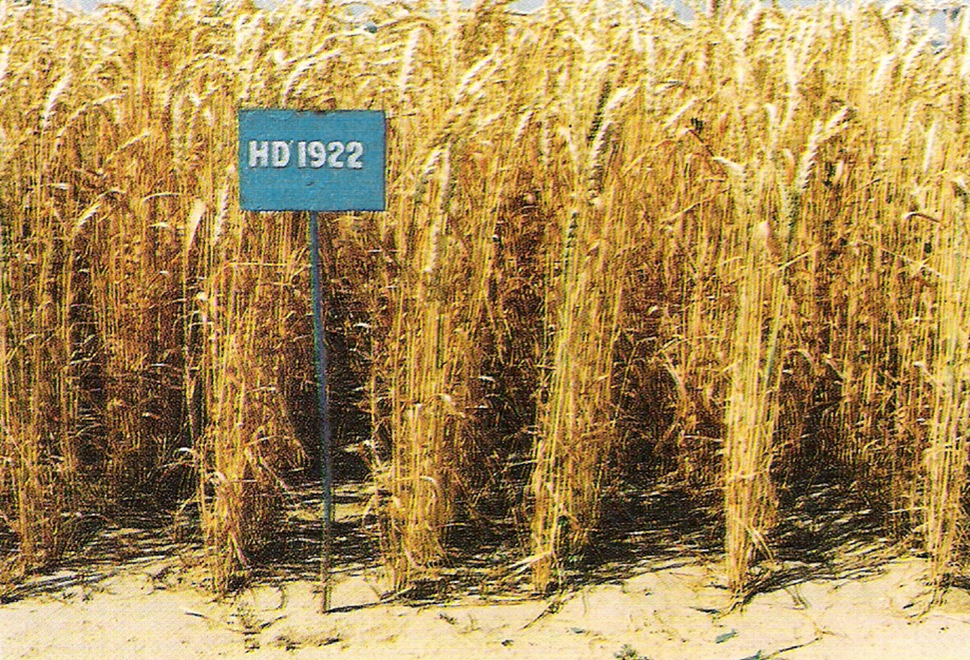
Wheat variety HD 1922

Slide 8
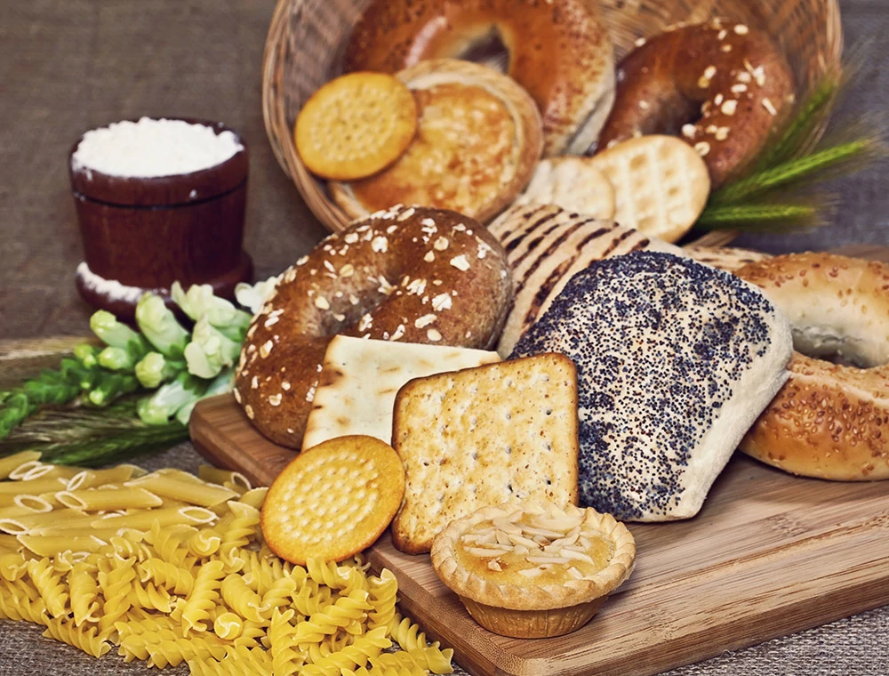

Food Contain Gluten
Several products such as
bread, pasta, cakes, salad dressings, some sauces, and even toothpastes and cosmetic products involve gluten.
Processed meats
Soup base
Soy sauce
Thickeners
Medications

Slide 9
Gluten-related disease
diseases, such as celiac disease, non-celiac gluten sensitivity, and gluten ataxia. Dermatitis Herpetiformis.
Treatment of the gluten-related diseases with the gluten free diet has positive effects because it normalizes mucosal histology and relieves the clinical symptoms.
Environmental and genetic factors play role in the pathogenesis of celiac disease.
The environmental factors in celiac disease are lack of breastfeeding, inappropriate timing of complementary feeding, cesarean delivery, gastrointestinal infections, using of antibiotics.

Slide 10
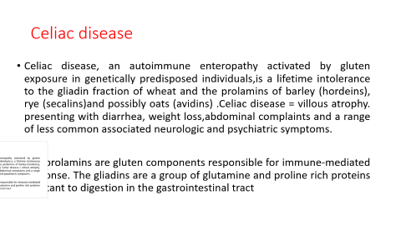
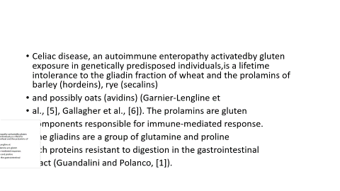
Celiac disease
Celiac disease, an autoimmune enteropathy activated by gluten exposure in genetically predisposed individuals,is a lifetime intolerance to the gliadin fraction of wheat and the prolamins of barley (hordeins), rye (secalins)and possibly oats (avidins) .Celiac disease = villous atrophy. presenting with diarrhea, weight loss,abdominal complaints and a range of less common associated neurologic and psychiatric symptoms.
The prolamins are gluten components responsible for immune-mediated response. The gliadins are a group of glutamine and proline rich proteins resistant to digestion in the gastrointestinal tract

Slide 11
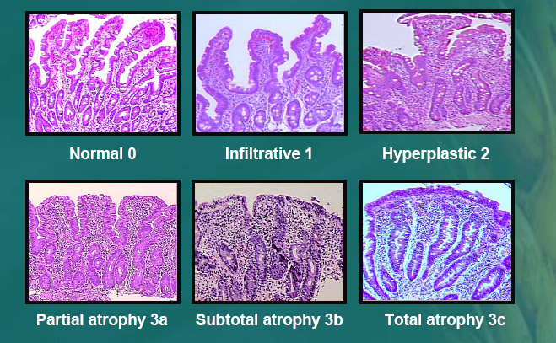
Celiac Disease = Abnormal Biopsies

Slide 12
Non-Celiac Gluten Sensitivity
Gluten reactions without identified allergic or autoimmune mechanisms
Distress when eating gluten, improvement with GFD
  Occurs within few hours – few days to gluten exposure
Normal labs
  Normal celiac titers (TTG, EMA)
  No IgA deficiency
  Normal IgE levels, skin prick testing to wheat
Normal small intestinal biopsies

Slide 13
Gluten ataxia
This is a rare condition in which your immune system attacks the nervous system when you eat gluten. It can be related to celiac or NCGS. People with gluten ataxia often don't have digestive complaints. Gluten ataxia can affect the part of the brain that controls coordination. You may feel clumsy or lose your balance.
You also may have:
Trouble using your hands, fingers, arms, and legs
Tingling in your extremities
Trouble speaking or moving your eyes
A strict gluten-free diet can help you feel better. It can stop the condition from getting worse, too.

Slide 14
Dermatitis herpetiformis (DH)
Dermatitis herpetiformis (DH) is an uncommon cutaneous eruption associated with gluten sensitivity and CD, characterized by intensely pruritic, inflammatory papules and vesicles on the forearm, knees, scalp, or buttocks.

Slide 15

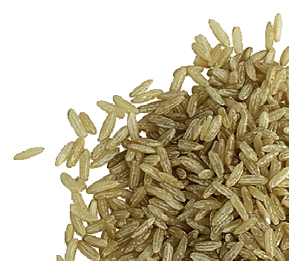
What is the Reality?
“Gluten free means you can’t eat any grains.”
Most grains are gluten free. For those with a medical reason to go GF, there are many choices.
Buckwheat
Corn
Millet
Oats *
Quinoa
Rice almond
Potato
* Oats are inherently GF but frequently contaminated.
Notes:
As we all know!

Slide 16
What are common gluten-free foods?
Non-processed meats and fish
Fresh fruits and vegetables
Nuts
Beans and legumes
Grains like rice and corn
Most cheese and dairy
Eggs

Slide 17
The commercial gluten-free products are available in the market. Immunological analyses provide information on the gluten content of foods and, according to the law, all foods must be clearly labeled .According to Turkish Food Codex the “gluten free” phrase can be used on condition that the gluten level in the food to be presented to the consumer does not exceed 20 mg/kg (Ministry of Food, Agriculture and Livestock.According to the European Directive from January 2012, a food can be labeled “gluten free if it contains less than 20 ppm of gluten .Although the tolerable gluten level varies individually, it is important to exclude all dietary gluten in the meal plan .Patients with celiac disease should cooperate with the dietician/nutritionist in choosing the appropriate foods.

Slide 18
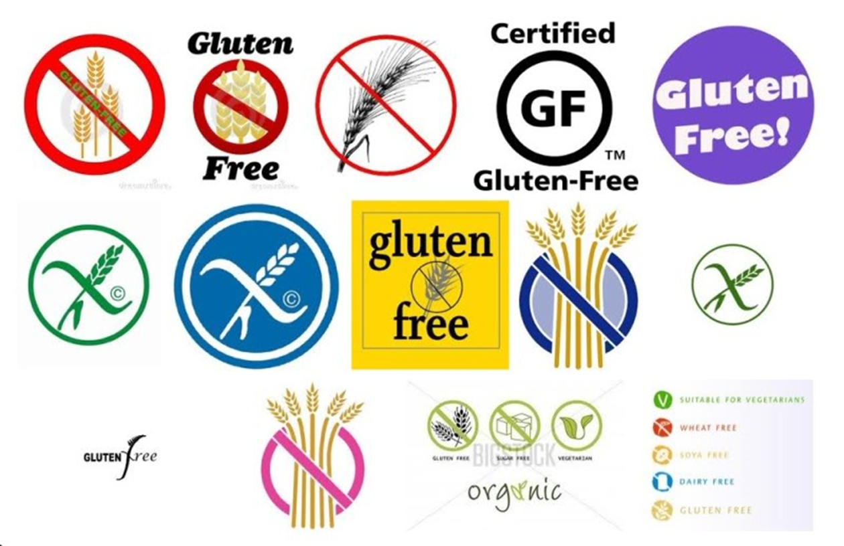
Gluten Free Labeling

Slide 19
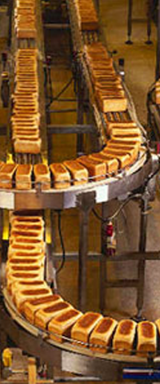

What is the Reality?
“The way we process grains may be contributing to health problems.”
This issue may have a “grain of truth” in it. Bread produced in more traditional ways (slow fermentation with “good” bacteria) is a very different product than today’s typical commercial bakery breads, quick rising with extra vital wheat gluten.
Italian research shows fermentation with specific bacteria can lower gluten from
75,000 ppm to 12 ppm – technically GF.
benefit health by encouraging eating less processed food, there is no need to cut out whole grains, legumes, dairy.
Oldways and the Whole Grains Council
Notes:
As we all know!

Slide 20
Gluten-free food should be consumed in moderation. A study of gluten-free foods targeted at children found that 88% of the products didn't offer many health benefits, and 79% of them were high in sugar.
Gluten-free bakery products are also high in fat, sugar, salt, and refined carbohydrates.
All of the nutrients in gluten-containing grains, such as B12 vitamins, fiber, zinc, iron, and potassium, can easily be replaced by following a well-rounded, whole-foods-based diet consisting of vegetables, fruits, healthy fats, and nutritious protein sources.

Slide 21
References
Akhondi H, Ross AB. Gluten-Associated Medical Problems. [Updated 2022 Oct 31]. In: StatPearls [Internet]. Treasure Island (FL): StatPearls Publishing; 2024 Jan-. Available from: https://www.ncbi.nlm.nih.gov/books/NBK538505/.
Guandalini S., and Polanco I. (2015). Nonceliac gluten sensitivity or wheat intolerance syndrome? J. Pediatr. 166,(4), pp. 805-811.
Garnier-Lengline H., Cerf-Bensussan N., and Ruemmele F. M. (2015). Celiac disease in children. Clin. Res. Hepatol. Gastroenterol., 39, (5), pp. 544-551.
Gallaghera E., Gormley T. R., and Arendt E. K. (2004).Recent advances in the formulation of gluten-free cereal- based products. Trends in Food Science and Technology 15, (3-4), pp. 143-152.
Bonciani D, Verdelli A, Bonciolini V, D'Errico A, Antiga E, Fabbri P, Caproni M. Dermatitis herpetiformis: from the genetics to the development of skin lesions. Clin Dev Immunol. 2012;2012:239691.

Slide 22




