Slide 2
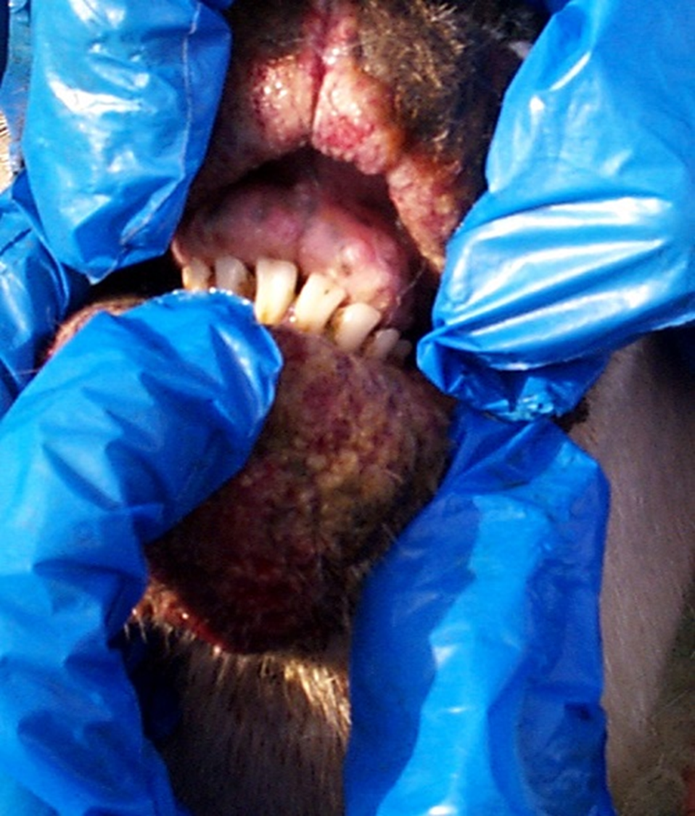
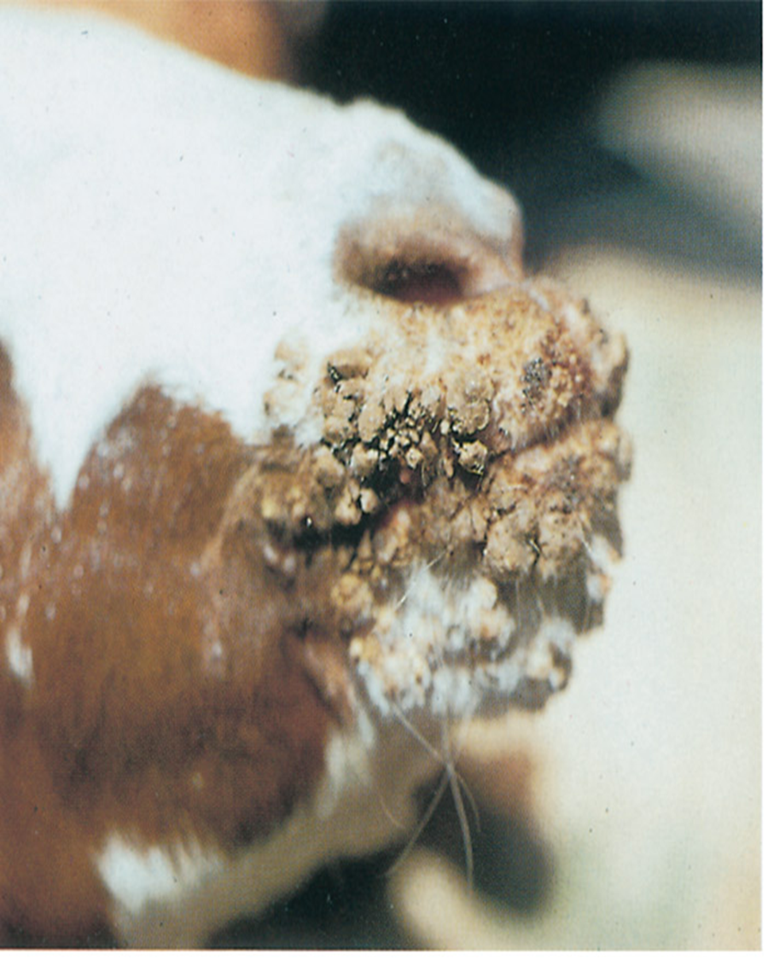
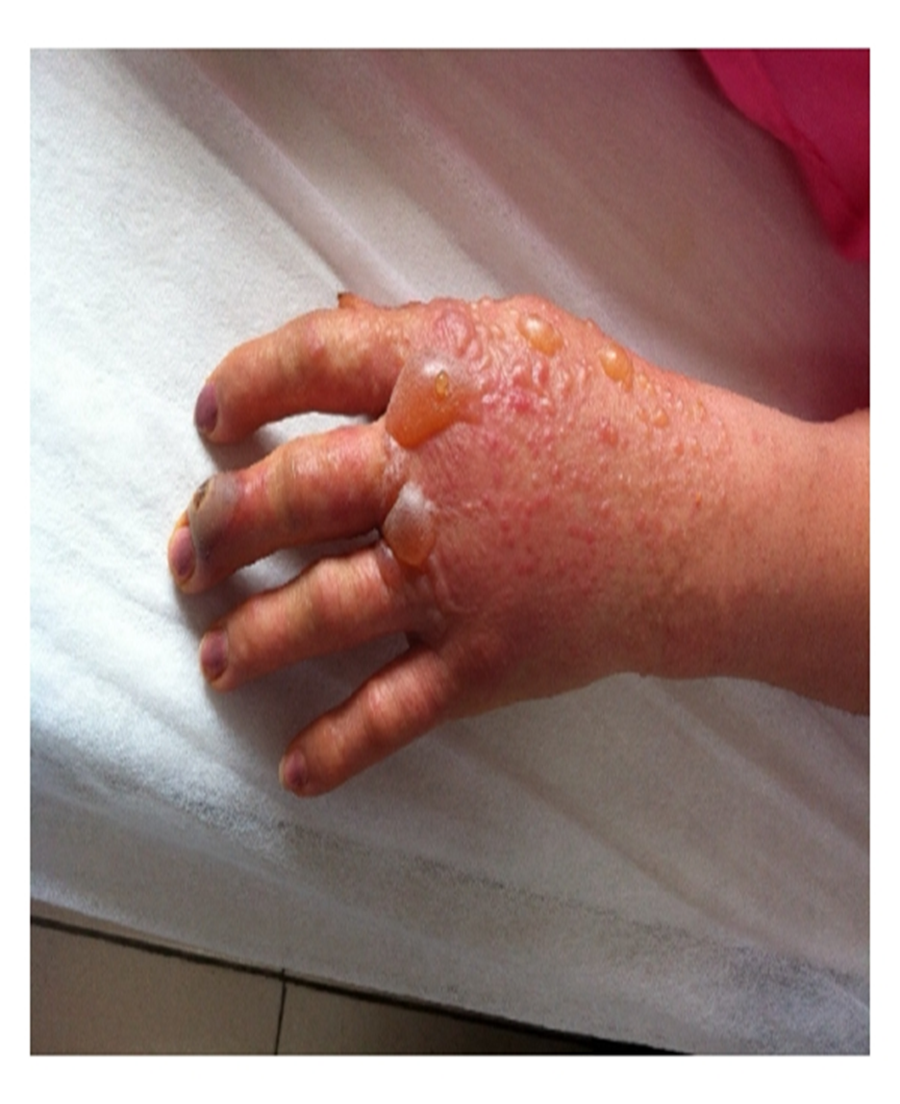
Orf (Also referred to as, Contagious pustular dermatitis (CPD), Scabby Mouth, Contagious Ecthyma)

Slide 3
اعداد د.ناديا ابراهيم د.ظافر عبد علي د.هوازن ثامر

Slide 4
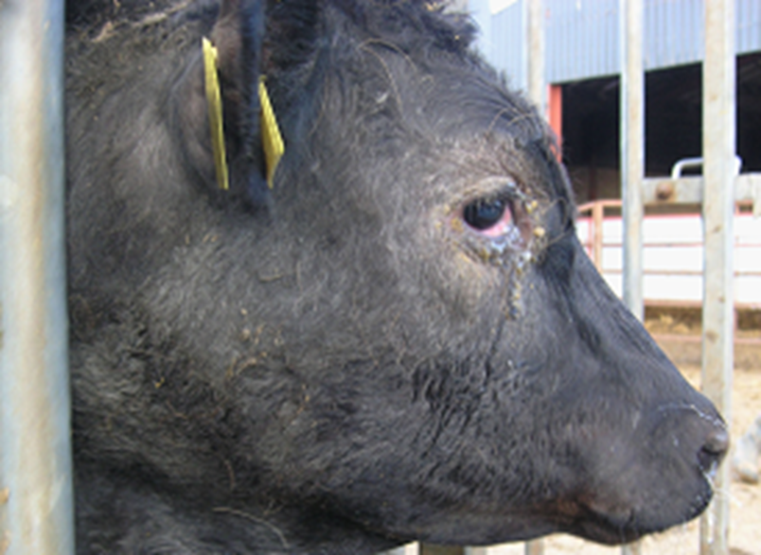
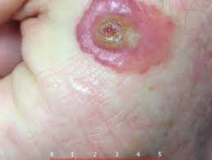
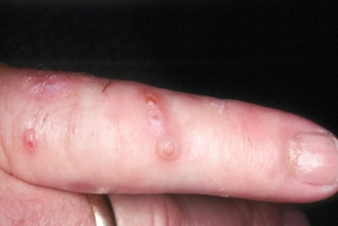

Slide 5
Orf disease
Also referred to as, Contagious pustular dermatitis )CPD(, Scabby Mouth, Contagious Ecthyma) . A farmyard pox جدري المزرعة. The disease is endemic in livestock herds worldwide. Orf is primarily a disease of sheep and goats where it causes lesions to develop around their mouth also it has been reported as a natural disease in humans, steenbok الظبيand alpacasاللاما, chamoisنوع من الغزال and, reindeer الرنة, musk oxenثيران المسك, dogs, cats, mountain goats, bighorn sheep, dall sheepاغنام الدال, and red squirrels.
Orf is a zoonotic disease, meaning humans can contract this disorder through direct contact with infected sheep and goats or with fomites carrying the orf virus. Orf virus in humans is a common and widespread zoonotic viral infection that affects the skin. The main difference between animal and human orf virus infections is that humans develop lesions on their hands and fingers. In rare cases, lesions can occur on the face as well. instead of around or inside their mouths.

Slide 6
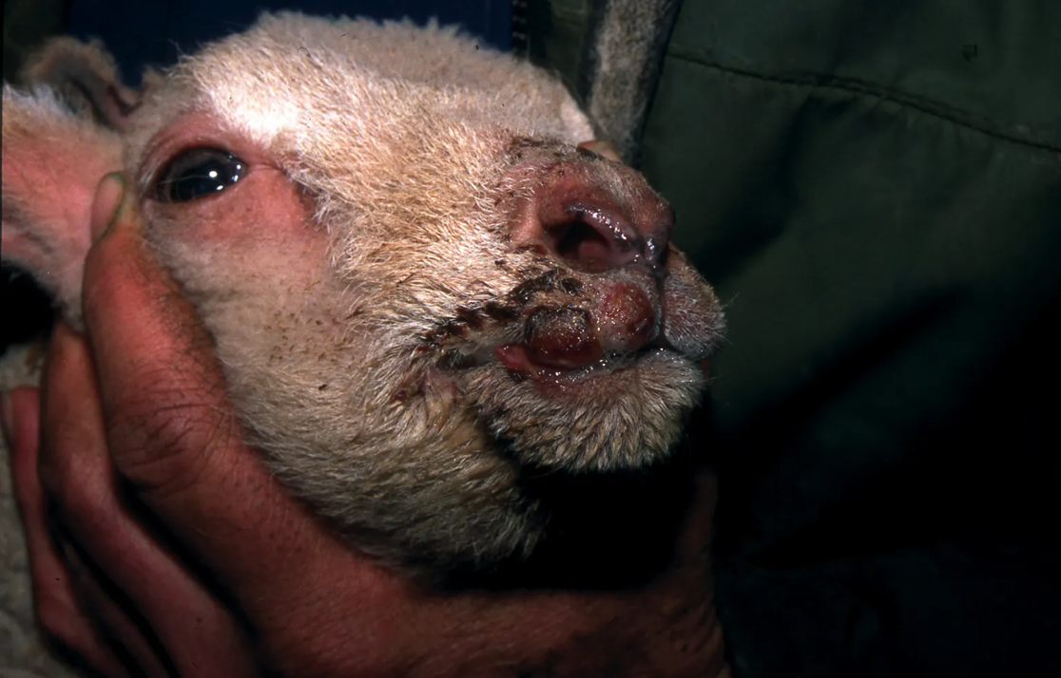

Slide 7
While orf is usually a benign self-limiting illness which resolves in 3-6 weeks, in the immunocompromised especially patients with inherited or acquired T cell dysfunction it can be very progressive and even life-threatening. Serious damage may be inflicted on the eye if it is infected by orf, even among healthy individuals.
The most at risk of infection :is most often an occupational hazard. include shepherds, wool shearers, butchers, farmers, and veterinarians &other people who live around livestock, especially sheep and goats. A few activities put at even greater risk for becoming infected, including: Tending to sheep or goats by bottle feeding, tube feeding, or sheering them Engaging in casual contact with infected animals, such as petting, Coming into contact with contaminated equipment, Being bitten by an animal with orf virus.
While it’s easy for orf to spread from an animal to a human, it’s rare for this infection to be passed from person to person.

Slide 8
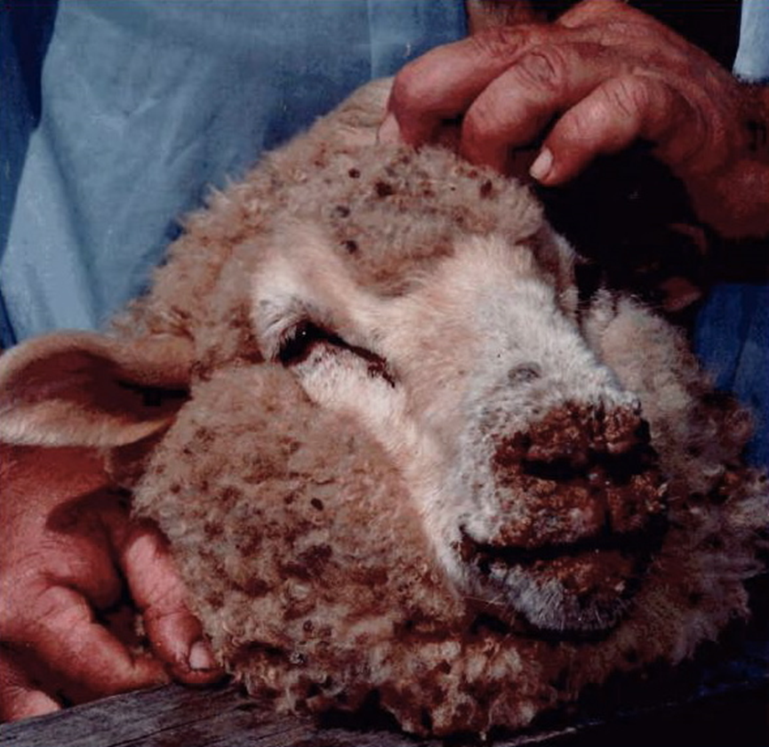
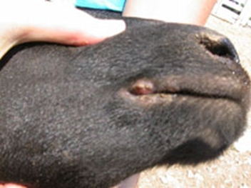
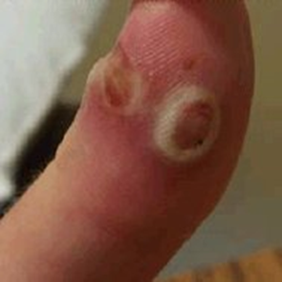

Slide 9
The cause of orf disease
Orf virus is the prototype member of the genus Parapox virus of the family Poxviridae . Orf virus is a double-stranded DNA virus. As a poxvirus, Orfviridae shares the family’s rare trait for promiscuous مختلط mammalian cell entry. They do not require a specific receptor; instead, they utilize ambiguousغامض and common place components such as glycosaminoglycan's for attachment and fusion into the host cell.
After successful entry, Orf viridae starts pumping out a medley خليط او مزيجof virulence factors – all with the aim of immunomodulation eg: viral-vascular endothelial growth factor ,Anti-inflammatory proteins, orf “viral” Interleukins, apoptosis inhibitor, interferon resistance, a granulocyte-macrophage colony-stimulating factor ,inhibitory factor, ,chemokine binding protein and proteins that promote virus survival and host cell manipulation or exploitation all made before any phase of viral replication.

Slide 11
The replication and extranuclear synthesis of the orf virus utilizes a double envelope structure that is unique to Poxviridae. A single extracellular virus is composed of many, individually infectious virions. This feature of Orf viridae and Pox viridae, in general, makes them particularly resilient مقاومand even capable of spread via fomites. Orf lesions commonly appear three to seven days after inoculation and progress through six clinical stages over the course of six to eight weeks, ending in resolution.The duration of each stage is approximately one week .Erythematous spots in the affected sites developing into Maculopapular stage, Target stage (papule or nodule with gray-white, necrotic center and red outer halo) , Acute-nodular weepy stage (draining papule or nodule) , Regenerative-nodular dry stage (firm, crusted papule or nodule) ,Papilloma stage (papule or nodule with a papillomatous surface and dry crust) ,Regression stage (lesion progressively shrinks in size and resolves, generally without residual

Slide 13
scar) .
pathological lesions
It can be found most frequently in the oral cavity (lip mucosa, tongue, gums), skin of the face and nose, they are also observed at the udder skin of ewes and the testis of male goats . It is particularly severe in artificially-reared lambs ,Outbreaks may occur within 10 to 14 days of pasture change especially onto those pastures which contain thistles & gorse which cause superficial trauma to the lips/mouth. The virus most commonly results in proliferative lesions at the hoof/horn junction and on the lips/gums.. Large scabs are often present at the commissure of the lips and along the gum margins surrounding the incisorالقواطع teeth. Much less commonly, lesions may involve the hard palate and tongue .. Lesions persist for four to eight weeks then slowly regress. Initial papule and vesicle stages are rarely observed. Scabs progressing to large proliferative wart-like structures, which bleed profusely following trauma to their base, are the more common presentation.

Slide 14
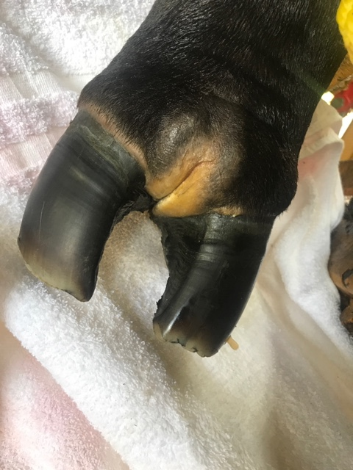

Slide 16
Orf is a highly contagious and fairly common disease of goats and sheep with worldwide distribution. Although this disease is usually self-limiting that could resolve within 1 month in adult animals, it can be fatal in kids causing considerable economic losses worldwide every year because of their high culling rate and mortality .
This virus can remain infective in the environment for many months in dried scabs. The proportion of the flock affected can be high but mortality in uncomplicated cases is low.
In human may experience enlarged lymph nodes on elbowالمرفق or underneath arm, along with red streaks. A mild fever may develop, and you may also feel fatigued. humans may first notice a pimpleبثرة appear on their affected skin. The pimple eventually develops into a lesion. This lesion typically has a red center with a white ring around it. As the lesion grows, it turns red and begins seepingيسرب pus.

Slide 18
Temporary hair loss may result from the lesion if it is located around hair follicles. As it progresses, the lesion will dry out, and you’ll notice tiny black spots forming on the surface. Finally, the lesion becomes flat, and a dry crust forms around it. At this point, the healing process begins. Human-to-human transmission also exists, although such cases are very rare .
Diagnosis
Orf usually can be diagnosed based upon the patient history and physical examination. A biopsy or molecular testing can aid in confirming the diagnosis in difficult cases. The clinical differential diagnosis is extensive. In particular, orf should be distinguished from milker's nodule and cutaneous anthrax, infections that may also result in vesiculoulcerative lesions following contact with animals.Other infections that may present with papules or nodules include giant molluscum, atypical mycobacterial infections, paronychia ,cutaneous leishmaniasis, herpetic whitlow, tularemia, and sporotrichosis. Neoplastic entities, such as keratoacanthoma and pyogenic granuloma, are also in the differential diagnosis .The patient history and clinical findings are often sufficient for differentiating orf from these disorders.

Slide 19
Milker's Nodules Clinical Presentation:

Slide 21
Treatment
In human there's no specific treatment for orf. The blister on your skin should clear up in around 6 weeks. Cover it with a waterproof dressing to keep it clean and dry and stop it getting infected. If it becomes infected, you may need antibiotics. Secondary bacterial infection of orf is not uncommon and must be treated with topical or systemic antibiotics. Several case reports describe orf successfully treated with topical imiquimod resulting in rapid regression تراجعof the lesions. Imiquimod has been effective in both immunocompetent and immunocompromised patients.
In animals there is no treatment available for orf as it is a primary viral infection. However treatment with local antiseptics and pain relief can be helpful for secondary infections. Every animal with clinical signs should be kept and fed separately from symptom free animals.

Slide 22
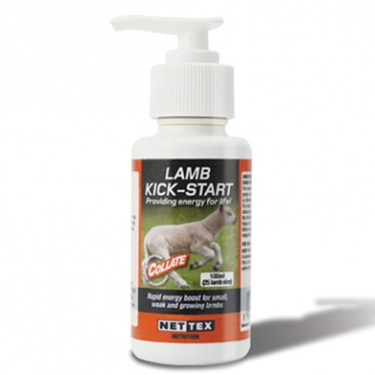
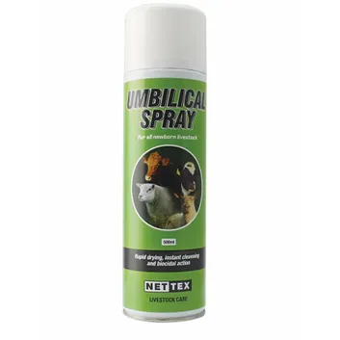
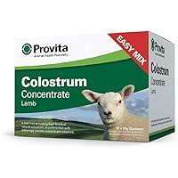
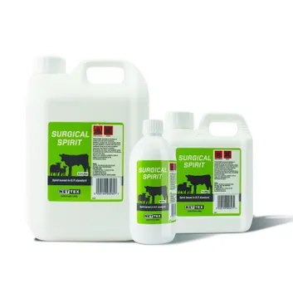

Slide 23
In immunocompetent patients treatment is not necessary since the infection spontaneously resolves within several weeks. Topical antiseptics can be used to minimize risk for secondary bacterial infections. These patients may develop giant persistent lesions and may require intervention for resolution. Case reports describe successful treatment with cryotherapy, electrocautery, curettage, imiquimod, intralesional interferon injections, or topical cidofovir .Wide local excision has been performed for refractory infections that cannot be managed with less invasive therapies, but recurrence after excision is common . Early manual removal of scabs will delay healing.. Scabby mouth sores or on the legs are susceptible to flystrike. Commercial vaccines labeled for goats and sheep are available. Ewes should be vaccinated NOT LESS THAN 7 WEEKS before lambing and moving to lambing areas. Lambs can be vaccinated from one day old. Bactokill spray is effective against orf in sheep and ringworm in cattle. Ringworm and Orf are two of the most contagious skin infections in livestock farming.

Slide 25
PREVENTION
Reinfection with orf virus can occur. However, reinfection is commonly characterized by decreased lesion size and faster resolution .Use of nonpermeable gloves when handling infected animals may reduce risk for human infection. Orf virus vaccines have been used in animals but appear only partially effective and are not available for use in humans.
Orf Virus Complications
Though they are rare, complications can occur. We are at a greater risk of complications if we are immunocompromised due to conditions like HIV or chemotherapy treatments. Complications may include bacterial infection, a rash that looks like a bulls-eye target, or a skin condition known as bullous pemphigoidالفقاع الفقاعي, which forms large blisters. Orf outbreaks in sheep and goats usually lead to high culling rate and mortality in newborn kids and lambs, posing a great threat to the development of goat and sheep industry.

Slide 26
Recommendations
avoiding the direct consumption of fresh or unpasteurized milk should be highly encouraged to prevent these food-borne illnesses. In addition, farm workers and consumers should be very careful when milking the goats and when touching fresh milk to minimize the potential risk of such infections. To this end, protective measures (i.e., wearing protective clothing and gloves) should be taken when touching fresh milk.
study is that live ORFV can be isolated from the saliva of goats. For dairy goats, an important maternal behavior is that the ewe will lick the newborn kids immediately after lambing. Usually, the licking cleaning begins with the mouth and nose first, followed by the face, the head and other parts of the newborn kids. While this behavior is necessary for the establishment of the mother-infant bond it could inevitablyحتما او بالضرورة mediate the transmission of saliva-borne diseases.

Slide 28
Considering the finding of this study, licking the newborn kids should be an unignored explanation of kid Orf if their mother happens to carry ORFV in the saliva.
In addition, lick blocks are commonly used in many dairy goat farms for the supplementation of minerals and trace elements .Although direct evidence is lacking, these lick blocks can possibly serve as reservoirs of ORFV and allow the spread of Orf to goat housed together. The same conclusion may be also applied to the transmission of Orf through the fenceسياج, the wall, the waterers, the feeders and other shared devices of a farm which could be licked by ORFV-carrying animals. Because infectious ORFV can be present in the saliva of dairy animals, saliva droplet transmission may also be a possible route for Orf spread when they were kept in close contact due to excessive herd density. In addition, they have the nature to crowd together. All these aspects could promote the potential transmission of Orf via saliva droplets.

Slide 29
The widespread outbreak of Orf has caused great economic loss 0n industry, especially because of its fatal impact on newborn kids. According to the present study, infectious ORFV can be detected in the milk of lactating .This finding strongly suggests that milk can be a possible route for Orf transmission, and suckling milk by newborn kids is likely one of the most important reasons for the rapid outbreak of Orf in kids. so we must in this case separate mothers &kids.

Slide 30
Contagious pustular dermatitis virus and various bacteria
Virus &Staphylococcus aureus, may act together to cause severe facial dermatitis which appears as sharply-demarcated areasمناطق منقوشة on the muzzle and involving the lower lip with scab material also palpable within the hairs extending for a further 2-3 cms from the periphery of the visible lesions. The skin is edematous with serous exudation and superficial pus accumulation and other foreign material which may become desiccated forming hard scabs separated by deep fissures. Careful removal of the scabs reveals a deep bed of exuberantغزير granulation tissue.
Contagious pustular dermatitis virus and Dermatophilus congolensis may act together to produce large granulomatous massesكتلة حبيبية extending 4 to 8 cms from the coronary band often referred to as "strawberry foot rot". These lesions bleed profusely when traumatised. Typically, strawberry foot rot lesions only affect one leg and are more commonly seen in weaned lambsالحملان المفطومة recently moved onto stubbles. While lesions are severe in individual lambs, the proportion affected is generally low.

Slide 31
Contagious pustular dermatitis virus and various bacteria may act synergistically to cause severe facial dermatitis. Secondary bacterial infection of scabs show a good response to either intramuscular procaine penicillin or oxytetracycline injections and topical oxytetracycline spray for three to five consecutiveمتتالية او متعاقبة days.

