Slide 1
ورشة عمل بعنوان Epidemiological study of Setaria equina infection in donkeys أعداد أ.د.أثمار خضير عباس و م.د. عامر رسول فضل فــــرع الطفيـــليات

Slide 2
Introduction
Setaria equina (S. equina) is a common vector borne pathogen of equines all over the world, especially in tropical zones.
S. equina transmitted by Aedes aegypti and Culex pipens where L1 developed to L3 within 2 weeks in their thoracic muscles.
The equines acquired the infection during mosquito’s blood meal and the life cycle completed within 8-10 months [Perumal et al., 2016].
Prenatal infection reported as a route of transmission for Setaria species [Kim et al., 2010; Marzok & Desouky , 2009].
Adult worms mainly found in the peritoneal cavity of horse and donkey.
The worms were nonpathogenic but might induce varied degrees of peritonitis and might migrate to the eye, brain, lung, and scrotum of equines causing lacrimation, blindness, paraplegia, locomotor, and neurological disturbances [Solusby, 1986 ; Rhee et al ., 1994].
S. equina induced such pathogenic effects but also other Setaria species infect cattle (S. digitata and S.cervi) could induce blindness and CNS damage in equine where [Shin et al ., 2017].
The parasite reported the aberrant parasitism of adult worms in eye of donkey in Egypt. [Abu El-Magd, & AHMED, 1994]
Also, its stated the zoonotic importance of S. equina in man.[Taylor,2001; Abbas et al., 2016]

Slide 3
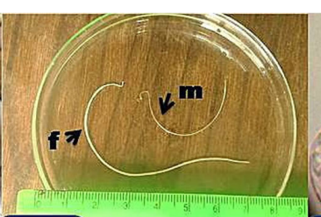
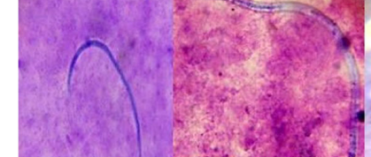
Morphology
Male measurements reached 45-70 mm (57 ± 2) long × 0.4-0.6 mm (0.45 ± 0.02) wide with coiled end and
Female reached 60-160 mm (110 ± 5) long × 0.6-0.91 mm (0.60 ± 0.04) wide in females with loose spiral end. [Abdel Rahman & M.M.I. 2020].
The larval stage of Microfilaria in Knott’s technique examination Fig. 1,2
Fig. 1 Male (m) and female (f) worms.
Fig. 2 Microfilaria in Knott’s technique (× 100).

Slide 4
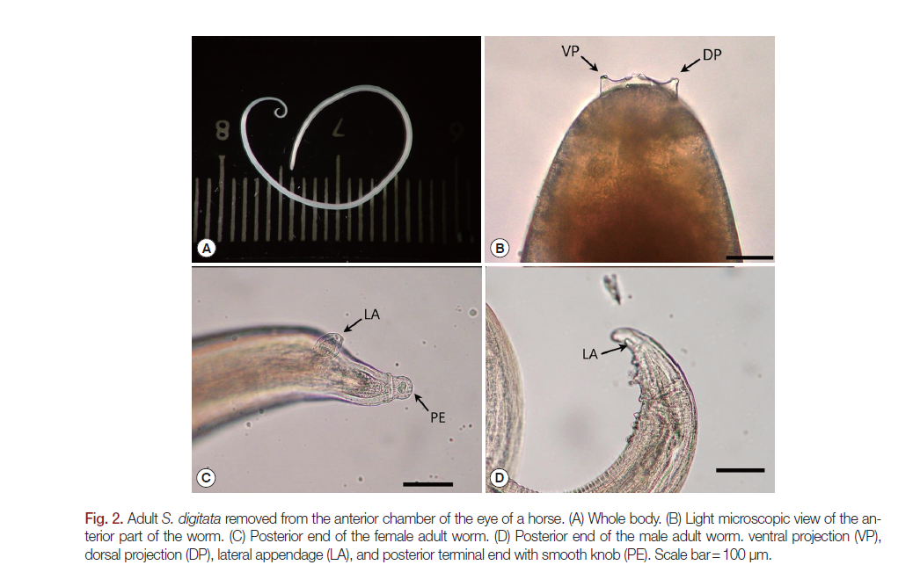

Slide 5
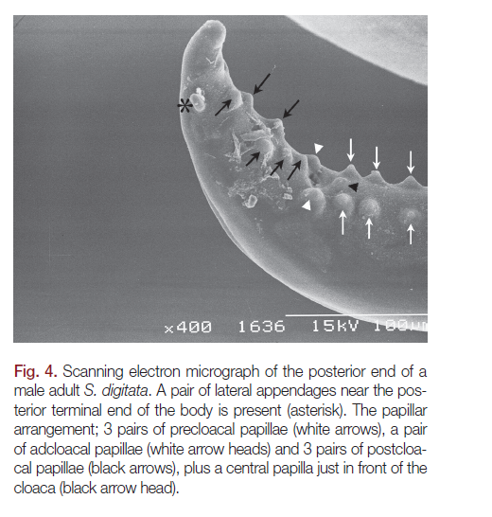
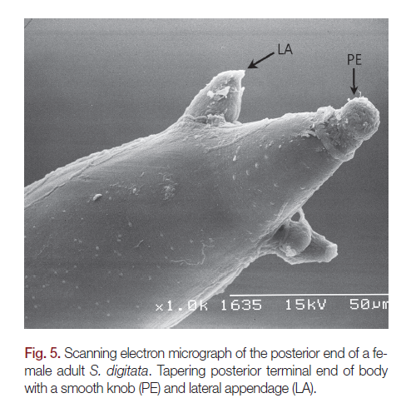
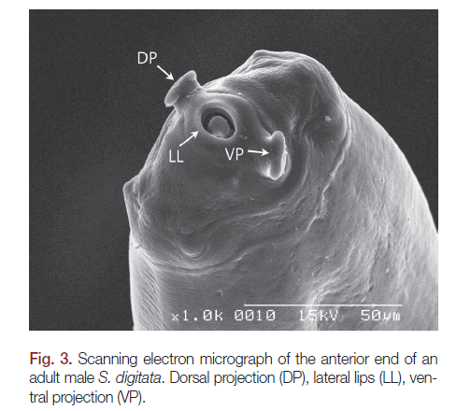

Slide 6
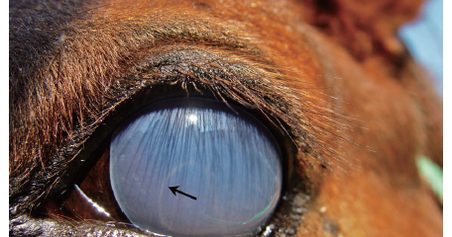

Slide 7
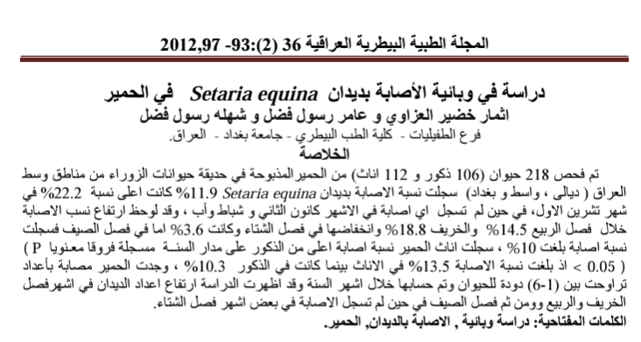
Aims of the study
The present study aimed to assess the following :
Investigate the prevalence rate of S. equina in donkeys in central part of Iraq.
Identify the worm by morphological features of the genus Setaria under the light microscope

Slide 8
Methodology
Animals
A total of 218 (106 male and 112 female) animals slaughtered in Baghdad ( Al-Zawra ) Zoo, brought from of central part of Iraq (Diyala, Wasit, Baghdad).
The Animals were examined during the period from December 2012 to August 2010.
Sample collection and processing
Adult worms were collected from peritoneal cavity of donkeys at the time of necropsy, washed with saline, cleared with lactophenol, and identified under light microscope according to [Burgu et al., 1995].
The data was analyzed by using the statistical program SAS .

Slide 9
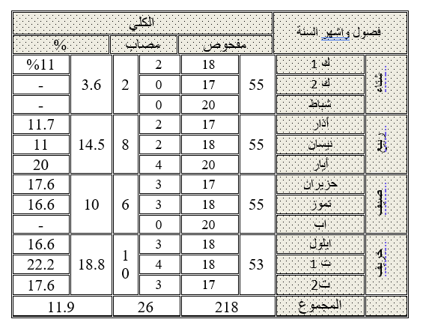
Results
The total infection rate of Setaria equina was 11.9% and the highest infection rate (22.2%) was recorded in October, where is no infection in January, February and August.
The high infection rate (14.5% ) during the months of spring and autumn (18.8%) and decrease in Winter and Summer 3.6% and 10%. Tab. 1
Tab.1

Slide 10
Results
40X
Adult worms inside the peritoneum of donkeys appeared milky white and thread like.
The worms was distinguished and confirmed the diagnosis by observing the distinctive morphological characteristics of the worm during microscopic examination and the shape of the front end of males and females. Fig. 3
Horn-like Structure
Fig.3
The anterior end

Slide 11
Results
x40
شوكتا الجماع
Male and Female posterior end shows the morphological characteristics of the worm by microscopic examination . Fig.4,5
Fig.4 Male posterior end
40x
Fig 5. female posterior end

Slide 12
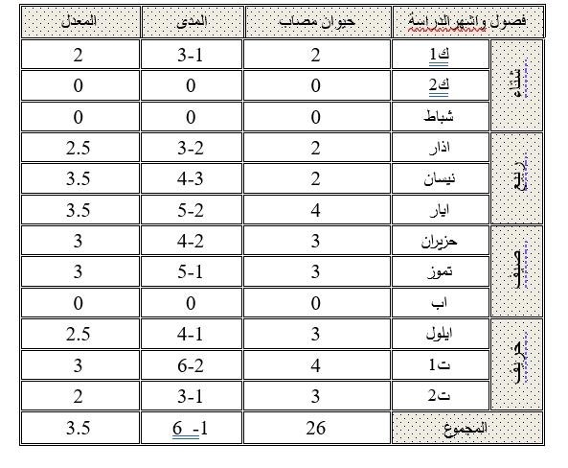
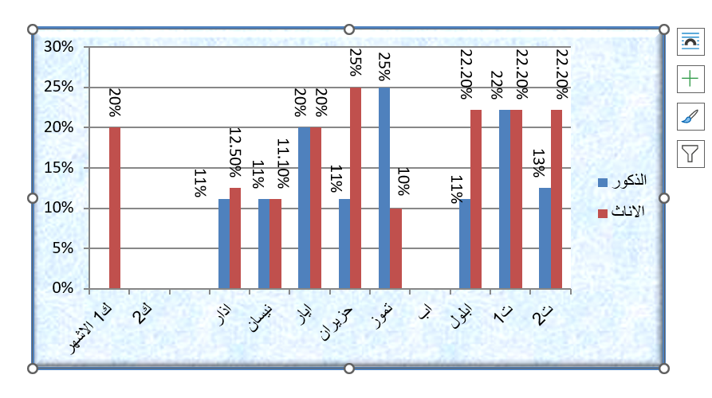
Results
Female donkeys with a higher proportion (13.5%) than male10.3% respectively differences ( P < 0.05 ). Fig. 6
Worm intensity ranged beween 1-6 worm and was shown high worm burden in Autumn and Spring fallowed by Summer and Tab.2
Finally Winter seasons ,which no infection was recorded in some months
Tab.2
Fig. 6

Slide 13
These worms were first recorded in Iraq by Leiper, (1957) and limited numbers of examined horses at thet time.
Ali et al., 1992; has recorded by 10.5% when conducting the autopsy of 124.
Al-Al-Alusy et al., 1994. found these worms in fifty of the horses of the city of Mosul through blood tests were able to detecting the worm diagnosed larval phases (nematodes).
While, other fallowing didn’t recorded any similar results for the difficulty of conducting the autopsy and investigation of adult worms) Al-Falahay , et al., 1992.
Discussion
Many species of Setaria were reported all over the world, but S.equina considered the most popular species recorded in donkeys. In Iraq, S.equina had not been studied by many authors and this study were cited by 11 world and middle east studies and mainly in Egypt.

Slide 14
Conclusion
The worms of the genus Seteria represent economic importance.
The diseases may cause [Cerebrospinal Nematodiasis], and this is no less important in the equine in Iraq and the rest of the world.
Recommendations
Using scanning electron microscopy considered a good choice to distinguish the ultrastructures .
Perform the phylogenetic analysis and detect relationships between different filarial worms, which could not detect by the morphological characterization of adult worms.
The need of the programs for proper and an effective control strategy against filariasis specially S. equina in Iraq.
The diagnosis of S. equina microfilariae in blood samples by PCR will be crucial for rapid and effective treatments .

Slide 15
Thank you

