Slide 1
Dog Diseases By Assist. Prof. Dr. Nabeel Mohammed Hassan Abu Al Maaly

Slide 2
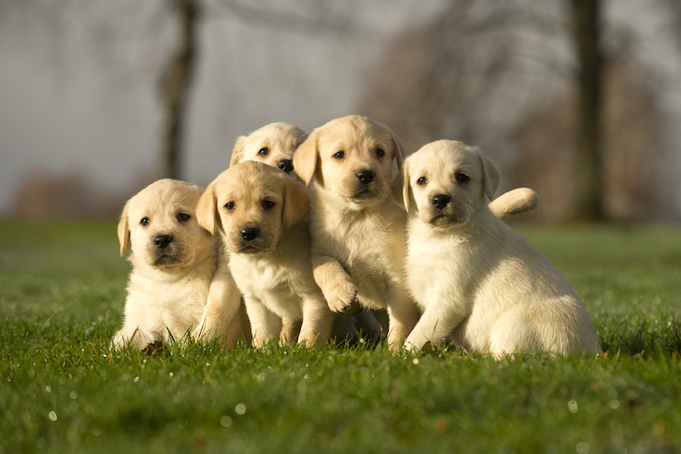
Dogs Diseases

Slide 3
Miniature-Poodles-head-portrait-outdoors-1

Slide 6
Dog breeds

Slide 7
Boxer dog

Slide 8
Belgian Malinois

Slide 9
Bulldog

Slide 10
Siberian Husky

Slide 11
Dalmatian

Slide 12
Doberman

Slide 13
labrador-retriever-vs-golden-retriever-

Slide 14
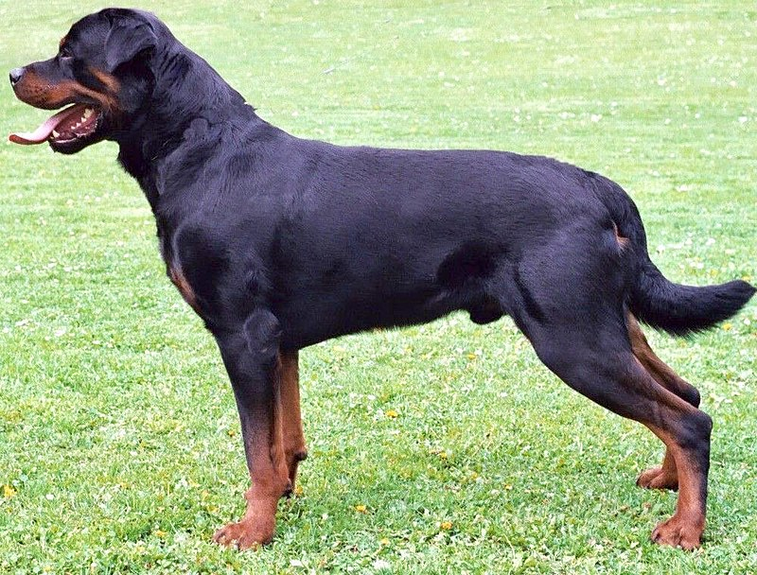
Rottweiler

Slide 15
German shepherd

Slide 16
labrador Retriever

Slide 17
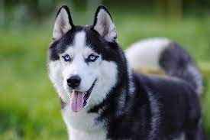
Husky

Slide 18
Some Dog diseases
Viral enteritis is one of the most common causes of infectious diarrhea in dogs younger than 6 months of age. Canine parvovirus (CPV)-2 and canine coronavirus (CCoV) have been incriminated as primary pathogens. CPV-1 and canine rotaviruses (CRV) can produce mild to inapparent illness in young pups (less than 8 weeks old), and their clinical significance is considered low. Astrovirus, herpesvirus, enteroviruses, calicivirus, parainfl uenza virus, reovirus, and other virus-like particles have been isolated from or identified in feces from

Slide 19
CANINE PARVOVIRUS ENTERITIS
Canine parvovirus enteritis is probably one of the most common infectious disorders of dogs and the most prevalent virus in dogs with infectious diarrhea.
Th is highly contagious, oft en fatal, disease is caused by strains of CPV-2 (2, 2a, 2b, and 2c).

Slide 22
Natural CPV infections have been reported in domestic dogs ( Canis familiaris ), bush dogs (Speothos venaticus), coyotes ( Canis latrans ),
wolves ( Canis lupus ), crab-eating foxes ( Cerdocyon thous ), and maned wolves ( Chrysocyon brachyurus ); most if not all Canidae are susceptible.

Slide 23
Acute CPV enteritis can be seen in dogs of any breed, age, or sex. Nevertheless, pups between 6 weeks and 6 months of age and Rottweilers, Doberman pinschers, Labrador retrievers, American Staffordshire terriers, German shepherds, and Alaskan sled dogs seem to have an increased risk. Some outbreaks of severe gastroenteritis and mortality due to CPV-2c infections in adult dogs (more than 6 months old) have been reported.

Slide 24
Pathogenesis
CPV spreads rapidly from dog to dog via oronasal exposure to contaminated feces. Virus replication begins in lymphoid tissue of the oropharynx, mesenteric lymph nodes, and thymus and is disseminated to the intestinal crypts of the small intestine by means of viremia. Marked plasma viremia is observed 1 to 5 days after infection. Subsequent to the viremia, CPV localizes predominantly in the gastrointestinal (GI) epithelium lining the tongue, oral and esophageal mucosae, and small intestine and lymphoid tissue, such as thymus, lymph nodes, and bone marrow. It can also be isolated from the lungs, spleen, liver, kidney, and myocardium.

Slide 25
Clinical signs
CPV infection has been associated with three main tissues — GI tract, bone marrow, and myocardium — but the skin and nervous tissue can also be affected. In addition, other clinical complications of secondary infection or thrombosis can occur. A marked variation is found in the clinical response of dogs to intestinal infection with CPV, ranging from inapparent infection to acute fatal disease. Inapparent, or subclinical, infection occurs in most dogs, mainly in puppies with intermediate MDA titers that can protect from disease but not from infection.

Slide 26
Parvovirus Enteritis
CPV enteritis may progress rapidly, especially with the newer strains (a, b, c) of CPV-2. Vomiting is oft en severe and is followed by diarrhea, anorexia, and rapid onset of dehydration. The feces appear yellow-gray and are streaked or darkened by blood. Elevated rectal temperature (40 ° to 41 ° C [104 ° to 105 ° F]) and leukopenia (mainly lymphopenia) may be present, especially in severe cases. Total leukocyte counts may be even within reference ranges because of concomitant virus-induced lymphopenia and neutrophilia consequent to infections by opportunistic bacteria. Those developing systemic inflammatory response syndrome have a greater risk of mortality. Death can occur as early as 2 days after the onset of illness and is oft en associated with gram-negative sepsis or disseminated intravascular coagulation, or both.

Slide 27
Neurologic Disease
Primary neurologic disease may be caused by CPV but more commonly occurs as a result of hemorrhage into the central nervous system (CNS) from disseminated intravascular coagulation or from hypoglycemia during the disease process, sepsis, or acid-base- lectrolyte disturbances.

Slide 28
Canine Parvovirus-2 Myocarditis
CPV myocarditis can develop from infection in utero or in pups younger than 6 weeks of age. All pups in a litter are usually affected. Pups with CPV myocarditis often die, or they succumb after a short episode of dyspnea, crying, and retching. Signs of cardiac dysfunction can be preceded by the enteric form of the disease or may occur suddenly, without apparent previous illness.

Slide 29
Diagnosis
The sudden onset of foul-smelling, bloody diarrhea in a young dog under 2 years of age) is often considered indicative of CPV infection. However, not all dogs with bloody diarrhea (with or without vomiting) are necessarily infected with CPV, and nonhemorrhagic diarrhea is often caused by CPV. Parasitic or enteropathogenic bacterial infections, alone or in combination, should also be considered.

Slide 30
Drug Dosage a (mg/kg) Route Interval (hr) Duration (days)
ANTIEMETIC AGENTS
Chlorpromazine 0.5 IM 8 prn
1.0 Rectally 8 prn
0.2 – 0.5 IV 8 prn
Metoclopramide 0.2 – 0.4 SC 8 prn
1 – 2 IV b 24 prn
Prochlorperazine 0.1 IM 6 – 8 prn
Ondansetron 0.1 – 0.15 IV 6 – 12 prn
Dolasetron 1 IV, PO 24 prn

Slide 31
ANTIMICROBIAL AGENTS
Ampicillin 10 – 20 IV, IM, SC 6 – 8 3 – 5
Cefazolin 22 IV, IM 8 3 – 5
Ceftiofur 2.2 – 4.4 SC 12 3 – 5
Gentamicin c 6 – 8 IM, SC, IV 24 3 – 5
Interferon- ω 2.5 × 10 6 units/kg IV 24 3
GASTRIC PROTECTANTS
Cimetidine 5 – 10 IM, IV 6 – 8 prn
Ranitidine 2 – 4 SC,IV 6 – 8 prn

Slide 32
MISCELLANEOUS THERAPY
Whole blood 10 – 20 mL/kg IV d prn
Plasma 10 – 20 mL/kg IV d prn
Dexamethasone sodium phosphate c 2 – 4 IV Do not repeat
Flunixin meglumine c 1 IV Do not repeat
Antiendotoxin serum e 8.8 mL/kg (diluted in equal amount crystalloid fluid) IV Do not repeat
Colloid fluids c,f 20 mL/kg IV 24 prn

Slide 33
Canine distemper
Viral shedding occurs by 7 days following experimental inoculation
(postinoculation [PI]). CDV, most abundant in respiratory exudates,
is commonly spread by aerosol or droplet exposure; however, it can
be isolated from most other body tissues and secretions, including
urine.

Slide 34
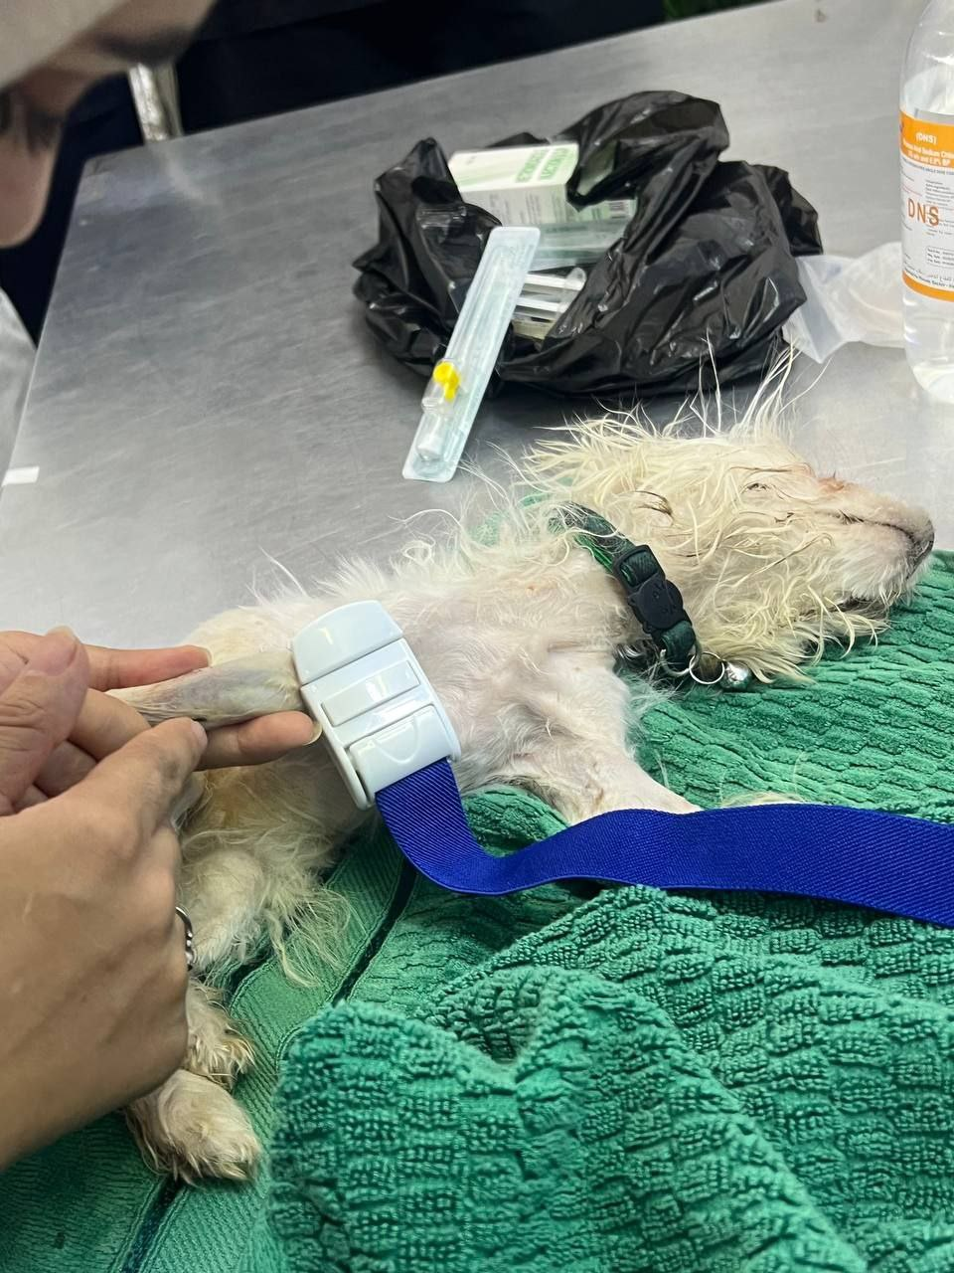

Slide 35
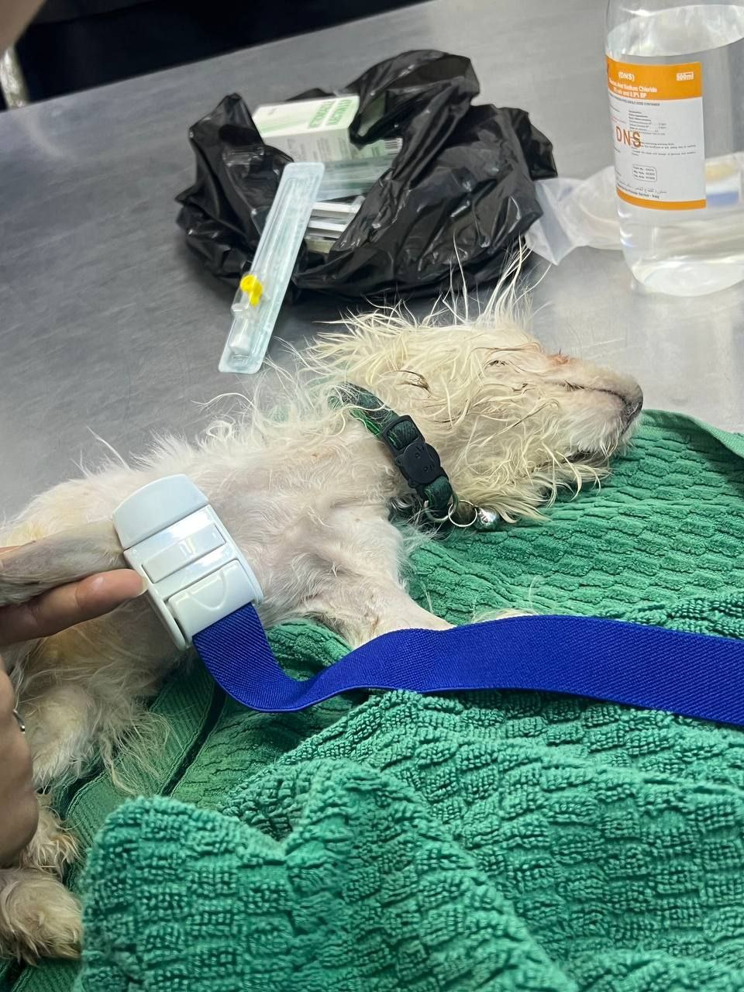

Slide 36
Systemic Infection
During natural exposure, CDV spreads by aerosol droplets and contacts
epithelium of the upper respiratory tract ( Web Fig. 3-1, Fig.
3-2 A,B ). Within 24 hours PI, it multiplies in tissue macrophages and
spreads in these cells via local lymphatics to tonsils and bronchial
lymph nodes. Original studies in dogs 16 have been repeated in ferrets,
in which virulent CDV takes advantage of mucosal surfaces for host invasion.

Slide 37
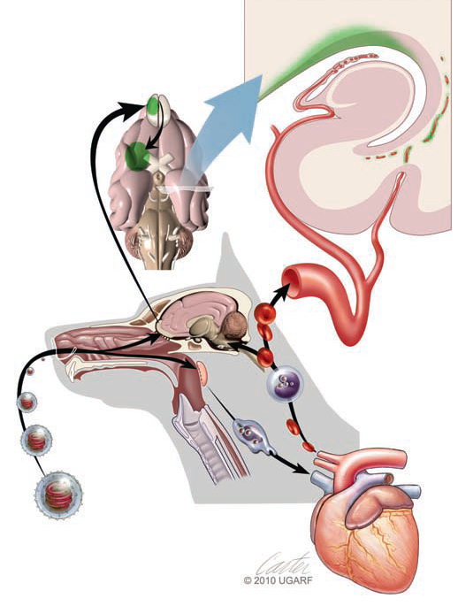

Slide 38
CLINICAL FINDINGS
Systemic Signs
Clinical signs of canine distemper vary depending on virulence of the
virus strain, environmental conditions, and host age and immune
status. More than 50% of CDV infections are probably subclinical.
Mild forms of clinical illness are also common, and signs include
listlessness, decreased appetite, fever, and upper respiratory tract
infection. Bilateral serous oculonasal discharge can become mucopurulent
with coughing and dyspnea.

Slide 39
Skin Lesions
Vesicular and pustular dermatitis in puppies is rarely associated with
CNS disease ( Fig. 3-3 A and B ), whereas dogs developing nasal and
digital hyperkeratosis ( Figs. 3-4 and 3-5 ) usually have various neurologic
complications. Viral invasion of cutaneous tissues has been
demonstrated.1 78 (See Pathogenesis .)

Slide 40
Neurologic Signs
Neurologic manifestations usually begin 1 to 3 weeks aft er recovery
from systemic illness; however, no way is known to predict which
dogs will develop neurologic disorders. Neurologic signs can also
coincide with multisystemic illness, or less commonly, they can occur
weeks to months later. Neurologic signs frequently develop in the
presence of nonexistent or very mild extraneural signs.

Slide 41
Drug Therapy for Canine Distemper
ANTIMICROBIAL
Ampicillin, amoxicillin 20 PO, IV, SC 8 7
Doxycycline c 5 – 10 PO, IV 12 7
Chloramphenicol 40 – 50 PO, SC 8 7
Florfenicol 25 – 50 SC, IM 8 3 – 5
Cephapirin 10 – 30 IM, IV, SC 6 – 8 3 – 5
ANTICONVULSIVE
Phenobarbital 10 – 20IV; Once To effect
then 2–8 PO 12 prn
ANTI-INFLAMMATORY
Dexamethasone
CNS edema 1 – 2 d IV 24 1day
Optic neuritis 0.1 PO, IV, SC 24 interval 3 – 5

Slide 42
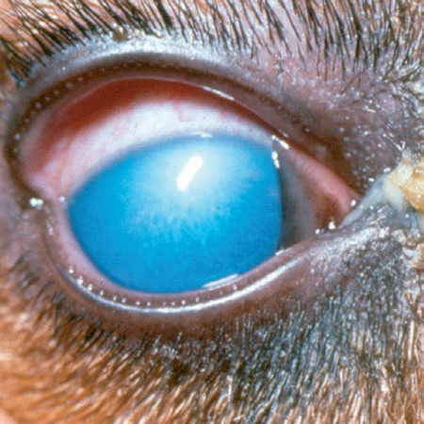
Infectious canine hepatitis

Slide 43
Thanks for Listening

