Slide 1
Anaerobic bacteria

Slide 2
Defenition:-
A microbe that can only grow under anaerobic condition .
Types of bacteria according the :
Oxygen

Slide 3
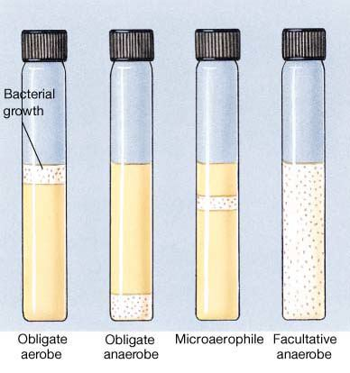

Slide 4
Definitions
Anaerobic bacteria:-
Bacteria that require anaerobic conditions to begin and sustain growth
Strict (obligate) anaerobic bacteria :-
Unable to grow if > than 0.5% oxygen
Moderate anaerobic bacteria:-
Capable of growing between 2-8% oxygen
Microaerophillic bacteria
Grows poorly in air, but better in anaerobic conditions
Facultative bacteria (facultative anaerobic)
Grows both in presence and absence of air

Slide 5
Why can’t anaerobic bacteria survive in oxygen?
The presence of oxygen leads to the production in cells of the superoxide radical (a negatively charged O2 molecule). Normally, the superoxide anion is lethal enough to kill almost any organism. Aerobic organisms and facultative anaerobes have the enzymes superoxide dismutase and catalase. These enzymes work together to convert superoxide to oxygen and water .

Slide 7
Classification of Medically Important Anaerobes
Gram positive cocci
Peptostreptococcus
Gram negative cocci
Veillonella
Gram positive bacilli
Clostridium perfringens, tetani, botulinum, difficile
Actinomyces
Lactobacillus
Gram negative bacilli
Bacteroides
Fusobacterium
Prevotella
Porphyromonas

Slide 8
Epidemiology
Endogenous infections
Indigenous microflora
Skin: Peptostreptococcus
Prevalence in areas exposed to air explained by (1) oxygen consumption by aerobes (2) low oxidation-reduction potential microhabitats
Upper respiratory: Propionibacterium
Mouth: Fusobacterium, Actinomyces
Intestines: Clostridium, Bacteroides, Fusobacterium
Vagina: Lactobacillus
Profound modification of flora in pathophysiologic states
Antimicrobials and other medications
Surgery (blind loops)
Cancers
Exogenous infections

Slide 9
Role of Anaerobes
Role in normal host physiology
Prevent colonization & infection by pathogens
Bacterial interference through elaboration of toxic metabolites, low pH, depletion of nutrients
Interference with adhesion
Contributes to host physiology
B. fragilis synthesizes vitamin K and deconjugates bile acids

Slide 10
Sites of anaerobic infections

Slide 11
Virulence factors
Attachment and adhesion
Polysaccharide capsules and pili
Invasion
Alteration in host tissue (trauma, disease)
Aerotolerance
Establishment of infection
Polysaccharide capsule (B. fragilis)
Spore formation (Clostridium)
Maintenance of reduced environment
Tissue damage
Elaboration of toxins

Slide 12
Clinical features of anaerobic infections
The source of infecting micro-organism is the endogenous flora of host
Alterations of host’s tissues provide suitable conditions for development of opportunist anaerobic infections
Anaerobic infections are generally polymicrobial
Abscess formation
Exotoxin formation

Slide 13
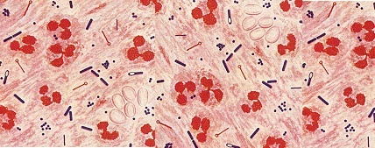
Importance :
Dominate the indigenous flora (colonization resistance)
Commonly found in infection
Easy to overlook
special precautions
Slow growth
Mixed infection
Difficult treatment

Slide 14
Presence as Normal flora :
Skin
Nose
Mouth, throat
Stomach
Large intestine >10¹¹ / gram colonic contents
Vagina
Endocervix
Urethra

Slide 15
Modefied by :
Pathophysiologic states
Antimicrobial agents , antacids
Hormonal changes
Age

Slide 16
Epidemiology :
Almost all infections are indigenous except
Tetanus
Infant ,wound botulism
Gas gangrene { some cases }
Bites
C .difficile {nosocomial }

Slide 17
Characters of anaerobic infection :
Suppuration
Abscess formation
Tissue destruction{gangrene}
Septic thrombophlebitis
Some have unique pathology
Actinomycosis
Psedomembranous colitis
Gas gangrene

Slide 18
Predisposing factors :
Low O tension
Trauma, dead tissue , deep wound
Impaired blood supply
Presence of other organisms
Foreign bodies

Slide 21
Anaerobic cocci
Epidemiology
Normal flora of skin, mouth, intestinal and genitourinary tracts
Pathogenesis
Opportunistic pathogens, often involved in polymicrobial infections
Virulence factors not as well characterized
Brain abscesses, periodontal disease, pneumonias, skin and soft tissue infections, intra-abdominal infections
Peptostreptococcus
P. magnus: chronic bone and joint infections, especially prosthetic joints
P. anaerobius: female genital tract and intra-abdominal infections
Veillonella
Normal oral flora; isolated from infected human bites

Slide 22
Anaerobic gram positive bacilli
No Spore Formation
Actinomyces
Lactobacillus
Spore Formation
Clostridium
C. perfringens
C. difficile
C. tetani
C. botulinum

Slide 23
Actinomyces
strict anaerobes
Colonize upper respiratory tract, female GU tract
Low virulence; development of disease when normal mucosal barriers are disrupted
Diagnosis:
Macroscopic colonies of organisms resembling grains of sand (sulfur granules)
Culture

Slide 24
Actinomycosis
Cervicofacial Actinomycosis
Poor oral hygiene, oral trauma
Slowly evolving, painless process
Chronic granulomatous lesions that become suppurative and form sinus tracts
Treatment: surgical debridement and prolonged penicillin

Slide 25
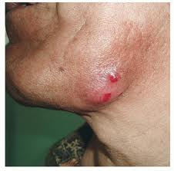
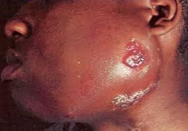
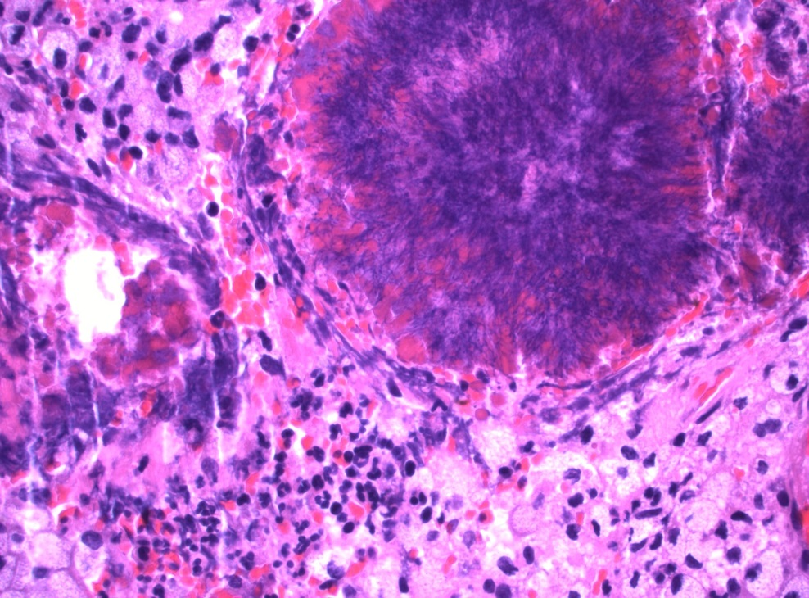

Slide 26
Lactobacillus
strict anaerobes
Colonize GU tract
Produces H₂O₂ which is bactericidal to Gardnerella vaginalis
Vagina heavily colonized (10⁵/ml) by Lactobacillus crispatus & jensonii
Clinical disease
Transient bacteremia from GU source
Endocarditis
Bacteremia in immunocompromized host

Slide 27
Clostridium
Epidemiology
Ubiquitous,
Present in soil, water, sewage
Normal flora in GI tracts of animals and humans
Pathogenesis
Spore formation
resistant to heat, dessication, and disinfectants
can survive for years in adverse environments
Rapid growth in nutritionally enriched, oxygen deprived environment
Toxin elaboration (histolytic toxins, enterotoxins, neurotoxins)

Slide 28
Clostridium perfringens
Epidemiology
GI tract of humans and animals
Type A responsible for most human infections
Pathogenesis
α-toxin: lecithinase (phospholipase C) that lyses erythrocytes, platelets and endothelial cells
ß-toxin: necrotizing activity
θ-toxin: hemolysin
Enterotoxin: binds to brush borders and disrupts small intestinal transport
Clinical manifestations
Self-limited gastroenteritis
Soft tissue infections: cellulitis, fascitis or Myonecrosis (gas gangrene)

Slide 29
Clostridial soft tissue infections

Slide 30
Myonecrosis

Slide 31
Myonecrosis xray

Slide 32
Clostridial myonecrosis
Clinical course
<48 hours incubation
Local area with marked pain, swelling, serosanguinous discharge, bullae, slight crepitance
May be associated with increased CPK
Treatment
Surgical debridement
Antibiotics
Hyperbaric oxygen

Slide 33
Clostridium difficile
Epidemiology
Colonizes GI tract of 5% healthy individuals
Endogenous infection
antibiotic exposure associated with overgrowth of C. difficile
Exogenous infection
spores detected in hospital rooms of infected patients
Pathogenesis
Enterotoxin (toxin A)
produces chemotaxis, induces cytokine production and hypersecretion of fluid, development of hemorrhagic necrosis
Cytotoxin (toxin B)
Induces polymerization of actin with loss of cellular cytoskeleton

Slide 34
C. difficile colitis

Slide 35
C. difficile colitis
Clinical syndromes
Asymptomatic colonization
Antibiotic-associated diarrhea
Pseudomembranous colitis
Diagnosis
Isolation of cytotoxin or enterotoxin
Treatment
Discontinue antibiotics
Metronidazole or vancomycin
Relapse in 20-30% (spores are resistant)

Slide 36
Clostridium tetani
Epidemiology
Spores found in most soils
Disease in un-vaccinated or inadequately immunized
Disease does not induce immunity
Pathogenesis
Spore inoculated into wound
Tetanospasmin
Heat-labile neurotoxin
Retrograde axonal transport to CNS
Blocks release of inhibitory neurotransmitters (GABA) resulting in spastic paralysis
Binding is irreversible
Tetanolysin
Oxygen labile hemolysin, unclear clinical significance

Slide 37
C. tetani exotoxin

Slide 39
Tetanus
Treatment
Debridement of wound
Metronidazole
Tetanus immunoglobulin
Vaccination with tetanus toxoid
Prevention
Vaccination with a series of 3 tetanus toxoid
Booster dose every 10 years

Slide 40
Clostridium botulinum
Epidemiology
Commonly isolated in soil and water
Human disease associated with A, B, E, F
Pathogenesis
Botulinum toxin targets cholinergic nerves
Prevents release of acetylcholine
Recovery depends upon regeneration of nerve endings

Slide 41
C. Botulinum Exotoxin

Slide 42
Botulism
Diagnosis
Isolation of organism
Culture implicated food and stool of patient
Isolation of toxin
Mouse bioassay
Treatment
Supportive care
Elimination of organism from GI tract
Gastric lavage
Metronidazole or penicillin
Trivalent botulinum toxin (A, B, E) to bind circulating botulinum toxin
Prevention
Prevention of spore germination (Acid PH, storage <4°C)
Destruction of preformed toxin (20 min at 80°C)

Slide 43
LABORATORY DIAGNOSIS:
When anaerobic infection is suspected;
a) Specimens have to be collected from the site containing necrotic tissue.
b) Pus is better than swabs.
c) Specimens has to be send to the laboratory within 1/2 hour
d) Fluid media like cooked meat broth are the best culture media.
e) Specimens have to incubated anaerobically for 48 hours.

Slide 44
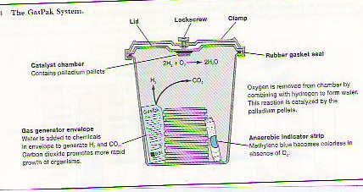
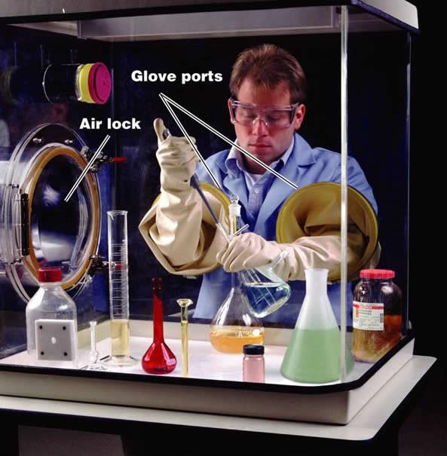

Slide 45
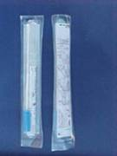

Slide 46
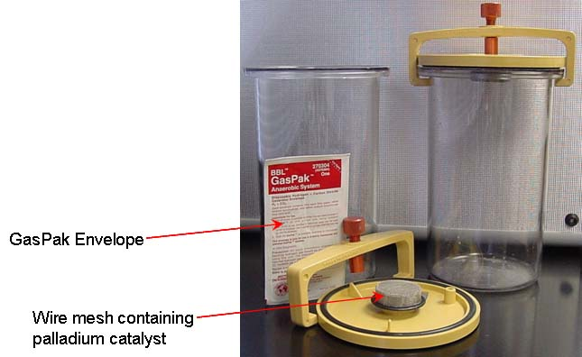

Slide 47
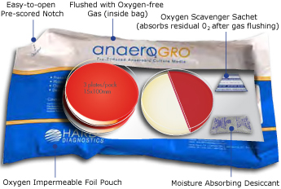

Slide 48
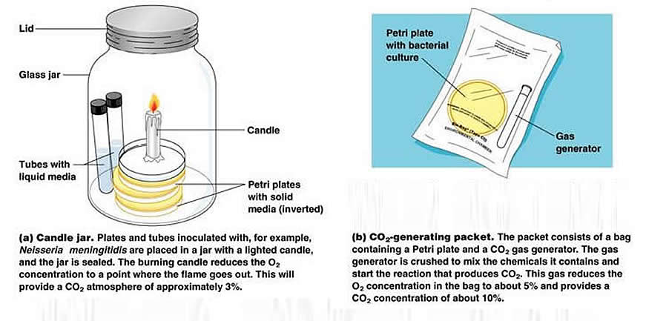
Anaerobic cultivation in anaerobic jar

Slide 49
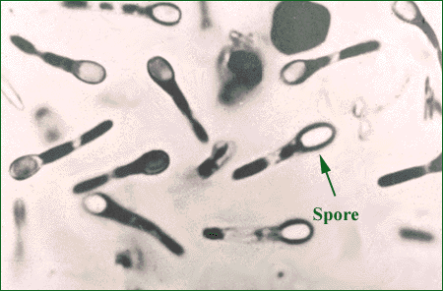

Slide 50
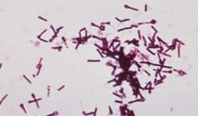

Slide 51
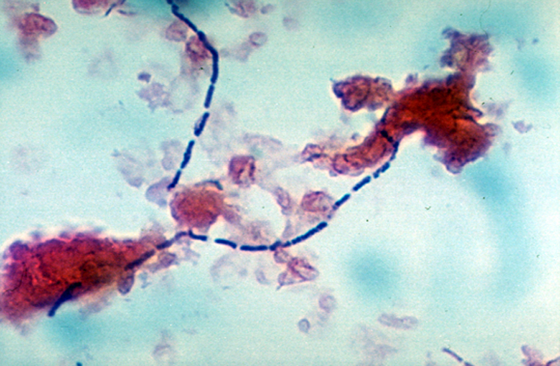
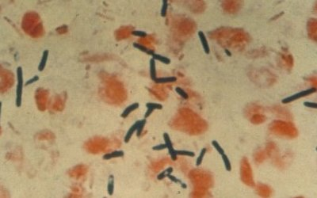

Slide 52
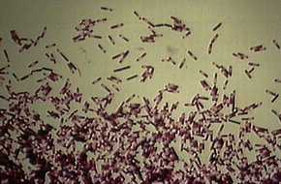

Slide 53
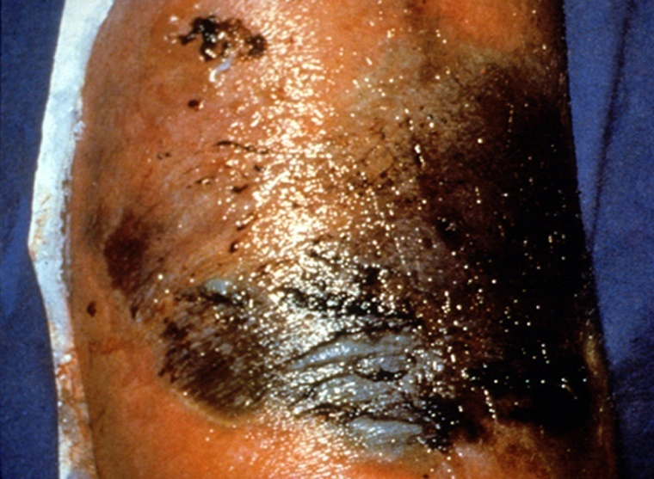

Slide 54
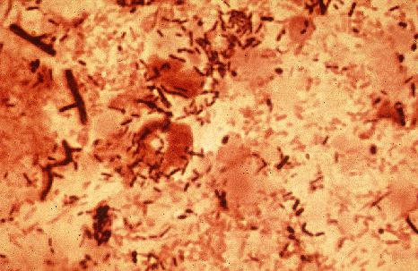

Slide 55
Thank you

