Slide 1
استخدام الجس عبر المستقيم لفحص الحمل في الابقار للفترة من 29-30\1\2025
التي اقيمت في فرع الجراحة والتوليد شعبة التوليد
المحاضرين
ا.م.د. حيدر عبدالكريم حسن
ا.م.د. عماد مجيد علي
ا.م.د. ايناس علي سلطان

Slide 2
Pregnancy Diagnosis in domestic farm animals
1.Sale
2.Monitor development of pregnancy
3.Confirm absence of twin
4.Monitor early embryonic death
5.Improve record keeping data
6.Management
7. Feeding

Slide 3
The goal of any method used to perform pregnancy examination is to determine the pregnancy status with:
• 100% accuracy (No false positives or negative)
• Determine the pregnancy as early as possible
•Judge the age of the conceptus
•Determine the viability of the conceptus
•Possibly determine the sex of the fetus
•And have the results immediately

Slide 4
Methods: Direct or Indirect

Slide 5
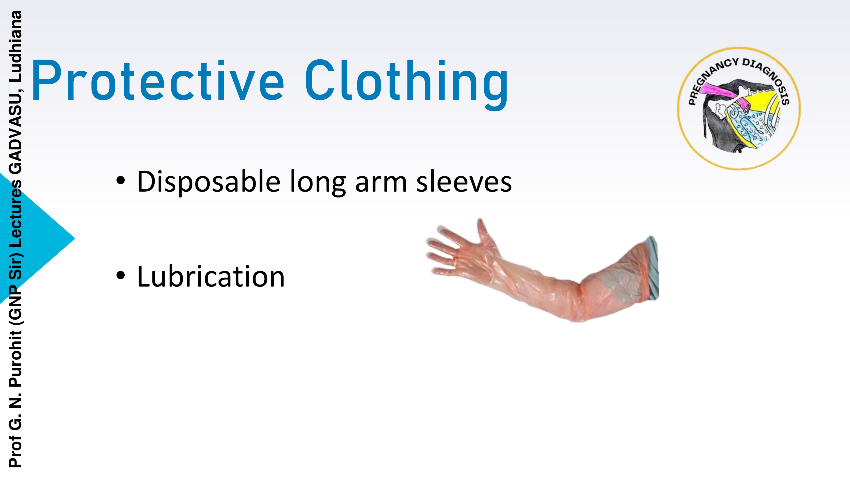

Slide 6
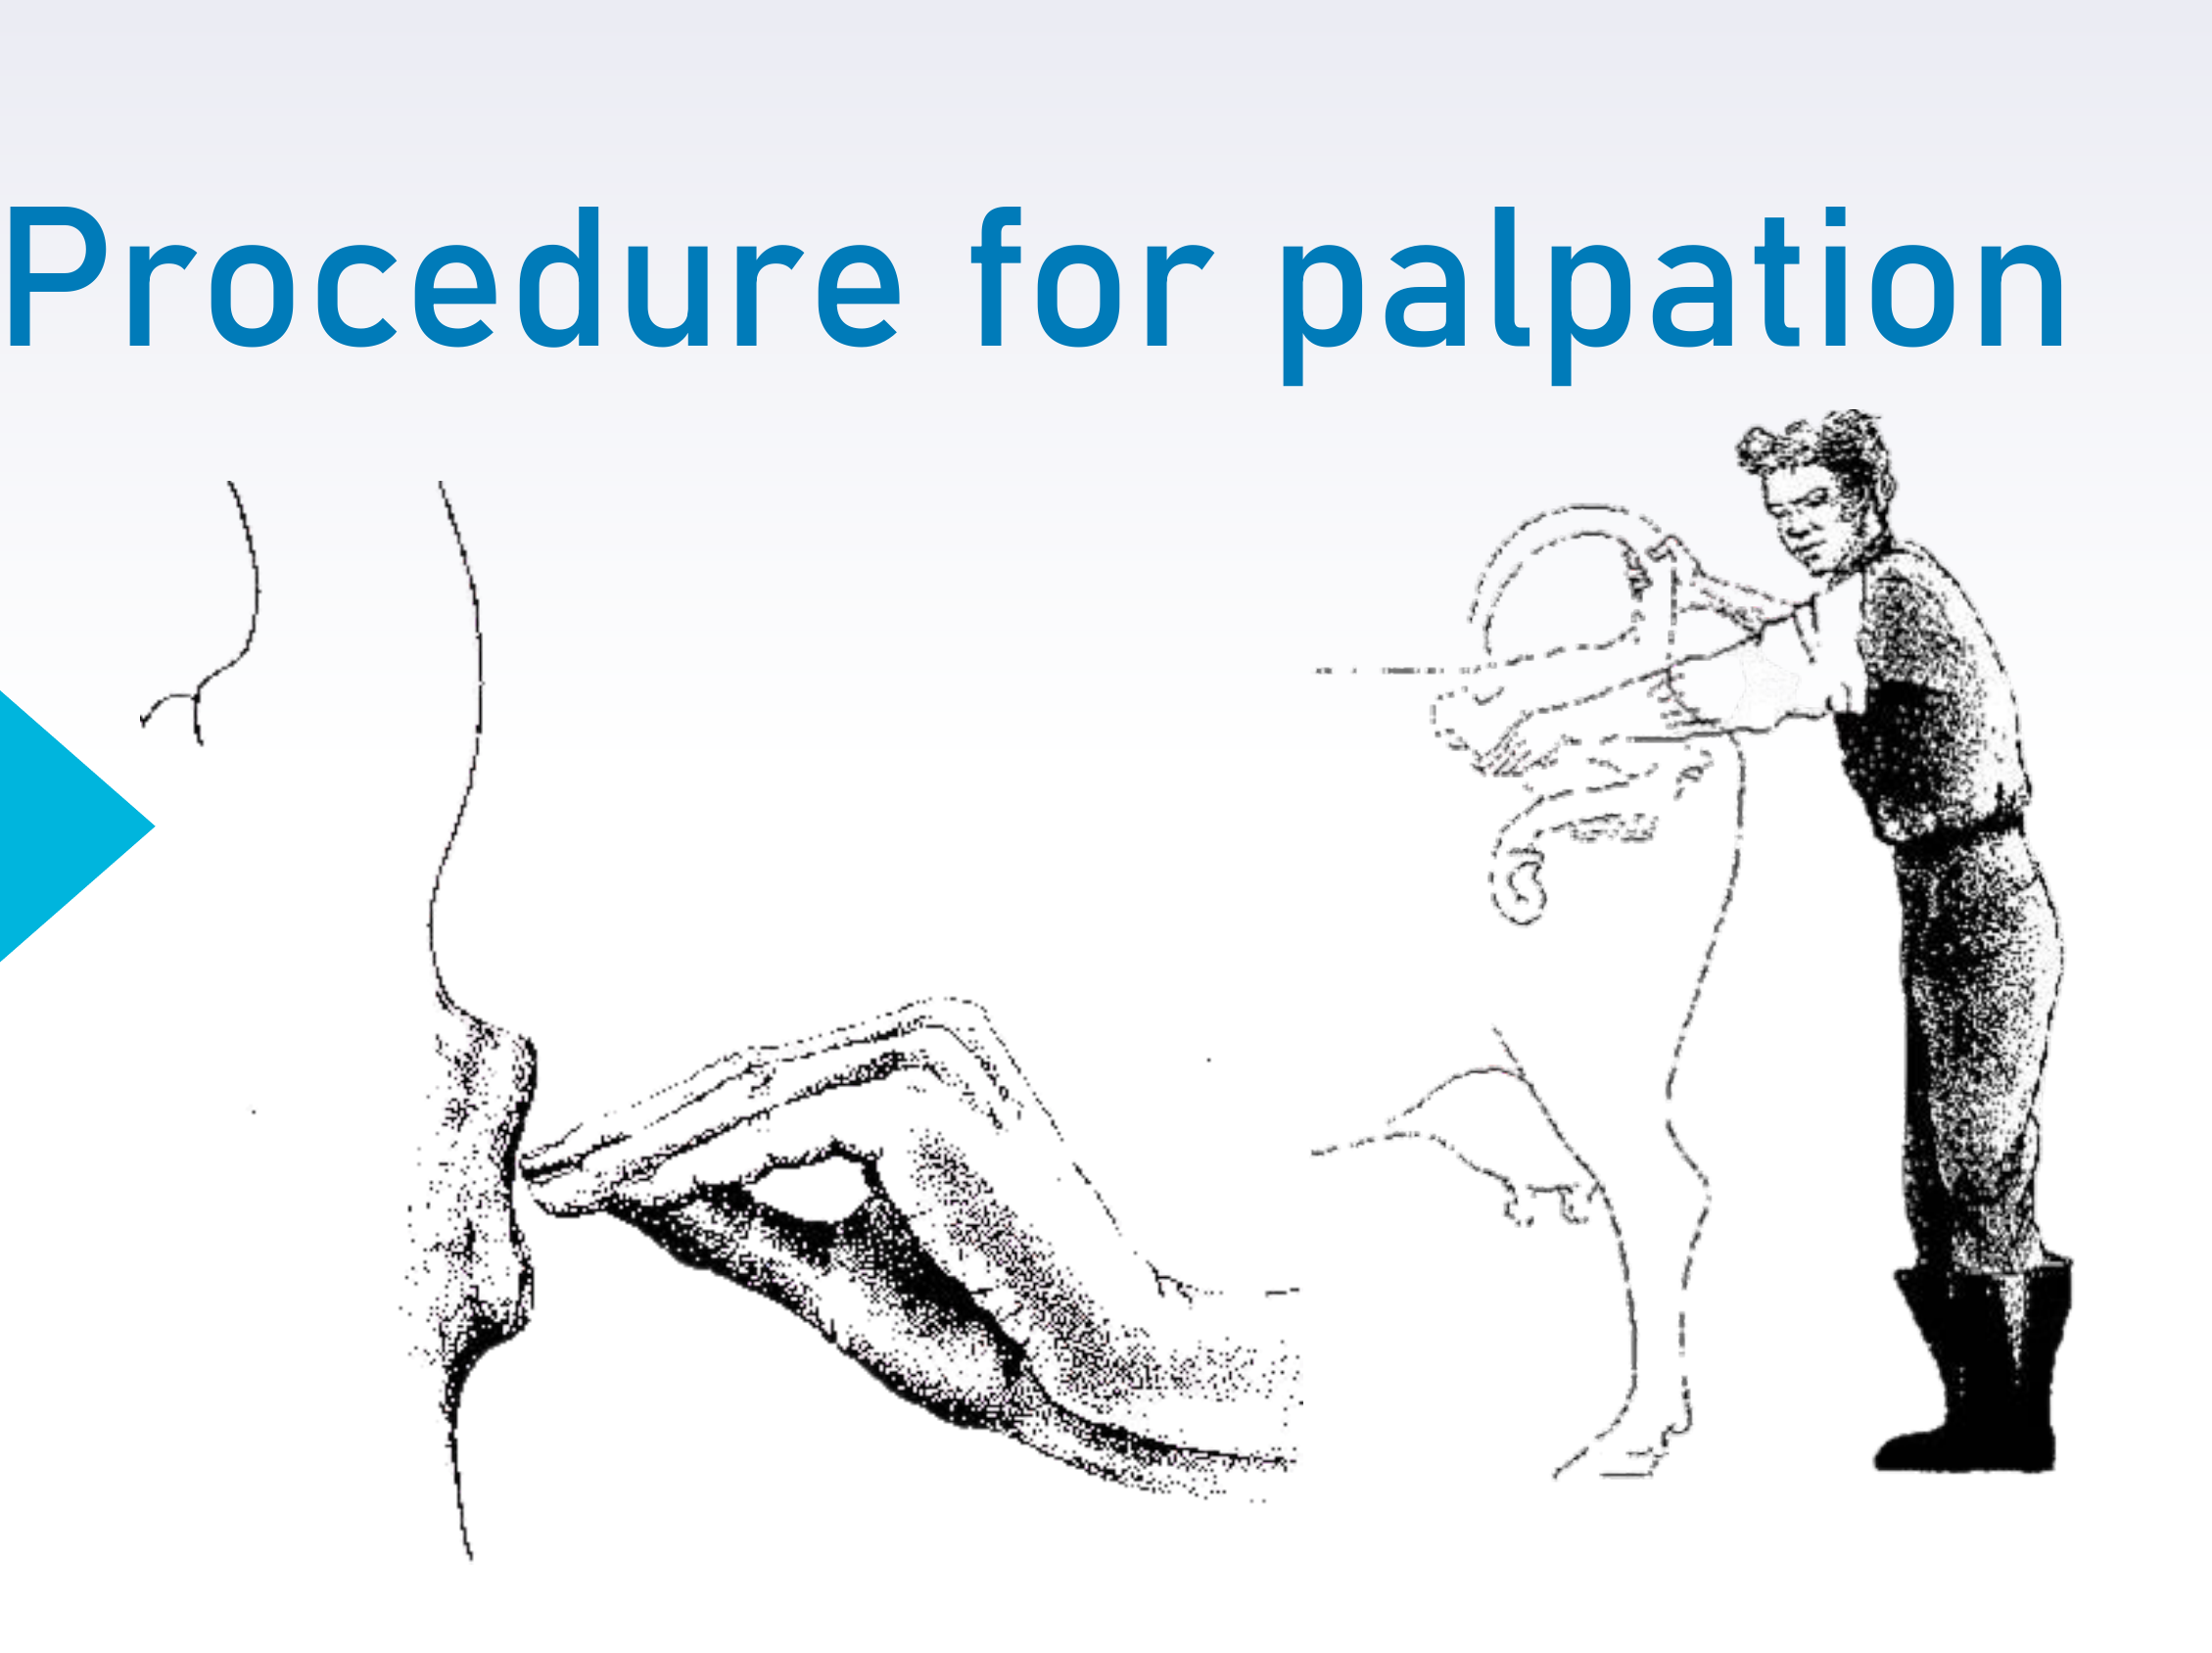

Slide 7
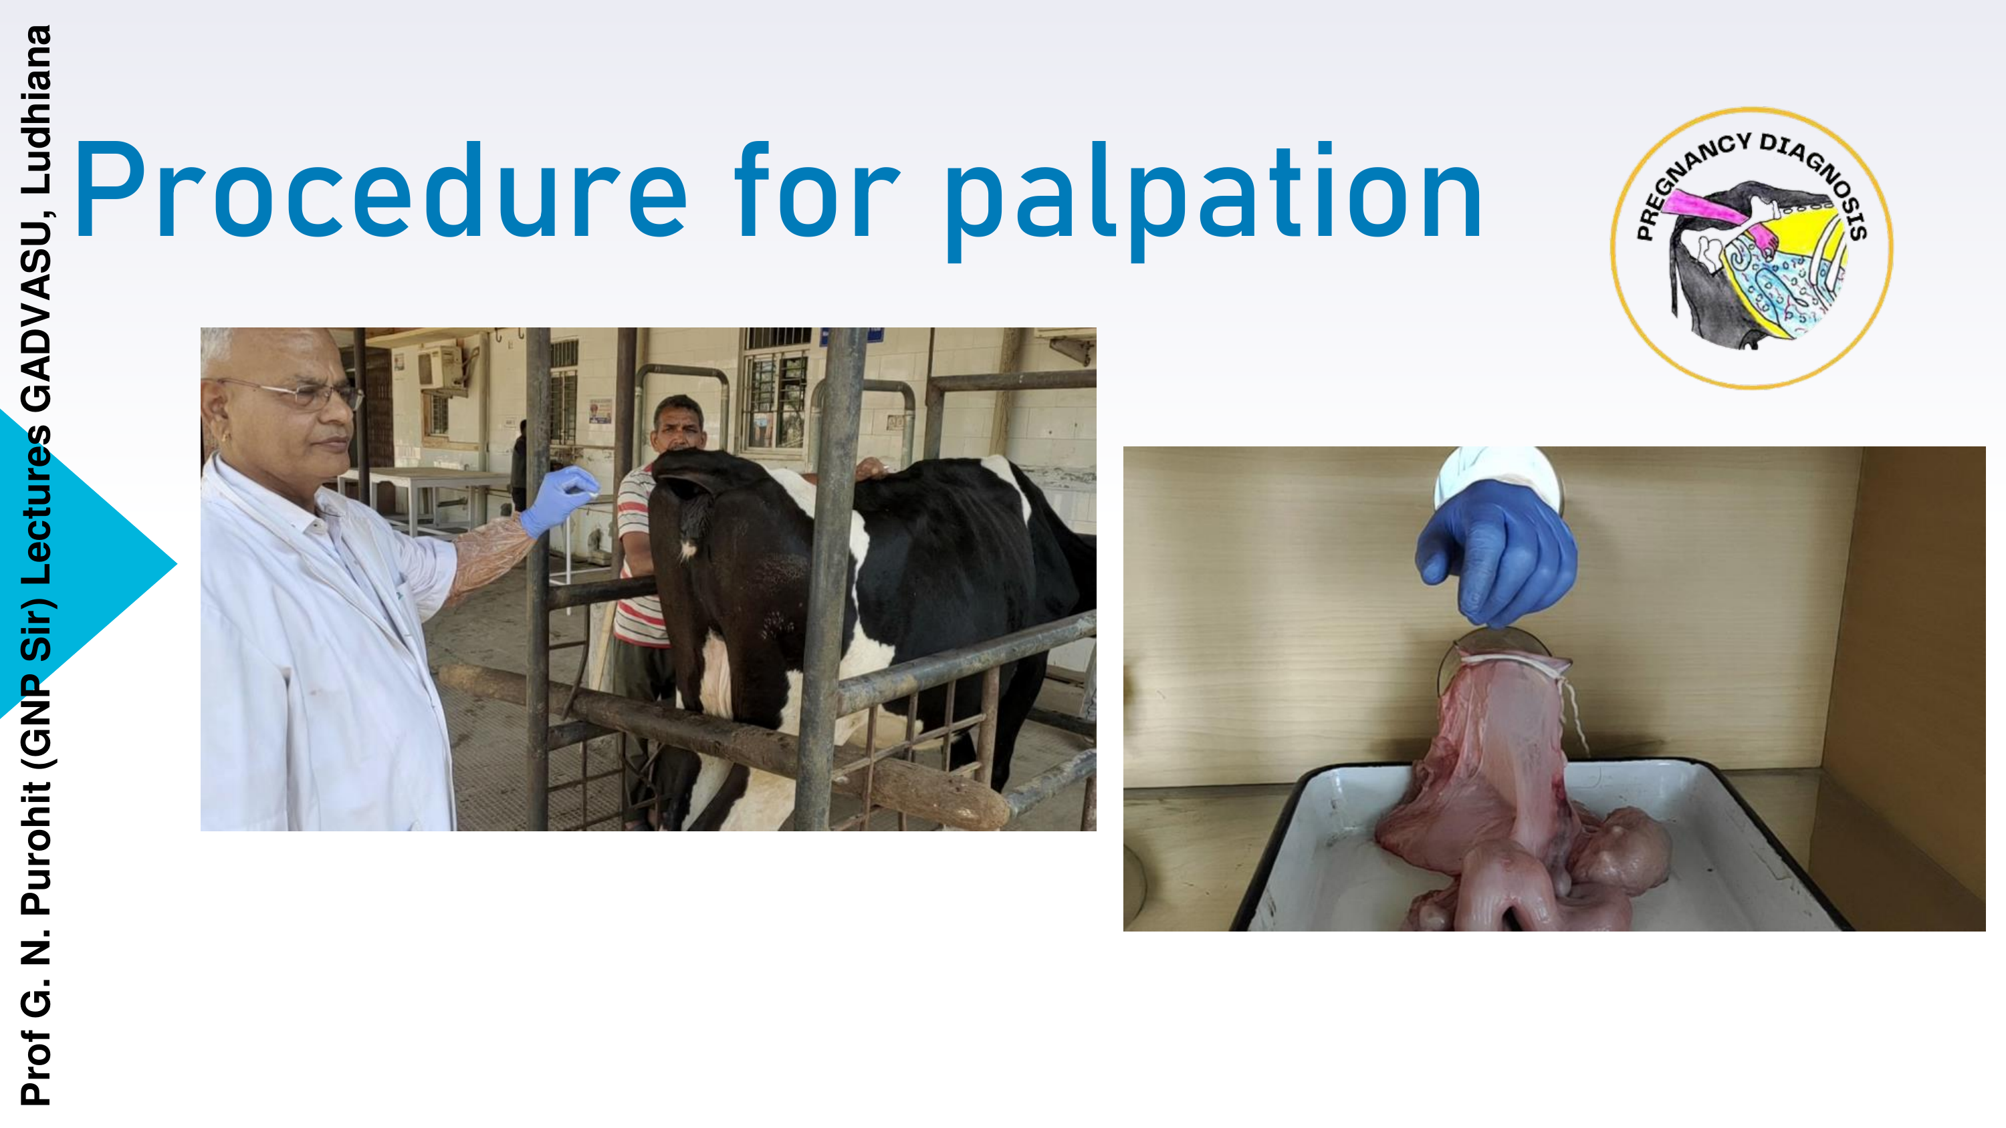

Slide 8
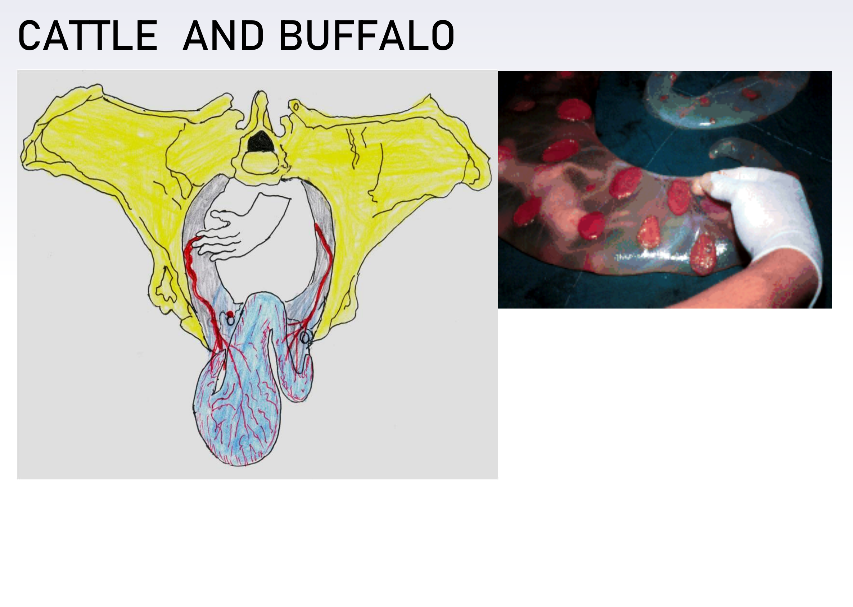

Slide 9
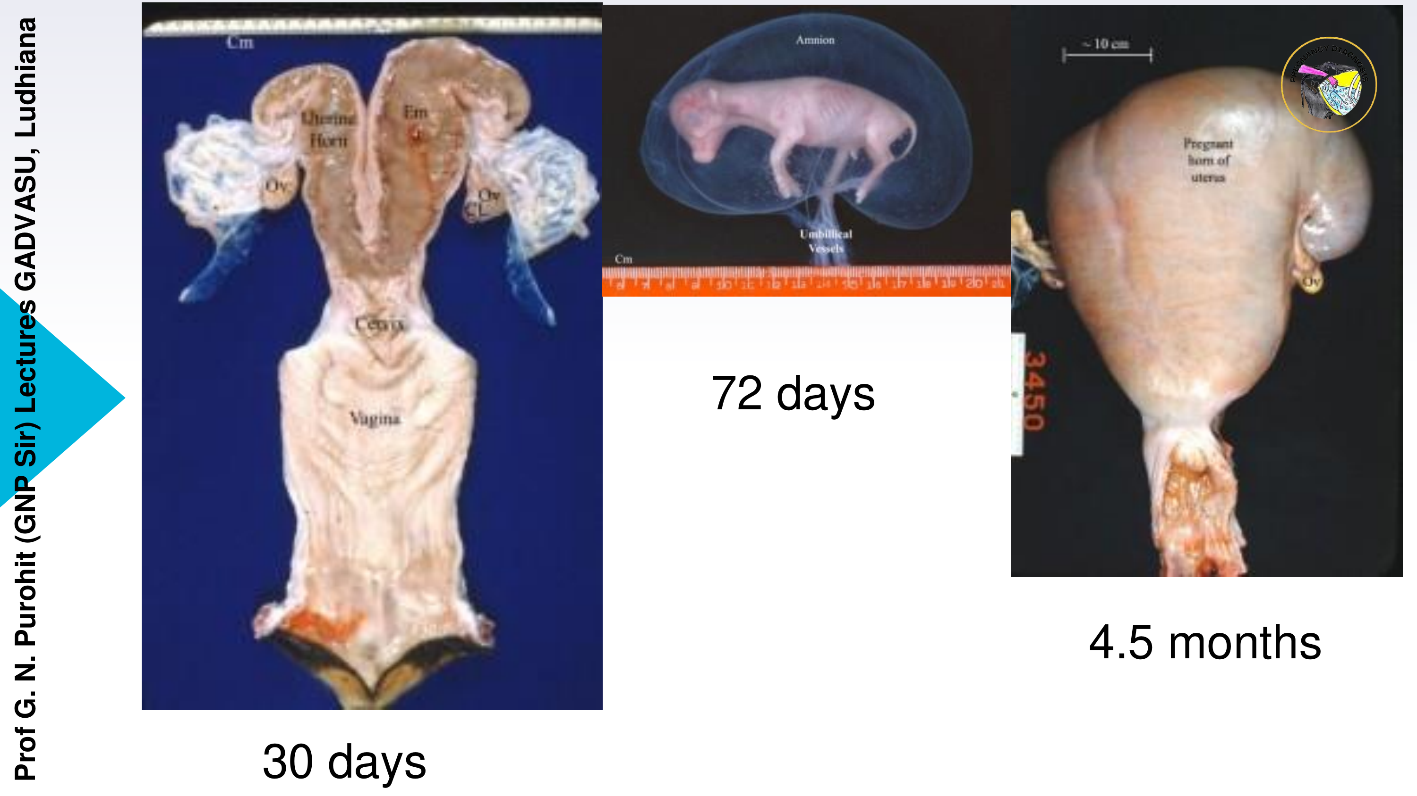

Slide 10
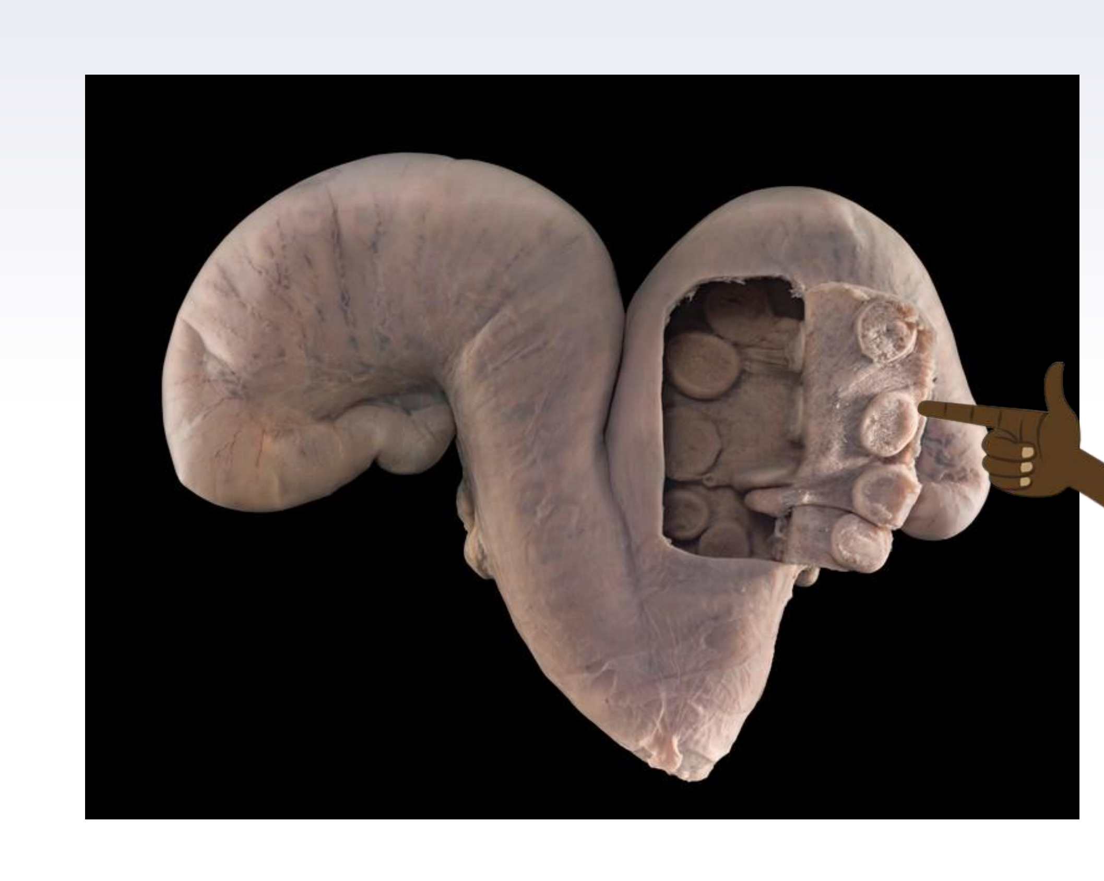

Slide 11
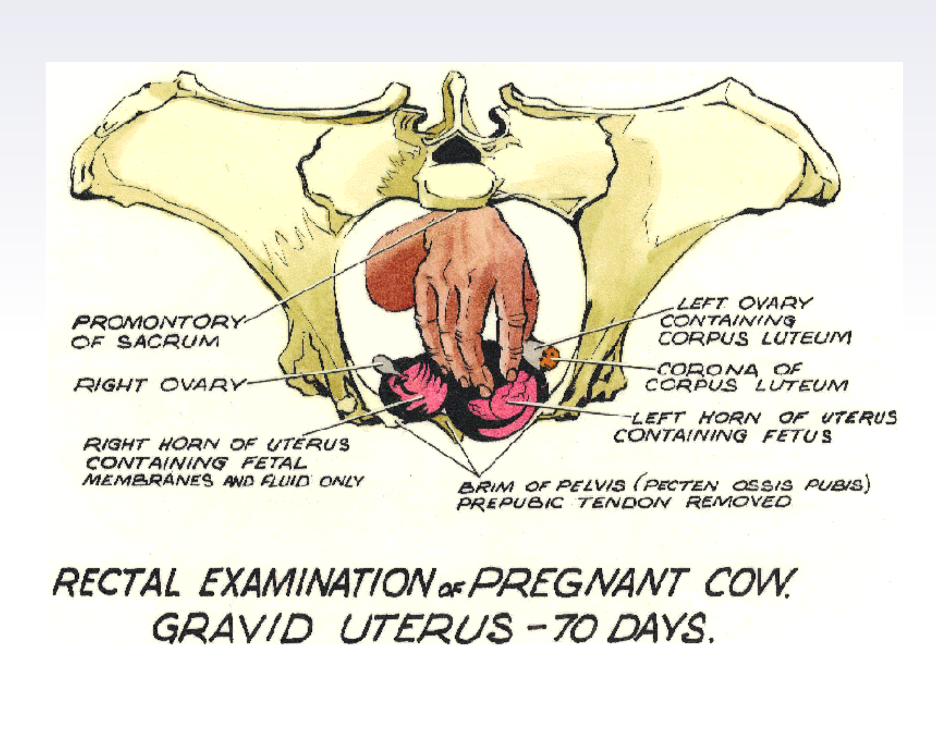

Slide 12
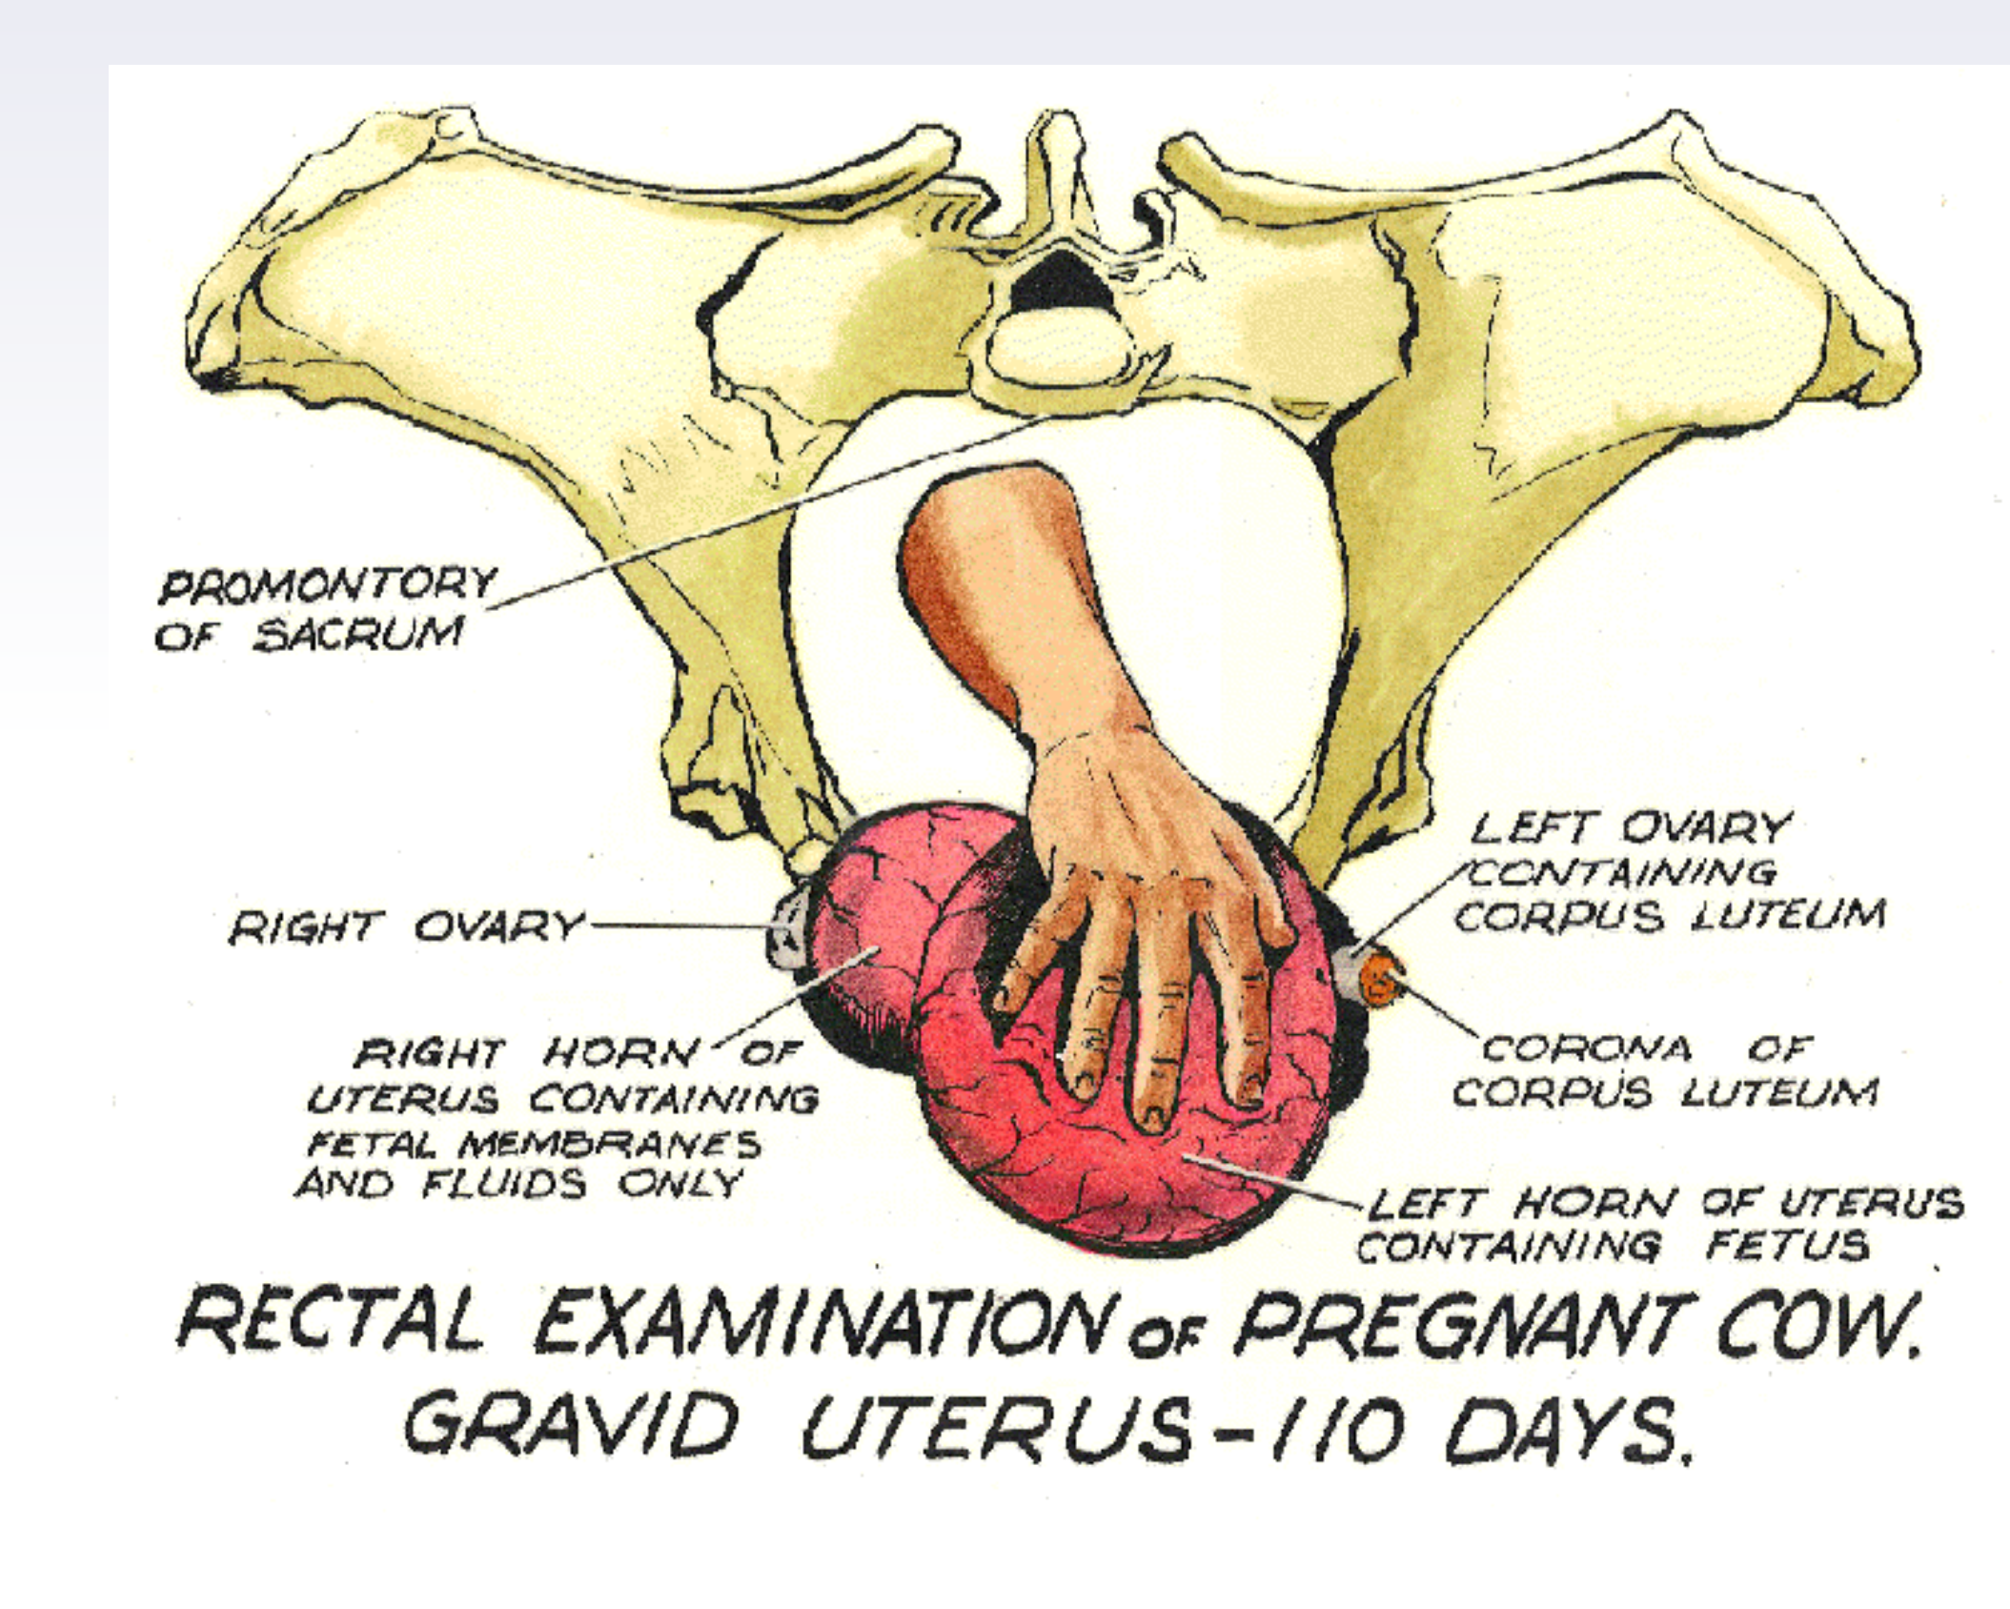

Slide 13
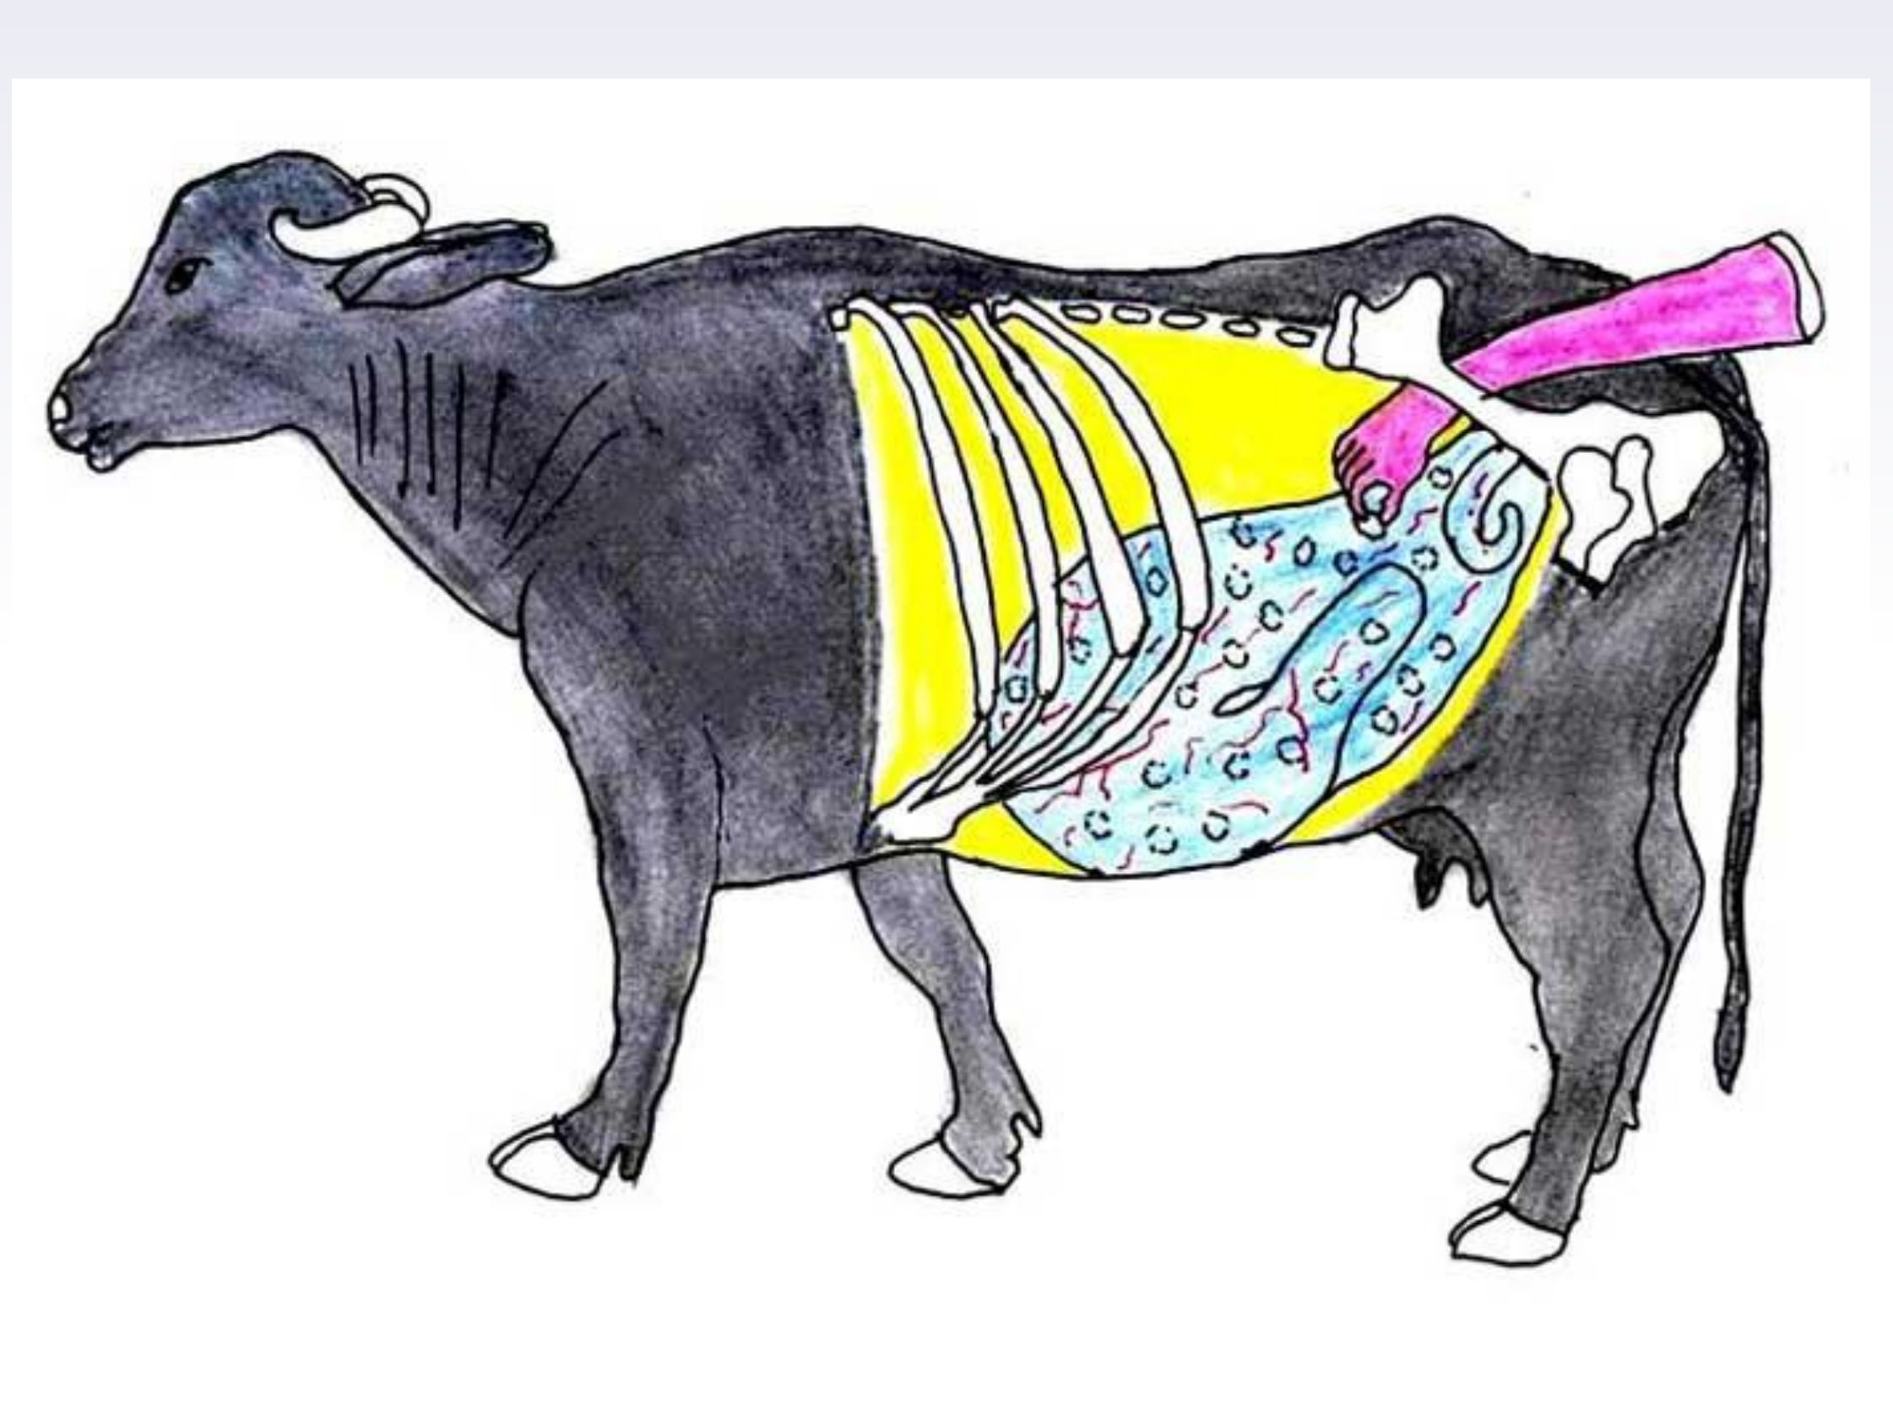

Slide 14
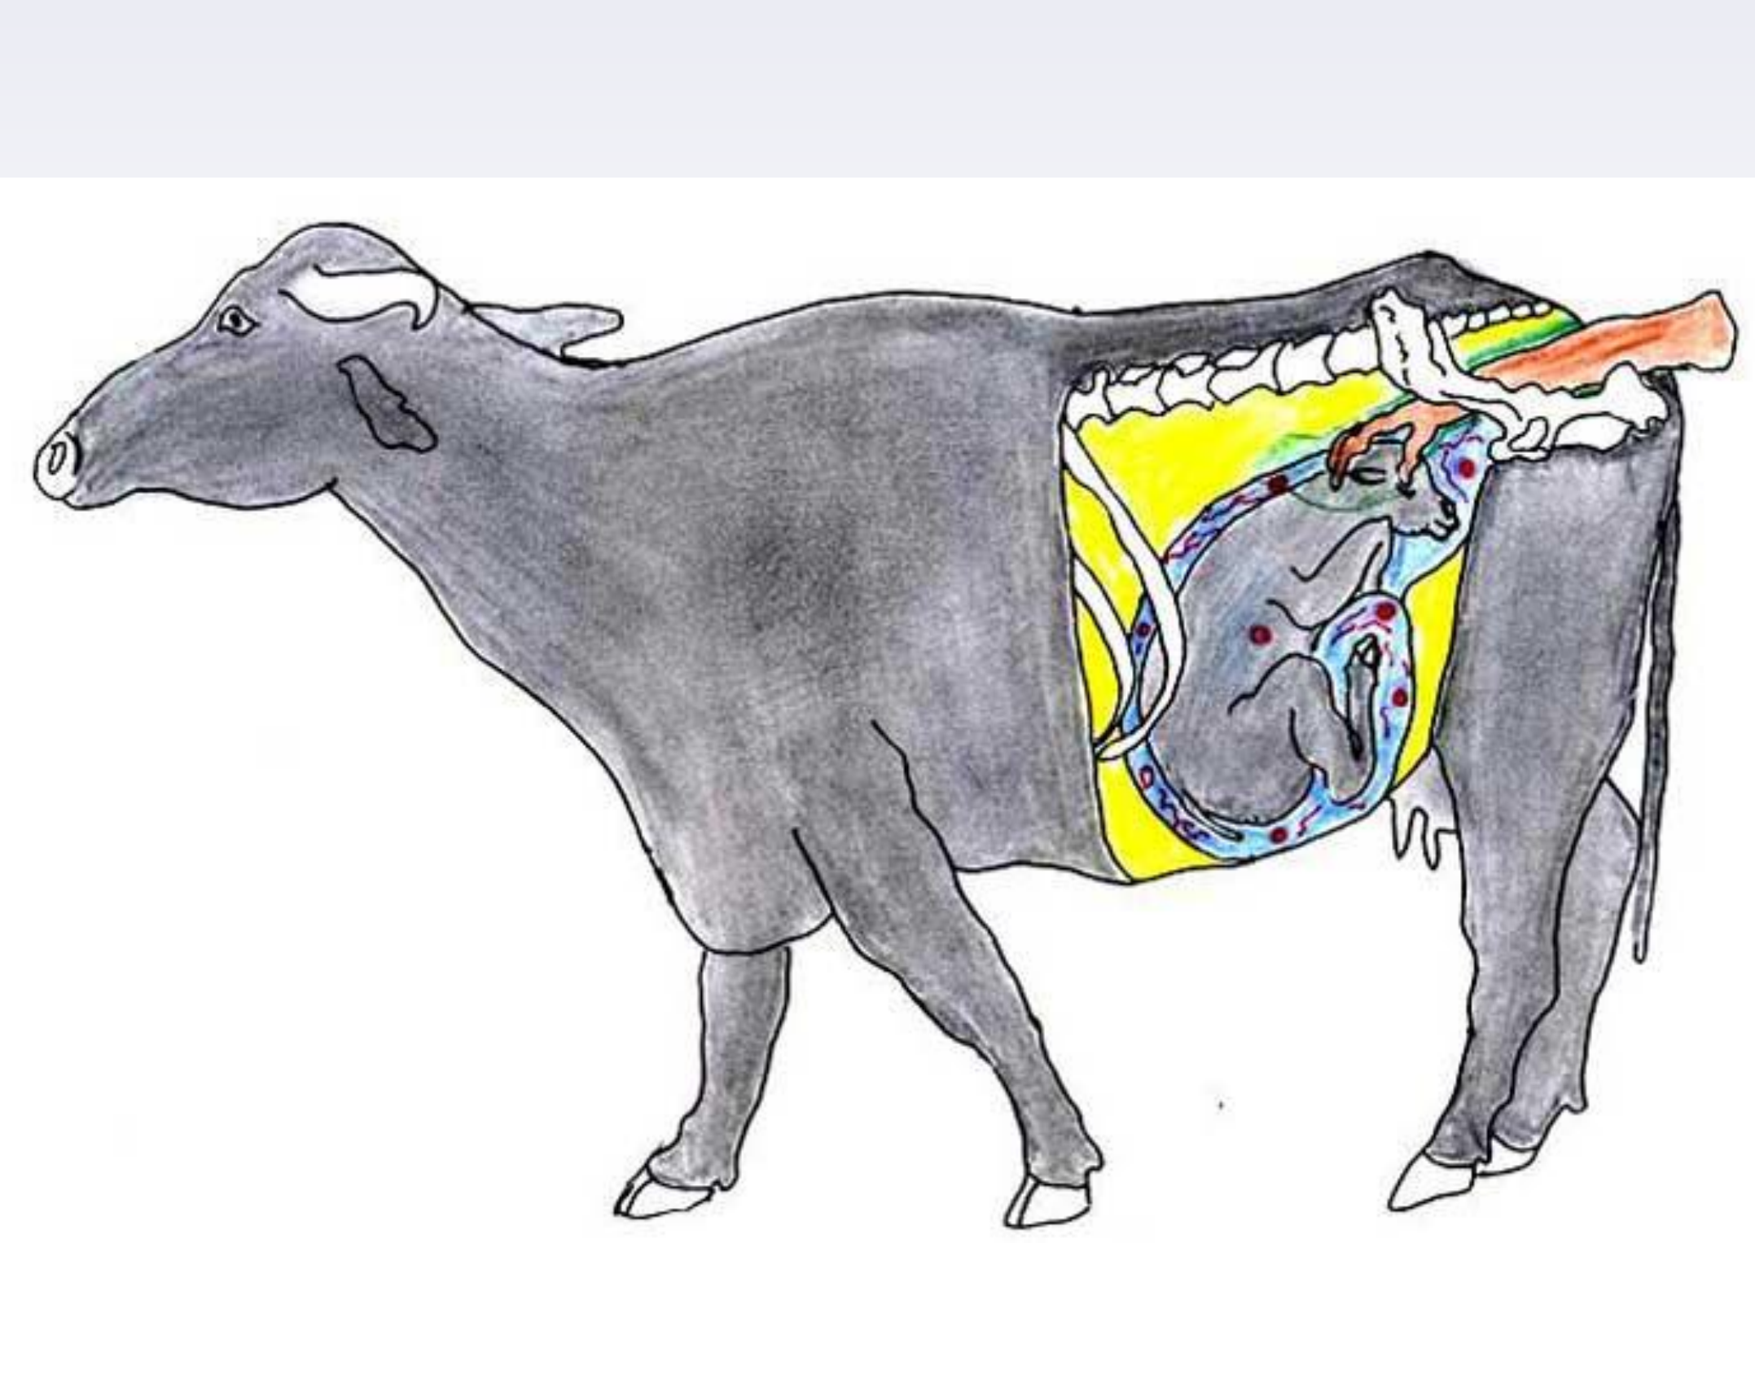

Slide 15
