Slide 1

Stains used in veterinary parasites detection
Republic of Iraq
Ministry of Higher Education and Scientific Research
University of Baghdad
College of Veterinary Medicine
By
Howaida Hamle Abed & Ali Issa Fadhl

Slide 2
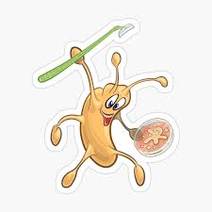
Stains and dyes
Stains and dyes are used to highlight the specimen at the microscopic level to study it at higher magnification for histopathological studies and diagnostic purposes.
What is Staining?
Staining, in microbiology, can be defined as a technique which is used to enhance and contrast a biological specimen at the microscopic level.

Slide 3
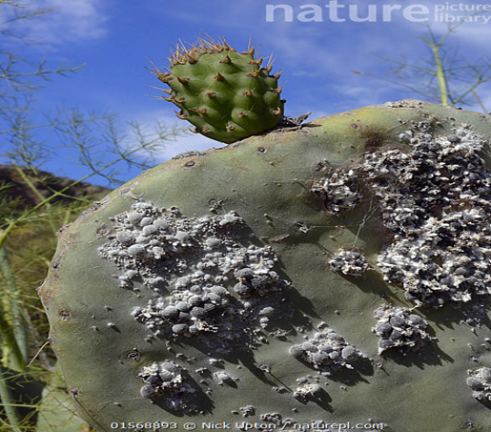
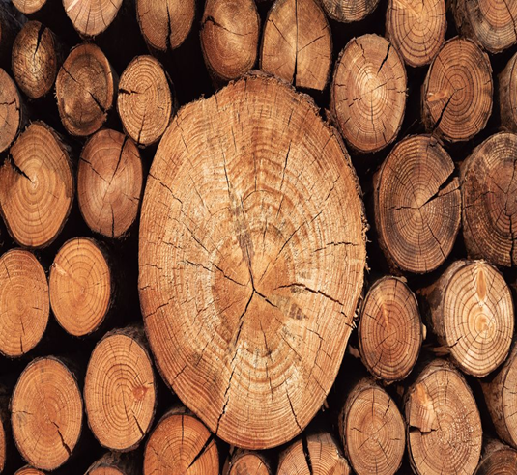
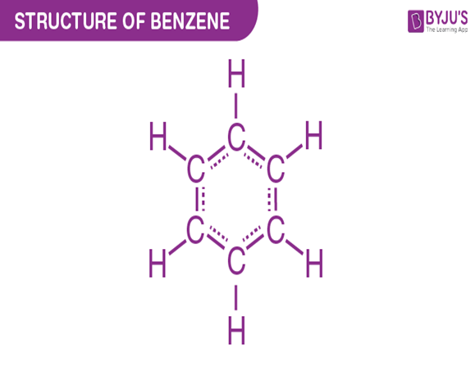
Classification of dyes :-There are two main types of dyes used in histology :-
A-Natural dyes , includes carmine (is obtained from cochineal ,the dried bodies of the female insect Dactylopius cacti ) and Haematoxylin is extracted from the wood of a small tree.
B-Synthetic dyes are large group of organic compound derived from benzene .

Slide 4
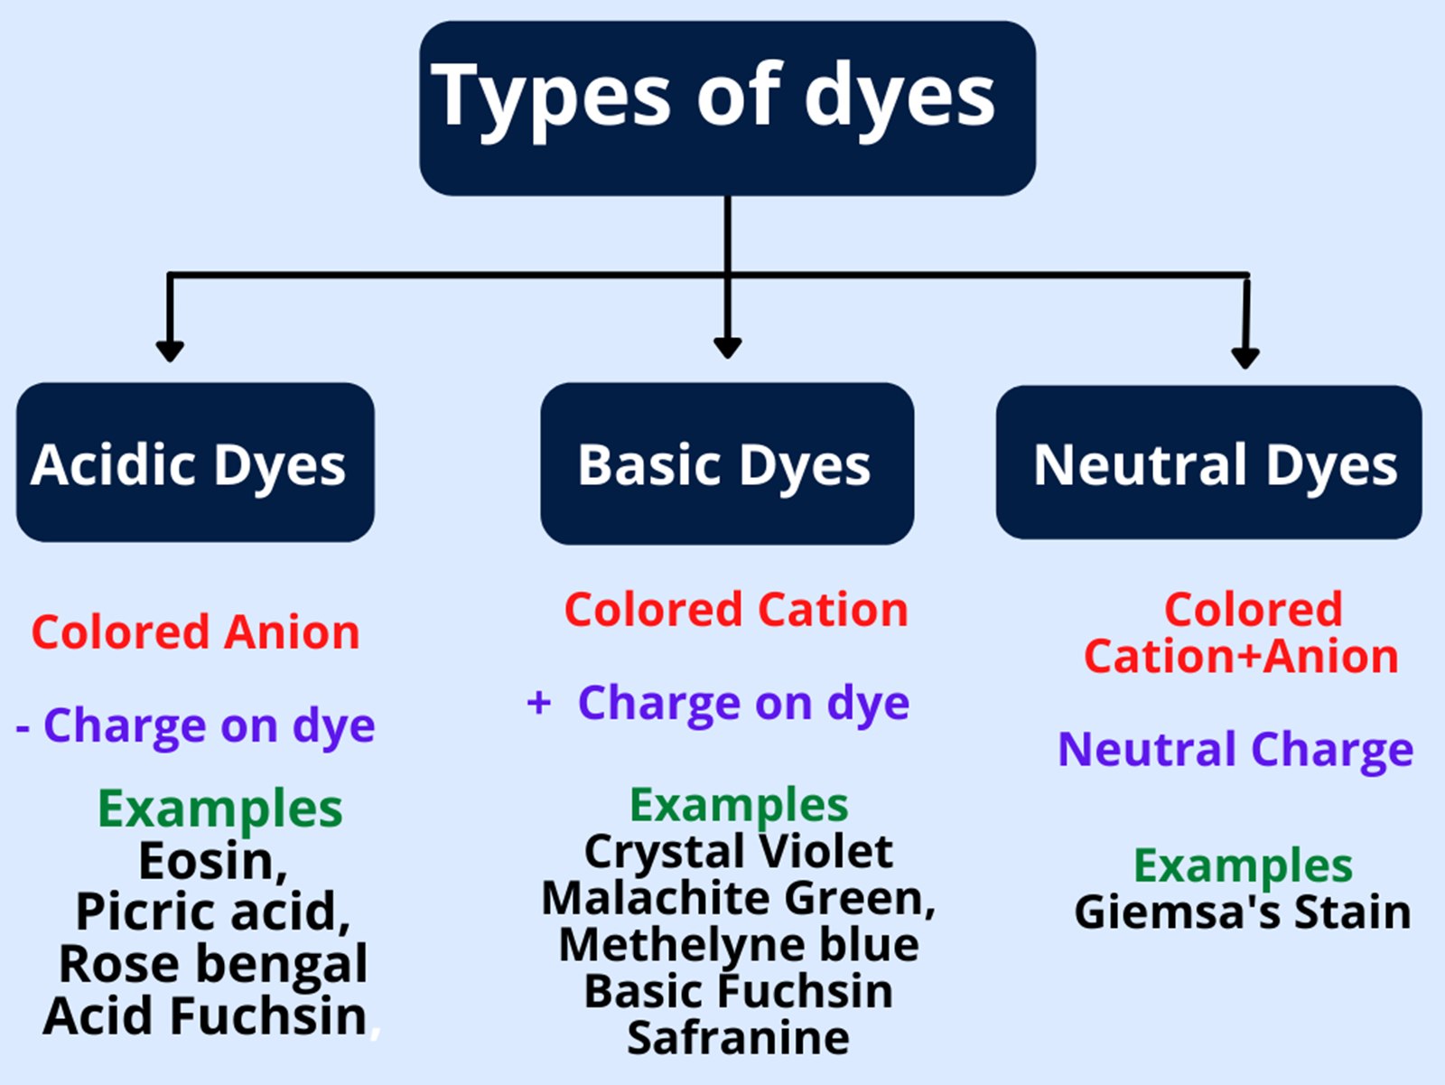

Slide 5
Bascic ,Acidic And Neutral Stains
A basic stain is a dye, the base which contains the coloring substance is combined with an acidic radicle (Cl, SO3).acidic tissue lik nuclie
An acidic stain ,is one in which the acidic component of the dye is couloured ,the base is colourless ,usally sodium (Na).basic structure like cytoplasm .

Slide 6
Neutral stain, is produced by the interaction of an acidic and basic dye ,( colored both parts of the dye molecule).like the Romanowasky dyes are the best known of the neutral stain).an affinity for acidophilic and basophilic elements in cell and certain tissue compound neutrl stain ,this given triple staining effect .
(Neutral stain are soluble in alcohol while the basic and acidic dyes are soluble in water and alcohol)

Slide 7
Preparation of the Biological Specimen
The preparation of the biological specimen to be analyzed under a microscope depends on the type of staining.
Wet Mounting: Living biological specimens are mounted on a glass slide with water and specific stains.
Fixation: It is a multi-step process which is done to preserve the shape of cells and tissues. Heat fixation is done to kill and adhere the specimens. Chemical fixation is done to generate strong bonds and increase the rigidity of the samples. Common chemical fixatives used are formaldehyde, picric acid, methanol and ethanol.

Slide 8
Mordant: Mordants are chemical agents that are used along with dye to make the specimen stainable, which otherwise is unstainable. Mordants are of two types:
Basic Mordants: They react with acidic dyes.
Acidic Mordants: They react with basic dyes.
When staining is done with the help of mordants, it is known as indirect staining. On the other hand, when staining is done without the help of mordants, it is known as direct staining.

Slide 9
Types of specimens

Slide 10
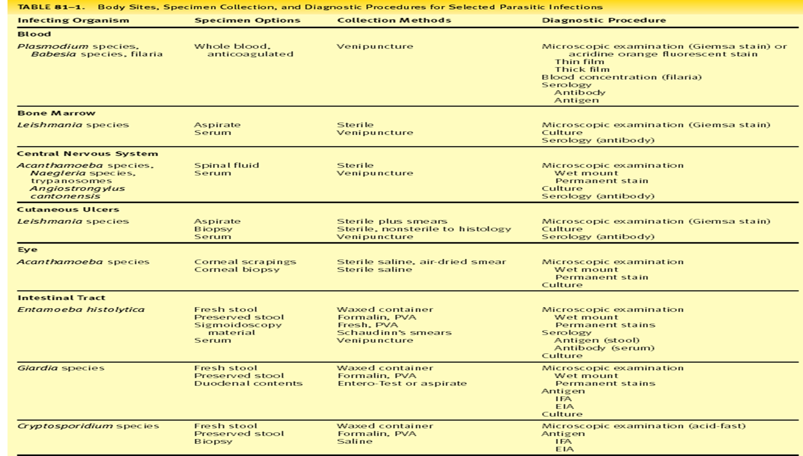

Slide 11
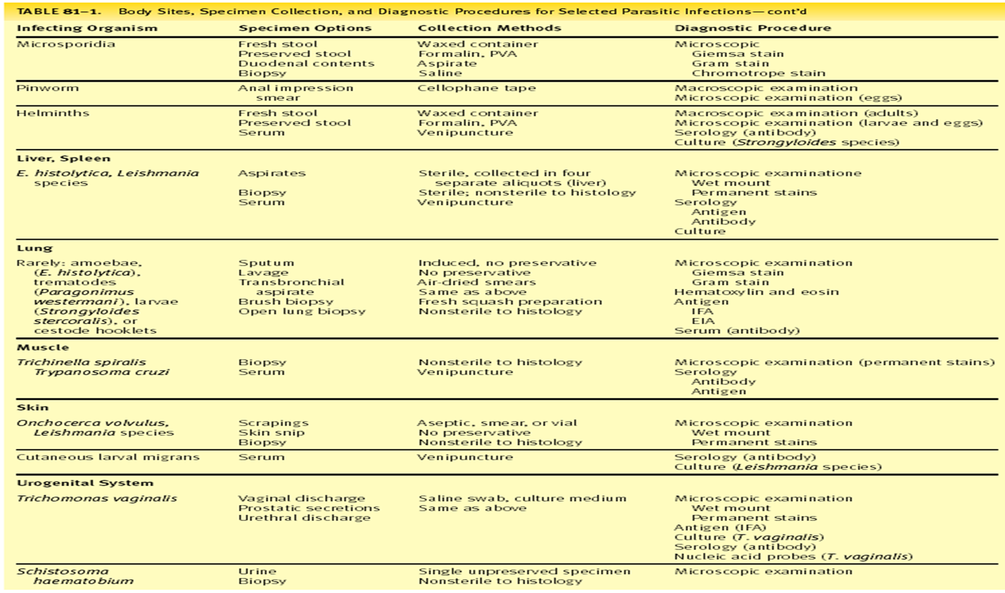

Slide 12
Parasitology staining …..
Temporary stains
Eosin
Saline
Acridine Oragne
Lugol’s Iodine
Thomson’s stain
Sargeant’s stain
Burrow’s stain
Permanent stains
Auramine Phenol
Field’s stain (A/B)
Giemsa stain
Iron Hematoxylene (A/B)
Trichrome
Modified Trichrome
Modified Ziehl - Neelsen

Slide 13
OBJECTIVES OF STAINING
Improves visibiltiy by greater contrast between the organism and the background.
Differentiate various morphological types (by shape, size, arrangement, etc.).
Determine the staining characteristic of organism and, at times, direct diagnosis of disease.
Demonstrate the purity of culture.
Observe certain structures (flagella, capsules, endospores, etc.),

Slide 14
Romanowsky Stains

Slide 15
Introduction
are named after a man called Dmitri Leonovich Romanowsky who invented it in 1891 .
• Defined as; stains that are used in haematology and cytological studies to differentiate cells in microscopic examinations of blood and bone marrow samples.
They are also applied to detect the presence of haemoparasites such as malaria, trypanosomes, leishmania and others parasites.

Slide 16
Romanowsky stains are neutral in a way that they are composed of oxidized methylene blue (azure) dyes and Eosin Y.
The azures are purplish- blue and are basic while the eosin is pinkish red and is acidic.
They stain the cell components differently depending on their PH.
This ability to produce a wide range of hues (colours) allowing cellular components to be easily differentiated is called Romanowsky effect/ metachromasia.

Slide 17
Romanowsky stains are universally employed for staining of blood films. All Romanowsky combinations have two essential ingredients i.e. methylene blue and eosin or azure.
Methylene blue is the basic dye and has affinity for acidic component of the cell (i.e. nucleus) and eosin/azure is the acidic dye and has affinity for basic component of cell (i.e. cytoplasm).
Most Romanowsky stains are prepared in methyl alcohol so that they combine fixation and staining.

Slide 18
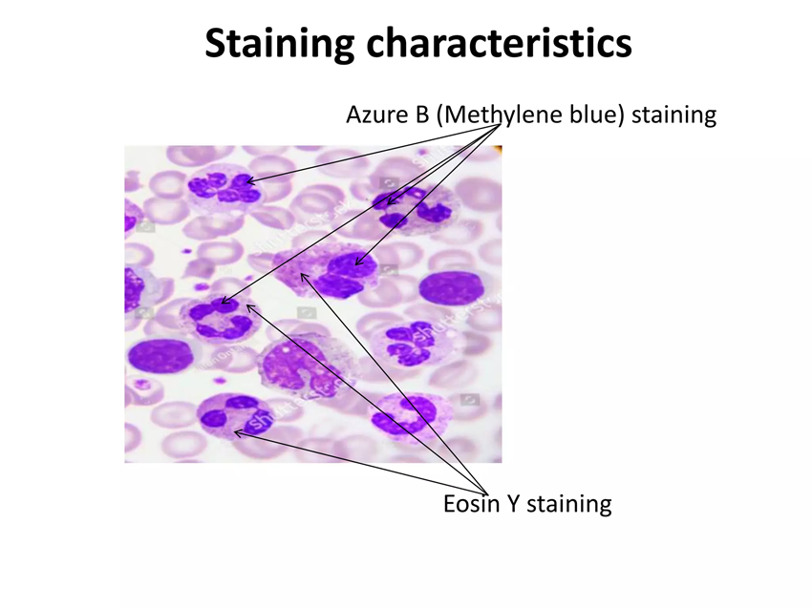
Principle • Romanowsky stains
work on the principle that “the acidic components of the cell are stained by the basic dye (azure) forming a blue-purple colour while the basic components of the cell are stained by the acidic dye (eosin Y) forming a pin- red colouration.”

Slide 19
Types of Romanowsky stains
1. Leishman stain
2. Giemsa stain
3.Field stain
4. Wright stain
5. Jenner stain
6. JSB stain

Slide 20
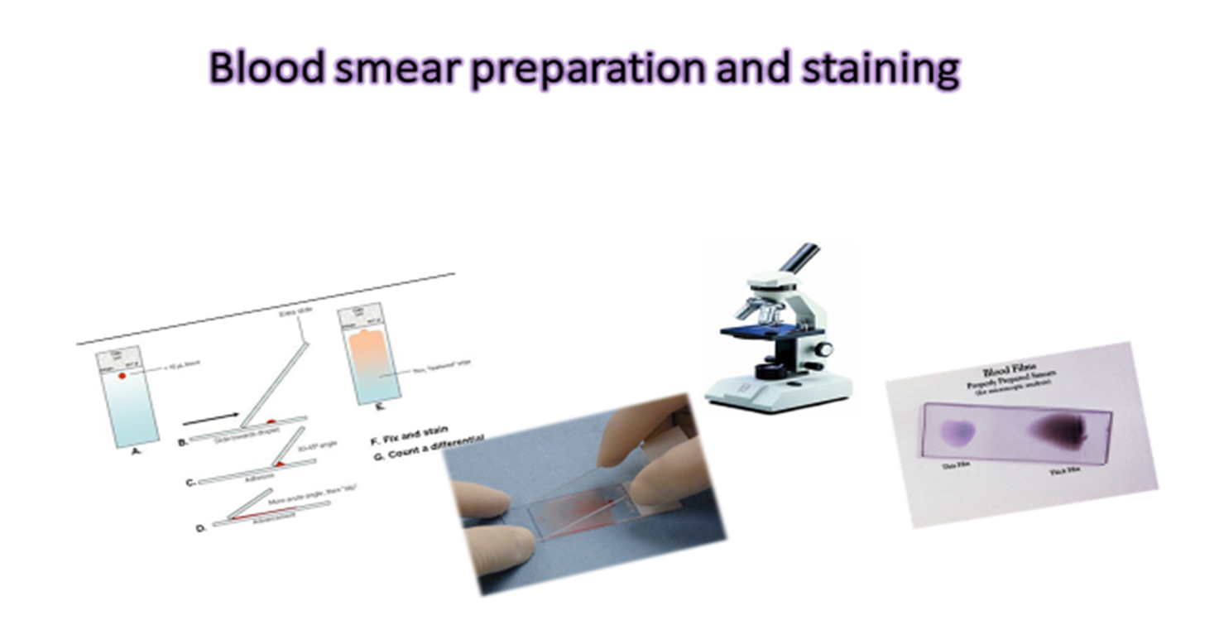

Slide 21
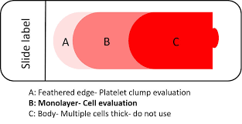
Definition “A blood smear is a blood test that gives information about the number and shape of blood cells.”

Slide 22
three basic steps to make blood film:
1.Preparation of blood smear.
2.Fixation of blood smear.
3.Staining of blood smear.
The peripheral blood film (PBF) is of two types:
1. Thin blood film
2. Thick blood film :This is prepared for detecting blood parasites such as malaria and microfilaria.

Slide 23
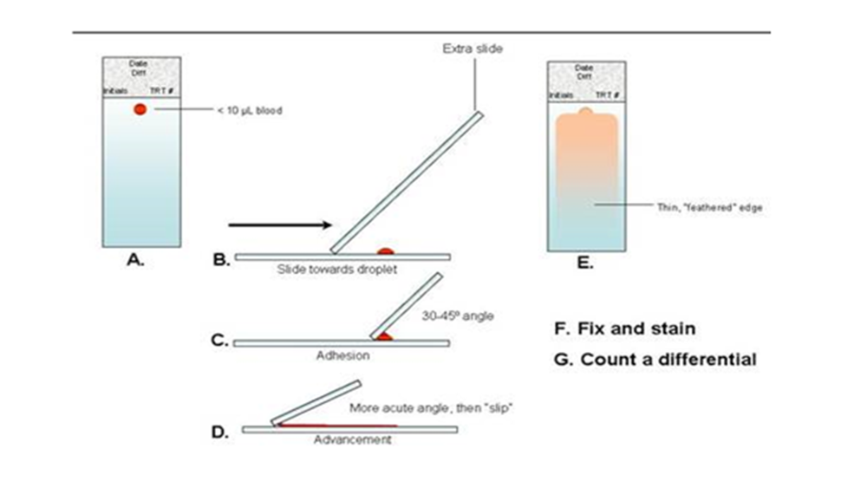

Slide 24
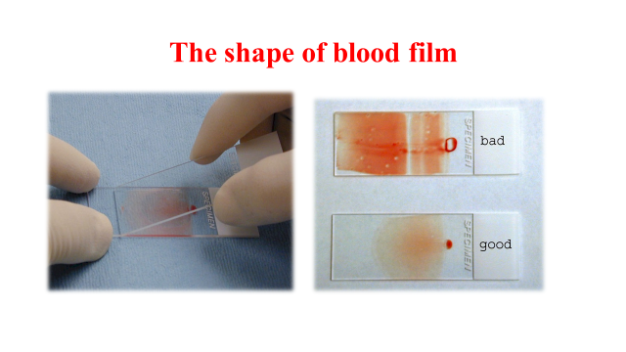

Slide 25
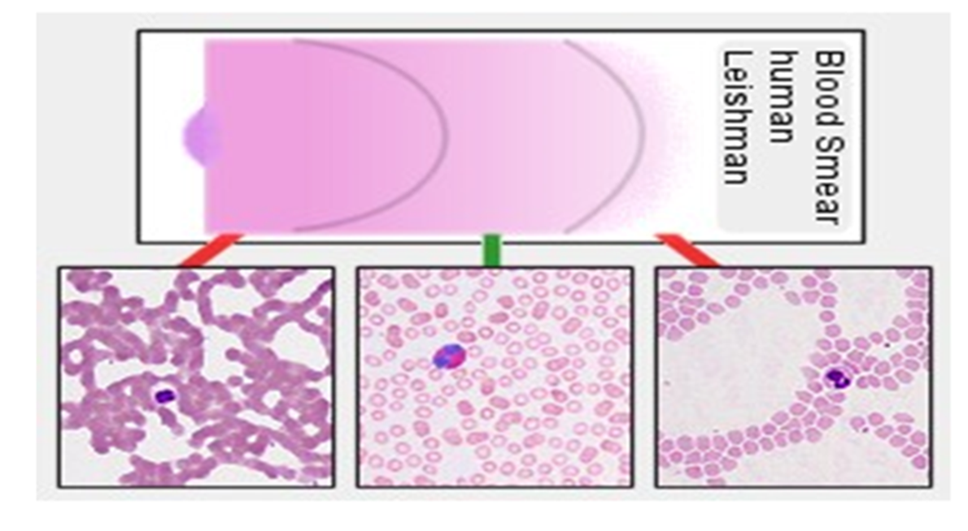

Slide 26
Leishman’s stain

Slide 27
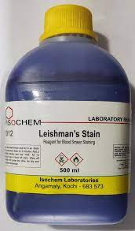
Leishman stain
Leishman stain, also known as Leishman's stain, is used in microscopy for staining blood smears.
It is generally used to differentiate between and identify white blood cells, malaria parasites, and trypanosomas.

Slide 28
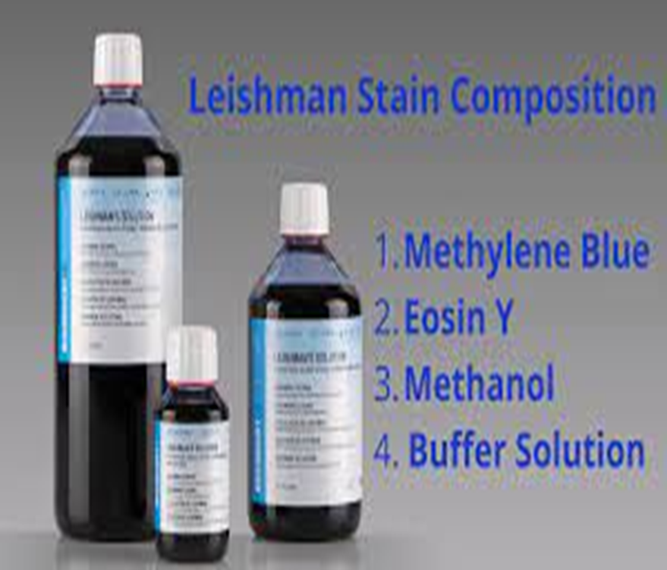
Composition of leishman’s stain
Polychromed methylene blue.
Eosin azure (leishman powder).
Acetone free absolute alcohol.
1.5gms leishman powder in 1 liter acetone free absolute alcohol.

Slide 29
Affinity of Stains for Cellular Components:
Methylene Blue and Nucleic Acids: Methylene blue, a basic dye with a positive charge, exhibits a strong affinity for negatively charged nucleic acids, such as DNA and RNA.
When Leishman stain is applied to a specimen, methylene blue readily binds to the phosphate groups in the nucleic acids, resulting in the staining of cell nuclei. This property allows for the visualization of nuclei as blue or purple structures.

Slide 30
Eosin and Cytoplasmic Proteins: Eosin, on the other hand, is an acidic dye with a negative charge. It interacts predominantly with positively charged proteins found in the cytoplasm.
As a result, eosin imparts a pink or red coloration to the cytoplasmic regions of cells.

Slide 31
Preparation of Leishman Stain
Weigh the required amounts of methylene blue and eosin separately. The typical ratio is approximately 1 gram of eosin to 0.5 grams of methylene blue.
Gradually add methanol to the glass container containing the methylene blue, stirring continuously to create a methylene blue-methanol solution.
Similarly, add methanol to the container with eosin, stirring to create an eosin-methanol solution. Stir both solutions until the dyes completely dissolve, creating clear, homogeneous solutions.
Carefully pour the eosin-methanol solution into the methylene blue-methanol solution.
Gently mix the combined solution to ensure uniform dye blending. This mixture will result in a Leishman stain.
To remove any impurities or particles affecting staining quality, filter the Leishman stain through fine filter paper or a funnel.
Collect the filtered stain in a clean, labeled container suitable for storage.

Slide 32
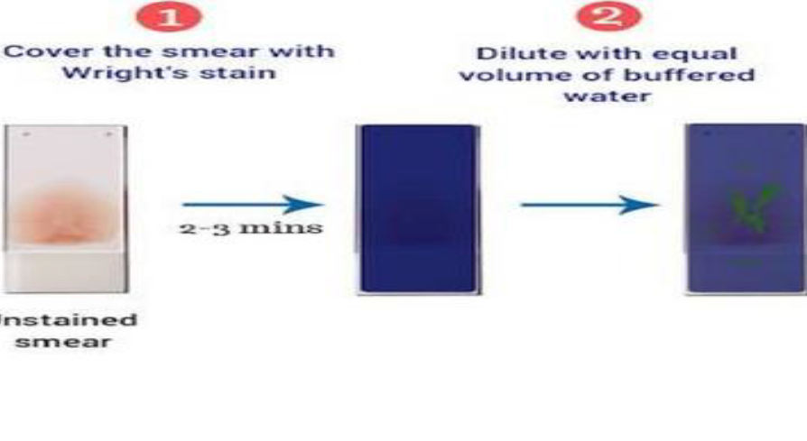
Staining Procedure
Place the smear on the staining rack .
Pour leishman stain to cover the smear completely allow to fix for 2-3 mins .
Add water twice the amount of leishman’s stain allow to fix for 7-10 mins.
Appearance of golden scum or sheen on the surface of stain.
Wash the stain off the slide with running water .
Wipe the back of slide and air dry the slide.

Slide 33
Staining Procedure

Slide 34
Uses of Leishman Staining
Medical Applications.
Research Applications:Hematological &Microbiological Research.
Veterinary and Agricultural Applications
Veterinary Medicine: Veterinarians use Leishman staining to diagnose animal blood-related disorders and infections. It aids in identifying abnormal blood cell morphology and detecting blood parasites, which can affect the health of pets and livestock.

Slide 35

Advantages and Limitations

Slide 36

Advantages
Selective Staining: Leishman staining offers selective staining of different cellular components
Versatility: It applies to many specimens.
Diagnostic Utility: In clinical hematology, for diagnosing blood disorders and parasitic infections.
Research Tool: Staining is fundamental to biological research, enabling scientists to study cell morphology and cellular behavior in normal and pathological conditions.
Cost-Effective: Leishman stain is relatively cost-effective compared to more complex staining methods, making it accessible to laboratories with budget constraints.

Slide 37

disadvantages
Limited Chemical Resistance: Leishman stain may fade over time or with exposure to light, limiting the long-term storage and archival capabilities of stained slides.
Not Suitable for All Microorganisms: Leishman staining may not suit all microorganisms, particularly those with unique cell wall structures or characteristics.
Health and Safety Concerns: Leishman staining involves the use of methanol, which is flammable and toxic. Careful handling and appropriate safety precautions are necessary to minimize health and safety risks.
Artifact Formation: Artifacts, such as drying or staining artifacts, can affect the quality of stained specimens if proper techniques are not followed.

Slide 38
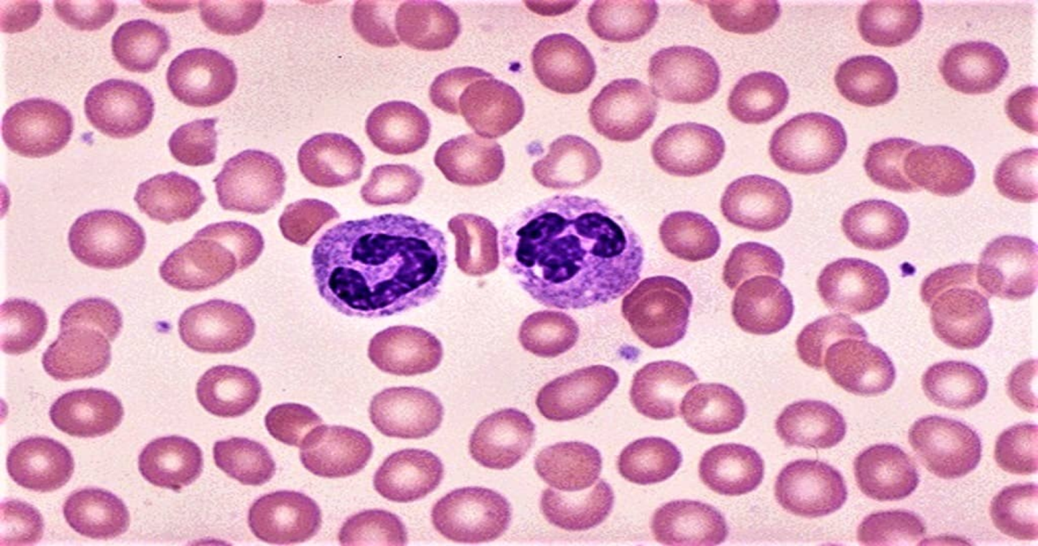
Normal blood smear stained with leishman stain under the microscope

Slide 39
Giemsa stain

Slide 40
Introduction
Giemsa stain is a type of Romanowsky stain named after Gustav Giemsa, a German chemist who created a dye solution.
It was primarily designed for the demonstration of malarial parasites in blood smears, but it is also employed in histology for routine examination of blood smears.

Slide 41
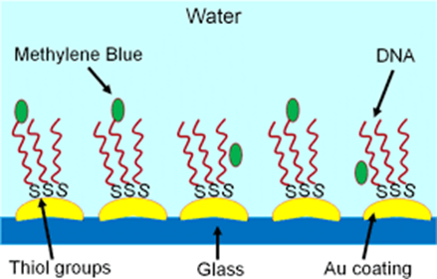
Principle of Giemsa Stain
Giemsa stain is a differential stain and contains a mixture of azure, methylene blue, and eosin dye. It is specific for the phosphate groups of DNA and attaches itself to where there are high amounts of adenine-thymine bonding.

Slide 42
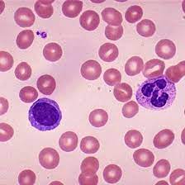
Interpretation
Azure and methylene blue, a basic dye binds to the acid nucleus producing blue-purple color.
Eosin is an acidic dye that is attracted to the cytoplasm and cytoplasmic granules which are alkaline-producing red-orange coloration.

Slide 43
Preparation of Giemsa Stain
Ingredients | Gm/L
Giemsa powder | 7.6
Glycerol | 500 ml
Methanol | 500 ml
Preparation of the Giemsa Stain Stock solution (500ml)
Into 250ml of methanol, add 3.8g of Giemsa powder and dissolve.
Heat the solution up to ~60oC
Then, add 250ml of glycerin to the solution, slowly.
Filter the solution and leave it to stand for about 1-2 months before use.

Slide 44
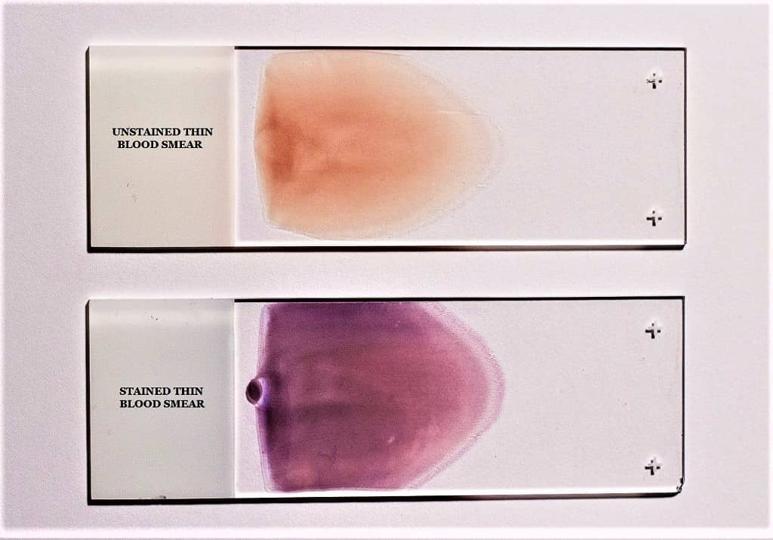
Preparation of Working solution :-Add 10ml of stock solution to 80ml of distilled water and 10ml of methanol
Staining procedure 1: Thin Film staining
On a clean dry microscopic glass slide, make a thin film of the specimen (blood) and leave to air dry.
dip the smear (2-3 dips) into pure methanol for fixation of the smear, leave to air dry for 30seconds
Flood the slide with 5% Giemsa stain solution for 20-30 minutes.
Flush with tap water and leave to dry
NOTE: In case of emergencies, leave the Giemsa stain solution for 5-10 minutes

Slide 45
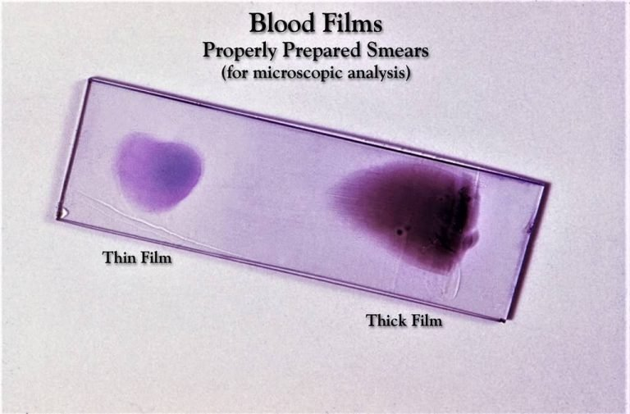
Staining Procedure 2: Thick Film Staining
Add a thick smear of blood and air dry for 1 hour on a staining rack.
Dip the thick blood smear into diluted Giemsa stain (prepared by taking 1ml of the stock solution and adding to 49ml of phosphate buffer or distilled water, but the results may vary differently).
Wash the smear by dipping in in buffered water of distilled water for 3-5 minutes
Leave it to dry

Slide 46
In parasitology , this stain is most commonly used in parasitology to detect intraerythrocytic (plasmodia, Babesiae) and exoerythrocytic (Trypanosomes, Microfilaria) parasites.
It is also used for the detection of intracellular amastigotes of Leishmania species or Trypanosoma cruzi.

Slide 47
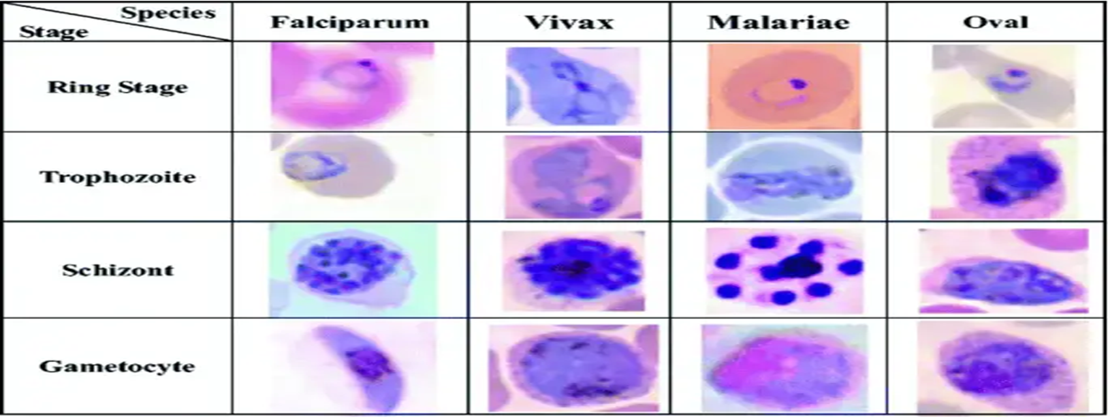
Photomicrograph of a Wright-Giemsa-stained peripheral blood smear illustrating several stages of Plasmodium species

Slide 48
Advantages and Limitations

Slide 49
Advantages:
Readily available, easy to prepare, maintain and use.
Limitations:
Working Giemsa stain must be prepared shortly before use.
.

Slide 50
Field's stain

Slide 51
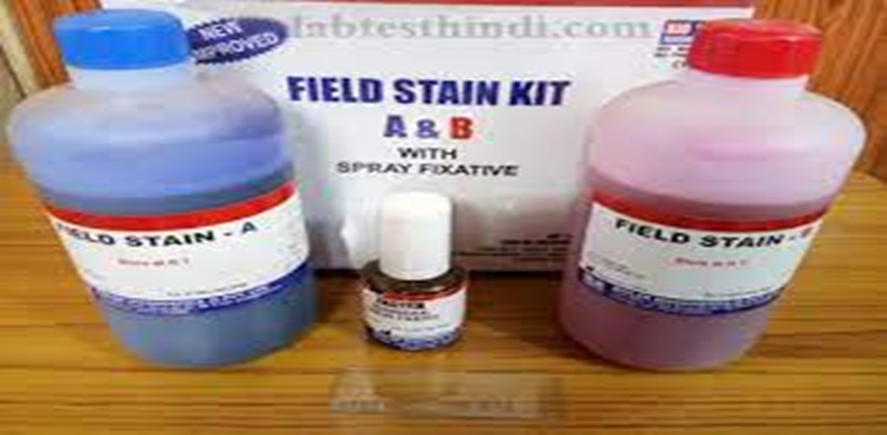
Field’s stain was introduced to provide a quick method for staining thick films for malaria parasites.
◆ It this water-based Romanowsky stain is composed of two solutions, Field’s stain A and Field’s stand B.
◆ It is buffered to the correct pH and neither solution requires dilution when staining thick films.

Slide 52
Field stain consists of:
Field stain A from the reagents:
Methylene blue (analytical grade) = 1.6 grams.
Azur = 1 gram.
Disodium dihydrogen phosphate anhydrous = 10 grams.
Potassium dihydrogen phosphate anhydrous = 12.5 grams.
Distilled water = 1000 mL.
Field stain A (ready-made powder).
Mix the powder into the water until it is dissolved.
Filter the solution.
Label the date.

Slide 53
Field stain B reagents:
Eosin(yellow water soluble) powder = 2.0 grams.
Disodium dihydrogen phosphate anhydrous = 10 grams.
Potassium dihydrogen phosphate anhydrous = 12.5 grams.
Distilled water = 1000 mL.
Field Stain B (Orange color)
Using Commercially Available Powder:
Field stain B commercially available powder = 4.8 grams.
Distilled water is heated to 80 °C or kept at 60 °C for 30 min. = 600 mL.
Mix well the field stain B until it is dissolved.
Filter and label the date.

Slide 54
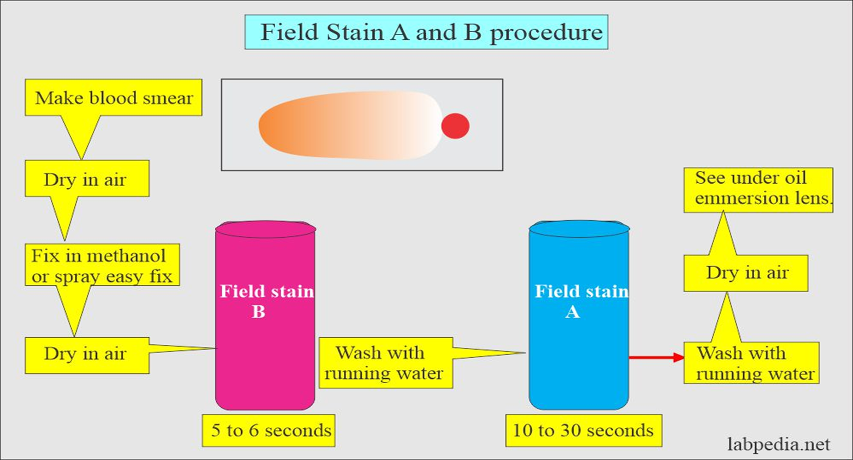

Slide 55
Wright's stain

Slide 56
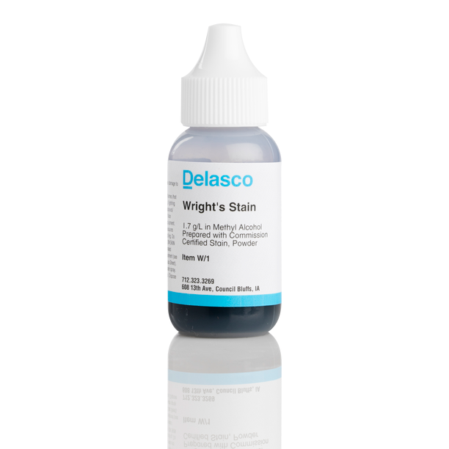
Wright's stain
is named for James Homer Wright, who devised the stain, a modification of the Romanowsky stain, in 1902. Because it distinguishes easily between blood cells, it became widely used for performing differential white blood cell counts, which are routinely ordered when conditions such as infection or leukemia are suspected.

Slide 57
Wright's stain
Wright's stain is a hematologic stain that facilitates the differentiation of blood cell types. It is classically a mixture of eosin (red) and methylene blue dyes.
It is used primarily to stain peripheral blood smears, urine samples, and bone marrow aspirates, which are examined under a light microscope.
In cytogenetics, it is used to stain chromosomes to facilitate diagnosis of syndromes and diseases.

Slide 58
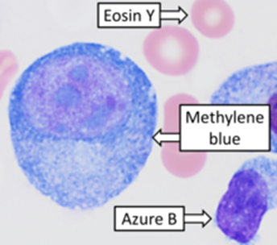
Wright’s stain principle
Wright’s polychromatic stain comprises a combination of Eosin and Methylene blue. Since Wright’s stain is methanol-based, it does not require a fixation step before staining. However, fixation by air drying can help reduce water artifacts that may occur on humid days or with aged stains.
Methanol fixes the cells to the slide, while Eosin Y, an acidic anionic dye, and Methylene blue, a basic cationic dye, ionize when diluted in buffered water. Eosin stains basic components such as hemoglobin and eosinophilic granules an orange to pink color, while Methylene blue stains acidic cellular components such as nucleic acid and basophilic granules in varying shades of blue. Neutral components of the cells are stained by both components of the dye, resulting in variable colors.
Phosphate buffer at pH 6.5 dilutes the stain enabling ionization.

Slide 59
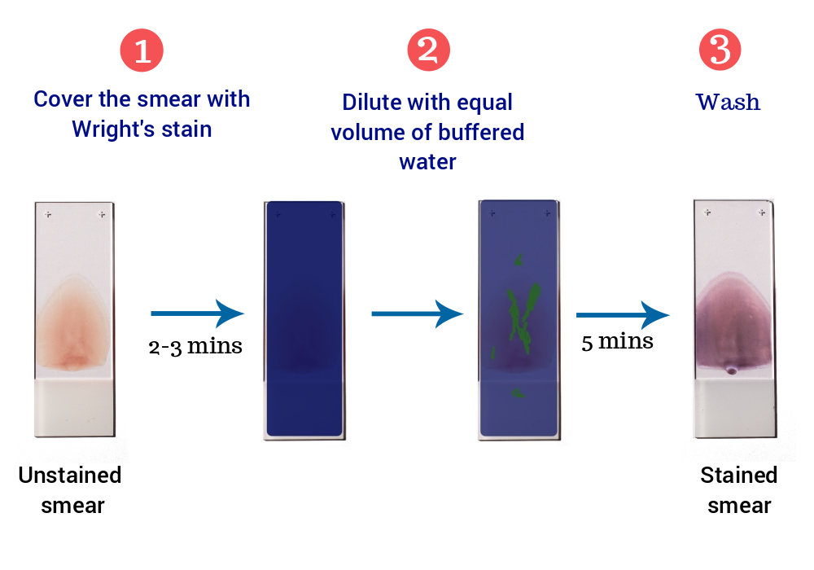
Staining method:-

Slide 60
JENNER STAIN

Slide 61
JENNER STAIN:
PRINCIPLE:
It is similar to wright stain ,used for staining blood smears.
The Jenner stain Solution is a mixture of several thiazin dyes in a methanol solvent. • Ionic and nonionic forces are involved in the binding of these dyes.
The staining solution has anionic and cationic properties.
The negatively charged phosphoric acid groups of DNA attract the purple polychromatic cationic dyes to the nuclei.
The blue basophilic granules are stained by the polychromatic cationic dyes.

Slide 62
JASWANT SINGH BHATTACHARJI STAIN (JSB )

Slide 63
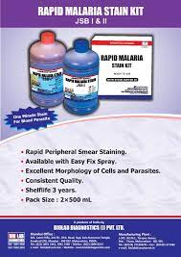
JASWANT SINGH BHATTACHARJI STAIN (JSB )
Rapid staining method for detection of malaria.
Useful for the diagnosis of malaria in thick smear samples of blood.
Composition: ▪ 1st solution- methylene blue, potassium dichromate, & sulphuric acid diluted in water.
2nd solution- eosin dissolved in water.

Slide 64
Staining technique:
• Prepare thin and thick smears from malaria cases on micro slides • De-haemoglobinise the thick smear
• Fix the thin smear in methanol for few minutes
• Take 3 staining jars for J.S.B. I, J.S.B.II and tap water
• Dip the smears in J.S.B. II for few seconds and immediatedly wash in water
• Drain the slides free of excess water
• Dip the smears in J.S.B.I for 30-40 seconds
• Wash well in water and dry
• Examine the smears under oil immersion

Slide 65
Jaswant Singh Battacharya (JSB) Stain for thick and thin films: This is the standard method used by the laboratories under the National Malaria Eradication Programmer in India.

Slide 66


