Slide 1
Training course on methods of diagnosing Aspergillus spp. for the period 7-9 May 2024
BY:
Dr. Zainab A. A. Al-haddad
Lec. Aseel Ibrahiam
Vet. Nawal Dahd

Slide 4
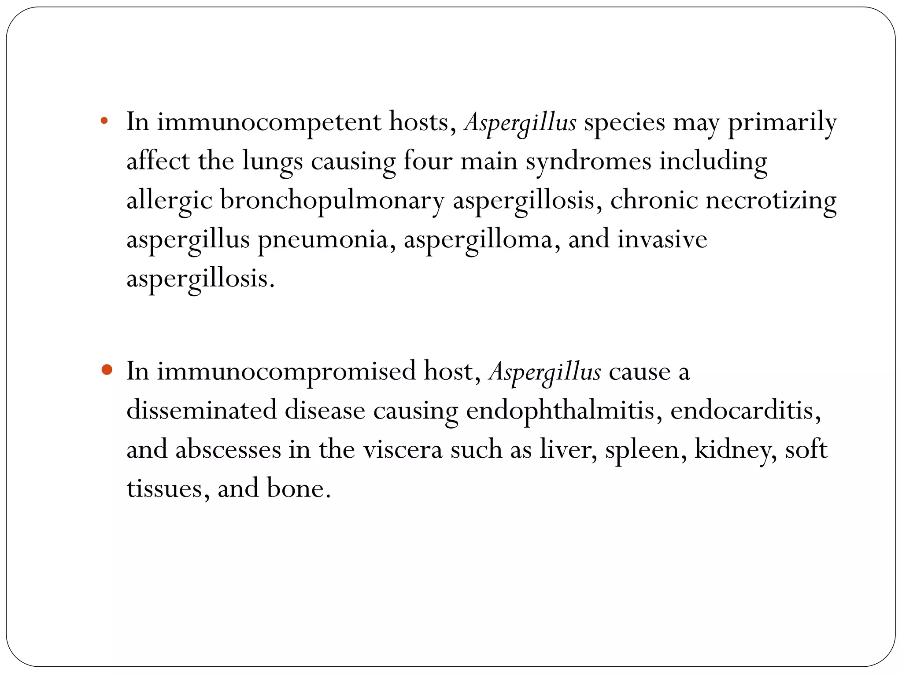

Slide 6
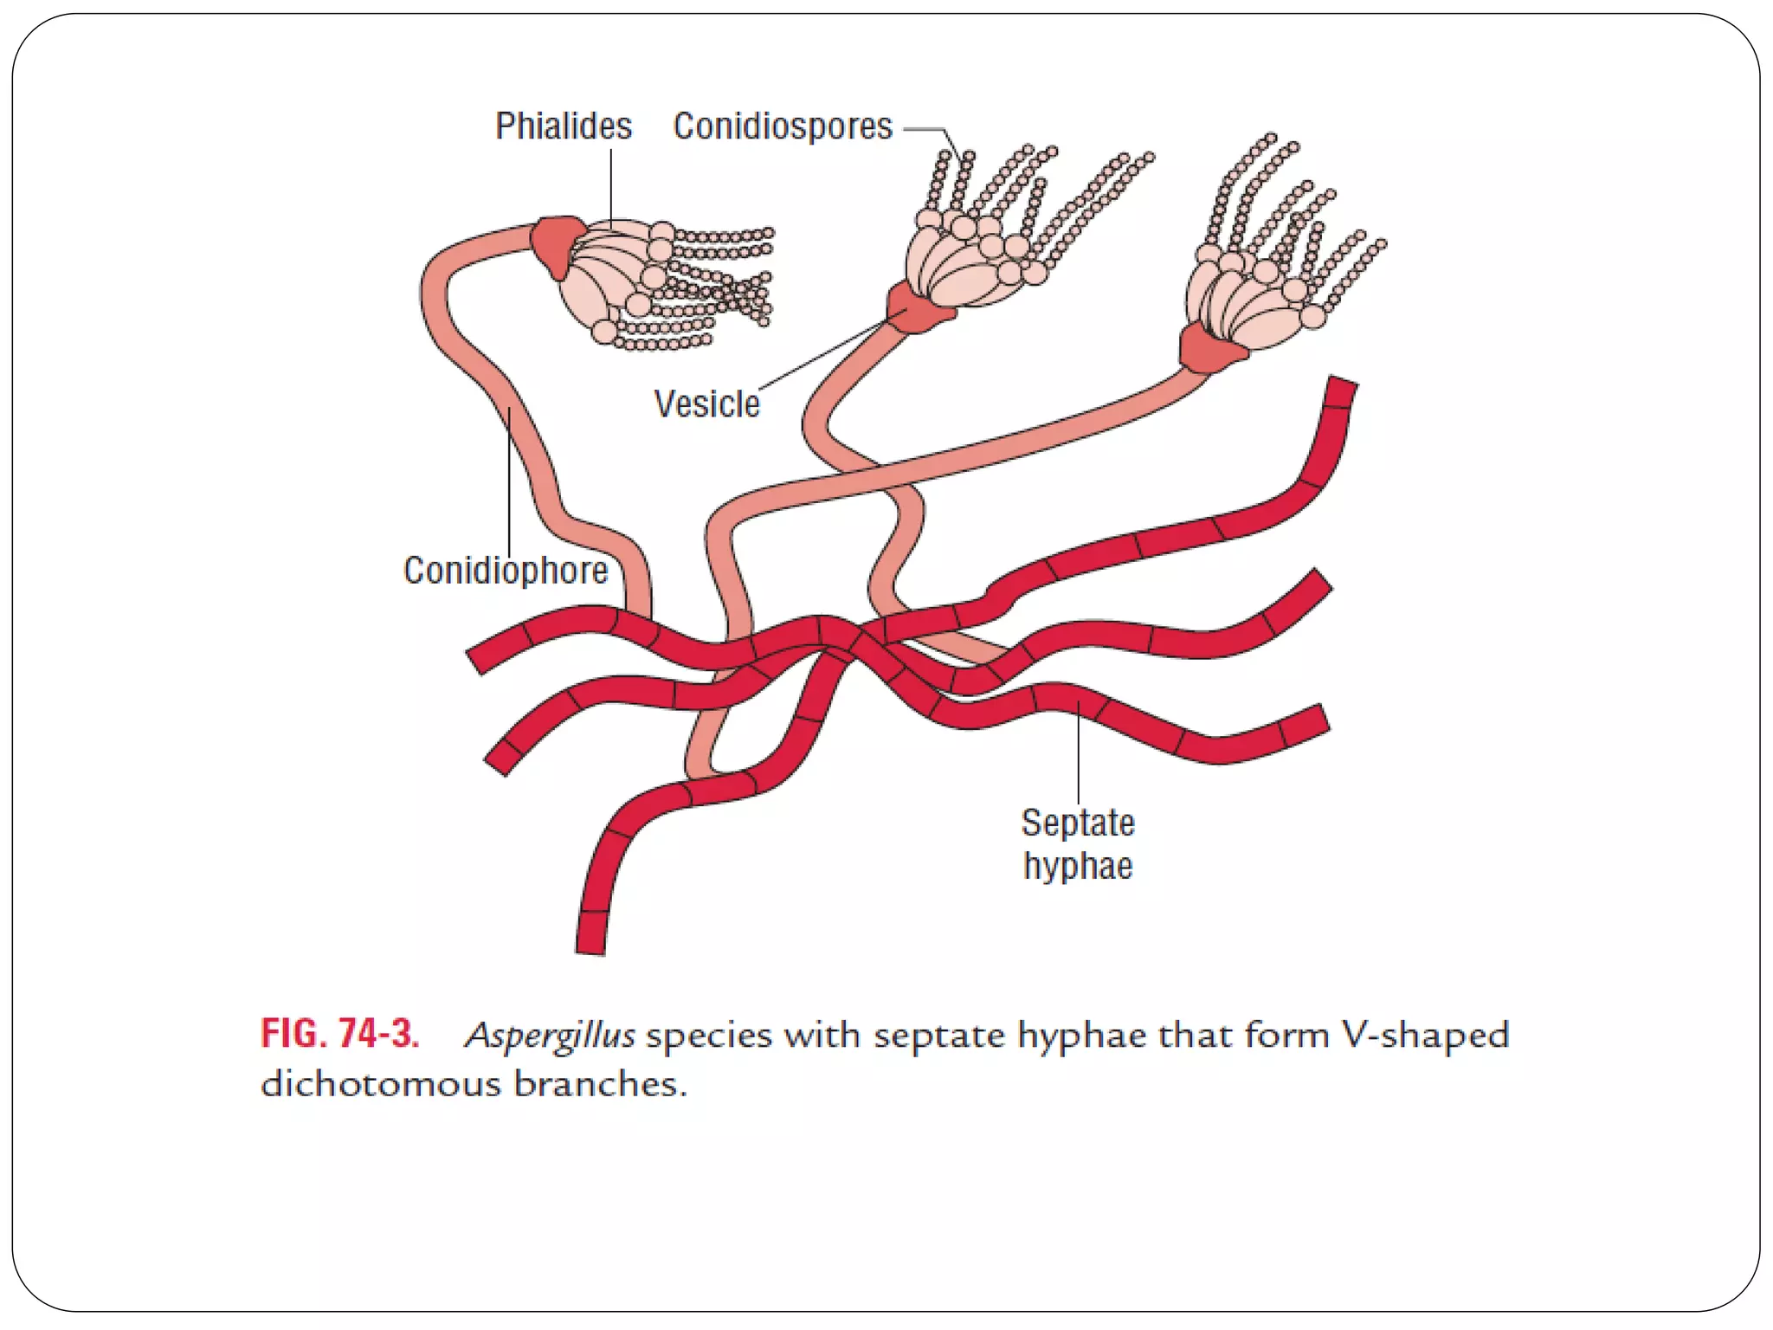

Slide 19
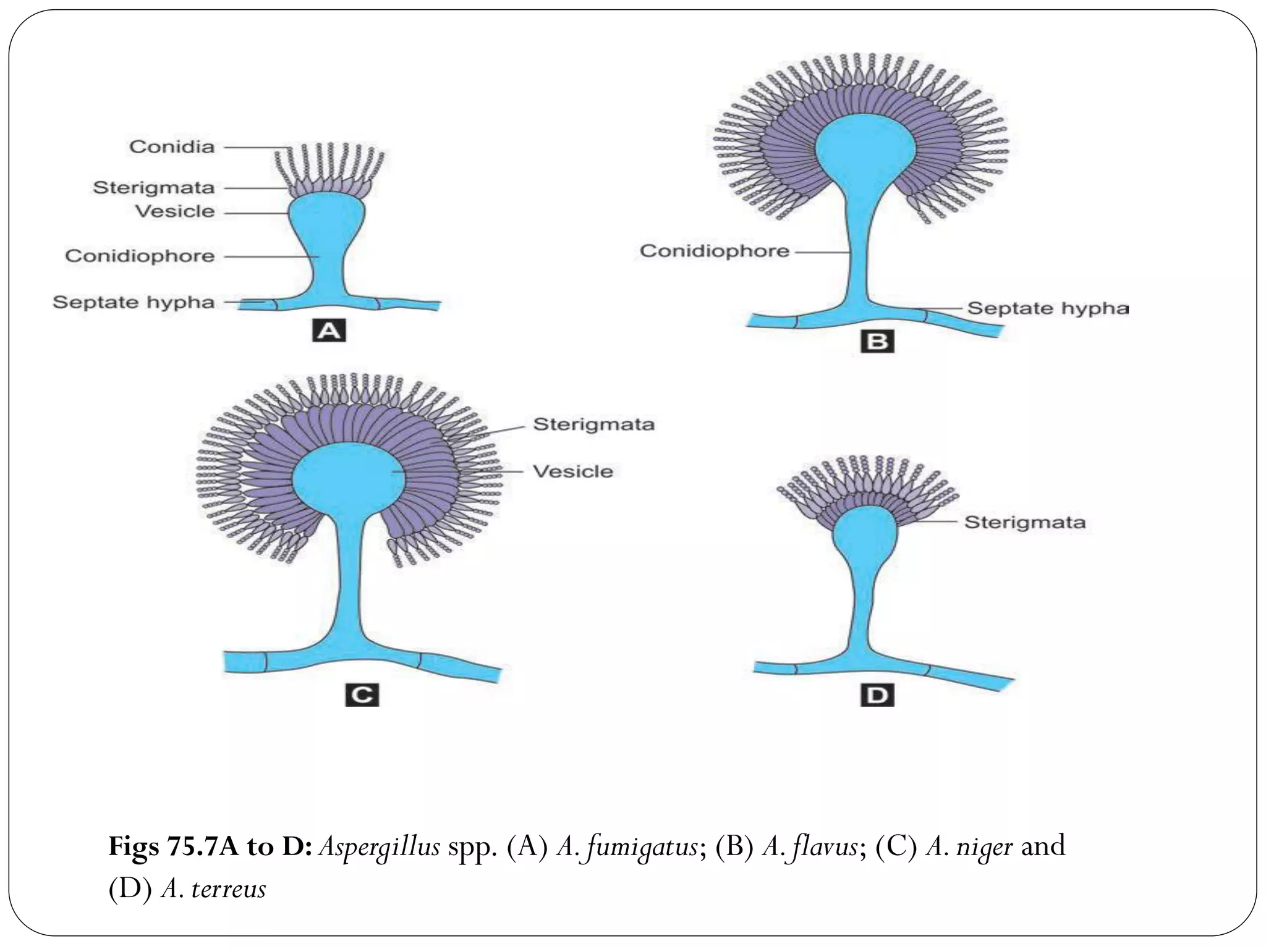

Slide 20
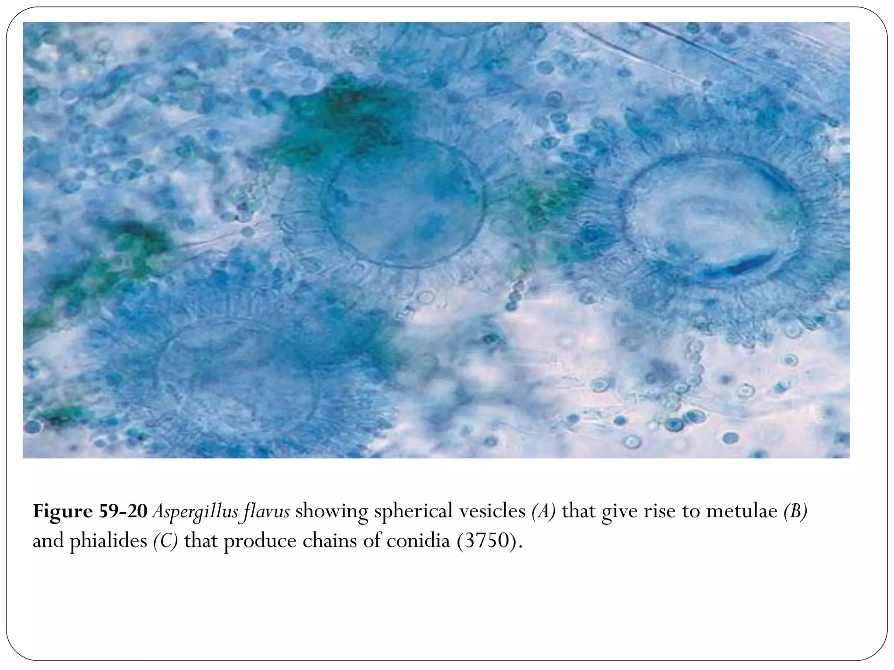

Slide 21
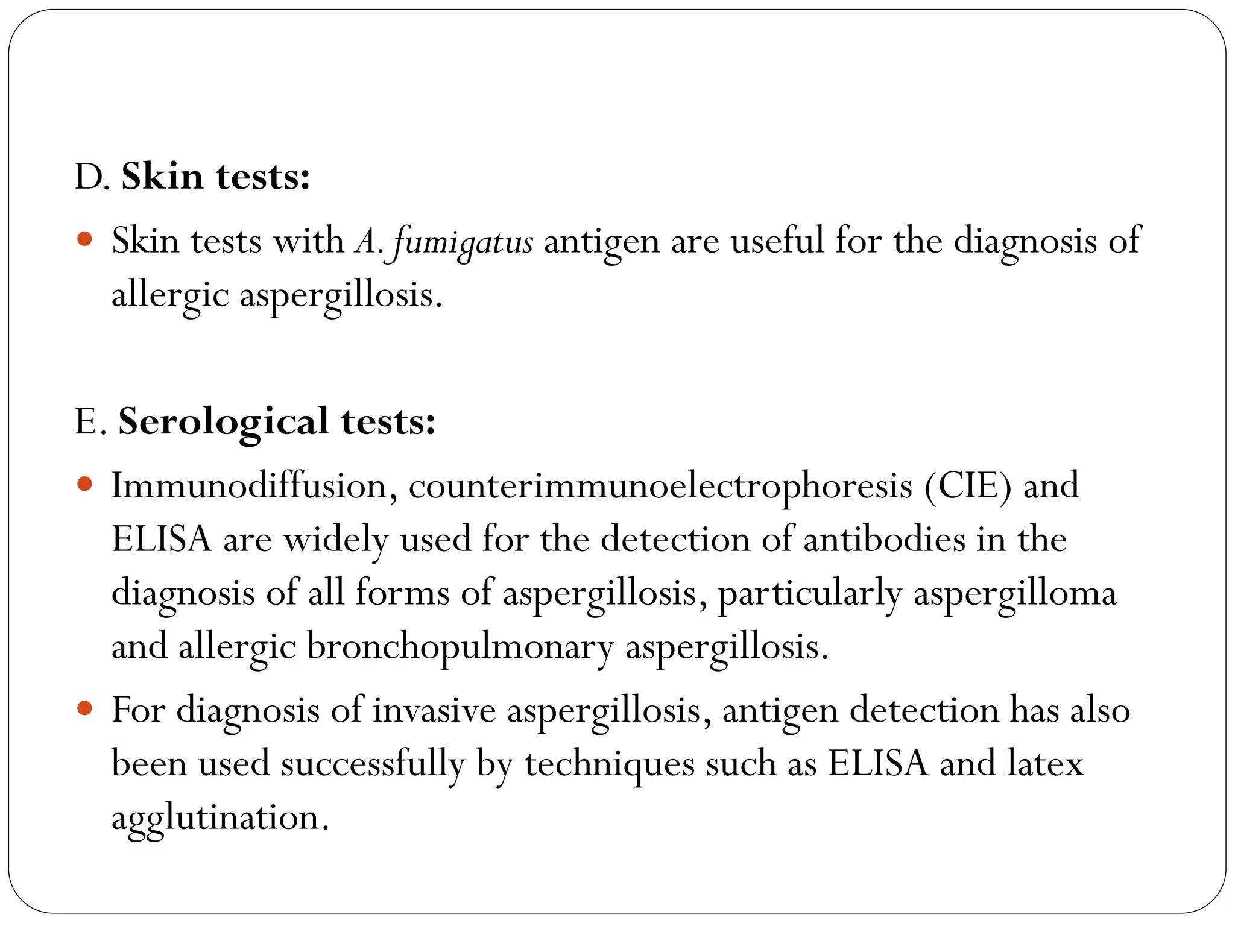

Slide 24
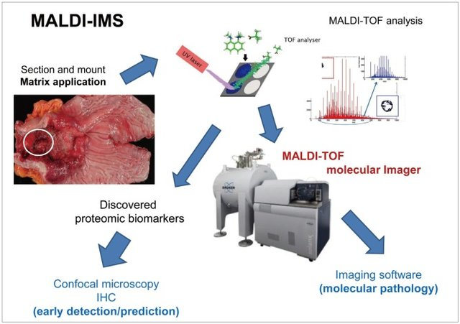

Slide 25
Matrix-assisted laser desorption/ionization time-of-flight imaging mass spectrometry (MALDI-TOF-IMS) procedure, has developed as a promising tool for investigating the spatial distribution of biomolecules in intact tissue specimens.
Ion densities of various molecules can be displayed as heat maps while preserving anatomical structures. For example, in gastric cancer, specially mounted tissues are subjected to matrix application and MALDI-TOF analysis.
The discovered proteomes can be visualized in paraffin-embedded slides or visualized through confocal microscopy with a fluorescence-tagged biomarker antibody.
MALDI-TOF molecular imaging can yield molecular images through an imaging software. IHC, immunohistochemistry.

Slide 26
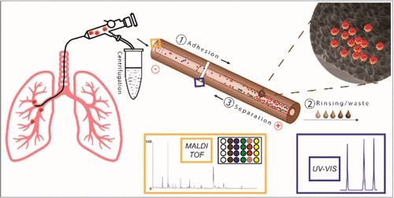
Diagnosis of fungal infection in lung parenchyma is relatively difficult. Bronchoscopy with bronchoalveolar lavage is very useful in its diagnosing. Therefore, a method for rapid online concentration and analysis of Aspergillus conidia in bronchoalveolar lavage fluid using the combination of transient isotachophoresis (tITP) and micellar electrokinetic chromatography (MEKC) with subsequent off-line identification of the separated conidia by matrix-assisted laser desorption/ionization time-of-flight mass spectrometry (MALDI-TOF MS) is described in this study. In the proposed procedure, conidia were first dynamically adhered onto the roughened part of the inner surface of a fused silica capillary prepared by etching with supercritical water. Then the adhered conidia were desorbed, concentrated, and separated using a combination of tITP and MEKC. Finally, the fractions containing the separated conidia were collected from the capillary and analyzed by MALDI-TOF MS. The adhesion efficiency under the optimized experimental conditions was about 80%. This rapid diagnosis will contribute to timely initiation of therapy and increase the patient's chances of survival.

Slide 28
Thank you for listening

Slide 29
الجزء العملي
Laboratory Diagnosis of Aspergillosis:-
The presumptive assumption of the fungus is made based on the colony morphology, and for the definitive identification, microscopic observation of hyphae and the conidial head is done. The conidial head consists of conidiophores.
Sample:-
For the laboratory diagnosis of aspergillosis, the specimen of choice is sputum, sinus drainage, bronchial washing, bronchoalveolar lavage (BAL) fluid, a biopsy of the infected area (lung), and skin scraping.

Slide 30
Direct Examination
For the direct examination of the Aspergillus spp. 10 %, KOH wet mount is prepared. Then microscopic observation of the Aspergillus spp. is done. The hyphae of the Aspergillus spp. are hyaline and septate. Its diameter is 3-6µm, and dichotomous branching (type of branching in which two branches are approximately equal in size).
A biopsy is also taken in the case of fungal granuloma. For the examination, biopsy material should be kept in a tube of KOH. It is then incubated overnight at 37°C. For the histological examination of the biopsy material, the preferable staining methods are Hematoxylin and Eosin, Periodic Acid-Schiff, and Grocott-Gomori’s methenamine silver stain. Hyphae appear branched at a nearly 45-degree angle. Finger-like appearance is seen in the branching elements. In invasive aspergillosis, a proliferation of hyphae is seen throughout the tissue. It occurs in parallel or radial arrays. Aspergilli colonizing pulmonary cavity lesions grow as tangled masses of hyphae.
The chronic infection may exhibit atypical hyphal features. Swelling may be seen in this condition, up to 12µm in diameter. Similarly, there may be an absence of conspicuous septa in this condition, as seen in the Aspergillus fungus balls.

Slide 31
2. Fungal Culture:-
Different media used for the fungal culture are Sabouraud Dextrose Agar (SDA), Potato Dextrose Agar (PDA), Czapek Dox Agar, and Malt extract agar. Inoculation is done in SDA agar with antibiotics and without cycloheximide at 25°C and 37°C, respectively. The isolate can be subcultured on the Czapek Dox agar and 2% Malt Extract Agar and incubated at 25°C. For the induction of the sporulation, PDA can be used. Culture should be examined after 48 hrs of inoculation. Then it should be examined daily for a week, twice a week for further four weeks, before discarding the plate. Colonies of different Aspergillus spp. produces different colors.

Slide 32
Species | Colonies | Reverse
A. flavus | Velvety, yellow to green or brown | Golden to red-brown
A.fumigatus | Velvety or powdery at first, turning to smoky-green | White to tan
A. niger | Woolly white to yellow at first, turning to dark brown to black | White to yellow
A. terreus | Velvety cinnamon brown | White to brown
A. glaucus | Green with yellow areas, occasionally brown | Yellowish to maroon
A. nidulans | Plain green in color with dark red-brown cleistothecia | Olive to drab-gray or purple-brown

Slide 33
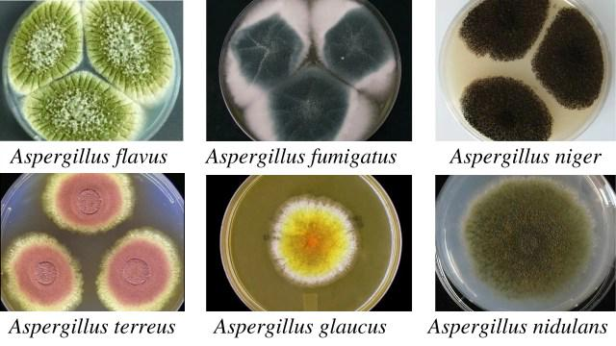

Slide 34
Microscopic observation of Aspergillus spp.
Species | Phialides | Color of Conidia
A. fumigatus | Uniseriate | Grey, green or blue-green
A. flavus | Biseriate or Uniseriate | Yellow to green
A.niger | Biseriate | Black
A.terreus | Biseriate | Orange to brown
A. nidulans | Biseriate | Dark green

Slide 35
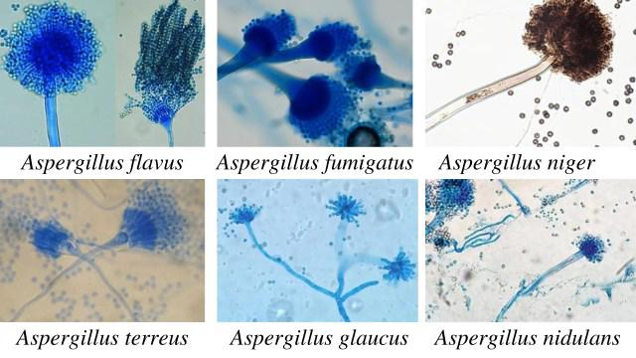
Aspergillus spp. is a common laboratory contaminant. So, to confirm the relevance of positive culture, their quantitation is necessary. For this, 6-consecutive morning samples are required, out of which should show the same fungal growth in the 50% sample.

Slide 36
3. Immunodiagnosis
In the case of aspergilloma, a high percentage of patients demonstrates precipitating IgG antibodies. In case of allergic bronchopulmonary aspergillosis:
• Skin test reaction is positive for Aspergillus antigens.
• Elevated level of IgE
• Specific IgE and IgG precipitating antibodies to Aspergillus spp. in serum.
i. Detection of Antibody
An immunodiffusion test is done using commercial or laboratory-prepared antigens. Biotin-avidin-linked enzyme immunoassay (BALISA) is a sensitive enzyme-linked immunosorbent assay that uses biotin-avidin amplification systems. It is used for the demonstration of antibody isotypes. Antigens used are the crude culture filtrate, cell wall, or cytoplasmic extracts of A. fumigatus.

Slide 37
ii. Detection of Antigen
This test is useful for the detection of the antigen in immunosuppressed patients. In that condition, demonstrable antibodies may be absent in them. In invasive infection, antigen detection is useful. Various tests can detect the soluble antigen in the serum, urine, body fluids, and within-host phagocytic cells. They are:
• Latex agglutination test
• RIA
• ELISA and BALISA
For the demonstration of the Aspergillus antigens in the cerebrospinal fluid, western blot analysis was done by Ray and colleagues.

Slide 38
iii. Molecular Techniques:-
Different molecular techniques for the detection of the Aspergillus spp. are DNA probes, DNA sequencing, PCR (real-time PCR), and nested PCR assay
iv. Molecular Typing:-
Molecular typing is based on the phenotypic and genotyping characters. Typing based on the phenotyping characters is based on antigens, enzymes, morphology, and biochemistry. Typing based on genotyping methods involves analysis of genomic DNA, mitochondrial DNA (mtDNA), and ribosomal DNA (rDNA). Restriction fragment length polymorphism (RFLP) involves restriction endonucleases that cleave the DNA on specific sequences.

Slide 39
v. Detection of Fungal Metabolites:-
For the detection of the fungal metabolites, G-test is done. G-test helps to detect circulating β-(1,3)-D-glucan. Aspergillus galactomannan (the cell wall content) is used as an indicator mannitol as a marker diagnosis of invasive aspergillosis.
vi. Skin Tests:-
A skin test is done for patients with suspected allergic bronchopulmonary aspergillosis, atopic dermatitis, or allergic asthma. The 0.1 ml antigen (1000 PNU/ml aspergillin) is given intradermally for this test.
Results:
• Type I hypersensitivity: Erythema and wheal within 1 hour.
• Type III: Arthus reaction within 4-10 hours develops.
• Type IV reaction: induration >5mm diameter after 24 hours.
4. Animal Pathogenicity:-
Rabbits and mice are model animals for testing the pathogenicity of the Aspergillus spp. Conidia are injected intravenously, which results in granulomatous lesions in various organs, especially in kidneys.

