Slide 1
A training course on
Fungi Contaminating Food
29-31/10/2024
By
Dr. Zainab A. A. Al-haddad
Lec. Aseel Ibrahim
Sen.Ch.Vet. Nawal D. Mahmood

Slide 2
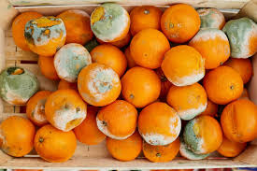
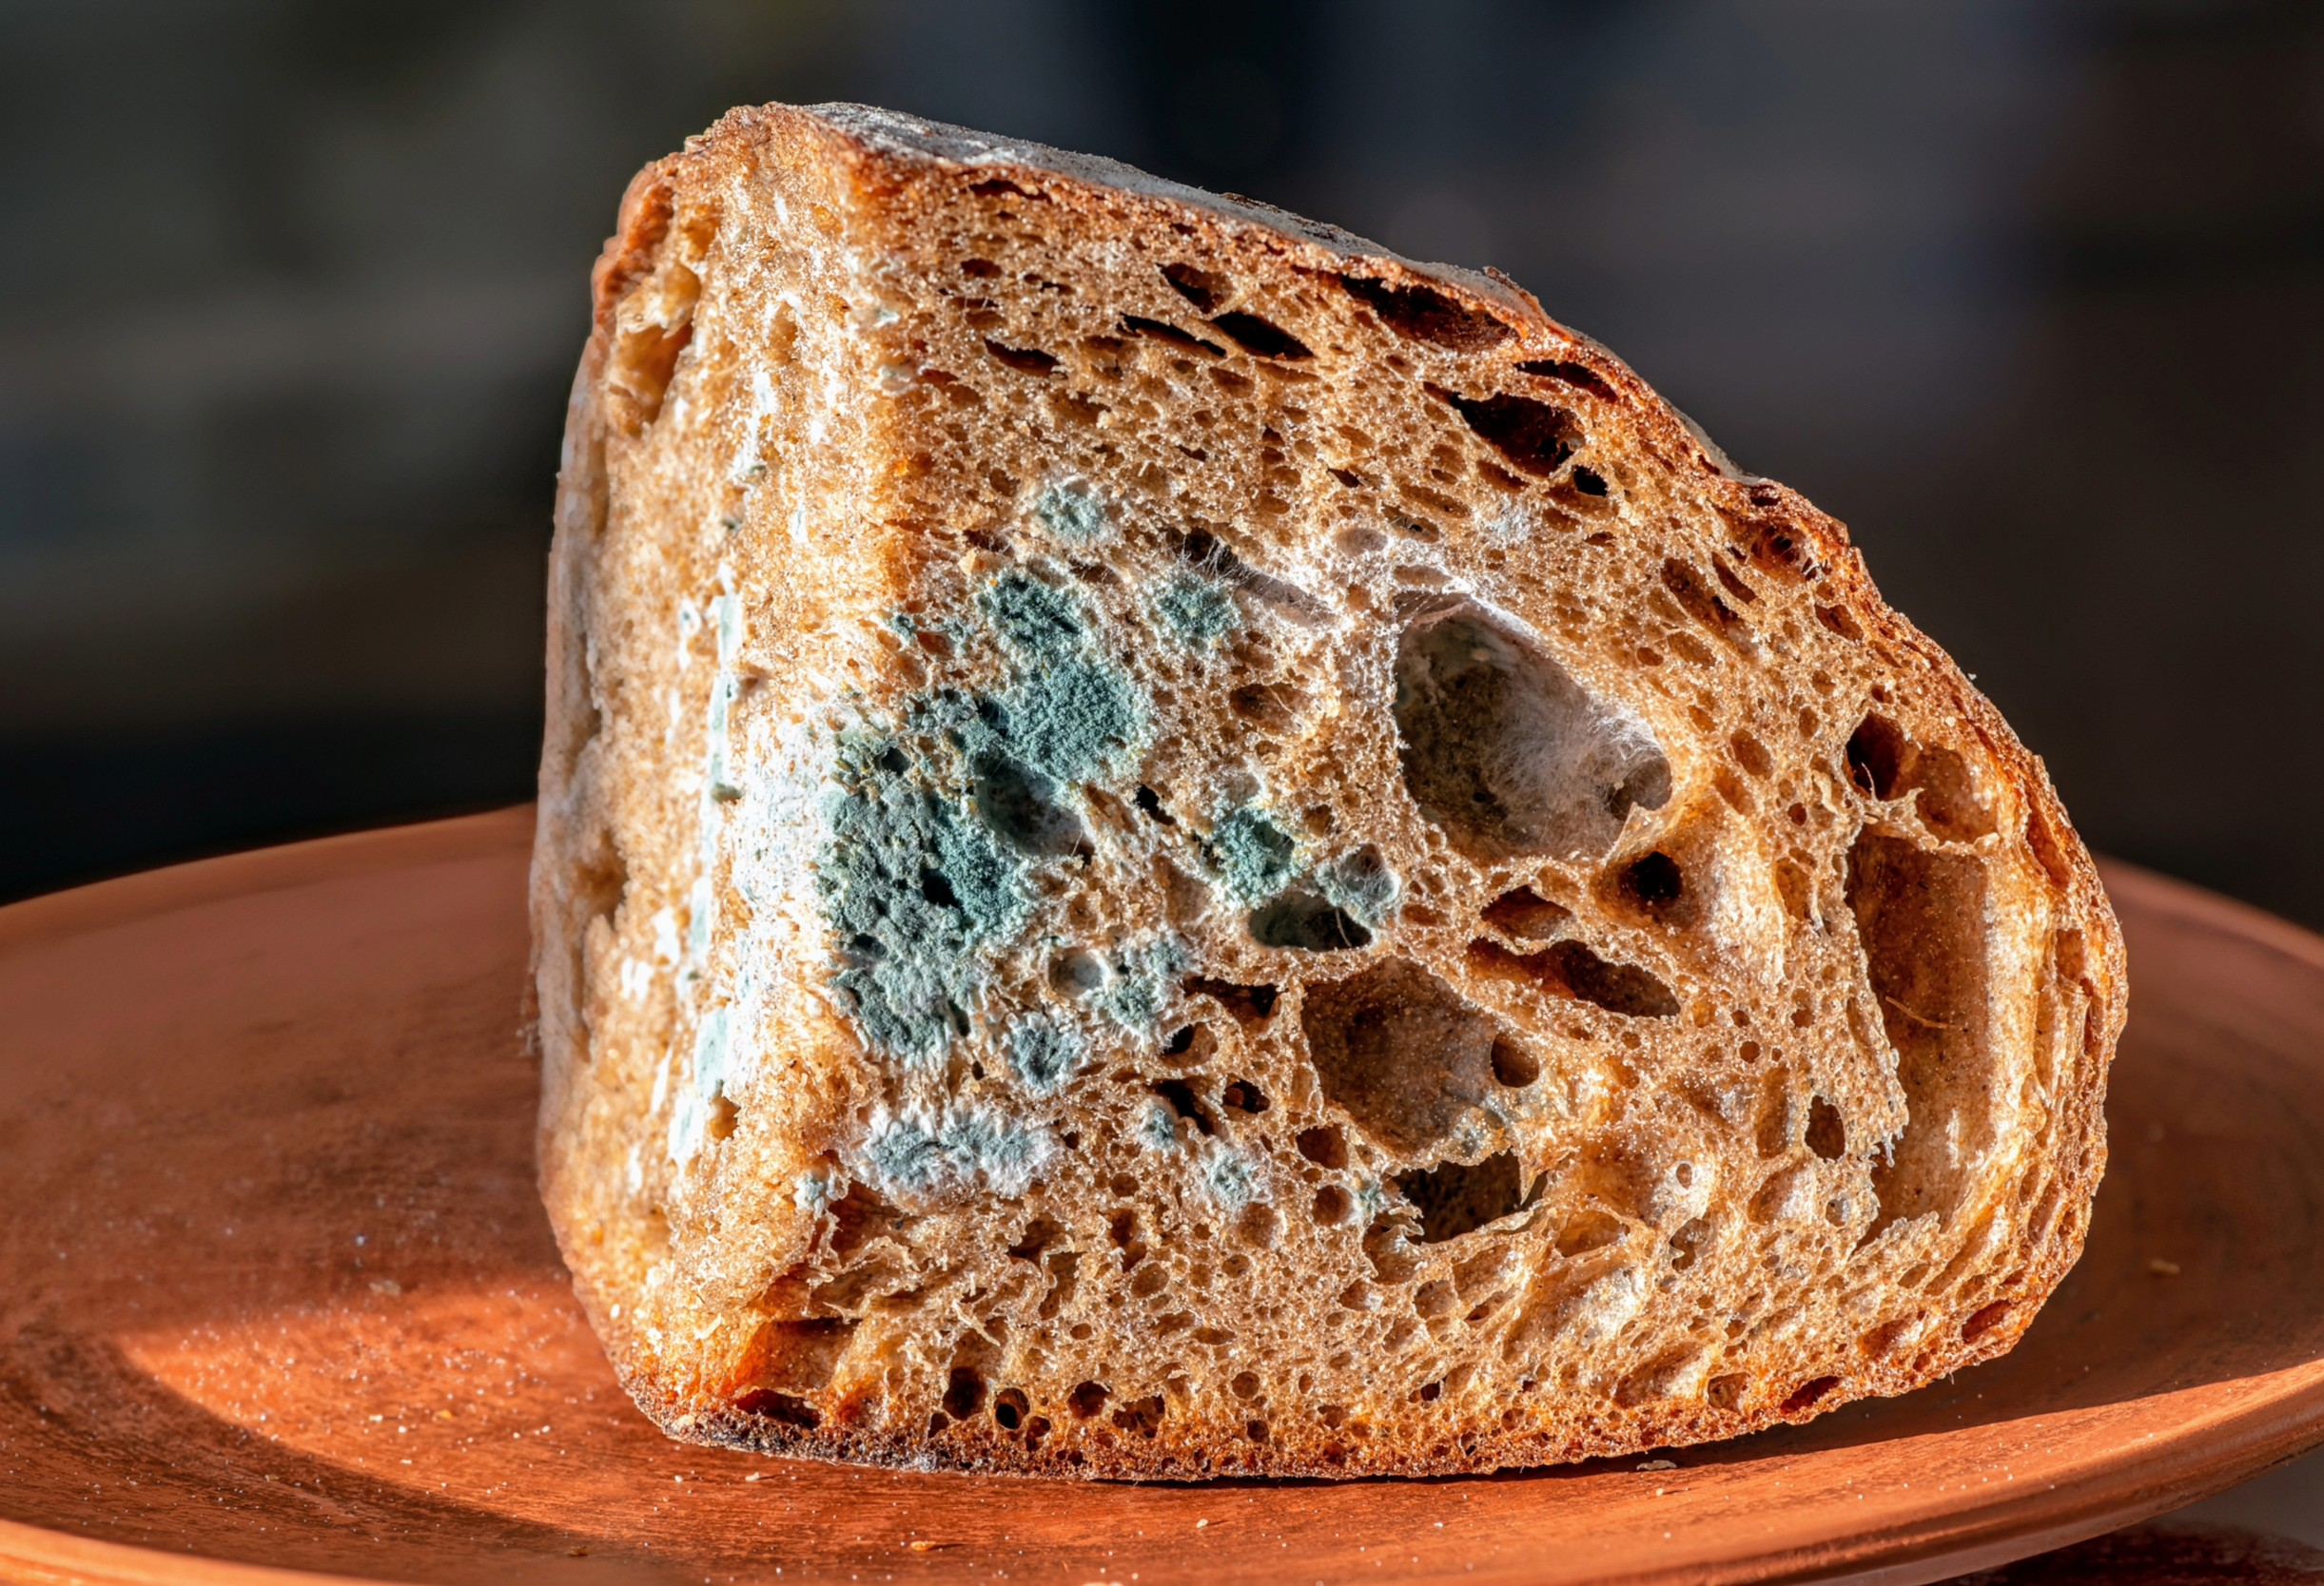

Slide 3
Under specific conditions, some fungi can produce toxic metabolites called mycotoxins, leading to food contamination. The major toxin-producing moulds include genera of Aspergillus, Fusarium, Penicillium, and Alternaria.
Fungal contaminants like Aspergillus and Penicillium spp. are the most common source of proteinase and peptidase enzymes causing breakdown of compounds such as gelatine. It has been estimated that around half of the fungi found in the environment could cause infections in people (mycosis)

Slide 4
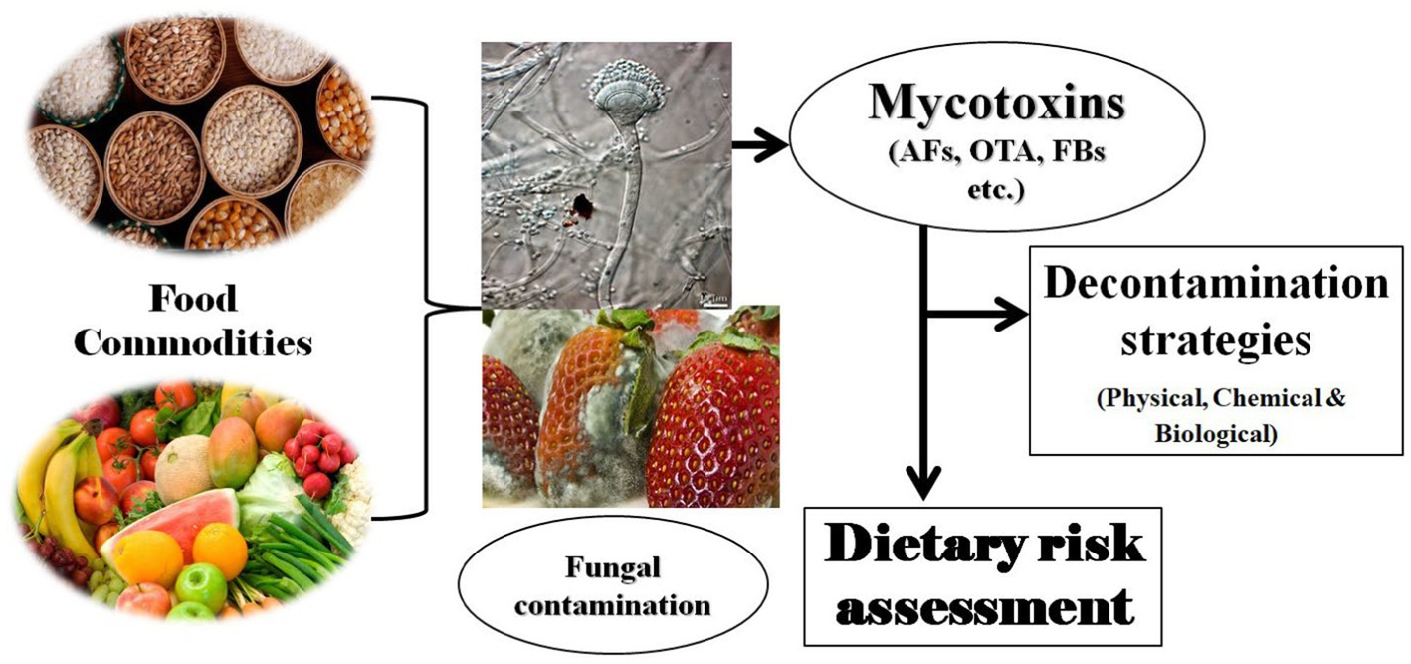
Fungi are well known as common contaminants of the indoor environment with the ability to grow on many types of building materials and to subsequently release biological particles into the indoor air.

Slide 5
Foods are high in Fungus:
1-Cheese.
2-Vinegar and foods containing vinegar, such as salad dressing, ketchup, and pickles.
3-Sour cream, sour milk, and buttermilk.
4-Meat or fish.
5-Breads and other food made with yeast.
6-Jarred jams and jellies.
7-Sauerkraut.
Temperature and moisture are the major factors for fungi growth in stored food grains. Aeration, drying to safe moisture level, hermetic storage is commercially adopted

Slide 6
Mycotoxins are naturally occurring toxins produced by certain moulds (fungi) and can be found in food. The moulds grow on a variety of different crops and foodstuffs including cereals, nuts, spices, dried fruits, apples and coffee beans, often under warm and humid conditions.
mycotoxins, are the chemical contaminants produced by these organisms.

Slide 7
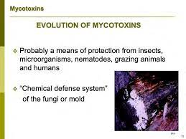

Slide 8
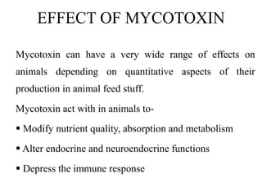

Slide 9
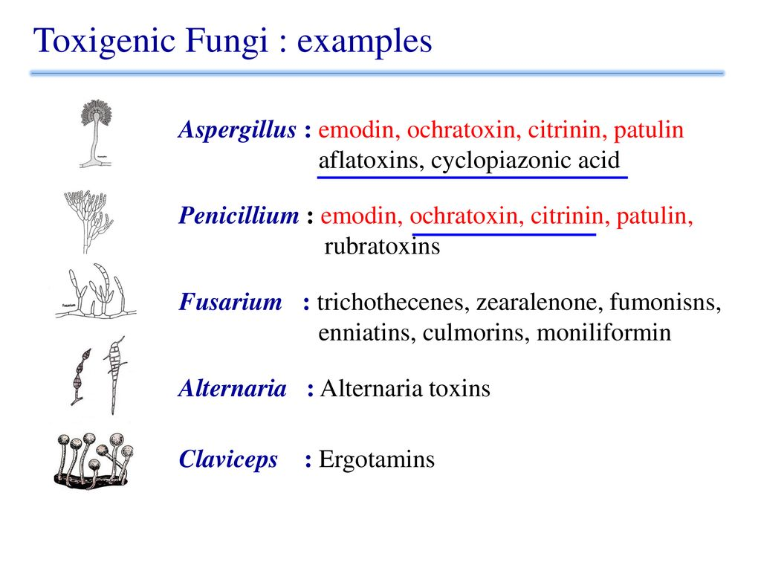

Slide 10
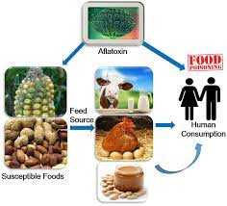

Slide 11
Fungi are organisms that absorb nutrients from dead and deacying matter. For example, fungi can grow on bread, pickle, dead plants and animals, etc., and obtain nutrients from them. Molds most often found on meat and poultry are Alternaria, Aspergillus, Botrytis, Cladosporium, Fusarium, Geotrichum, Monilia, Manoscus, Mortierella, Mucor, Neurospora, Oidium, Oosproa, Penicillium, Rhizopus and Thamnidium. These molds can also be found on many other foods.

Slide 12
The most reported foodborne fungus is Aspergillus flavus. It exists as one of the dominant species found in common stored products, especially grains. It thrives in these conditions as the low water activity and high-temperature environments supply the optimal conditions for growth.
The fungi grow from tiny spores that float around in the air. When some of these spores fall onto a piece of damp food or other materials, they grow into molds.

Slide 13
Some food-borne illnesses could be due to fungi or their byproducts, such as poisoning by mushrooms or mycotoxins.
Hence, the Aspergillus flavus and mushroom are the two fungi which can cause food poisoning.
Food losses due to fungal spoilage are common for perishable foods such as fruits and vegetables, with sources of contamination ranging from pre-harvest (irrigation water, soil, contaminated seeds) to post-harvest steps (handling, storage and transportation, cross-contamination).

Slide 14
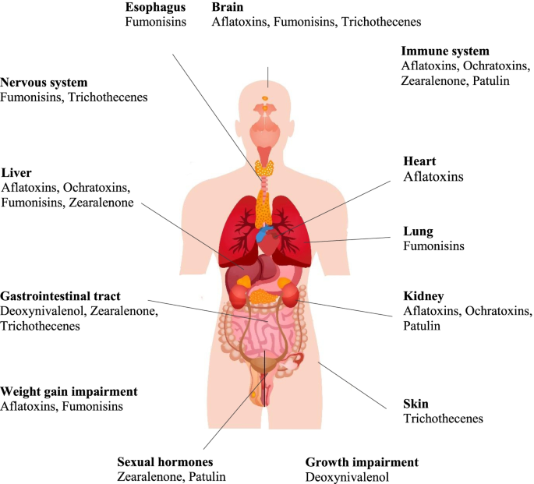

Slide 15
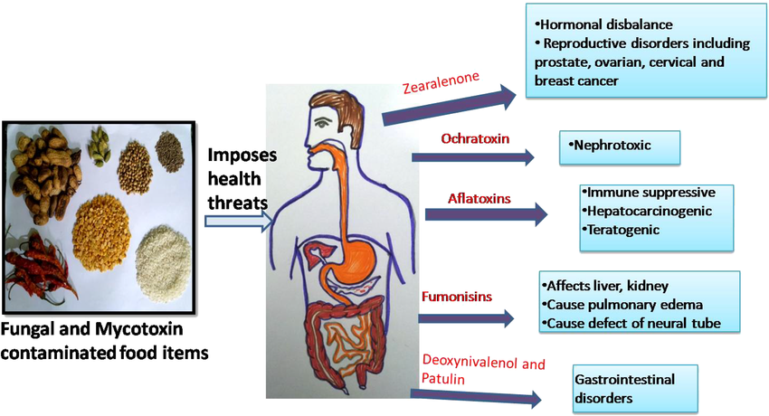

Slide 16
The fungus effect on food
you really don't want to eat moldy food. The repercussions range from unpleasant and off-tasting food to severe illness that can turn deadly. “Many molds are categorized as spoilage microorganisms, which means they spoil food and don't make you sick.
Fungi that cause food poisoning are : Aspergillus flavus that produce aflatoxins. Penicillium verrucosum that produce ochratoxins.
The good news is that most fungi and other microorganisms die at 160-170 degrees Fahrenheit (71-77 degrees Celsius).

Slide 17
A fungal culture test is used to find out whether have a fungal infection. The test may help identify the type of fungus. The test is also used to help guide treatment and to see if treatment is working.
The control of Fungi on Food:
Growth of heat-resistant fungi can be controlled by lowering the water activity, adding sulfur dioxide, sorbate, or benzoate; washing of fruits in hypochlorite solution before heat treatment reduces the number of ascospores and makes the heat destruction more successful.

