Slide 1


The Smart Dentin Grinder®

Slide 2
The Komita Bio Smart Dentin Grinder is a dental device designed to process dentin material into the small tooth particles of specific size 300 - 1200 microns within time less than 15 minutes , convert dentin of the tooth to autogenous graft material.

Slide 3
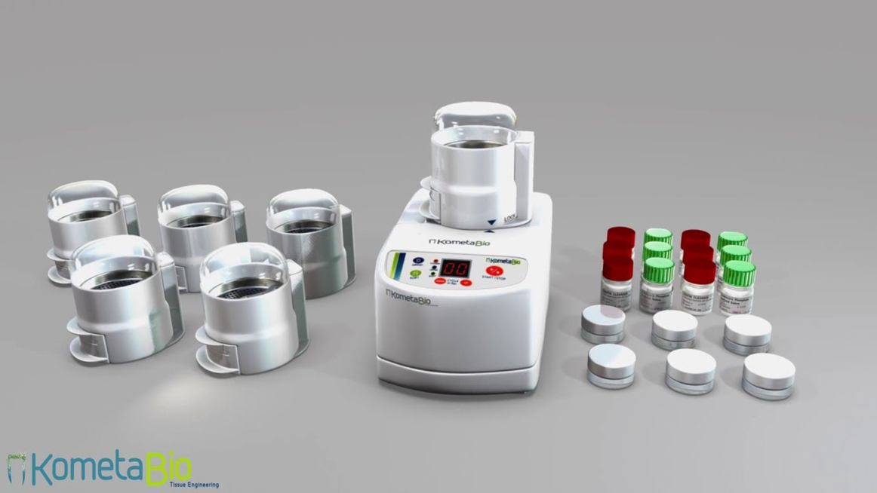
Smart dentin grinder kit :
Consist from four part included ;
1. smart dentin grinder unit.
2.desposible grinder camper.
3. mixing container.
4.chemical agent
A-cleanser
B- phosphate buffer saline

Slide 4
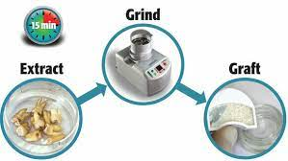
Indications:
Autogenous Grafts: The device is indicated for procedures where the patient's own dentin is preferred for grafting.
Tooth Preservation: It can be used in cases where extracted teeth need to be preserved and repurposed for grafting.

Slide 5
Advantages:
Biocompatible: Using the patient's dentin reduces the risk of immunological rejection.
Natural Matrix: Dentin provides a natural matrix for bone formation, promoting successful integration.
Economical: Utilizing the patient's teeth as a graft source can be cost-effective compared to other grafting materials.

Slide 6
Disadvantages:
Limited Quantity: The amount of graft material may be limited by the availability of extracted teeth.
Processing Time: The grinding process may add time to the overall grafting procedure.
Technical Skill: The proper use of the device requires technical skill and expertise.

Slide 7
Tooth graft procedures involved:
Patient Evaluation:
Assess the patient's oral health and determine the need for a tooth graft.
Identify a suitable dentin for extraction.
Tooth Extraction:
Extract the selected tooth, ensuring minimal damage to the dentin.
Dentin Processing:
The extracted tooth or dentin is processed to remove any contaminants and to obtain the necessary grafting material.
Smart Dentin Grinder Usage:
If a device like the "Komita Bio Smart Dentin Grinder" is available, it is the efficient and precise processing of dentin.
The smart features could include automation, real-time monitoring, and optimization of the grinding process.
Graft Placement:
Prepare the recipient site in the patient's mouth where the graft will be placed.
Carefully insert the processed dentin into the prepared site.
Graft Integration:
Monitor the healing process as the graft integrates with the surrounding tissues.
Follow-up appointments may be necessary to ensure proper healing.

Slide 8
Case presentation

Slide 9
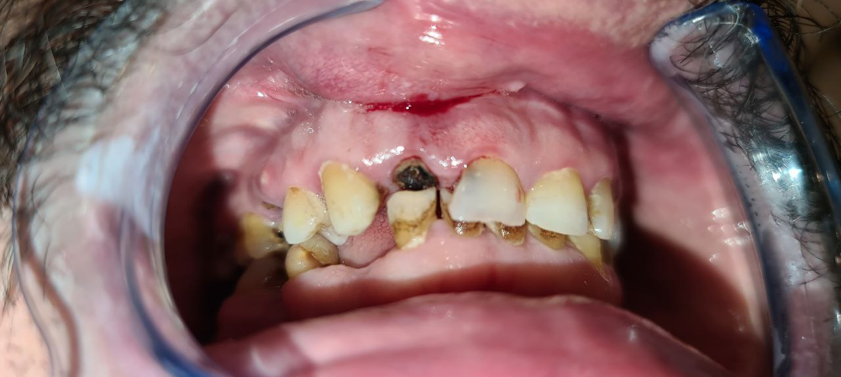
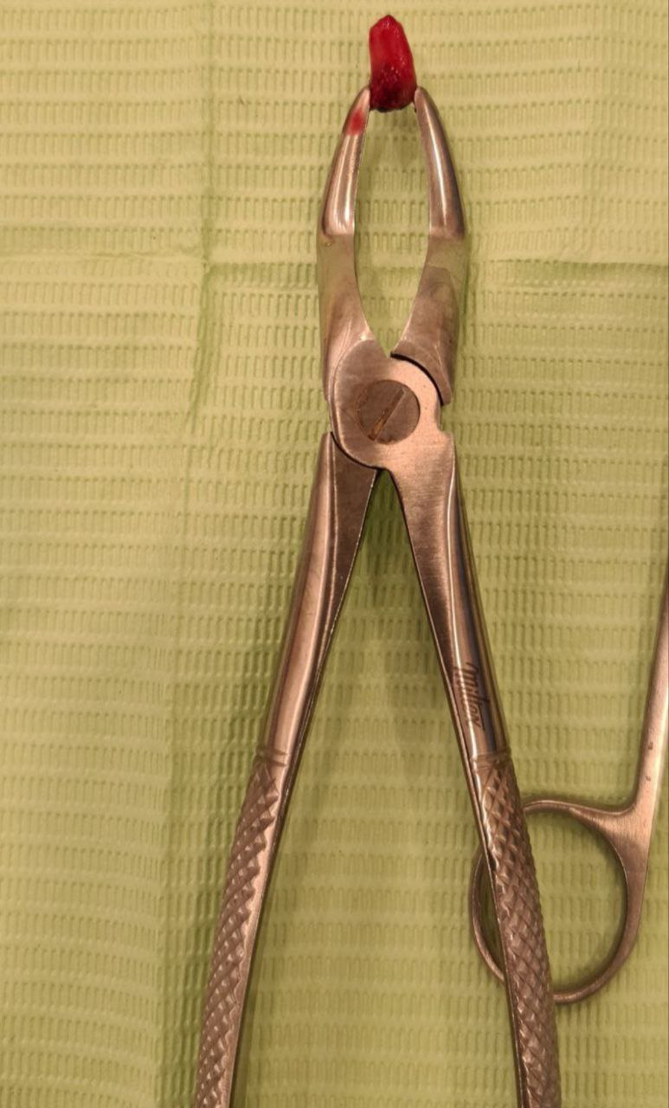
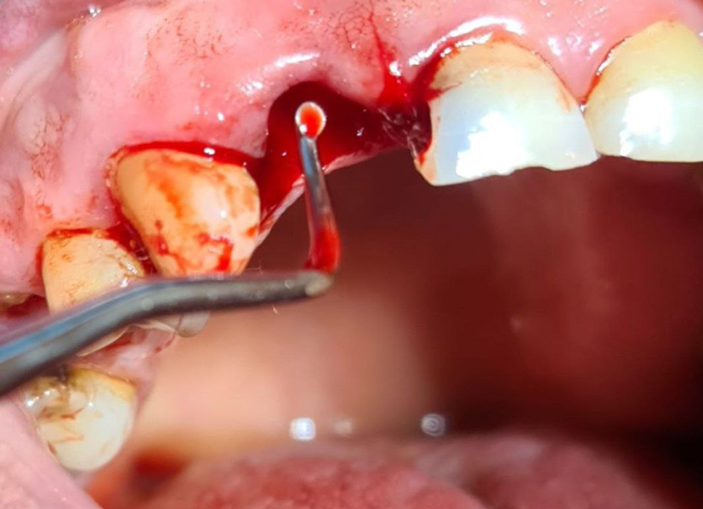
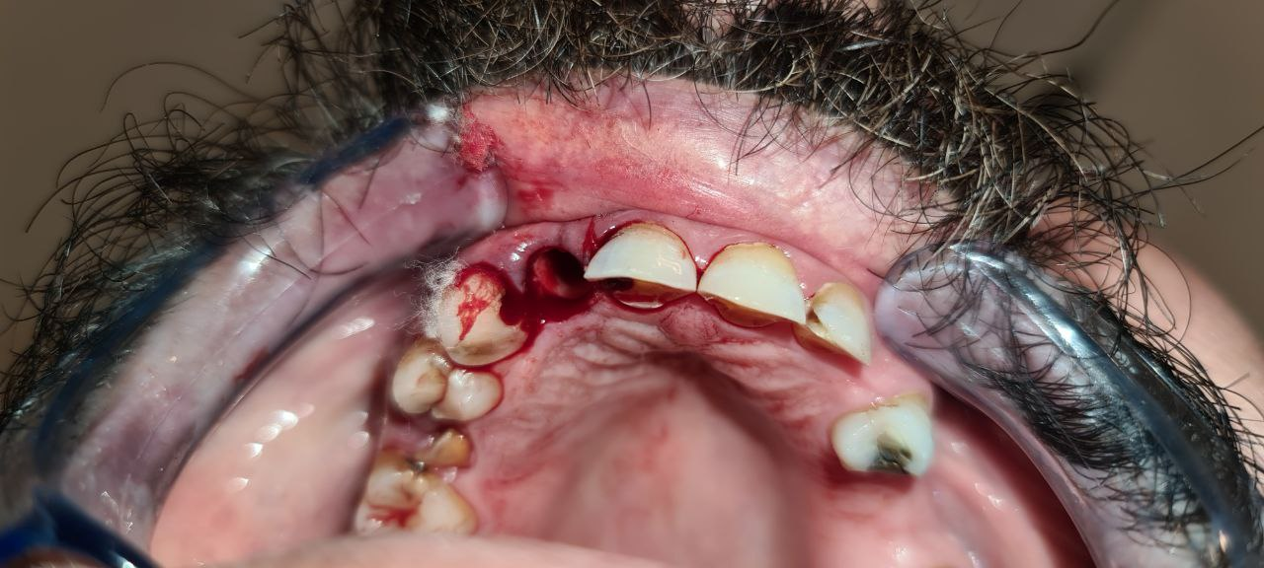
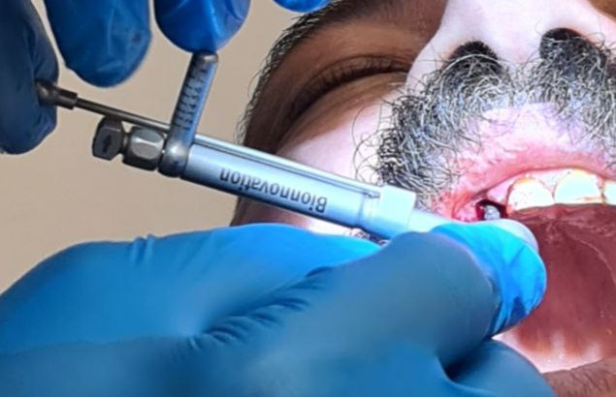

Slide 10
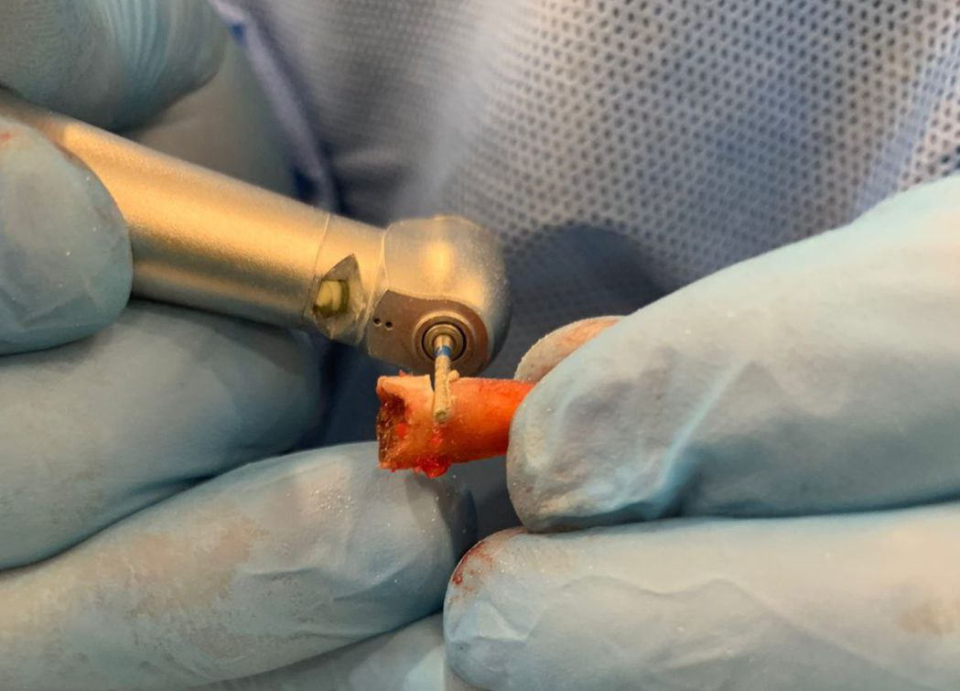
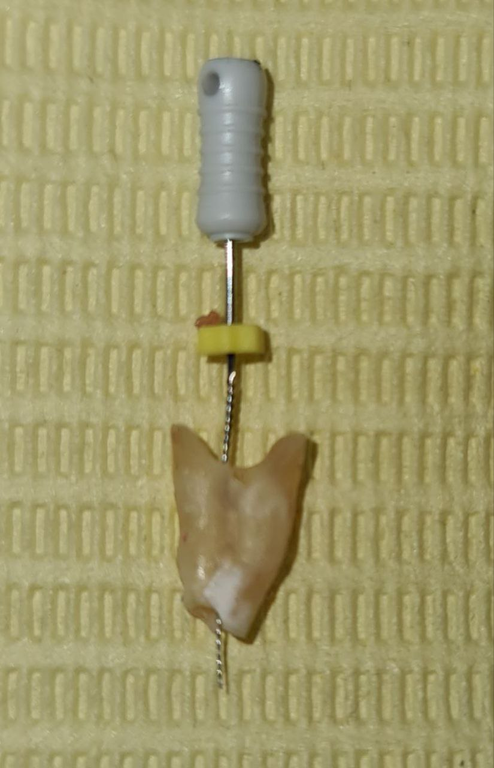
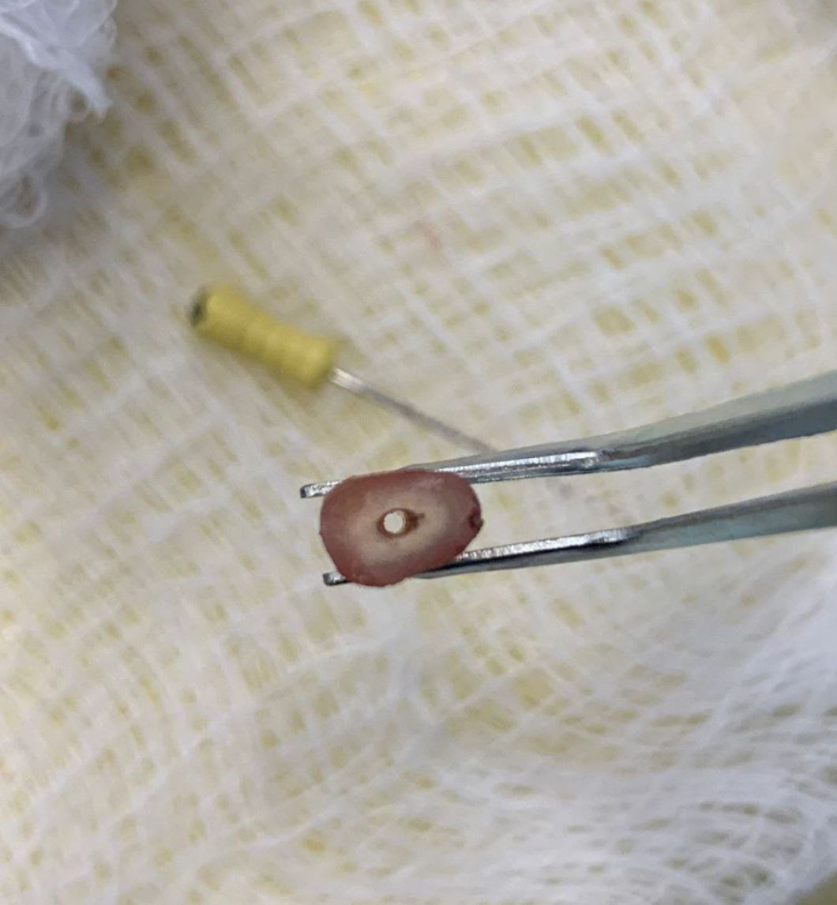

Slide 11
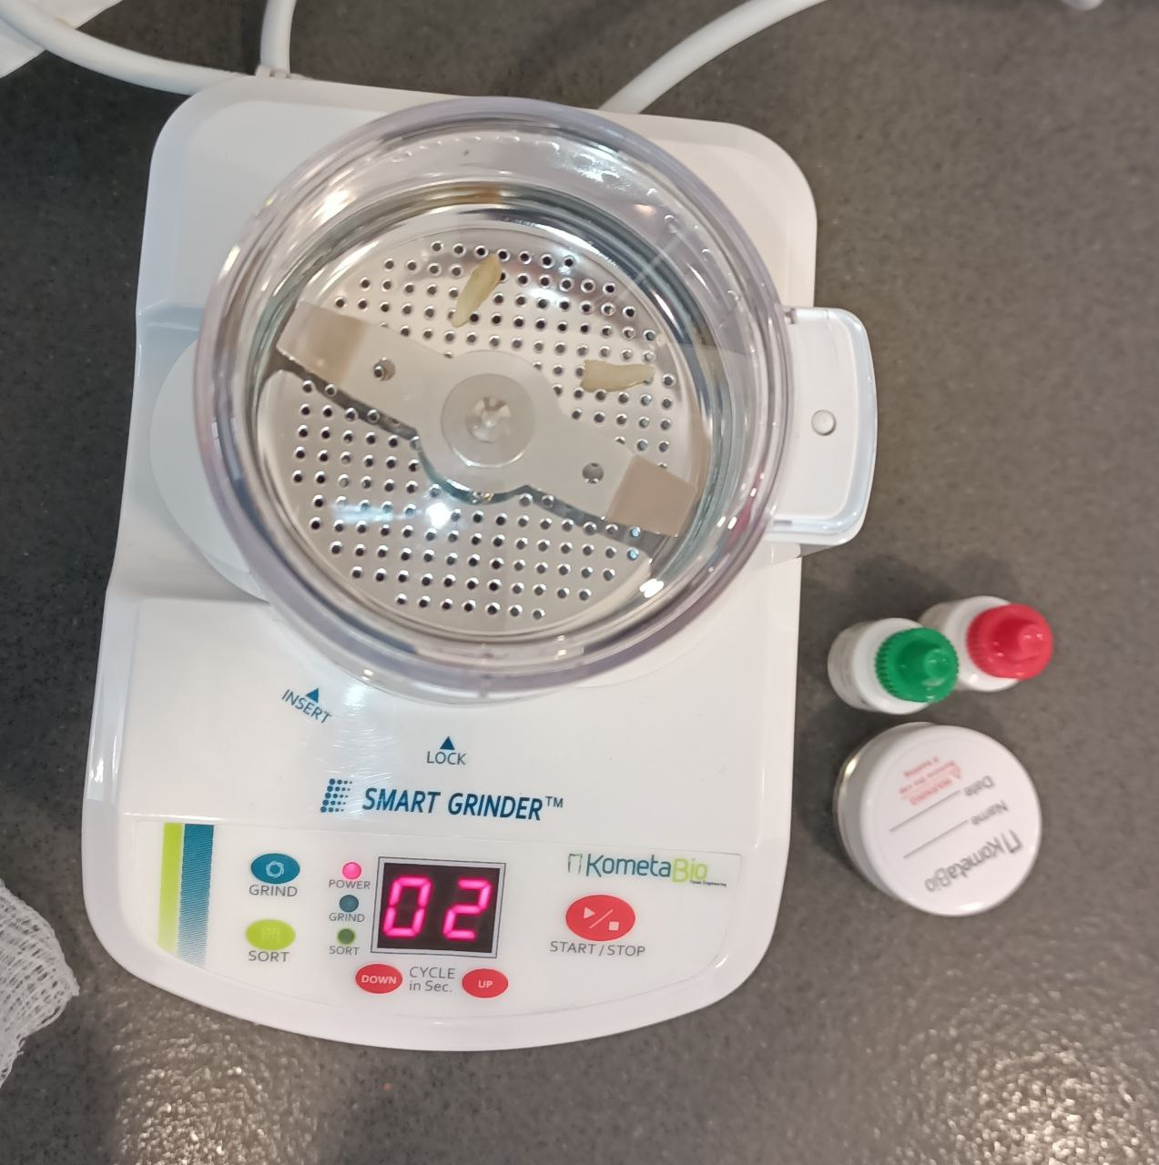
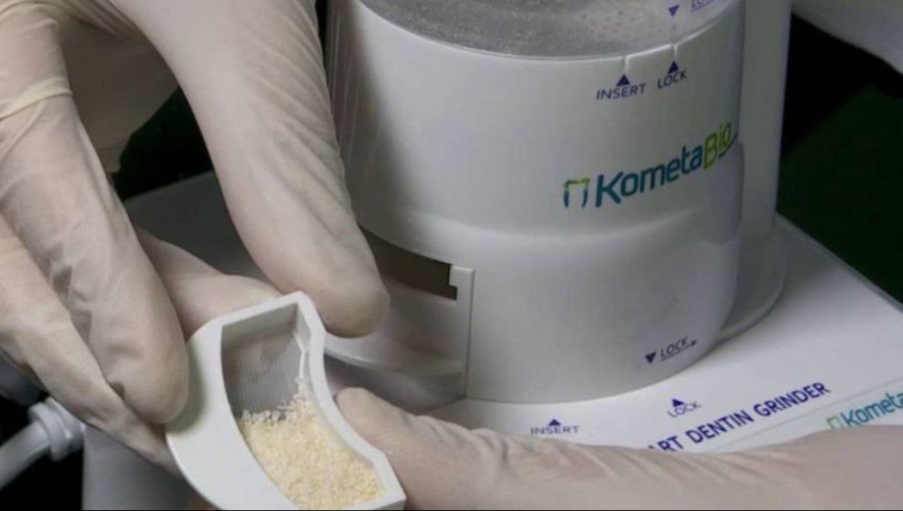
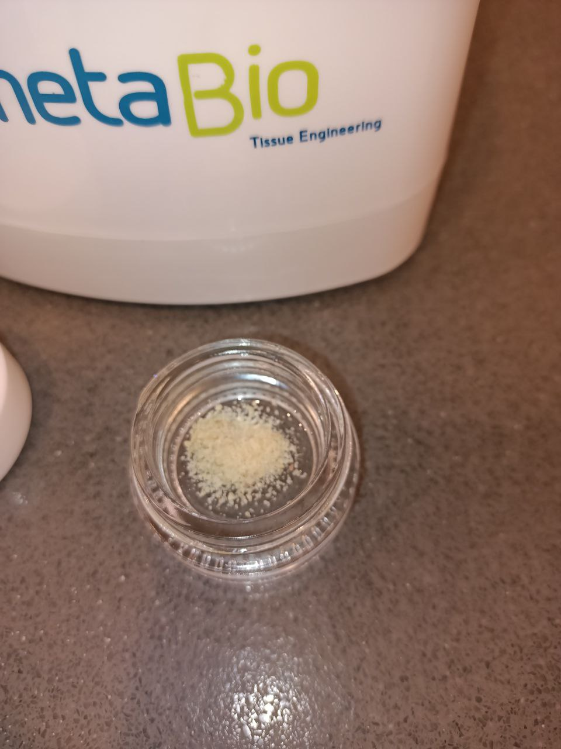

Slide 12
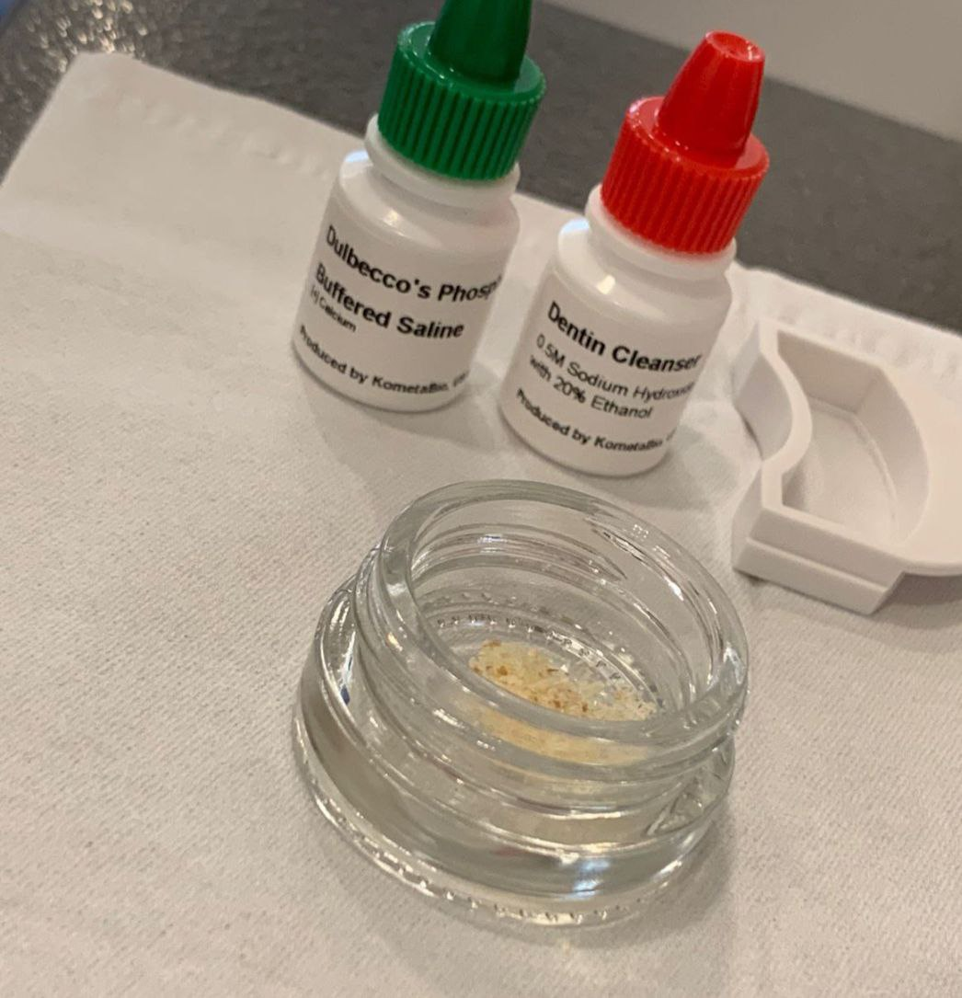
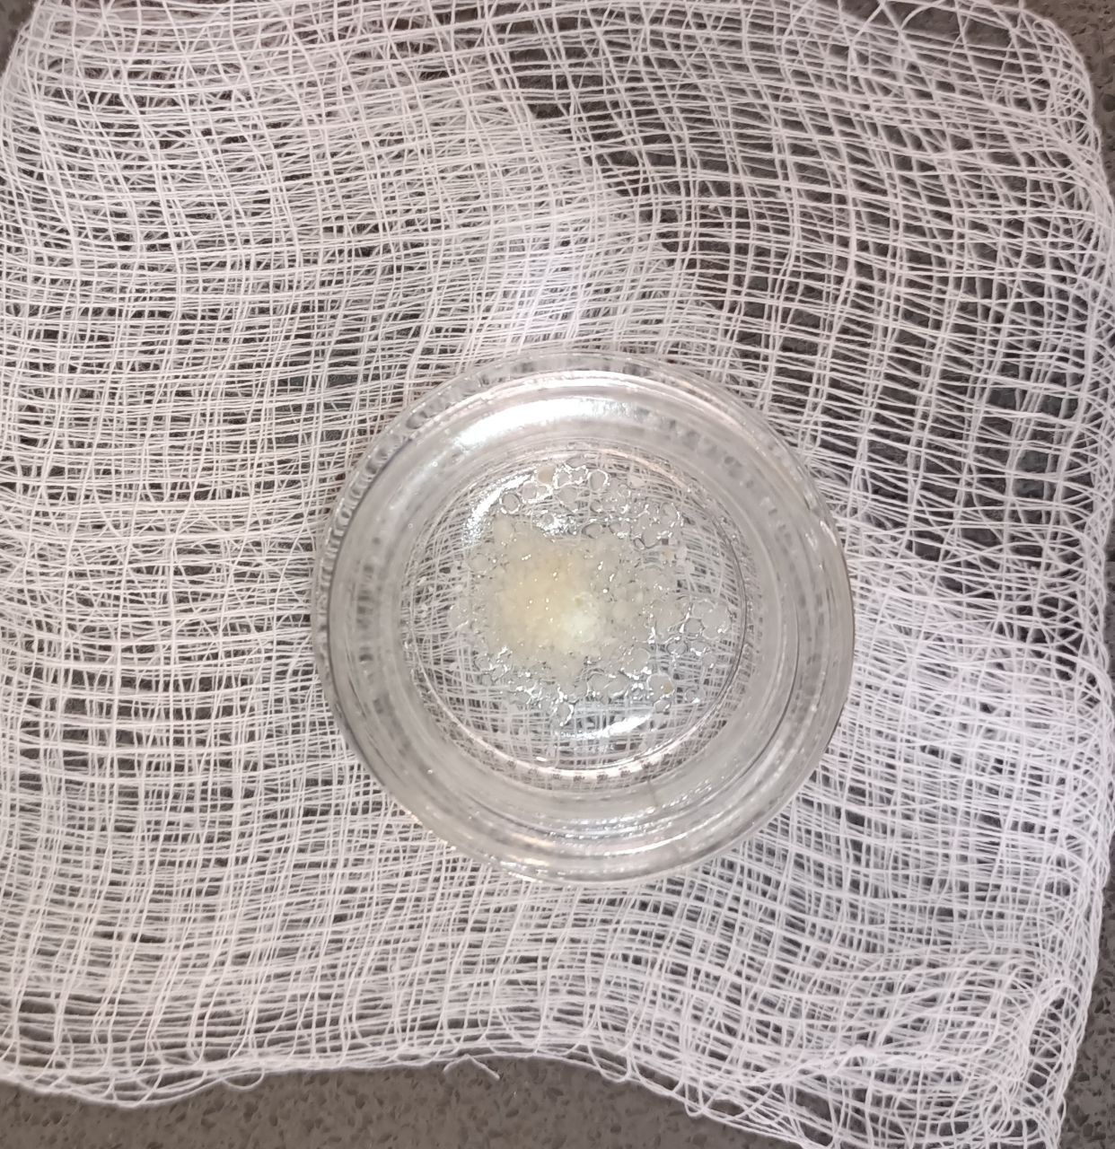

Slide 13
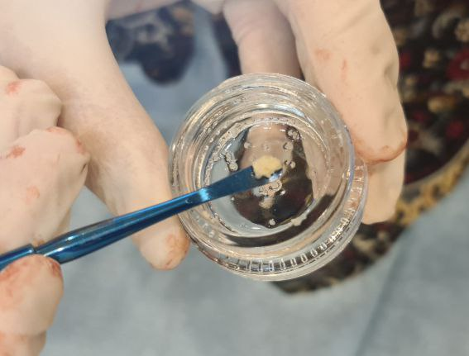

Slide 14
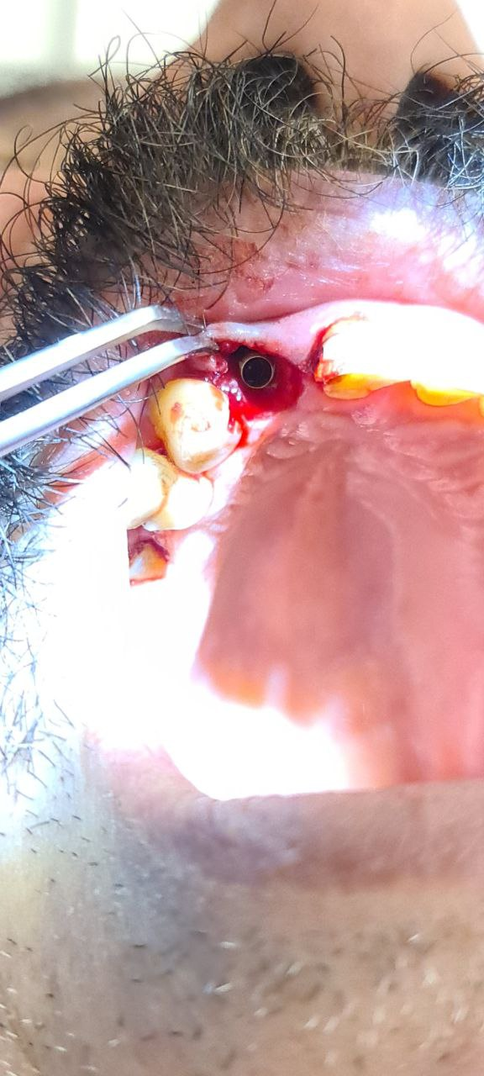
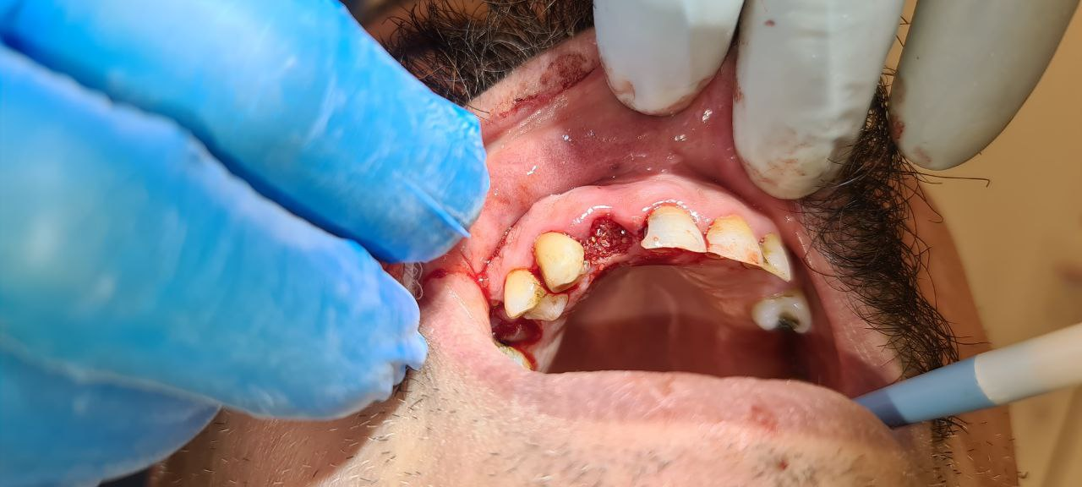
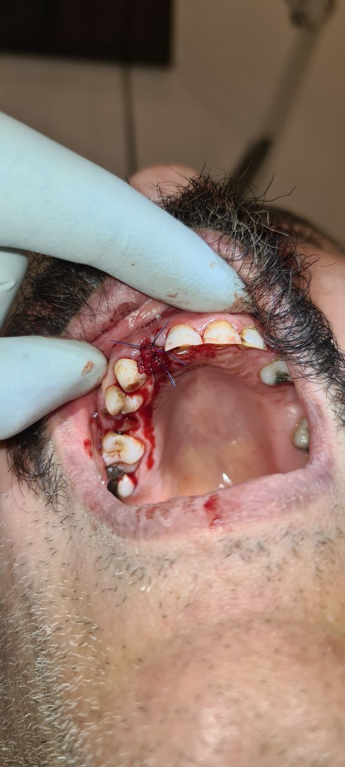

Slide 15
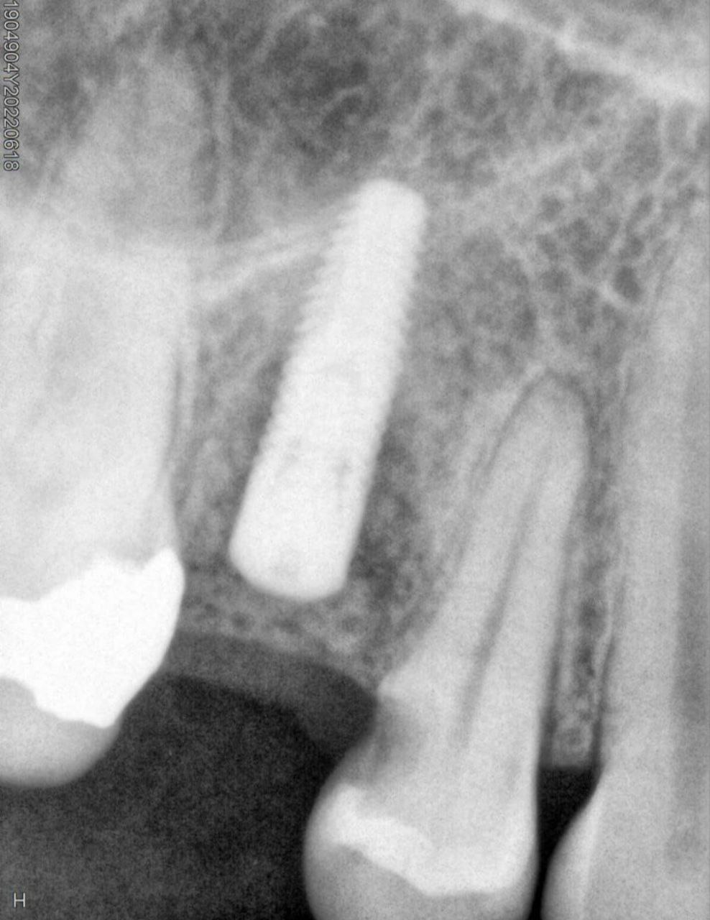
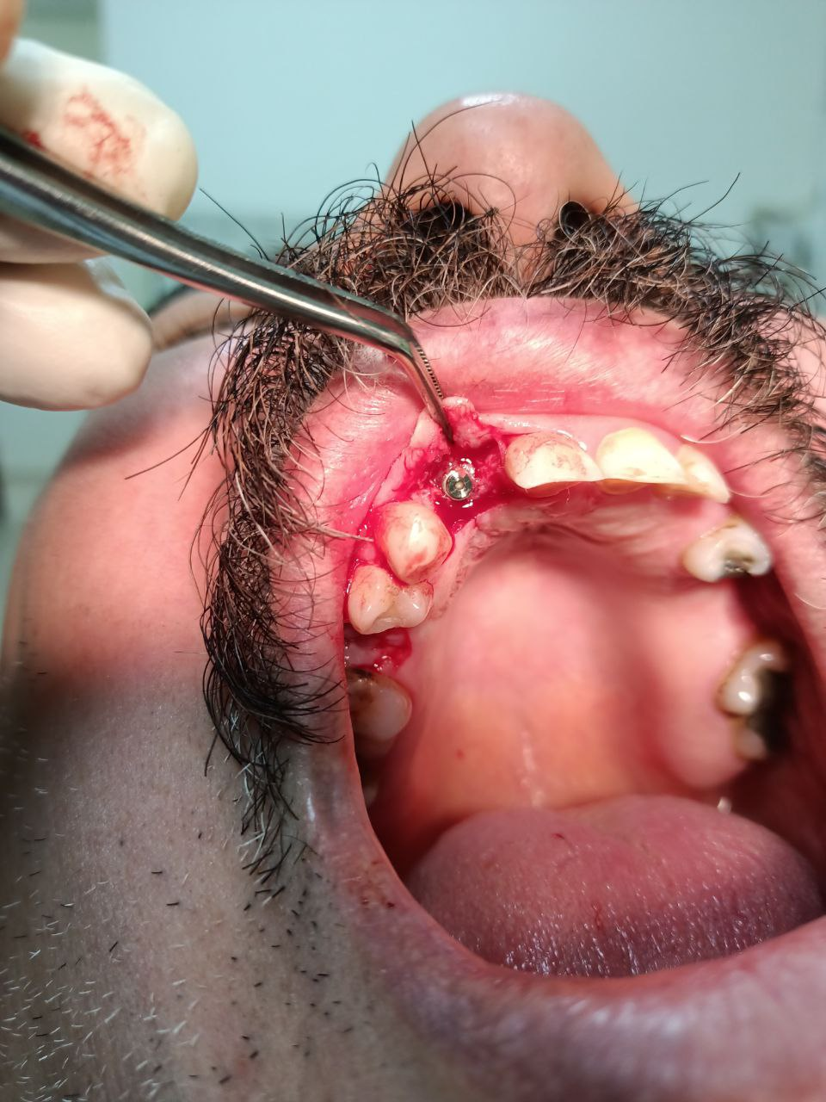
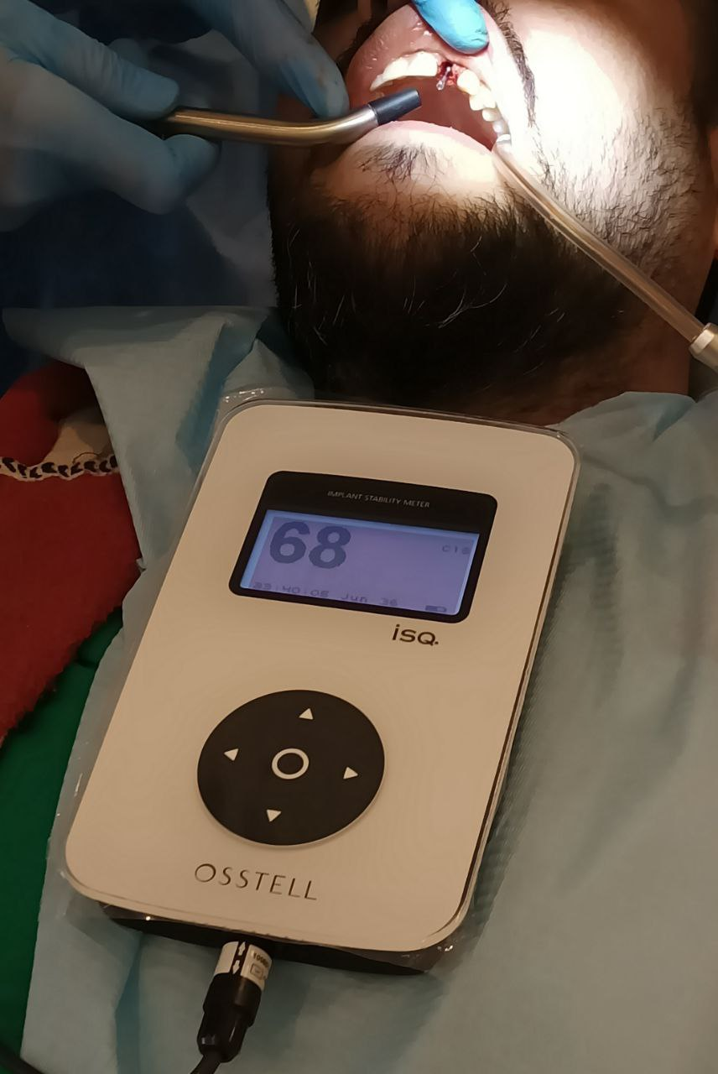
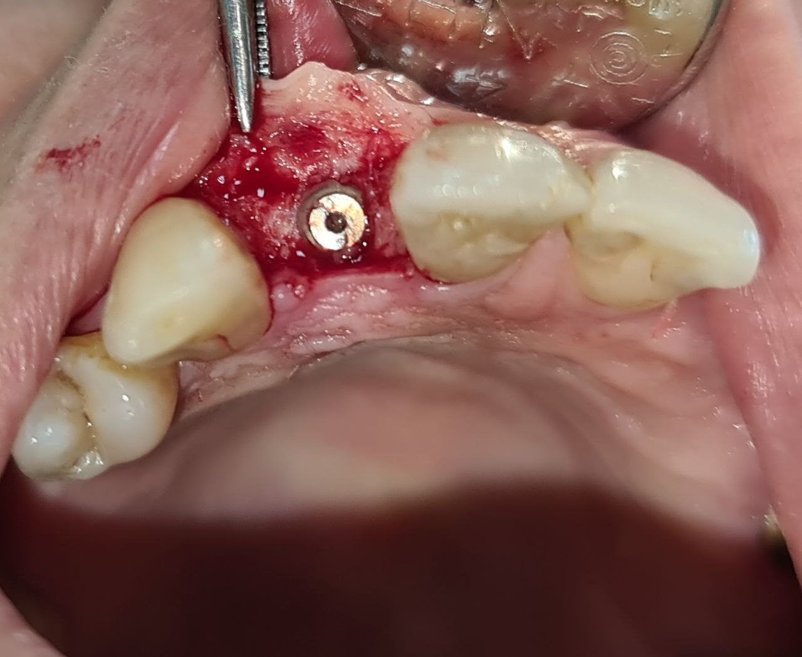

Slide 16
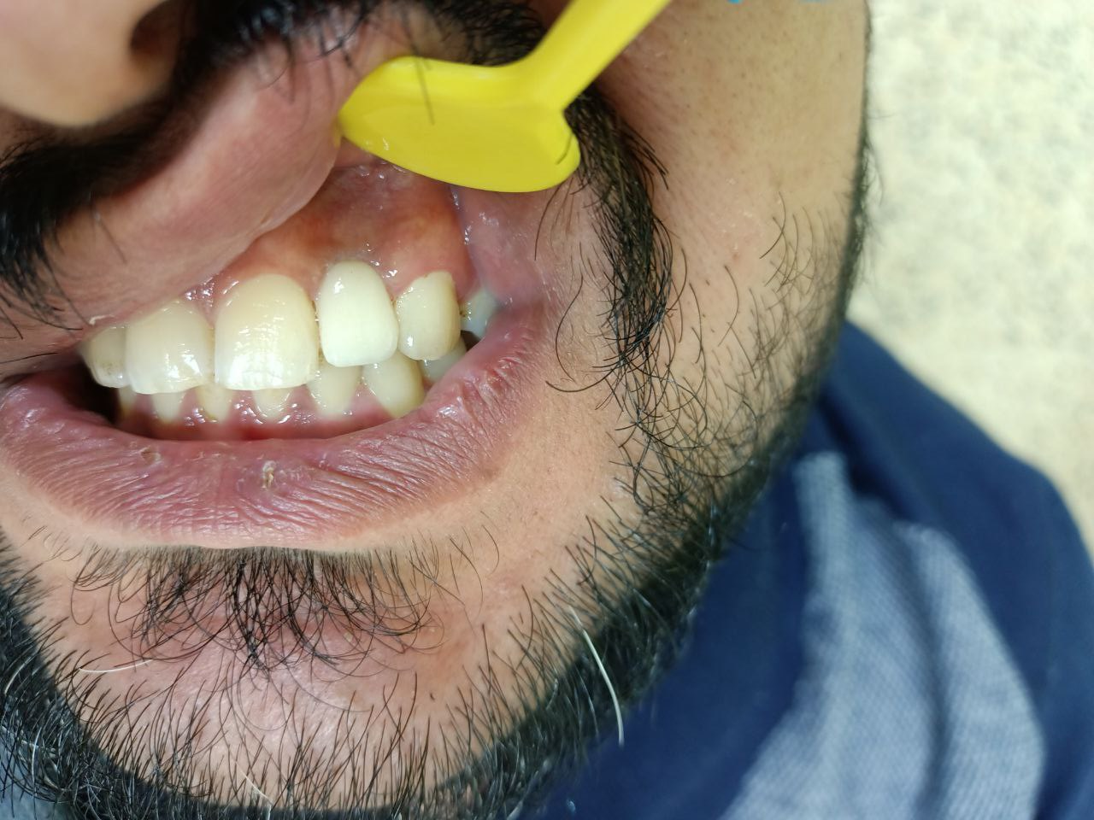
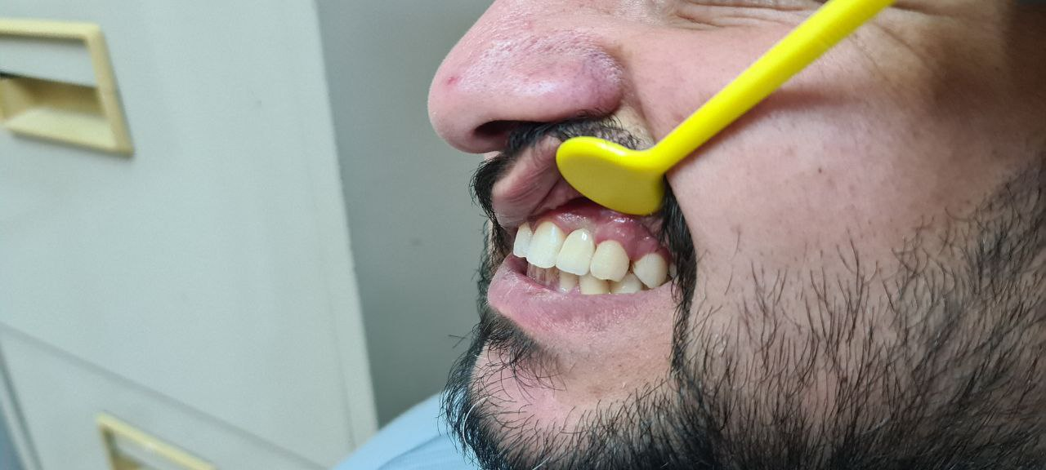

Slide 17
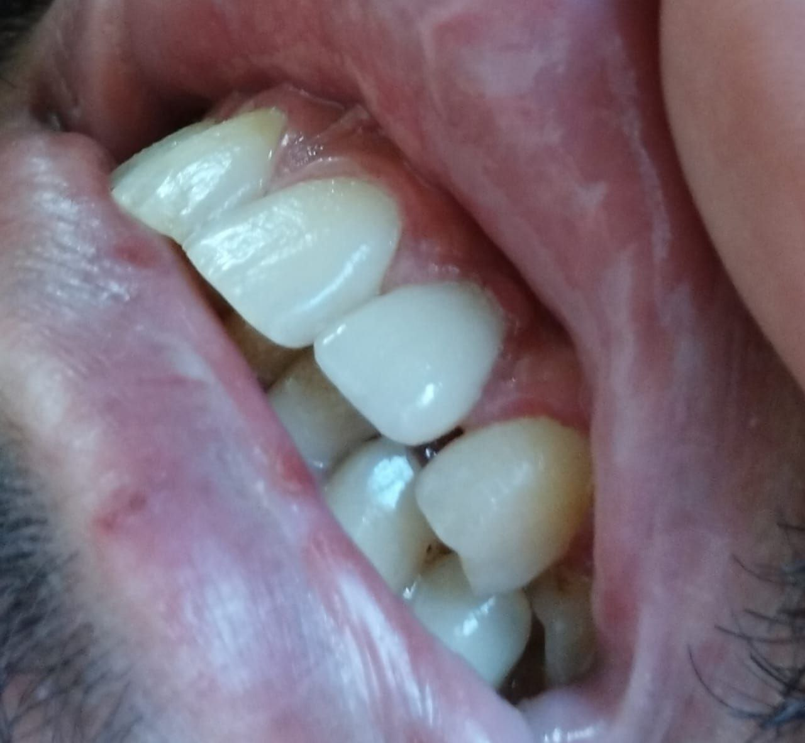
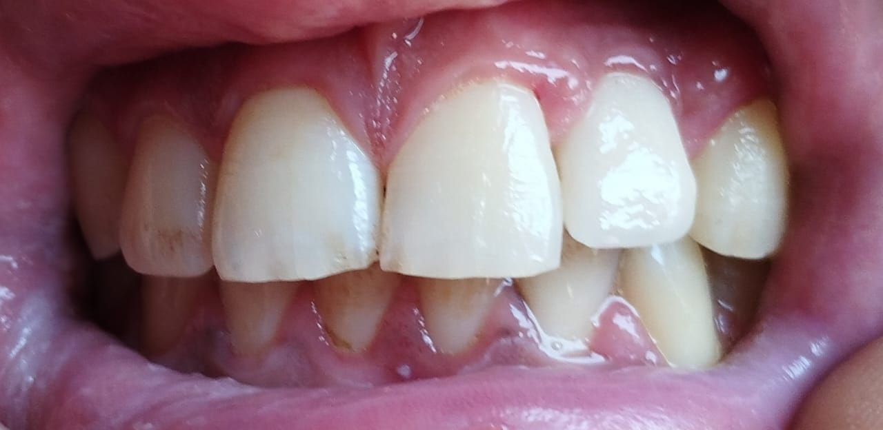

Slide 18


