Slide 1
(GWAS) Genome Wide Association Studies
Dr. Rami Al-Tameemi

Slide 2
Outline
Introduction about GWAS
Goal of associating mapping
Linkage vs association mapping
Strategies of GWAS
Consideration during GWAS
TASEL software
Types of models commonly used
Data format and import
Data imputation and filtering
Analysis and result

Slide 3
What is Genome Wide Association Study (GWAS)?
It is also known as whole genome association study
Eucalyptus
GWAS is an examination of a genome-wide set of genetic variants in different individuals to see if any variant is associated with a trait.
Example:
Is the gene determining our height?
At what chromosome and at what position?

Slide 4
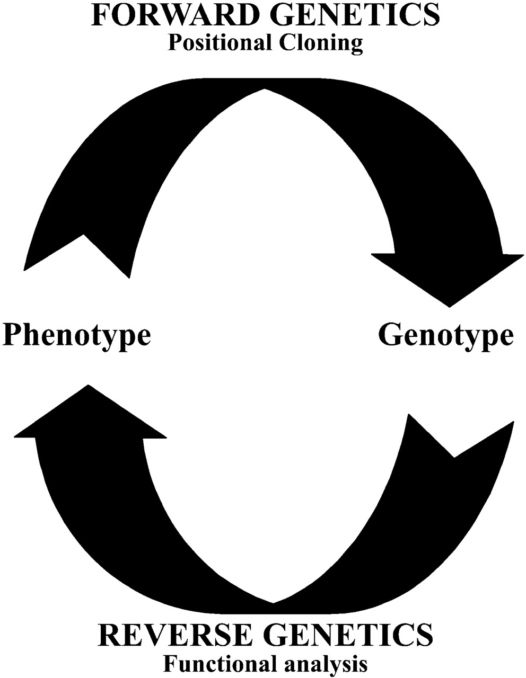
Forward genetics seeks to find the genetic basis of a phenotype or trait
How we link? GWAS etc.
Reverse genetics seeks to find what phenotypes arise as a result of particular genetic sequences.

Slide 5
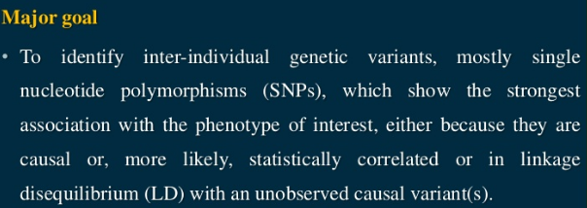
Goal of GWAS

Slide 6
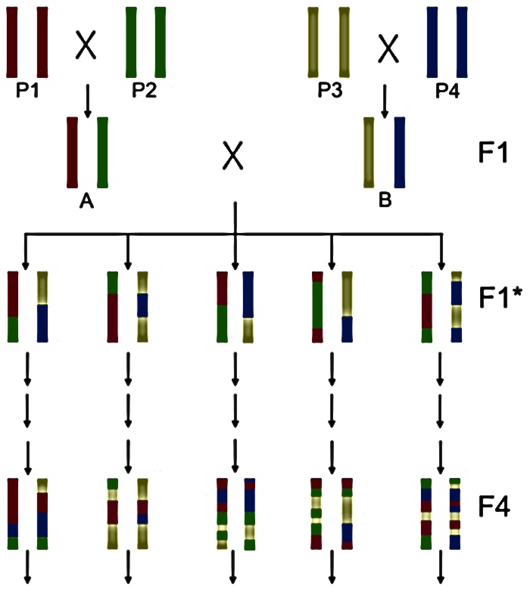
Bi parental QTL
GWAS vs. conventional QTL mapping methods
GWAS
What if it is 10 parent
uses historical recombination
20 parent
100 parent
1000 parent
10000_....
Fn—for 1-2 traits only it takes 6-10 years
Fn

Slide 7
Inconsistencies
Sample handling
Sample DNA mix up
Misplacing
A single sample processed twice
Gene extraction (poor quality leading to sequencing error)

Slide 8
GWAS vs. conventional QTL mapping methods…
Drawbacks bi-parental linkage mapping
Less resolution because of limited markers near to the gene
Requires years to develop a mapping population
Gene discovery is limited to the genetic background of the two parents
Capture only a portion of the genetic diversity of the species
GWAS
higher recombination rates due to the evolutionary history
High resolution mapping
Large informative samples

Slide 9
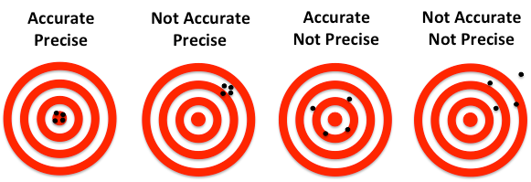
Technological error
Problems related to repetitive regions (“Assembly head ache”)
Accuracy of the machine-

Slide 10
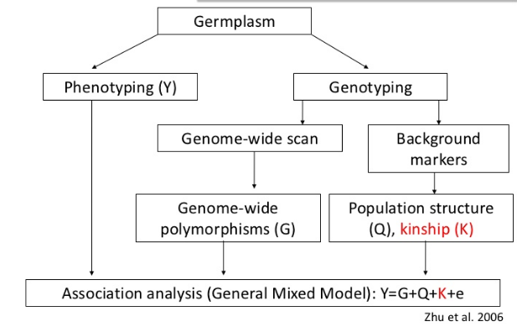
Strategies of GWAS mapping
using SSR marker, Illumina
Infinium
Lab,
Green house or field

Slide 11
There is a revolution going on in computation power and technology
Genotyping
Technological and knowledge advancement
Measure and analysis of thousands and millions variables
Relatively less cost
High speed (automation)
Computational capacity (super computer)
Storage and retrieval capacity (terabits)

Slide 12
Some software used for analyses of GWAS
OMIC tools
Genemapper
GAPIT – Genome Association and Prediction Integrated Tool in R
TASSEL -Trait Analysis by association, Evolution and Linkage
many more coming ….

Slide 13
TASEL application in genetic studies
Why TASSEL?
It can be handled by any beginner easily
It has lots of build in functions
Trusted
TASSEL does the following :
Association mapping and identifying SNPS or markers correlates to traits
Linkage disequilibrium analysis
Diversity estimates
Genomic selection etc.

Slide 14
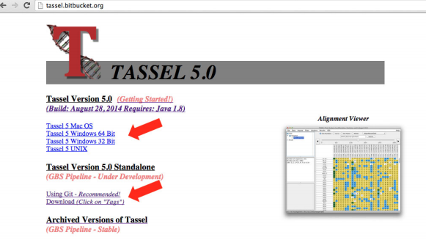
TASSEL software can be freely downloaded from website
www.maizegenetics.net

Slide 15
y = G + Q + e
y = G + Q + K + e
G= genotype SNP or marker data
Q=population structure (PCA data)
K=kinship coefficient data
e=error

Slide 16
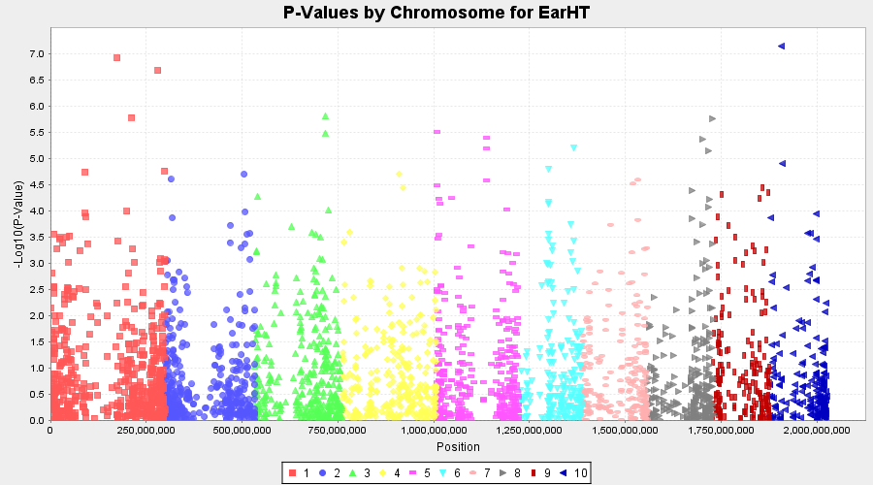
Manhattan pot

Slide 17
Conclusion
This presentation demonstrates that association mapping analysis can help identify the molecular markers significantly linked to traits of interest.
Introduces TASSEL software user manuals
Implementation of GLM and MLM models in TASSEL software allows one to account for effects due to both population genetic structure and relatedness.

Slide 18
Recommendation
Encourage student to use these techniques because its very fast and accurate.
These techniques need big server to do the analysis data so we should make contact with other universities to help us to get the big server.
Try to give training course to the students and lecturer staff.

Slide 19
America
South Dakota
Brooking's
South Dakota State University
SDSU

Slide 21
References and Readings
TASSEL user manual, http://www.maizegenetics.net/tassel, The Buckler Lab at Cornell University
Bradbury PJ, Zhang Z, Kroon DE, Casstevens TM, Ramdoss Y, Buckler ES. (2007) TASSEL: Software for association mapping of complex traits in diverse samples. Bioinformatics 23:2633-263
https://arxiv.org/pdf/1010.4681.pdf, Population Structure and Cryptic Relatedness in Genetic Association Studies
Zhang Z, Ersoz E, Lai C-Q, Todhunter RJ, Tiwari HK, Gore MA, Bradbury PJ, Yu J, Arnett DK, Ordovas JM,Buckler ES. (2010) Mixed linear model approach adapted for genome-wide association studies. NatureGenetics 42:355-360.
Book
Oraguzie, N. C., E.H.A. Rikkerink, S. E. Gardine, and H. N. de Silva (eds.)Association mapping in plants. Springer, NY.

Slide 22
Thanks

