Slide 1

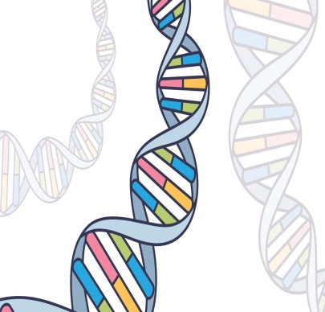
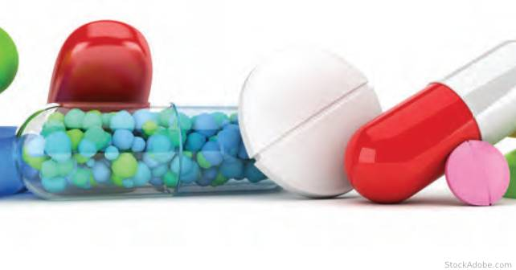
Pharmacogenetic , Concept and applications
مفهوم وتطبيقات علم الصيدله الجزيئيه
Prof. Dr. Basima Q. Hasan
Thursday ,16/5/2024

Slide 2
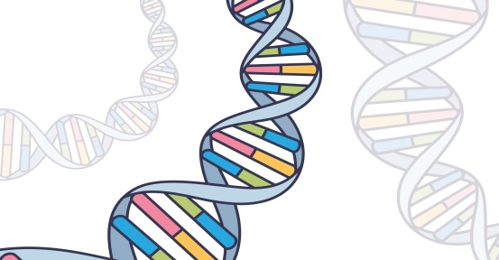

Pharmacogenetic
Pharmacogenetics or Pharmacogenomics (PGx) is defined as: The study of variations of DNA and RNA characteristics as related to drug response. deals with the influence of genetic variation on drug response in patients by correlating gene expression or single-nucleotide polymorphisms (SNP) with a drug's efficacy or toxicity. Pharmacogenetics and pharmacogenomics can be used interchangeably.

Slide 3

Aim of Pharmacogenetic
The list below provides a few more commonly known aims applications of
Pharmacogenetic :
1- Improve drug safety, and reduce ADRs;
2- Tailor treatments to meet patients' unique genetic pre-disposition, identifying
optimal dosing
3- Improve drug discovery targeted to human disease; and
4- Improve proof of principle for efficacy trials.
Pharmacogenomics may be applied to several areas of medicine, including pain management, cardiology, oncology, and psychiatric .A place may also exist in forensic pathology, in which pharmacogenomics can be used to determine the cause of death in drug-related deaths where no findings emerge using autopsy

Slide 4
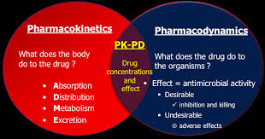
PK-PD
Pharmacokinetic PK(ADME)حركيه الدواء
Pharmacodynamics (PD) ديناميكيه الدواء

Slide 5

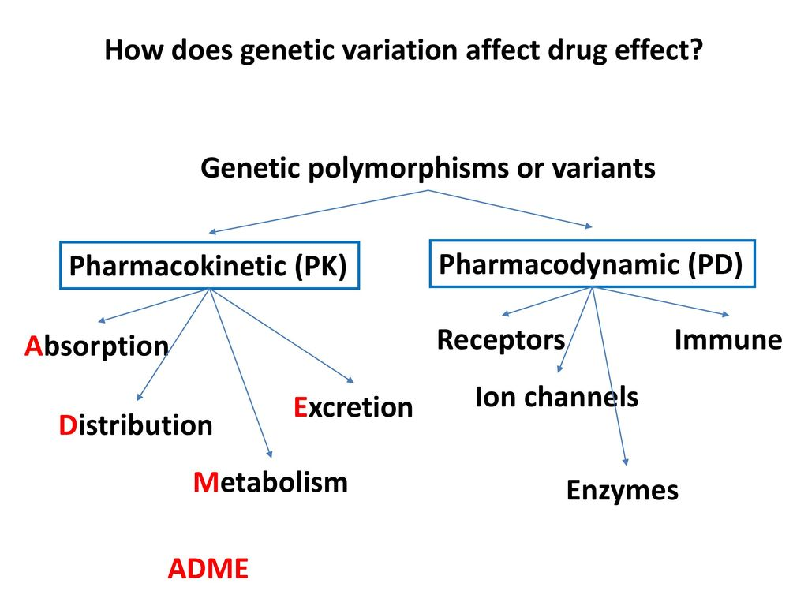
Pharmacogenetic
Genetic variation may influence all of these processes, since they
involve numerous different molecules produced by genes,
such as
transport proteins and pumps
carrier's molecules
enzymes
Hepatic and
renal function

Slide 6


How does pharmacogenetics work?
The cytochrome P450 system
are a family of enzymes found throughout the body which are responsible for the synthesis and metabolism of various molecules and chemicals within the cell, most notably including the active ingredient of most drugs.
Common variations - known as polymorphisms - in the genes that determine cytochrome P450 enzyme activity may affect the function of the enzymes.
Cytochrome P450 enzymes, particularly CYP2C9, CYP2C19, and CYP2D6, are responsible for approximately 70% of drug metabolism in the body
These are most commonly seen in the metabolism of medication.
Drugs may be metabolized quickly or slowly.
If a cytochrome P450 enzyme metabolizes a drug slowly, the drug remains active longer and a lower dose is needed to get the desired effect whereas normal doses may cause toxicity.
Additionally, there are other genes outside of the cytochrome-p450 system that affect drug metabolism and as a result - a patient’s response to medications.
.

Slide 7

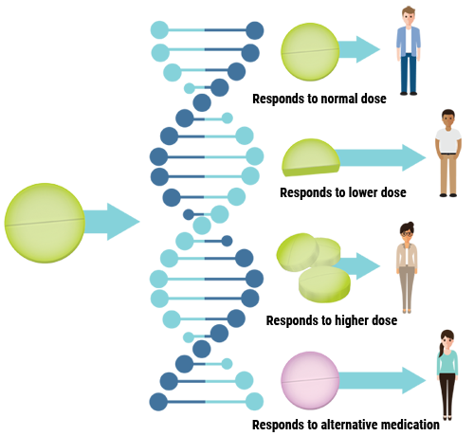
Drug activity
These variations are broken down into four categories based on their expected effect on drug metabolism:
Poor.
Intermediate.
Normal.
Rapid / Ultra Rapid.

Slide 8


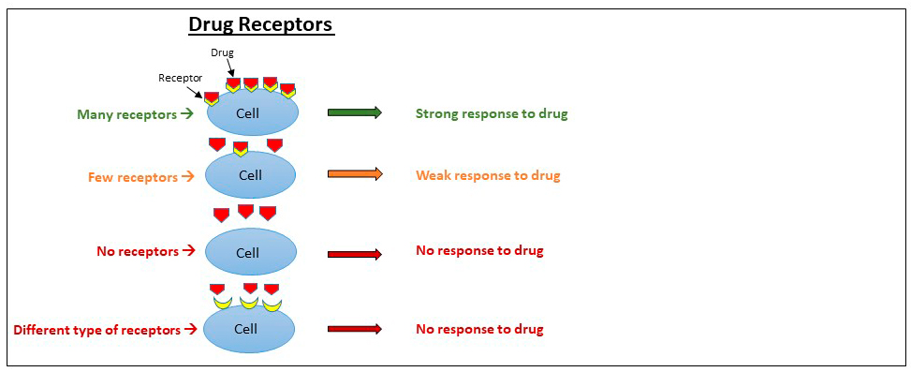
Pharmacogenetic
Ligands (drugs) that attracted the receptors may be classified as agonists or
antagonists.
Agonists produce the biological response as a result of receptor –ligand
interactions therefore agonists possess efficacy.
On the contrary antagonists did not provoke any biological activity after binding
to its receptor.
There are different types of receptors:
1. Transmembrane ion-channels receptors
2. Transmembrane G-protein-coupled receptors
3. Transmembrane receptors with cytosolic
domain
4. Intracellular (cytoplasm or nucleus) receptors

Slide 9
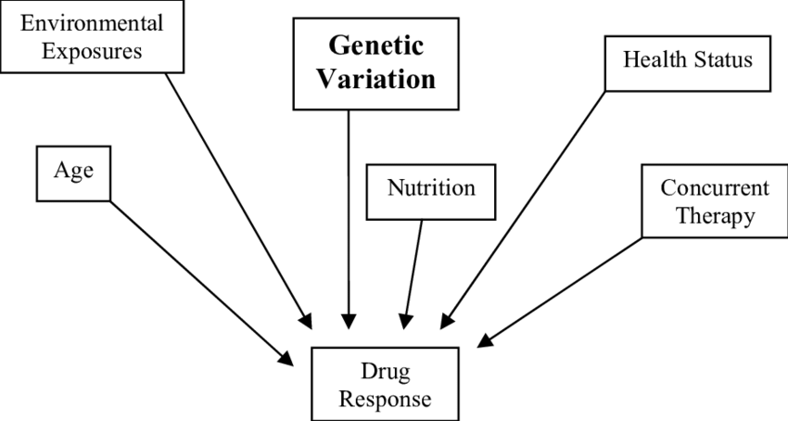
Drug response
    Responses to virtually all drugs can vary between individuals according to:
    intrinsic factors (such as age, health and genetics) and/ or
    extrinsic factors (such as diet, the use of concomitant drugs and
    weight , sex , rout of administration ) that may affect drug PK and/or PD parameters

Slide 10

Genetic variants and drug response
    Responses to virtually all drugs can vary between individuals according to:
    Examples of genetic variants that influence drug
    response include:
    single nucleotide polymorphisms (SNPs) = is a DNA sequence variation occurring when a single nucleotide — A, T, C or G — in the genome (or other shared sequence) differs between members of a biological species or paired chromosomes in a human
    insertions and deletions,
    copy number variations

Slide 11

Role of Pharmacogenetic in drug discovery and development
Drug discovery and development is an elaborate and time consuming process. The average time taken from synthesis of a new chemical entity (NCE) to its marketing has increased from an average, the journey from discovery to market takes 12 years,
It includes two major phases,
phase I being the discovery of the drug compound, which is the most crucial stage in drug development,
and phase II being animal and clinical studies followed by marketing.
Variable drug response generally occurs because of genetic variability in drug-metabolizing enzymes, drug transporter proteins, and drug targets among individuals.
the FDA has laid down guidelines for pharmaceutical firms regarding submission of Pharmacogenetic data for their drug products in labelling.

Slide 12


The applications of pharmacogenomics in drug development process are represent in this Table It can be seen that it has a vital role at every key stage of the drug development process
Stage Application of pharmacogenetics/pharmacogenomics
Drug target Identification - characterization of the gene coding for the drug
target and to assess the variability
Phase I clinical trial - Patient selection – Inclusion/Exclusion criteria
-Dose range selection
Phase II clinical trial Dose modification
Phase III clinical trial Interpretation of trial results based on
Pharmacogenetic test results
Phase IV clinical trial Analysis of reported adverse events with
Pharmacogenetic test
Regulatory issues Requirements for submission of Pharmacogenetic data
during development by FDA
Patient therapeutics - Personalization of drug therapy
- Pharmacogenetic data in drug labelling
- Identification of responders and non responders
- Identification of high risk groups of adverse events

Slide 13
Drug development and discovery
After sequencing of the human genome,
the number of drug targets was estimated to be around 8000,
out of which 4990 could be actually acted upon –
2329 for antibodies and 794 for drug proteins.
Based on ligand binding study, 399 molecular targets belonging to 130 protein families have been identified.
currently, the number of targets ranges only around 218, though the estimated numbers are very high these targets are known to exhibit variations owing to genetic polymorphisms.

Slide 14
Drug development and discovery
In most cases, variation in drug response in a disease is attributed to many genes rather than a single gene mutation.
The results of pharmacogenetic study do not apply when used clinically, as only single gene mutations are studied when in fact multiple genes are involved.
In such cases, more than pharmacogenetic study, it would be appropriate to do pharmacogenomic study comparing single nucleotide polymorphism (SNP) maps and gene expression between normal and affected individuals.
This can identify the genetic factors associated with the disease and thus provide newer targets to characterize and evaluate, for the purpose of drug development.

Slide 15
The future of pharmacogenetics
In a conclusion pharmacogenetics
is promising, with potential improvements in drug efficacy,
reduction of adverse drug reactions,
and optimization of drug dosages tailored to individual patients.
Advances are expected in genetic testing, drug development, and precision medicine, leading to more personalized healthcare.
*These new branches of science make it possible to achieve the concept of treat each patient as unique, complex, fascinating individual.
* At the end doubts about achieving individualized therapeutics with the help of this integrated system is still a dream in 21st century era.

